Slide 1
CS 5413: High Performance Systems and Networking
Hakim Weatherspoon
Assistant Professor, Dept of Computer Science
CS 5413: High Performance Systems and Networking
January 25, 2017

Slide 2
Goals for Today
Background
Why take this course?
How does this class operate?
Class details

Slide 3

Who am I?
Prof. Hakim Weatherspoon
  (Hakim means Doctor, wise, or prof. in Arabic)
  Background in Education
    Undergraduate University of Washington
      Played Varsity Football
        Some teammates collectively make $100’s of millions
        I teach!!!
    Graduate University of California, Berkeley
      Some class mates collectively make $100’s of millions
      I teach!!!
  Background in Operating Systems
    Peer-to-Peer Storage
      Antiquity project - Secure wide-area distributed system
      OceanStore project – Store your data for 1000 years
    Network overlays
      Bamboo and Tapestry – Find your data around globe
    Tiny OS
      Early adopter in 1999, but ultimately chose P2P direction

Slide 4











Context
The promise of the Cloud
  A computer utility; a commodity
  Catalyst for technology economy
  Revolutionizing for health care, financial systems,
  scientific research, and society
SEATTLE
Notes:
The cloud completes the commoditization process and makes storage and computation a commodity.

Slide 5
Context
The promise of the Cloud
  ubiquitous, convenient, on-demand network access to a shared pool of configurable computing resources (e.g., networks, servers, storage, applications, and services) that can be rapidly provisioned and released with minimal management effort or service provider interaction.
NIST Cloud Definition
SEATTLE
Notes:
The cloud completes the commoditization process and makes storage and computation a commodity.
Public vs private
IaaS, PaaS, SaaS
On demand (self service), network access, resource pooling, rapid elasticity, measured service

Slide 6
Context
The promise of the Cloud
  ubiquitous, convenient, on-demand network access to a shared pool of configurable computing resources (e.g., networks, servers, storage, applications, and services) that can be rapidly provisioned and released with minimal management effort or service provider interaction.
NIST Cloud Definition
SEATTLE
Notes:
The cloud completes the commoditization process and makes storage and computation a commodity.
Public vs private
IaaS, PaaS, SaaS
On demand (self service), network access, resource pooling, rapid elasticity, measured service

Slide 7
Context
The promise of the Cloud
  ubiquitous, convenient, on-demand network access to a shared pool of configurable computing resources (e.g., networks, servers, storage, applications, and services) that can be rapidly provisioned and released with minimal management effort or service provider interaction.
Requires fundamentals in distributed systems
  Networking
  Computation
  Storage
NIST Cloud Definition
Notes:
The cloud completes the commoditization process and makes storage and computation a commodity.
Public vs private
IaaS, PaaS, SaaS
On demand (self service), network access, resource pooling, rapid elasticity, measured service

Slide 8


High Performance Networks
How to optimize a global network of data centers?

Slide 9
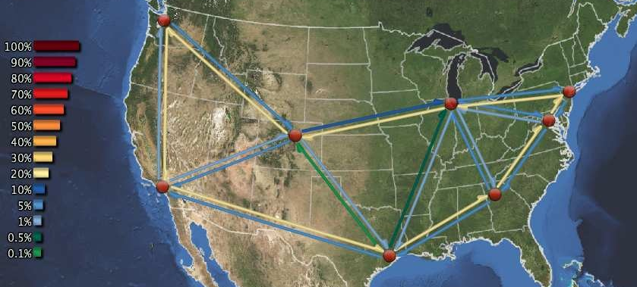
High Performance Networks
How to optimize a global network of data centers?
  E.g. Need to optimize movement of data between DCs
  [NSDI 2013, NSDI 2008, FAST 2009, IMC 2010, DSN 2010]

Slide 10

High Performance Networks
How to optimize a global network of data centers?
  E.g. Investigate novel data center designs
  [ToN 2013 and ANCS 2012; best paper]
Core Switch (CS)
Aggregate
Switch (AS)
…
…
…
ToR
…
…
…
…
…
…

Slide 11
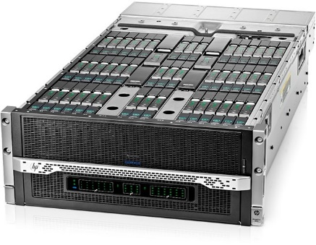
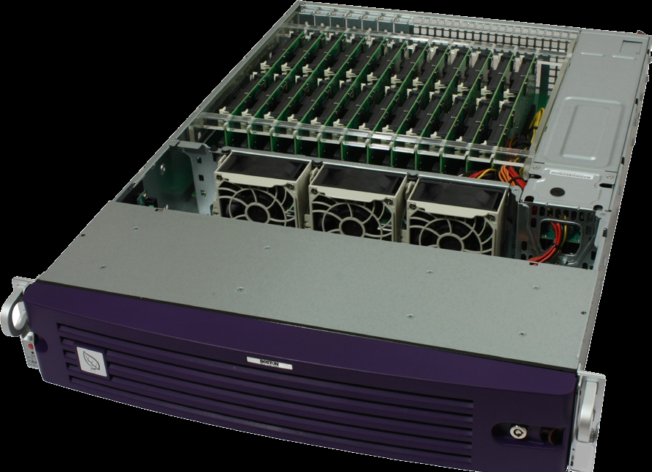
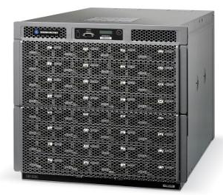
High Performance Networks
How to optimize a global network of data centers?
Rack-scale computers
  Rack is now the new computing block
  New hardware trends allows to create a rack containing ~100s-1000 SoC
HP Moonshot
Boston Viridis
AMD SeaMicro
Notes:
If in the past we used to scale by server
we now scale by rack

Slide 12
SW Programming the L1/L2 of the Network
High Performance Networks
Application
Dataplane programming (e.g. P4)
via P4FPGA [SOSR’16, http://p4fpga.org]
Physical Layer programming
via SoNIC [NSDI’13,’14, IMC’14, SIGCOMM 2016]
Transport
Network
Data Link
Physical
64/66b PCS
PMA
PMD
Notes:
Programmers treat layers 1 and 2 as black box

Slide 13
SW Programming the L1/L2 of the Network
High Performance Networks
Application
Dataplane programming (e.g. P4)
via P4FPGA [SOSR’16, http://p4fpga.org]
Physical Layer programming
via SoNIC [NSDI’13,’14, IMC’14, SIGCOMM 2016]
Transport
Network
Data Link
Physical
64/66b PCS
PMA
PMD
Notes:
Programmers treat layers 1 and 2 as black box

Slide 14

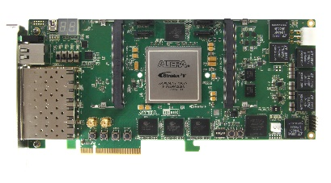
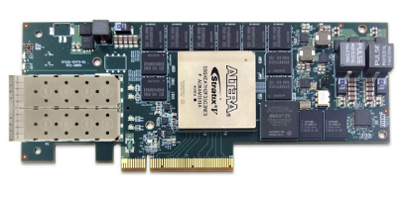

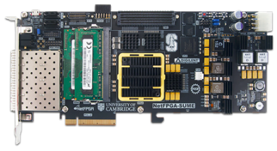


SW Programming the L1/L2 of the Network
High Performance Networks
P4: Programming Protocol-Independent Packet Processors
[SOSR’16]
Use P4 to describe many different network applications
Compile P4 to many different FPGA platforms
P4 HLIR
intermediate
representation
intermediate
representation
p4c-fpga
BSV(Bluespec
System Verilog)
BSV(Bluespec
System Verilog)
Verilog
Verilog
FPGA firmware

Slide 15
SW Programming the L1/L2 of the Network
High Performance Networks
E.g. Move Consensus into the network
  Consensus as a Service (CAANS)
  Consensus protocols are the foundation for fault-tolerant systems
Key: Low latency and high throughput

Slide 16
SW Programming the L1/L2 of the Network
High Performance Networks
Datacenter Time Protocol [SIGCOMM 2016]
Synchronization protocol in the PHY
  Each physically link is already synchronized!
  No protocol stack overhead
  No network overhead
  Scalable: peer-to-peer and decentralized
Application
Transport
Network
Data Link
Physical
Packet i
Packet i+1
Packet i+2
Notes:
We can implement covert timing channel by modulating IPGS at sub-microsecond scale

Slide 17
SW Programming the L1/L2 of the Network
High Performance Networks
Datacenter Time Protocol [SIGCOMM 2016]
Synchronization protocol in the PHY
  Bounded and precise synchronization
  Bounded by 4 oscillator ticks (25ns) peer-to-peer
  Bounded by 150ns for an entire datacenter
    No clock differs by more than 150ns
  Free – No network traffic: Use the PHY!
Application
Transport
Network
Data Link
Physical
Packet i
Packet i+1
Packet i+2
Notes:
We can implement covert timing channel by modulating IPGS at sub-microsecond scale

Slide 18
High Performance Networks
Network Latency Control via Rack-scale computing
Assuming synchronized time, schedule every packet
Every node is allocated a full time slot to a single destination
No two nodes will be able to communicate with the same destination at the same time
1
2
3
4
Node 1
2
3
4
5
Node 2
3
4
5
1
Node 3
4
5
1
2
Node 4
5
1
2
3
Node 5
1
2
3
4

Slide 19
High Performance Networks
Network Latency Control via Rack-scale computing
Benefits
No network contention
Full bisection bandwidth
  Direct connect topology
  Route through one random intermediate node
Bounded latency
Low power
1
2
3
4
Node 1
2
3
4
5
Node 2
3
4
5
1
Node 3
4
5
1
2
Node 4
5
1
2
3
Node 5
1
2
3
4

Slide 20
High Performance Storage
Large organizations considering using the cloud
  New York Times
  Netflix
  Nintendo
  Cornell
  Library of Congress
The more data you have, the harder it is to move
  Switching providers entails paying for bandwidth twice
  Inhibits opportunistic migration

Slide 21

High Performance Storage
How hard is it to move a PetaByte?
Titan tech boom, randy katz, 2008

Slide 22
High Performance Storage
All my valuable data/computation is in the cloud
Am I locked in to one provider forever?
  The more data you have, the harder it is to move
RACS: Redundant Array of Cloud Storage
  Collaboration with the Internet Archive and IBM
  [SOCC 2010]; See Also [EuroSys 2007, FAST 2009, FAST 2013]
k=3
n=4
RACS(3,4)
Notes:
RACS: Redundant Array of Cloud Storage
Stripe data over n cloud storage repositories
Any k-subset contains a complete copy of data
Tolerate up to (n-k) failures
Written RACS(k,n)

Slide 23

High Performance Storage
All my valuable data/computation is in the cloud Am I locked in to one provider forever?
  The more data you have, the harder it is to move
RACS: Redundant Array of Cloud Storage
  Collaboration with the Internet Archive and IBM
  See Also [EuroSys 2007, FAST 2009, FAST 2013]
RACS(3,4)
33KB
Object
100 KB
33KB
Object
100 KB
33KB
33KB
k=3
n=4
Relative Storage | n/k
Relative Upload Bandwidth | n/k
Relative Download Bandwidth | 1
RACS(3,4)
Notes:
RACS: Redundant Array of Cloud Storage
Stripe data over n cloud storage repositories
Any k-subset contains a complete copy of data
Tolerate up to (n-k) failures
Written RACS(k,n)

Slide 24
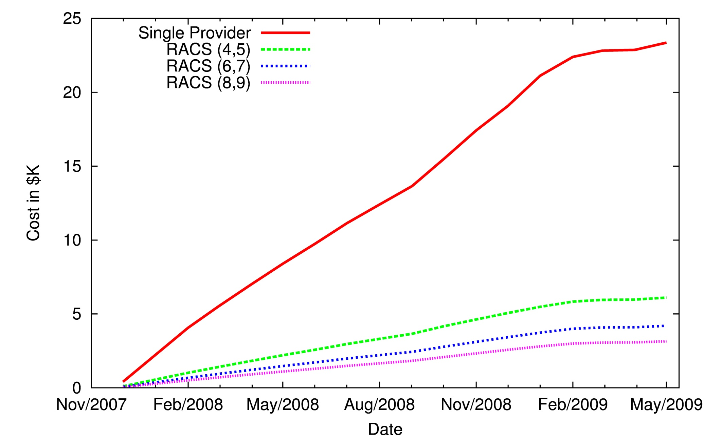
High Performance Storage
Estimated Cost of Switching Cloud Providers
33KB
RACS(3,4)
Object
100 KB
33KB
33KB
Relative Storage | n/k
Relative Upload Bandwidth | n/k
Relative Download Bandwidth | 1
33KB

Slide 25
High Performance Storage
RACS: How do I optimize storage globally
  Collaboration with Internet Archive / IBM
Gecko: How do I optimize storage locally
  Collaboration with Google and Microsoft
33KB
Object
100 KB
RACS(3,4)
33KB
33KB
33KB
Relative Storage | n/k
Relative Upload Bandwidth | n/k
Relative Download Bandwidth | 1
Notes:
RACS and Gecko

Slide 26
High Performance Computation
Can I compute in the cloud if some of my data is in a vault at
home or on another provider
Xen-Blanket and VirtualWire
    Collaboration with IBM
    [HotCloud 2012, EuroSys 2012]
33KB
33KB
33KB
33KB

Slide 27
High Performance Computation
Can create your own
Cloud-within-a-Cloud
Migrate computation among different cloud providers
App
33KB
Guest OS
Xen-Blanket
VMM 1
App
Object
100 KB
Guest OS
33KB
App
Xen-Blanket
Guest OS
VMM 2
Xen-Blanket
33KB
VMM
Xen-Blanket
VMM 3
33KB
Xen-Blanket
VMM 4

Slide 28
High Performance Computation
Can create your own
Cloud-within-a-Cloud
Demo: http://supercloud.cs.cornell.edu
Migrate computation among different cloud providers
Switch
VM
VM
33KB
VM
Xen-Blanket
VM
VMM 1
Object
100 KB
33KB
Xen-Blanket
VMM 2
Xen-Blanket
33KB
VMM
Xen-Blanket
VMM 3
33KB
Xen-Blanket
VMM 4

Slide 29
My Contributions
Cloud Networking
  SoNIC/DTP in SIGCOMM 2016, NSDI 2014/2013, and IMC 2014
  Wireless DC in ANCS 2012 (best paper) and NetSlice in ANCS 2012
  Bifocals in IMC 2010 and DSN 2010
  Maelstrom in ToN 2011 and NSDI 2008
  Chaired Tudor Marian (2010), Ki Suh Lee (2016), Han Wang (2017) PhD
Cloud Computation & Vendor Lock-in
  Supercloud in SoCC 2016, OSR 2015 / IEEE Internet Computing-2013
  Xen-Blanket in EuroSys-2012 and HotCloud-2011
  Overdriver in VEE-2011
  Chaired Dan William (2012) and Zhiming Shen (~2017) PhD
Cloud Storage
  Isotope/Gecko in FAST 2015, 2013 / HotStorage 2012
  RACS in SOCC-2010
  SMFS in FAST 2009
  Antiquity in EuroSys 2007 / NSDI 2006
  Chaired Lakshmi Ganesh (2011) and Ji Yong Shin PhD 2016

Slide 30
Goals for Today
Be brief!
Background on course and Professor
Why take this course?
How does this class operate?
Class details

Slide 31
Why take this course
Learn about systems abstractions, principles, and artifacts that have lead to the high performance systems and networks we see in the cloud,
Understand attributes of systems research that is likely to have impact,
Become comfortable navigating the state of the art in systems and networking,
Gain experience in thinking critically and analytically about systems research, and
Acquire the background needed to work on cloud and data center problems currently under study at Cornell and elsewhere.

Slide 32
Who is the course “for”?
MEng students
  Students who have mastered 4410/4411
  PhD students as well
  Serious undergraduates
MEng Project
  Projects in this course can be used to satisfy MEng project requirements

Slide 33
Goals for Today
Be brief!
Background
Why take this course?
How does this class operate?
Class details

Slide 34
How this class operates
Instructor: Hakim Weatherspoon
  hweather@cs.cornell.edu
  Office Location: 427 Gates Hall
TA: Vishal Shrivastav
  vishal@cs.cornell.edu
Lectures:
  CS 5413: M,W,F: 1:25–2:15 PM, 110 Hollister Hall
  Three slots reserved a week,
  ***but lecture will be twice a week on average***

Slide 35
Course Help
Course staff, office hours, etc:
  http://www.cs.cornell.edu/courses/cs5413/2017sp
MEng projects
  http://www.cs.cornell.edu/courses/cs5413/2017sp/projects.htm

Slide 36
CS 5413: Overview
This is a hands-on course
  Objective: Have fun!
  Build systems and networks
Prerequisite:
  Mastery of CS 4410 and 4411 material
    Fundamentals of OS design
    How parts of the OS are structured
    What algorithms are commonly used
    What are the mechanisms and policies used
    Programming in C/C++
Class Structure
  Lecture/Readings/Reading questions
  In-class labs/Take-home Homeworks
  Course Project/BOOM
  Prelim

Slide 37
CS 5413: Topics
Overview
  Cloud computing, and Internet vs Data Center Networks
High Performance Networking Basics
  Textbook networking vs Data Center Networks
  Network protocol stack: TCP/IP protocol stack
High Performance Data Center Systems & Networks
  Basic Switching Technologies: 50Gb/s routers &NetFPGA
  Data Center Topologies, Software Router Designs,
  Alternative switching technologies, Data Center Transport
  Software defined networking, virtual networks
  Rack-scale networks and computers
  Disaggregated Datacenters
  Middleboxes, advanced topics
  Data Center traffic and analysis

Slide 38
CS 5413: Paper Readings
Required reading is always one paper and/or book reading
  Book reading provides basic background knowledge
  Papers pulled from, best journals and conferences
    TOCS, SOSP, OSDI, …
Read papers before each class and bring notes
  takes ~1 hr, write notes and questions
Answer a paper related question and turn in at least two hours before beginning of class
  Turn on online via Course Management System (CMS)
  No late reviews will be accepted

Slide 39
CS 5413: Paper Reading Questions
A question(s) related to the reading will be posted at usually a week before class.
Each student is required to write a response to question
Turn question response in online before class via CMS
  Be succinct
    Usually can answer question in two or three sentences or at most one paragraph

Slide 40
CS 5413: Lecture Format
40 minute presentation
All students are required to read ahead of time and participate!
Counts in final grading.
May have student (group) presentations

Slide 41
CS 5413: In-class Labs/Homeworks
In-class Labs
  Work in groups
  ~once per week
  Need a laptop
  Designed to finish during class
Take-home Homeworks
  work in groups
  1-3 weeks per lab/homework
  Topics
    Building a network proxy (singled, then multi-threaded)
    Building a chatserver
    Implement a programmable dataplane device or softward-defined network (sdn) switch/controller
Facilities
  Laptops and local Fractus cloud

Slide 42
CS 5413: Project/BOOM
One major project per group
  Groups include three people
Group formation – early February
Initial selection of project topic – due mid-February
Survey of area (related works)–late begin of February
Midterm draft paper – late of March
Peer reviews—due a week later
Final demo/presentation–due begin of May
Final project report – due a week later
Extra – BOOM
http://boom.cornell.edu/students-and-faculty/project-guidelines/
BOOM Submission – due March 31st
BOOM Presentation – April 19th

Slide 43
CS 5413: Project Infrastructure
SoNIC: Software Network Interface Cards
NetFPGA/P4FPGA
Fractus: our very own (mini) cloud
Amazon’s Cloud Infrastructure EC2/S3
Emulab
PlanetLab
Cornell’s Center for Advanced Computing (CAC)
…

Slide 44
Academic Integrity
Submitted work should be your own
Acceptable collaboration:
  Clarify problem, C syntax doubts, debugging strategy
  You may use any idea from any other person or group in the class or out, provided you clearly state what you have borrowed and from whom.
  If you do not provide a citation (i.e. you turn other people's work in as your own) that is cheating.
Dishonesty has no place in any community
  May NOT be in possession of someone else’s homework/project
  May NOT copy code from another group
  May NOT copy, collaborate or share homework/assignments
  University Academic Integrity rules are the general guidelines
Penalty can be as severe as an ‘F’ in CS 5413
Notes:
To draw a very clear line, you may use any idea from any other person or group in the class or out, provided you clearly state what you have borrowed and from whom. If you do not provide a citation---that is, you turn other people's work in as your own---that is cheating. Anything else is fair game. Of course, we will be grading you on the ideas you have added, but you should always borrow as much as you can as a starting point as there is no point in reinventing the wheel.

Slide 45
Stress, Health and Wellness
Need to pace yourself to manage stress
  Need regular sleep, eating, and exercising
Do not come to class sick (with the flu)!
  Email me ahead of time that you are not feeling well
  People not usually sick more than once in a semester

Slide 46
Before Next time
Read one paper below and write review
  The Cost of a Cloud: Research Problems in Data Center Networks, A. Greenberg, J. Hamilton, D. A. Maltz, P. Patel. ACM SIGCOMM computer communication review, Volume 39, Issue 1 (January 2009), pages 68--73. http://dl.acm.org/citation.cfm?id=1496103 (can only access link within Cornell network). http://131.107.65.14/en-us/um/people/dmaltz/papers/DC-Costs-CCR-editorial.pdf (can access outside Cornell network)
Check website for updated schedule

