Slide 1
TCP over SoNIC
Abhishek Kumar Maurya (am2633@cornell.edu)
Amarinder Singh Bindra (ab2546@corenll.edu)
Gaurav Aggarwal (ga286@cornell.edu)

Slide 2
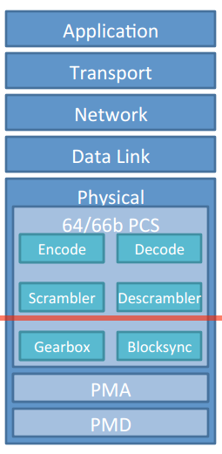
SoNIC Overview
Implementation of physical and data link layer in software
Real-time access to network stack
Real-time traffic monitoring
Fine-grained control on Inter packet delay
Commodity processor and field-programmable gate array (FPGA) board

Slide 3
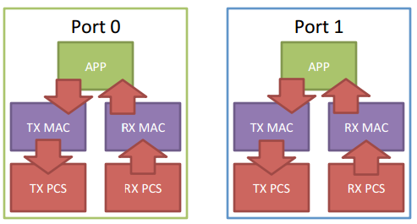
Project Overview
Implementation of Transmission Control Protocol (TCP) layer on top of SoNIC
TCP state machine for tracking connection state
Separate Tx and Rx threads for packet and acknowledgement handling
Synchronization between Rx and Tx threads
Notes:
and achieving reliable data transfer while satisfying real-time constraints and line speed.

Slide 4
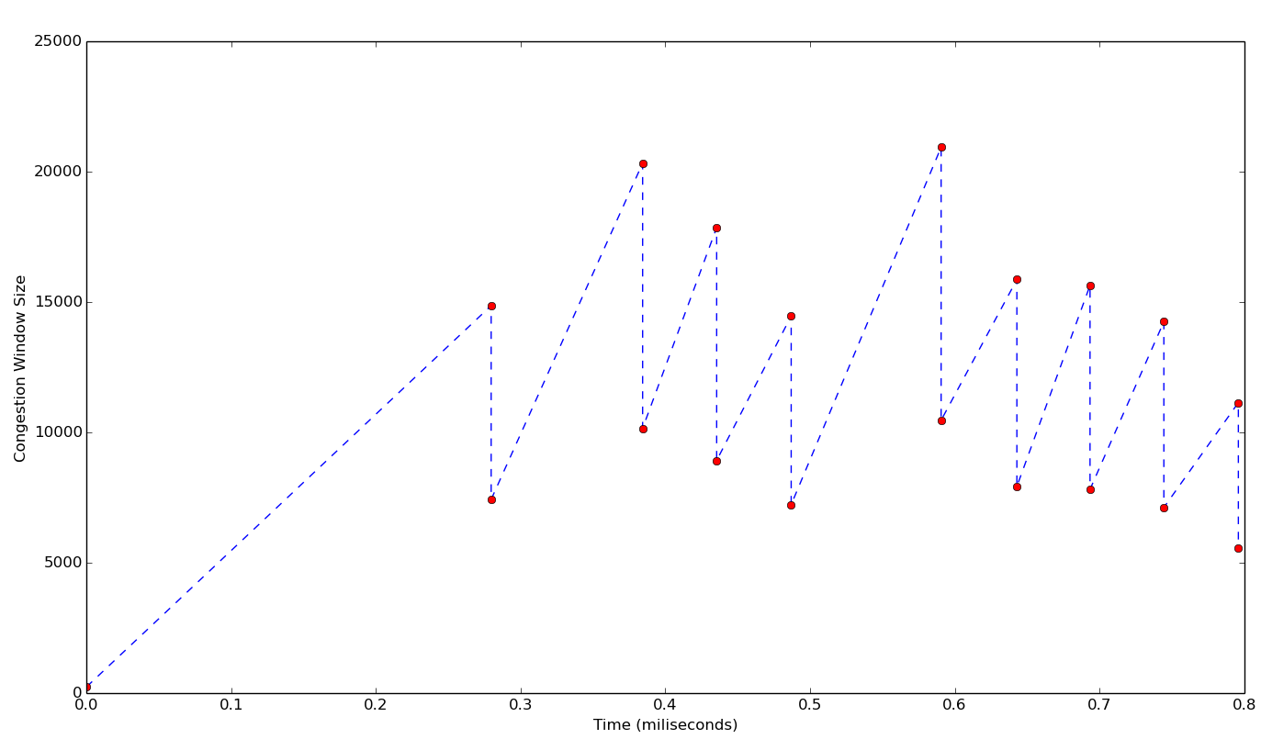
Implementation of TCP over UDP
Congestion Window Size vs Time
TCP state machine
Cumulative ACK
Congestion Control
  Go-Back-N
  Additive Increase Exponential Decrease
Notes:
When the cumulative ACK timeout is less, throughput is less because more time is spent in thread context switches.
As we increase timeout, throughput increases because less time is wasted in thread context switches.
After a threshold value, throughput again starts decreasing because in the case of packet loss, sender now has to wait for a longer time resulting in less bandwidth utilization.
Go-Back-N protocol at TCP sender which sends all the unacknowledged packets in the case of packet loss which is detected by missing acknowledgement.
Congestion control mechanism which halves the congestion window size in the case of packet loss.

Slide 5
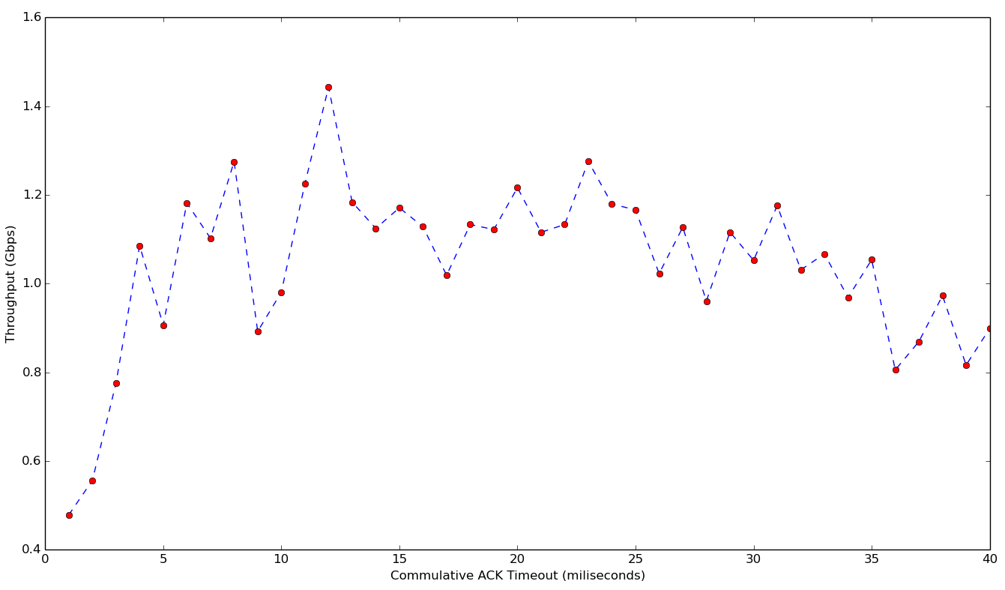
Results
Throughput vs Cumulative ACK
Best throughput ~1.4-1.5Gbps

Slide 6

TCP over SoNIC in User Space
Sender (Port 0)
Receiver (Port 1)
Tx MAC
Rx MAC
Tx MAC
Rx MAC
Tx PCS
Rx PCS
Tx PCS
Rx PCS
PIPE
A new mode to spawn 4 TCP handler threads
User Space Pipe between Tx PCS and Rx PCS of Sender and Receiver and vice versa

Slide 7
Results

Slide 8
Results

Slide 9
TCP over SoNIC in Kernel Space
Sender(Port 0)
Receiver (Port 1)
Tx MAC
Rx MAC
Tx MAC
Rx MAC
Tx PCS
Rx PCS
Tx PCS
Rx PCS
A new mode to spawn 4 TCP handler threads
For loopback Port 0 is directly connected to Port 1

Slide 10
Results

Slide 11
Results

Slide 12
Results

Slide 13
Results

Slide 14
Future Work
Fast Re-Transmit
  Packet Buffering
  Loss Detection using 3-Duplicate ACKs
Slow Start

Slide 15
DEMO

Slide 16
Q & A

Slide 17
References
TCP RFC https://www.ietf.org/rfc/rfc793.txt
SoNIC http://fireless.cs.cornell.edu/sonic/
SoNIC: Precise Real-time Software Access and Control of Wired Networks http://fireless.cs.cornell.edu/sonic/sonic_nsdi2013.pdf
PHY Covert Channels: Can you see the Idles? http://fireless.cs.cornell.edu/publications/chupja_nsdi2014.pdf

