Slide 1
Data Center Virtualization: Xen and Xen-blanket
Hakim Weatherspoon
Assistant Professor, Dept of Computer Science
CS 5413: High Performance Systems and Networking
November 17, 2014
Slides from ACM European Conference on Computer Systems 2012 presentation of
“The Xen-Blanket: Virtualize Once, Run Everywhere” and Dan Williams dissertation

Slide 2
Where are we in the semester?
Overview and Basics
Data Center Networks
Basic switching technologies
Data Center Network Topologies (today and Monday)
Software Routers (eg. Click, Routebricks, NetMap, Netslice)
Alternative Switching Technologies
Data Center Transport
Data Center Software Networking
Software Defined networking (overview, control plane, data plane, NetFGPA)
Data Center Traffic and Measurements
Virtualizing Networks
Middleboxes
Advanced Topics

Slide 3
Goals for Today
The Xen-Blanket: Virtualize Once, Run Everywhere
D. Williams, H. Jamjoom, and H. Weatherspoon. ACM European Conference on Computer Systems (EuroSys), April 2012, pages 113-126..

Slide 4



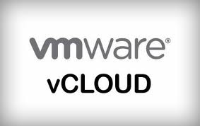

Background & motivation
Infrastructure as a Service (IaaS) clouds
Inter-cloud migration?
Uniform VM image?
Advanced hypervisor level management?

Slide 5
research challenges
Lack of interoperability between clouds
How can cloud user homogenize clouds?
Lack of control in cloud networks
What cloud network abstraction enables enterprise workload to run without modification?
Lack of efficient cloud resource utilization
How can cloud users exploit oversubscription in the cloud while handling overload?

Slide 6

Xen-Blanket
A second-layer hypervisor
Inter-cloud migration?
Uniform VM image?
Advanced hypervisor level management?
VM
VM
VM
VM
VM
VM
Xen-Blanket

Slide 7
Xen-Blanket
Xen-Blanket (Eurosys’12)
HVM guest
Xen-Dom 0
HVM guest
Xen-Dom 0
Dom 0
Dom U
Ring 3
App
App
Ring 1
Kernel
Kernel
Kernel
Kernel
Kernel
Xen-Blanket
Ring 0
Xen
Xen

Slide 8
contributions towards superclouds
Cloud interoperability
Enable cloud user to homogenize clouds
The Xen-Blanket
Enterprise Workloads
VM
VM
VM
VM
VM
VM
Supercloud
Cloud Interoperability
(The Xen-Blanket)
Third-Party Clouds

Slide 9
contributions towards superclouds
Cloud interoperability
User control of cloud networks
Enable cloud user to implement network control logic
VirtualWire
Enterprise Workloads
VM
VM
VM
VM
VM
VM
User Control of Cloud Networks
(VirtualWire)
Supercloud
Cloud Interoperability
(The Xen-Blanket)
Third-Party Clouds

Slide 10
contributions towards superclouds
Cloud interoperability
User control of cloud networks
Efficient cloud resource utilization
Enable cloud user to oversubscribe resources and handle overload
Overdriver
Enterprise Workloads
VM
VM
VM
VM
VM
VM
User Control of Cloud Networks
(VirtualWire)
Efficient Cloud Resource Utilization
(Overdriver)
Supercloud
Cloud Interoperability
(The Xen-Blanket)
Third-Party Clouds

Slide 11
roadmap: towards superclouds
Cloud interoperability
User control of cloud networks
Efficient cloud resource utilization
Related work
Future work
Conclusion
Enterprise Workloads
VM
VM
VM
VM
VM
VM
User Control of Cloud Networks
(VirtualWire)
Efficient Cloud Resource Utilization
(Overdriver)
Supercloud
Cloud Interoperability
(The Xen-Blanket)
Third-Party Clouds
Notes:
9 min

Slide 12
Clouds are not interoperable
Image format not yet standard
AMI, Open Virtualization Format (OVF)
Paravirtualized device interfaces vary
virtio, Xen
Hypervisor-level services not standard
Autoscale, VM migration, CPU bursting
Need homogenization (consistent interfaces, services across clouds)

Slide 13
provider-centric homogenization
Rely on support from provider
May take years, if ever (e.g., standardization)
“Least common denominator” functionality
VM 1
VM 2
VM 3
VM 4
Interface
Interface
Cloud A
Cloud B
Consistent VM/Device/Hypervisor Interfaces
Consistent Hypervisor-level Services

Slide 14
user-centric homogenization
VM 1
VM 2
VM 3
VM 4
No special support from provider
Can be done today
Custom, user-specific functionality
Interface
Interface 1
Interface 2
Cloud A
Cloud B
Consistent VM/Device/Hypervisor Interfaces
Consistent Hypervisor-level Services

Slide 15
nested virtualization approaches
Require support by bottom level hypervisor
No modifications to top-level hypervisor
The Turtles Project (OSDI’10) (provider-centric)
No support from bottom level hypervisor
Modify top-level hypervisor
The Xen-Blanket (user-centric)

Slide 16
the xen-blanket
User 1
User 2
Assumption:
Existing clouds provide full virtualization (HVM)
Future work:
Xen-Blanket in paravirtualized guest
VM
VM
VM
Xen-Blanket
User controlled VMM
Xen-Blanket
User controlled VMM
Xen / KVM
Provider controlled VMM
Hardware
No support for nested virtualization

Slide 17
without hypervisor support
No virtualization hardware exposed to second layer
Can use paravirtualization or binary translation
We use paravirtualization (Xen)
Heterogeneous device interfaces
Create set of Blanket drivers for each interface
We have built drivers for Xen and KVM (virtio)

Slide 18
PV device I/O
Paravirtualized device I/O essential for performance
Domain 0 hides physical device details from guests
Ring 3
Dom 0
Guest
Kernel User
Ring 1
Physical Device Driver
Backend Driver
Frontend Driver
Ring 0
Xen
Hardware

Slide 19
PV-on-HVM
HVM guest still needs PV device I/O
Platform PCI Driver makes Xen internals look like PCI device
Physical device details still hidden from guests
Ring 3
Dom 0
HVM Guest
Ring 1
Physical Device Driver
Backend Driver
Kernel User
Ring 0
HVM Frontend Driver
Xen
Hardware
Xen Platform PCI Driver

Slide 20
blanket drivers
Physical device details are hidden from entire Xen-Blanket instance
Blanket Frontend Driver interfaces with provider-specific device interface
like PV-on-HVM
Provider-specific device interface details are hidden from second-layer guests
Ring 3
Dom 0
HVM Guest
Dom 0
Guest
Ring 1
Physical Device Driver
Backend Driver
Blanket Frontend Driver
Backend Driver
Frontend Driver
Ring 0
Xen-Blanket
Blanket Hypercalls
Xen
Hardware

Slide 21
technical details
Address translation
Virtual addresses are two translations from machine addresses (needed for DMA)
Hypercall assistance
Communication between frontend blanket driver and backend driver
vmcall must be issued from ring 0
Most hypercalls are passthrough
Many more details in thesis

Slide 22
overhead evaluation setup
Used up to 2 physical hosts (six-core 2.93 GHz Intel Xeon X5670 processors, 24 GB of memory, four 1 TB disks, and 1 Gbps link)

Slide 23
lmbench microbenchmarks
 | Native (µs) | HVM (µs) | PV (µs) | Xen-Blanket (µs)
Null Call | 0.19 | 0.21 | 0.36 | 0.36
Fork Proc | 67 | 86 | 220 | 258
Ctxt switch (2p/64K) | 0.45 | 0.66 | 3.18 | 3.46
Page fault | 0.56 | 0.99 | 2.00 | 2.10
Compare Xen-Blanket to PV

Slide 24
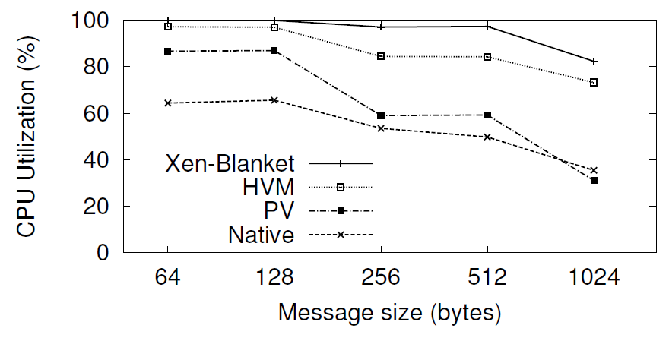
blanket driver overhead
Two VMs on two physical hosts using netperf
Can receive at line speed on 1Gbps link
Within 15% CPU utilization of single layer

Slide 25
kernbench
Up to 68% overhead on kernbench
APIC emulation causes many vmexits

Slide 26
user-defined oversubscription
Type | CPU (ECUs) | Memory (GB) | Disk (GB) | Price ($/hr)
Small | 1 | 1.7 | 160 | 0.085
Cluster 4XL | 33.5 | 23 | 1690 | 1.60
Factor | 33.5x | 13.5x | 10x | 18.8x
Resources do not all scale the same as price
Opportunity to exploit CPU scaling

Slide 27
kernbench revisited
kernbench kernel compile benchmark
Rent one 4XL EC2 instance
Use Xen-Blanket to partition it 40 ways
All instances (on average) finished the same time as EC2 small instance
47% price reduction per VM per hour

Slide 28
cloud interoperability
The Xen-Blanket
User-centric homogenization
Nested virtualization without support from underlying hypervisor
Runs on today's clouds (e.g., Amazon EC2)
Download the code:
http://code.google.com/p/xen-blanket/
New opportunities
performance: user-defined oversubscription

Slide 29
Before Next time
Project Interim report
Due Monday, November 24.
And meet with groups, TA, and professor
Fractus Upgrade: Should be back online
Required review and reading for Wednesday, November 19
Extending networking into the virtualization layer, B. Pfaff, J. Pettit, T. Koponen, K. Amidon, M. Casado, S. Shenker. ACM SIGCOMM Workshop on Hot Topics in Networking (HotNets), October 2009.
http://conferences.sigcomm.org/hotnets/2009/papers/hotnets2009-final143.pdf
Check piazza: http://piazza.com/cornell/fall2014/cs5413
Check website for updated schedule

