Slide 1
Data Center Traffic and Measurements: Available Bandwidth Estimation
Hakim Weatherspoon
Assistant Professor, Dept of Computer Science
CS 5413: High Performance Systems and Networking
November 14, 2014
Slides from ACM SIGCOMM conference on Internet measurement (IMC), 2014,
presentation of “MinProbe: Accurate, Minimum Overhead, Available Bandwidth
Estimation in High Speed Wired Networks”

Slide 2
Where are we in the semester?
Overview and Basics
Data Center Networks
Basic switching technologies
Data Center Network Topologies (today and Monday)
Software Routers (eg. Click, Routebricks, NetMap, Netslice)
Alternative Switching Technologies
Data Center Transport
Data Center Software Networking
Software Defined networking (overview, control plane, data plane, NetFGPA)
Data Center Traffic and Measurements
Virtualizing Networks
Middleboxes
Advanced Topics

Slide 3
Goals for Today
MinProbe: Accurate, Minimum Overhead, Available Bandwidth Estimation in High Speed Wired Networks
Ki Suh Lee, Erluo Li, ChiunLin Lim, Kevin Tang and Hakim Weatherspoon. In Proceedings of the 14th ACM SIGCOMM conference on Internet measurement (IMC), November 2014.

Slide 4

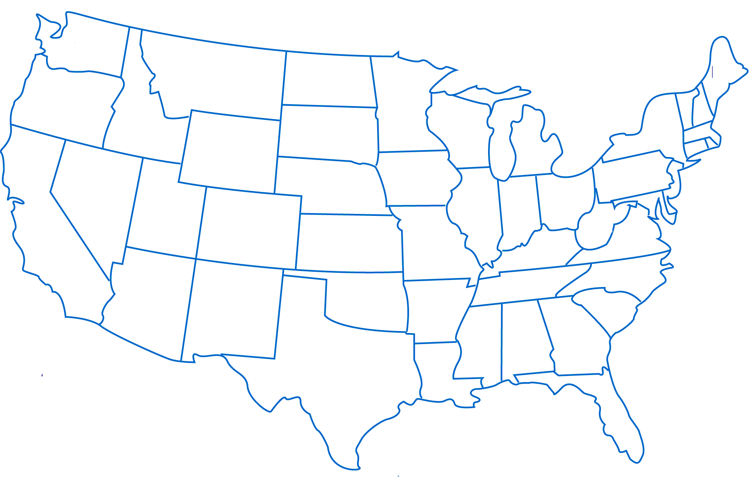

Available Bandwidth Estimation
Basic building block
Network Protocol
Networked Systems
Distributed Systems
Which of the two paths has more available bandwidth?
How do I measure with minimum overhead?
End-to-end: How to measure without access to anything in the network?
Notes:
1’20”

Slide 5
Available Bandwidth Estimation
Passive Measurement
Polling counters: Port Stats or Flow Stats
Active Measurement
Probe Packets: Packet Pair or Packet Train
Probe Packets:
Notes:
We are going to use active probe because we assume autonomous system.

Slide 6
Active Measurement
Narrow link: least capacity
Tight link: least available bandwidth
Narrow link
Network Capacity
Cross Traffic
Tight link
Available Bandwidth
Notes:
Quick example
Narrow link is 2 Gbps
Tight link is

Slide 7
Active Measurement
Estimate available bandwidth by saturating the tight link
Saturate/Congest Tight Link
Estimate Available Bandwidth?
Packet Queuing Delays Increase
Measuring (Increased) Queuing Delay
Narrow link
Network Capacity
Cross Traffic
Tight link
Available Bandwidth
7

Slide 8
Active Measurement
Estimate available bandwidth by saturating the tight link
8Gbps
L_{A}⁸ < L_{B}⁸, congestion!
6Gbps
L_{A}⁸
L_{B}⁸
4Gbps
L_{A}⁴ == L_{B}⁴, no congestion
4Gbps
L_{A}⁴
L_{B}⁴
1Gbps
L_{A}¹ == L_{B}¹, no congestion
1Gbps
L_{A}¹
L_{B}¹
Rate
Narrow link
Probe Train #
Network Capacity
Cross Traffic
Tight link
Available Bandwidth
Notes:
Can also put the actual figure up.
----- Meeting Notes (11/6/14 13:26) -----
Circle the knee,
4 figures.

Slide 9
By measuring the increase in packet train length*, we can compute the queuing delay experienced, hence estimate the available bandwidth.
* Increase in packet train length == increase in sum of inter-packet gap
Notes:
Increase

Slide 10
Limitations of Available Bandwidth Estimation
Intrusive/Expensive
100s of probe packets per packet train
Inaccurate
Especially in high speed network
Does not work well for bursty traffic

Slide 11
Goals of Available Bandwidth Estimation
Cheap
Use as little probe packets as possible
Accurate
How close is the estimation to the actual value
Works for all traffic patterns
Notes:
Challenges comes after problem.
Cheap, accurate.

Slide 12
MinProbe: Bandwidth Estimation in PHY
Cheap
Use as little probe packets as possible
100s of probe packets per train→ 20 packets per train
Using application traffic as probe
Accurate
How close is the estimation to the actual value
Error < 0.4Gbps, with a resolution of 0.1Gbps
Works for all traffic patterns
Works with bursty cross traffic
Notes:
Understand available bandwidth estimation,
Challenges
-overhead
-accurate
-works for all patterns
Change challenge to goal

Slide 13
Outline
Introduction
Challenges
Design: MinProbe
Evaluation
Conclusion
Notes:
----- Meeting Notes (10/20/14 16:35) -----
Goal slide:
Two slides.
Cheap
-- 20 packets, application packets
Accurate
-- 0.5Gbps error
Work high bw
-- 10Gbps
----- Meeting Notes (10/30/14 15:49) -----
5 to 6 minues.

Slide 14
Challenges
Cannot Control at 100ps
Cannot Measure at 100ps
L_{A}⁸
L_{B}⁸
Notes:
?
Summary: two basic issues.
At the sender end, in order to generate accurate probe rate, need fine control of packet timing at 100ps.
What can commodity machine do? forwarding.
Incoming rate is accurately controlled with increase rate.
Linux kernel forwarding lost control on timing.
Similarly, intel dpdk does better at lower data rate, but still have no control over high data rate.
Takeaway, with commodity machine, obtaining the level of control to generate accurate probe rate is not possible.
Similarly, the problem of measuring packet timing at the receiver end is also difficult.
----- Meeting Notes (11/6/14 13:57) -----
10Gbps every bit is 100ps.
In userspace we generated packet with instantenous rate from 0.1 Gbps, each pair of packet
Experiment is simple, we have one forwarding element.
The batching
slow down and clear.
Two lines to emphasize

Slide 15
Challenges
Cannot Control at 100ps
Cannot Measure at 100ps
L_{A}⁸
L_{B}⁸
State-of-art (software) tools do not work at high speed because they cannot control and capture inter-packet spacing with required precision.
Notes:
?
Summary: two basic issues.
At the sender end, in order to generate accurate probe rate, need fine control of packet timing at 100ps.
What can commodity machine do? forwarding.
Incoming rate is accurately controlled with increase rate.
Linux kernel forwarding lost control on timing.
Similarly, intel dpdk does better at lower data rate, but still have no control over high data rate.
Takeaway, with commodity machine, obtaining the level of control to generate accurate probe rate is not possible.
Similarly, the problem of measuring packet timing at the receiver end is also difficult.
----- Meeting Notes (11/6/14 13:57) -----
10Gbps every bit is 100ps.
In userspace we generated packet with instantenous rate from 0.1 Gbps, each pair of packet
Experiment is simple, we have one forwarding element.
The batching
slow down and clear.
Two lines to emphasize

Slide 16
Outline
Introduction
Challenges
Design: MinProbe
Evaluation
Conclusion
Notes:
----- Meeting Notes (10/20/14 16:35) -----
Goal slide:
Two slides.
Cheap
-- 20 packets, application packets
Accurate
-- 0.5Gbps error
Work high bw
-- 10Gbps
----- Meeting Notes (10/30/14 15:49) -----
5 to 6 minues.
----- Meeting Notes (11/6/14 13:57) -----
Missing transition
A slide with red font

Slide 17
MinProbe can accurately control and measure inter-packet gaps, thus can accurately control and measure probe train lengths, enabling accurate available bandwidth estimation.
Notes:
----- Meeting Notes (10/20/14 16:35) -----
Goal slide:
Two slides.
Cheap
-- 20 packets, application packets
Accurate
-- 0.5Gbps error
Work high bw
-- 10Gbps
----- Meeting Notes (10/30/14 15:49) -----
5 to 6 minues.
----- Meeting Notes (11/6/14 13:57) -----
Missing transition
A slide with red font

Slide 18
MinProbe: Better Accuracy
Application
Transport
Packet i
Packet i+1
Packet i+2
Network
Data Link
Physical
Notes:
----- Meeting Notes (10/17/14 17:10) -----
Modulating packet at PHY layer
----- Meeting Notes (10/20/14 16:35) -----
always sending bits
fill with idle.
key is access / control idle in phy layer
given this, we can precisely generate packet train, and measure packet train.
----- Meeting Notes (10/21/14 21:24) -----
Need to mention that it is sufficient to measure with packet gap

Slide 19
MinProbe: Better Accuracy
Idle Characters (/I/)
Each bit ~100 picoseconds
7~8 bit special character in the physical layer
700~800 picoseconds to transmit
Only in PHY
Application
Transport
Packet i
Packet i+1
Packet i+2
Network
Data Link
Physical
Notes:
----- Meeting Notes (10/17/14 17:10) -----
Modulating packet at PHY layer
----- Meeting Notes (10/20/14 16:35) -----
always sending bits
fill with idle.
key is access / control idle in phy layer
given this, we can precisely generate packet train, and measure packet train.
----- Meeting Notes (10/21/14 21:24) -----
Need to mention that it is sufficient to measure with packet gap

Slide 20
MinProbe: Better Accuracy
Probe Generation
8Gbps
1500 B
1500 B
1500 B
Rate
382 /I/s
382 /I/s
8.0Gbps
4Gbps
1500 B
1500 B
1500 B
4.0Gbps
2290 /I/s
2290 /I/s
1.0Gbps
1Gbps
1500 B
1500 B
1500 B
Probe #
11374 /I/s
11374 /I/s
By modulating Inter-packet gap at PHY layer,
we can generate accurate probe rate.
Notes:
Emphasize exact amount. That is what makes us accurate.

Slide 21
MinProbe: Better Accuracy
Probe Generation
Rate
8.0Gbps
4.0Gbps
1.0Gbps
Probe #
Notes:
Emphasize exact amount. That is what makes us accurate.

Slide 22
MinProbe: Better Accuracy
With shared N and (Rmin, Rstep, Rmax)
Emulate existing bandwidth estimation algorithm
Pathload, Pathchirp, SLoPS …
Rate
8.0Gbps
4.0Gbps
…
…
1.0Gbps
Probe #
Notes:
If sender and receiver both share certain information. Number of packet in a train.

Slide 23
MinProbe: Low Overhead
Reduce the # of probe packets required
# of probe packet per probe train | Error (%)
5 | +15%
20 | -1%
40 | -2%
60 | -3%
80 | -3%
100 (Pathload) | -4%
Notes:
Minprobe also reduces the number of probe packet we need in a packet train. The intuition is that because we have a more accurate instrumentation to the network, you need less probe to obtain a similar level of accuracy.

Slide 24

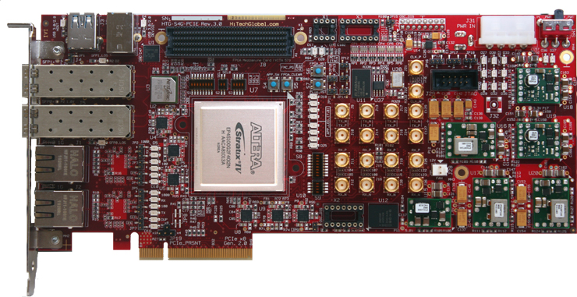
MinProbe: Very Low Overhead
Estimator
Estimator
Mbox Ctrl
Mbox Daemon
Userspace
Kernel space
IPG Tx/Rx
Flow Table
IPG Tx/Rx
Modulated
Probe Traffic
Incoming Traffic
Forwarding Path
SoNIC (NSDI 2013)
MinProbe Middlebox
Notes:
To further lower the overhead, we designed minprobe to be a middlebox.
Based on the sonic platform in NSDI 2013
It is very similar to a software switch, the datapath is in kernel and hardware.
The key component in the datapath is the module to modify the interpacket gap and measure the received interpacket gap.
The estimator communicates with the kernel datapath through a daemon and executes the estimation algorithm.

Slide 25
MinProbe: Bandwidth Estimation in PHY
Modulated traffic
Modulated traffic
Incoming traffic
Un-modulated traffic
200 /I/s @ 8Gbps
200 /I/s @ 8Gbps
Packet Size 792 Bytes
Notes:
Let me give you an example on how do we module the interpacket gap.
Here we have two flows that go through the middelbox and we are trying to modulate one of the flow.
The graph shows the interpacket gap distribution of both flows.
We modulated the red flow to generate a probe train of 8Gbps by modulating each interpacket gap to 200 idle characters, for a packet size of 792 bytes.
----- Meeting Notes (11/6/14 14:04) -----
Probability distribution
x-axis
two flow

Slide 26
Outline
Introduction
Challenges
Design: MinProbe
Evaluation
Conclusion

Slide 27
Questions:
Can MinProbe accurately estimate avail-bw at 10Gbps?
Can existing estimation algorithms work with MinProbe?
How do the following parameters affect accuracy?
Packet train length
probe packet size distribution
cross packet size distribution
cross packet burstiness
Does MinProbe work in the wild, Internet?
Does MinProbe work in rate limiting environments?
Can MinProbe accurately estimate avail-bw at 10Gbps?
Can existing estimation algorithms work with MinProbe?
How do the following parameters affect accuracy?
Packet train length
probe packet size distribution
cross packet size distribution
cross packet burstiness
Does MinProbe work in the wild, Internet?
Does MinProbe work in rate limiting environments?

Slide 28



Experiment Setup
Chicago
Boston
Cleveland
Cornell(NYC)
NYC
Controlled Environment
National Lambda Rail

Slide 29
MinProbe: Can we measure at 10Gbps?
Cross Traffic
Probe Traffic
Probe Traffic
MinProbe
tight link
MinProbe
10Gbps
Cross Traffic, paced at 1.0, 3.0, 6.0, 8.0Gbps

Slide 30
MinProbe: Can we measure at 10Gbps?
Cross Traffic
Probe Traffic
Rate
9.6 Gbps
…
0.2Gbps
0.1Gbps
…
MinProbe
tight link
MinProbe
10Gbps
Cross Traffic, paced at 1.0, 3.0, 6.0, 8.0Gbps

Slide 31
MinProbe: Can we measure at 10Gbps?
Rate
9.6 Gbps
…
0.2Gbps
0.1Gbps
…
0.1Gbps
8.1Gbps
Available Bandwidth = 2Gbps
10Gbps
Cross Traffic 8Gbps
Notes:
----- Meeting Notes (11/6/14 14:13) -----
Show blue
Show orange,
Show little green
Show all green.

Slide 32
MinProbe: Can we measure at 10Gbps?
Rate
9.6 Gbps
…
0.2Gbps
0.1Gbps
…
0.2Gbps
8.2Gbps
Available Bandwidth = 2Gbps
10Gbps
Cross Traffic 8Gbps
Notes:
----- Meeting Notes (11/6/14 14:13) -----
Show blue
Show orange,
Show little green
Show all green.

Slide 33
MinProbe: Can we measure at 10Gbps?
Rate
9.6 Gbps
…
0.2Gbps
0.1Gbps
…
0.3Gbps
8.3Gbps
Available Bandwidth = 2Gbps
10Gbps
Cross Traffic 8Gbps
Notes:
----- Meeting Notes (11/6/14 14:13) -----
Show blue
Show orange,
Show little green
Show all green.

Slide 34
MinProbe: Can we measure at 10Gbps?
Rate
9.6 Gbps
…
0.2Gbps
0.1Gbps
…
1.0Gbps
1.9Gbps
2.0Gbps
3.0Gbps
4.0Gbps
5.0Gbps
6.0Gbps
Queued
10.0Gbps
Queued
10.0Gbps
Queued
10.0Gbps
Queued
10.0Gbps
Queued
10.0Gbps
9.0Gbps
9.9Gbps
Available Bandwidth = 2Gbps
10Gbps
Cross Traffic 8Gbps
Notes:
----- Meeting Notes (11/6/14 14:13) -----
Show blue
Show orange,
Show little green
Show all green.

Slide 35
MinProbe: Can we measure at 10Gbps?
Rate
9.6 Gbps
…
0.2Gbps
0.1Gbps
…
Available Bandwidth = 4Gbps
10Gbps
Cross Traffic 6Gbps
Notes:
----- Meeting Notes (11/6/14 14:13) -----
Show blue
Show orange,
Show little green
Show all green.

Slide 36
MinProbe: Can we measure at 10Gbps?
Rate
9.6 Gbps
…
0.2Gbps
0.1Gbps
…
Available Bandwidth = 7Gbps
10Gbps
Cross Traffic 3Gbps
Notes:
----- Meeting Notes (11/6/14 14:13) -----
Show blue
Show orange,
Show little green
Show all green.

Slide 37
MinProbe: Can we measure at 10Gbps?
Rate
9.6 Gbps
…
0.2Gbps
0.1Gbps
…
Available Bandwidth = 9Gbps
10Gbps
Cross Traffic 1Gbps
Notes:
----- Meeting Notes (11/6/14 14:13) -----
Show blue
Show orange,
Show little green
Show all green.

Slide 38
MinProbe: Can we measure at 10Gbps?
10Gbps
Notes:
----- Meeting Notes (1/24/14 10:03) -----
Robustness: Forward error correction
----- Meeting Notes (10/20/14 16:35) -----
Map
Show one at a time.
----- Meeting Notes (11/6/14 14:13) -----
Make this bigger.

Slide 39
MinProbe: National Lambda Rail
Chicago
Boston
Cleveland
Cornell(NYC)
NYC
Cornell(Ithaca)
10Gbps
Notes:
----- Meeting Notes (1/24/14 10:03) -----
Robustness: Forward error correction
----- Meeting Notes (10/20/14 16:35) -----
Map
Show one at a time.

Slide 40
Questions:
Can MinProbe accurately estimate avail-bw at 10Gbps?
Can existing estimation algorithms work with MinProbe?
How do the following parameters affect accuracy?
Packet train length
probe packet size distribution
cross packet size distribution
cross packet burstiness
Does MinProbe work in the wild, Internet?
Does MinProbe work in rate limiting environments?

Slide 41
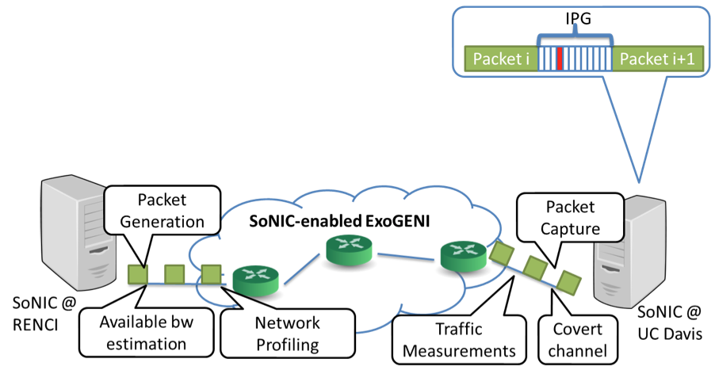
MinProbe: In rate limiting environment?
Rate Limiters may be an issue?
Provisioned 1Gbps virtual network
If the probe train is less than 1200 packets, no packet loss
No
Notes:
----- Meeting Notes (1/24/14 10:03) -----
Robustness: Forward error correction
----- Meeting Notes (10/20/14 16:35) -----
Map
Show one at a time.

Slide 42
Outline
Introduction
Challenges
Design: MinProbe
Evaluation
Conclusion
Notes:
----- Meeting Notes (10/20/14 16:35) -----
Goal slide:
Two slides.
Cheap
-- 20 packets, application packets
Accurate
-- 0.5Gbps error
Work high bw
-- 10Gbps
----- Meeting Notes (10/30/14 15:49) -----
5 to 6 minues.

Slide 43
Conclusion
Modulation of probe packets in PHY
Accurate control & measure of packet timing
Enabled available bandwidth estimation in 10Gbps
Accurate, Minimum Overhead, Available Bandwidth Estimation in High Speed Wired Networks

Slide 44
Before Next time
Project Interim report
Due Monday, November 24.
And meet with groups, TA, and professor
Fractus Upgrade: Should be back online
Required review and reading for Monday, November 17
The Xen-Blanket: Virtualize Once, Run Everywhere, D. Williams, H. Jamjoom, and H. Weatherspoon. ACM European Conference on Computer Systems (EuroSys), April 2012, pages 113-126.
http://dl.acm.org/citation.cfm?id=2168849
http://fireless.cs.cornell.edu/publications/xen-blanket.pdf
Check piazza: http://piazza.com/cornell/fall2014/cs5413
Check website for updated schedule

