Slide 1
Data Center Traffic and Measurements
Hakim Weatherspoon
Assistant Professor, Dept of Computer Science
CS 5413: High Performance Systems and Networking
November 10, 2014
Slides from SIGCOMM Internet Measurement Conference (IMC) 2010 presentation of
“Analysis and Network Traffic Characteristics of Data Centers in the wild”

Slide 2
Where are we in the semester?
Overview and Basics
Data Center Networks
  Basic switching technologies
  Data Center Network Topologies (today and Monday)
  Software Routers (eg. Click, Routebricks, NetMap, Netslice)
  Alternative Switching Technologies
  Data Center Transport
Data Center Software Networking
  Software Defined networking (overview, control plane, data plane, NetFGPA)
  Data Center Traffic and Measurements
  Virtualizing Networks
  Middleboxes
Advanced Topics

Slide 3
Goals for Today
Analysis and Network Traffic Characteristics of Data Centers in the wild
  T. Benson, A. Akella, and D. A. Maltz. In Proceedings of the 10th ACM SIGCOMM conference on Internet measurement (IMC), pp. 267-280. ACM, 2010.

Slide 4
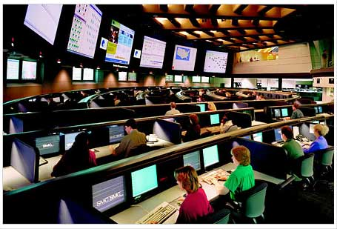








The Importance of Data Centers
“A 1-millisecond advantage in trading applications can be worth $100 million a year to a major brokerage firm”
Internal users
  Line-of-Business apps
  Production test beds
External users
  Web portals
  Web services
  Multimedia applications
  Chat/IM

Slide 5
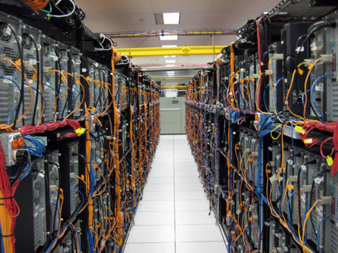

The Case for Understanding Data Center Traffic
Better understanding → better techniques
Better traffic engineering techniques
  Avoid data losses
  Improve app performance
Better Quality of Service techniques
  Better control over jitter
  Allow multimedia apps
Better energy saving techniques
  Reduce data center’s energy footprint
  Reduce operating expenditures
Initial stab→ network level traffic + app relationships

Slide 6
Take aways and Insights Gained
75% of traffic stays within a rack (Clouds)
  Applications are not uniformly placed
Half packets are small (< 200B)
  Keep alive integral in application design
At most 25% of core links highly utilized
  Effective routing algorithm to reduce utilization
  Load balance across paths and migrate VMs
Questioned popular assumptions
  Do we need more bisection? No
  Is centralization feasible? Yes

Slide 7


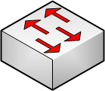




Canonical Data Center Architecture
Core (L3)
Aggregation (L2)
Edge (L2)
Top-of-Rack
Application
servers
Notes:
Rack of application servers
Point out 3 layers (core, gag, edge), show how 2-Tier and 3-Tier are different
Show links captured by SNMP
Show links captured by packet sniffers

Slide 8
Dataset: Data Centers Studied
DC Role | DC Name | Location | Number Devices
Universities | EDU1 | US-Mid | 22
 | EDU2 | US-Mid | 36
 | EDU3 | US-Mid | 11
Private Enterprise | PRV1 | US-Mid | 97
 | PRV2 | US-West | 100
Commercial Clouds | CLD1 | US-West | 562
 | CLD2 | US-West | 763
 | CLD3 | US-East | 612
 | CLD4 | S. America | 427
 | CLD5 | S. America | 427
10 data centers
3 classes
  Universities
  Private enterprise
  Clouds
Internal users
  Univ/priv
  Small
  Local to campus
External users
  Clouds
  Large
  Globally diverse
Notes:
Data from 10 date centers -- 5 clouds, 3 uni, 2 enterprise
Big data centers used for clouds
Enterprise/uni data located closer to premise of users

Slide 9
Dataset: Collection
SNMP
  Poll SNMP MIBs
  Bytes-in/bytes-out/discards
  > 10 Days
  Averaged over 5 mins
Packet Traces
  Cisco port span
  12 hours
Topology
  Cisco Discovery Protocol
DC Name | SNMP | Packet Traces | Topology
EDU1 | Yes | Yes | Yes
EDU2 | Yes | Yes | Yes
EDU3 | Yes | Yes | Yes
PRV1 | Yes | Yes | Yes
PRV2 | Yes | Yes | Yes
CLD1 | Yes | No | No
CLD2 | Yes | No | No
CLD3 | Yes | No | No
CLD4 | Yes | No | No
CLD5 | Yes | No | No

Slide 10
Canonical Data Center Architecture
Core (L3)
SNMP & Topology
From ALL Links
Aggregation (L2)
Packet
Sniffers
Edge (L2)
Top-of-Rack
Application
servers
Notes:
Rack of application servers
Point out 3 layers (core, gag, edge), show how 2-Tier and 3-Tier are different
Show links captured by SNMP
Show links captured by packet sniffers

Slide 11
Applications
Start at bottom
  Analyze running applications
  Use packet traces
BroID tool for identification
  Quantify amount of traffic from each app

Slide 12
Applications
Differences between various bars
Clustering of applications
  PRV2_2 hosts secured portions of applications
  PRV2_3 hosts unsecure portions of applications
Notes:
App mix found in the dc impact the results we look at next

Slide 13
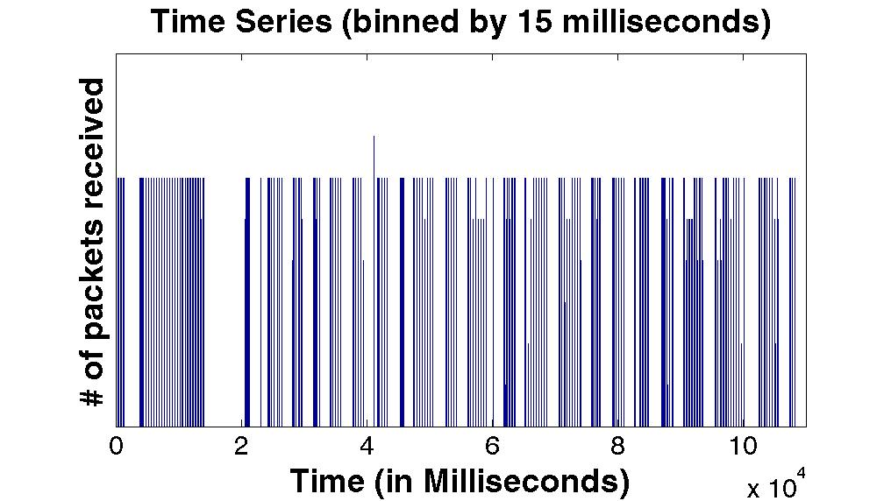
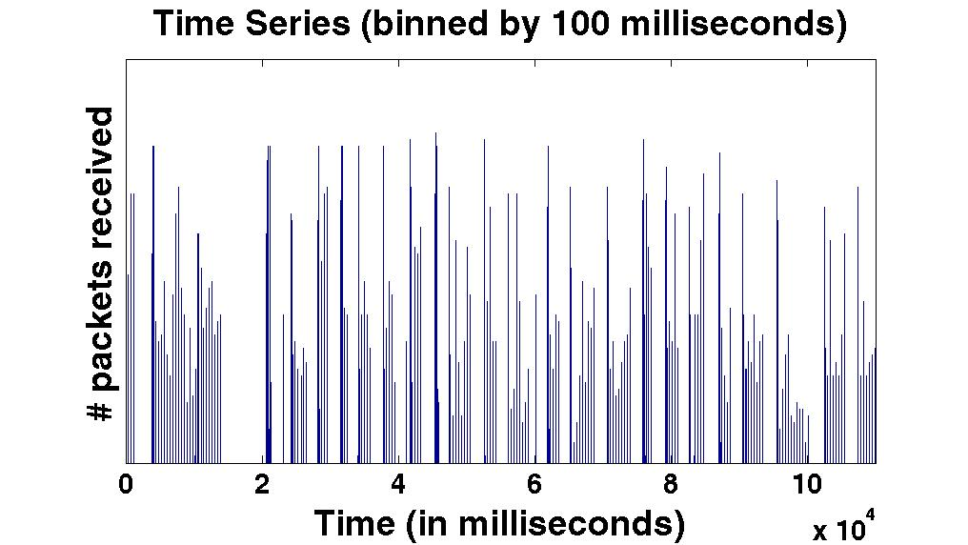
Analyzing Packet Traces
Transmission patterns of the applications
Properties of packet crucial for
  Understanding effectiveness of techniques
ON-OFF traffic at edges
  Binned in 15 and 100 m. secs
  We observe that ON-OFF persists
Notes:
Important for understanding effective assumptions and types of techniques that can be used

Slide 14
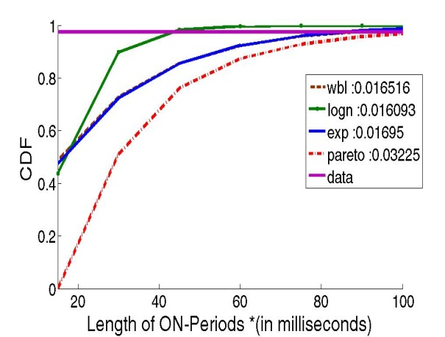
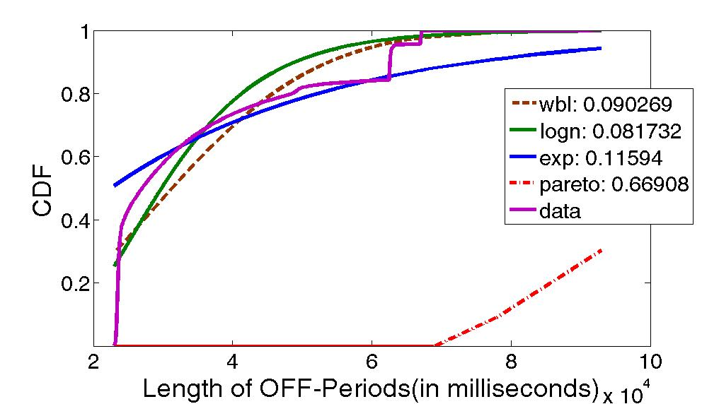
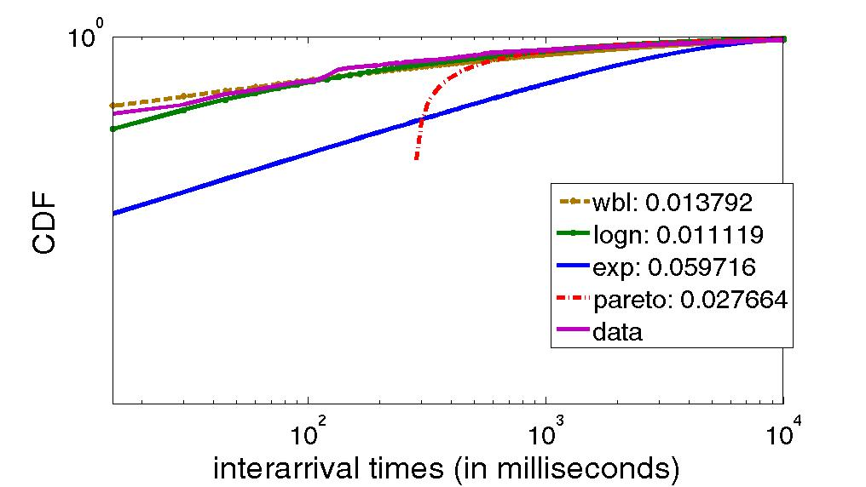
Data Center Traffic is Bursty
Understanding arrival process
  Range of acceptable models
What is the arrival process?
  Heavy-tail for the 3 distributions
    ON, OFF times, Inter-arrival,
  Lognormal across all data centers
Different from Pareto of WAN
  Need new models
Data Center | Off Period Dist | ON periods Dist | Inter-arrival Dist
Prv2_1 | Lognormal | Lognormal | Lognormal
Prv2_2 | Lognormal | Lognormal | Lognormal
Prv2_3 | Lognormal | Lognormal | Lognormal
Prv2_4 | Lognormal | Lognormal | Lognormal
EDU1 | Lognormal | Weibull | Weibull
EDU2 | Lognormal | Weibull | Weibull
EDU3 | Lognormal | Weibull | Weibull
Notes:
What are you curvingfitting for log normal parameters or the actual distributions
Not fit == different
We == conventionally

Slide 15
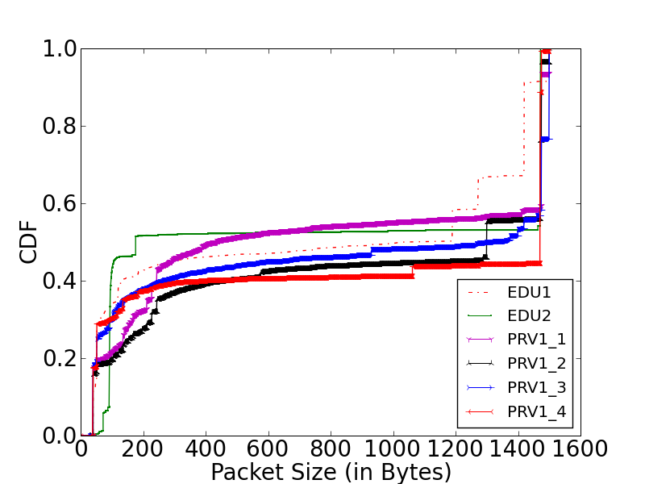
Packet Size Distribution
Bimodal (200B and 1400B)
Small packets
  TCP acknowledgements
  Keep alive packets
Persistent connections → important to apps

Slide 16
Canonical Data Center Architecture
Core (L3)
Aggregation (L2)
Edge (L2)
Top-of-Rack
Application
servers
Notes:
Rack of application servers
Point out 3 layers (core, gag, edge), show how 2-Tier and 3-Tier are different
Show links captured by SNMP
Show links captured by packet sniffers

Slide 17
Intra-Rack Versus Extra-Rack
Quantify amount of traffic using interconnect
  Perspective for interconnect analysis
Extra-Rack
Edge
Intra-Rack
Application
servers
Extra-Rack = Sum of Uplinks
Intra-Rack = Sum of Server Links – Extra-Rack
Notes:
intra-rack - traffic within
extra-rack – traffic leaving
Use equation to show how derived

Slide 18
Intra-Rack Versus Extra-Rack Results
Clouds: most traffic stays within a rack (75%)
  Colocation of apps and dependent components
Other DCs: > 50% leaves the rack
  Un-optimized placement

Slide 19
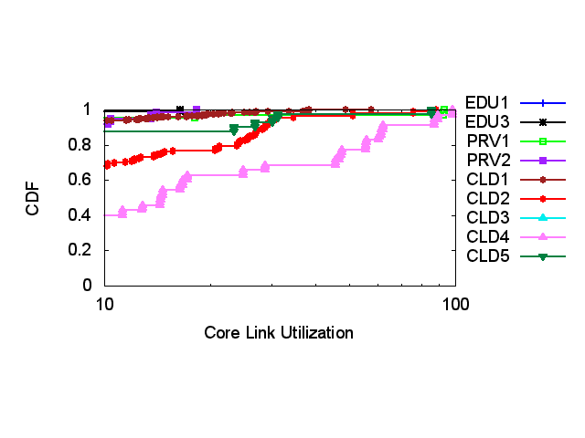
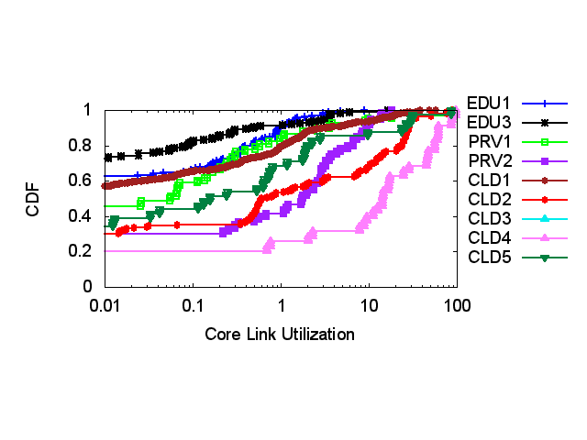
Extra-Rack Traffic on DC Interconnect
Utilization: core > agg > edge
  Aggregation of many unto few
Tail of core utilization differs
  Hot-spots → links with > 70% util
  Prevalence of hot-spots differs across data centers

Slide 20
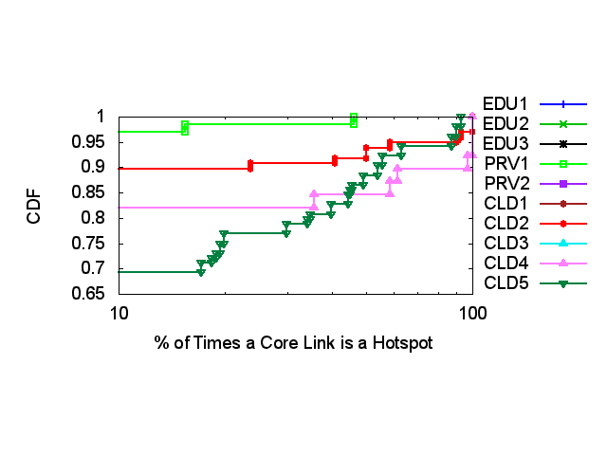
Persistence of Core Hot-Spots
Low persistence: PRV2, EDU1, EDU2, EDU3, CLD1, CLD3
High persistence/low prevalence: PRV1, CLD2
  2-8% are hotspots > 50%
High persistence/high prevalence: CLD4, CLD5
  15% are hotspots > 50%

Slide 21
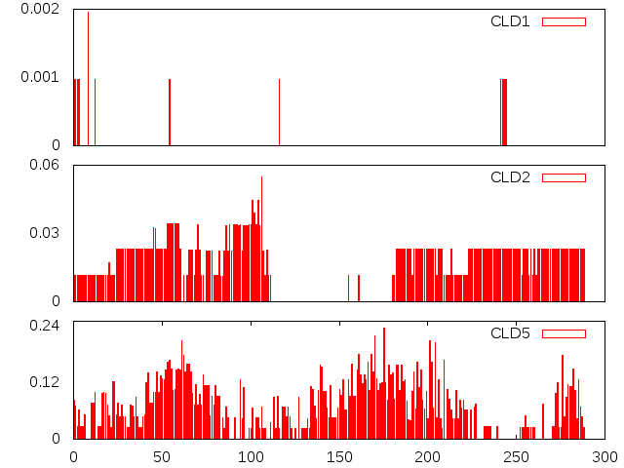
Prevalence of Core Hot-Spots
0.6%
0.0%
6.0%
0.0%
24.0%
0.0%
0 10 20 30 40 50
Time (in Hours)
Low persistence: very few concurrent hotspots
High persistence: few concurrent hotspots
High prevalence: < 25% are hotspots at any time

Slide 22
Observations from Interconnect
Links utils low at edge and agg
Core most utilized
  Hot-spots exists (> 70% utilization)
  < 25% links are hotspots
  Loss occurs on less utilized links (< 70%)
    Implicating momentary bursts
Time-of-Day variations exists
  Variation an order of magnitude larger at core
Apply these results to evaluate DC design requirements

Slide 23
Assumption 1: Larger Bisection
Need for larger bisection
  VL2 [Sigcomm ‘09], Monsoon [Presto ‘08],Fat-Tree [Sigcomm ‘08], Portland [Sigcomm ‘09], Hedera [NSDI ’10]
  Congestion at oversubscribed core links

Slide 24
Argument for Larger Bisection
Need for larger bisection
  VL2 [Sigcomm ‘09], Monsoon [Presto ‘08],Fat-Tree [Sigcomm ‘08], Portland [Sigcomm ‘09], Hedera [NSDI ’10]
  Congestion at oversubscribed core links
  Increase core links and eliminate congestion

Slide 25
Calculating Bisection Bandwidth
Core
Bisection
Links
(bottleneck)
Aggregation
Edge
App
Links
Application
servers
If Σ traffic (App ) > 1 then more device are
Σ capacity(Bisection needed at the bisection
Notes:
intra-rack - traffic within
extra-rack – traffic leaving
Use equation to show how derived

Slide 26
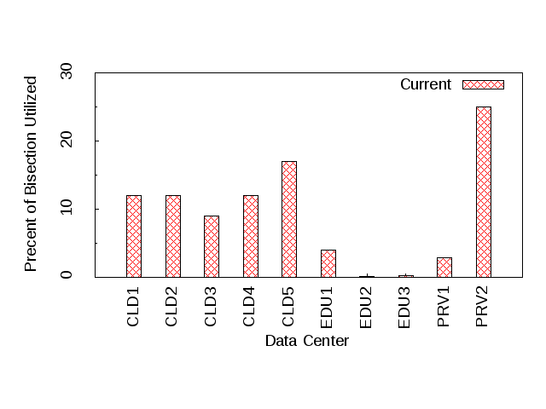
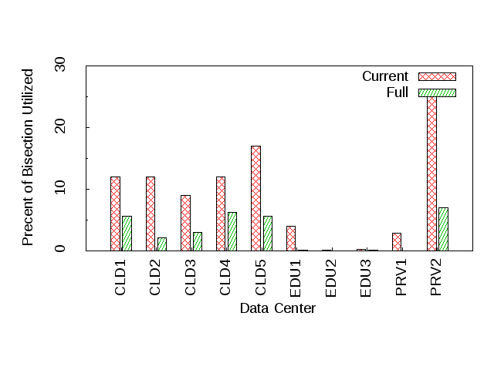
Bisection Demand
  Given our data: current applications and DC design
  NO, more bisection is not required
  Aggregate bisection is only 30% utilized
Need to better utilize existing network
  Load balance across paths
  Migrate VMs across racks

Slide 27
Insights Gained
75% of traffic stays within a rack (Clouds)
  Applications are not uniformly placed
Half packets are small (< 200B)
  Keep alive integral in application design
At most 25% of core links highly utilized
  Effective routing algorithm to reduce utilization
  Load balance across paths and migrate VMs
Questioned popular assumptions
  Do we need more bisection? No
  Is centralization feasible? Yes

Slide 28
Related Works
IMC ‘09 [Kandula`09]
  Traffic is unpredictable
  Most traffic stays within a rack
Cloud measurements [Wang’10,Li’10]
  Study application performance
  End-2-End measurements

Slide 29
Before Next time
Project Interim report
  Due Monday, November 24.
  And meet with groups, TA, and professor
Fractus Upgrade: Should be back online
Required review and reading for Wednesday, November 12
  SoNIC: Precise Realtime Software Access and Control of Wired Networks, K. Lee, H. Wang and H. Weatherspoon. USENIX symposium on Networked Systems Design and Implementation (NSDI), April 2013, pages 213-225.
  https://www.usenix.org/system/files/conference/nsdi13/nsdi13-final138.pdf
Check piazza: http://piazza.com/cornell/fall2014/cs5413
Check website for updated schedule

