Slide 1
Alternative Switching Technologies: Wireless Datacenters
Hakim Weatherspoon
Assistant Professor, Dept of Computer Science
CS 5413: High Performance Systems and Networking
October 22, 2014
Slides from the “On the Feasibility of Completely Wireless Datacenters” at the ACM/IEEE
Symposium on Architectures for Networking and Communications Systems (ANCS),
October 2012.

Slide 2
Where are we in the semester?
Overview and Basics
Data Center Networks
Basic switching technologies
Data Center Network Topologies (today and Monday)
Software Routers (eg. Click, Routebricks, NetMap, Netslice)
Alternative Switching Technologies
Data Center Transport
Data Center Software Networking
Software Defined networking (overview, control plane, data plane, NetFGPA)
Data Center Traffic and Measurements
Virtualizing Networks
Middleboxes
Advanced Topics

Slide 3
Goals for Today
On the Feasibility of Completely Wireless Datacenters
J. Y. Shin, E. G. Sirer, H. Weatherspoon, and D. Kirovski, IEEE/ACM Transactions on Networking (ToN), Volume 21, Issue 5 (October 2013), pages 1666-1680.

Slide 4



Conventional Datacenter
Core Switch
…
Aggregate Switch
Top of Rack Switch
…

Slide 5
Going Completely Wireless
Opportunities
Low maintenance : no wires
Low power: no large switches
Low cost: all of the above
Fault tolerant: multiple network paths
High performance: multiple network paths
Which wireless technology?

Slide 6
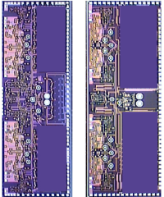
60GHz Wireless Technology
Short range
Attenuated by oxygen molecules
Directional
Narrow beam
High bandwidth
Several to over 10Gbps
License free
Has been available for many years
Why now?
Rx
Tx
CMOS Integration
Size < dime
Manufacturing cost < $1
7 mm
5 mm
[Pinel ‘09]

Slide 7
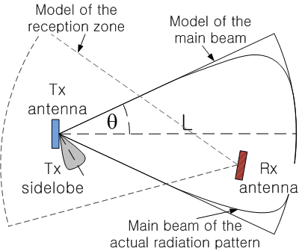
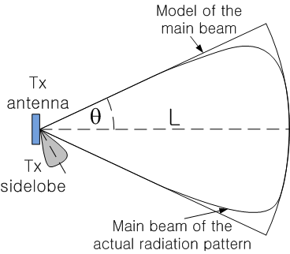
60 GHz Antenna Model
One directional
Signal angle between 25° and 45°
Maximum range < 10 m
No beam steering
Bandwidth < 15Gbps
TDMA (TDD)
FDMA (FDD)
Power at 0.1 – 0.3W
How to integrate to datacenters?

Slide 8
Designing Wireless Datacenters
Challenges
How should transceivers and racks be oriented?
How should the network be architected?
Interference of densely populated transceivers?

Slide 9
Completely Wireless Datacenters
Motivation
Cayley Wireless Datacenters
Transceiver placement and topology
Server and rack designs
Network architecture
MAC protocols and routing
Evaluation
Physical Validation: Interference measurements
Performance and power
Future
Conclusion

Slide 10
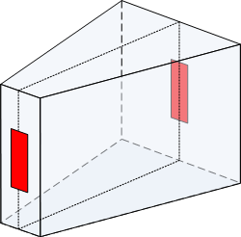

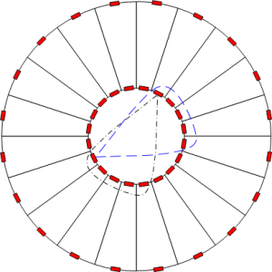
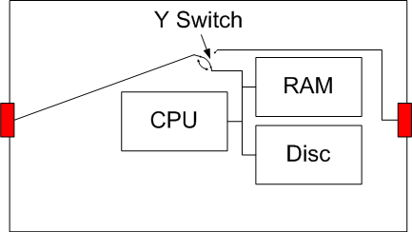
Transceiver Placement: Server and Rack Design
3D View
Rack
Server
3-way switch (ASIC design)
Inter-rack space
Intra-rack space
2D View
How do racks communicate with each other?

Slide 11
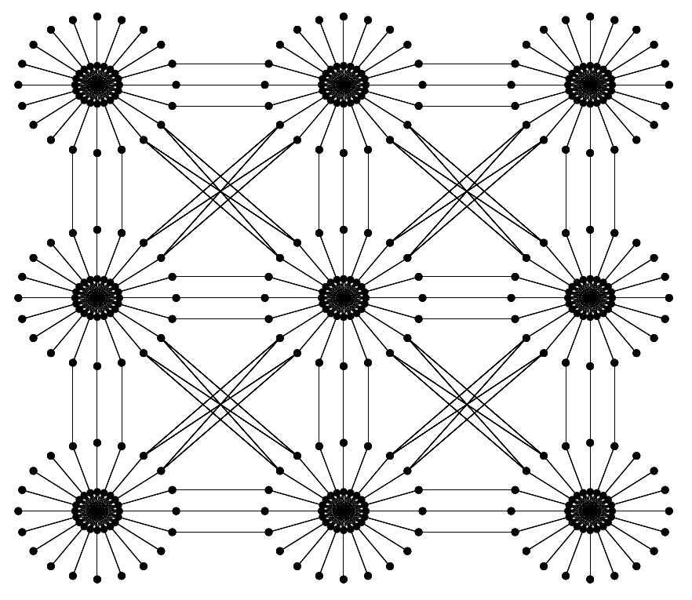

Cayley Network Architecture: Topology

Slide 12
Masked Node Problem and MAC
Most nodes are hidden terminals to others
Multiple (>5) directional antennae => Masked node problem
Collisions can occur
Dual busy tone multiple access [Hass’02]
Out of band tone to preserve channels
Use of FDD/TDD channels as the tone

Slide 13
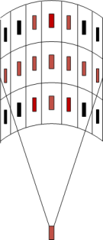

Cayley Network Architecture: Routing
Geographical Routing
Inter rack
Diagonal XYZ routing
Turn within rack
Shortest path turning
Within dst rack to dst server
Up down to dst story
Shortest path to dst server

Slide 14
Completely Wireless Datacenters
Motivation
Cayley Wireless Datacenters
Transceiver placement and topology
Server and rack designs
Network architecture
MAC protocols and routing
Evaluation
Physical validation: Interference measurements
Performance and power
Future
Conclusion

Slide 15
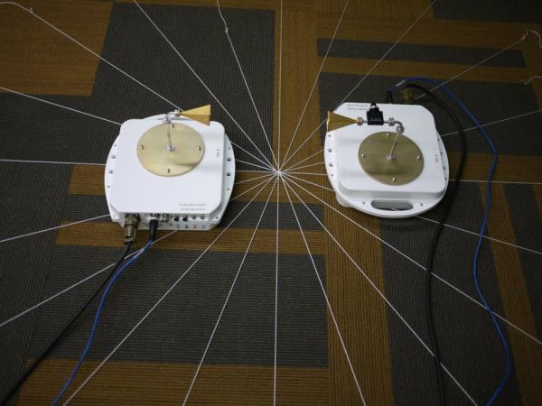
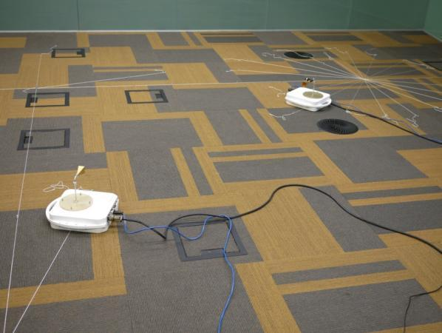
Hardware Setup for Physical Validation
Use of a conservative platform
Real-size datacenter floor plan setup
Validation of all possible interferences
Intra-rack communications
Inter-rack communications

Slide 16
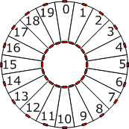
Physical Validation: Interference Evaluation (Signal angle θ = 15° )

Slide 17
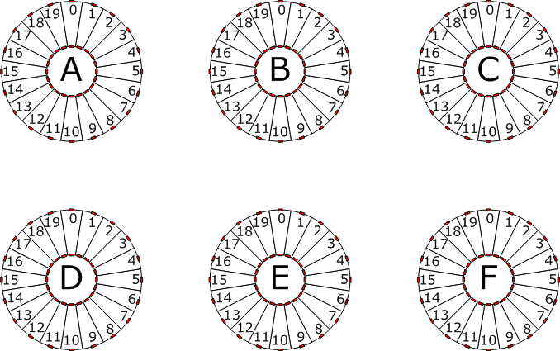
Physical Validation: Interference Evaluation (Signal angle θ = 15° )
Edge of signal:
can be eliminated
Potential Interference:
can be blocked using conductor
curtains

Slide 18
Evaluation
Performance: How well does a Cayley datacenter perform and scale?
Bandwidth and latency
Failure tolerance: How well can a Cayley datacenter handle failures?
Server, story, and rack failure
Power: How much power does a Cayley datacenter consume compared to wired datacenters

Slide 19
Evaluation Setup
Simulate 10K server datacenter
Packet level: routing, MAC protocol, switching delay, bandwidth
Conventional datacenter (CDC)
3 Layers of oversubscribed switches (ToR, AS, CS)
(1, 5, 1), (1, 7, 1) and (2, 5, 1)
Latency: 3-6us switching delay
Bandwidth: 1Gbps server
FAT-tree: Equivalent to CDC (1,1,1)
Cayley wireless datacenter
10Gbps bandwidth
1 Transceiver covers 7 to 8 others
Signal spreading angle of 25°
Low latency Y-switch (<< 1us)
(1,5,1)
(1,7,1)
(1,1,1)
(2,5,1)
Core
2
1.4
10
1
Aggregate
10
10
10
5
Top of Rack
10
10
10
10

Slide 20
Evaluation Setup
Uniform random
Src and dst randomly selected in entire datacenter
MapReduce
Src sends msg to servers in same row of rack
Receiver sends msg to servers in same column of rack
Receivers send msg to servers inside same pod with 50% probability

Slide 21
Bandwidth
Burst of 500 x 1KB packets per server sent
Cayley datacenters have the most bandwidth
s

Slide 22
Latency
Uniform random benchmark
MapReduce benchmark
Cayley datacenters typically performs the best

Slide 23
Fault Tolerance
Cayley datacenters are extremely fault tolerant
25%
55%
77%
99%

Slide 24
Power Consumption to Connect 10K Servers
Conventional datacenter (CDC) *
Depending on the oversubscription rate 58KW to 72KW
Cayley datacenter
Transceivers consume < 0.3W
Maximum power consumption: 6KW
Less than 1/10 of CDC power consumption
Switch Type | Typical Power
Top of rack switch (ToR) | 176W
Aggregation switch (AS) | 350W
Core switch (CS) | 611W
* Cost and spec of Cisco 4000, 5000, 7000 series switches

Slide 25
Discussion and Future Work
Only scratched the surface
How far can wireless datacenters go with no wires?
Need larger experiment/testbed
Interference and performance of densely connected datacenter?
Scaling to large datacenters (>100K servers)?
Scaling to higher bandwidth (> 10Gbps)?

Slide 26
Conclusion
Completely wireless datacenters can be feasible
Cayley wireless datacenters exhibit
Low maintenance
High performance
Fault tolerant
Low power
Low cost

Slide 27
References
S. Pinel, P. Sen, S. Sarkar, B. Perumana, D. Dawn, D. Yeh, F. Barale, M. Leung, E. Juntunen, P. Vadivelu, K. Chuang, P. Melet, G. Iyer, and J. Laskar. 60GHz single-chip CMOS digital radios and phased array solutions for gaming and connectivity. IEEE Journal on Selected Areas in Communications, 27(8), 2009.
Z.J. Hass and J. Deng. Dual busy tone multiple access (DBTMA)-a multiple access control scheme for ad hoc networks. IEEE Transactions on Communications, 50(6), 2002.
PEPPM. Cisco Current Price List. http://www.peppm.org/Products/cisco/price.pdf, 2012.

Slide 28
Related Work
 | Link Technology | Modifications Required | Working Prototype
Helios (SIGCOMM ‘10) | Optics w/ WDM 10G-180G (CWDM) 10G-400G (DWDM) | Switch Software | Glimmerglass, Fulcrum
c-Through (SIGCOMM ’10) | Optics (10G) | Host OS | Emulation
Flyways (SIGCOMM ‘11, HotNets ‘09) | Wireless (1G, 10m) | Unspecified
IBM System-S (GLOBECOM ‘09) | Optics (10G) | Host Application; Specific to Stream Processing | Calient, Nortel
HPC (SC ‘05) | Optics (10G) | Host NIC Hardware

Slide 29
Before Next time
Project Interim report
Due Monday, October 27.
And meet with groups, TA, and professor
Lab3 – Packet filter/sniffer
Due yesterday, Tuesday, October 21. But, 24 hour grace period.
Lab1/2 redux due Friday, October 24
Fractus Upgrade: SAVE ALL YOUR DATA
Fractus will be upgraded from October 28th to 30th
Can use Red Cloud during upgrade period, then switch back to Fractus
Required review and reading for Wednesday, October 22
Data center TCP (DCTCP), M. Alizadeh, A. Greenberg, D. A. Maltz, J. Padhye, P. Patel, B. Prabhakar, S. Sengupta, and M. Sridharan. ACM SIGCOMM Computer Communication Review (CCR), Volume 40, Issue 4 (October 2010), pages 63-74.
http://dl.acm.org/citation.cfm?id=1851192
http://www.sigcomm.org/sites/default/files/ccr/papers/2010/October/1851275-1851192.pdf
Check piazza: http://piazza.com/cornell/fall2014/cs5413
Check website for updated schedule

