Slide 1
Software Routers: NetSlice
Hakim Weatherspoon
Assistant Professor, Dept of Computer Science
CS 5413: High Performance Systems and Networking
October 15, 2014
Slides from Ki Suh Lee’s presentation at the ACM/IEEE Symposium on Architectures for
Networking and Communication Systems (ANCS), October 2012.

Slide 2
Where are we in the semester?
Overview and Basics
Data Center Networks
  Basic switching technologies
  Data Center Network Topologies (today and Monday)
  Software Routers (eg. Click, Routebricks, NetMap, Netslice)
  Alternative Switching Technologies
  Data Center Transport
Data Center Software Networking
  Software Defined networking (overview, control plane, data plane, NetFGPA)
  Data Center Traffic and Measurements
  Virtualizing Networks
  Middleboxes
Advanced Topics

Slide 3
Goals for Today
NetSlices: Scalable Multi-Core Packet Processing in User-Space
  T. Marian, K. S. Lee, and H. Weatherspoon. ACM/IEEE Symposium on Architectures for Networking and Communications Systems (ANCS), October 2012, pages 27-38.

Slide 4



Packet Processors
Essential for evolving networks
  Sophisticated functionality
  Complex performance enhancement protocols

Slide 5
Packet Processors
Essential for evolving networks
  Sophisticated functionality
  Complex performance enhancement protocols
Challenges: High-performance and flexibility
  10GE and beyond
  Tradeoffs

Slide 6
Software Packet Processors
Low-level (kernel) vs. High-level (userspace)
Parallelism in userspace: Four major difficulties
  Overheads & Contention
  Kernel network stack
  Lack of control over hardware resources
  Portability

Slide 7


Overheads & Contention
NIC
Cache coherence
Memory Wall
Slow cores vs. Fast NICs
CPU
Memory
Memory

Slide 8
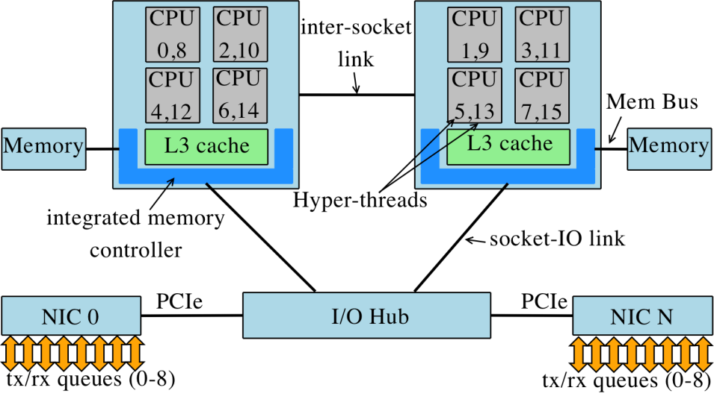
Kernel network stack & HW control
Raw socket: all traffic from all NICs to user-space
Too general, hence complex network stack
Hardware and software are loosely coupled
Applications have no control over resources
Application
Application
Network
Stack
Network
Stack
Network
Stack
Application
Network
Stack
Application
Network
Stack
Application
Network
Stack
Network
Stack
Application
Network
Stack
Network
Stack
Application
Application
Application
Raw socket
Network
Stack

Slide 9
Portability
Hardware dependencies
Kernel and device driver modifications
  Zero-copy
  Kernel bypass

Slide 10
Outline
Difficulties in building packet processors
NetSlice
Evaluation
Discussions
Conclusion

Slide 11

NetSlice
Give power to the application
  Overheads & Contention
  Lack of control over hardware resources
    Spatial partitioning exploiting NUMA architecture
  Kernel network stack
    Streamlined path for packets
  Portability
    No zero-copy, kernel & device driver modifications

Slide 12



NetSlice Spatial Partitioning
Independent (parallel) execution contexts
  Split each Network Interface Controller (NIC)
    One NIC queue per NIC per context
  Group and split the CPU cores
  Implicit resources (bus and memory bandwidth)
Temporal partitioning
(time-sharing)
Spatial partitioning
(exclusive-access)

Slide 13

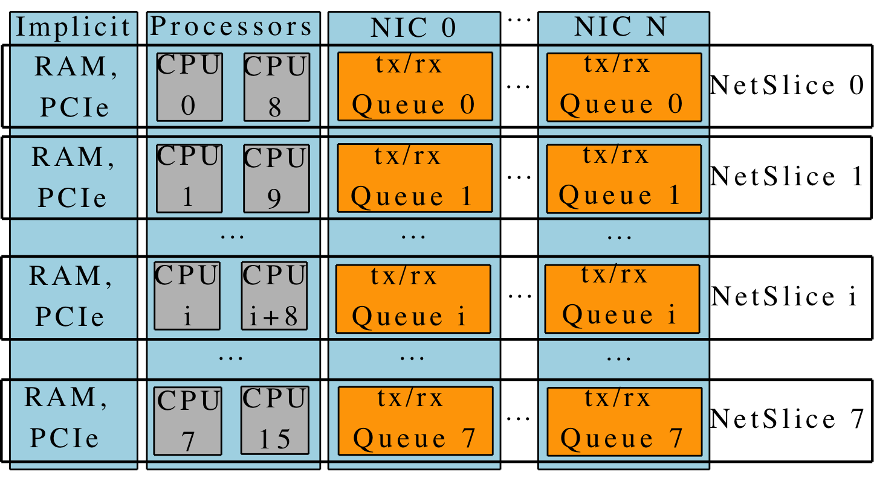
NetSlice Spatial Partitioning Example
2x quad core Intel Xeon X5570 (Nehalem)
  Two simultaneous hyperthreads – OS sees 16 CPUs
  Non Uniform Memory Access (NUMA)
    QuickPath point-to-point interconnect
  Shared L3 cache

Slide 14
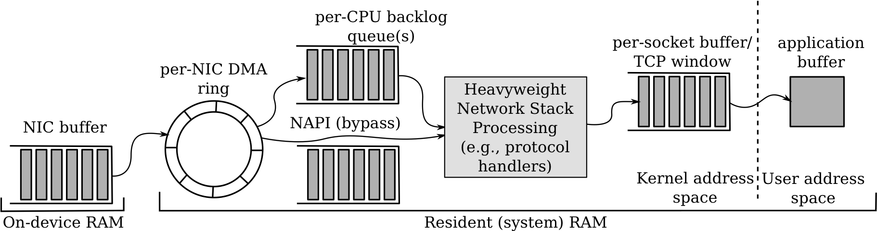
Streamlined Path for Packets
Inefficient conventional network stack
  One network stack “to rule them all”
  Performs too many memory accesses
  Pollutes cache, context switches, synchronization, system calls, blocking API
Heavyweight
Network Stack

Slide 15
Portability
No zero-copy
  Tradeoffs between portability and performance
  NetSlices achieves both
No hardware dependency
A run-time loadable kernel module

Slide 16
NetSlice API
Expresses fine-grained hardware control
Flexible: based on ioctl
Easy: open, read, write, close
1: #include "netslice.h"
2:
3: structnetslice_rw_multi {
4: int flags;
5: } rw_multi;
6:
7: structnetslice_cpu_mask {
8: cpu_set_tk_peer, u_peer;
9: } mask;
10:
11: fd = open("/dev/netslice-1", O_RDWR);
12:
13: rw_multi.flags = MULTI_READ | MULTI_WRITE;
14: ioctl(fd, NETSLICE_RW_MULTI_SET, &rw_multi);
15: ioctl(fd, NETSLICE_CPUMASK_GET, &mask);
16: sched_setaffinity(getpid(), sizeof(cpu_set_t),
17: &mask.u_peer);
18
19: for (;;) {
20: ssize_tcnt, wcnt = 0;
21: if ((cnt = read(fd, iov, IOVS)) < 0)
22: EXIT_FAIL_MSG("read");
23:
24: for (i = 0; i<cnt; i++)
25: /* iov_rlen marks bytes read */
26: scan_pkg(iov[i].iov_base, iov[i].iov_rlen);
27: do {
28: size_twr_iovs;
29: /* write iov_rlen bytes */
30: wr_iovs = write(fd, &iov[wcnt], cnt-wcnt);
31: if (wr_iovs< 0)
32: EXIT_FAIL_MSG("write");
33: wcnt += wr_iovs;
34: } while (wcnt<cnt);
35: }

Slide 17
NetSlice Evaluation
Compare against state-of-the-art
  RouteBricks in-kernel, Click & pcap-mmap user-space
Additional baseline scenario
  All traffic through single NIC queue (receive-livelock)
What is the basic forwarding performance?
  How efficient is the streamlining of one NetSlice?
How is NetSlice scaling with the number of cores?

Slide 18
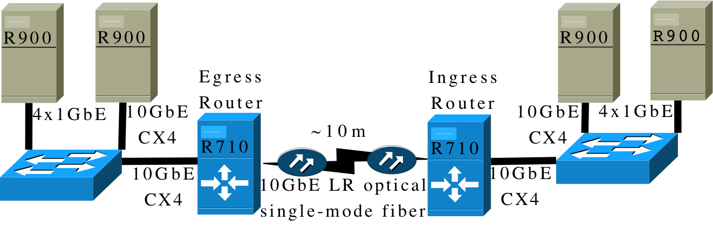

Experimental Setup
R710 packet processors
  dual socket quad core 2.93GHz Xeon X5570 (Nehalem)
  8MB of shared L3 cache and 12GB of RAM
    6GB connected to each of the two CPU sockets
    Two Myri-10G NICs
R900 client end-hosts
  four socket 2.40GHz Xeon E7330 (Penryn)
  6MB of L2 cache and 32GB of RAM

Slide 19
Simple Packet Routing
End-to-end throughput, MTU (1500 byte) packets
74% of
kernel
1/11 of
NetSlice

Slide 20
Linear Scaling with CPUs
IPsec with 128 bit key—typically used by VPN
  AES encryption in Cipher-block Chaining mode

Slide 21
Outline
Difficulties in building packet processors
Netslice
Evaluation
Discussions
Conclusion

Slide 22
Software Packet Processors
Can support 10GE and more at line-speed
  Batching
    Hardware, device driver, cross-domain batching
  Hardware support
    Multi-queue, multi-core, NUMA , GPU
  Removing IRQ overhead
  Removing memory overhead
    Including zero-copy
  Bypassing kernel network stack

Slide 23


Software Packet Processors
 | Batching | Parallelism | Zero-Copy | Portability | Domain
Raw socket |  |  |  |  | User
RouteBricks |  |  |  |  | Kernel
PacketShader |  |  |  |  | User
PF_RING |  |  |  |  | User
netmap |  |  |  |  | User
Kernel-bypass |  |  |  |  | User
NetSlice |  |  |  |  | User

Slide 24
Software Packet Processors
 | Batching | Multi-queue | Zero-Copy | Portability | Domain
Raw socket |  |  |  |  | User
RouteBricks |  |  |  |  | Kernel
PacketShader |  |  |  |  | User
PF_RING |  |  |  |  | User
netmap |  |  |  |  | User
Kernel-bypass |  |  |  |  | User
NetSlice |  |  |  |  | User

Slide 25
Software Packet Processors
 | Batching | Multi-queue | Zero-Copy | Portability | Domain
Raw socket |  |  |  |  | User
RouteBricks |  |  |  |  | Kernel
PacketShader |  |  |  |  | User
PF_RING |  |  |  |  | User
netmap |  |  |  |  | User
Kernel-bypass |  |  |  |  | User
NetSlice |  |  |  |  | User

Slide 26
Software Packet Processors
 | Batching | Multi-queue | Zero-Copy | Portability | Domain
Raw socket |  |  |  |  | User
RouteBricks |  |  |  |  | Kernel
PacketShader |  |  |  |  | User
PF_RING |  |  |  |  | User
netmap |  |  |  |  | User
Kernel-bypass |  |  |  |  | User
NetSlice |  |  |  |  | User

Slide 27
Software Packet Processors
 | Batching | Parallelism | Zero-Copy | Portability | Domain
Raw socket |  |  |  |  | User
RouteBricks |  |  |  |  | Kernel
PacketShader |  |  |  |  | User
PF_RING |  |  |  |  | User
netmap |  |  |  |  | User
Kernel-bypass |  |  |  |  | User
NetSlice |  |  |  |  | User

Slide 28
Software Packet Processors
 | Batching | Parallelism | Zero-Copy | Portability | Domain
Raw socket |  |  |  |  | User
RouteBricks |  |  |  |  | Kernel
PacketShader |  |  |  |  | User
PF_RING |  |  |  |  | User
netmap |  |  |  |  | User
Kernel-bypass |  |  |  |  | User
NetSlice |  |  |  |  | User
Optimized for RX path only

Slide 29
Software Packet Processors
 | Batching | Parallelism | Zero-Copy | Portability | Domain
Raw socket |  |  |  |  | User
RouteBricks |  |  |  |  | Kernel
PacketShader |  |  |  |  | User
PF_RING |  |  |  |  | User
netmap |  |  |  |  | User
Kernel-bypass |  |  |  |  | User
NetSlice |  |  |  |  | User

Slide 30
Discussions
40G and beyond
  DPI, FEC, DEDUP, …
Deterministic RSS
Small packets

Slide 31
Conclusion
NetSlices: A new abstraction
  OS support to build packet processing applications
  Harness implicit parallelism of modern hardware to scale
  Highly portable
Webpage: http://netslice.cs.cornell.edu

Slide 32
Before Next time
Project Progress
  Need to setup environment as soon as possible
  And meet with groups, TA, and professor
Lab3 – Packet filter/sniffer
  Due Thursday, October 16
  Use Fractus instead of Red Cloud
Required review and reading for Friday, October 15
  “NetSlices: Scalable Multi-Core Packet Processing in User-Space”, T. Marian, K. S. Lee, and H. Weatherspoon. ACM/IEEE Symposium on Architectures for Networking and Communications Systems (ANCS), October 2012, pages 27-38.
  http://dl.acm.org/citation.cfm?id=2396563
  http://fireless.cs.cornell.edu/publications/netslice.pdf
Check piazza: http://piazza.com/cornell/fall2014/cs5413
Check website for updated schedule

