Slide 1
Data Center Network Topologies: VL2 (Virtual Layer 2)
Hakim Weatherspoon
Assistant Professor, Dept of Computer Science
CS 5413: High Performance Systems and Networking
September 26, 2014
Slides used and adapted judiciously from COS-561, Advanced Computer Networks
At Princeton University

Slide 2
Where are we in the semester?
Overview and Basics
Data Center Networks
Basic switching technologies
Data Center Network Topologies (today and Monday)
Software Routers (eg. Click, Routebricks, NetMap, Netslice)
Alternative Switching Technologies
Data Center Transport
Data Center Software Networking
Software Defined networking (overview, control plane, data plane, NetFGPA)
Data Center Traffic and Measurements
Virtualizing Networks
Middleboxes
Advanced Topics

Slide 3
Goals for Today
VL2: a scalable and flexible data center network
A. Greenberg, J. R. Hamilton, N. Jain, S. Kandula, C. Kim, P. Lahiri, D. A. Maltz, P. Patel, and S. Sengupta. ACM Computer Communication Review (CCR), August 2009, pages 51-62.

Slide 4
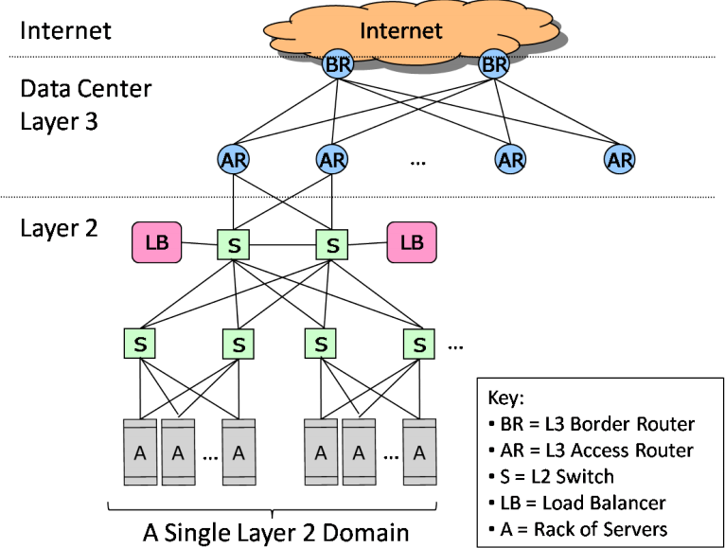
Architecture of Data Center Networks (DCN)

Slide 5
Conventional DCN Problems
CR
CR
1:240
AR
AR
AR
AR
S
S
S
S
I have spare ones,
but…
I want more
1:80
S
S
S
S
. . .
S
S
S
S
1:5
A
A
…
A
A
A
…
A
A
A
…
A
A
A
…
A
Static network assignment
Fragmentation of resource
Poor server to server connectivity
Traffics affects each other
Poor reliability and utilization

Slide 6
Objectives:
Uniform high capacity:
Maximum rate of server to server traffic flow should be limited only by capacity on network cards
Assigning servers to service should be independent of network topology
Performance isolation:
Traffic of one service should not be affected by traffic of other services
Layer-2 semantics:
Easily assign any server to any service
Configure server with whatever IP address the service expects
VM keeps the same IP address even after migration

Slide 7
Measurements and Implications of DCN
Data-Center traffic analysis:
Traffic volume between servers to entering/leaving data center is 4:1
Demand for bandwidth between servers growing faster
Network is the bottleneck of computation
Flow distribution analysis:
Majority of flows are small, biggest flow size is 100MB
The distribution of internal flows is simpler and more uniform
50% times of 10 concurrent flows, 5% greater than 80 concurrent flows

Slide 8
Measurements and Implications of DCN
Traffic matrix analysis:
Poor summarizing of traffic patterns
Instability of traffic patterns
Failure characteristics:
Pattern of networking equipment failures: 95% < 1min, 98% < 1hr, 99.6% < 1 day, 0.09% > 10 days
No obvious way to eliminate all failures from the top of the hierarchy

Slide 9
Virtual Layer 2 Switch (VL2)
Design principle:
Randomizing to cope with volatility:
Using Valiant Load Balancing (VLB) to do destination independent traffic spreading across multiple intermediate nodes
Building on proven networking technology:
Using IP routing and forwarding technologies available in commodity switches
Separating names from locators:
Using directory system to maintain the mapping between names and locations
Embracing end systems:
A VL2 agent at each server

Slide 10
Virtual Layer 2 Switch (VL2)
The Illusion of a Huge L2 Switch
CR
1. L2 semantics
CR
. . .
AR
AR
AR
AR
2. Uniform high capacity
3. Performance isolation
S
S
S
S
S
S
S
S
. . .
S
S
S
S
A
A
A
…
A
A
…
A
A
A
A
A
A
A
A
A
A
A
A
A
A
A
A
A
…
A
A
…
A
A
A
A
A
A
A
A
A
A
A
A
A

Slide 11
VL2 Goals and Solutions
Objective
Approach
Solution
1. Layer-2 semantics
Employ flat addressing
Name-location separation & resolution service
2. Uniform high capacity between servers
Guarantee bandwidth for hose-model traffic
Flow-based random traffic indirection (Valiant LB)
3. Performance Isolation
Enforce hose model using existing mechanisms only
TCP
“Hose”: each node has ingress/egress bandwidth constraints

Slide 12
Name/Location Separation
Cope with host churns with very little overhead
VL2
Directory Service
Switches run link-state routing and maintain only switch-level topology
Allows to use low-cost switches
Protects network and hosts from host-state churn
Obviates host and switch reconfiguration
…
x → ToR₂
y → ToR₃
z → ToR₄
…
…
x → ToR₂
y → ToR₃
z → ToR₃
…
ToR₁
. . .
ToR₂
. . .
ToR₃
. . .
ToR₄
ToR₃
y
payload
Lookup &
Response
y, z
ToR₃
x
y
z
ToR₄
z
z
payload
payload
Servers use flat names
Notes:
Lazy update of stale cache entries when packet erroneously reaches the old ToR (who forwards to the directory server, who updates with unicast)

Slide 13
Clos Network Topology
Offer huge aggr capacity & multi paths at modest cost
VL2
Int
. . .
D (# of 10G ports) | Max DC size (# of Servers)
48 | 11,520
96 | 46,080
144 | 103,680
Aggr
. . .
K aggr switches with D ports
. . .
. . . . . .
TOR
. . .
. . . . . . . .
20 Servers
20*(DK/4) Servers
Notes:
D/2 ports facing up, and D/2 ports facing down…

Slide 14
Valiant Load Balancing: Indirection
Cope with arbitrary TMs with very little overhead
I_{ANY}
I_{ANY}
I_{ANY}
Links used for up paths
[ ECMP + IP Anycast ]
Harness huge bisection bandwidth
Obviate esoteric traffic engineering or optimization
Ensure robustness to failures
Work with switch mechanisms available today
Links used for down paths
T₁
T₂
T₃
T₄
T₅
T₆
I_{ANY}
T₃
T₅
y
z
payload
payload
1. Must spread traffic
2. Must ensure dst independence
Equal Cost Multi Path Forwarding
x
y
z

Slide 15
VL2 Directory System
RSM
RSM Servers
3. Replicate
RSM
RSM
2. Set
4. Ack
(6. Disseminate)
. . .
. . .
. . .
Directory Servers
DS
DS
DS
2. Reply
2. Reply
5. Ack
1. Lookup
1. Update
Agent
Agent
“Lookup”
“Update”

Slide 16
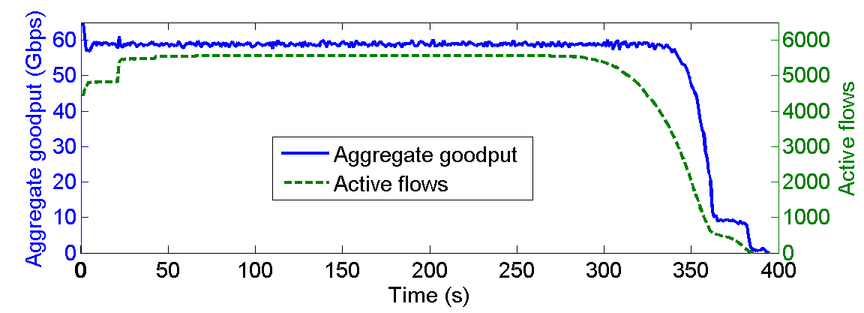
Evaluation
Uniform high capacity:
All-to-all data shuffle stress test:
75 servers, deliver 500MB
Maximal achievable goodput is 62.3
VL2 network efficiency as 58.8/62.3 = 94%

Slide 17
Evaluation
Fairness:
75 nodes
Real data center workload
Plot Jain’s fairness index for traffics to intermediate switches
Fairness Index
1.00
0.98
0.96
0.94
Aggr1 Aggr2 Aggr3
0 100 200 300 400 500
Time (s)

Slide 18
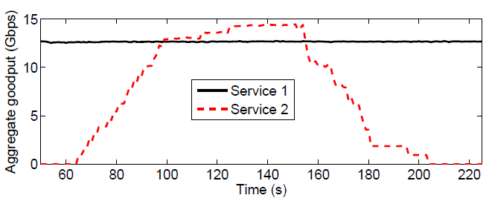
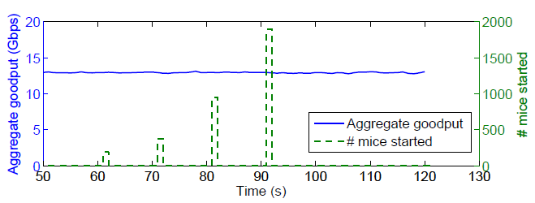
Evaluation
Performance isolation:
Two types of services:
Service one: 18 servers do single TCP transfer all the time
Service two: 19 servers starts a 8GB transfer over TCP every 2 seconds
Service two: 19 servers burst short TCP connections

Slide 19
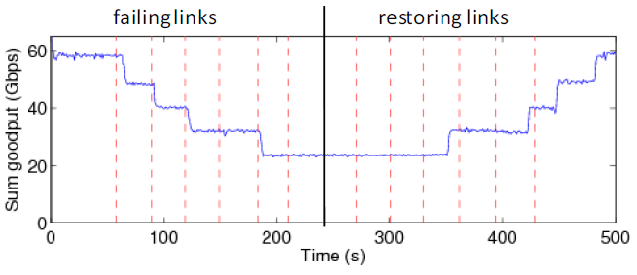
Evaluation
Convergence after link failures
75 servers
All-to-all data shuffle
Disconnect links between intermediate and aggregation switches

Slide 20
Perspective
Studied the traffic pattern in a production data center and find the traffic patterns
Design, build and deploy every component of VL2 in an 80 server testbed
Apply VLB to randomly spreading traffics over multiple flows
Using flat address to split IP addresses and server names

Slide 21
Critique
The extra servers are needed to support the VL2 directory system,:
Brings more cost on devices
Hard to be implemented for data centers with tens of thousands of servers.
All links and switches are working all the times, not power efficient
No evaluation of real time performance.

Slide 22
VL2 vs. SEATTLE
Similar “virtual layer 2” abstraction
Flat end-point addresses
Indirection through intermediate node
Enterprise networks (Seattle)
Hard to change hosts → directory on the switches
Sparse traffic patterns → effectiveness of caching
Predictable traffic patterns → no emphasis on TE
Data center networks (VL2)
Easy to change hosts → move functionality to hosts
Dense traffic matrix → reduce dependency on caching
Unpredictable traffic patterns → ECMP and VLB for TE

Slide 23
Other Data Center Architectures
VL2: A Scalable and Flexible Data Center Network
consolidate layer-2/layer-3 into a “virtual layer 2”
separating “naming” and “addressing”, also deal with dynamic load-balancing issues
A Scalable, Commodity Data Center Network Architecture
a new Fat-tree “inter-connection” structure (topology) to increases “bi-section” bandwidth
needs “new” addressing, forwarding/routing
Other Approaches:
PortLand: A Scalable Fault-Tolerant Layer 2 Data Center Network Fabric
BCube: A High-Performance, Server-centric Network Architecture for Modular Data Centers

Slide 24
Ongoing Research

Slide 25
Research Questions
What topology to use in data centers?
Reducing wiring complexity
Achieving high bisection bandwidth
Exploiting capabilities of optics and wireless
Routing architecture?
Flat layer-2 network vs. hybrid switch/router
Flat vs. hierarchical addressing
How to perform traffic engineering?
Over-engineering vs. adapting to load
Server selection, VM placement, or optimizing routing
Virtualization of NICs, servers, switches, …

Slide 26
Research Questions
Rethinking TCP congestion control?
Low propagation delay and high bandwidth
“Incast” problem leading to bursty packet loss
Division of labor for TE, access control, …
VM, hypervisor, ToR, and core switches/routers
Reducing energy consumption
Better load balancing vs. selective shutting down
Wide-area traffic engineering
Selecting the least-loaded or closest data center
Security
Preventing information leakage and attacks

Slide 27
Before Next time
Project Progress
Need to setup environment as soon as possible
And meet with groups, TA, and professor
Lab0b – Getting Started with Fractus
Use Fractus instead of Red Cloud
Red Cloud instances will be terminated and state lost
Due Monday, Sept 29
Required review and reading for Friday, September 26
“The Click Modular Router”, E. Kohler, R. Morris, B. Chen, and M. F. Kaashoek. ACM Symposium on Operating Systems Principles (SOSP), December 1999, pages 217-231.
http://dl.acm.org/citation.cfm?id=319166
http://www.pdos.lcs.mit.edu/papers/click:sosp99/paper.pdf
Check piazza: http://piazza.com/cornell/fall2014/cs5413
Check website for updated schedule

