Slide 1
Lecture 6: Azure IoT Hub and The Sensor Lifecycle
Ken Birman
Spring, 2022

Slide 2
Next “on Bat”… a 2-lecture sequence
We will be looking at IoT again, but this time with the goal of thinking about how DHT sharding interacts with IoT applications with sensors.
It will stretch over 2 lectures, so you won’t see the whole story today.
By the end we’ll have learned how big data systems compute on sharded data in a DHT, and then looked at how that approach could also work for large-scale collection of IoT data from sensors.

Slide 3
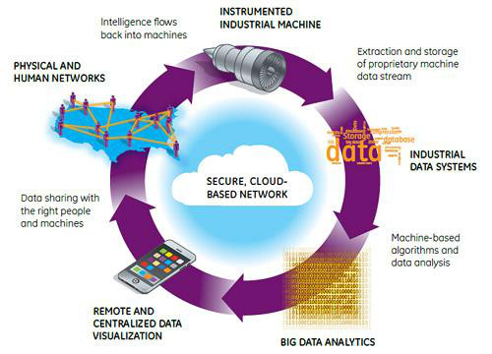
The future smart world
Puzzles…
Who “builds” this world?
Will they maintain it properly?
Can the devices be trusted?
http://www.plmconnections.com
Notes:
In an early lecture, we stressed that the form the cloud takes today is very much a function of the cloud revenue pattern: revenue generates investment which leads to innovations that enhance cost-effectivess and in turn, enhance or sustain revenue.
But how can this work for an emerging technology that enters a crowded, very active space?
Clearly, IoT confronts us with a chicken-and-egg problem. For IoT to reshape the cloud revenue would be required. Yet if the existing cloud hobbles IoT, then until the revenue is there, IoT will stumble.
The dilemma confronting vendors is to be very smart in placing some very focused technology bets. This centers on finding ways to use as much of the cloud as we can, unchanged, and then extend it with a minimal amount of vitally needed extra technology. Nobody is going to be all-in for IoT until they can make money on IoT!

Slide 4
Long-Standing Issue with Sensors
People have talked about using sensors to create a “smart world” since 1980’s, but it hasn’t been as simple as they imagined!
It is fairly easy to put RFID tags on devices, but those are passive.
In fact “full fledged” IoT with sophisticated sensors and actuators poses a wide range of challenges that we are only starting to appreciate.
Notes:
A cheap way to create a smart world is for physical objects to at least “identify themselves” when asked to do so. This can be done by placing RFID tags, which chirp a bar code if exposed to RF energy in the proper portion of the spectrum.
Since RFID only requires little stickers, the technology is almost free to deploy, but because no computing occurs, RFIDs are purely passive and with very limited use cases.
Sensors that actually do something are another matter: they confront resource limitations because interests functionality invariably consumes power and memory.

Slide 5
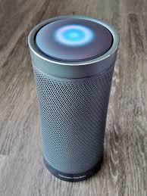
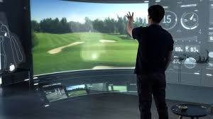
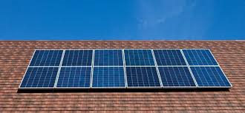
Iot is everywhere, but poorly managed
Your Internet router, and networked printer
Cortana/Alexa/Siri/Google Nest
Your TV and home entertainment system
The network-connected microwave, fridge, range.
Smart hot-water heater, and A/C, and room heating units
Smart power meter, to connect them all together
Smart water meter (might even be able to diagnose leaks)
Solar panels on the roof, energy storage batteries in the wall
Notes:
The devices themselves are already there and many are network enabled. But nothing manages them in a coherent way.

Slide 6
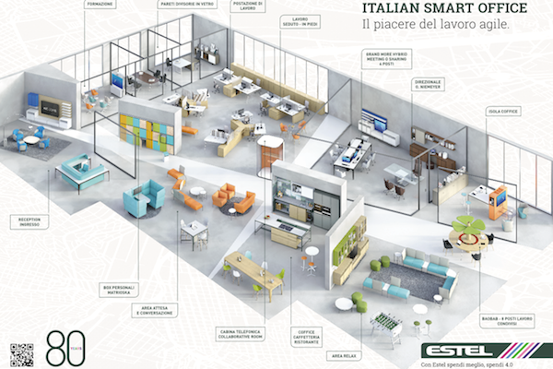
IoT doesn’t need to be obvious!
Estel: Italian design
firm specializing in
smart offices
The technology is subtle
but pervasive. Dozens
of smart devices
Notes:
Plenty of companies want to help you blend the smart devices into elegant high-tech offices and similar spaces. It is important to appreciate that IoT can easily be pervasive and yet unobtrusive. Indeed, devices that look nothing like cameras or microphones could easily be watching and listening, already.
Stated this way the remark may seem frightening. Yet how many smart phones are present in the classroom today? 100? 150? So in fact we tolerate those “intrusions” if we can trust the devices not to spy upon us. Indeed, making the technology unobtrusive and non-threatening is a key step to universal acceptance.

Slide 7
… Examples of IoT in the office
Room occupancy, temperature, humidity sensors and sector control
Sensor to detect exterior light, actuator to control lights & window shades
Desktop microphone for conferencing
Smart copier/scanner with network-enabled functionality
The elevator system
The expresso machine that automatically orders new coffee packs
Door locks that check ID cards

Slide 8
… Even the electric power grid is smart
Most of the world’s bulk electric power systems are becoming smart
This is IoT on a “grand scale” and covers more than just power: coal/gas delivery, scheduling of power plants, maybe even water delivery, too.
But this means that the power grid will need to keep a close eye on everything using electric power, or generating it. More IoT!

Slide 9
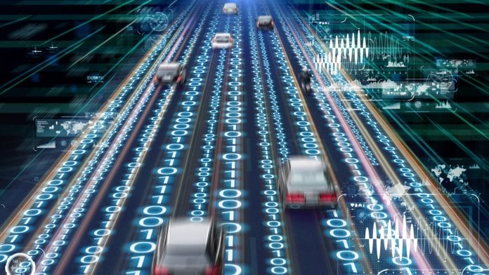
… the list really is endless
Smart farm
Smart city
Smart highway
Smart emergency first-response….

Slide 10
More puzzles: Contextualization
How do IoT devices know which room they are in?
Alexa, adjust the shades to block the glare on my display
Siri, use active noise cancellation to block that street noise
Cortana, find me a nearby conference room we can book for an hour.
… in addition to the IoT devices themselves we will need increasingly detailed “environmental maps” for everything, down to individual rooms!
Notes:
If a device is unable to orient itself relative to the the environment, it will be unable to take contextualized actions. But how will a small sensor learn things like building layout and the current purpose of the particular room in which it was placed? This knowledge can be gained using machine learning, but again, we get a chicken-and-egg puzzle: without connectivity to the devices how would we bootstrap the knowledge acquisition activity?

Slide 11
… contextualization is a Cloud computing task we might do in a Microservice!
We have a database of knowledge about the residents of a home
We also have IoT sensors and knowledge of where they are located.
Occupant says “Hey Cortana, can you block this glare?”
You do a query to figure out that the sunlight from a particular window in the TV area is reflecting onto the occupant, who is on the couch there…

Slide 12
Who keeps this stuff Secure + Robust?
Even if every light bulb “could” have a computer in it, why would this benefit anyone, and who would make sure the broken ones are replaced?
How can we protect privacy and ensure that these things are secure? What costs could be incurred for violations?
What if a sensor malfunctions? Can we figure out that it needs repair?

Slide 13
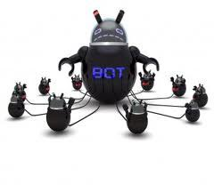
Situation today?
Very poorly managed, huge numbers of IoT devices yet very little attention to software upgrades, network security issues raised.
There are network-enabled printers that turned out to have entire spy computing systems embedded in them, to retain copies of everything.
Largest “zombie/bot” population? By one estimate, it
may be Internet WiFi routers with default password settings!

Slide 14
Azure IoT Today: Aiming for a Minimal but adequate launch point.
Microsoft has focused on IoT for corporate customers with huge numbers of smart devices, and little control over them.
And within that first step, they focus on management of the “fleet” of sensor and actuator devices:
Unmanaged sensors are a danger and a nightmare to the “owner”
Seems like a necessary first step, in any case
Can we “secure” the IoT devices, and make them “trustworthy”?

Slide 15
Key architectural elements?
Microsoft product: Azure IoT Hub, Iot Edge and Intelligent Edge
First, the hub handles secure registration of devices and status tracking
Next, it automates software upgrades
It deals with issues of intermittent connectivity
For devices that can be controlled from the cloud, it creates a “model”
to enable you to perform those control actions

Slide 16
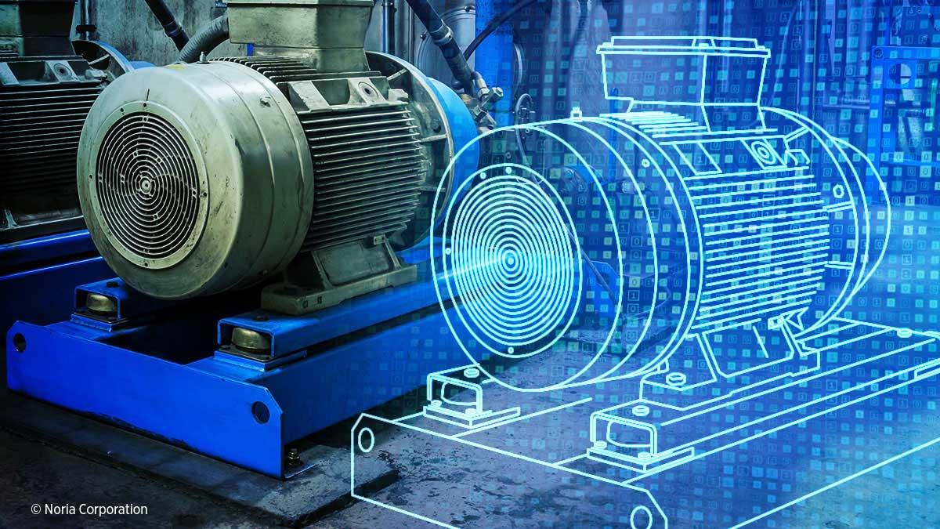
Reminder: Digital Twin Concept
In the real world we have some physical devices, like these turbines.
They are equipped with sensors that monitor conditions and actuators, used to control the device remotely.
In the cloud, we maintain a digital representation for the turbine, like this engineering diagram. The software sensors and actuators in the cloud representation are virtual control points wired to the real-world sensors and actuators.

Slide 17
Azure IoT Hub implements this concept
The hub is a database and we can understand it as holding the engineering diagram and also the “virtual” sensors and actuators.
Azure uses a real database for this purpose (SQL server).
A form of device driver links each virtual sensor to its real-world counterpart and each actuator to its real-world control point

Slide 18
Azure IoT hub: Database of sensors.
The first step centers on secure registration of devices. The Azure IoT Hub manages a scalable database of sensors and associated data.
The enterprise owner also records information such as:
Device make and model,
Software revision level, battery lifetime, when it was last serviced
Where it is located, role it plays (information for contextualization)
Additional application-specific information or “knowledge”

Slide 19
This makes it an Active database!
In a normal database the data tuples are just plain old data objects.
In Azure IoT Hub, the objects in the database are intended to hold meta-data on behalf of the “real” sensors and actuators, and to keep this data in sync with the actual sensor or actuator when connectivity is possible.
In effect, we now have meta-data describing the sensor combined with live properties (like battery level, photos cached, filter settings) that are wired to the actual device and change in real-time!

Slide 20
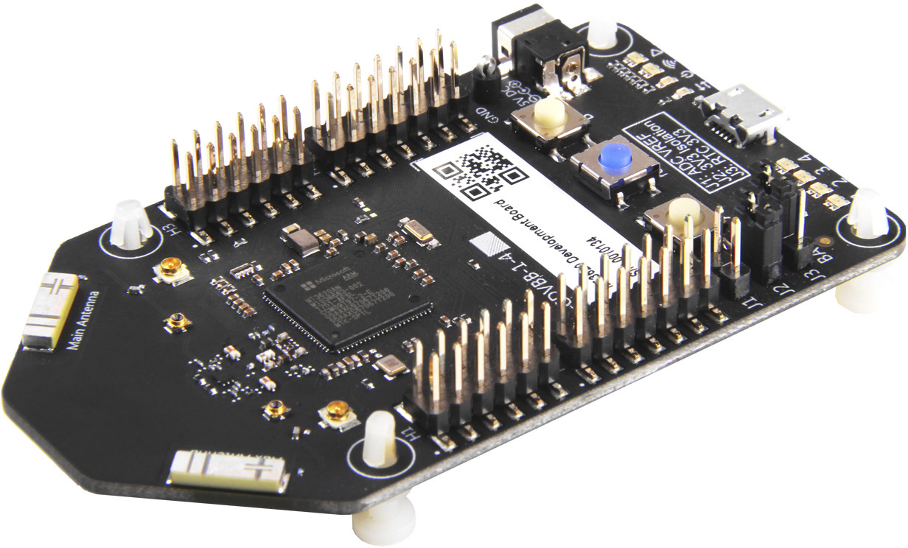
Device security
Azure Sphere Development Kit
The level of security for today’s network-enabled IoT devices is poor to non-existent, making them way too easy to hack or disable.
So Microsoft has a new product aimed at sensor manufacturers. The Azure Sphere is a special low-power security chip that embodies a hardware root of trust and low-power cryptographically protected HTTPS.
With Azure Sphere, device manufactures can secure existing sensor products, and the resulting sensors will interoperate with Azure IoT hub.

Slide 21
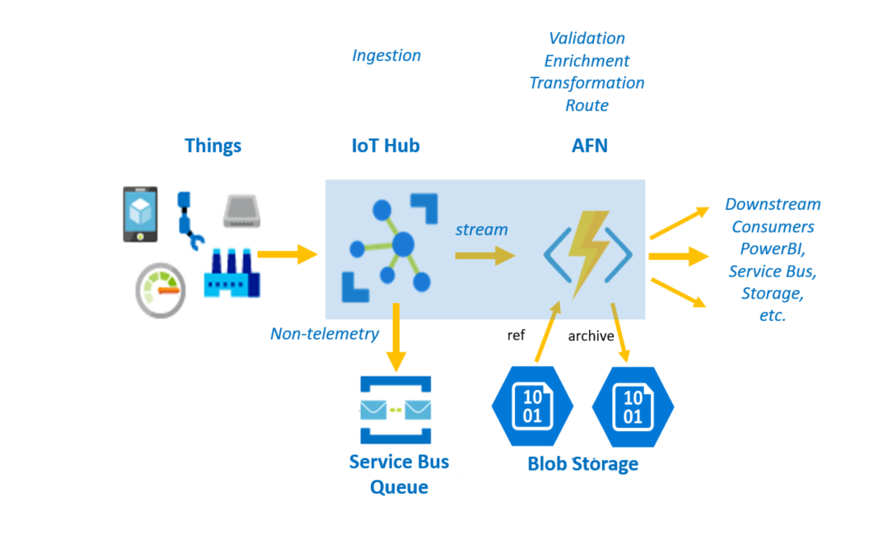
IoT Programming via Templates
Like much of the cloud, Azure IoT offers “recipes” that developers download and then customize.
Here is an example from a scenario
that they “story-board” on the Azure
IoT Hub website.
This one relates to smart manufacturing

Slide 22
How do “recipes” like this work?
In fact they are tied to large amounts of
  Video training materials
  Actual demo code you can download and try, then customize
  Written documentation
  For this example, visit https://github.com/microsoft/IoT-For-Beginners. It has a lot of content (scroll past the index at the top, which is in a GitHub style that might confuse you. The welcome and overview is below the list of contents)

Slide 23
Every Azure IoT device has a “proxy”
Many devices have limited network connectivity and won’t always be online.
So in Azure IoT Hub, every device has a cloud-hosted “representative”: a software agent that can respond to device operations 24x7, and then will push updates (like new software revisions) when an opportunity arises.
The agent can also schedule maintenance operations.
Notes:
The way to understand this idea of a proxy is to ask yourself “how do I send a command to a device if it isn’t connected right this second?”
With sensors, this is a very common issue. Connectivity is sometimes poor due to mobility, but issues of battery life and even building-wide power management arise too. So we cannot assume full connectivity or cloud access to the full data on the sensors.
Azure’s solution is to use a form of virtualization: the device has a kind of stand-in (that’s what proxy “means”) to collect and hold commands and data and program updates until the next change to talk to it arises. The proxy is like a virtual version of the real sensor. Cloud applications interact with the virtualized proxy, and it passes information through to the actual sensor, and back.
If the sensor is connected the commands might be sent instantly. But if not, they simply queue up.

Slide 24
Proxy programming
In this Azure proxy mode, you can send information to a device even if the device is currently disconnected! The proxy is always available.
For example, a firmware update or patch, or new device configuration.
But obviously the action can’t occur until the device connects. So there is always a back-and-forth: Event “to” the device, and later, an event “back”. Applications will need to work in this very asynchronous way.

Slide 25
Quality of Service issues
For many devices, network quality is also an issue.
Over time, a network link might be unavailable, or available but slow, or temporarily very fast (at a high price).
In normal networks we don’t think about this much. But for IoT, our applications may need to be dynamically responsive as conditions change.
Notes:
This term (QoS) covers a whole lot of possible properties. It really is about the ability to request some form of guarantee…. The specifics of that guarantee might depend on your needs.

Slide 26
The quality of the sensor itself is also a serious concern
With large numbers of sensors we often get redundancy
Wood and Marzullo explored this in a system called Meta here at Cornell.
Key idea: first, that sensors have “range of accuracy”, and second that time also has a range of accuracy. Finally, that by leveraging this insight, we can actually identify and correct for many kinds of inaccuracy!

Slide 27
Clocks also have limited accuracy
There are standard protocols for synchronizing them.
But at any instant in time, clocks could still have drifted from the exact time.
The term clock skew is an estimate of the worst-case drift between two non-faulty clocks, if you were to read them at the same instant in time.

Slide 28
Deep Dive: How does sensor accuracy impact the way we might use them?
75
Temp
Sensor A claims temperature was 70F at 10:01am
70
65
Time

Slide 29
Deep Dive: How does sensor accuracy impact the way we might use them?
75
But sensor accuracy was registered as +/- 1.5F, and clock skew for sensors is +/- 5s.
Actual temperature and time are in the bounding box
Temp
70
65
Time

Slide 30
Deep Dive: How does sensor accuracy impact the way we might use them?
75
Temp
Perhaps the room actually has three devices
that measure temperature either directly, or in some
indirect way: A, B and C.
70
65
Time

Slide 31
Deep Dive: How does sensor accuracy impact the way we might use them?
75
Temp
Now we can recognize that one (the orange one) is faulty or miscalibrated. But the actual temperature must be in the overlap of the two correct ones, so we not only can figure this out, we can even improve the accuracy!
70
65
Time
Notes:
This is really amazing: Even with 1 failed sensor, the rule that correct sensors must overlap lets us get a much more accurate result than if we just had one working sensor!

Slide 32
Deep Dive: How does sensor accuracy impact the way we might use them?
75
Temp
70
65
Time
Knowledge of temperature trends could give us a further way to improve the data! Also, by now we can see that we need to schedule service on the yellow sensor, or remove it entirely.
Notes:
Here, machine learning could pay off: trend analysis might take us even beyond what overlap can do…

Slide 33
Meta: “Rules” for computing with imprecise sensors
Suppose we tell the smart system to “turn on the office A/C if the temperature rises above 71F”
Does this mean “if the temperature might be more than 71?” Or “if the temperature is definitely more than 71?”
The correct action is very different! In our example, the temperature is probably 70.1, but could be as high as 71.6

Slide 34
“Might” versus “Definitely”
Might is a way to talk about “any value in the bounding box.”
If the temperature is 70.1 +/- 1.5 at time 10:03 +/- 5s, it “might” have
any value in the temperature range, or the time range.
Definitely would mean that the allowed range has “no intersection” with the bounding box
In our example, the temperature is definitely more than 69F

Slide 35
Temporal accuracy concerns
Fred Schneider likes to distinguish three properties:
Precision: How close is a clock to other non-faulty clocks?
Accuracy: How close is the clock to “true” time?
Drift: How quickly is a clock losing precision or accuracy?
Recall: For a pair of clocks, the “skew” is their difference if measured at the same instant in true time. Drift is the “rate at which skew increases.” Precision and accuracy are both forms of skew.
Notes:
Accuracy: A characterization of the degree of skew from a correct clock to true time (an atomic clock).
Precision: A characterization of the degree of skew you might observe between a pair of correct clocks.
Skew: The associated “measurement”. If clock A reads T_{A} and clock B reads T_{B} then the skew is currently abs(T_{A}-T_{B}).
Drift: the rate at which skew is changing. For example, perhaps the skew is getting larger by 1ms per second of real-time that elapses.

Slide 36
Patriot Missile Defense in the IraQ war
The Patriot anti-missile system was implemented as a two-processor system.
A radar unit, on the ground, computed the trajectory of an incoming threat and tells the anti-missile when and where to intercept the target. Then the anti-missile launches and makes a pinpoint rendezvous.
Would you prefer for the two clocks (the radar, and the defensive missile) to have the best possible precision, or accuracy?

Slide 37
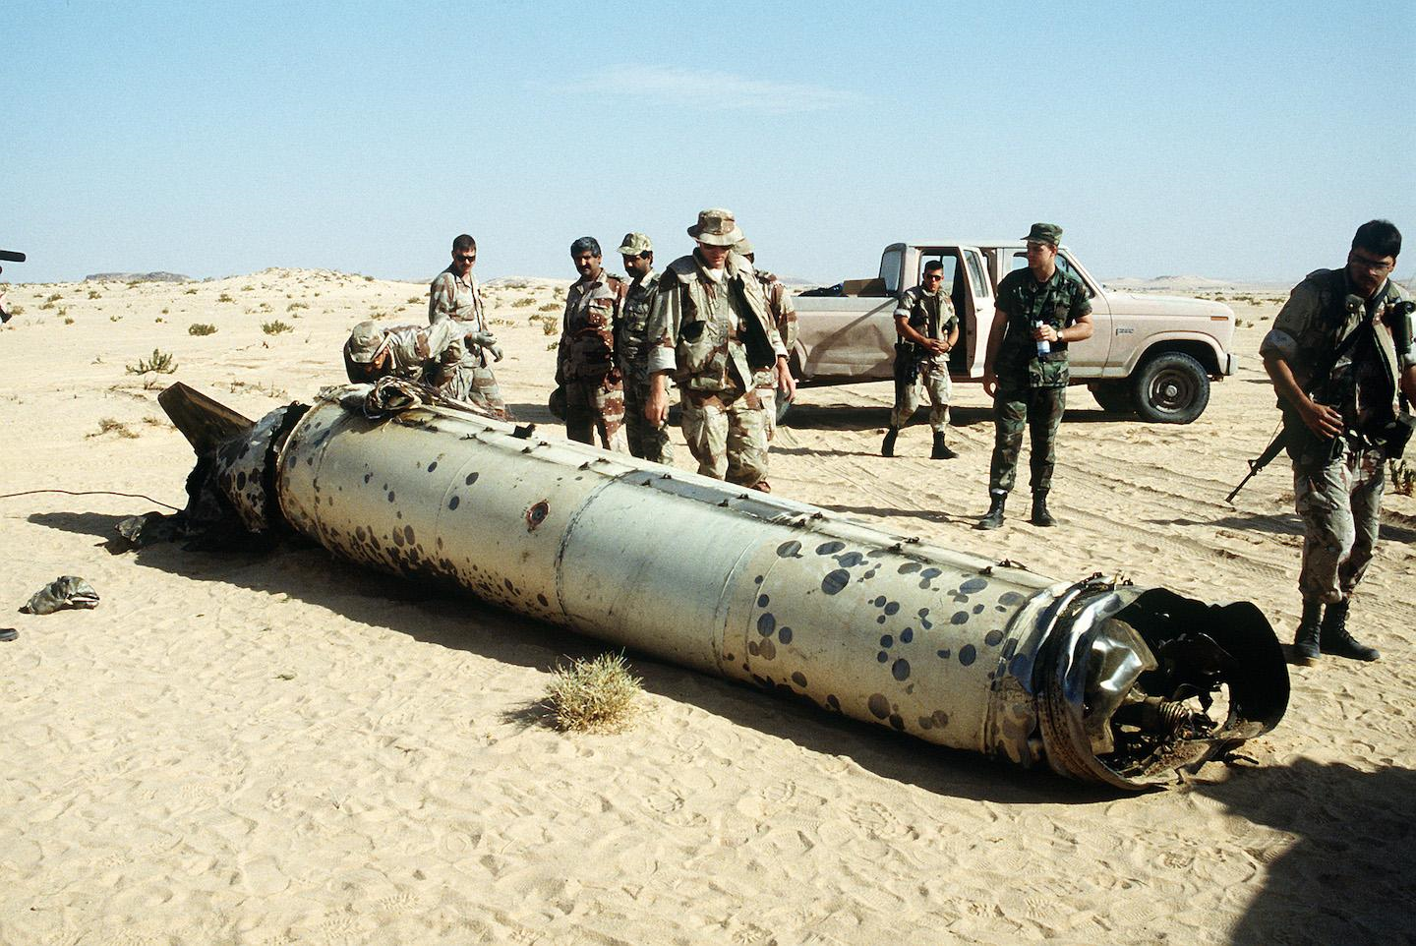
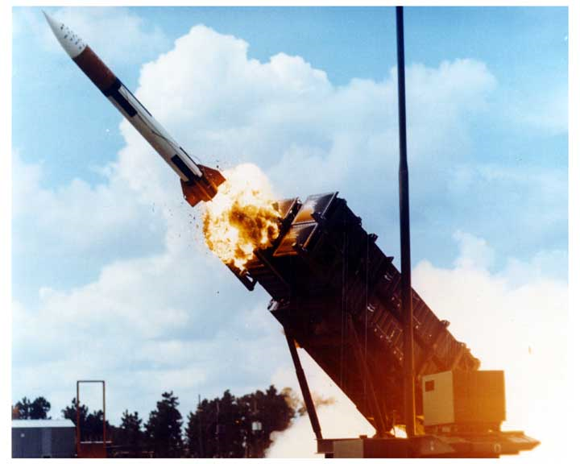
What actually happened?
Iraq launched Scud missiles at various targets (“flying garbage cans filled with dynamite (and maybe worse)”.
Israel fired on dozens of Scuds. Time after time, the Patriot missiles kept missing: they reached the right spot, but just a few milliseconds late!
The anti-missile would punch through the fuselage of the Scud, but miss the warhead, and then both would fall to earth… and explode on the ground

Slide 38
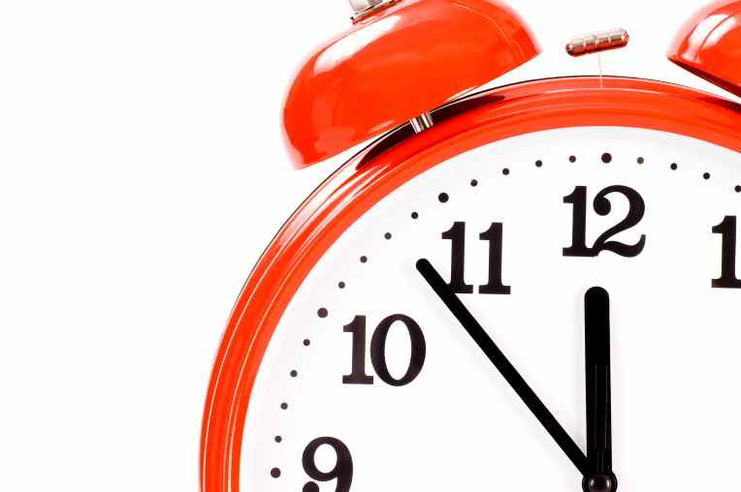
Why was the Patriot Late?
Later they discovered that the clocks in the radar computer system were drifting very slightly – they were slightly fast.
After 3 or 5 days, this might add up to a few milliseconds of inaccuracy.
So when the radar said to the patriot: “intercept a thread that will be at location (x,y,z) at time T, the time “T” was a few milliseconds late! Since then, the issue has been fixed (IronDome works really well).

Slide 39
Other puzzles that could arise
Think about a sensor tracking a cow’s temperature and located in her rumen (a form of stomach). This won’t harm her or hurt at all.
When she drinks cold water, the temperature genuinely drops. But in fact we aren’t measuring her body temperature at that moment.
Even an accurate sensor would have periods when it isn’t tracking the metric we are interested in!

Slide 40
Other puzzles that could arise
A smart highway tells two cars to follow some pattern: car A can enter the passing lane and pass car B. Car B should stay to the right until car A has passed by. If this is given by times, the same question arises.
Or two drones scanning some field, taking commands from a control system.
In Fred’s terminology: We need a high degree of precision for temporal coordination in such cases, but this is complicated by the tendency to use absolute time of day when computers interact with one-another.

Slide 41
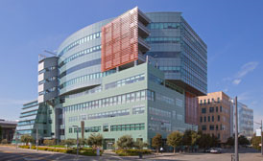

More puzzles: “Information flow”
Cloud-Hosted Intelligence
Building Management System
Room Management System
Because the IoT world will be large and geographically distributed, information needs to be moved around to carry out intelligent tasks. Yet customers may insist that we limit and control the flow of private data.

Slide 42
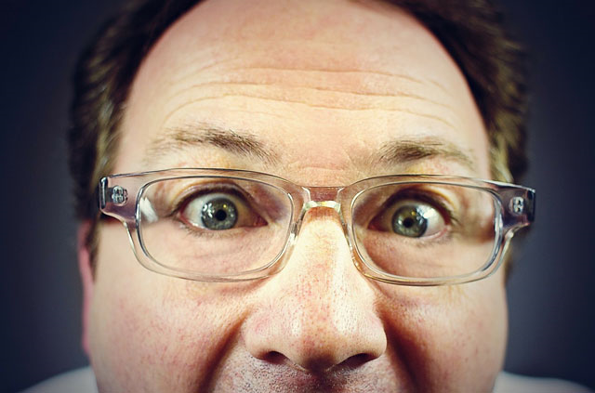
Privacy
Suppose that the cloud learns sensitive information
If Siri/Alexa/Cortana can hear your commands, it can listen to you.
Who owns that information it gathered?
Who should be permitted to listen to it?
It would be nice to say “all my private stuff stays in my house” but only the cloud really has the resources to understand everyone at large scale
Extra: not important, will cover if time permits

Slide 43
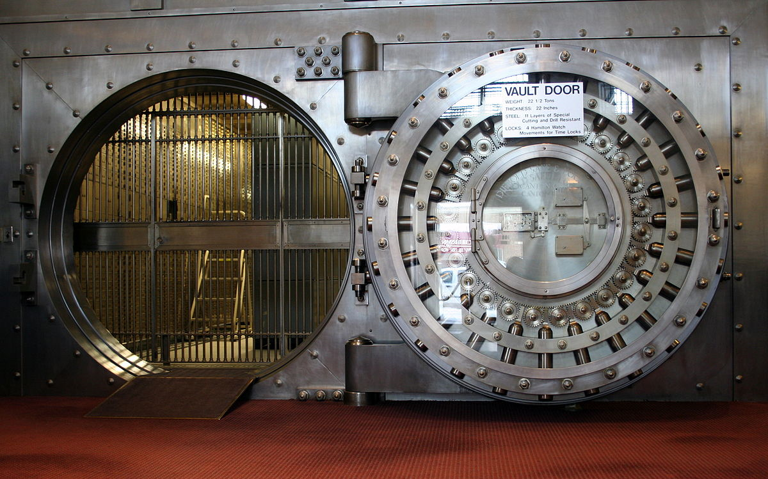
Security
Beyond personal privacy, companies developing new products are at risk of competitors spying on them!
They benefit from the technology, but if their IP gets stolen, they lose it all!
So there are questions of protection not of private data, but also of company IP. But if you own your private data, how will the system figure out which remarks are private and which are related to your job?
Extra: not important, will cover if time permits

Slide 44
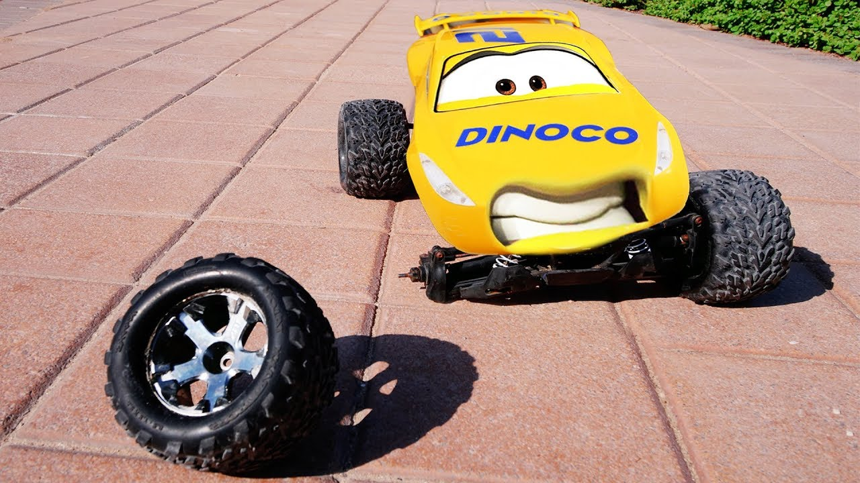
Fault-Tolerance
With so many moving parts, some will fail!
In fact failures can occur at every level
A sensor could go offline
It could stay online but send confused/incorrect data, or bad timestamps
The network connection could freeze up or break
The cloud servers could shut down or be reconfigured
Extra: not important, will cover if time permits

Slide 45
Example: Landlord’s Management tool
To see how these can come into conflict, consider a solution aimed at the landlord of a large residential complex.
It might have hundreds of units (apartments or condos)
Landlord needs to operate this intelligently
Extra: not important, will cover if time permits

Slide 46
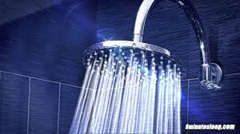
Avoiding harm to a building
In fact a major goal for smart buildings is to anticipate problems and fix them, perhaps even before they become serious.
Think about an apartment complex with a forgetful tenant in a drought area. If he starts the shower running but forgets and goes shopping, huge water waste can occur. Someone should shut the water off!
But then there is a privacy issue raised: will this reveal that the tenant has early senile dementia? He could be harmed if this became known.
Extra: not important, will cover if time permits

Slide 47
Similar issues
Window left open and yet heat is on.
Stove was left on, or lights, or TV… but tenants aren’t home. Microwave was set to 30 minutes instead of 30 seconds.
Tenant falls and can’t get to a phone or call for help.
Fire in the area. First-responders need to know where people are located.
Extra: not important, will cover if time permits

Slide 48
IoT Can Help!
The challenge is to build trustworthy solutions that won’t violate privacy and yet will help in cases like these.
The answer is to create systems that safeguard your data by keeping it close to where they gather it (which is why Azure IoT Edge is designed to even live right in the home).
When data does get sent to the cloud, it should be for a specific task. Then, when finished with that task, “leave no trace behind”.

Slide 49
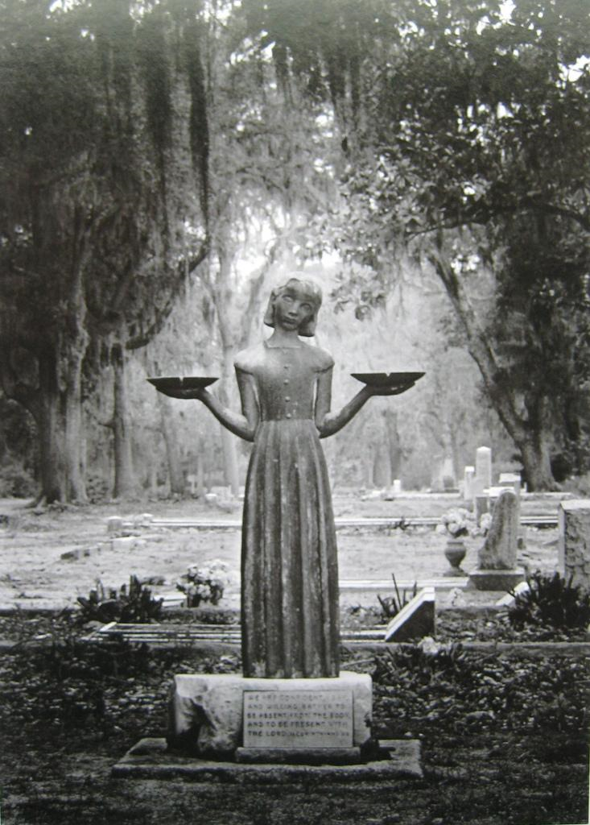
Societal balancing act!
Those of us who will build these systems need to decide what to do! And worse, we can’t even trust the sensors themselves!
The law is far behind the technology curve. Don’t expect to find answers in courtrooms for a long time.
Yet because companies ultimately have a revenue and profit motive, if you focus purely on corporate goals, you might do something evil.

Slide 50
Does existing cloud encounter these issues?
A few of the same issues arise in any cloud-scale system.
So in fact our challenge isn’t really to invent everything from scratch, and some of these policy issues are familiar ones..
The actual challenge is more subtle: we need to learn to “repurpose” what the cloud is already able to do, in these new roles and ways.

Slide 51

Big part of the issue
Leakage
At very large scale, the cloud “mixes” tasks on behalf of different users (“multi-tenancy”), for cost-efficiency reasons.
For example, AWS Dynamo and Azure Cosmos both hold data for huge numbers of applications. The same is true for the global file system.
Of course they keep track of which data is owned by which user, and you don’t normally “see” other people’s data. But information could leak.
Notes:
If a platform like Cosmos or Dynamo has programmability features (and they do), people might find ways to attack them. An attacker could have a legitimate user account, but then send a sneaky query that somehow confuses the platform, so that it sends back information about users that this attacker should not be able to access. Bugs and unintended API issues are a common source of such problems, and they are very hard to completely eliminate. Even worse, some of those attackers might be people who worked as hired staff or consultants on the technology in question, and they may have deliberately installed those backdoors. This is very common, unfortunately.
So, for example, the attacker uploads a few photos, but then manages to download all the medical images from when a political figure was treated at a hospital that uses the same cloud image database for its medical images. Or perhaps the attacker is able to access private photos taken by a media figure because their phone does an automated cloud backup and saves them in this same shared photo storage system. There is so much cloud technology out there that we could have an almost infinite number of security gaps, already, and new ones are probably being added all the time. We can’t even find them automatically, because these systems are so complex that they don’t have clean “specifications” we could use for checking.
Yet the cloud is also so pervasive and so inexpensive for such uses that there may not be any cost-effective alternative except to store photos on it, for example.

Slide 52
Summary
Tackling the IoT opportunity will be a huge opportunity, but also a huge investment and an enormous amount of work.
Today’s cloud is incredibly powerful and this existing powerful solution will make a big difference.
But getting from here to there will still require new technology development.

