Slide 1
CS5412: Lecture 4 implementing a smart Farm
Ken Birman
Spring, 2022

Slide 2
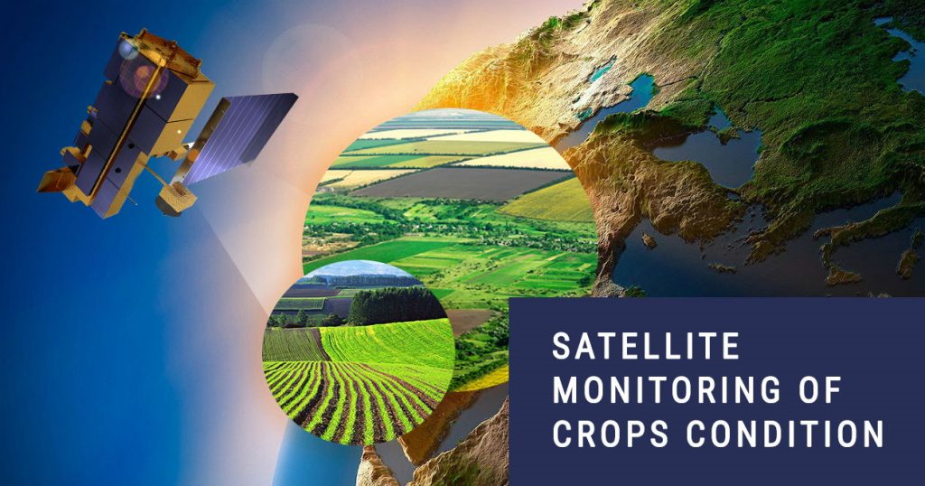
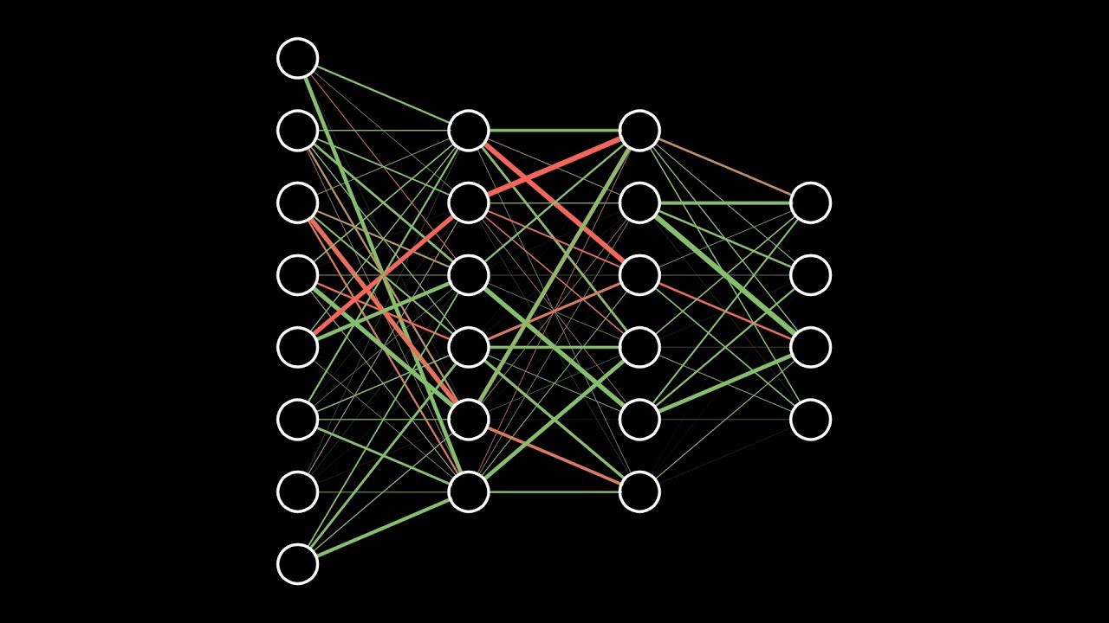

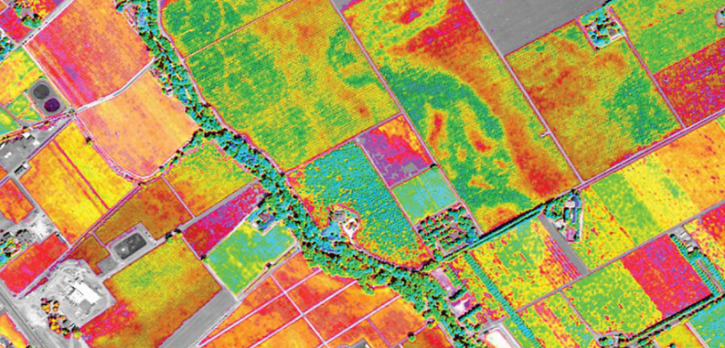
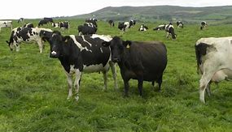
The world is generating a new wave of IoT/ML pipelines… there are many use cases
Data sources Federated ML Smart Distributed AI Queries
How much should I budget for raw milk purchases in March for my yoghurt factory?”

Slide 3
… “Machine Intelligence for Farming”
The Cornell CIDA initiative is a campus-wide effort in this area
Profs Giordano and Birman decided to collaborate through CIDA.
ANSC 3150: Cutting edge ideas for dairy management
CS 5412: How to build effective cloud computing solutions
By pooling ideas, we can advance both our teaching and research

Slide 4
IoT uses the cloud, but isn’t quite the same as “web support”
“Where is 164 Morrison Hall? Is there a nearby dining hall?”
“Is Jennifer Lopez happy to be back with Ben Affleck?”
Twitter, Reddit, Google, Amazon, Tik Tok – all are cloud apps.

Slide 5
Do we just need different μ-services?
The cloud architecture used for the web, today, is a kind of graphical pipeline centered on:
Rapid responses to web queries, like from Facebook
Batched updates which accumulate as they are passed “inward” and will be done later. Eventually the effects propagate up to the first tier.
For IoT edge settings, we generally need immediate reactions. And we also need to deal with challenges like data errors.

Slide 6
Examples of how data might be bad
You have to tell it what to do – it won’t guess. And you may need to clean up bad data: that would confuse the analysis.
Coding is generally needed, at some steps.
Real dairy examples:
“Cow 1281 was inseminated on January 2019 and had her calf in July 2021.” “Cow 8711 body temp 0, weight 0 on Jan 5, 2022”.
“Farmer Jones was last located at <invalid-GPS-coordinates>”

Slide 7
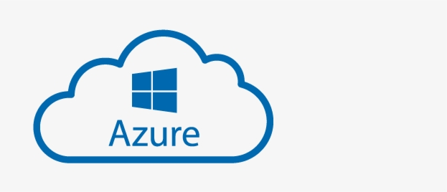

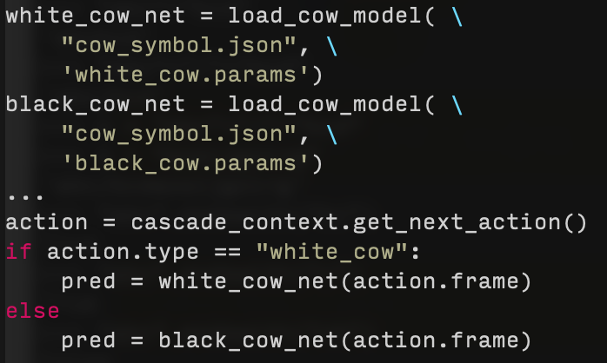
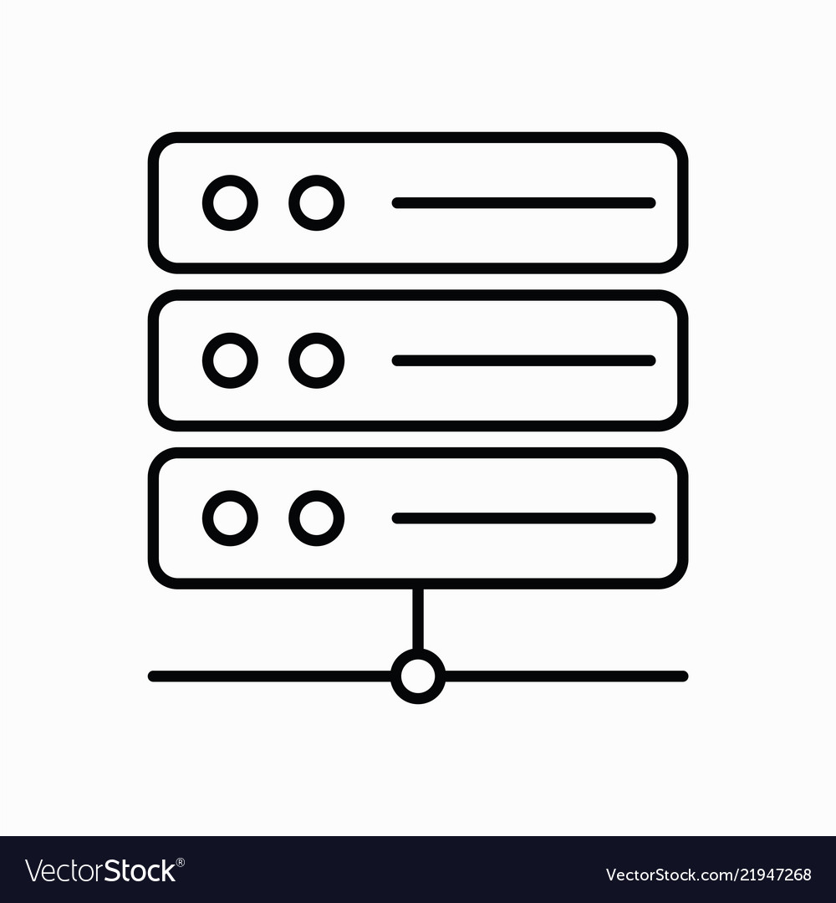
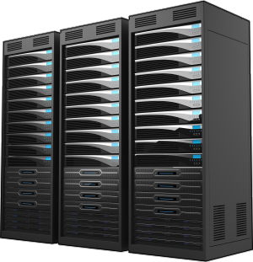



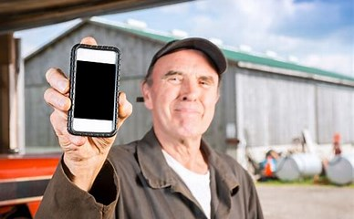

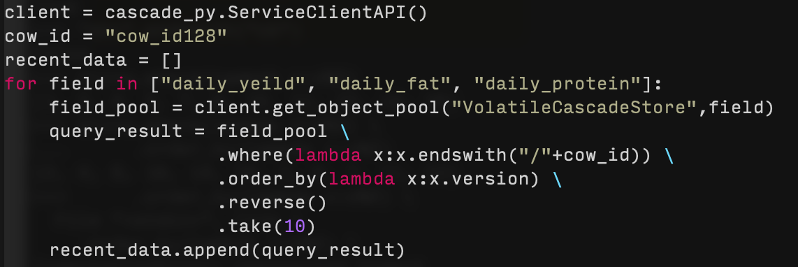
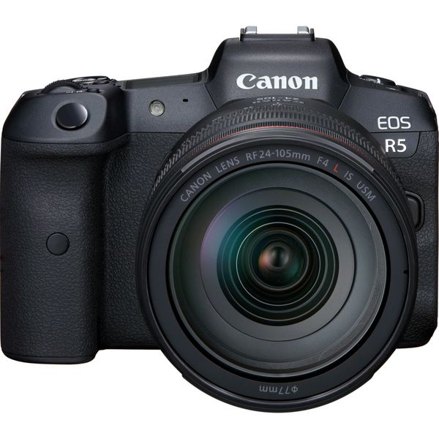
DAIRY INTELLIGENCE PLATFORM WE CREATED
Date | cow_id | daily_yield | daily_fat | … | daily_protein
12/3/20 | 1 | 14 | 3.96 | … | 2.89
… | … | … | … | … | …
1/10/21 | 237 | 20 | 4.42 | … | 4.55
<field>/<cow_id>{<ts(ver)>}
daily_protein/cow_id1{ver_1} = 2.89
Integrate daily data
Download blobs from Azure &
Store to Cascade VCSS subgroup
Upload daily date to Azure Blob Storage
Date | cow_id | …
12/3/20 | 1 | …
… | … | …
12/3/20 | 237 | …
daily_fat/cow_id237{ver_38} = 4.42
Cascade backend
Filtered image frames
Store to subgroup VCSS
Trigger image analysis
Farm server
Action = black_cow_infer
Streaming image frames through TCP portal
External Client to Cascade
CV model
Image analysis
cow id: 127
LINQ query to retrieve data of most recent 10 days from Cascade about cow 128
Probability of calving in next 8h is: 80%
ML Model
birth prediction

Slide 8
Internet of things (IoT)
Today’s cloud has been enlarged in recent years so that we can connect devices to the cloud, very much in the same way as we attach clients.
The idea is to create a device (say, a smart thermostat) so that it produces web pages in the same format used when a web browser talks to the cloud. Now the sensor can “talk to the cloud” to upload new data.
Same for things that take actions (“actuators”).

Slide 9
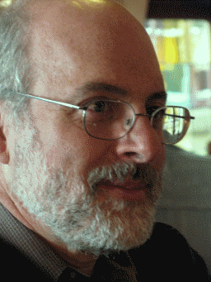
What is IoT best at, today?
Suppose a company wants to implement a good physical security solution.
This could include swipe cards, facial recognition, etc at various doorways.
Swipe sensor to function server: {NewSwipe, Name=Ken_Birman, ….}
Camera to function server: {NewImage, }
Function server to audit-log: {Tuesday, 10:05am, Ken_Birman, …}
Function server to door-lock: {Say=“You are approved to enter”, Unlock}

Slide 10
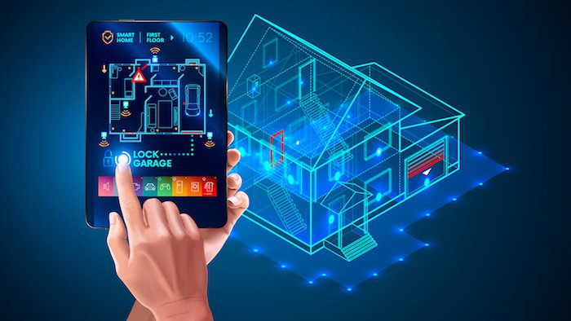
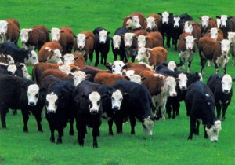
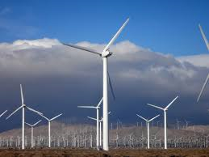
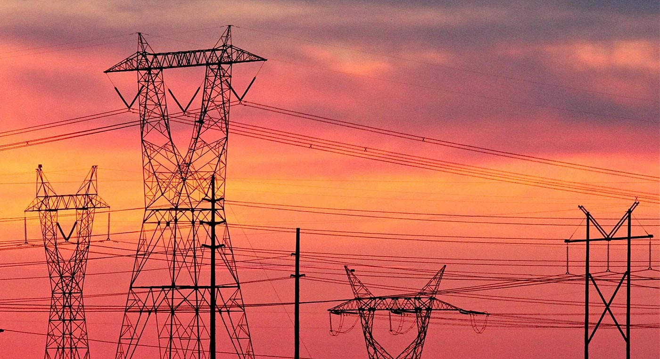
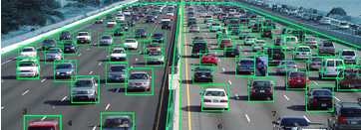
… But the future is thrilling!
Smart Homes
Smart Farms
Smart Grid
Smart Highways
These are just a few examples of future cloud IoT opportunities
10

Slide 11
IoT Edge versus IoT Cloud
Many devices need even lower latency than 100ms. For example, a drone flying over a farm may need continuous directions on where to fly.
To solve this, vendors have created specialized “mini-clouds” that run on a machine or a small cluster close to the devices: in the home, or office building, or on the farm, or even in a truck that can go from place to place.
This is called an IoT Edge approach. The IoT Edge connects back to the IoT cloud, where more of the heavy-lifting can occur, but handles “easy” tasks.

Slide 12
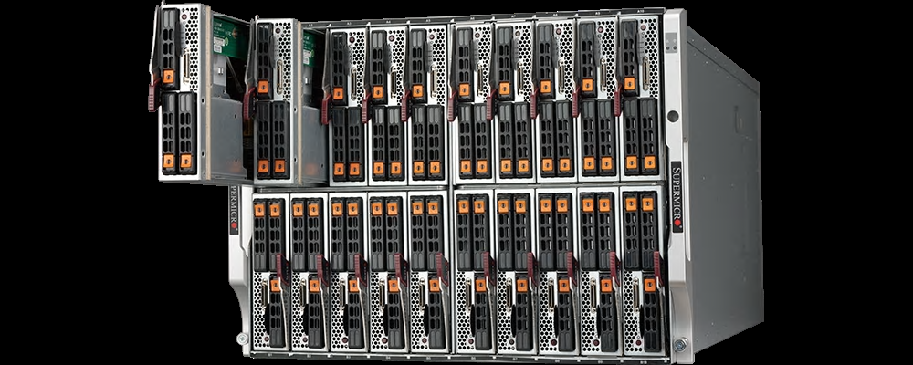
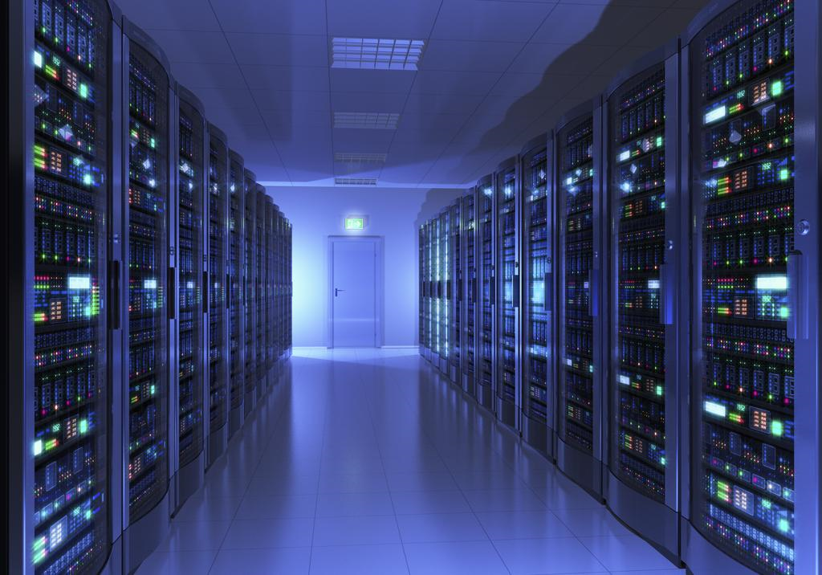
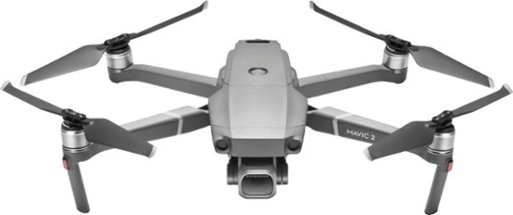
A drone, an IoT Edge, and a cloud
Internet link (might not always be up, and may be slow).
IoT Edge Server runs a stripped-down set of cloud functionality, but close to the device.
Full cloud datacenter

Slide 13

Example we will revisit often
Pigs
What’s that?
Cows
Cow p=.85 Pig p=.6
Cow:Bessie p=.97
Most likely a cow!
Pig:Wilber p=.04
Cow:Bessie
First tier: inexpensive computation on meta-data
Key-value object store holds specialized knowledge models for categories (cows, pigs, dogs, trees…)
IoT Cloud Infrastructure

Slide 14
Unfortunately… this is oversimplified
This animation showed the “important aspects” but left out a lot of details.
Let’s look at it a second time and show some of the missing parts.

Slide 15
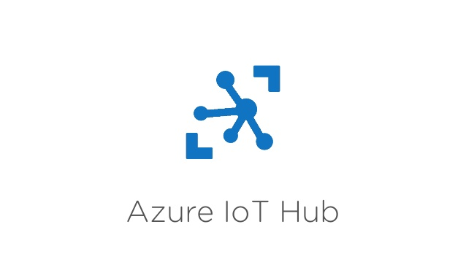
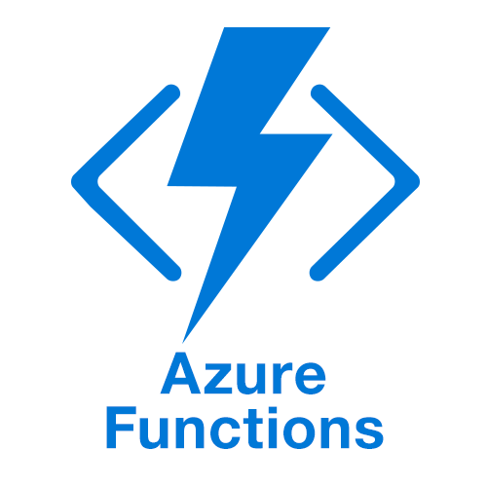
Suppose a cow stumbles. Is it hurt?
Image upload path
Blob Store
NoSQL Database
Image processing engine
. . .
Azure IoT Hub
Vendor-supplied services (fairly rigid)
Google GRPC Slow but universal
IoT Devices
No Hardware Accelerators

Slide 16
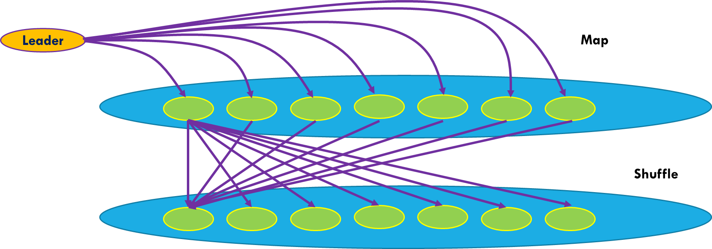
Suppose a cow stumbles. Is it hurt?
Image upload path
Blob Store
NoSQL Database
Image processing engine
Cow hoof-health evaluation microservice
. . .
Azure IoT Hub
Today: Functions do lightweight computing and interact purely with vendor-supplied (standardized) services.
Google GRPC Slow but universal
IoT Devices
Ken’s research: Tools to build these smart μ-Services

Slide 17
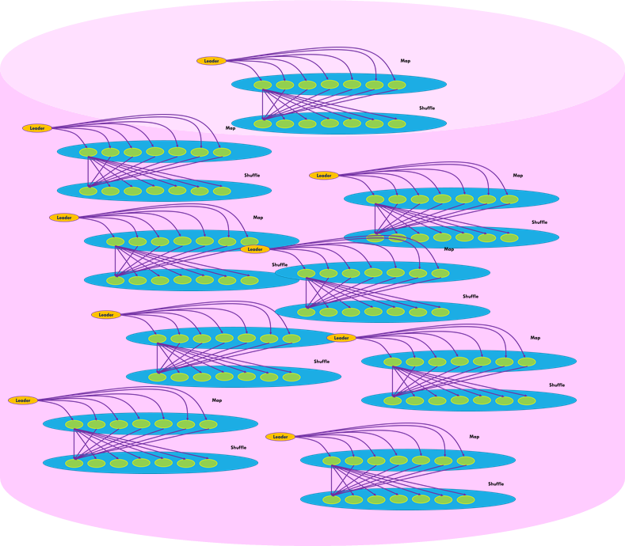
Revisiting our Edge IoT Example
Image upload path
Blob Store
NoSQL Database
Image processing engine
. . .
Azure IoT Hub
Google GRPC Slow but universal
IoT Devices
Hardware Accelerators and Machine-Learned Models Available. Managed by the “App Service”

Slide 18
Many steps involved!
We needed to send a drone to watch the herd. Fields are big… it had to find them first.
It figured out which cow is which
It noticed that Bessie walked unevenly
It asked “Is she hurt? Or was she just walking on rough terrain?”
We decided to call a vet and have her check Bessie’s right front foot.

Slide 19
Many components were involved
Azure Blob Upload: For putting photos into the Binary Large Objects store.
Cosmos DB: A general-purpose NoSQL database with “processing” power.
Azure image processing service: Can do many “photoshop” tasks.
Azure IoT Hub: Secure connectivity to our drone.
Azure IoT Edge: Wasn’t even shown, but it was on the prior slide (“mini-cloud close to the IoT device or drone”).
Azure Function Service: Lightweight container launching.
Specialized μService with GPU accelerator: You can build these and manage them with the Azure Hybrid Cloud layer, which includes the Azure App Service.
Notes:
Azure is a bit like a Swiss watch, with a LOT of moving parts that all cooperate. For example, many elements use Cosmos DB and yet we didn’t actually see how they use it in this graphic (we will learn more later in the class). Similarly, for the standard Azure image processing service. Meanwhile, some are harder to build than others. Cornell’s “Derecho” software library is intended to help you create new specialized IoT services with machine intelligence, and Microsoft encourages this. Just the same, it is easier to build such a service with Derecho than to install it cleanly into Azure (we recommend using the Azure Hybrid Cloud tools, and these in turn would automatically know how to set up the Azure App Service to run your Derecho solution – but even that takes multiple steps). Most of these others will be discussed in future lectures.

Slide 20
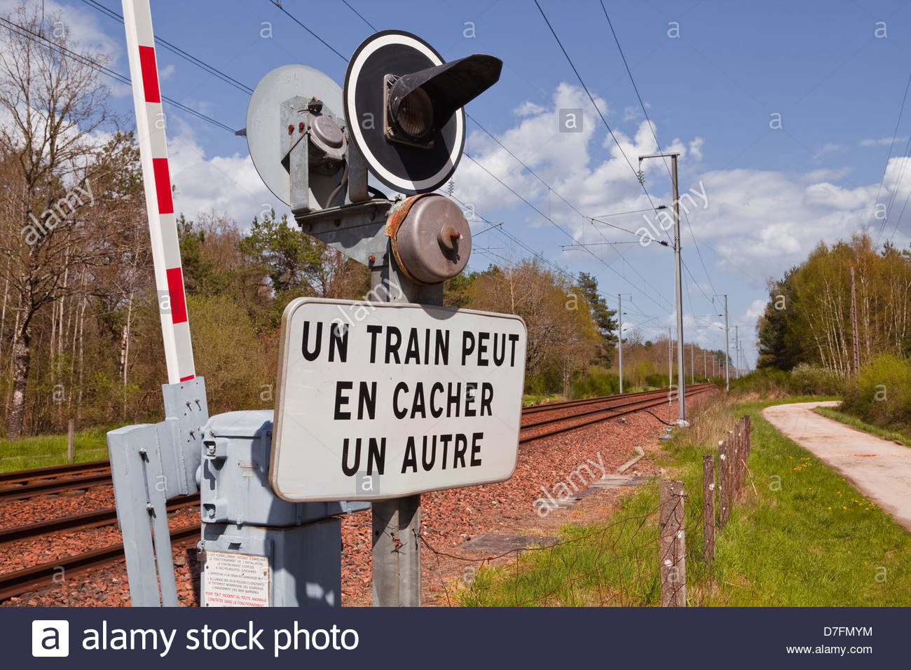
Concept: Critical Path
The pathway in your system that shapes performance for some task.
If you make the critical path faster, you accelerate the task.
But there might be a second critical path just a tiny bit slower than the one you are focused on, so fixing one might just reveal the other.

Slide 21
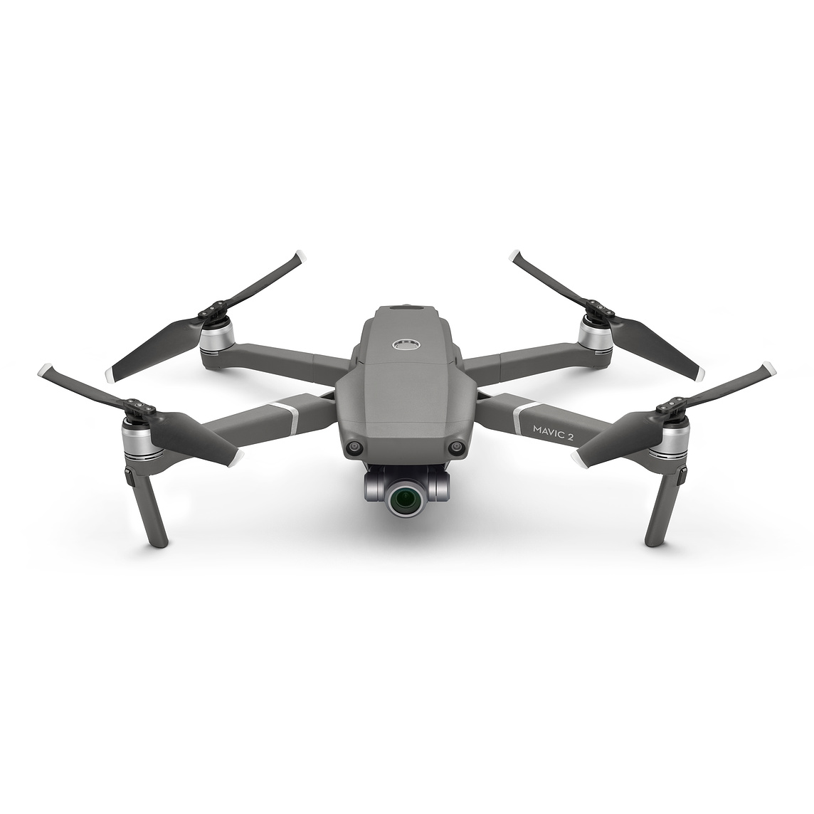
Critical Path? Many elements!
Sharded, replicated blob store
Thick line denotes “large objects”
router
2-node shard
Photo upload
Key-hash
replica
N1
N2
Done!
Event meta-data
Function Svc
Sharded knowledge store
IoT Hub
Function
Key-hash
N3
N4
Rough terrain, p=.03
Hoof crack, p=.78
GPU
GPU
GPU-accelerated computation
Schedule the vet!
Hoof crack, p=.78

Slide 22
Function Model
Each function is a small program that will be launched with arguments extracted from the event.
The function runs on some machine selected by the Function server, which has a pool of machines that it manages elastically.
To make things simple, the function and any files it needs are wrapped up into a container: a kind of virtual machine, very cheap to launch.

Slide 23
How the event is passed to the function
When an event occurs, a new instance of the event handling function you registered will be launched in a “clean” state.
The event itself is available either as program arguments, or via an API
You can also register a shell script if you wish.
Notes:
And they receive arguments via command line, just as if you were launching them on your desktop, or via a framework that turns that into a procedure call in Python or C# or some other programming language.

Slide 24
Example: Passing parameters to Azure Functions (AWS Lambda is quite similar)
In Azure, a function trigger defines how a function is invoked. A function must have exactly one trigger. Triggers have associated data, which is usually the payload that triggered the function.
Input and output bindings provide a declarative way to connect to external data or μ-services from within your code. Bindings are optional and a function can have multiple input and output bindings.
Triggers and bindings let you avoid hardcoding many details that would involve complicated “boilerplate.” You can arrange to receive data (for example, the content of a queue message) via parameters in the trigger.

Slide 25
What if a device can generate many kinds of events?
A single “function program” will handle all of them: switch(event-type) { …. }
The event type would be passed as one of the event parameters. This way there is still just one trigger for the function.
Your logic for dealing with a single event should be short and simple.

Slide 26
How do functions talk to μ-Services?
Just like with web pages, there are three main options:
Remote method invocation (for example over the RESTful RPC layer, or JNI, or WCF). Google GRPC would work here too, but Microsoft prefers for you to use Azure’s own solutions.
Via a message “bus” (no storage: like a “broadcast”)
Via a message “queue” (stores messages, like an email)
Use the remote method approach for immediate actions with immediate responses. The other two “decouple” the source and receiver.
Notes:
A function is valuable as a way to shed load (like if the event can be handled quickly).
This definitely can involve pulling data from some set of microservices. You “bind” the function to them, and then it can issue RPC requests.
We use a message bus for notifications: “If anyone is interested, IBM shares just spiked 10%”. The publisher is basically not aware of who the subscribers are or even if there are any. These often use some form of topics (like “sudden stock movements”).
We use a message queue for delayed, batched operations. “When you get a chance, credit $100 to Ken’s meal card account.” This is mostly used if the sender knows the target but it might be busy or not even running right this second.

Slide 27
Fancier Case: Point, Focus and Shoot
Suppose that some event occurs: “Animal motion detected”.
This might require us to swivel the camera or point the drone.
After the camera is pointed towards the location, focus the lens.
When the focus converges, we shoot a photo.
Now the thumbnail is sent to the server.
If the photo is considered interesting, we’ll download it.

Slide 28
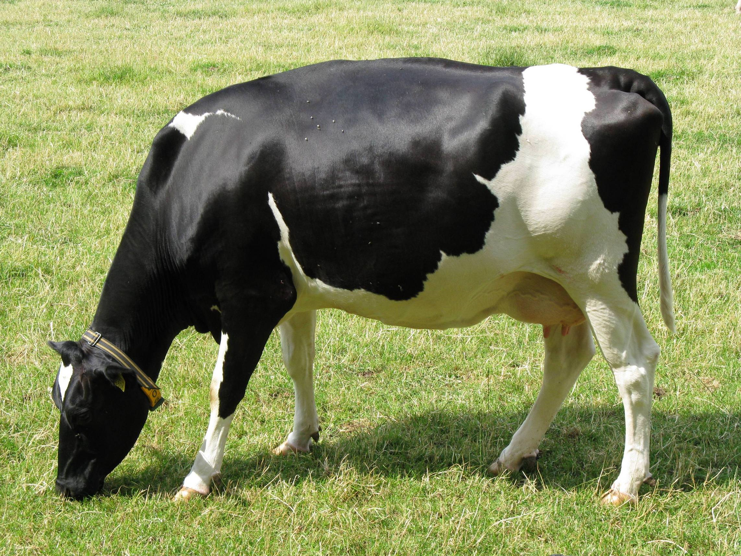
This is a form of state machine!
Idle
Handle various mundane events
Motion event {args…}
Swivel
Movement sensed! Point the camera
Send swivel command to Camera {args…}
Camera movement done {args…}
Focus
Pointed! Focus the camera
Send focus command to Camera {args…}
Focus operation done {args…}
Take Photo
Focused! Take a photo
Send photo command to Camera {args…}
Captured photo {info, }
Orange: “camera to Azure IoT”
Green: “Azure IoT to camera”

Slide 29
Definition: State Machine
A state machine is a program that is in some “state”, corresponding to the nodes in the figure. The states form a directed graph.
Events cause some action (label on the arrow) and also a transition to the same state (loop back) or some other state.
In an IoT setting, we favor deterministic state machines: The same events, handed to the state machine in the same state, produce the same effect.

Slide 30
… THAT STATE IS HELD IN A KEY-VALUE STORE
The function loads it, mutates it, then stores it back.
An atomicity issue arises if concurrent events trigger two functions that try to make conflicting updates to the state machine state.
If we solve this by adding locks to the key-value store, Jim Gray’s scalability warning applies! To avoid locks, we use a kind of “atomic” conditional key-value put.
HTTP://WWW.CS.CORNELL.EDU/COURSES/CS5412/2019SP

Slide 31
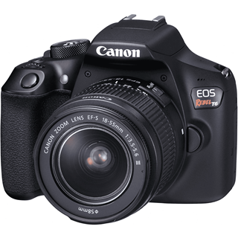
Stateful behavior with a function Normal Case
Updated state replaces prior state (“Replace state version 17 with state version 18”)
New Event
1
Function launched to handle it
4
Current State: Data in the (key,value) store can hold any information you like
Version=17
2
5
Triggered action
(issued after successful state update)
3
Notes:
I oversimplified when I told you about Put when we first touched on the key-value concept. A normal get/put solution wouldn’t easily be able to support this type of conditional update, at least not without locking.
But in fact there are versions of Get that track version numbers for the state they fetch. And then Put makes sure to only overwrite the proper version.
This allows you to code a program that (1) reads the state, and at the same time, learns the current version number. (2) updates the state “in place”. (3) Conditionally rewrites the state. The key-value server checks to see if the version you are writing is actually numbered correctly. If so, the update goes through.
Now if two processes manage to end up in a race, one will succeed, but the other will fail: it will try to write “version 18” and yet there already is a version 18. The key-value service would reject the update and the process can recompute the update (reread, recompute, retry the write but now with version number 19) and it works!
This avoids locks but still provides consistency.

Slide 32
Stateful behavior with a function Concurrency conflict
Tries to update version 17, but discovers that version has already been changed to 18…
New Event
1
Function launched to handle it
4
Current State: Data in the (key,value) store can hold any information you like
Version=17
2
5
3
Must retry!
Notes:
Here the conditional put checked and found that the (key,value) version wasn’t 16 when the CPut was attempted. The application will need to retry.

Slide 33
Stateful behavior with a function Retry Case
Updated state replaces prior state (“Replace state version 18 with state version 19”)
New Event
1
Function launched to handle it
8
Current State: Data in the (key,value) store can hold any information you like
Version=18
6
9
Triggered action
(issued after successful state update)
7
Notes:
I oversimplified when I told you about Put when we first touched on the key-value concept. A normal get/put solution wouldn’t easily be able to support this type of conditional update, at least not without locking.
But in fact there are versions of Get that track version numbers for the state they fetch. And then Put makes sure to only overwrite the proper version.
This allows you to code a program that (1) reads the state, and at the same time, learns the current version number. (2) updates the state “in place”. (3) Conditionally rewrites the state. The key-value server checks to see if the version you are writing is actually numbered correctly. If so, the update goes through.
Now if two processes manage to end up in a race, one will succeed, but the other will fail: it will try to write “version 18” and yet there already is a version 18. The key-value service would reject the update and the process can recompute the update (reread, recompute, retry the write but now with version number 19) and it works!
This avoids locks but still provides consistency.

Slide 34
Functions versus μ-services
Use functions for simple read-only actions (the function can still fetch the data from some set of μ-services). Pass updates to μ-services.
Limit multi-step functions to simple state-machine logic.
Use μ-services for complex or stateful tasks.
Ideally, find some way to leverage existing μ-services. They often have magic superpowers, like access to hardware accelerators.
Build your own μ-services if there are no existing options that match.

Slide 35
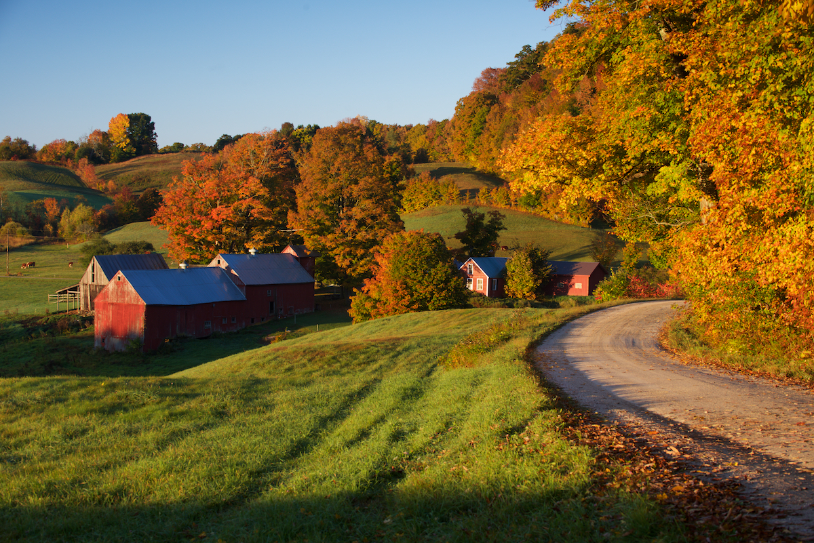
Microsoft FarmBeats
Quick reminder of some smart farming ideas:
Drones that would survey fields and help with intelligent decisions about seed choices, irrigation, fertilizers, pesticide/fungicide use, etc.
BlockChain style audit trails of actions in dairy or similar situations
Real-time monitoring of animal health and related tasks, like milking
Systems to recycle farm waste into useful products like bio-oil
Maybe a “smart calendar” for the farmer’s wall, showing upcoming tasks, explaining the reasoning, like an iPad but for the farm

Slide 36
Microsoft FarmBeats
Farmbeats was a research project aimed at prototyping solutions to those kinds of problems.
It evolved and became a new product from Microsoft – a kind of “app platform” that runs on Azure IoT Edge and IoT Cloud and is intended to support more and more farming use-cases over time.
There is some duplication of functionality because Farmbeats existed before they ported it to start to use more of Azure cloud’s IoT approach.

Slide 37
Microsoft FarmBeats
We can actually use this platform to work with drones
It has great software for drone flight control, photo upload, other similar tasks.
Microsoft has used to build up soil “maps” showing humidity and other important properties for farms. Then, using NOAA weather databases, we can predict how the farm conditions may look over the coming months and event select seeds parcel by parcel to optimize for the specific setting.

Slide 38
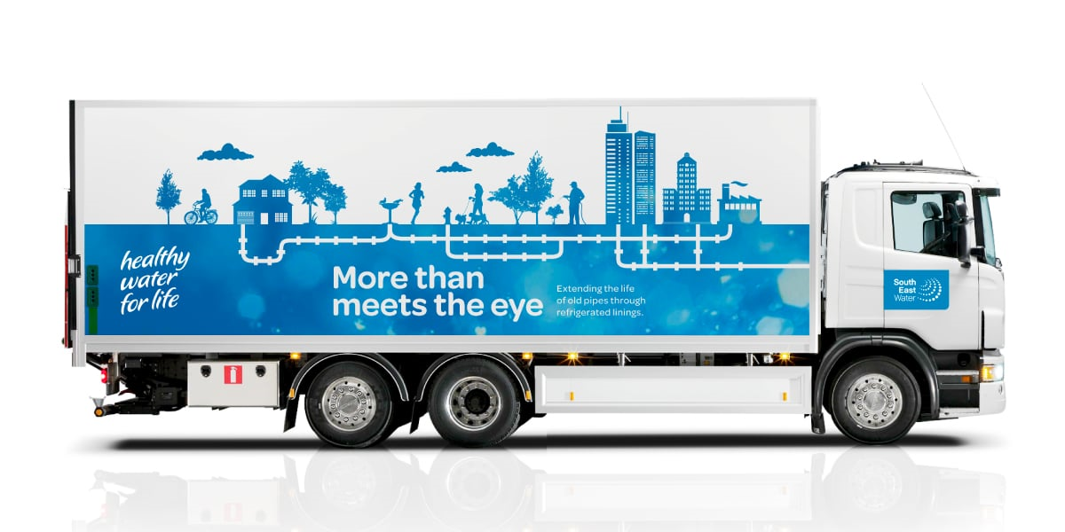
Where does computing occur?
IoT Edge inside!
The offline training involves “big data analytics” and need to be done on massive data centers with huge compute and storage resources.
But the dynamic form of control and learning needs to occur in real-time, on the IoT Edge: a cluster of computers “near” the farm.
The IoT Edge system might dynamically update a model that was mostly created offline on the IoT Cloud, but still needs additional “tuning”

Slide 39
Dynamic Updates
What would be examples of dynamic updates?
The drones will discover today’s wind patterns and output a learned model that they steadily refine as they scan the field.
The drones may discover a very dry area, or a muddy one. Crop issues in that whole area would probably be associated with irrigation issues, even if they “show up” as brown spots, or as fungal breakouts on the leaves.

Slide 40
Using Dynamic Updates to update plans
With dynamically learned updates, a control system might realize that it can triple battery lifetime by switching to a new drone flight plan that sails on the breezes in a particular way.
So here we would have a system that recomputes the flight plan, uploads the new plans (but without activating them), then tells all the drones to pause briefly, then allows all to start using the new plans.
Question: Why upload, then pause, and only then switch to the new plan?

Slide 41
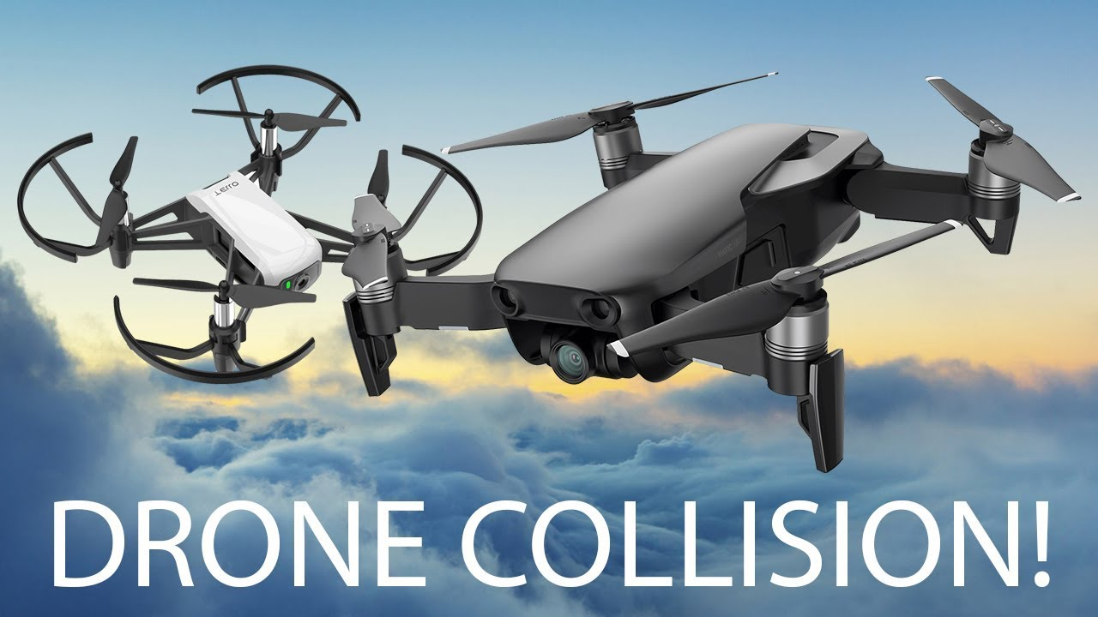
… because we prefer not to see this!
Starting to use insecticide spraying policy from plan B
Still using search plan A
Notes:
I posed that question to get you thinking about the sense in which consistency within a system (“are all the sensors using the same plan”) needs to match with physical consistency obligations.
If we allowed a drone to switch to plan B while some other drone is still using plan A, we end up with a risk of problems, such as collisions.
This forces us to briefly pause our drones. To make the pause delay as small as feasible, we would upload plan B while continuing to use plan A. Then when every drone has B available (and is accessible via wireless) we ask all drones to pause. When every drone has paused, all can switch to the new plan and resume the search.

Slide 42
Functions? Or μ-Services?
We actually could implement everything as a giant state machine with a large amount of state in our Azure key-value store.
But would that be the best plan?
It might be very hard to debug such a complex function application.
The logic itself might be very complicated, especially since everything will be event driven.
As we “learn current conditions” we run into a big-data problem. A function server isn’t intended for such cases.

Slide 43
Should everything be in μ-Services?
Historically this was the most popular approach.
But we end up with ultra-specialized services, and they run all the time, so they might not be very cost-effective.
The nice feature of the function model is that it offers such a simple way to handle large numbers of events elastically.

Slide 44
Approach this leads towards
Use the functions for “lightweight” tasks and actions
Ideal for read-only actions like making a quick decision
OK for reporting events that go into some kind of record or log
But don’t use functions for serious computing.
Then build new μ-services for the heavy-weight tasks, like learning a new machine-learned model, or computing the optimal search path with wind.

Slide 45
Summary of the pros and cons
 | Functions | μ-Service
Length of a typical “action” | Typically a single “RPC” or some other event from a client or sensor. Execution time is often very short: milliseconds | Long-running, could continuously evolve some form of knowledge base using background computation that might be quite slow/costly.
Long-term state | Lives outside the functions, like in a key-value store | Could be in memory, or in local files, or could be in other μ-Services.
Resource footprint | Long-term state is small, function itself runs in a lightweight container | Long-term state might be huge, computation runs on heavier-weight compute nodes dedicated to the role for long periods of time
Access to accelerators | Probably not. | If needed, yes.
Cost to own & operate | Pay only for cycles you use. | Can be very costly, but amortized over many clients.

Slide 46
How to create new functions
Register the corresponding event (or class of events).
Tell the function server to run your container for the specific events it will handle.
Develop code using cloud-vendor supplied tool that will provide a skeleton. You might write just a few lines to specialize it for your events.

Slide 47
How to create new μ-Services?
Architecture can be fairly complex, so you’ll start by really thinking hard about functionality, data representations, API.
Many services have a non-trivial internal structure: a top-level group but with several subgroups inside it, playing distinct roles.
Usually developed on a cluster of Linux servers using libraries that help with hard aspects.

Slide 48
How to create new μ-Services?
We can start with Jim Gray’s suggestion: key-value sharding from the outset.
Within a shard, data will need to be replicated. This leads to what is called the “state machine replication model”, which involves
A group of replicas (and a membership service to track the set)
Each update occurs as a message delivered to all replicas
The updates are in the identical order
No matter what happens (failures, restarts) “amnesia” won’t occur.

Slide 49
Will this scale?
Jim Gray’s analysis told us that general database transactions won’t scale.
But this simple key-value approach would scale very well provided that updates and queries run on a single shard at a time.
This was a sweet spot in Jim’s model.

Slide 50
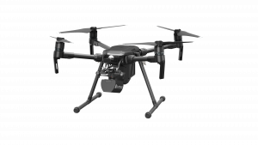
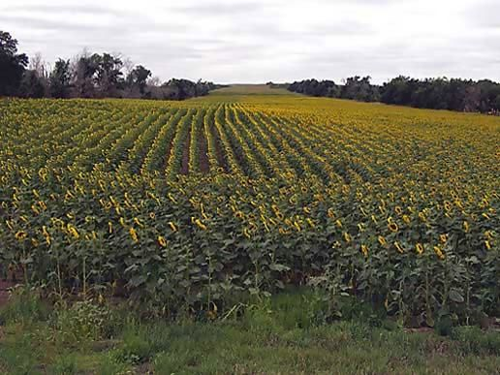
So, back to our FarmBeats Drones
Message bus or queue
Azure Function Server
μ-Services: some Azure provided, some “new”
Functions: Lightweight, event-triggered programs in containers, “pay for what you use” resource model

Slide 51
How might we tackle the cases mentioned earlier?
Consider one example:
“Image analysis: “Are these plants healthy or diseased?”
How might we solve such a problem using modern machine learning? How would we turn our solution into a μ-service? How would a function in a function server interact with it?

Slide 52
Image knowledge base
We could start with labeled data: photos from drones that are hand-labeled to tag crop damage and identify possible causes.
Use this to train a computer-vision model (perhaps, a convolutional neural network – a CNN).
The resulting models will be large tensors. Copy them to our μ-service.

Slide 53
Image knowledge
We might have two cases: one for initial thumbnail images (small, low-resolution) and a second for follow-up detail imaging (ultra-high resolution)
Now our μ-service could have an API with operations such as “classify new thumbnail”, “analyze follow-up imagery”.
The function server would take a drone event and just turn around and make a call into the μ-service

Slide 54
Secondary actions
The μ-service would then be able to “tell” the function what action to take. This avoids having to talk directly to the drones: the functions become specialists in drone operations, while the μ-service plays general roles.
Similarly for requesting “follow-up detail”: the μ-service can request this in its reply to the function layer, and then the function would turn to the μ-service that plans detailed imaging studies for advice on camera angles and image settings to use.
Functions aren’t doing much, but they glue the heavy lifters together.

Slide 55
Summary
An IoT system like a smart farm has a lot of “moving parts”!
Even so, we can break the tasks down and map them to a μ-services model, using a KVS to store any needed state.
Some tasks look tricky at first, but once you see how key-value versioning works, it enables exactly the kind of atomic operations we seem to need.

