Slide 1
CS5412/Lecture 28
The Future Cloud
Ken Birman
CS5412 Spring 2022

Slide 2
Our last lecture!
Today, we’ll peer into a crystal ball (using lots of web search)
Look at business articles about the future of the cloud, drawing on white papers published in various sources (listed on the syllabus page and in the notes).

Slide 3

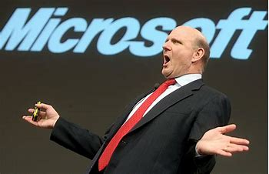
Core question
We have better technology!
Who wins? And why?
I dominate the market!

Slide 4
The evolution of the cloud as a market shapes the cloud as a technology base
To understand where the cloud will go in five or ten years, we should try to understand how cloud use and demand will change (or not change).
Investments in new technology concepts and development align with cloud use patterns that scale poorly, and opportunities to increase efficiency.
In contrast, things we do well now and will continue to do more of in the future evolve towards greater cost-effectiveness, not new technology.

Slide 5
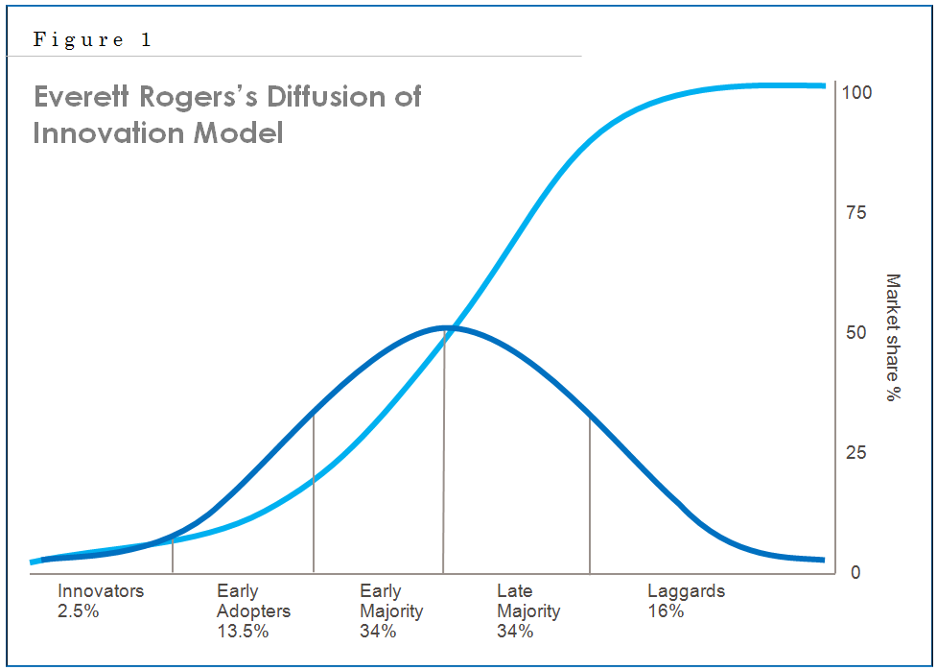
Reminder: Curve shapes
We’ve previously discussed how rapidly-expanding markets are often close to saturating just as they seem to be growing exponentially quickly.
We also discussed the “two peak”
adoption curve from Crossing the Chasm
Keep these curves in mind because
as we look to the future, both are relevant!

Slide 6
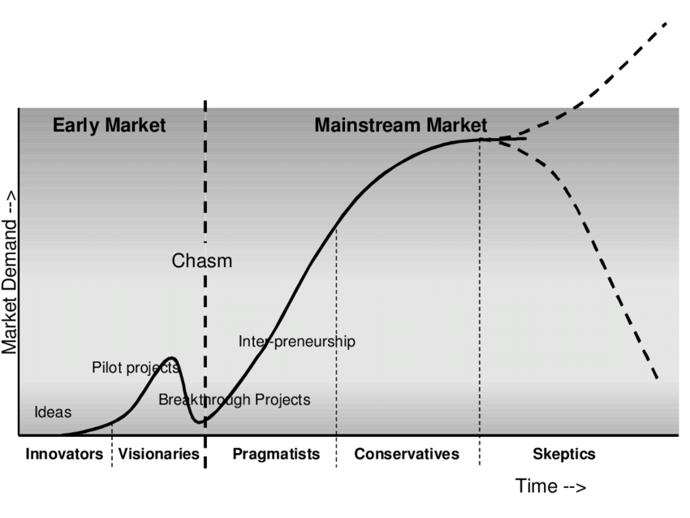
Reminder: Curve shapes
We’ve previously discussed how rapidly-expanding markets are often close to saturating just as they seem to be growing exponentially quickly.
We also discussed the “two peak”
adoption curve from Crossing the Chasm
Keep these curves in mind because
as we look to the future, both are relevant!

Slide 7
can we really predict future growth?
One idea is to split the question into two sub-questions
For things the cloud does now, what trends are revealed by market
research focused on expenditures?
Money is our metric of growth.
This assumes that that what is happening now would more or less
continue to happen for a while longer – “probably, no big shakeups”.
Things the cloud isn’t doing now are different: here we are speculating
about new markets, perhaps based on unsatisfied demand.

Slide 8
How do companies do predictions?
They basically do data mining, or pay someone to do it.
The usual process is to pose a bunch of questions (assumptions) about the market they are excited about. Lots of questions.
Then through interviews with leaders at the top potential clients, they try to learn about the broader trends without limiting themselves to only their favorite clients or their investors. This gives some sense of the picture.

Slide 9
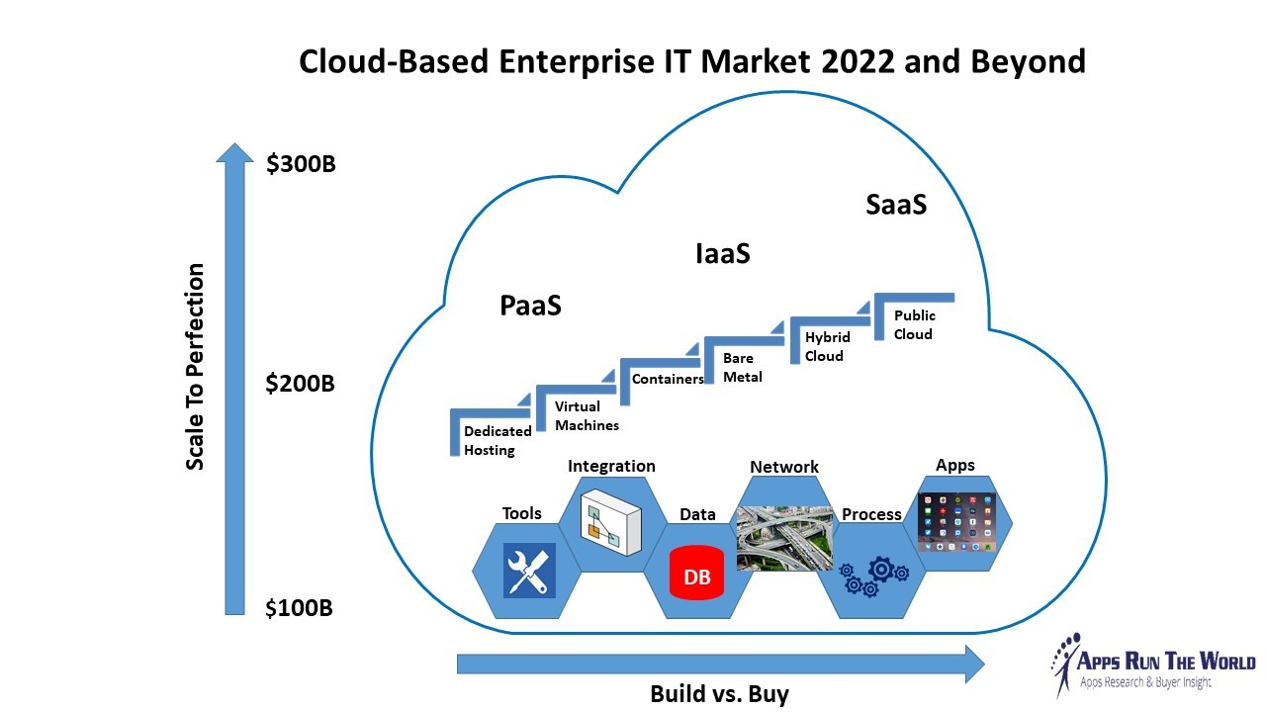
Example: Public reporting by a business Analysis firm
The report is public because
they are hoping to drum up
business from readers.
They see a shift from
PaaS to IaaS to SaaS.
PaaS: Cloud as a “platform”
for tasks like direct sales or
company web sites.
https://www.appsruntheworld.com/first-look-at-2017-2022-paas-iaas-saas-markets-as-14-top-cloud-computing-billionaires-expand-across-enterprise-it/

Slide 10
Wait, what’s with the AAS thing?
There are incredibly many “as a service” concepts tied to the cloud.
Examples: IaaS, SaaS, PaaS, plus some you need to write out in words (for example, SaaS means “system as a service” but “storage as a service” is a big deal too).
In general, “as a service” means “Available for rent on demand. A vendor offers this technology or capability to a large (usually public) clientel.”

Slide 11
If AAS were used in other settings…
Uber/Lyft do “transportation as a service.”
AirBnB does “accommodations as a service.”
Cornell does “knowledge as a service.”

Slide 12
Back to that business analysis…
This firm sees a shift from
PaaS to IaaS to SaaS.
PaaS: Cloud as a “platform”
IaaS: “Rent bare metal”, use
it to create hybrid solutions.
https://www.appsruntheworld.com/first-look-at-2017-2022-paas-iaas-saas-markets-as-14-top-cloud-computing-billionaires-expand-across-enterprise-it/

Slide 13
What do business analysts say?
This firm sees a shift from
PaaS to IaaS to SaaS.
PaaS: Cloud as a “platform”
IaaS: “Rent bare metal”
SaaS: Cloud hosts “solutions”
like Office 365, Azure IoT
https://www.appsruntheworld.com/first-look-at-2017-2022-paas-iaas-saas-markets-as-14-top-cloud-computing-billionaires-expand-across-enterprise-it/

Slide 14
What do business analysts say?
This firm sees a shift from
PaaS to IaaS to SaaS.
PaaS: Cloud as a “platform”
IaaS: “Rent bare metal”
SaaS: Cloud hosts “solutions”
(also known as “systems”)
As we transition towards SaaS
the cloud hosts Apps.
https://www.appsruntheworld.com/first-look-at-2017-2022-paas-iaas-saas-markets-as-14-top-cloud-computing-billionaires-expand-across-enterprise-it/

Slide 15
They talk about an “APP Model”. But What makes an “app”?
The term is a reference to our iPhones and iPads, or Androids: solutions to end-user problems that heavily reuse vendor-provided software tools and infrastructure.
Think about Microsoft Farmbeats: the 2019 version was “home built” and has an IaaS feel. But within a year or two, Farmbeats++ could easily shift towards being more like a collection of Digital Agriculture Apps that share a common Azure IoT Infrastructure. This author is predicting such a shift.

Slide 16
How does this impact our topic?
In CS5412 we mostly looked at components and how one uses them.
We also dug deeper to learn how they work, and how we could build versions on our own that would work differently and bring new functionality.
An App perspective suggests that “developers will favor standard components.”
What technology gap does this expose?

Slide 17
… we’ll need better μ-Service creation tools
(Maybe, Like Derecho, or Cascade!)
The tool set for building new μ-services is pretty basic today, like early client-server, where the lack of tools became a major stumbling block.
Azure App Service and the AWS tool for app hosting were both created for web page builders using μ-service models. Those situations have different real-time, consistency and fault models.
An App perspective only makes sense with customized knowledge servers that would need to be supported by an IoT version of the App Service.

Slide 18
Should this lack of tools worry us?
Yes and no!
Yes, because we can think back to early client-server computing days, or the early cloud, when inadequate tools caused the whole industry to stumble and forced major system-wide rebuilds, again and again.
No, because if there is an exciting market, a real one, the money will flow and tools will follow!

Slide 19
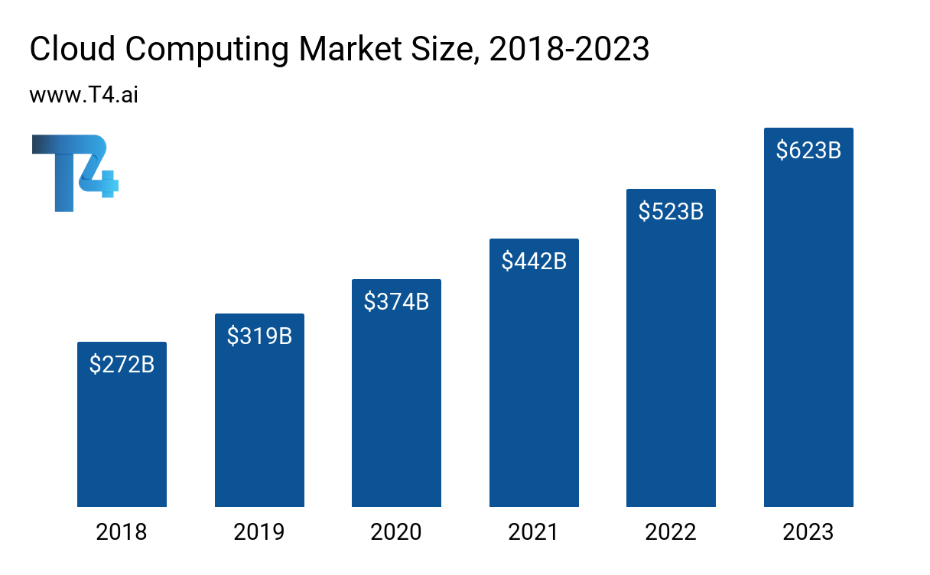
How is the market evolving?

Slide 20
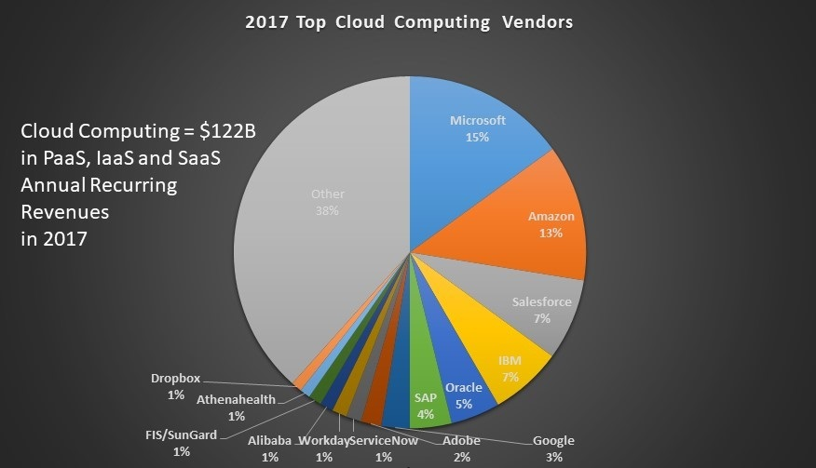
How is the market evolving?
In this analysis, from 2017,
Microsoft broke through
and for the first time ever
Amazon was less dominant
than Microsoft.
The reason is that this chart
focuses on just PaaS, IaaS,
and SaaS, plus looks at
the subset of cloud revenue
expected to “recur” annually
https://www.appsruntheworld.com/first-look-at-2017-2022-paas-iaas-saas-markets-as-14-top-cloud-computing-billionaires-expand-across-enterprise-it/

Slide 21
Diving in…
The article actually breaks down the revenue they used to build the chart, which is somewhat unusual for articles of this kind (many pull charts from thin air, and this is why I liked this one).
What it reveals is that the Microsoft acquisition of LinkedIn, combined with very strong growth for Office 365, has fueled a very strong growth in Microsoft market share, which was quite a bit smaller as recently as 2015

Slide 22
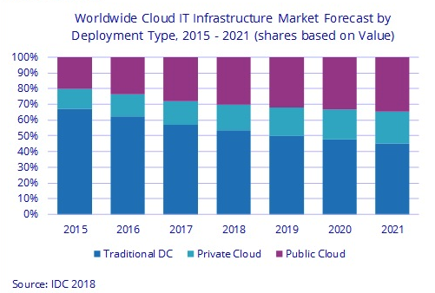
Market Share Trend analysis
This chart from IDC shows that
there is a noticeable shift from
traditional owned data centers
towards public clouds (AWS, Azure)
With Office 365, one explanation is
that companies are shifting their
in-house business tasks into cloud SaaS

Slide 23
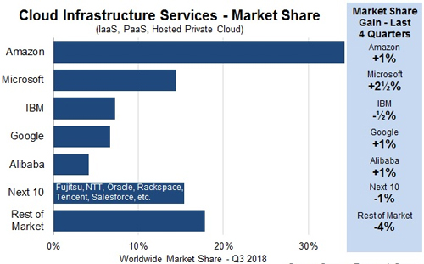
Sliced in different ways, you can reach very different conclusions
This Q3 2018 data from awsinsider.com
(a company with an obvious reason to
favor AWS) shows AWS strongly ahead
of Microsoft and every other vendor.
But notice that it doesn’t include SaaS,
and instead uses a category called
“hosted private cloud”. What is that?

Slide 24
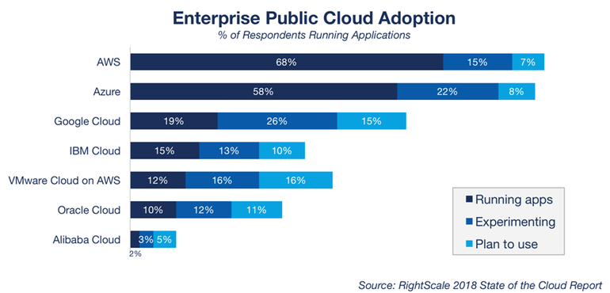
Most “enterprises” are exploring shifts towards the cloud
This is a market research
report from zdnet.com
It shows that Azure and
AWS have similar use
patterns, but with more
experimenting or planning
to adopt Azure than AWS.

Slide 25
AWS use is more oriented towards IaaS
This is a market research
report from zdnet.com
It shows that Azure and
AWS have similar use
patterns, but with more
experimenting or planning
to adopt Azure than AWS.

Slide 26
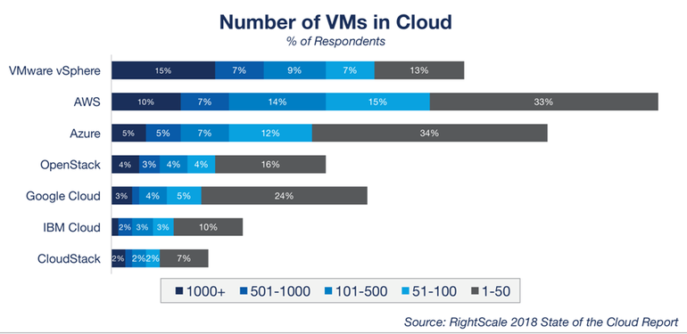
Most “enterprises” are exploring shifts towards the cloud
If we look just at VMs
we are focusing on
IaaS rather than SaaS
Here AWS is the clear
winner. And more
companies are
experimenting with AWS too.

Slide 27
AWS government cloud
Hosted Private Cloud means “using AWS infrastructure but not a shared public cloud.” The biggest such example is “government cloud”
This is a line of business in which Amazon builds and operates clouds specifically for the US government and military, securely.
That particular line of revenue greatly increases the AWS revenue for cloud as a whole, but in a distinct category.

Slide 28
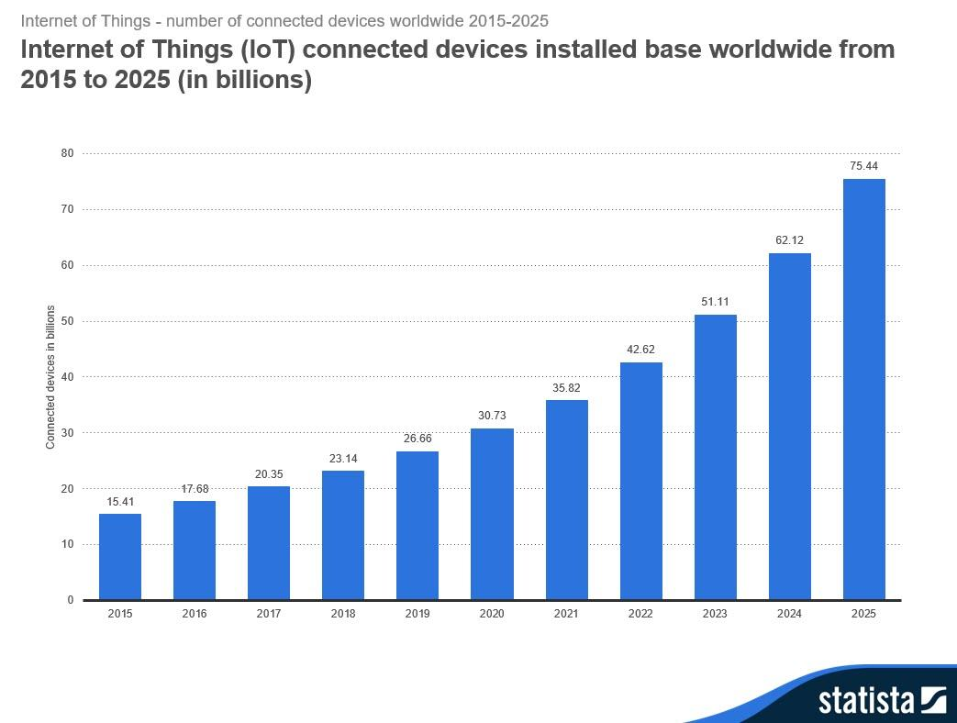
What about IoT as a market?
This chart from “statistica”
looks at how many smart
devices are out there world-wide
It includes everything from
routers and smart TVs to home
thermostats that do smart sector
control and heat different rooms
in different patterns.

Slide 29
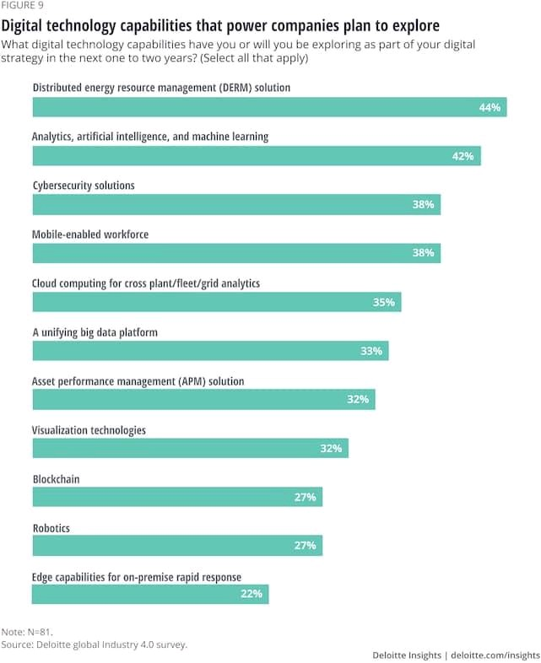
IoT Market: Smart Grid
If the power grid of the future will be
smart, what will make it smart?
Part of the answer is “it will need to be, to
handle distributed energy resources.”
Then they point to various specifics that
are mostly IoT and cloud, like ML/AI,
mobility, cloud computing, data analytics,
blockchain!

Slide 30
Every area has similar stories!
I happen to work in smart grid, but smart farming is clearly such a story too, and there are smart manufacturing ones, smart cities…
All such stories seem to center on the cloud. IoT is a unifying element because these clouds need to sense the external world and react to new events, or even control things in that external world.
In some ways, IoT is so basic and so obvious that it even goes unstated!

Slide 31
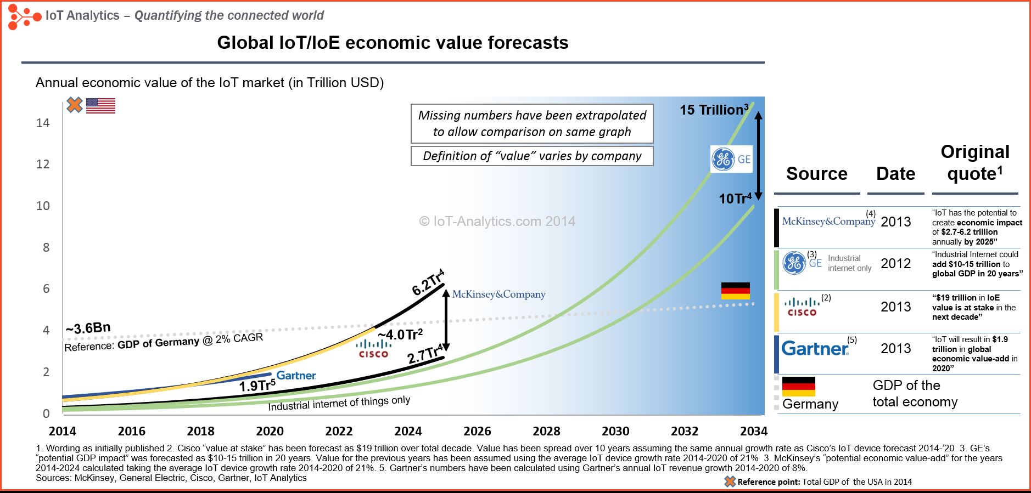
IoT Dollar value estimates (composite)
Source: IoT-Analytics.com

Slide 32
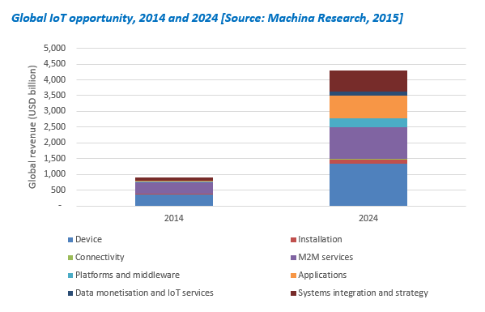
Cloud Share of IoT Market?
This estimate, by Machina
Research Inc, suggests that
the device dollar value will
soon be much smaller than the
platform and app value
So this supports the view that
Apps could become a very big
market for the cloud fairly quickly

Slide 33
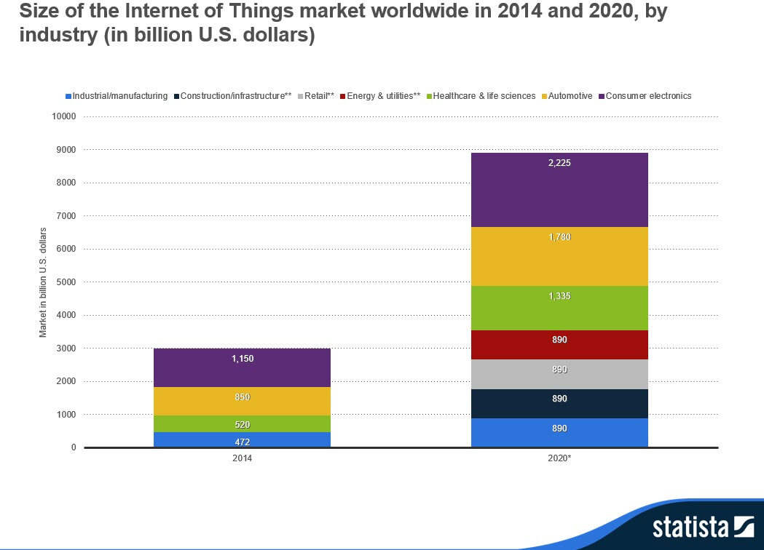
Which industries are dominant?
Again, by Statistica.
Strong growth across the board
but especially in “non” consumer
electronic categories, like
automation of retail stores and
smart energy systems.
Smart agriculture isn’t included here.

Slide 34
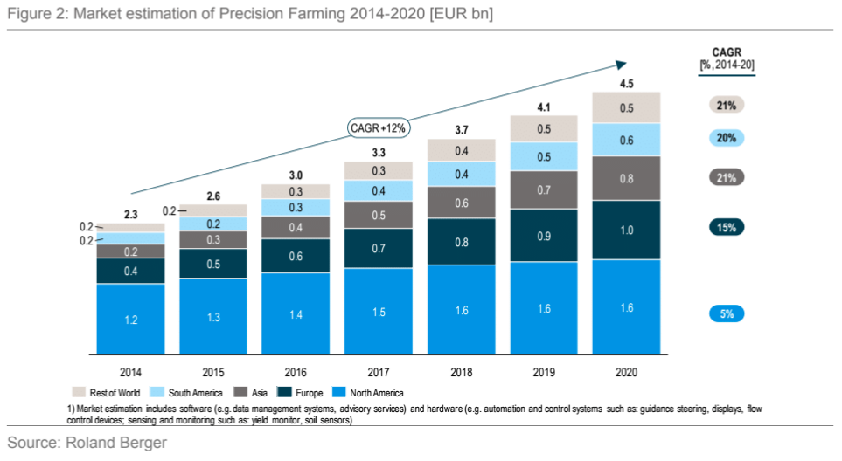
What about smart farming?
This estimate is by
a consultancy called
Roland Berger that
specializes in farm
automation trends.
It supports a view that
global growth is strong
while US growth is slow.

Slide 35
What can we conclude?
This data generally backs the view that the cloud will become a major player in markets related to IoT during the next five to ten years.
It also supports the view that integrated solutions (SaaS) are growing more rapidly than cloud as a “bare metal hosting VMs” but that there is still huge growth ahead in the IaaS sector.
And it suggests that the main uses of IoT are in managed enterprises, not random situations where sensors are just dumped into the environment.

Slide 36
So how can we leverage this insight?
Back to our focus on actual cloud infrastructure.
It seems to be telling us that the big need isn’t going to center on cloud scalability for things the cloud is already doing perfectly well.
On the other hand the sheer scale of the use causes it to be a very high
value market, where products that improve efficiency could find uptake.
So on this more mature side of the cloud, expect the emphasis to be on
sqeezing more work out of the infrastructure using less money / energy.

Slide 37
Meanwhile…
On the IoT side, we’ve spent a semester seeing that the technology base today is just now taking baby steps, but that the opportunity is real.
These predictions suggest that the market may look more like an App market (like Office 365) than like an IaaS market (VMs and hybrid cloud)
So companies that build Apps, or enable people to build Apps, will find strong demand for their solutions (if the solutions are good ones).

Slide 38
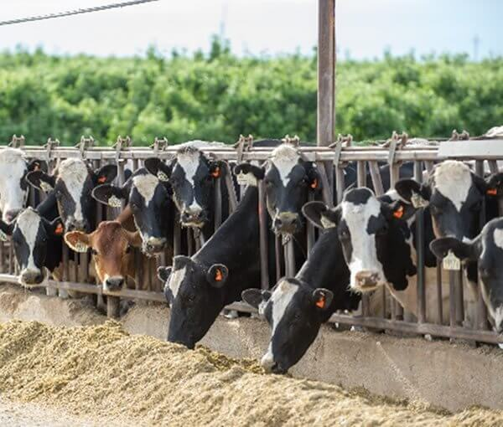
Apps for the smart Farm
https://www.cowmanager.com
As a case in point, think about FarmBeats
As we saw in Ranveer’s talk, FarmBeats makes a lot of use of Azure IoT, but many elements seem to be actively evolving.
FarmBeats is not yet an “IoT App” or even an “App ecosystem”. Someday it would need to be an App, if the App concept is to be a success.

Slide 39
Biggest open question?
To me, it centers on customized hand-built μ-services, for individual apps (in which case the need for IDEs and other developer tools is the biggest need)
… versus some kind of general purpose “ML as a service” solution, where a precreated vendor-supplied service somehow magically covers all the needed intelligent behaviors.
Such a service could definitely leverage hardware accelerators, a big win
But that same hardware could also be made accessible to custom μ-services
through a suitable library, so this isn’t a decisive advantage

Slide 40
How does it work today?
You need to build your μ-service (and it probably is a group of processes, so you need to manage membership, state, handle failures…). Derecho can help on those tasks, if you don’t mind coding in C++.
You’ll need to register it with Azure or AWS (using JSON files) and then build triggered functions that can talk to it (more JSON files). Some steps are not very intuitive and will require “research” (hours wasted!)
You need to improvise your own debugging and performance analysis tools, and are on your own for long-term “life cycle” aspects.

Slide 41
Aspects a professional solution would need
Clearly, automated help creating those configuration and “task control” JSON files, integrated with AWS Cloud9 or Azure Visual Studio/VSCode.
For the APIs offered to the functions, automation of the API “declarations” and the logic to import them and call them from the function side.
Careful tuning (by the vendor) of the resulting paths. We want our functions running within 1ms or less of an event, and won’t have time to launch the container at the last moment, or bind to the service. So those have to be done ahead of time, anticipating the need.

Slide 42
More professional tools we will want
Launch service
Authenticate if needed
Register micro/service to accept RPCs
There should be an easy way to create functions able to call the service, using those RPC APIs
We need an efficient upload path for image objects
There will need to be tools for garbage collection (and tools to track space use)
… and tools for managing the collection of configuration parameter files and settings for an entire application
.… and lifecycle tools, for pushing patches and configuration changes in a clean way.

Slide 43
Plus, some larger challenges
Code debugging support for issues missed in development and then arising at runtime
Performance monitoring, hotspot visualization and performance optimization (or even, performance debugging) tools
Ways to enable a trusted micro-service to make use of hardware accelerators like RDMA or FGPA (even if the end user might not be trusted to safely to so)
Many accelerators save money and improve performance but are just not
suitable for direct access by hordes of developers with limited skill sets.
Some could destabilize the data center or crash nodes, and some might have
security vulnerabilities.

Slide 44


Can it be done?
I’m doomed! My boss wants me to lead the μ-service development group!
Actually, no problem!
This is not such a terribly long or frightening list.
The big vendors, like Microsoft and Amazon, can definitely build this sort of technology, and they will do an incredibly good job on it, too.
And they will, if the market is as promising as it looks.
Flow of revenue leads to investment in profitable businesses.
Amazing! My boss wants me to lead the μ-service development group!

Slide 45

Will Farmbeats revolutionize agriculture?
Perhaps so!
But it won’t be an easy task for Microsoft marketing and sales. Farmbeats has to create a deployable and cost-effective IoT standard even as it also builds a compelling product that farmers would be keen to purchase
Pulling all of this off at the same time is a huge challenge!

Slide 46
Every opportunity faces this challenge!
We have talked during the semester about smart transportation systems, smart highways and roadway intersections, smart power grids, smart homes, smart farming. We saw how 5G cellular could take this further!
Every one of these areas is confronted with that similar mix of opportunity and puzzles. It feels… kind of like the cloud itself felt, back in 2005
So in some sense, we might predict that by 2040 the IoT edge will be a mature technology space!

Slide 47

Conclusions?
The cloud infrastructure is an expanding opportunity area!
Using it to create new Apps will fuel many small and big companies
Leveraging the power of the cloud to learn from examples (big data) is an
incredible enabler to do things that were impossible with stand-alone code.
Cloud IoT is more of a speculative bet, but looks like a good one.
Even if the cloud just securely manages IoT, this already brings value!
Apps for the IoT edge: maybe a case where 1+1 is way more than 2?
E.g., could secured IoT devices plus apps that leverage them take off?

