Slide 1
CS5412 / Lecture 26
The Challenges of Introducing RDMA into cloud datacenters
Ken Birman
Spring, 2022

Slide 2
Context for this lecture
We saw how the need for performance has pushed some very fancy machine learning components closer to the edge, like Facebook TAO. Hardware accelerators improve performance and reduce costs for these components.
As we connect the cloud to sensors, we’ll get an even greater demand for real-time updates (hence replication), consistency and coordination at the edge. Cascade and Derecho are examples of a response to that need.
Notes:
So Derecho wins using RDMA. But is RDMA really working in the cloud?
Bad news: only “sort of”. It works at Microsoft in Azure, and at Google. But nowhere else.

Slide 3
Context for this lecture
Then we learned about how accelerators of all forms are central to performance and also eco-cost-effectiveness in the cloud.
In the case of Derecho this speed centered on RDMA.
But the real edge with the actual sensors will be 5G. And even inside the cloud itself, Derecho would often live on an edge-cloud, like Azure IoT. Can we just deploy RDMA everywhere?
Notes:
So Derecho wins using RDMA. But is RDMA really working in the cloud?
Bad news: only “sort of”. It works at Microsoft in Azure, and at Google. But nowhere else.

Slide 4
Tiny remark about 5G Cellular
Actually, 5G will not support RDMA of the kind we use inside a datacenter.
Instead, a standard called DPDK (Dataplane Developers Toolkit) is more likely to be used with 5G WiFi and 5G cellular
But understanding the pain of introducing RDMA will be useful anyhow, because DPDK will be disruptive too, in similar ways!

Slide 5
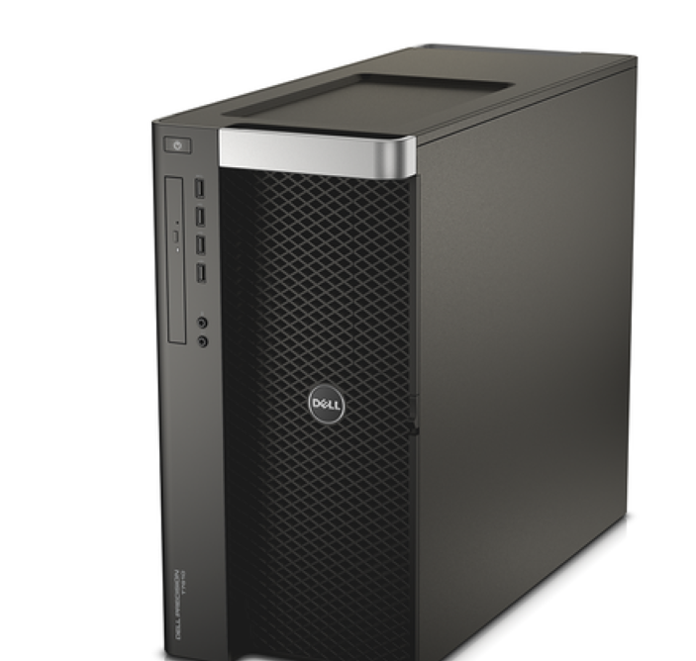
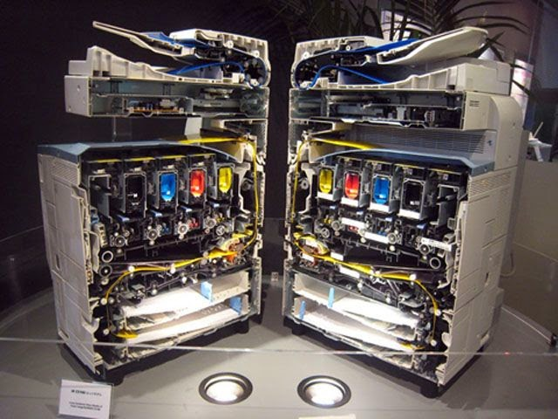


Life on the edge
“Cut through the stack for speed!”
The edge demands disruptive changes.
… early adopters tend to experience a lot of pain.
Nothing works… the hardware may lack programming tools… is
undocumented… may even have hardware bugs. And “cutting through the stack” may have unexpected consequences elsewhere.
None of the rosy predictions are as easy to leverage as you might expect.
Hint: Start by duplicating some reported result for the same setup!
Notes:
This isn’t uncommon. Rollouts are surprisingly painful and slow. We’ll see why today.

Slide 6
Let’s Drill down on Derecho as a focus
Provides ultra-fast data replication with Paxos guarantees
Key steps:
Identified a hardware capability that has been overlooked for data
replication tools: RDMA transfers
Studied that hardware closely. It has many capabilities, but used two:
  Reliable “two-sided” RDMA transfers (Q posts a receive, then P’s send can start)
  Reliable “one-sided” RDMA (Q permits P to write into a memory area)

Slide 7

Is Derecho as great as Ken claims?
All of our experiments were totally honest.
But… there are complications.
To understand them, we need to understand the hardware better

Slide 8
Today’s Lecture topic
What made it hard to build Derecho?
Where are the surprises?
In what ways did Paxos and virtual synchrony “evolve”
The underlying concepts were unchanged
But the implementations are very different than in older systems!

Slide 9
Derecho Starts with a basic fast multicast
What would be the best way to do an RDMA multicast with reliability similar to N side-by-side TCP connections?
We could just have N side-by-side reliable unicast RDMA connections
We could use one-sided RDMA and have N “round-robin ring buffers”.
The sender could do a lock-free buffer “put” and the receiver, a lock-
free “get”.
We could do a tree to disseminate the data using RDMA unicast

Slide 10
It turns out that there isn’t one answer!
The problem with doing N side-by-side RDMA connections is that with reliable RDMA Unicast (or with TCP!) the sender and receiver need to agree on the size of the object being sent.
The receiver will need to have a suitable memory buffer posted for
the incoming DMA transfer.
So this means the sender must tell the receiver the buffer size first, then
wait for the receiver to post the buffer: an RPC interaction.
Plus, the solution turns out to scale poorly if you do it this way.

Slide 11
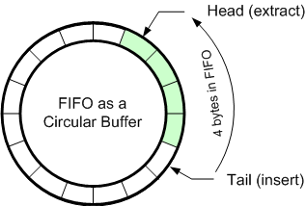
With small messages, use N ring buffers
One-sided RDMA writes into ring buffers work
well for smaller messages (maybe up to 1KB).
Inside Derecho this is called SMC.
There needs to be one ring per destination, each with enough memory
for R messages. The memory is allocated and posted in advance
Lock-free updates to the counters of messages in the buffer and free
slots are easy to implement.
The round-robin buffer soaks up any mismatch in speed between the
sender and receiver.

Slide 12
With large messages, though…
Here we need something fancier.
We don’t want to do N RDMA unicast writes for a big object: inefficient.
So we need a tree.

Slide 13
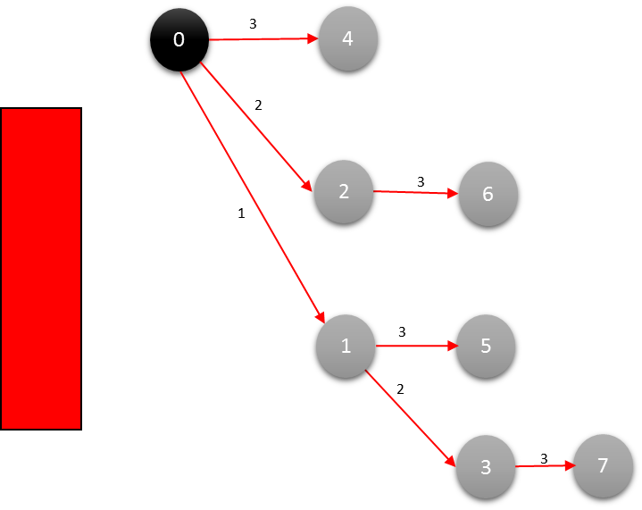
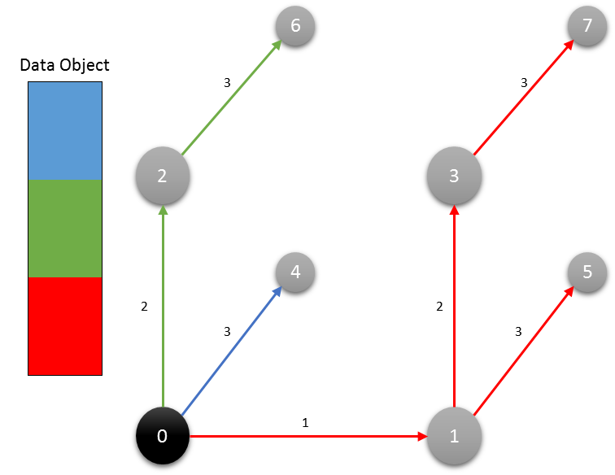
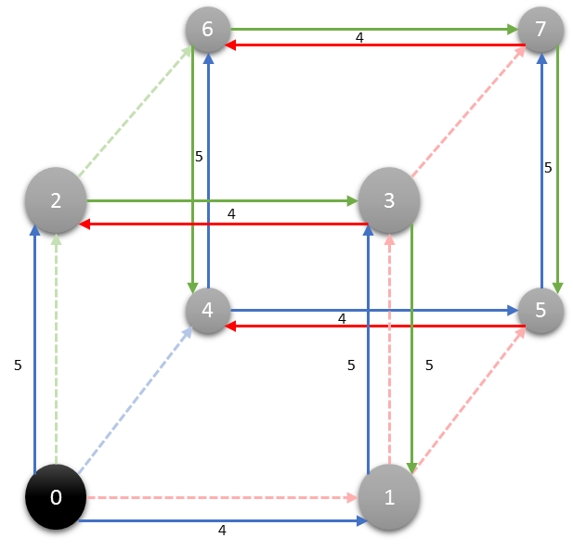
RDMC: Multicast oN RDMA
Dest
Source
Dest
Dest
Multicast
Dest
Binomial Tree
Binomial Pipeline
Final Step
Notes:
This was discussed in lecture 6. The main thing we saw is that to get the highest performance, we need to keep the data flowing.
In the binomial tree on the left, we get data to the leaf nodes as quickly as possible, but even so, the leaves sit idle until the last transfer. Moreover, no link is ever more than half loaded, because these are bidirectional connections but we use them in just one direction. So half the bandwidth was abandoned before we even started!
When we wrap 3 binomial trees around a hypercube, our algorithm is fancier but now we can keep things busier. By also sending data in a series of blocks, the system ends up fully loaded, much like in a bucket brigade (once we “warm things up”) with every node receiving one block but sending some other block, continuously and concurrently. The entire cube is lit up and busy.
Of course the structure is entirely an overlay, yet it works incredibly well. It maintains steady flows.
Key ideas were thus: keep all links fully busy in both directions. And send data in blocks. This uses the hardware in a nearly optimal way.

Slide 14
Key idea… and Limitation…
RDMA is good at large, steady streams. RDMC is optimized for that case, and works best as a pipeline. SMC is tuned for streams of small messages.
But protocols like Paxos also need some amount of back-and forth
SMC and RDMC aren’t matched to “2 phase” kinds of interactions.
Notes:
For example, think about this:
Node P says “is everyone ready to commit this transaction:?
Nodes Q, R, S all respond “Yup”
Node P waits for responses, tabulates, then says “Commit”
… many multicast protocols work this way, including Lamport’s Paxos. But it keeps pausing for message exchanges. During those pauses, no work is occurring.
RDMA wants to be continuously busy. Can we get rid of the pauses?

Slide 15
Implementation: Derecho = RDMC/SMC + SST
Derecho group with members {A, B, C}
in which C is receive-only
V₃ = { A, B, C }
Current view, showing senders A and B
C is a “receive-only” member
A
B
C
A
B
C
A
B
C
m_{A:1}
m_{A:2}
m_{A:3}
m_{A:4}
m_{A:5}
m_{B:1}
m_{B:2}
m_{B:3}
m_{B:4}
 | Suspected |  |  | Proposal | nCommit | Acked | nReceived |  |  | Wedged
A | F | T | F | 4: -B | 3 | 4 | 5 | 3 | 0 | T
B | F | F | F | 3 | 3 | 3 | 4 | 4 | 0 | F
C | F | F | F | 3 | 3 | 3 | 5 | 4 | 0 | F
B fails, resulting in an
uncertain state
Notes:
This pausing issue is why RDMC needs to be paired with a second structure, the shared state table or SST. We see it on the bottom right.
It looks like a spreadsheet or database and in fact this is all it is: a table, shared by the members of the group.

Slide 16
Derecho’s Shared State Table
Derecho uses the SST for back-and-forth sharing of data:
Instead of messages, SST lets programs talk through shared memory
Each row is a “struct” in C++. Derecho developers define the format.
Each machine can write to its own row, “push” to other machines
Each has a read-only replica of the rows of others
P’s row | 227 | 16 | True
Q’s row | 188 | 19 | False
R’s row | 191 | 18 | False
Notes:
The SST is a way to share information that isn’t purely focused on high-volume streaming. The model here is all-to-all interaction through a shared table.
Every process can do updates, and every process can read the table.
We actually have to implement this table over RDMA. RDMA doesn’t give it to us. So the first thing is to have every process that uses Derecho allocate a copy of the whole table, locally, in DRAM close to where it runs Derecho. With n processes, we end up with n local tables, each on a different machine.
Next, we make the rule that a process owns one row (and can change it), but can only read the other rows. Here P owns the first row but can read the other two rows.
The columns are decided by the user of SST. Here, the user is Derecho itself.
Updates occur locally. So far, nothing is happening to get data from P to Q, so P can change the table all it likes and Q sees nothing.

Slide 17
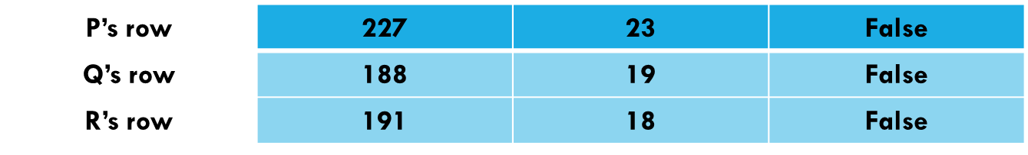
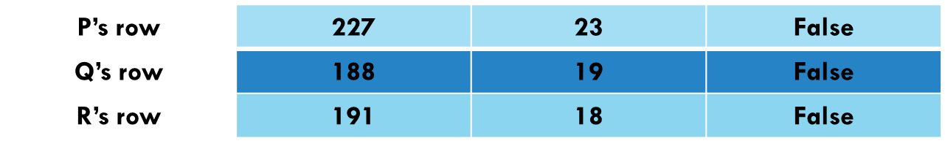

SST Push operation
P updates its row, then SST issues a series of one-sided RDMA writes. These copy the changes to other machines
… the transfers occur “silently” and Q’s row is updated to match P’s new version. The actual transfer is via DMA, low address in memory first, reliable, fifo, etc. Q rereads the data to see that it changed
P’s row | 227 | 23 | False
Q’s row | 188 | 19 | False
R’s row | 191 | 18 | False
P’s row | 227 | 16 | True
Q’s row | 188 | 19 | False
R’s row | 191 | 18 | False
RDMA writes
Machines Q and R have read-only copies of P’s row
Notes:
When the SST Push operation occurs, Derecho uses one-sided RDMA to send P’s updates to Q and R. Now we will see bytes traverse the network.
Nothing actually tells Q that P’s row changed. But if Q scans periodically, it will notice. This is like having an open file folder on your desktop and then seeing that when some other thing updates it, the open folder updates to show you the new contents.
Keep in mind that Q can update the Q row, but has read-only access to P’s row. So when P did this update, and copied the data to Q, that’s the only situation where that specific row could change, from Q’s perspective.
The key point: P is writing directly into Q’s memory with Q not involved at all. Q does grant permission ahead of time, but then doesn’t even know this is happening (well, if Q looks at the data segment owned by P, it sees the updates. But there is no interrupt).
So this replicated table is an illusion created by copying, done by the RDMA hardware.

Slide 18
SST Programming
Because the SST is lock-free, values can change “under your feet”.
But this is also good, in the sense that threads don’t disrupt one-another.
It motivates us to program the SST in an unusual way
Notes:
We don’t want to add locks because with RDMA, those are very expensive.
So we have a pattern of all-to-all updates flowing constantly from every machine to every other machine. (In actual fact the flow occurs only within individual shards, not within the entire group, but that’s a detail we don’t need to worry about: for today the pattern of traffic is more important than whether there are n² SST connections or a smaller number… in actual fact there are a total of n² connections, but SST is only using small subsets of them in an active way. This is getting very technical so we won’t fuss about it today).
So what’s the key idea? It goes back to that 2-phase commit from the prior slide. Suppose that P’s messages to Q were passed through the SST. And Q,R,S, etc responded through the SST. We can perhaps replace all the messages with smaller transfers of just updates to rows: a few integers at a time.
Then P can send continuously and can actually launch Paxos “votes” continuously. Responses continuously flow back. And Paxos commit decisions can occur in batches. We eliminate the pauses and also the message structure overheads, which can be large (a message has to be formatted, parsed, and interrupts occur… very costly in Linux. SST just moves the data and has zero overheads in these senses!)

Slide 19
SST Programming
SST programming: via a kind of “predicates”
if (some condition holds) { … trigger this code … }
We made a choice: we create rows of “monotonic” values that
change in one direction, like a counter (it only gets bigger)
We define “aggregating” operators that compute things like min.
If the underlying values only get larger, min only gets larger too
Notes:
This is an example of a coding style we used to implement Derecho. We code our 2PC and similar interactions in this slightly strange way.
The code here would be used inside Derecho. This is not something you would use.
Derecho has a thread in every process that loops and keeps evaluating these if statements that run over the SST table to notice changes.
This is actually very efficient. See Derecho paper for full details!

Slide 20
Stable and Monotonic predicates
A deduction (a predicate) is stable if, once it becomes true, it remains true
Suppose counter is a column in the SST, and is monotonic
min(counter) = v is not stable in the SST: if the counters grow, min grows
… but min(counter) ≥ v, in contrast, remains true once it becomes true
Notes:
Idea: if values change under your feet, at least have them change is just one direction. Like counters that only get bigger.
This makes it way easier to code those if statements.

Slide 21
Stable and Monotonic predicates
A deduction (a predicate) is stable if, once it becomes true, it remains true
Some stable predicates are also monotonic, in this sense:
If Pred(min(c)) holds, then ∀ v < c, Pred(v) holds.
Monotonic predicates allow receive-side batching of actions,
like delivery of messages 0..min(c)
if (… messages 0..min(c) are stable) { deliver(0, min(c)) }
Notes:
This is an idea used in Derecho to make deductions about batches of events.
Basically, if we noticed that, say, message 18 is deliverable, we design our predicates so that we can safely infer that all messages 0-18 are deliverable as a batch.
It gives us a very efficient way to do work in “chunks” (batches). For example, a batch of 2PC commit actions can be performed all at once using this coding style.

Slide 22
This is not an obvious way to program!
Notice how the hardware forced us to program differently:
The hardware is very fast, but only if used in a certain way
To use it in that way, at that speed, we couldn’t do “normal” things,
like sending messages and waiting for acknowledgements, or votes
So we had to invent this new shared table abstraction, and had to
rewrite the standard Paxos protocols in a totally new way
Notes:
Real point? The hardware is forcing us to rethink how we write code. It isn’t terribly hard to do, but if you don’t do it you are in the old “pause during round-trip interactions” model that was so slow. RDMA won’t turn out to help.
A good mental image is this: Imagine that you are driving a car with an infinite speed button. But each time you press it, you just get as far as the next group of cars and then have to slow down (you aren’t supposed to crash into them). The button won’t help much. You won’t get home earlier.
The new programming style has given us a way to get rid of these pause events, by using the SST. We actually could have programmed the SST to exchange real messages (Derecho has this, called the SSTMC layer), but that would use a lot of space. So the mixture here is of direct overwriting of cells in the SST, no pauses, and batch reasoning. It wasn’t so hard to do, but is a bit mind-twisting when you first see it.
This is one reason RDMA is slow to enter the cloud. It is a harder technology to use than you may expect. Easy to use just like message passing, but the ideal value requires programming with it in a new way.

Slide 23
… Not unusual with new hardware!
New hardware often results in ideas like Derecho
Specialty hardware can be extremely fast, but often requires that you
use it in some very unfamiliar way.
If we just run the old style of algorithm on the new hardware, but in the
old way, we wouldn’t benefit
Notes:
And this story is seen again and again!

Slide 24
… or even some old hardware
After building it, we realized that Derecho is actually faster on TCP too, although not quite as fast as with RDMA.
This is because modern TCP in a datacenter is incredibly fast, only about 4x slower than RDMA if you use it “just right” (TCP won’t hit this rate out of the box, it takes a lot of tweaking the application to get those speeds)
Also, TCP has pretty high “lowest delay” numbers (latency)

Slide 25
2-phase commit “via” SST
P writes something, like “I propose to change the view”.
Q and R echo the data, as a way to say “ok”
When all have the identical data in their rows, we consider that the operation has committed.
In fact the SST can carry many kinds of information: values that change (ideally, in one direction: monotonic), messages, even multicasts.
Notes:
Here are the slides for the 2PC story, just explained again.

Slide 26
A long sequence of 2PC actions
For a single 2PC, SST wouldn’t be much faster
But Derecho has to do 2PC on millions of Paxos atomic multicasts/second
At those speeds, the SST monotonicity pays off
Senders ask for votes on all messages up to n. N is a counter.
Receivers vote ok up through k, and this allows monotonic reasoning.
Notes:
This is interesting: With a single 2PC encoded into the SST, it doesn’t run any differently than using messages for the 2PC exchanges.
But with a long series of 2PC operations running in a steady stream, SST lets Derecho get big efficiencies from batching! Suddenly the batching and lock-free sharing model starts to seem way more efficient and interesting.
Think about 1000 2PC interactions in a shard with 5 members. Each 2PC would have required 4000 messages for inquiry, 4000 responses, 4000 commits. Maybe 4000 acks. So perhaps 1000*12000 = 12M messages. Each message had to be created, sent, triggers an interrupt, gets parsed, then space is recycled. Overheads are insane.
With SST, we implement this using counters that we overwrite. No overheads and basically, SST only sends data that actually changes, so very efficient. We do the 2PC actions in batches (all the ones that can finish at once). Suddenly our 12M messages are entirely gone, and we are just looking at the data movement, which is kind of like updating a NUMA memory unit.
Is it surprising that Derecho can do the same set of 2PC interactions 10,000 faster?

Slide 27
Initial conclusion
We managed to make Derecho very fast, but to do so:
Had to come up with a way to move bytes at crazy speed.
Then had to come up with a “control plane” that can run separate from
the data plane.
Turned out it needed a lot of 2PC kinds of mechanism. To get those to
be fast we invented this whole way to program the SST.
A lot of work, but the payoff was extreme speed.

Slide 28
Derecho: The remaining puzzles
To get the full speed of the technology
You need to work in C++. But many people prefer Python, Java…
Programs need to be “zero copy”. But most people have no idea
if the packages they use do copying
Your code needs to be nearly lock free and rather pipelined.
Few people are used to coding this way
Is it worth it? Derecho is as much as 15,000x faster than other options…
but only if you use it properly!

Slide 29
Zero Copy requirement
Moreover, to get the full possible speed of Derecho, you need to write code that won’t involve any copying (even using memcpy, or even automated copying done in the programming language runtime).
Copying is slower than RDMA!
This is quite tricky: Your application needs to use RDMA “everywhere” for large objects where performance will be critical.

Slide 30
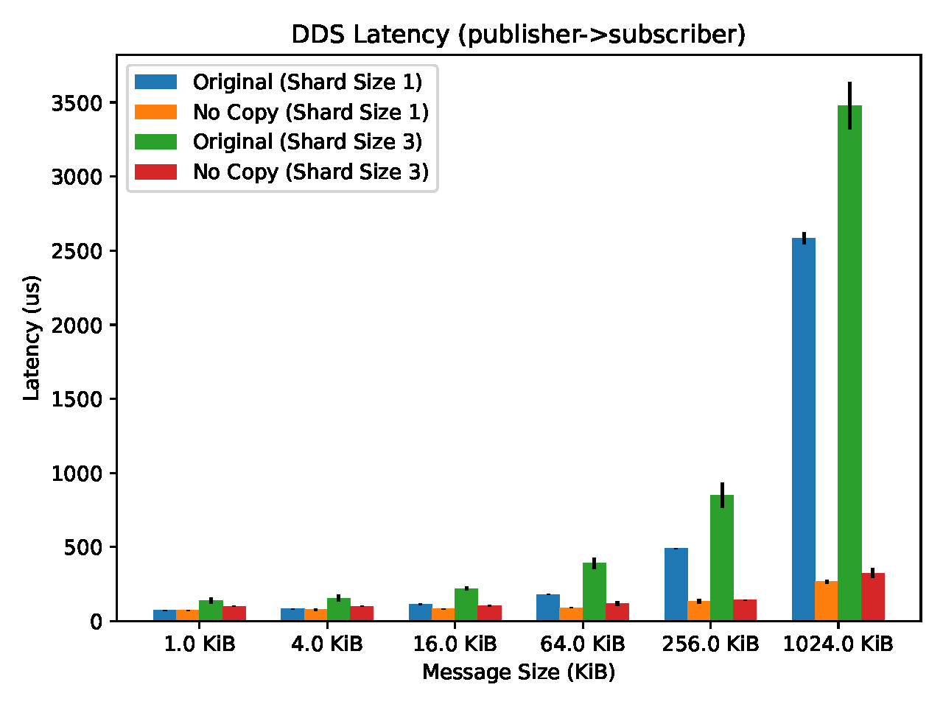
Zero copy opportunity
This shows two runs of the Cascade DDS (message bus) with various numbers of servers (shard size) and various messages sizes.
In each case we just measured delay from when a message is published to when it is received.
Yellow and red used a zero-copy approach. This one change dropped 1MB delay from 3.1ms to just 230us: a 13.5x speedup!

Slide 31
… there are more puzzles, too
Modern DRAM is internally concurrent: each cache line is independent.
If we write, say, 1MB we are writing into 156,000 cache lines. Intel guarantees “total store order” (TSO) but ARM and AMD are different.
When the RDMA sender is told “send complete”, have these writes really finalized? And will the remote system’s cache coherency hardware ensure that if an application looks at that message, it will see the new bytes?

Slide 32

Memory fencing
A memory fence tells the CPU that memory may have been updated and cached data must be refreshed.
An example: lock acquire and release are memory fenced. Suppose Y is data in the Derecho SST, and X guards Y. We update Y, then flip X to true
The reader sees X become true. Will it see the new Y? Without a fence, the reader might see a corrupted version of Y due to old cached data.

Slide 33
Other accelerators: Similar stories
GPU units require entire special programming languages (CUDA) and a really peculiar programming style (move object into GPU, load program, press “run”, move results back into CPU memory)
FPGA accelerators have to be coded in a gate-level language, like the ones used for VLSI chip design.
Network interfaces can be programmed, but the run a very strange kind of code focused on moving messages (P4, but it isn’t yet a standard).

Slide 34
Now we know all about Derecho.
Should everyone switch to it in all their edge systems?
Notes:
Well, we don’t really know all about it. You can read the paper for more information.
The point is: to build Derecho we invented a whole new multi-TCP thing, and a whole new way of coding Paxos. This is insane but to really leverage the hardware we had no choice!

Slide 35
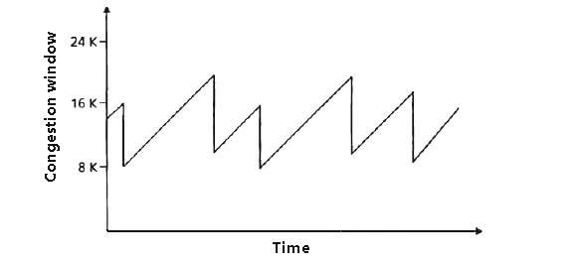
There is a small issue…
Not so fast… RDMA doesn’t really work in datacenters! A long history…
RDMA was invented in connection with a novel networking approach
called Infiniband. It competes with optical ethernet
In ethernet, senders send packets, and packets are dropped if
congestion (overload) occurs.
This causes loss if the packets are part of UDP messages, but TCP
retransmits missing chunks.
  It “backs off” (slows down) if loss occurs
  Additive increase, multiplicative backoff
Notes:
Now the thing is… RDMA also would need to coexist with TCP.
That isn’t so easy either!

Slide 36
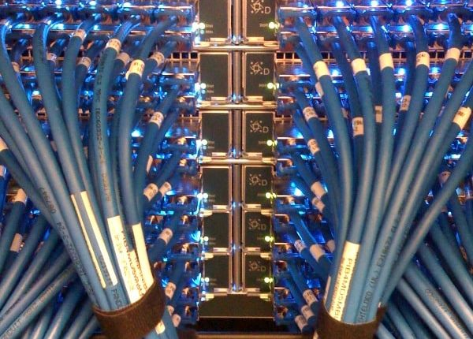
Infiniband isn’t Ethernet
In Infiniband, no device sends unless it has permission to send from the receiving device first
So when a router transmits a packet to another router, for example, the receiver has granted “credit” for the sender to send B bytes.
This is true for every step along the route!
Hop by hop, no data is moved without assurance of a place to put it
The optical network layer is so reliable that Infiniband is lossless!
  More precisely: Loss is incredibly rare and usually caused by some form of crash
Notes:
We could run both side by side. But that uses a lot of extra power and cables.

Slide 37
Supercomputers love Infiniband
The “market share” for Infiniband in HPC systems is extremely high
Ethernet is unpopular because those packet drops aren’t rare, and this
causes erratic performance.
So we now have 15 years of experience with Infiniband with as many as
hundreds of thousands of datacenter computers!
RDMA was born in this world: DMA transfer over Infiniband works because
hop by hop, no loss ever occurs. Every piece of data is moved reliably
at “optical network” speed. Today: 200Gbps (bi-directional) is available
In contrast, memcpy with a single core is more like 36 Gbps for large
transfers that can’t leverage the L2 cache.

Slide 38
RDMA on Converged Ethernet: RoCE
The idea emerged of running RDMA over optical ethernet, around 2010
Puzzle: RDMA doesn’t do retransmits over Infiniband, and a full TCP-style
solution wouldn’t be nearly as fast
So, how to get RDMA to run in a setting without sender credits?
They introduced a concept of “Priority Pause Frames”

Slide 39
RDMA on Converged Ethernet: RoCE
The idea emerged of running RDMA over optical ethernet, around 2010
They introduced a concept of “Priority Pause Frames”
An overloaded router or switch or NIC sends PPFs to the sender of a
flow if it becomes overloaded by incoming data
The RDMA NIC pauses, then restarts the transfer (the entire transfer)
if it receives even a single PPF
… but unfortunately, PPF didn’t work very well
It can generate PPF “storms” and RDMA performance collapse
Notes:
Sadly, just running RDMA on Ethernet has not been a simple thing. It is just starting to work now, in 2018.

Slide 40
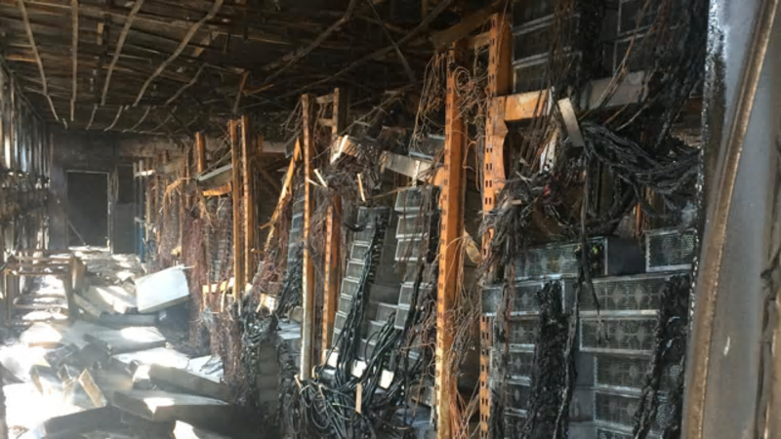
“But Does ROCE work??”
There are many stories of datacenter technologies that didn’t work well
They include optical Ethernet multicast (broadcast), early web server technologies, early packet routing solutions, early ways of connecting browsers to web servers, early DDoS attack filters
Often, they disabled entire datacenters when they malfunctioned!
… so datacenter operators are not eager to embrace
RoCE yet, because “a little unstable” can mean “my
datacenter could be toast”

Slide 41
Ethernet “broadcast storms”
A long story, but we’ll abbreviate it…
Your friendly local ethernet supports broadcast (all receive everything) but also a more selective “multicast” (it has a form of topics, represented by an integer, and only machines subscribing to the topic receive the messages for that topic).
… but, the integers must be in a fairly small range (12 bits)
Notes:
This is an old and seemingly tangential story. Ethernet once had a disruptive new technology called IP multicast (aka broadcast).
People thought it would be awesome.
Actually, it was disruptive in the negative sense.

Slide 42
Imagine a massive datacenter
Suppose it was using this feature
With widespread use, we run low on multicast addresses
And it turns out that even if we fix this (IPv6) the hardware has the same issue for a different reason!
… with a few thousand addresses in use, it treats multicast as broadcast

Slide 43
What does this mean? “Treats Ethernet multicast as a broadcast”?
In your design, some message was intended for 2 receivers, perhaps even in the same rack (it won’t be forwarded, when things work properly).
Instead, it gets delivered to every computer in the whole data center.
We end up with all-to-all messages: broadcasts, and everyone receives every single one of them!

Slide 44
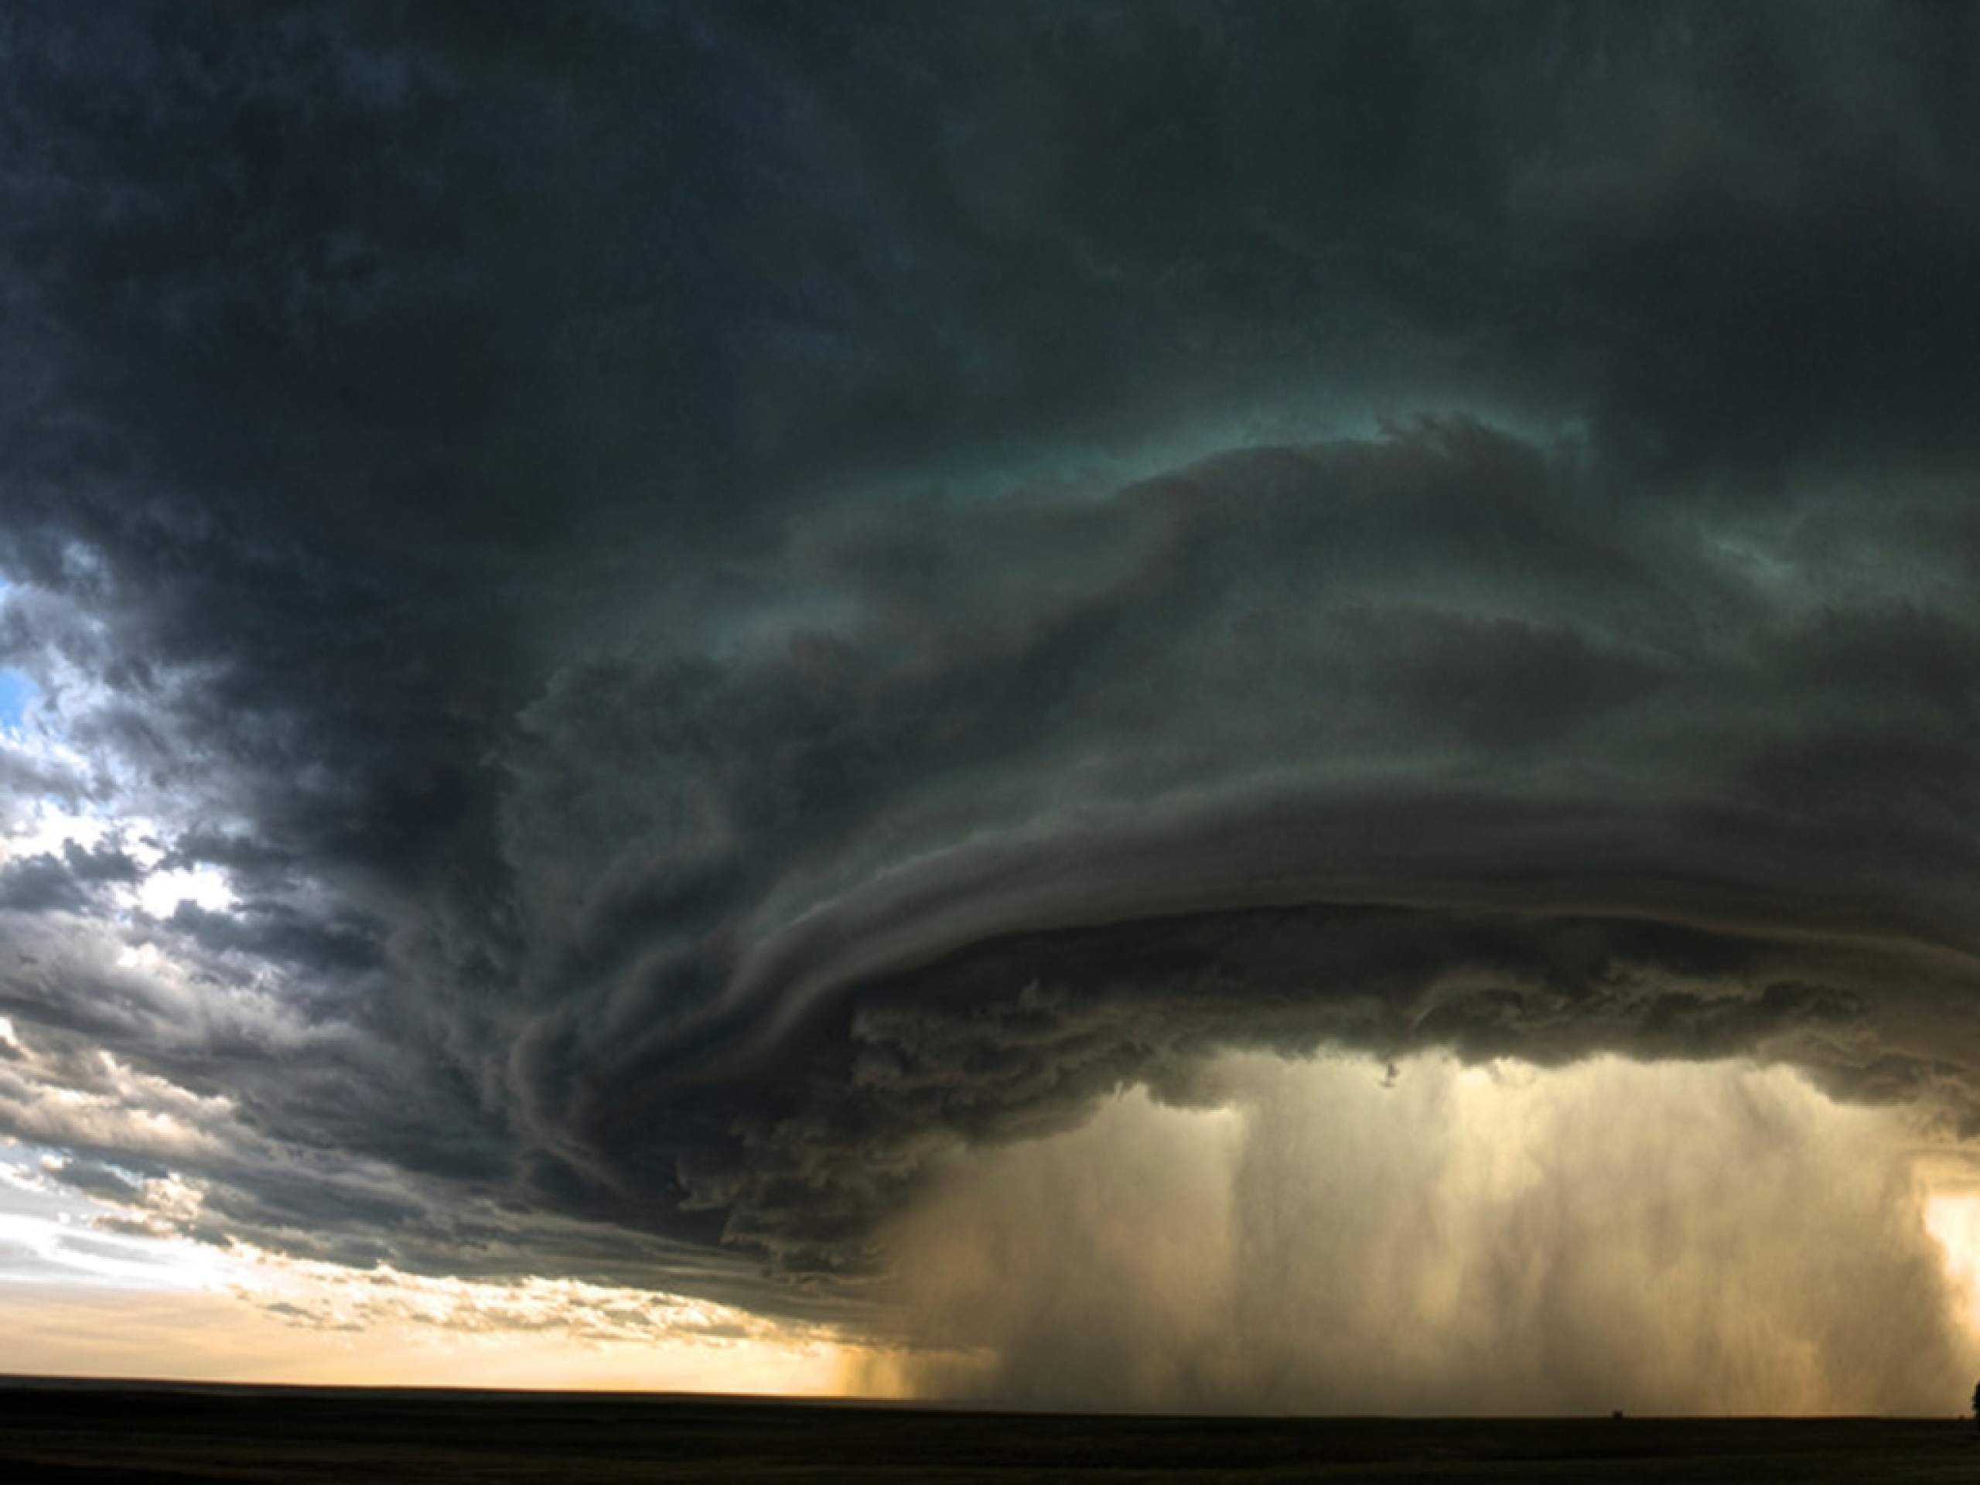
Try to visualize the pattern
Suppose that we have a half million machines
Some application forms small groups of perhaps 4 machines. There are 10,000 machines running this: 2,500 small groups. The groups have a message traffic of 20 msgs/s (the 4 members send ~5 msgs/s each).
Now suppose that due to this hardware problem, every multicast behaves like a broadcast. How many messages/second are delivered to an average machine in the data center, one not part of the 10,000?
Every machine suddenly receives 50,000 msgs/s
Notes:
It is hard to even imagine how horrible these events were.
You had all of Google or something, and you run some app, and the whole data center collapses and nobody understands why.
Basically, the hardware broke. It didn’t work properly at scale.

Slide 45
Could RDMA multicast or Derecho trigger such a storm?
No, not in a literal sense
The multicast storm was caused by a feature of routing and NICS
specific to the way that Ethernet class-D multicast forwarding is done
In fact the “cause” is that a hardware hash-table fills up and overflows
(underlying limitation: “Bloom filter” hash tables are too small)
But in the larger sense, the story is about how a technology used by one subsystem can overwhelm the whole datacenter and disrupt other systems
So you need to ask: “Could enabling use of RDMA disrupt the cloud?”
Notes:
Back on message: RDMC isn’t Ethernet broadcast. Yet it is normal to worry: could it be harmful in this way, too?
Is there some issue nobody noticed?

Slide 46
Turning this into a technical question
The cloud is stable because TCP congestion control is stable.
RDMA doesn’t use TCP congestion control.
Does this imply that if we use RDMA heavily, our TCP traffic will be starved and our data center will become unstable?
In fact… yes. RDMA can be destabilizing in this way! Enter… DCQCN

Slide 47
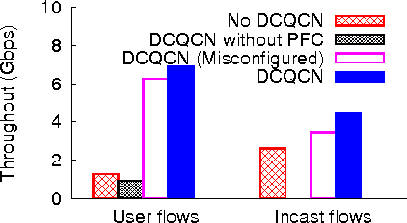

DCQCN
Data Center Quantum Congestion Notification is a new idea from Microsoft and Mellanox that uses end-to-end congestion notification
Basically, these are the same as credits in Infiniband
Experiments on modest datacenter clusters worked well!
RDMA + DCQCN enabled RDMA to work in normal datacenters!
A disruptive and transformational development!
Not so fast… does it really work? At full scale?
Notes:
Ok, now recently, people claim to have figured out how to run RDMA on RoCE next to TCP/IP without PPF storms. Cool. But should we trust them?
If so, we have an amazing breakthrough! But… if not… we have a disaster in the making.

Slide 48

Microsoft Azure Set up a red team
Goal: Deploy DCQCN side by side with normal
TCP/IP in a new Microsoft datacenter, during the
burn-in testing period (about six weeks long)
Test aggressively – try and see if they can trigger problems.
Includes misconfiguration, but not “breaking the logic”
They want to know: are we getting into trouble here?
Guess what? It didn’t work!

Slide 49
Issues that were identified
RDMA and normal TCP/IP interfered with each other.
PPF standard requires “Enterprise VLAN” feature on switches. Azure doesn’t use this technology.
But they solved these
They repurposed another (also unused) feature called “DiffSrv”
There was a DiffSrv packet format that could be reused for PPFs
DiffSrv also allowed TCP/IP to run side-by-side with RDMA, isolated

Slide 50
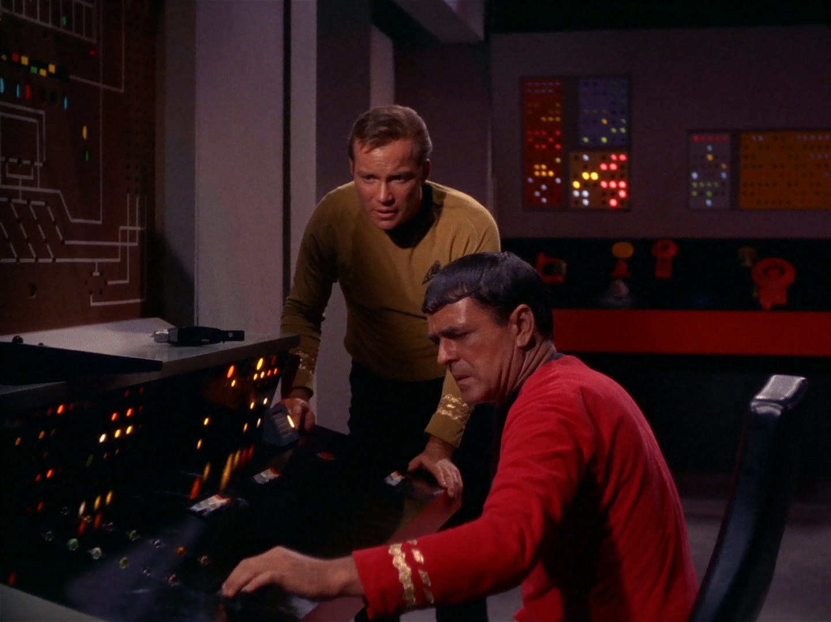
… it still didn’t work
“Jim, it dinna work.
Antimatter containment will fail in 3 minutes!”
They discovered that RDMA + DCQCN + DiffSrv + PPF could cause a new kind of routing / congestion loop
It was triggered by a form of resource exhaustion because the TCP/IP layer and the RDMA layer were sharing buffers inside NICs, switches and routers.
By dividing the resources into pools, this could be solved. But their hardware lacked a way to do that. They solved it by “overprovisioning”
They bought more memory for the routers and switches than needed
Then configured to make sure that the memory never gets used up

Slide 51
More limitations
RDMA only works if the application is working from “pinned” memory pages, and works best if the memory pages are huge.
Seems to be at odds with virtualization
Advances in RDMA hardware may help reduce these issues
When an RDMA transfer finishes, the program can definitely access the data. But if you instantly do a DMA transfer to disk, or try to display it on a graphics device, caches and pipelines may need to be flushed first.
There is no standard way to actually do this.

Slide 52
In the end, they got it running! ☺
Today, Azure uses RDMA, but only for system services (for now)
Azure HPC actually does have application-layer RDMA, but only for people who use a package called MPI.
In fact, MPI doesn’t share the devices with normal TCP/IP
Instead, Azure HPC computers have an entire extra Infiniband network
In the future, Microsoft may expand use of RDMA to allow some trusted subsystems to also use it. Probably it will never be free for general use.
Notes:
Long story short: they did get it all working, they think.
The general mood is to wait a year or so more and see what happens.
But apparently RDMA in the cloud on ROCE may be a reality soon. At least at Google and Microsoft.

Slide 53

… So, can you use Derecho on Azure?
Nope. It may be possible to run Derecho on Azure HPC soon, and perhaps also on Azure containers.
But virtualization seems to be incompatible with RDMA
And even where Microsoft has RDMA, they don’t allow you to access it yet.
Plus, if you had Derecho, would you be able to get the full speed?

Slide 54
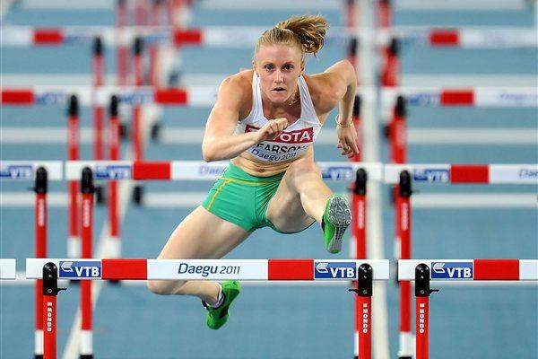
RDMA is just one of many “players”
This story of RDMA as an accelerator in the cloud is just one of a few
Each technology has many hurdles to overcome!
Is it way faster than not using it?
Will it save the cloud owner money?
Is it stable? Really stable?
How hard will it be to “manage”?
How hard is it to program?
Notes:
And it isn’t even just RDMA.

Slide 55
Edge version of this
The actual sensors are on 5G platforms. We can use a layer called the data plane developer’s toolkit, DPDK, to uniformly talk to the network whether it is 5G or other technology.
And there are ways to simulate RDMA on DPDK such as “urdma”, which is a library some graduate student built in Switzerland a few years ago.
But would Derecho run on such a layer? And would it make sense?

Slide 56
Moral of our story?
Modern hardware enables big steps
… but when you take them you potentially stumble.
… and even after the big step many questions still remain open!

Slide 57
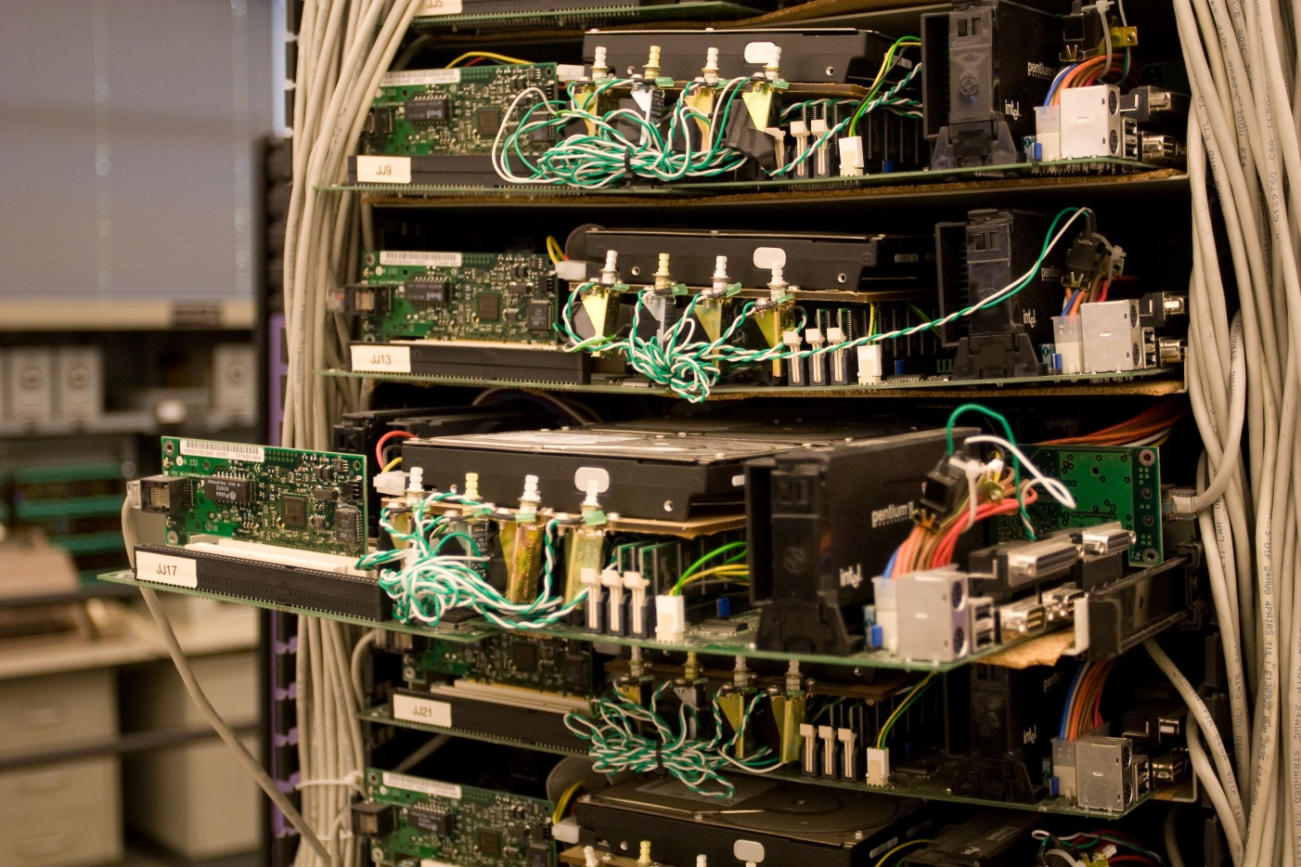

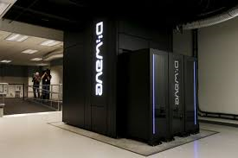
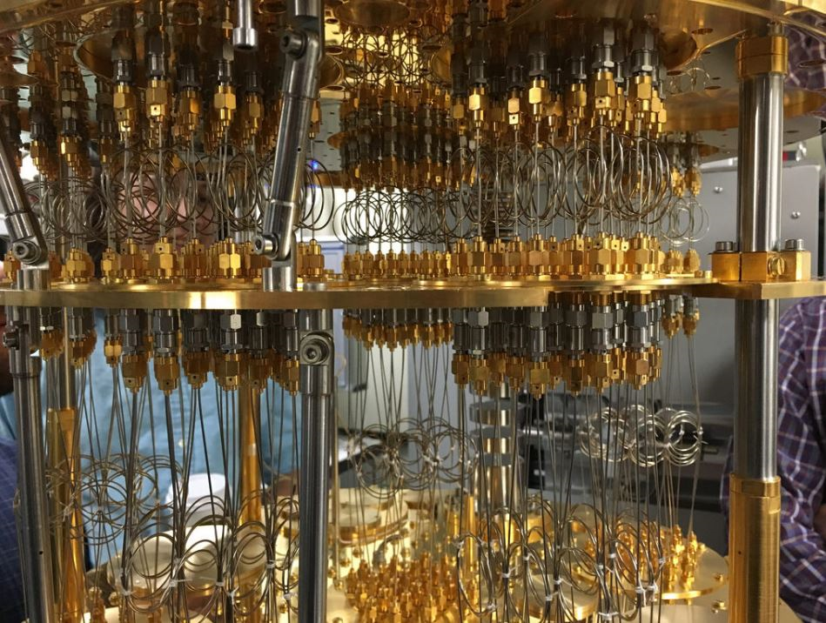
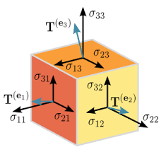
Programmable components
General purpose cores on NUMA machines
Network Interface Card (NIC) for modern RoCE (RDMA-capable Converged Optical Ethernet). Optical network itself.
Storage components (SSD)
Network Switches and Routers
Field Programmable Gate Array (FPGA), FPGA clusters, ASICs.
GPU (graphics accelerator) and GPU clusters.
TPU (tensor processor unit) and TPU clusters.
Quantum computing hardware
Notes:
Tons of hardware promises breakthroughs yet could be damaging…

Slide 58
Each would have a similar story
Every one of these has amazing potential, but to leverage it can require changing all sorts of things that used to be standard in Linux
As the modern data center evolves, we will run into that issue often.
Yes, we want accelerators. But the pain level is substantial!

Slide 59

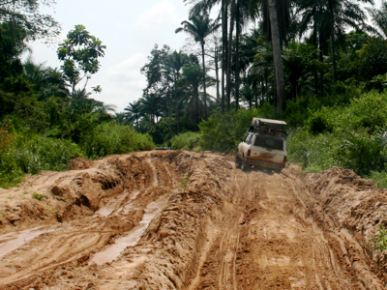


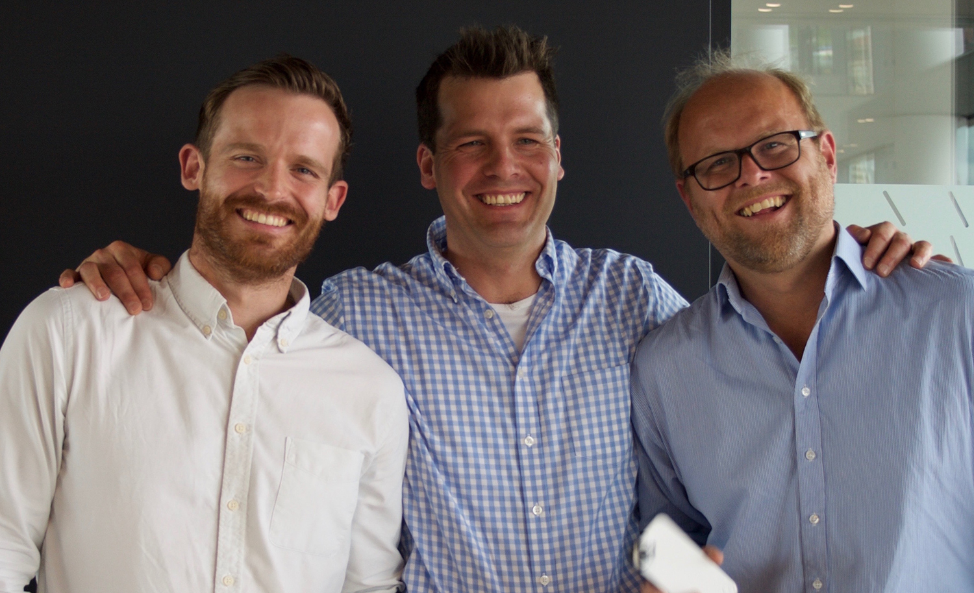
Rough Road Ahead!
The latest new thing always sounds amazing…
100x Speedups have a chance of adoption, if your pain tolerance is high!
Paradise awaits!
The boss: Paid to say “no”!
The pitch. What could go wrong?
Road to Paradise
Notes:
It will be so awesome once we just get past this muddy patch….

