Slide 1
CS5412 / Lecture 24 Social Network graphs
Ken Birman
Spring, 2022

Slide 2
Today… a “big data” topic
The last few lectures have looked at computing on sharded big data. But not all big data is actually stored in this form.
Today, we will look at the way that Facebook creates and manages its TAO database for the social networking graph. This is a central form of big data in Facebook, and most cloud platforms have a similar system.
IoT will cause us to create new kinds of social network graphs (for example to track Covid spread). This is a huge opportunity area for researchers.

Slide 3
What is “big data” usually about?
Early in the cloud era, research at companies like Google and Amazon made it clear that people respond well to social networking tools and smarter advertising placement and recommendations.
The idea is simple: “People with Ken’s interest find this store fantastic.” “Anne really like Eileen Fisher and might want to know about this 15% off sale on spring clothing.” “Sarah had a flat tire and needs new ones.”
Notes:
In the early days of machine learning there were two big surprises.
One was that smart ad placement hugely impacted click-through revenue and sales. And the other was that you can actually learn a lot by collecting these immense data sets and more or less classifying similar groups of users to learn huge models: “users like Ken, faced with choices like these, would often click on X and then purchase Y.”
All this occurred just as the machine learning community suddenly rediscovered neural networks (around 2004) and that model for learning completely took off.
So we saw an industry-wide transformation that is still playing out today, but it centers on learning from huge data sets.

Slide 4
they had a lot of customers and data
Web search and product search tools needed to deal with billions of web pages and hundreds of millions of products.
Billions of people use these modern platforms.
So simple ideas still involve enormous data objects that simply can’t fit in memory on modern machines. And yet in-memory computing is far faster than any form of disk-based storage and computing!
Notes:
One of our early lectures had far more examples of scale.

Slide 5
What are the big data files?
Snapshot of all the web pages in the world, updated daily.
Current product data & price for every product Amazon knows about.
Social networking graph for all of Facebook

Slide 6
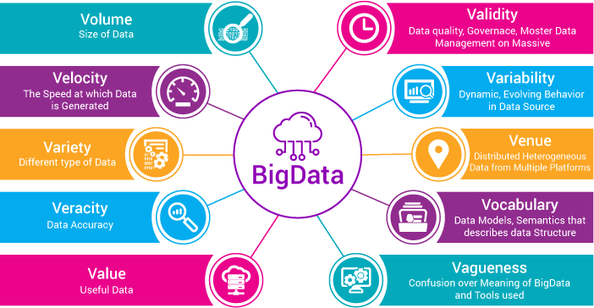
Many challenges
XenonStack.com
Notes:
We’ve seen pictures like this before, but I like the breakdown this company arrived at (they do consulting on all 10 aspects of the big data challenge).

Slide 7
Visualizing the pipeline
Data starts out sharded over servers
Early pipeline stages are extremely parallel: they extract, transform, summarize
Eventually we squeeze our results into a more useful form, like a trained machine-learning model. The first stages can run for a long time before this converges
Copy the model to wherever we plan to use it.
Notes:
Because the data is so large and so sharded, big data is always about parallel computing and often, even the results are held in a massive sharded results layer: data is all sharded, all the time.

Slide 8
For web pages this is “easy”
The early steps mostly extract words or phrases, and summarize by doing things like counting or making lists of URLs.
The computational stages do work similar to sorting (but at a very large scale), e.g. finding the “most authoritative pages” by organizing web pages in a graph and then finding the graph nodes with highest weight for a given search.
When we create a trained machine-learning model, the output is some sort of numerical data that parameterizes a “formula” for later use (like to select ads).
Notes:
Well, perhaps not easy, but easier: web pages have a standard representation and a mix of text and images and sometimes semi-structured content like tables. Powerful tools exist for data mining over these kinds of representations and are quite standard by now. So once you learn which packages to use, your job is simplified.

Slide 9
What about for social networks?
Here we tend to be dealing with very large and very dynamic graphs.
The approaches used involve specialized solutions that can cope with the resulting dynamic updates.
Facebook’s TAO is a great example, we’ll look closely at it.
Notes:
Facebook’s TAO deals with the other type of data, namely graphs representing social network information. Their slides have notes and I won’t modify those.

Slide 10
TAO Facebook’s Distributed Data Store for the Social Graph
Cornell PhD who worked with Professor van Renesse. Graduated in 2010
Became “director of engineering”, and then recently joined a startup.
Nathan Bronson, Zach Amsden, George Cabrera, Prasad Chakka, Peter Dimov, Hui Ding, Jack Ferris, Anthony Giardullo, Sachin Kulkarni, Harry Li, Mark Marchukov, Dmitri Petrov, Lovro Puzar, Yee Jiun Song, Venkat Venkataramani
Presented at USENIX ATC – June 26, 2013
Notes:
So now we are going to take the Facebook slides on their TAO system and actually look at their slides. Why do this?
Well, this is real, and we might as well be as real as possible whenever possible.
Facebook considers TAO to be the core of its entire social networking system.

Slide 11
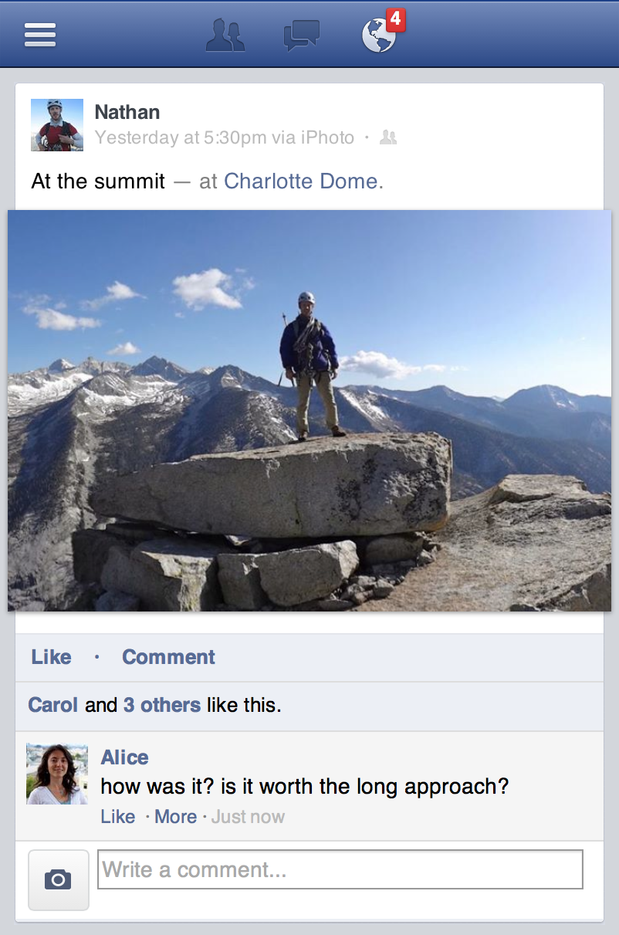


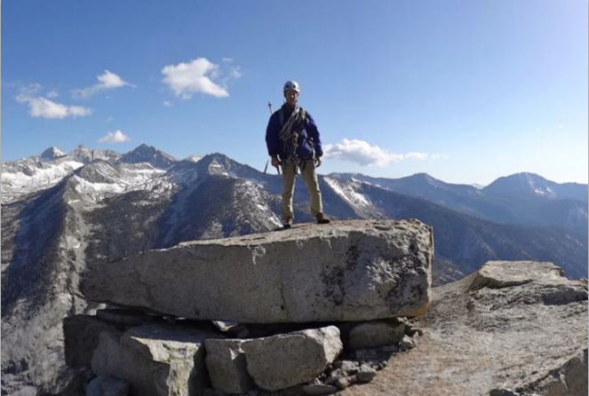



The Social Graph
USER
LOCATION
AT
GPS_DATA
FRIEND
AUTHOR
CHECKIN
PHOTO
USER
Carol
POST
LIKE
PHOTO
FRIEND
LIKE
LIKE
USER
LIKE
USER
USER
EXIF
COMMENT
EXIF_INFO
USER
COMMENT
(hypothetical encoding)
AUTHOR
Notes:
NOTES: spend less time here
So what is the social graph? The most basic nodes are obviously users and their relationships, but we also use it to model physical things and to encode all of a users activity on Facebook.
Consider this post, where I uploaded a photo of myself at the top of a climb in the Sierras.
…
OK, so now we have a flexible and powerful representation of the data behind this post, how do we go about rendering it?

Slide 12
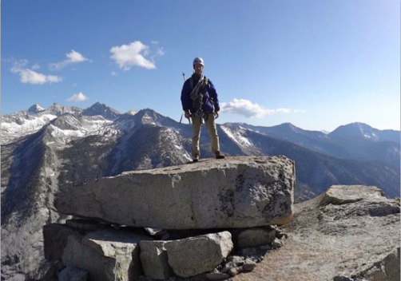
Dynamically Rendering the Graph
USER
Web Server (PHP)
LOCATION
AT
GPS_DATA
FRIEND
CHECKIN
AUTHOR
PHOTO
USER
Carol
POST
LIKE
PHOTO
FRIEND
LIKE
USER
LIKE
USER
LIKE
USER
EXIF
UPLOAD_ FROM
COMMENT
EXIF_INFO
USER
COMMENT
APP
iPhoto
AUTHOR
Notes:
Now that we have this flexible and fine-grained representation of the content of this post, we need to actually turn it into HTML. We do this in a straightforward fashion, by having the web servers query the graph, filter, aggregate, and then render the result. A fundamental feature of the Facebook workload is that we do this aggregation every time; we dynamically render the site during every request.

Slide 13
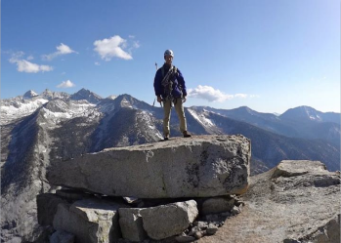
Dynamically Rendering the Graph
TAO
USER
Web Server (PHP)
LOCATION
GPS_DATA
AT
AUTHOR
FRIEND
CHECKIN
PHOTO
LIKE
USER
Carol
PHOTO
POST
FRIEND
LIKE
USER
LIKE
USER
LIKE
USER
EXIF
UPLOAD_ FROM
COMMENT
EXIF_INFO
USER
COMMENT
APP
iPhoto
AUTHOR
1 billion queries/second
many petabytes of data
Notes:
Okay, so now we’ve got enough boxes and arrows on the screen that I can show you where TAO fits. For the data types it handles, TAO is responsible for the right side of the picture.
TAO is a service that stores the graph and allows the web servers to read and write it.
So how do we go about actually turning the typed nodes and typed edges into HTML? At a high level, we basically dynamically render from the graph every time.
No page caching
Dynamically generate the page every time

Slide 14
TAO opts for NoSQL Model
Most TAO applications treat the graph like a very restricted form of SQL database: it looks like SQL.
But first, they limit the operations: it isn’t full SQL.
And then they don’t guarantee the ACID properties.
In fact the back end of TAO actually is serializable, but it runs out of band, in a batched and high-volume way (BASE: eventually, consistency happens).
The only edge consistency promise is that they try to avoid returning broken association lists, because applications find such situations hard to handle.

Slide 15
Concept: A data dependency
For TAO, if a node has an edge to some other node, we say that there is a data dependency: the origin of that directed edge “depends” on the destination
They think of the graph as “broken” if a dependent node can’t find the node it depends upon.
It would show up as a “?” on the Facebook feed, and they don’t like that
Ideally, you only see a “?” if they deleted some sort of spam, fake news, etc
The graph has a depth and so we can talk about dependencies at depth d

Slide 16

Dynamic Resolution of Data Dependencies
POST
1
CHECKED_IN
COMMENT
AUTHOR
ATTACH
LIKED_BY
LOCATION
COMMENT
PHOTO
USER
Carol
USER
2
AUTHOR
UPLOAD_ FROM
USER
3
APP
iPhoto
Notes:
Let’s dig a little deeper into how the web server renders the page. The edges are dynamic data dependencies that we resolve by doing multiple query rounds

Slide 17
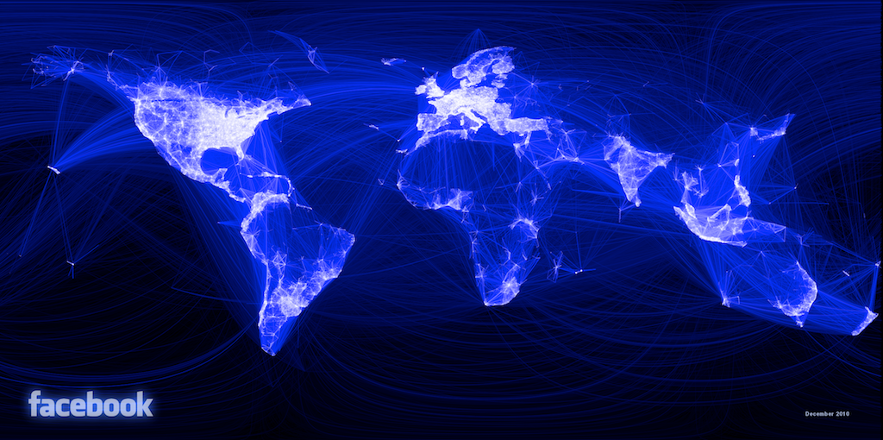
What Are TAO’s Goals/Challenges?
Efficiency at scale
Notes:
Efficiency at scale – more than 1 G qps, many PB of data
Dynamic data dependency resolution requires multiple rounds of graph queries to render page, so reads need to be fast. Our data centers are geographically distributed, so reads need to come from the local data center.
Facebook is a communication medium, so modifications to the graph should become immediately available.
Query amplification …

Slide 18
What Are TAO’s Goals/Challenges?
Efficiency at scale
Low read latency
Timeliness of writes
High Read Availability
Notes:
Efficiency at scale – more than 1 G qps, many PB of data
Dynamic data dependency resolution requires multiple rounds of graph queries to render page, so reads need to be fast. Our data centers are geographically distributed, so reads need to come from the local data center.
Facebook is a communication medium, so modifications to the graph should become immediately available.
Query amplification …

Slide 19

Graph in Memcache
memcache
(nodes, edges, edge lists)
Web Server (PHP)
Obj & Assoc API
mysql
USER
LOCATION
GPS_DATA
AT
AUTHOR
FRIEND
CHECKIN
PHOTO
LIKE
USER
Carol
PHOTO
POST
FRIEND
LIKE
USER
LIKE
USER
LIKE
USER
EXIF
UPLOAD_ FROM
COMMENT
EXIF_INFO
USER
COMMENT
APP
iPhoto
AUTHOR
Notes:
Facebook’s workload has had these constraints for a long time, even before we constructed a graph-specific data store. 6 or 7 years ago engineers developed the objects and associations API …

Slide 20
Objects = Nodes
Associations = Edges
Identified by unique 64-bit IDs
Typed, with a schema for fields
Identified by <id1, type, id2>
Bidirectional associations are two edges, same or different type
id: 1807 =>
type: POST
str: “At the summ…
<1807,COMMENT,2003>
time: 1,371,704,655
id: 2003 =>
type: COMMENT
str: “how was it …
<308,AUTHORED,2003>
time: 1,371,707,355
id: 308 =>
type: USER
name: “Alice”
<2003,AUTHOR,308>
time: 1,371,707,355
Notes:
objects …
associations …
If you consider the edges out of a particular node, there is often a natural ordering. For the association between a post and its comments, for example, …
The time-ordering of edges is so common in the social graph that we make it part of the API, using it to express the outbound edges as an ordered list instead of a set. We call this an association list.

Slide 21
Association Lists
<id1, type, *>
Descending order by time
Query sublist by position or time
Query size of entire list
id: 1807 =>
type: POST
str: “At the summ…
<1807,COMMENT,4141>
time: 1,371,709,009
newer
id: 4141 => type: COMMENT
str: “Been wanting to do …
<1807,COMMENT,8332>
time: 1,371,708,678
id: 8332 => type: COMMENT
str: “The rock is flawless, …
<1807,COMMENT,2003>
time: 1,371,707,355
id: 2003 => type: COMMENT
str: “how was it, was it w…
older
Notes:
…
So in addition to the ability to query a single object or association, we also include in the API the ability to return a portion of a single association list.
The API only provides operations to read an object, an association, or an association list. This effectively means that the only fields that are indexed are ids, types, and time.

Slide 22
Inverse associations
Bidirectional relationships have separate a→b and b→a edges
inv_type(LIKES) = LIKED_BY
inv_type(FRIEND_OF) = FRIEND_OF
Forward and inverse types linked only during write
TAO assoc_add will update both
Not atomic, but failures are logged and repaired
Nathan
FRIEND_OF
FRIEND_OF
AUTHORED_BY
Carol
AUTHOR
LIKES
LIKED_BY
“On the summit”

Slide 23
Objects and Associations API
Reads – 99.8%
Point queries
obj_get 28.9%
assoc_get 15.7%
Range queries
assoc_range 40.9%
assoc_time_range 2.8%
Count queries
assoc_count 11.7%
Writes – 0.2%
Create, update, delete for objects
obj_add 16.5%
obj_update 20.7%
obj_del 2.0%
Set and delete for associations
assoc_add 52.5%
assoc_del 8.3%
Notes:
TODO: replace wall of text with pie chart

Slide 24
What Are TAO’s Goals/Challenges?
Efficiency at scale
Low read latency
Timeliness of writes
High Read Availability

Slide 25
Independent Scaling by Separating Roles
Stateless
Web servers
TAO
Cache
Objects
Assoc lists
Assoc counts
Sharded by id
Servers –> read qps
Sharded by id
Servers –> bytes
Database
Notes:
Even though database has cache, this system lets us tune
Practical advantages to this system:
mature storage layer
complete tool set for free – backups, replication, bulk migrations, data export
incremental turn-up

Slide 26
Subdividing the Data Center
Inefficient failure detection
Many switch traversals
Web servers
Cache
Many open sockets
Lots of hot spots
Database
Notes:
The separation of cache and databases gives us linear scaling, but only up to a point. Hot spots in the cache become more numerous as the individual servers account for a smaller fraction of the total capacity. There are a fixed number of ports on cost-effective ethernet switches, so the networking even in a single building is not homogeneous between every server. Every web server talks to every cache server, which starts to stress the operating system. The communications stack in the web server also needs to detect failures in cache servers, so as the number of distinct clients grows the failure detectors get less effective. We can reduce the impact of all of these problems by subdividing both the web and cache servers, and arranging for web servers to talk to a subset of cache servers that is fewer switch hops away.

Slide 27
Subdividing the Data Center
Web servers
Cache
Distributed write control logic
Thundering herds
Database

Slide 28
Follower and Leader Caches
Web servers
Follower cache
Leader cache
Database

Slide 29
What Are TAO’s Goals/Challenges?
Efficiency at scale
Low read latency
Timeliness of writes
High Read Availability

Slide 30
Write-through Caching – Association Lists
Web servers
Ensure that range queries on association lists always work, even when a change has recently been made. Not ACID, but “good enough” for TAO use cases.
X –> Y
ok
Follower cache
X,A,B,C
Y,A,B,C
X,A,B,C
Y,A,B,C
refill X
X –> Y
ok
refill X
Leader cache
X,A,B,C
Y,A,B,C
X –> Y
ok
Database
X,…
Y,…
Notes:
Using invalidates to repair the cache after a write works fine for objects, because they are individually invalidated. If we invalidate one of the edges in an association list, however, we will also have to discard all of the edges that come after it. In this example, we want to update the first element of an association list containing X, A, B, and C. The write proceeds in the same way as before, but instead of sending an invalidation we send a refill message. This causes any caches that hold X to requery the containing association list from the leader.
Refills have the nice property that they are idempotent, so we don’t have to send them synchronously as part of the write, and we can log them for replay if they fail.
Idempotent cache consistency messages are very useful from an operational perspective.

Slide 31
Asynchronous DB Replication
Master data center
Replica data center
Web servers
Writes forwarded to master
Follower cache
Inval and refill embedded in SQL
Leader cache
Database
Delivery after DB replication done

Slide 32
What Are TAO’s Goals/Challenges?
Efficiency at scale
Low read latency
Timeliness of writes
High Read Availability

Slide 33
Key Ideas
TAO has a “normal operations” pathway that offers pretty good properties, very similar to full ACID.
But they also have backup pathways for almost everything, to try to preserve updates (like unfollow, or unfriend, or friend, or like) even if connectivity to some portion of the system is disrupted.
This gives a kind of self-repairing form of fault tolerance. It doesn’t promise a clean ACID model, yet is pretty close to that.

Slide 34
Improving Availability: Read Failover
Master data center
Replica data center
Web servers
Follower cache
Leader cache
Database

Slide 35
TAO Summary
Efficiency at scale Read latency
Separate cache and DB
Graph-specific caching
Subdivide data centers
Write timeliness
Write-through cache
Asynchronous replication
Read availability
Alternate data sources

Slide 36
Single-server Cache Node Peak Observed Capacity
Notes:
TODO: maybe add a number for each of the high-level points?

Slide 37
Write latency
Notes:
TAO’s writes are performed synchronously in the master region, so a write in a slave region includes an inter- region round trip. Figure 11 compares the latency in two data centers, the master and a remote region 58.1 milliseconds away (average round trip). Average write latency in the master region was 12.1 msec; in the remote region it was 74.4 = 58.1 + 16.3 msec.

Slide 38
Not on this slide set
Much more data about performance under various conditions
The role of association time in optimizing cache hit rates
Optimized graph-specific data structures
Write failover
Failure recovery
Workload characterization

Slide 39
What will come next?
(End-of-TAO)

Slide 40
As we look beyond Spark and TAO…
TAO showed us that the Hadoop style of computing on sharded data isn’t really enough.
We also need a data ingress infrastructure optimized for the expected workload and customized for the specifics of the target setting.
Because Facebook has such a social-network centrism, it makes sense that the company would innovate on social network graph infrastructure tools

Slide 41
The edge and IoT
Edge computing will demand new architectures and tools, as well!
Up to now we have treated IoT computing as if it would be mostly a job for standard big-data analytics.
But in fact real IoT and edge applications have a “social structure” of their own, emerging from the roles the various elements are playing

Slide 42
Think of smart cars in a smart city
Each vehicle has its own on-board computing infrastructure and a lot of knowledge of its current task, goals, plans.
Around it are smart urban support solutions, like smart traffic intersections and people carrying smart devices
The next generation of applications will need to put those together to create high value for consumers (and high value companies to provide those solutions)

Slide 43
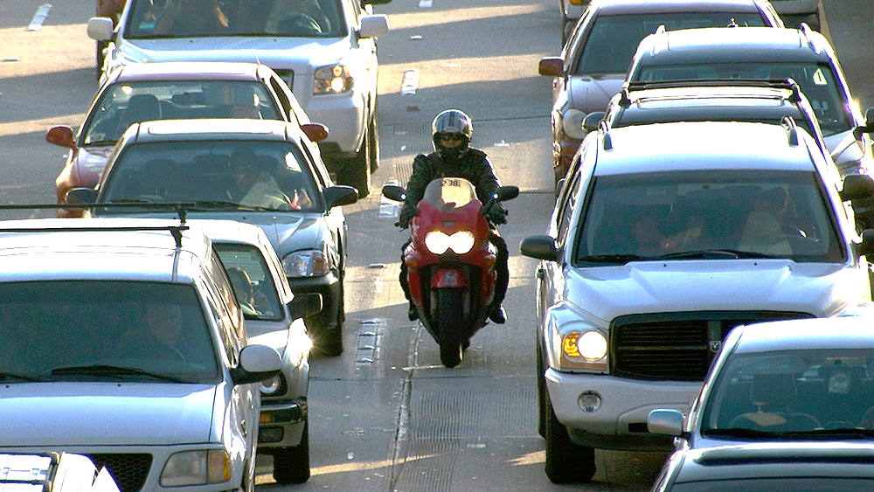
Two of my favorite examples
A smart intersection or roadway must send warnings within 25-30ms!

Slide 44
Are there “graphs” here?
No, if we mean specifically Facebook TAO social networking graphs
But the information of relevance to a vehicle or a pedestrian is a kind of graph in which the nodes are other entities and the edges represent interactions, and the queries we might use have to run on that graph.
We want to warn “Watch out for that bicycle!” but do that we have to query vehicle paths and proximity and know which ones are impacted

Slide 45
TAO could inspire those next solutions
Like TAO they need to be geo-scalable, timely, graph-oriented
One big difference is that we can rapidly discard the past: these smart solutions often care mostly about current state, although they may have learned “characteristics” from past observations (like, “Trinity is an insane motorcycle driver,” but “Joe the Uber driver is slow and careful”)
We could start with a TAO-like model and build from there…

Slide 46
What will motivate the developers?
Facebook is motivated to serve their customers amazingly well but also cost-effectively.
They also earn revenue by placing advertisements in smart ways that lead to click-throughs and purchases.
Future developers need a paycheck. So early IoT edge and 5G solutions will align with revenue opportunities. Always ask: “Who pays, and why?”

Slide 47
Conclusions: Big IoT DAta
The big data world will be evolving rapidly under demand from IoT uses.
We should look for existing solutions and ask how much of the infrastructure can be reused for these IoT cases. Example: Hybrid cloud can increase our confidence that a μ-service model is genuinely viable.
But we should be “cautious” and not change lots of things all at once. The cloud is surprisingly delicate and not everything would scale, be easy to manage, be cost-effective, be performant, etc.
Follow the money to understand which aspects will mature most quickly.

