Slide 1
CS 5412/Lecture 2
Elasticity and Scalability
Ken Birman
Spring, 2022

Slide 2

Concept of Elastic scalability
Not this kind of elastic!
The sheer size of the cloud requires a lot of resources.
The pools of instances making up a μ-service have instances added or removed elastically, meaning “on demand”.
This occurs in a single data center, but in fact many μ-services have a global span and run in hundreds of data centers, coordinating actions.
Notes:
For many people, learning about the cloud feels like a leap into the void.
Many things act very differently than you might expect because the scale at which our solutions need to be used is just so immense. So much of what you learned in computing doesn’t apply “easily”.
What we will discover is that your knowledge really does apply in the cloud, but simply that it takes a little while to learn the right mental models for the larger-scale cloud computing styles and approaches that work best.

Slide 3
Load swings are inevitable in this model
People sleep in Seattle while they are waking up in New York.
People work in Mumbia when nobody is working in the USA
So any particular datacenter sees huge variation in loads.

Slide 4
Should these elastic services be built as one big thing, or many smaller things?
Much like our “how to implement a NUMA server topic”
One big thing: we would need to have all the members of the elastic pool share a single “state”, like by holding it in a database (or replicating data but holding it in memory).
Many small things: We split the data itself into chunks (“shards”).

Slide 5
Single big service performs poorly… why?
Until 2005 “one server” was able to scale and keep up, like for Amazon’s shopping cart. A 2005 server often ran on a small cluster with, perhaps, 2-16 machines in the cluster.
This worked well.
But suddenly, as the cloud grew, this form of scaling broke. Companies threw unlimited money at the issue but critical services like databases still became hopelessly overloaded and crashed or fell far behind.

Slide 6

Jim Gray’s Famous Paper
At Microsoft, Jim Gray anticipated this as early as 1996.
He and colleagues wrote a wonderful paper from their insights:
Basic message: divide and conquer is really the only option.
Jim Gray
(Jan 1944 – Jan 2007)
The dangers of replication and a solution. Jim Gray, Pat Helland, Patrick O'Neil, and Dennis Shasha. 1996. In Proceedings of the 1996 ACM SIGMOD Conference. pp 173-182. DOI=http://dx.doi.org/10.1145/233269.233330
Notes:
In fact, almost nothing scaled. Jim studied this and tried to understand root causes.

Slide 7
How their paper approached it
The paper uses a “chalkboard analysis” to think about scaling for a system that behaves like a database.
It could be an actual database like SQL Server or Oracle
But their “model” also covered any other storage layer where you want
strong guarantees of data consistency.
Mostly they talk about a single replicated storage instance, but look
at structured versions too.
Notes:
Even with a pencil and paper analysis, he and his colleagues identified a huge issue!

Slide 8
The core issue
The paper assumes that your goal is some form of lock-based consistency, which they model as database serializability (in CS5412 we might
prefer “state machine replication”, but the idea is similar).
So applications will be using read locks, and write locks, and because we want to accommodate more and more load by adding more servers, the work spreads over the pool of servers.
This is a very common way to think about servers of all kinds.
Notes:
He posed his analysis as an asymptotic cost question, like in an algorithms class where you study complexity. But here we have more moving parts.

Slide 9
Their setup, as a picture
Applications using the database: client processes
During the run, T concurrent requests are issued. Here, 3 are running right now, but T could be much larger.
The database
Notes:
The model starts with clients talking to a database. There are T transactions that need to run. They won’t run all at the same time, of course. Here, three are active.

Slide 10
Their Basic setup, as a picture
Applications using the database: client processes
During the run, T concurrent requests are issued. Here, 3 are running right now, but T could be much larger.
Server 1
Server 2
Server N
For scalability, the number of servers (N) can be increased
Notes:
And there are N servers. We want to have N x the capacity, so the goal is to scale well and be able to throw more servers at the problem if the system overloads.

Slide 11

Key parameters
N, the number of servers running the service.
T, the number of tasks the service is asked to perform.
Goal: For larger T, use more servers (make N bigger).
Our beta test was a success with 1000 shoppers.
But we will see as many as 100,000 at the same time.
Can we just pay for extra cloud servers?
Or must we redevelop the entire system from scratch?

Slide 12
What should be The goals?
A scalable system needs to be able to handle “more T’s” by adding to N
Instead, they found that the work the servers must do will increase as T⁵
Worse, with an even split of work, deadlocks occur as N^{3,} causing feedback (because the reissued transactions get done more than once).
Example: if 3 servers (N=3) could do 1000 TPS, with 5 servers the rate might drop to 300 TPS, purely because of deadlocks forcing abort/retry.

Slide 13
This is bad news
Bottom line:
The simplest ways of scaling slow down as N³T⁵
This polynomial grows so fast it looks nearly exponential.
More servers (N) or more load (T) will “bring your system to its knees”

Slide 14
Why services slow down at scale
The paper pointed to several main issues:
Lock contention. The more concurrent tasks, the more likely that they
will try to access the same object (birthday paradox!) and wait for locks.
Abort. Many consistency mechanisms have some form of optimistic
behavior built in. Now and then, they must back out and retry. Deadlock
also causes abort/retry sequences.
The paper actually explores multiple options for structuring the data, but ends up with similar negative conclusions except in one specific situation.
Notes:
Basically, you see higher and higher rates of transactions banging into each other and either waiting (which can be slow), or deadlocking (which causes a rollback), or in some “optimistic” scenarios, aborting.
The rate of growth of overhead is a polynomial, like the number of servers or the number of transactions raised to an exponent like 2 or 3.
Now this may sound very database-specific but in fact the same issues arise in any consistent cloud service because Jim’s model was so general it could apply even if you have never thought about databases in your life!

Slide 15
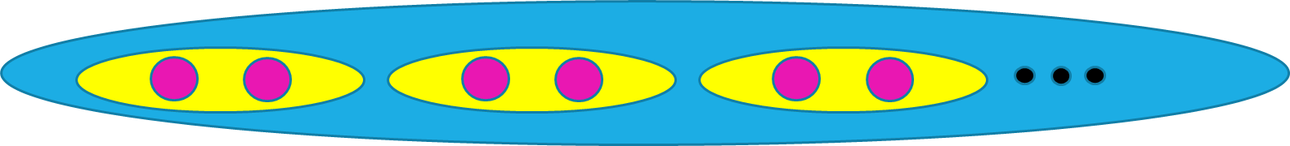
Sharding: Key ideas
One μ-service spanning many machines, split into shards with two machines per shard.
All of the data is in the service, but spread out. No single place has all the data. Every item is a (key,value) pair, with a unique “name” (key)
Any specific data item is in some single shard, probably with 2 or 3 identical replicas holding it (for fault-tolerance).
Applications need to be coded in a special way in order to efficiently compute on sharded data.

Slide 16
Sharding: Key ideas
We have N servers. Organize them into N/S “shards” with S servers each
S will normally be 2 or 3. N could be very large
Now, define some rule for deterministically mapping each (key,value) data
item to a shard (for example, random hashing in [0… N/S-1])
The entire data set is held in the service, but any given shard has just a
portion of the data.

Slide 17
Example of a sharding rule
Take the given key. Where did it come from? It might be like a file system pathname, for a file holding this one object.
Hash the key. Hashing yields a pseudo-random (“random-looking”) number.
Take the has result and apply modulo N/S. This will give an index in [0 … S-1]
That index will now tell us which shard “owns” this (key,value) pair.

Slide 18
Sharding: This works… but carefully
A transaction
A read or write to some (key,value) tuple. Here, Hash(key)%K=1
A shard with 2 replicas handling Hash(key)%K=2
Sharded storage
μ-service with 2 servers per shard
K shards
We will often see this kind of picture. Cloud IoT systems make very heavy use of key-based sharding. A (key,value) store holds data in the shards.

Slide 19
Hard part?
Sharding does not permit “multi-shard transactions”.
Each shard must be self contained and able to do the whole job.
Otherwise the cross-shard interactions reintroduce the costs Gray cited!

Slide 20
Sharding: This works… but carefully
Each transaction accesses just one shard
Storage
μ-service
If a transaction does all its work at just one shard, never needing to access two or more, we can use state machine replication to do the work.
No locks or 2-phase commit are required. This scales very well.

Slide 21
DefN: State Machine Replication
We have a set of servers: {P, Q, R, … }
Each server holds a replica of some data and has the identical logic (code).
Any server can handle a read: the code just reads the local replica.
To do an update, we use an atomic multicast or a durable Paxos write (multicast if the state is kept in-memory, and durable if on disk).
Replicas see the same updates in the same order, hence stay in the same state.
Notes:
With state machine replication we don’t have full transactions, so Jim’s issues don’t arise: there aren’t any locks, or any notion of deadlock/abort/retry.

Slide 22
State machine replication on shards doesn’t support arbitrary transactions
These transactions read and write multiple shards and need atomicity.
Storage
μ-service
Transactions that touch multiple shards require complex locking. Jim Gray’s analysis applies: as we scale this case up, performance collapses.

Slide 23
State machine replication in which each shard is totally independent works
If updates and queries are done entirely on one shard, Jim’s analysis does not apply. This is because we can actually avoid locking (the update order is enough to ensure sequential progress of the replicas, with consistency).
An application could also access multiple shards, but independently, without any “cross shard” guarantees.
This is how sharded storage is used in today’s cloud.

Slide 24
Example: A μ-service for caching
Let’s look closely at the concept of caching as it arises in a cloud, and at how we can make such a service elastic.
This is just one example, but in fact is a great example because key-value data structures are very common in the cloud.
Our example makes use of Google’s GRPC: one of a few tools for helping client programs talk to server programs
Notes:
So let’s look at how companies like Facebook use elastic caching to cache binary large objects: blobs.

Slide 25

Google RPC (GRPC)
Client
GetPhoto(“ken”)
Server
stub
stub
Server declares the callable procedures, “stubs” are created. These are methods with identical arguments. There is one each for client & server
Client program links to the client stub. Client code can call GetPhoto(“ken”)
The stub starts by looking up server’s network address (“binding”). If the server is running, the client makes a TCP connection.
Now the caller’s arguments are serialized into a message, and it is sent on the TCP connection to the server. The server stub deserializes them.
When the called procedure is done, a reply is sent back to the caller.

Slide 26




Accessing Sharded Storage, with shards of size 1 (one server per shard)
Client
Pool of servers implementing a single sharded μ-service
Key=Birman
Value=
Hash(“Birman”)%100000
Each machine has a set of (key,value) tuples stored in a local “Map” or perhaps on NVMe
In effect, two levels of hashing!
Notes:
This is how a distributed cache might be implemented. This example caches data items in a single process (each blue circle is one process on some server), so it won’t tolerate failures: if a single cache element were to get shut down for some reason, we would lose the associated shard – a portion of the cache would go cold.
At FB, even a brief glitch can put back-end services under load spikes, so actually they compute the likely frequency of such events. Only a few would happen per day. Yet this is occurring at massive scale, and even a few per day may be enough that you wouldn’t want that frequency of cache failures.

Slide 27
With two servers per shard, we add state machine replication
Key=“Ken”
Value=
Hash(“Ken”)%100000
These two machines both store a copy of the (key,value) tuple in a local “Map” or perhaps on NVMe
In effect, two levels of hashing!
Notes:
So one possible answer is to replicate the server handling each shard. Here we have two replicas per shard. In fact this model is common. Sharding with two replicas is very common, and sometimes for especially critical data we might have three copies. Even more would be used if we had a hot spot and wanted to spread the load, but not all key-value sharding solutions have that degree of sophistication.
If the management layer understands the fault-tolerance model and replication pattern, it can avoid shutting down both replicas simultaneously. So the owners of the FB cache would need to understand the management subsystem and configure it appropriately. Then their cache implementation would need to include a replication mechanism.
These aren’t such easy steps, which is one reason people tend to use existing μ-services rather than casually building their own: they could certainly implement a key-value cache, but would have way more trouble adding all these features needed in really serious deployments.

Slide 28
Reminder of Terminology
Our service in this example is called a “key value store” (KVS) or a “distributed hash table” (DHT)
Each replica holds a “shard” of the KVS: a distinct portion of the data.
Hashing is actually done using a cryptographic function like SHA 256. You can turn any value into a random-looking integer. Then modulus function
turns this integer into a shard number.
Notes:
On this question of hashing: In cloud computing, most companies favor SHA-256 (followed by a simple modulus operation) because SHA-256 is fast to compute but also very random looking. Not all hashing methods are good at really spreading data around in a uniform way.
Even so, people worry about hot spots. A common mistake is to imagine that random hashing somehow eliminates them, but random fluctuations in placement could cause a hot spot. Or some key might simply be far more popular than other keys, so that even with an even distribution of items we get a skewed load pattern.
One solution is to have 2N servers but maybe 8N shards, so each server ends up owning 4 “mini-shards”. This way if some shards host popular keys or something, the odds of being an unlucky server with an unfair load are a bit lower.

Slide 29
Some challenges for the developer
A key is like a “name”
Suppose your data doesn’t have an obvious “key” to use. How would you create a unique name for each data object?
What if we wanted to store a data structure, such as a table or tree, in our DHT? Would we put the whole thing on one shard with one key, or spread each object (each row, or each node) around, using one key per object?
What performance impact would these choices have?
Is a data structure one objects, or many objects?
If the application using the data is on machine P, and the data is in a DHT on machines {Q,R,S…}, what costs would it pay?

Slide 30
Elasticity Adds a Further dimension
If we expect changing patterns of load, the cache may need a way to dynamically change the pattern of sharding.
Since a cache “works” even if empty, we could simply shut it down and restart with some other number of servers and some other sharding policy. But cold caches perform very badly.
Instead, we would ideally “shuffle” data.

Slide 31
Elastic shuffle
Perhaps we initially had data spread over 4 shards.
We could drop down to 2 shards during low-load periods. Of course half our items (hopefully, less popular ones) are dropped.
Shard A
Shard B
Shard C
Shard D
Notes:
Elasticity forces us to think about what happens if the key-value sharded service needs to drop down from say 8 members to 4 or 2, perhaps at night.
This would be useful because the cloud could borrow the machines it frees up for other uses, like recomputing indices or product recommendations.

Slide 32
Elastic shuffle
Here, we shuffle data to map from 4 shards down to 2.
Shard A
Shard B
Shard C
Shard D
Shard A’
Shard B’
… later, we could shuffle it again to elastically expand the cache.
Notes:
A really high-quality μ-service cache would understand the elasticity event and would make deliberate choices of which cached items to retain in the new set of shards.

Slide 33
But how would other services know which servers own which shards?
A second issue now arises: how can applications that use the cache find out that the pattern just changed?
Typically, big data centers have a management infrastructure that owns this kind of information and keeps it in files (lists of the processes currently in the cache, and the parameters needed to compute the shard mapping).
If the layout changes, applications are told to reread the configuration. Later we will learn about one tool for this (Zookeeper). GRPC would consult this configuration data to find the server that the client needs to talk to.
Notes:
OK, your program wants to do a “get” operation. Fine, a library implements it. But how does the library realize we just changed the server membership and sharding rule?
Systems like Azure and AWS use a service called Zookeeper for this.
We will learn about Zookeeper later but it would hold a file containing the μ-service members and also the policy. When changing the list, it would automatically notify current applications using the policy, and they would reread the list.
Things like this make the μ-service harder to implement, but more effective in real production use.

Slide 34
Typical DHT API?
The so-called MemCached API was the first widely popular example. We saw it on Christina’s slides on Tuesday.
Today there are many important DHTs (Cassandra, Dynamo DB, MemCached, and the list just goes on and on).
All support some form of (key,value) put, get, and (most) offer watch.
Some hide these basic operations behind file system APIs, or “computer-to-computer email” APIs (publish-subscribe or queuing), or database APIs.
Notes:
Get and put work as you would expect.
The watch API will notify you if an item is updated. Maybe not so useful for a blob service, but in other situations watch can be very valuable.

Slide 35
Use case: FB Content Delivery Network
Facebook’s CDN is a cloud-scale infrastructure that runs on point of presence datacenters in which key-value caches are deployed.
Role is to serve videos and images for end-users. Weak consistency is fine because videos and images are immutable (each object is written once, then read many times).
Requirements include speed, scaling, fault-tolerance, self-management
Notes:
The rest of the lecture focuses on how Facebook does image caching (and now, video caching too). Huge thing for them since Facebook is at global scale.
The material is based on the following paper:
An Analysis of Facebook Photo Caching.Qi Huang, Ken Birman, Robbert van Renesse, Wyatt Lloyd, Sanjeev Kumar, Harry Li. The 24th ACM Symposium on Operating Systems Principles (SOSP, 2013). November1- 4, 2013, Pittsburgh.
We expect you to read this paper, because it covers the core material from this lecture. In general, readings are just recommendations, but anything specifically covered in lecture could appear on the prelim or even come up during project demos.

Slide 36
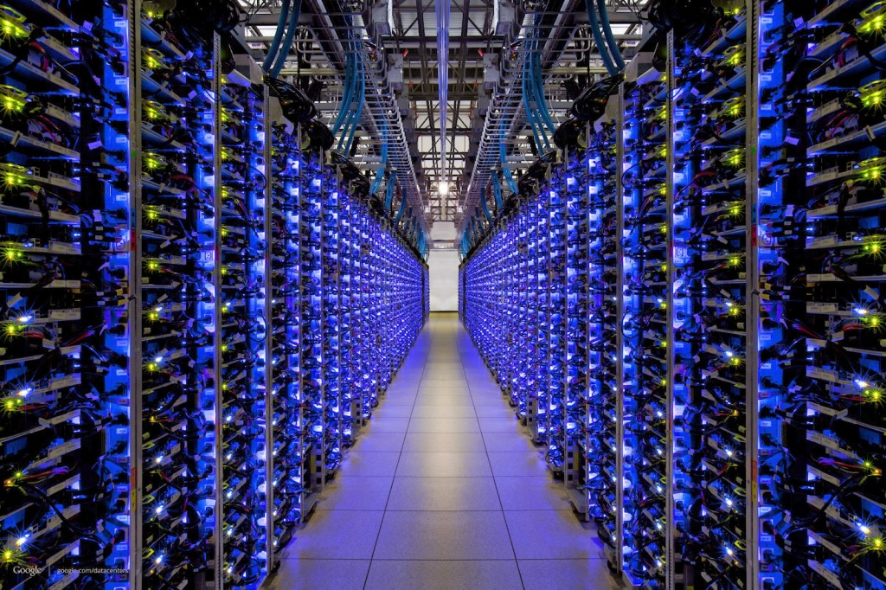
The FB BLOB cache is part of A hierarchy deployed at global scale…
Point of Presence mini-datacenters
Fully Capable datacenters
We think of Facebook as havine one core database or knowledge repository… but in fact the data is replicated
Notes:
The first thing to appreciate is that like any cloud-scale solution, Facebook’s caching infrastructure is hierarchical and “georeplicated”.
Facebook has a hierarchy of data centers: big ones that we can think of as serving data from a core database and smaller ones that mostly just are running the cache service.
The image shows a core database. This is actually a replicated data set shared among the Haystack servers (each has its own copy). As such, all of Facebook knows that there are several “last resort” systems with copies of the critical data. But unlike what the picture might seem to suggest, the core database isn’t in one place. It actually is duplicated at multiple Haystack locations, each with its own full replica.

Slide 37
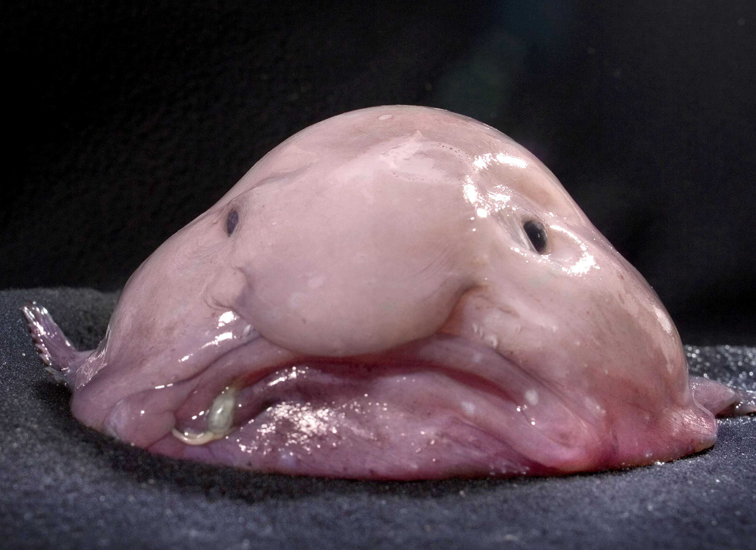

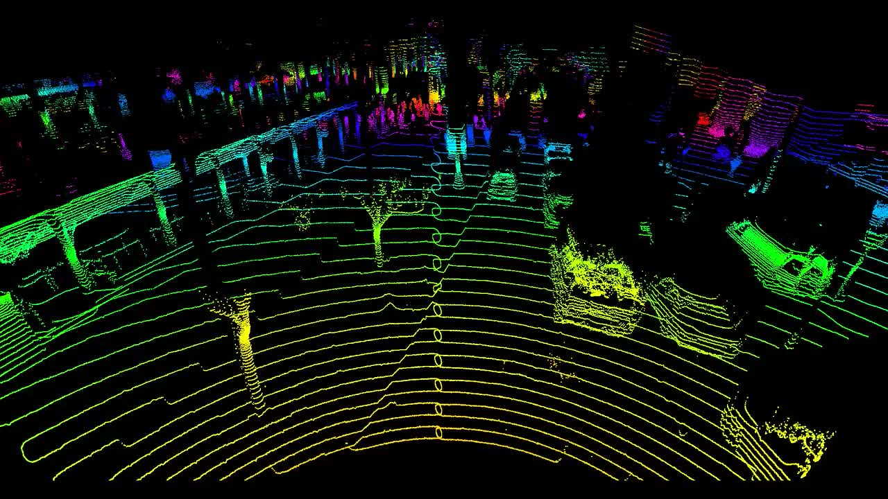
… the data is just “Blobs”
Facebook image data is stored in “blobs”: Binary Large Objects
  This includes original images, videos
  Resized versions, and ones with different playback quality
  Versions that have been processed to tag people, augmented reality
Notes:
The actual content would be photos and videos. Blobs.
But any single blob can exist in multiple versions: we sized for various screens or different playback quality, or perhaps edited in various ways (those are “effects” on the left, not the real data). So from a single original blob in its full resolution there can be various derived versions that were computed by applying some recipe to the original raw data.
This will be important in the remainder of the lecture because it costs a surprising amount of compute time to do some of these operations. Facebook would rather not do them more than once.

Slide 38
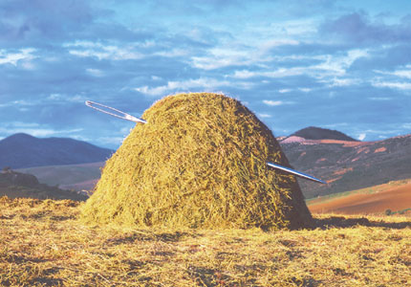
Haystack
Holds the real image and video data in huge “film strips”, write-once.
Designed to retrieve any object with a single seek and a single read. Optimized for SSD (these have good transfer rates but are best for write-once, reread many loads, and have a long delay for starting a write).
Facebook doesn’t run a lot of copies
One on the West Coast, one more on the East Coast
Each has a backup right next to it.
Main issue: Haystack would easily get overloaded without caching
Notes:
Think of Haystack as the ultimate photo album.
But it is at risk of being overloaded, so the single overarching goal is to try to serve all requests from copies of the photos, not the originals.

Slide 39
A cache for blobs?
$$$
Goal: a μ-service we can run anywhere, and that can adapt in size as loads vary.
The keys would be photo or video id’s.
For each unique blob, FB has a special kind of tag telling us the resized dimensions of the particular instance we are looking at.
Resizing takes time and requires a GPU. So
FB wants to avoid recomputing them.
Notes:
The version issue is that we need to resize the image or video depending on the screen. FB does this work because otherwise your phone battery runs down too fast.

Slide 40
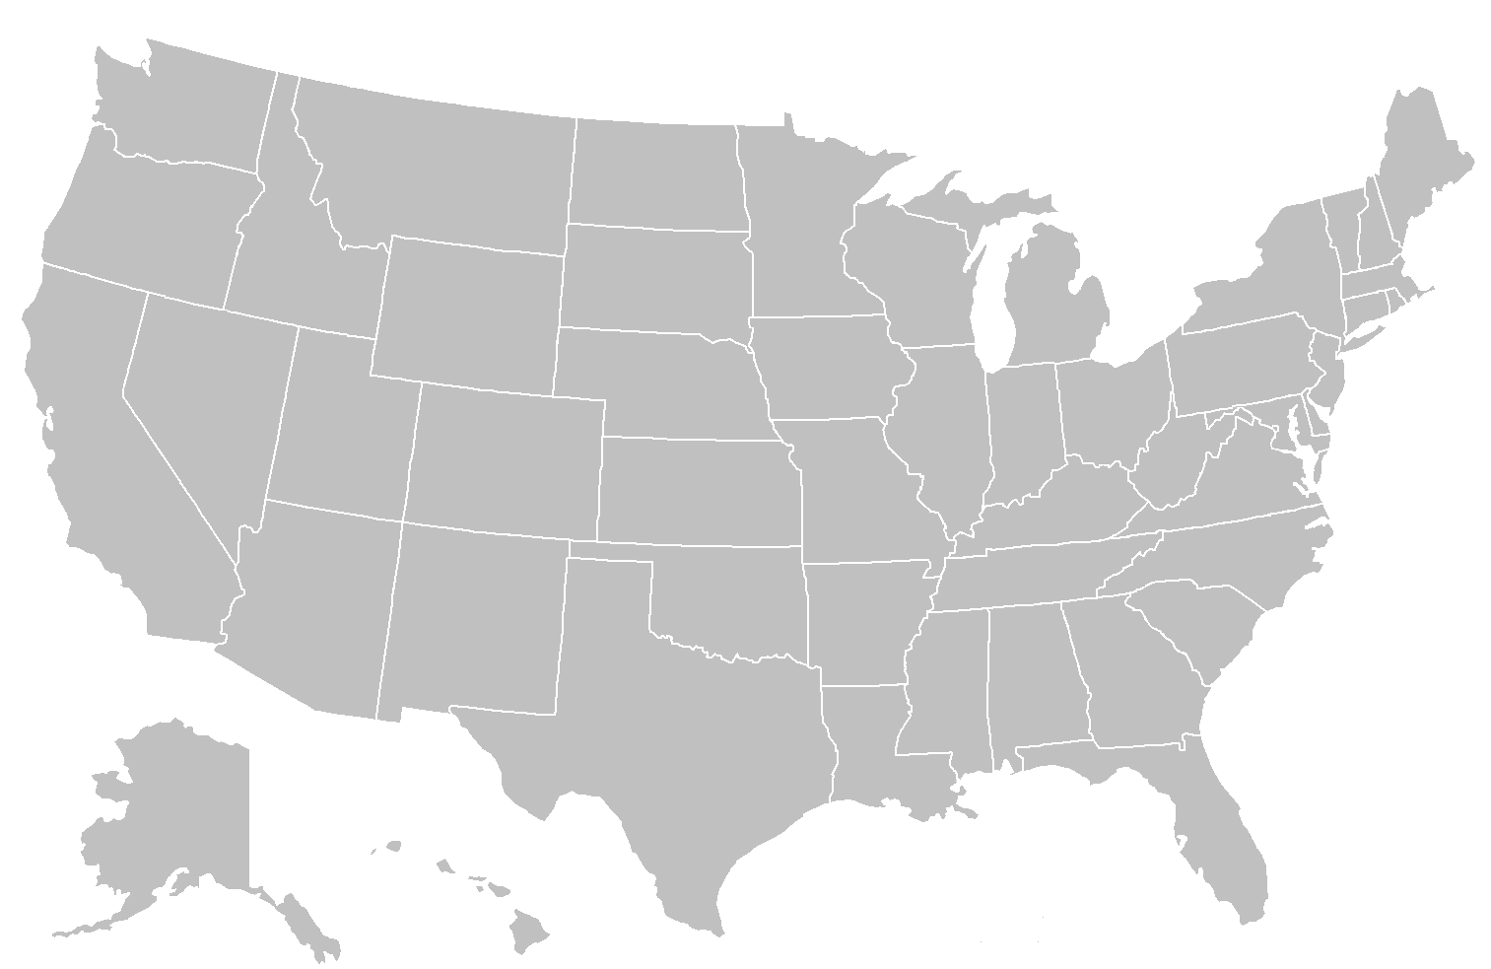


True data center
holds the original
photo in Haystack
First, FB fetches your feed. This will have URLs with the image ID embedded in them. The browser tells the system what size of screen it has.
Big Datacenter
Client
Facebook Edge Cache
Browser
Cache
Origin Cache
Haystack
If you’ve recently seen the image, Facebook finds the blob in a cache on your computer
Notes:
So here’s our picture at national scale.

Slide 41
With a UID and a
target size, we can
search for the blob
in the nearest point of
presence cache.
Big Datacenter
Client
Facebook Edge Cache
Browser
Cache
Origin Cache
Haystack
If the image wasn’t found in your browser cache, maybe it can be found in an “edge” cache
Notes:
So how does the caching structure work?
Your computer has a cache right on your iphone. This is the browser cache.
Then we could go via Akamai (a big cache run by a caching company), or directly to Facebook. And Akamai itself talks to Facebook. So in some sense all routes lead into Facebook, unless the image is found in one of those first caches.
Then we get the edge which is where Facebook does resizing. As you’ll recall, CS5412 is an edge computing class.
Deeper inside is the Haystack layer and its own caching.

Slide 42
Origin:
Coordinated
FIFO
Main goal:
traffic sheltering
Datacenter
Client
Facebook Edge Cache
Browser
Cache
Origin Cache
Haystack
In the limit, fetch from Haystack. It has a cache too
Cache layers
Notes:
The origin cache is close to Haystack. So even at the last hop we use caching.

Slide 43
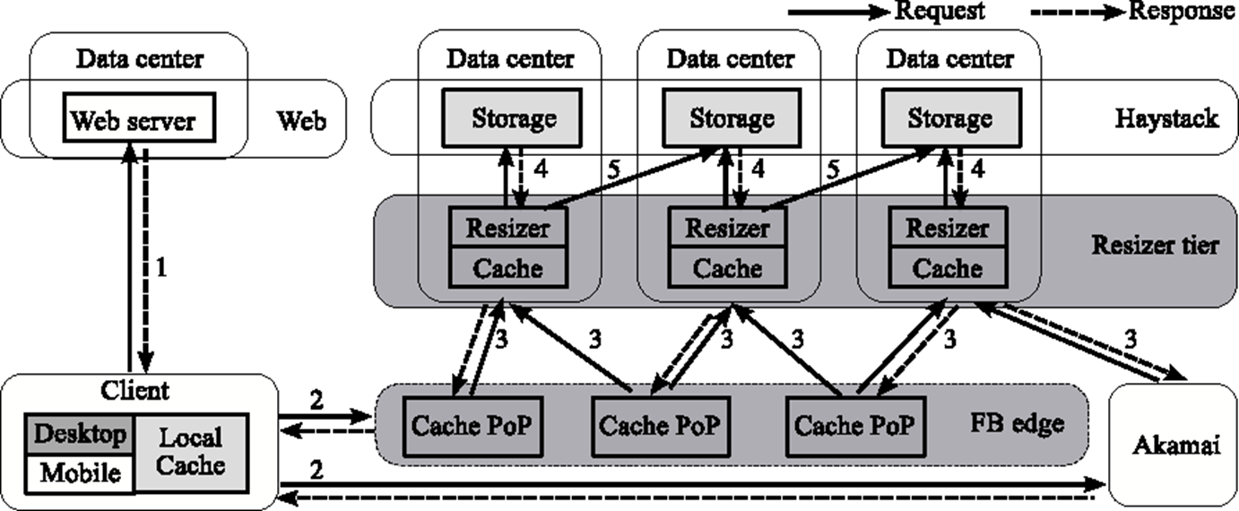
Architectural detail (Complex)
Dark Gray: We instrumented it
Pale Gray: We can figure out its behavior
Notes:
Our instrumentation lived in the dark gray places but we could deduce cache hits from the light gray ones.

Slide 44
Architectural detail (we weren’t able to instrument the pink part)
Notes:
We did our experiments during periods when Akamai wasn’t actually active, to make things a bit simpler.

Slide 45
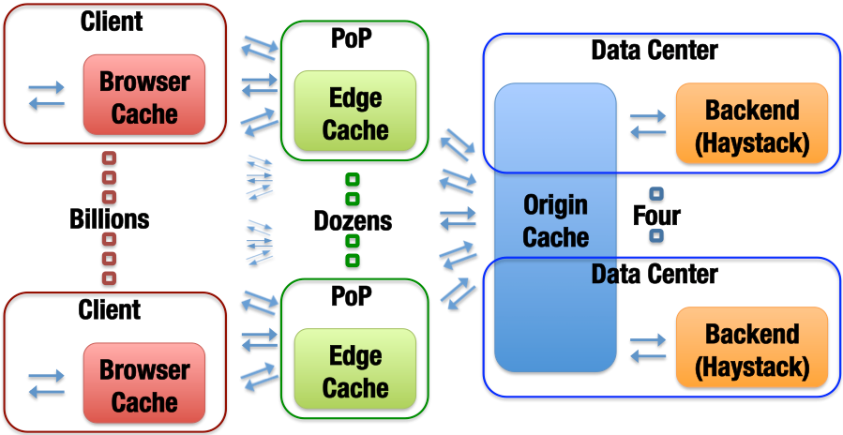
Blob-Serving Stack (the FB portion)
Notes:
Same structure, nicer image.

Slide 46
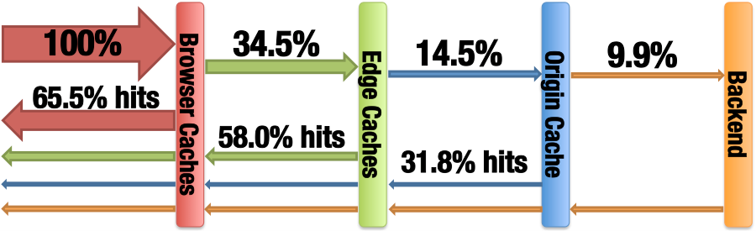
What we Observed
Month long trace of photo accesses, which we sampled and anonymized. Captures cache hits and misses at every level.

Slide 47
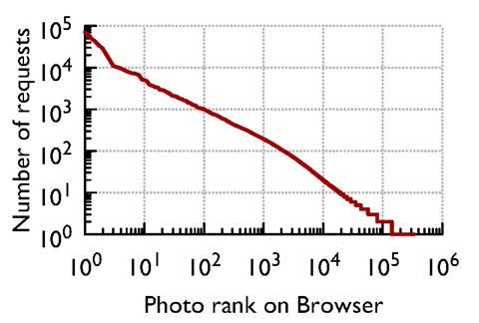
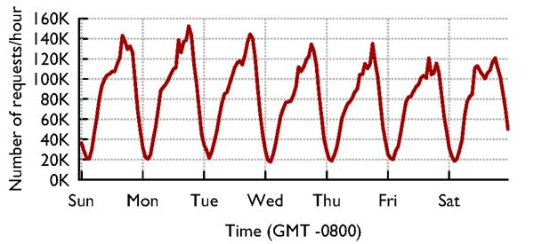
Caches see “circadian” Patterns
Accesses vary by time of day…
… and by photo: Some are far more popular than others

Slide 48
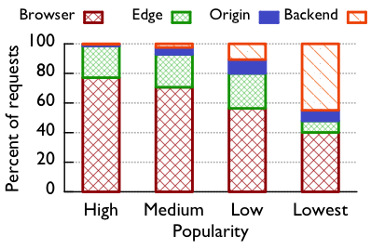
Photo cacheability by popularity
The main job of each layer
is different.
This is further evidence that cache
policy should vary to match
details of the actual workload

Slide 49
GEO-Scale Caching
One way to do far better turns out to be for caches to collaborate at a WAN layer – some edge servers may encounter “suddenly popular” content earlier than others, and so those would do resizing operations first.
WAN collaboration between Edge caches is faster than asking for it from Haystack, and also reduces load on the Haystack platform.
Key insight: the Facebook Internet is remarkably fast and stable, and this gives better than scaling because the full cache can be exploited.
Notes:
Most people assume that fetching something from LA, if you live in Ithaca, is a stupid idea. Facebook’s Internet seems to work unexpectedly well!
For them, remote caches are close enough to be useful even cross country. And this gives a WAY bigger effective cache size.

Slide 50
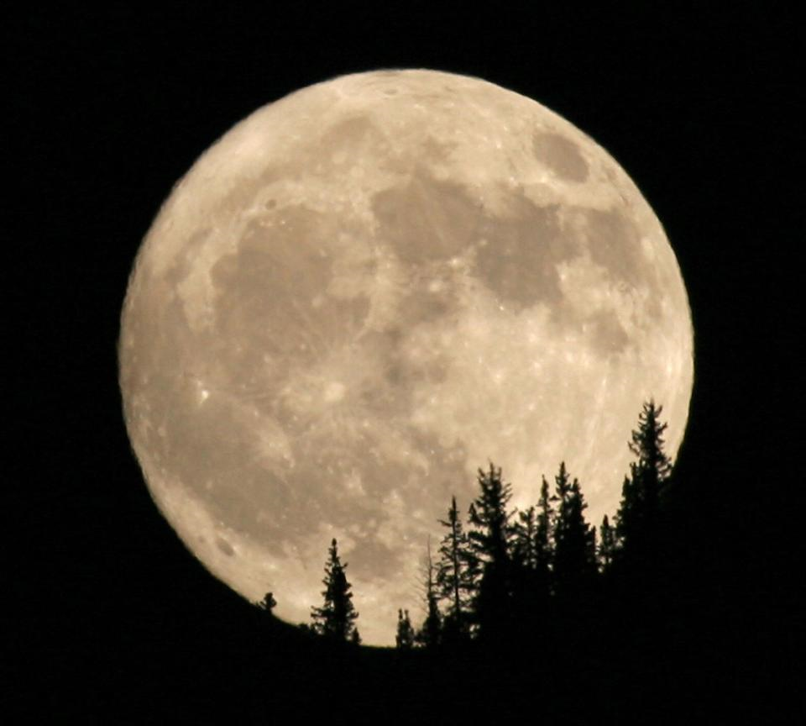


People are sleeping in Seattle
Remote fetch:
cooperation between
point-of-presence
cache systems to share
load and resources
People are having breakfast in Ithaca
In Ithaca, most of your content probably comes from a point of presence in the area, maybe the red one (near Boston)
But if Boston doesn’t have it or is overloaded, they casually reach out to places like Spokane, or Arizona, especially during periods when those are lightly loaded, like 5am PT!

Slide 51
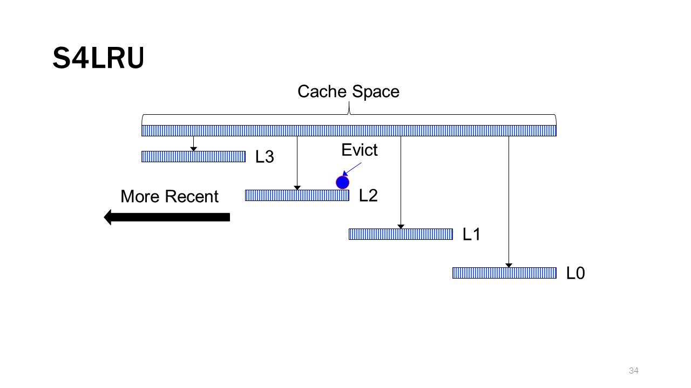
Cache retention/eviction policy
Facebook was using an LRU policy.
We used our trace to evaluate a segmented scheme called S4LRU
It outperforms all other algorithms we looked at
Notes:
The famous segmented LRU concept!
Each chunk kind of uses a different policy.
Think of the top chunk as being long-lived items that should stay in cache for a long time, and the bottom as a chunk for transient images needed just for a brief period.

Slide 52
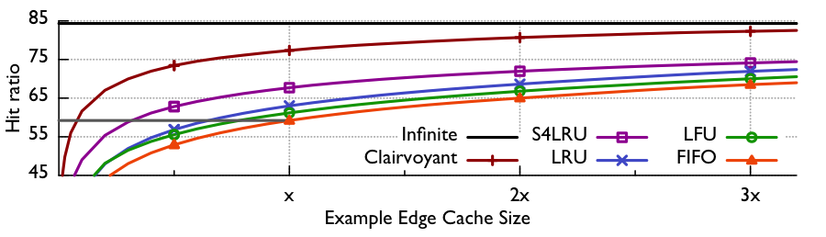
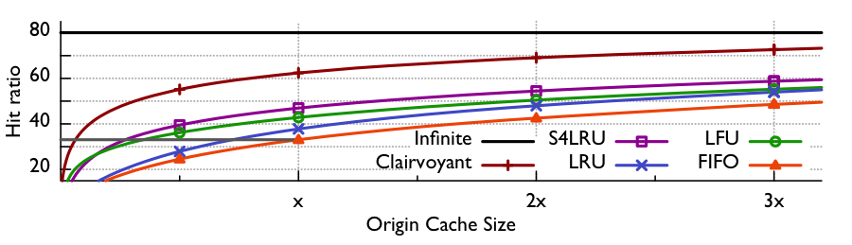
Here we see that S4LRU is far better than normal LRU

Slide 53

So… switch to S4LRU, right?
They decided to do so…
Total failure!
Why didn’t it help?

Slide 54
S4LRU didn’t really work well!
It turned out that the algorithm worked well in theory but created a pattern of reads and writes that were badly matched to flash memory
Resulted in a whole two year project to redesign the “operating system” layer for big SSD disk arrays based on flash memory: the RIPQ project.
Once this change was made, S4LRU finally worked as hoped!
RIPQ will not be on exams
Notes:
S4LRU didn’t turn out to make efficient use of the hardware.
Core issue is like the NUMA thing from the last lecture: the hardware isn’t perfect and has limitations. S4LRU, used naively, has too much overhead. But with effort it was possible to invent a solution that uses S4LRU and also is hardware-friendly (uses the hardware closer to its sweet spot)

Slide 55
RIPQ: Key Innovations
Only write large objects to the SSD once: treats SSD like an append-only “strip of images”. Same trick was needed in Haystack.
SSD is quite good at huge sequential writes. So this model is good.
But how can they implement “priority”?
The cache is an in-memory data structure with pointers onto the SSD.
They checkpoint the whole cache periodically, enabling warm restart.
RIPQ will not be on exams
Notes:
The notion of ordering (priority, in the sense of “priority queue”) is important but they virtualize with one-level of indirection. The in-memory data structure, which they have a way to rebuild if the unit crashes and restarts, worries about ordering.
The actual workload seen by the SSD is in the form of huge segments that get written in one steady pass. They do garbage collect by rereading active data and then rewriting it, now and then, when a segment on SSD has lots of holes (no-longer-needed data that was previously cached but by now has been bumped from cache)
The bit I/O pattern becomes one of huge one-directional writes that treat the whole SSD like a massive tape drive. This works well.
Then the in-memory data structure has pointers to the SSD content (and to some stuff that is temporarily still in memory because it hasn’t yet been written).

Slide 56

RIPQ entries are pointers to SSD objects
RIPQ will not be on exams

Slide 57
Additional optimizations
They actually store data in long “strips” to amortize the access delay across a large number of reads or writes.
And they cache hot images, plus have an especially efficient representation of the lists of pointers (for the various levels of the cache)
All of this ensures that they run the SSD in its best performance zone.
RIPQ will not be on exams

Slide 58
RIPQ Has High Fidelity
Object-wise hit-ratio (%)
RIPQ achieves ≤0.5% difference for all algorithms
RIPQ will not be on exams
Notes:
Basically, they end up slightly cheating relative to LRU and GDSF but you won’t notice.

Slide 59
RIPQ Has High Fidelity
Object-wise hit-ratio (%)
+16%
+16% hit-ratio ➔ 23% fewer backend IOs
RIPQ will not be on exams
Notes:
… and those policies are worth using, because they do far better than FIFO (which happens to make great use of an SSD, but has this annoying tendency to dump things from the cache simply because they have been in it for a while, ignoring whether they are getting hits)

Slide 60
RIPQ Has High Throughput
Throughput (req./sec)
FIFO
RIPQ throughput comparable to FIFO (≤10% diff.)
RIPQ will not be on exams
Notes:
FIFO was ideal for SSD but had lousy cache hit behavior. Here we see that RIPQ has a nearly FIFO traffic pattern to the SSD even though it can support these policies with way better cache hit behavior.

Slide 61
What did we learn today?
A good example of a μ-service is a key-value cache, sharded by key.
The shard layout will depend on how many servers are running, and whether they are replicated. These are examples of configuration data.
Many μ-services are designed to vary the number of servers elastically.

Slide 62
More take-aways
Even a sharded cache poses questions about consistency.
In fact for a cache of images, CAP is a great principle.
But this doesn’t make the problem trivial, it just takes us to the next level of issues.

Slide 63
More take-aways
A company like Facebook wants critical μ-services to make smart use of knowledge about photo popularity, and about patterns of access.
With this information it can be intelligent about what to retain in the cache, and could even prefetch data or precompute resized versions it will probably need.
Fetching from another cache, even across wide-area links, is advantageous.

Slide 64

Conclusions?
In a cloud setting, we need massive scalability. This comes from hierarchy, replication and sharding. But we also need to match solutions to the setting.
Sharing in a (key,value) model is a great way to deal with scale. But that only gets you to the next set of questions. At cloud-scale nothing is trivial!
Facebook’s caching “product” is an amazing global system. Even if it was based on simple decisions, the global solution isn’t simple at all!
Notes:
By now I’m hoping you are already seeing a pattern. In lecture 1 we started to think about NUMA and in no time realized that effective use of the hardware forces us to adopt a container model.
Today we looked at caching and realized that doing a professional job even for a simple key-value sharding layer is tricky! A professional-quality μ-service would get the details right but would be hard to build. A less professional version might be ineffective because it wouldn’t be elastic, or maybe it would glitch each time it reconfigures, or perhaps wouldn’t cooperate over geographic scale links and hence would just get a lower hit rate, or maybe wouldn’t use the hardware effectively.
The bottom line is to just use the key-value store the vendor provides, obviously. But understand a little about the issues will make you smarter in how you use it. Moreover, not every key-value store has all of these features and you might want to be smart when you select the one you’ll build on!

