Slide 1
CS5412/Lecture 14
Blockchains for IoT (Part 1)
Ken Birman
CS5412 Spring 2022

Slide 2

Blockchains for IoT
Lucas Mearian. Not afraid of hyperbole!
What is blockchain? The most disruptive tech in decades!
“The distributed ledger technology, better known as blockchain, has the potential to eliminate huge amounts of record-keeping, save money and disrupt IT in ways not seen since the internet arrived.”
Lucas Mearian, ComputerWorld Staff Writer
Notes:
Actually, there is a most important and disruptive new concept in decades pretty much every year. Never be fooled by hype.

Slide 3
A more technical answer?
“A blockchain, originally block chain, is a growing list of records, called blocks, which are linked using cryptography. Each block contains a cryptographic hash of the previous block, a timestamp, and transaction data (generally represented as a Merkle Tree root hash).
By design, a blockchain is resistant to modification of the data.”
Wikipedia
Notes:
Basically, a BlockChain is just a cryptographically protected append-only-log. That’s it.
You add records at the end, and nobody can tamper with the existing ones even in the most minor ways – the cryptographic signatures would be disrupted.
So why not replace the whole thing? With BlockChain there are huge numbers of copies of the chain, so people would notice right away if different ones were circulated.

Slide 4
Best uses for blockchain?
Secure, trustworthy shared log (append-only file)
Records describe some form of announcement or transaction of broad value to the users. There are standard (web-like) languages for recording things in these records.
Example: Bank announcements of variable mortgage loan rates. Public announcements of weddings, divorces, births, deaths.

Slide 5
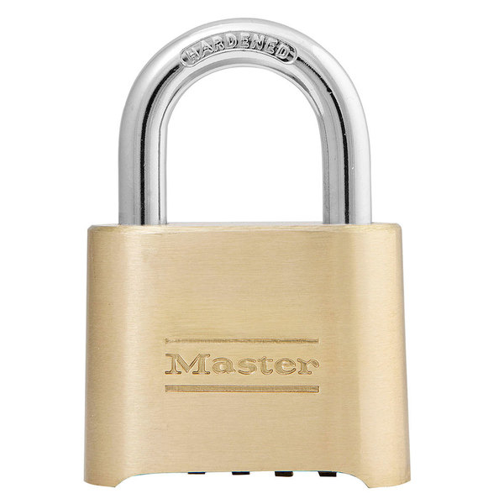
Best uses for blockchain?
3-9-2011, 10:19am: AFCU is raising mortgage rates to 3.95%
3-9-2011, 10:21am: Professor Ken borrows $5,000 at current rate
Prior Records

Slide 6
Best uses for blockchain?
If the blockchain is public, shared and tamperproof there can never be any basis for disagreement about the information.
The blockchain is publicly replicated to ensure that even the bank can’t cheat.
Cryptography prevents tampering
3-9-2011, 10:19am: CFCU is offering a special mortgage rate: 3.62%
3-9-2011, 10:19am: AFCU is raising mortgage rates to 3.95%
Prior Records

Slide 7
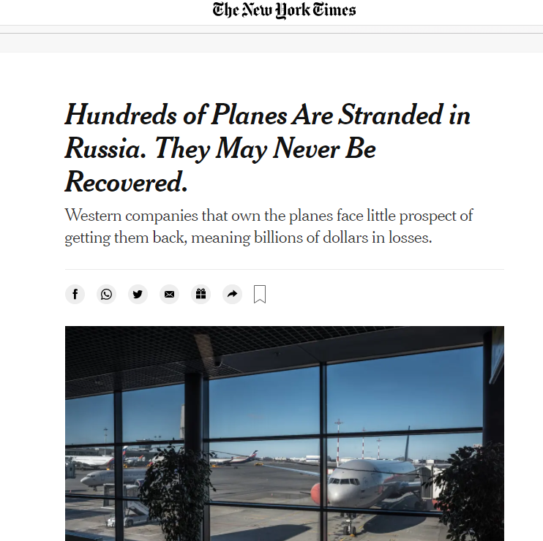
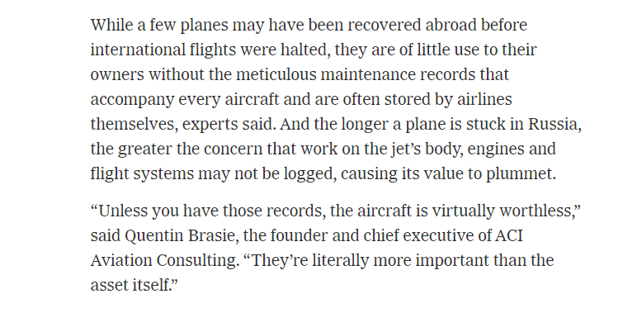
… or airplane maintenance logs

Slide 8
Terminology
In BlockChain settings, a transaction is a digital record describing some event.
Some transactions are complete and self-contained.
But BlockChain also supports transaction languages in which one transaction might refer to events defined by a past or future transaction.
Notes:
This basically says “put anything you like in the records.” In practice people often put code in the records – there are actual languages for this and you can write programs that act on data in the chain (even future data that will be added later).

Slide 9
Cryptographic Hash
A cryptographic hash is a bit string computed from some block of data in a manner that yields a constant-length result irrespective of the data size, and yet such that it would be infeasible to find other data that would hash to the same result.
There are a number of hashing schemes. A highly robust one is SHA-256. SHA-512 is even stronger. MD5 and SHA-1 have been compromised and are unsafe.
Notes:
A hash is like a random number but computed from the data. It is designed to be super hard to find other data that could give the same hash.

Slide 10
Even faster hash methods exist
(single core performance, all Golang implementations, see benchmark).
BenchmarkHighwayHash 11,986 MB/s
BenchmarkSHA256_AVX512 3,552 MB/s
BenchmarkBlake2b 972 MB/s
BenchmarkSHA1 950 MB/s (insecure)
BenchmarkMD5 684 MB/s (insecure)
BenchmarkSHA512 562 MB/s
BenchmarkSHA256 383 MB/s
Note: the AVX512 version of SHA256 uses the multi-buffer crypto library technique as developed by Intel, more details can be found in sha256-simd.
https://blog.minio.io/highwayhash-fast-hashing-at-over-10-gb-s-per-core-in-golang-fee938b5218a

Slide 11
Hardware can get even further
FPGA and ASIC solutions can be purchased that will run SHA-256 or SHA-512 at speeds of 25,000 to 30,000 MB/s
In some parts of the world there are entire datacenters equipped with huge numbers of these accelerator solutions. China dominates the business.
Very hard to be a BlockChain miner with a single desktop computer today!
Notes:
The speed of computing hashes turns out to be the key to why BlockChain is secure.

Slide 12

Cryptographic signature: encrypted hash
Given a message, anyone can compute the cryptographic hash for it
Some applications need a way to sign a document. It is
important that this kind of signature be “irrefutable”.
For this, we first compute a hash, then encrypt it in a special way so that only the signatory could encrypt it, yet anyone can decrypt and check it.

Slide 13
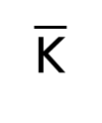
Public/Private Key Pair (normally, RSA)
This is a classic cryptographic method.
RSA creates two “keys”, both just long numbers together with a modulus n
that itself is a product of two very long prime numbers. Call them K,
One is designated as the public key and shared. You keep the other private.
RSA_{K}(RSA_{K}(X)) = RSA_{K}(RSA_{K}(X)) = X

Slide 14
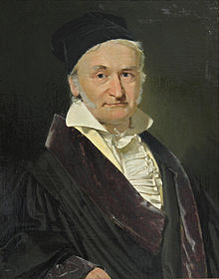
Why RSA works
In 1796, Gauss came up with the theory that ultimately gave us the (very simple) RSA technology. Gauss himself didn’t suggest this application.
In RSA encryption and decryption are just mathematical steps that involve a form of “bignum” arithmetic (modular exponentiation), performed block by block.
RSA is secret because there is no known method for factoring a giant composite number that might have 1000’s of binary digits. If we could factor the modulus, it would be trivial to recover the secret key from the public one.
Quantum computers might offer a path to doing so, but it would require devices with millions of qbits, way beyond anything feasible anytime soon.

Slide 15
RSA strengths, weaknesses
Very widely supported, basis of most “certificates” used in the Internet.
Many tricks exist, based on commutativity of RSA computation. Basically, for any two RSA keys, A and B, RSA_{A}(RSA_{B}(M)) = RSA_{B}(RSA_{A}(M)).
But RSA is fairly slow. The speed is a function of the data size. We don’t casually encrypt entire messages with RSA: it would be feasible but slow.

Slide 16
How would process P sign message M?
Compute the SHA-256 hash of M.
Now use P’s private key to encrypt the hash: SHA(M)_{private-key-of-P}
Process Q can easily verify that M has not been tampered with:
Q recomputes the SHA-256 hash for M
Now Q uses RSA with P’s public key to crypt P’s signature.
If they match, then Q has confirmed that M hasn’t changed.

Slide 17

Notarizing blinded data
There is even a method, by David Chaum, for signing an object that the signatory cannot see. It would be useful for secure voting:
Prepare your ballot, then blind it (encrypt) and obtain a signature.
The signature is proof that your vote was valid and only cast once. Submit
it for counting now, unblinded, via a secure anonymous “onion route”
The ballot itself has no identifying information, and neither does
the signature. So a third party can see that your vote is valid, and can
count it, and yet can’t learn how any particular individual voted.
Chaum also showed how to get a receipt which can be used to be sure your
vote was properly tabulated.
Notes:
This is a cool trick but maybe not totally relevant to BlockChain. Still, it turns out to be quite useful.

Slide 18
Parallelism?
A further win is to maximize parallelism and reduce record sizes.
In the case of BlockChain, each block contains a set of transactions represented as binary records. These records might be huge, hence slow to hash (and very slow to encrypt, were you to try that).
By having the creator store the record someplace reasonable and then just storing signatures in the BlockChain, we use it as efficiently as possible.

Slide 19
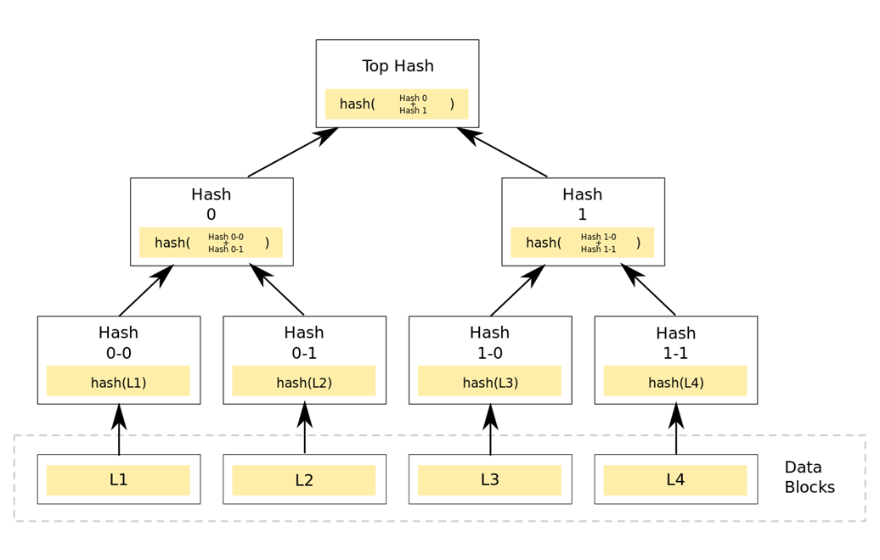
Merkle Tree: A tree of signed records.
Rather than making one list of N
records and then hashing them, we
often create a binary tree of hashes.
Very common in BlockChains, permits
us to run SHA-256 or SHA-512 in its
fastest “mode” of operation.
Often we think of the entire Block chain as a sequence of Merkle trees that change (only) by appending new subtrees (which also changes the root node)

Slide 20
This already gives us a basic solution!
Compute a series of records, each containing transactions signed by the initiator. The record needs to include the “name” of the initiator so that anyone needing to do so can look up the matching public key.
Associate each record with a key for lookup, and insert the (key,record) objects into the Merkle tree.
Then create some form of cryptographic proof that the new tree extends the prior tree. Logs are just one possible representation.

Slide 21
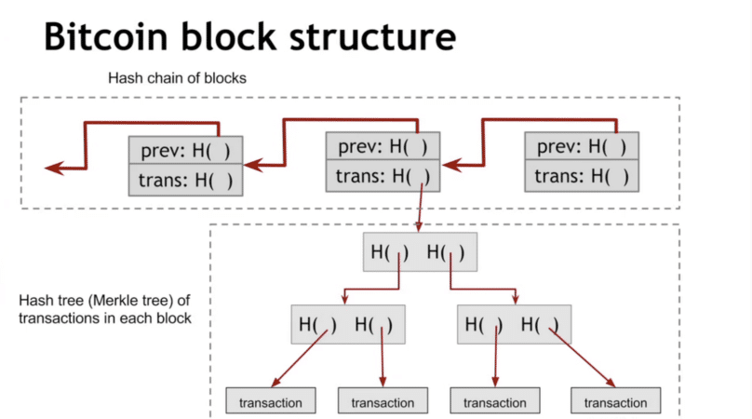
Our basic solution
https://coincentral.com/merkle-tree-hashing-blockchain/

Slide 22
Why is this secure?
If anyone tampers with any record in the chain, we can sense this by recomputing the Merkle tree. The signature won’t match.
To verify the entire chain, block by block recompute the Merkle tree, then recompute the sequence of pairwise hash values.
Verification is required when an untrusted BlockChain is initially loaded.
Notes:
The whole point is that because so many nodes have copies of the chain, and wouldn’t even consider new versions of past records, anyone can “verify” the chain by just tracking it and in the limit, maybe pulling duplicate copies from a few neighbors. If someone tries to change a record the chain breaks. And nobody can introduce a fake “complete” chain because everyone would notice.

Slide 23
Permissioned/Permissionless
BlockChain solutions split into two categories.
A permissioned BlockChain is managed by an authorized group of servers, which could be geodistributed or inside some datacenter. We generally assume that they don’t have true Byzantine faults.
A permissionless BlockChain is managed by an anonymous group of servers that volunteer to play the role, and might come and go at will.
Notes:
Permissioned systems are like normal servers, maybe a file server or a blob server. Any cloud vendor could offer this by saying “we have append-only logs, and we offer a form of mirroring and cryptographic protection across our WAN”. Many do.
Permissionless is a fully replicated worldwide system that everyone shares. This is what BitCoin uses.

Slide 24
… and two more sub-cases for the permissioned case
Permissioned blockchains can arise in two settings.
In a data center, just use Paxos plus logic to compute the needed
cryptographic signature chain. WAN mirrors protect against attempts
to compromise the whole data center and rewrite the whole log.
At geoscale, a permissioned blockchain just means the miners get an
authorization to mine – it can be withdrawn if they misbehave.
When people say “permissioned blockchain” they normally mean “in a wide-area environment, with Byzantine behavior controlled by the permissioning key-management technique.”

Slide 25
Attacks are an issue!
Wide-area replicated BlockChains can come under many forms of attack.
Compromised server might try to hand out “fake” versions of the chain.
It might try to generate huge rates of transactions on its own, and not
include your transactions. This is a form of DDoS attack.
It could try to corrupt individual transactions or records.
Notes:
With a global community sharing something, people will attack it – guaranteed. You wouldn’t see that in a permissioned system, but of course then you need to trust the operator, like Amazon or Microsoft or JP Morgan Bank.

Slide 26
Proof Of Work
A Proof of Work mechanism adds one more field to the blocks: a “nonce”.
The nonce is just a bit string of some size.
The rule is that to append B_{k+1} to the chain, in addition to hashing it with the hash of the prior block, P must also find a nonce such that when the nonce is included and a new hash is computed, the hash value ends with some desired number of 0 bits.
Notes:
To protect against attack, we make attacking costly and slow. Proof of work is to play that role in the permissionless case. We don’t need it for a permissioned system because a bank’s software won’t attack the bank’s own permissioned services.

Slide 27
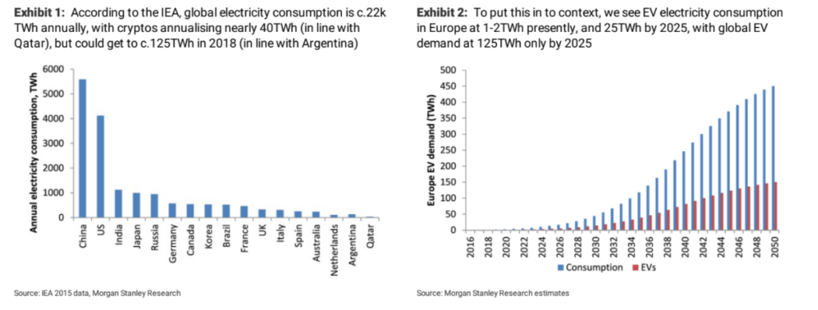
Proof of work
Finding such a nonce is hard work!
So while P could be keen to append its block, it may need to search for this nonce for many seconds or minutes.
The difficulty of finding a nonce value that will work prevents DDoS attacks.

Slide 28
… other ideas have been tried, but are not very successful
For example, proof of “stake” centers on the idea of doing mining in a way that favors wealthy miners who can prove they are big players.
The “stake” is like a printout of a bank account. “I own fifty buildings in New York City, seven golf courses, a hotel chain… I mined more blocks that Bill Gates and Jeff Bezos combined. I am “Mr. Big.” So. you can trust me to mine blockchain blocks (and to keep all my profits from doing that”).
Not very democratic. And so, not very popular!

Slide 29
How most BlockChains Work today
You can download the software as a VM or even compile it yourself.
You launch the code on your own servers – this makes you a “miner” as soon as the system has initialized itself.
The system downloads the entire current BlockChain, from other machines already running the BlockChain software (there is a web site listing some you can contact for copies).
Notes:
Again, this is the permissionless case.

Slide 30

Aside: Why the whole tree?
There is a lot of research (meaning, a huge amount) on ways to download and verify just a portion of the blockchain. None is really secure, yet.
In some settings this is going to be absolutely obligatory, but right now it isn’t how the big public blockchains work.
The most promising approaches provide “countersignatures” for the portion you want, provided by authorities you happen to trust.

Slide 31
Next, you verify the BlockChain
You’ll need to recompute all the Merkle trees and the chain of hashes.
In fact this may not take enormously long… today. Few BlockChains have huge amounts of content.
But someday, we might have BlockChains with hundreds of billions of records and total sizes in the petabytes. Then download speed and verification time and storage will become an issue!

Slide 32
Meanwhile, new blocks arrive
Each block extends some specific sequence of prior blocks.
If you turn out to have downloaded the wrong sequence, you may have to truncate your chain and download the longer sequence.
This is a “rollback”. During startup, substantial rollbacks can occur. Later they shouldn’t (assumes a fully connected network of mostly “correct” miners).

Slide 33
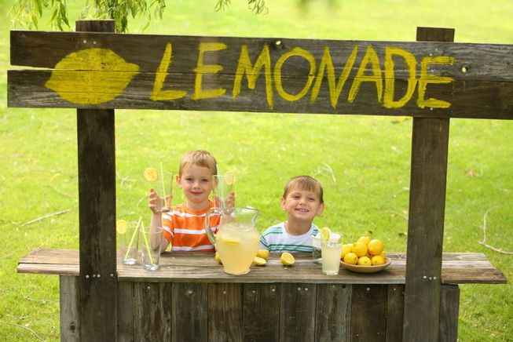
At this point you can create transactions
So, you open for business.
Someone shows up to buy a glass of your fresh lemonade.
You’ll generate the transaction (think “credit card payment slip”) and submit it to the system. It enters a pool of pending transactions.

Slide 34

When will your transaction go through?
Within an hour or so, you should see that your transaction got included into some block, and also that everyone seems to have adopted that block.
The chain has moved six or more blocks into the future.
So now you can hand that glass of frosty bliss to your happy customer!

Slide 35
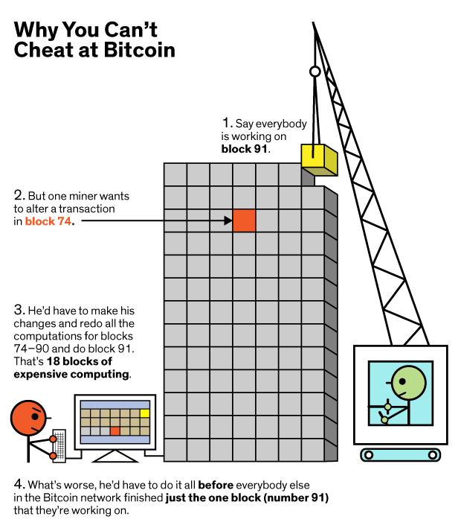
But nobody can cheat!
To modify a past record you
need to also modify every
signature subsequent to that
record.
The step where you have to find
these nonce values will be very
slow and you’ll lose the race.
https://medium.com/loom-network/

Slide 36
What if the attacker is a country?
A country could build whole datacenters, equipped with hardware to compute SHA-256 at ultra-high speeds.
In this case P (using the datacenter) could generate a lot of blocks quickly, for which they would be paid. Or could have an entire second BlockChain starting from months ago, and longer than the official main one.
To prevent most such attacks, BlockChain solutions make the proof-of-work task harder as a function of the rate at which blocks are being found.

Slide 37
What if the attacker is a country?
In effect, if P controls enough computing power, he can “gain control” of the BlockChain. The proof-of-work can become so hard that only P has the compute power to solve the puzzle!
P could then refuse to post some transactions, or cause trouble in other ways.
But this form of attack has not (yet) been seen.

Slide 38
What about races?
Permissionless BlockChains are at risk of a “race” situation in which one group of miners is working to append record R, and some other group, record S. A tie can easily occur.
BlockChain systems “adopt the longest chain” (may the best miners win). This can cause a rollback if a few blocks were appended by group A, but then group B suddenly publishes a longer extension.
In practice, rollbacks longer than 6 blocks are never observed.
Notes:
This kind of race involves just the last few blocks on the chain and causes a transient “fork” where one sequence will ultimately win and the other will eventually be forgotten. This is what happened during the one hour wait.

Slide 39
In contrast, Permissioned BlockChain doesn’t need Proof of work
A permissioned system is operated by known, trusted, authorized servers.
They won’t attack the chain by trying to overload it with transactions in an unfair way, and they would charge for any transactions they append on behalf of external clients.
So we can avoid this costly step with datacenter BlockChain solutions.

Slide 40
What if you don’t really trust the permissioned provider?
We can mix methods: a global “proof” with a local “data store”
Our permissioned provider can commit to some form of cryptographic root of each new version of the log (or tree), and to a proof that the new version extends the old version.
The “commit” is broadly shared and pins the provide down. Then for an append or a query, the provider can be asked to also provide a proof that they did the append, or that the query response is correct & complete

Slide 41

What’s In a Transaction?
Some BlockChain systems are very rigid. For example, a BitCoin BlockChain record can only support a few operations on BitCoins.
These represent transactions: Ken sells Ittay a packet of gum for 10
In a permissionless scheme, Ken would probably wait for a while before handing the gum to Ittay. With permissions, rollback risk can be reduced or even completely eliminated.

Slide 42
Fancier Transactions
There are several standards for encoding fancier “digital contracts” into records suitable for BlockChain.
One, called HyperLedger, uses HTML as its underlying “language”.
A second, Ethereum, has a sophisticated language of its own, and can even encode computational tasks into the transaction record.

Slide 43
One issue: Validation
In existing blockchain systems, every participant maintains a replica of the entire blockchain.
But as blockchains grow, this could become unworkable. A blockchain might be hundreds of gigabytes long… users will want to download portions
If a user only downloads the record they are seeking, how can the system validate that the entire chain is intact and properly signed?

Slide 44
More Issues
With permissionless BlockChain, is it really “safe” to trust that after six blocks have been appended, the chain won’t roll back and invalidate my transaction? (“When should Ken give the lemonade to Sally?”)
If a smart contract references future events, what would be the “semantics” of that contract, in a PL sense? Does the meaning depend on waiting for the future to occur? Can chains of dependencies arise, or contracts that are undecidable, or infeasibly complex to “evaluate”?

Slide 45
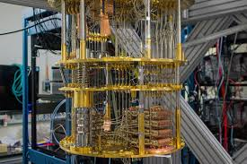
A really big issue
Quantum computers are advancing rapidly.
But many blockchains use cryptographic techniques known to be at risk if practical quantum computers emerge and can deal with really large quantum computations (on “bignum” numbers with thousands of digits).
People are asking: Is this becoming a real risk?

Slide 46
Will Quantum Computing break cryptography?
Which is closer to the truth?
A quantum computer can make non-deterministic guesses, check to see
if any are right (like guessing the factors of an RSA key), and then
output the correct one.
A quantum computer can compute a near-infinite number of discrete
fourier transforms “concurrently”, but you can only read out one data-
point of the result at a time.

Slide 47
Public Misunderstanding
Popularity of the “many worlds” interpretation of physics has clouded the public conception of what a quantum computer can do!
In fact many worlds could be a valid model, for the most elementary level of Planck-scale physics (the layer where people talk about mbranes and string theory, and loop-quantum gravity).
But our macroscopic (“causally emergent”) world is very remote from that most basic layer of physical reality.

Slide 48
Shor’s Algorithm
To factor RSA, Shor’s algorithm requires a special circuit specific to the size of the keys.
Then we input “all possible” n-bit integers, where n is the key length, like 1024. This involves a “coherent entanglement” of n qbits. But due to errors, qbits rapidly decohere. Error correction will require vastly more qbits, and nobody is sure how many. Perhaps millions or billions.]
The entangled data is then transformed by the circuit, which computes a DFFT

Slide 49
Reading the output
You read the output of a quantum computer by setting up the experiment again and again and then repeatedly extracting a single sample.
Over time, the values you read build up to a kind of probability density image, like a photo created pixel by pixel.
In the case of Shor’s algorithm this photo shows peaks that hint at the values of the factors. Now you can search for the factors close to those peaks. Quality of the search will depend on the sharpness of the peaks.

Slide 50
A lot of assumptions!
Nobody knows how quantum error correction “scales”. Today it works for 3 to 5 q-bit entanglements, at best.
Nobody knows how complex a computation we can perform without destroying coherence. In fact these quantum DFFT operations must be reversible in order to remain coherent, and hence perfectly precise.
Nobody knows how quickly we can set up such a run and sample it.
Nobody knows how sharp the peaks will need to be as a function of key length.

Slide 51
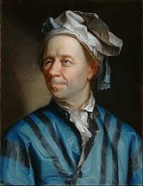
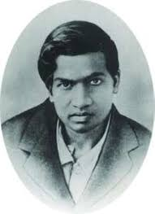
And worst of all…
Unfortunately, neither Euler nor Ramanujan really looked closely at this question!
Nobody knows if factoring large numbers is even a “hard” problem!
True, we lack a fast solution today. But the complexity of factoring is unknown.
But perhaps some numerical savant will find a solution… with classical computers! The same goes for finding a nonce with the desired hashing properties to mine blocks…

Slide 52

The entire Edifice could collapse!
If you bet heavily on BlockChain,
you are betting that people will
figure out a way to ensure that
it won’t yield to some kind of attack.
But in fact this is just a bet, today.

Slide 53
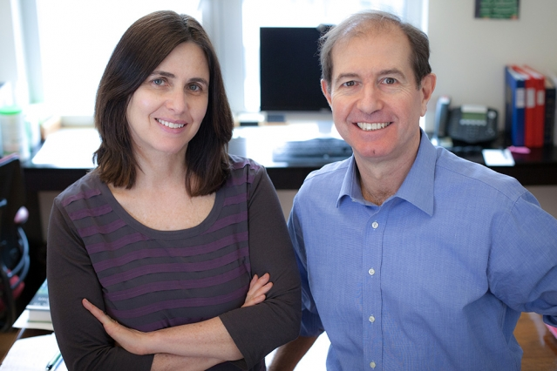
Provably secure systems
There is a theory of semantic cryptography safe against quantum attacks. It was developed by Goldwasser and Micali, who won the Turing Award for the insight.
They proved that secure encryption schemes must be probabilistic, rather than deterministic, with many possible encrypted texts corresponding to each message.
The Goldwasser–Micali (GM) lattice cryptosystem demonstrates the idea.

Slide 54
Could a BlockChain Use Lattice Cryptographic techniques?
At present, lattice cryptography is too computationally slow for practical use, and also causes too much “inflation” in the size of data.
Each bit in the data becomes a point in a very high dimensional space, leading to a billions-to-one increase in message sizes.
But continued research may yield much more compact solutions with the same properties. A new research initiative just started on this topic.
Notes:
Someday we may all have to switch to lattice cryptography, but not yet.

