Slide 1
CS5412 / Lecture 12: Gossip Protocols
Ken Birman
Spring, 2022
Lecture V

Slide 2
Building scalable infrastructures
Within a cloud computing environment we often need to manage very large pools of computers or services.
What is the best way to monitor and manage this kind of deployment?
In lectures 11 and 12 we will discuss the concept of using “gossip” as the basis for an unusually scalable style of solution. Amazon uses it in S3!

Slide 3


Gossip is used in Blockchain!
Hard to deny that Blockchain is big business!
Gossip is used to distribute updates in permissionless blockchain, where the participants are anonymous but might not be cooperating
Gossip makes it is very hard for attackers to disrupt updates.

Slide 4


Byzantine participants
Blockchain must tolerate (a few) Byzantine participants.
They seek to damage or disrupt the chain or to favor or delay transactions from certain parties, attempt to DDoS links, etc.
Even a Byzantine participant can’t modify or forge messages: messages are cryptographically signed.
Byzantine participant

Slide 5
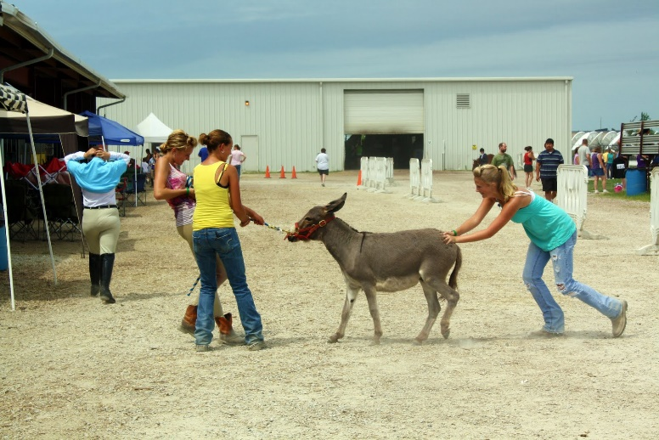



Gossip 101
Push-Pull in Action!
Suppose that Anne tells me something.
I’m sitting next to Fred, and I tell him
Later, he tells Mimi and I tell Frank
Each round doubles the number of people who know the secret.
This is an example of a push epidemic
Push-pull occurs if we exchange data
Not cooperating

Slide 6
Push/Pull gossip
Push-Pull in Action!
Combines push and pull, but requires an RPC-style of interaction:
Process P decides to gossip with process Q
P sends Q some form of concise “digest” of information available.
Q sends back its own digest, plus a list of items it wants from P.
P responds by sending those items, plus a list of items it wants from Q.
Q sends the requested items.
This avoids sending large duplicate objects

Slide 7
Each message is treated separately
We send requests but don’t actually “wait” for a response
This way if our peer turns out to be faulty or uncooperative, nothing bad can happen – we sent a first stage push-pull message but got not reply and don’t have any associated state that lingers, etc
If it works, great. If not, well, the next message will go to someone else.

Slide 8
Limited work per round
Think about maximum size gossip messages – there is always a limit.
All of these patterns have a fixed maximum number of messages that will be sent and received.
So, each process has a limit on how many bytes it will need to send for each gossip round.

Slide 9
Reasonable network assumptions
Gossip doesn’t assume all-to-all connectivity: outside the datacenter we often see more of a graph of peering connections.
Instead, we tend to assume an “expander” graph: every node is reachable from every other node within O(log(N)) hops. We also assume that the network is robust to link failures or Byzantine DDoS attack.
These are considered to be very practical, reasonable assumptions

Slide 10
Size constraint
For gossip to really have constant cost at each participant, we need to decide on a maximum message size.
Messages can grow to that maximum, but not beyond
But with unlimited numbers of processes, even if the events we gossip about are rare, the amount of information to share could grow as O(N)

Slide 11
Tricks for limiting message size
Many systems only gossip about “recent” information.
The theory is that older data is probably stale or wrong in any case.
Then the issue is “how many events can happen in Δ time?” This may be more manageable

Slide 12

Gossip scales very nicely but pure push or pure pull isn’t ideal
“Reinfection” eventually becomes dominant
Pure push case: Needs a long time to reach the last few processes
1.0
Participant load is constant, independent of size of the system.
Total network load linear in system size.
Information spreads in log(N) time, yet that limit on work per process remains in effect!
% infected
0.0
Time →

Slide 13
Gossip with push-pull is best
Push-Pull Terminates quickly and reaches every non-faulty process
1.0
Participant load is constant, independent of size of the system.
Total network load linear in system size.
Information spreads in log(N) time, yet that limit on work per process remains in effect!
% infected
0.0
Time →

Slide 14
One smallish risk
What if everyone decides to gossip to the same process all at once?
Selection of the target is random… it could happen.
But it is very unlikely and in fact the receiver could just ignore some messages. Gossip doesn’t require reliable messaging.

Slide 15
Gossip in distributed systems
We can even gossip about membership
Need a bootstrap mechanism, but then discuss failures, new members
This feature is not used in permissionless blockchain, but it is used in permissioned blockchain. In fact this is what distinguishes those models.
Gossip to repair faults in replicated data
“I have 6 updates from Charlie”
If we aren’t in a hurry, gossip to replicate data too

Slide 16
Why “if we aren’t in a hurry?”
Gossip is very robust, but log(N) time might not be fast.
Normally we run one round every second or so.
A data center with 100,000 computers would have log(N) = 17, so when something important happens, it would take 17 seconds to reach all nodes.
Size limit of messages can also be an issue

Slide 17
What if we actually are in a hurry?
One option is to mix gossip with a second mechanism.
UDP multicast can be useful here. This is an old and not-often used feature of the Internet UDP protocol (user datagram protocol, sometimes called “unreliable datagrams” to contrast with TCP).
Instead of having just one server for each IP address, UDP datagrams allow multiple servers to attach to the same shared IP address
With this feature, the UDP multicast will go to all receivers

Slide 18
Some warnings…
Many datacenters disable the router feature UDP multicast requires.
If they do this, it won’t work even though Linux might allow you to bind to that shared class-D multicast IP address, and to send to it – the messages just won’t reach other machines.
Also, because UDP multicast isn’t reliable, some receivers could receive the message, but others might drop it – silently. No retransmissions occur.

Slide 19
Bimodal Multicast
This was a protocol that uses UDP multicast as a first step, then “fills any gaps” using gossip.
Cool trick: If some node is asked to share the same message twice via gossip, instead it resends the UDP multicast. That way if a few processes seem to have missed some message, it gets retransmitted soon.
We get two delivery delay “curves”: one for UDP multicast, the second for gossip to fill the tiny number of remaining gaps.

Slide 20
A bimodal Delivery curve
In this picture, 99.9% of the messages are received via UDP multicast. So in a datacenter with 100,000 machines, only 100 or so miss it.
But then the gossip spread could be a bit slow
Gossip kicks in but takes time to fill the gaps
Percent infected
Time →

Slide 21
A bimodal Delivery curve
With a second UDP multicast, our curve looks much better!
Gossip kicks in, then a second UDP multicast occurs, and this leaves just a few stagglers
Percent infected
Maybe this guy is badly overloaded, or had a broken link, or was rebooting…
Time →

Slide 22
Is gossip atomic multicast?
Not really. It lacks a total order guarantee.
But some systems add a timestamp and deliver multicasts in timestamp order, breaking ties using the IP address of the senders.
At time τ, they have some estimated δ such that no messages are expected with timestamp ≤ τ-δ (if one were to turn up, they would silently discard it). When messages become “stable” in this sense, they deliver them.

Slide 23
Stragglers can miss messages
A machine that ran very slow for a while and missed messages will see them via gossip, but it may be too late to deliver them in correct order.
In effect, a mistake was already made and it is too late to fix it.
So… bimodal multicast can approximate atomic multicast, but only to some probabilistic limit. It won’t (can’t) be flawless.

Slide 24
Gossip about membership
Start with a bootstrap protocol
For example, processes go to some web site. On it they find a dozen nodes where the system has been stable for a long time
Pick one at random
It sends back a membership list. Now your node is up and running!
Then track “processes I’ve heard from recently” and “processes other nodes have heard from recently”
Generally, use push gossip to spread the word

Slide 25
Example: The Kelips DHT
The goal is similar to the goal for any DHT: Support put and get. Kelips does this entirely using gossip!
It ends up being very robust, but a bit slow – we don’t really use Kelips, but it does illustrate how gossip can let us build sophisticated data structures that “feel” like things where consensus would normally be used!
Note: Kelips does not support the “versioned” style of put. In fact with gossip, that type of functionality (“compare and swap”) is hard!

Slide 26
Main assumptions
Kelips was created for wide-area computing.
No node is sure who else is running the protocol, although there is a way to send messages to random other nodes.

Slide 27
Kelips in pictures
110 knows about other members – 230, 30…
Affinity Groups:
peer membership thru consistent hash
Affinity group view
id | hbeat | rtt
30 | 234 | 90ms
230 | 322 | 30ms
0
1
2
N
−
1
110
230
202
N
members per affinity group
30
Affinity group pointers

Slide 28
Kelips
202 is a “contact” for 110 in group 2
Affinity Groups:
peer membership thru consistent hash
Affinity group view
id | hbeat | rtt
30 | 234 | 90ms
230 | 322 | 30ms
0
1
2
N
−
1
110
Contacts
230
202
N
members per affinity group
group | contactNode
… | …
2 | 202
30
Contact pointers

Slide 29
Kelips
“cnn.com” maps to group 2. So 110 tells group 2 to “route” inquiries about cnn.com to it.
Affinity Groups:
peer membership thru consistent hash
Affinity group view
id | hbeat | rtt
30 | 234 | 90ms
230 | 322 | 30ms
0
1
2
N
−
1
110
Contacts
N
230
202
members per affinity group
group | contactNode
… | …
2 | 202
30
Resource Tuples
Gossip protocol replicates data cheaply
resource | info
… | …
cnn.com | 110

Slide 30
How it works
Kelips is entirely gossip based!
Gossip about membership
Gossip to replicate and repair data
Gossip about “last heard from” time used to discard failed nodes
Gossip “channel” uses fixed bandwidth
… fixed rate, packets of limited size

Slide 31
So, how does it work?
Affinity Groups:
peer membership thru consistent hash
Affinity group view
id | hbeat | rtt
30 | 234 | 90ms
230 | 322 | 30ms
0
1
2
N
−
1
110
Contacts
N
230
202
members per affinity group
group | contactNode
… | …
2 | 202
30
Contact pointers

Slide 32
How Kelips works
Node 175 is a contact for Node 102 in some affinity group
175
Hmm…Node 19 looks like a much better contact in affinity group 2
RTT: 235ms
Node 102
19
RTT: 6 ms
Gossip data stream
Gossip about everything
Heuristic to pick contacts: periodically ping contacts to check liveness, RTT… swap so-so ones for better ones.

Slide 33
Replication makes it robust
Kelips should work even during disruptive episodes
After all, tuples are replicated to √N nodes
Query k nodes concurrently to overcome isolated crashes, also reduces risk that very recent data could be missed
… we often overlook importance of showing that systems work while recovering from a disruption

Slide 34
Interesting things about Kelips
The actual DHT is not really “encoded” anywhere.
Instead, Kelips emerges from the mix of gossip and the hashing rule.
If all nodes have the same value of then Kelip will be “self-stabilizing”
They do have the same value for N because they gossip about membership!
N

Slide 35
Who uses Kelips?
Nobody!
In a datacenter we generally can track membership with perfect accuracy. We can then create a DHT just using hashing.
Kelips only makes sense if nodes don’t know the list of members.

Slide 36
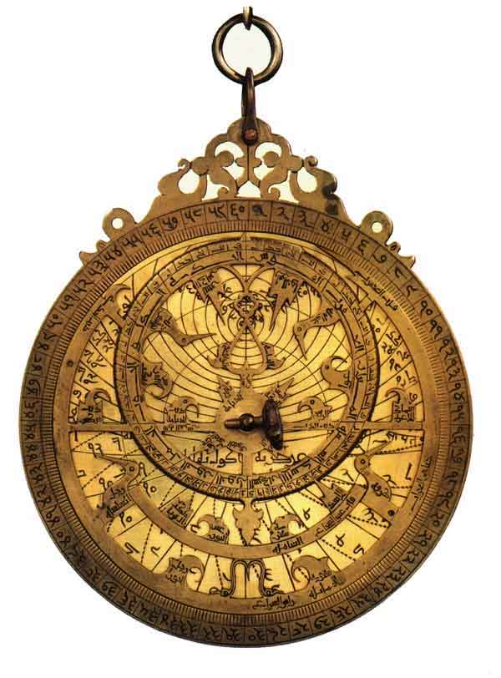

Astrolabe
Intended as help for applications adrift in a sea of information
Structure emerges from a randomized gossip protocol
An actual Astrolabe

Slide 37
Astrolabe is a flexible monitoring overlay
Name | Time | Load | Weblogic? | SMTP? | Word Version
swift | 2011 | 2.0 | 0 | 1 | 6.2
falcon | 1971 | 1.5 | 1 | 0 | 4.1
cardinal | 2004 | 4.5 | 1 | 0 | 6.0
Name | Time | Load | Weblogic? | SMTP? | Word Version
swift | 2271 | 1.8 | 0 | 1 | 6.2
falcon | 1971 | 1.5 | 1 | 0 | 4.1
cardinal | 2004 | 4.5 | 1 | 0 | 6.0
swift.cs.cornell.edu
Periodically, pull data from monitored systems

Slide 38

Astrolabe is a flexible monitoring overlay
Name | Time | Load | Weblogic? | SMTP? | Word Version
swift | 2011 | 2.0 | 0 | 1 | 6.2
falcon | 1971 | 1.5 | 1 | 0 | 4.1
cardinal | 2004 | 4.5 | 1 | 0 | 6.0
Name | Time | Load | Weblogic? | SMTP? | Word Version
swift | 2271 | 1.8 | 0 | 1 | 6.2
falcon | 1971 | 1.5 | 1 | 0 | 4.1
cardinal | 2004 | 4.5 | 1 | 0 | 6.0
swift.cs.cornell.edu
Periodically, pull data from monitored systems
Name | Time | Load | Weblogic? | SMTP? | Word Version
swift | 2003 | .67 | 0 | 1 | 6.2
falcon | 1976 | 2.7 | 1 | 0 | 4.1
cardinal | 2201 | 3.5 | 1 | 1 | 6.0
Name | Time | Load | Weblogic? | SMTP? | Word Version
swift | 2003 | .67 | 0 | 1 | 6.2
falcon | 1976 | 2.7 | 1 | 0 | 4.1
cardinal | 2231 | 1.7 | 1 | 1 | 6.0
cardinal.cs.cornell.edu

Slide 39
Astrolabe in a single domain
Each node owns a single tuple, like the management information base (MIB)
Nodes discover one-another through a simple broadcast scheme (“anyone out there?”) and gossip about membership
Nodes also keep replicas of one-another’s rows
Periodically (uniformly at random) merge your state with some else…

Slide 40
State Merge: Core of Astrolabe epidemic
Name | Time | Load | Weblogic? | SMTP? | Word Version
swift | 2011 | 2.0 | 0 | 1 | 6.2
falcon | 1971 | 1.5 | 1 | 0 | 4.1
cardinal | 2004 | 4.5 | 1 | 0 | 6.0
swift.cs.cornell.edu
Name | Time | Load | Weblogic? | SMTP? | Word Version
swift | 2003 | .67 | 0 | 1 | 6.2
falcon | 1976 | 2.7 | 1 | 0 | 4.1
cardinal | 2201 | 3.5 | 1 | 1 | 6.0
cardinal.cs.cornell.edu

Slide 41
State Merge: Core of Astrolabe epidemic
Name | Time | Load | Weblogic? | SMTP? | Word Version
swift | 2011 | 2.0 | 0 | 1 | 6.2
falcon | 1971 | 1.5 | 1 | 0 | 4.1
cardinal | 2004 | 4.5 | 1 | 0 | 6.0
swift.cs.cornell.edu
swift | 2011 | 2.0
cardinal | 2201 | 3.5
Name | Time | Load | Weblogic? | SMTP? | Word Version
swift | 2003 | .67 | 0 | 1 | 6.2
falcon | 1976 | 2.7 | 1 | 0 | 4.1
cardinal | 2201 | 3.5 | 1 | 1 | 6.0
cardinal.cs.cornell.edu

Slide 42
State Merge: Core of Astrolabe epidemic
Name | Time | Load | Weblogic? | SMTP? | Word Version
swift | 2011 | 2.0 | 0 | 1 | 6.2
falcon | 1971 | 1.5 | 1 | 0 | 4.1
cardinal | 2201 | 3.5 | 1 | 0 | 6.0
swift.cs.cornell.edu
Name | Time | Load | Weblogic? | SMTP? | Word Version
swift | 2011 | 2.0 | 0 | 1 | 6.2
falcon | 1976 | 2.7 | 1 | 0 | 4.1
cardinal | 2201 | 3.5 | 1 | 1 | 6.0
cardinal.cs.cornell.edu

Slide 43
Observations
Merge protocol has constant cost
One message sent, received (on avg) per unit time.
The data changes slowly, so no need to run it quickly – we usually run it every five seconds or so
Information spreads in O(log N) time
But this assumes bounded region size
In Astrolabe, we limit them to 50-100 rows

Slide 44
Big systems…
A big system could have many regions
Looks like a pile of spreadsheets
A node only replicates data from its neighbors within its own region

Slide 45
Scaling up… and up…
With a stack of domains, we don’t want every system to “see” every domain
Cost would be huge
So instead, we’ll see a summary
Name | Time | Load | Weblogic? | SMTP? | Word Version
swift | 2011 | 2.0 | 0 | 1 | 6.2
falcon | 1976 | 2.7 | 1 | 0 | 4.1
cardinal | 2201 | 3.5 | 1 | 1 | 6.0
Name | Time | Load | Weblogic? | SMTP? | Word Version
swift | 2011 | 2.0 | 0 | 1 | 6.2
falcon | 1976 | 2.7 | 1 | 0 | 4.1
cardinal | 2201 | 3.5 | 1 | 1 | 6.0
Name | Time | Load | Weblogic? | SMTP? | Word Version
swift | 2011 | 2.0 | 0 | 1 | 6.2
falcon | 1976 | 2.7 | 1 | 0 | 4.1
cardinal | 2201 | 3.5 | 1 | 1 | 6.0
Name | Time | Load | Weblogic? | SMTP? | Word Version
swift | 2011 | 2.0 | 0 | 1 | 6.2
falcon | 1976 | 2.7 | 1 | 0 | 4.1
cardinal | 2201 | 3.5 | 1 | 1 | 6.0
Name | Time | Load | Weblogic? | SMTP? | Word Version
swift | 2011 | 2.0 | 0 | 1 | 6.2
falcon | 1976 | 2.7 | 1 | 0 | 4.1
cardinal | 2201 | 3.5 | 1 | 1 | 6.0
Name | Time | Load | Weblogic? | SMTP? | Word Version
swift | 2011 | 2.0 | 0 | 1 | 6.2
falcon | 1976 | 2.7 | 1 | 0 | 4.1
cardinal | 2201 | 3.5 | 1 | 1 | 6.0
Name | Time | Load | Weblogic? | SMTP? | Word Version
swift | 2011 | 2.0 | 0 | 1 | 6.2
falcon | 1976 | 2.7 | 1 | 0 | 4.1
cardinal | 2201 | 3.5 | 1 | 1 | 6.0
cardinal.cs.cornell.edu

Slide 46
Astrolabe builds a hierarchy without any servers
Dynamically changing query output is visible system-wide
SQL query “summarizes” data
Name | Avg Load | WL contact | SMTP contact
SF | 2.6 | 123.45.61.3 | 123.45.61.17
NJ | 1.8 | 127.16.77.6 | 127.16.77.11
Paris | 3.1 | 14.66.71.8 | 14.66.71.12
Name | Avg Load | WL contact | SMTP contact
SF | 2.6 | 123.45.61.3 | 123.45.61.17
NJ | 1.8 | 127.16.77.6 | 127.16.77.11
Paris | 3.1 | 14.66.71.8 | 14.66.71.12
Name | Avg Load | WL contact | SMTP contact
SF | 2.2 | 123.45.61.3 | 123.45.61.17
NJ | 1.6 | 127.16.77.6 | 127.16.77.11
Paris | 2.7 | 14.66.71.8 | 14.66.71.12
Name | Load | Weblogic? | SMTP? | Word Version | …
swift | 2.0 | 0 | 1 | 6.2
falcon | 1.5 | 1 | 0 | 4.1
cardinal | 4.5 | 1 | 0 | 6.0
Name | Load | Weblogic? | SMTP? | Word Version | …
swift | 2.0 | 0 | 1 | 6.2
falcon | 1.5 | 1 | 0 | 4.1
cardinal | 4.5 | 1 | 0 | 6.0
Name | Load | Weblogic? | SMTP? | Word Version | …
swift | 1.7 | 0 | 1 | 6.2
falcon | 2.1 | 1 | 0 | 4.1
cardinal | 3.9 | 1 | 0 | 6.0
Name | Load | Weblogic? | SMTP? | Word Version | …
gazelle | 1.7 | 0 | 0 | 4.5
zebra | 3.2 | 0 | 1 | 6.2
gnu | .5 | 1 | 0 | 6.2
Name | Load | Weblogic? | SMTP? | Word Version | …
gazelle | 1.7 | 0 | 0 | 4.5
zebra | 3.2 | 0 | 1 | 6.2
gnu | .5 | 1 | 0 | 6.2
Name | Load | Weblogic? | SMTP? | Word Version | …
gazelle | 4.1 | 0 | 0 | 4.5
zebra | 0.9 | 0 | 1 | 6.2
gnu | 2.2 | 1 | 0 | 6.2
San Francisco
New Jersey

Slide 47
Large scale: “virtual” regions
These are
Computed by queries that summarize a whole region as a single row
Gossiped in a read-only manner within a leaf region
But who runs the gossip?
Each region elects “k” members to run gossip at the next level up.
Can play with selection criteria and “k”

Slide 48
Hierarchy is virtual… data is replicated
Blue leaf node “sees” its neighbors and the domains on the path to the root.
Name | Avg Load | WL contact | SMTP contact
SF | 2.6 | 123.45.61.3 | 123.45.61.17
NJ | 1.8 | 127.16.77.6 | 127.16.77.11
Paris | 3.1 | 14.66.71.8 | 14.66.71.12
Gnu runs level 2 epidemic because it has lowest load
Falcon runs level 2 epidemic because it has lowest load
Name | Load | Weblogic? | SMTP? | Word Version | …
swift | 2.0 | 0 | 1 | 6.2
falcon | 1.5 | 1 | 0 | 4.1
cardinal | 4.5 | 1 | 0 | 6.0
Name | Load | Weblogic? | SMTP? | Word Version | …
gazelle | 1.7 | 0 | 0 | 4.5
zebra | 3.2 | 0 | 1 | 6.2
gnu | .5 | 1 | 0 | 6.2
San Francisco
New Jersey

Slide 49
Hierarchy is virtual… data is replicated
Green node sees different leaf domain but has a consistent view of the inner domain
Name | Avg Load | WL contact | SMTP contact
SF | 2.6 | 123.45.61.3 | 123.45.61.17
NJ | 1.8 | 127.16.77.6 | 127.16.77.11
Paris | 3.1 | 14.66.71.8 | 14.66.71.12
Name | Load | Weblogic? | SMTP? | Word Version | …
swift | 2.0 | 0 | 1 | 6.2
falcon | 1.5 | 1 | 0 | 4.1
cardinal | 4.5 | 1 | 0 | 6.0
Name | Load | Weblogic? | SMTP? | Word Version | …
gazelle | 1.7 | 0 | 0 | 4.5
zebra | 3.2 | 0 | 1 | 6.2
gnu | .5 | 1 | 0 | 6.2
San Francisco
New Jersey

Slide 50
Worst case load?
A small number of nodes end up participating in O(log_{fanout}N) epidemics
Here the fanout is something like 50
In each epidemic, a message is sent and received roughly every 5 seconds
We limit message size so even during periods of turbulence, no message can become huge.

Slide 51
Criticism of Astrolabe
Uses complained that Astrolabe didn’t feel natural.
People expect a database, not a distributed query system. However, they do like the idea of dynamically searching for the root cause of a problem.
Gossip is slow, and management systems may need to react quickly. So if they do use Astrolabe, they might ask for a feature like the bimodal multicast UDP “acceleration”, which can speed things up when events occur.

Slide 52
Who uses Astrolabe?
When Werner Vogels joined Amazon, they adopted Astrolabe inside the S3 storage system.
It evolved substantially over time, but the gossip pattern was retained.
Today, many management systems use ideas similar to these, but the Astrolabe hierarchical approach is not currently seen even at Amazon.

Slide 53


Blockchains
Created as a joke but by now has a $29BUS market value. Pronounced “doge” not “doggy”
Blockchains have emerged as a new application for gossip, but in wide-area settings – not inside datacenters.
The area was pioneered by Bitcoin, the cryptocurrency.
Bitcoin is defined over an append-only tamperproof log (like Paxos!). A gossip protocol is used to share proposed updates robustly.

Slide 54
… we won’t dive into Blockchain today
The Bitcoin log is a bit complicated because of the cryptographic model.
But the policy for disseminating updates (log appends) is definitely a gossip protocol. Every node talks to some neighbors in the Bitcoin network “overlay” and they exchange data using gossip techniques.
The idea is that even if a few nodes are Byzantine, the overall blockchain can route around their bad behavior.

Slide 55

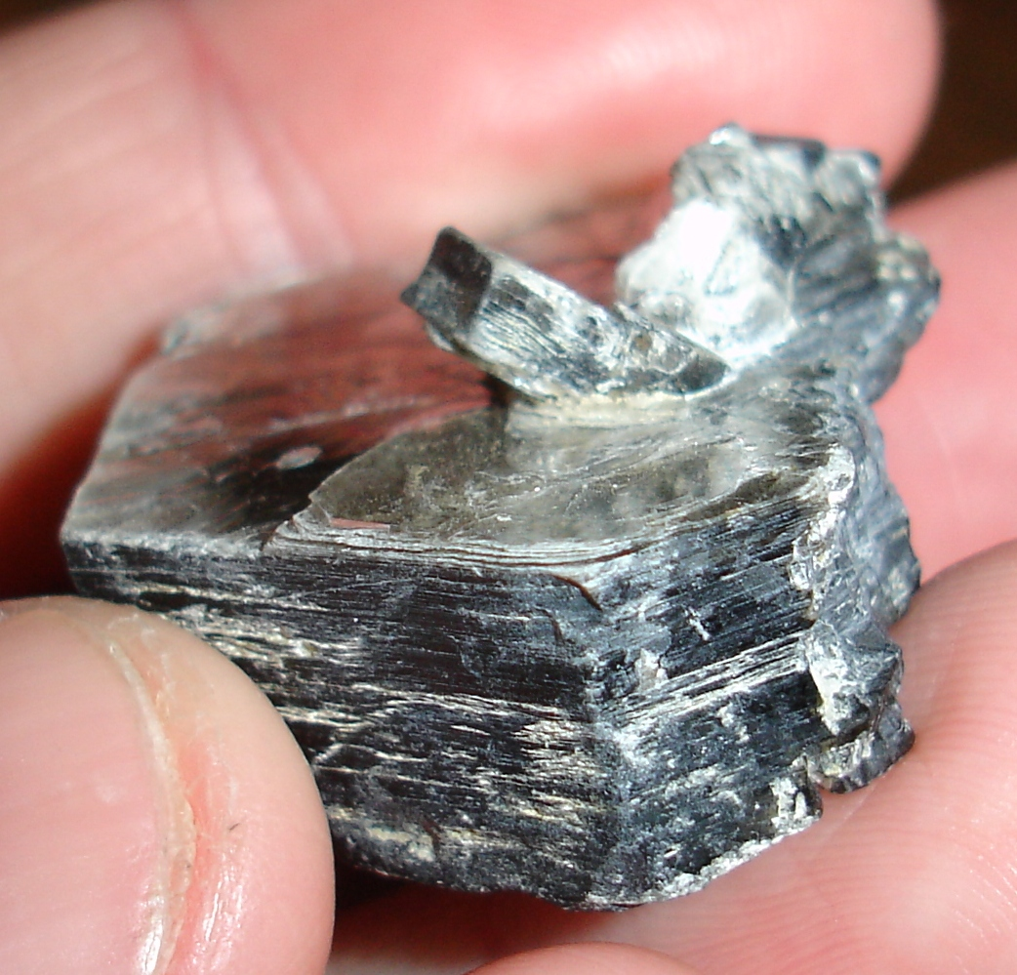
How to use Gossip in a project?
Lonnie Princehouse
I really like Lonnie Princehouse’s MiCA platform.
https://github.com/mica-gossip/MiCA
MiCA uses a Java-based coding style. You create and compose gossip and can even configure them to run at different gossip rates.

Slide 56
Summary
Gossip can be a powerful tool for building stable distributed protocols.
It is extremely easy to use, and robust!
But it can be challenging to create entire systems based on gossip. The technology works best as a tool for building subsystems with specific roles.

