Slide 1
Cascade: Full Details
Ken Birman
CS5412 Spring 2022 Lecture 10

Slide 2

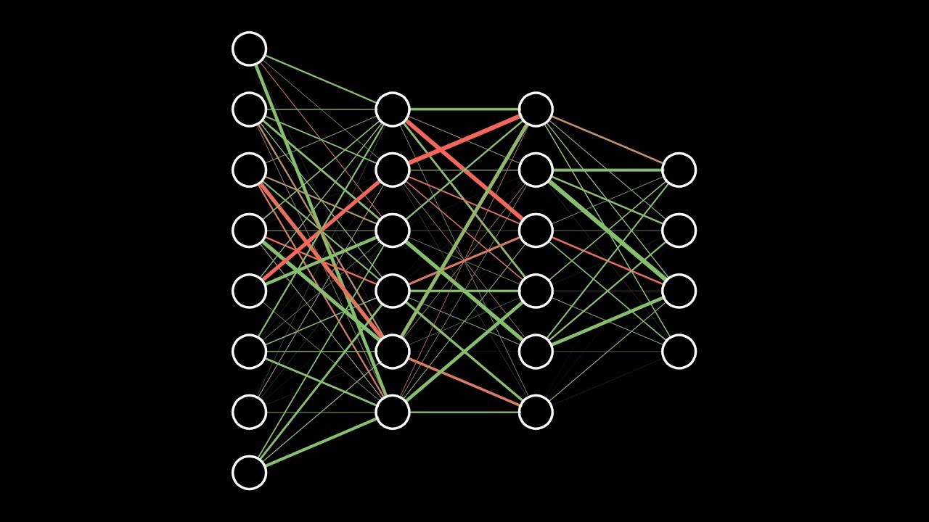

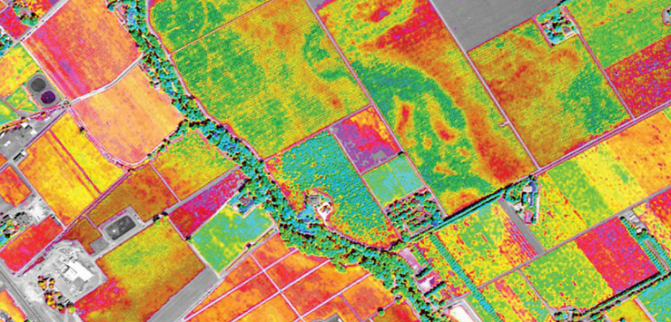
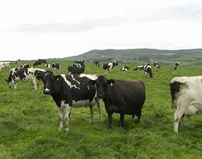
The world is generating a new wave of IoT/ML pipelines… there are many use cases
Data sources Federated ML Smart Distributed AI Queries
How much should I budget for raw milk purchases in March for my yoghurt factory?”

Slide 3
Federated ML
Increasingly seen in robotics, smart homes, 5G, digital twin scenarios.
The application is a graphical collection of AI classifiers / learners
Nodes represent computational tasks.
Edges represent data flow between distinct tasks.

Slide 4
Each λ represents a distinct ML element
Many are parallel: Single λ may run on a pool of compute nodes.
Thus, to build a D-AI we build pipelines linking parallel tasks.
Today’s cloud platforms have limited support for this model, lack the real-time and consistency guarantees needed for IoT.

Slide 5
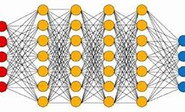
Distributed AI
A related concept
Used for AI algorithms designed to run on a parallel computer or cluster, for example stochastic gradient descent. Can also refer to the nodes in a DNN or CNN
A federated ML graph could have nodes that themselves are distributed AI components! Our graph would have subgraphs

Slide 6
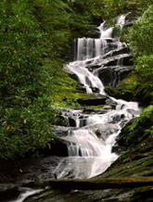
High level Cascade goals
Legacy support: Easy to use with no need to change your code
Much faster than standard platforms: low delay, high bandwidth
Stronger guarantees: Your ML doesn’t fight platform “noise”

Slide 7
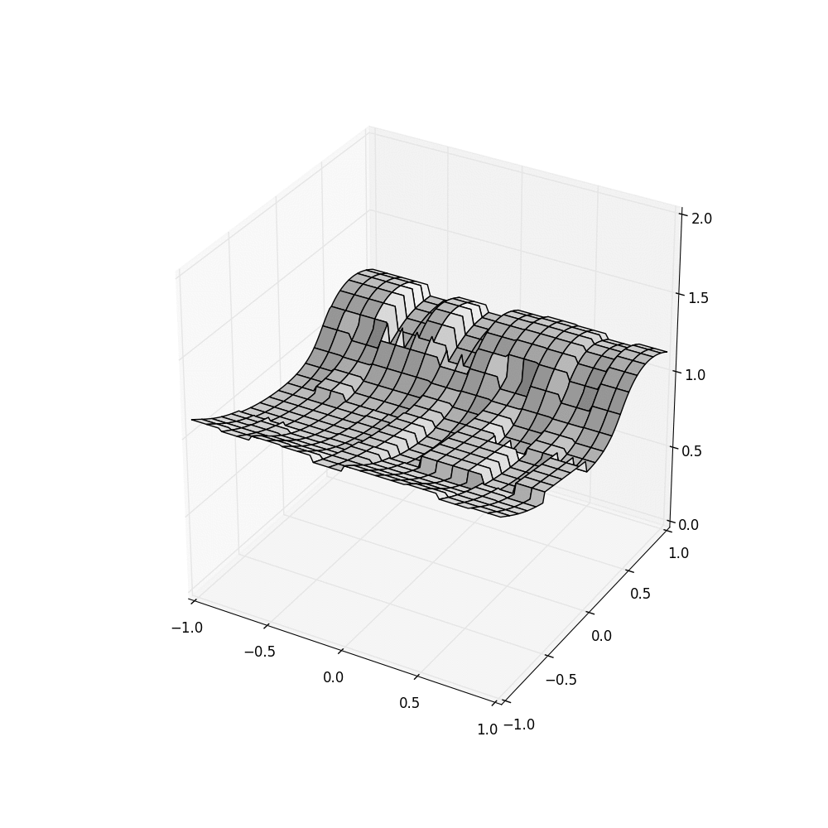
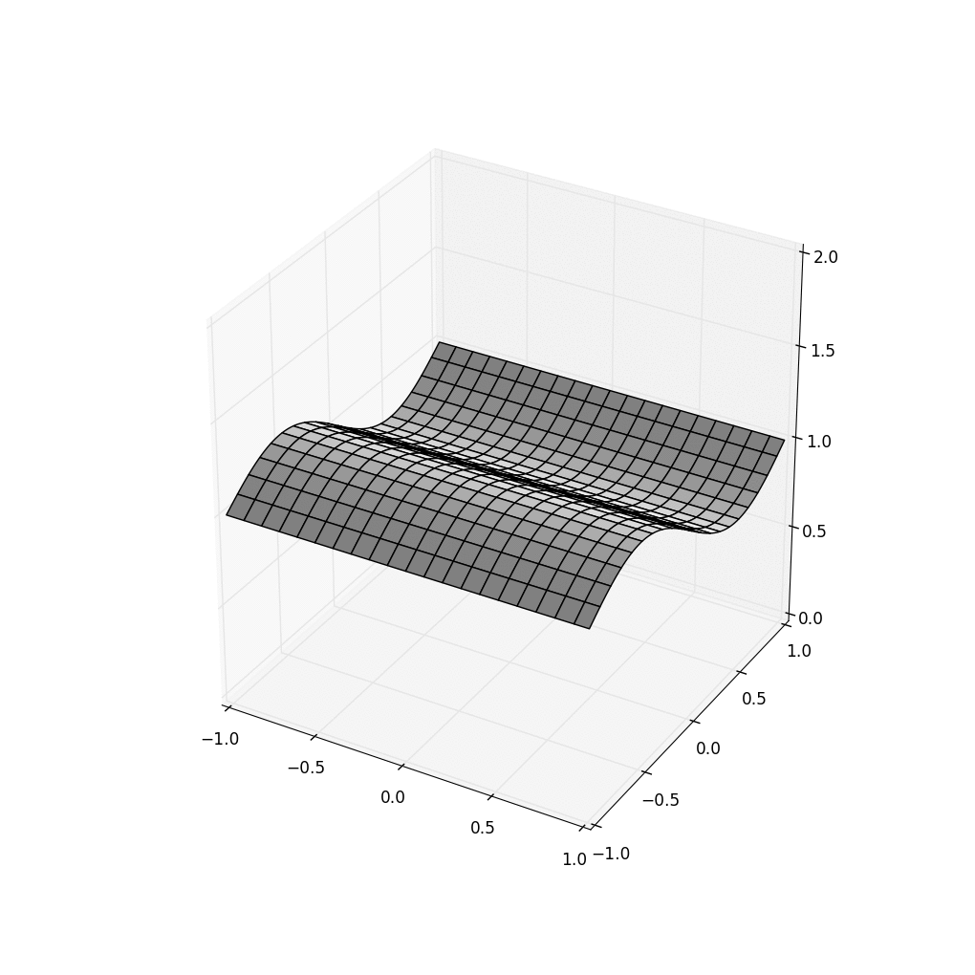

Consistency and Fault Tolerance
HDFS Cascade using Consistent Cascade With cuts but trusting Server clocks SENSOR Time
We provide high availability, auto-repair after failures, and strong consistency. Apache HDFS (used by Spark) becomes noisy under time pressure. Cascade (middle and right) supports “clean” temporal data access.

Slide 8





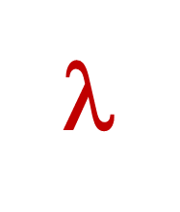
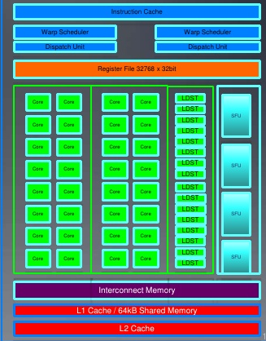
Traditional Approach
Request objects one by one
Your logic
File system or Key-Value Store
Runtime copies data into GPU
Accelerator Layer
Objects copied over datacenter TCP network
GPU
Your code is in its own address space, maybe on a different computer

Slide 9
Traditional Approach
Request objects one by one
Your logic
File system or Key-Value Store
Caching hides these costs, in iterative cases
$$$
Accelerator Layer
Objects copied over datacenter TCP network
GPU
Your code is in its own address space, maybe on a different computer

Slide 10
RDMA can help… a little
Request objects one by one
Your logic
File system or Key-Value Store
Runtime still copies data into GPU
RDMA
Accelerator Layer
$$$
Objects copied over datacenter TCP network
GPU
Your code is in its own address space, maybe on a different computer

Slide 11
Cascade Can be used this way...
Request objects one by one
Your logic
RDMA
Key-Value Storage Layer
Accelerator Layer
$$$
Objects copied over datacenter TCP network
GPU
Your code is in its own address space, maybe on a different computer
Cascade runtime environment

Slide 12
… but can also host user code
Fast-path logic (DLL)
Key-Value Storage Layer
Accelerator Layer
GPU
Cascade runtime environment

Slide 13
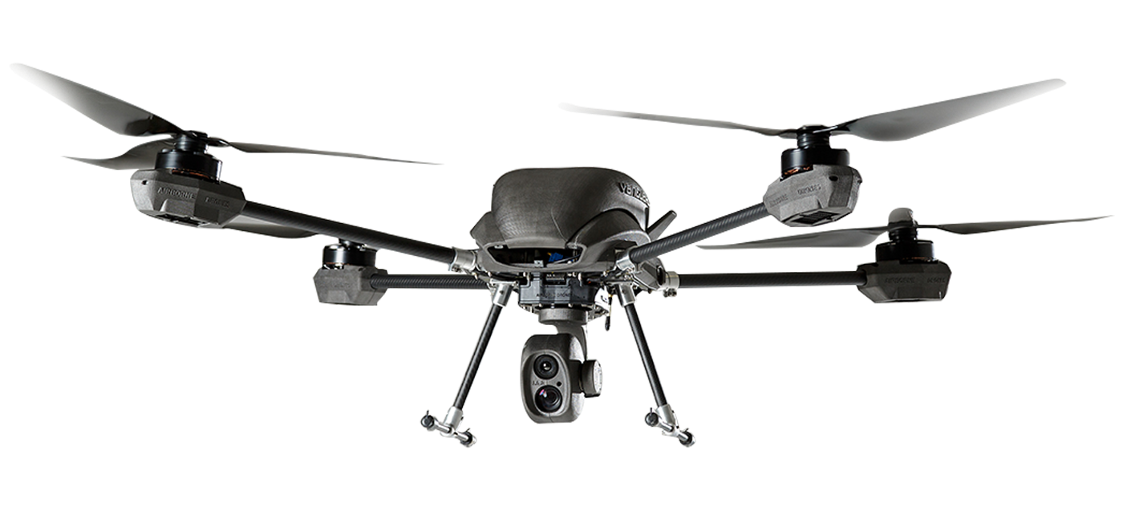
CASCADE: CUSTOMIZED SMART SERVICES
Request for classification triggers a C++ lambda in the Cascade address space
Fast-path logic (DLL)
Ideally, these are cached on GPU
Key-Value Storage Layer
RDMA directly into GPU memory
Image to classify
ML model, configuration, parameters
Accelerator Layer
GPU
GPU-accelerated kernel initiated from the lambda

Slide 14
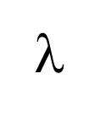
… and we can even run MapReduce
Derecho atomic multicast (vertical Paxos on RDMA)
Map… Shuffle… Reduce…

Slide 15
So… what makes it hard?
When storing objects, use the federation graph to anticipate how they will be used. Placement decisions should collocate objects at nodes where computations that need them will run.
Later, an event occurs. Launch the computational pipeline on nodes that will (all) have the required inputs.
Metrics: delay, throughput, balanced workload, resource utilization.

Slide 16
Fast-Path Performance
A simple federated ML pipeline
Cascade is close to ideal efficiency on our hardware and 100 to 10,000x faster than common options like Apache Flink
Downstream action
Downstream action
GPU
Input event
GPU
GPU
Hyperparameters, models, cloud data
Latency: 12us
Throughput: 8GB/s
Hyperparameters, models, cloud data
Hyperparameters, models, cloud data

Slide 17
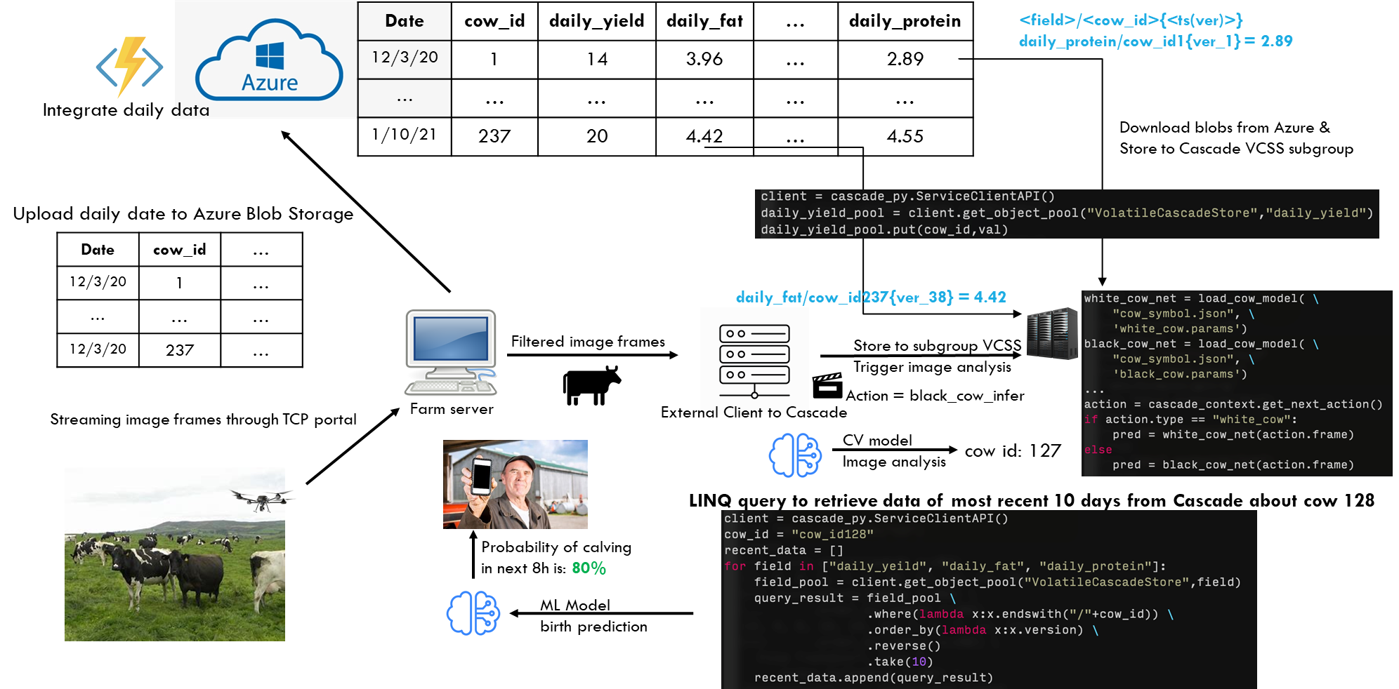
DAIRY INTELLIGENCE with Cascade

Slide 18
The Cascade Model
Is it a service? A library?

Slide 19
Cascade is a service
Cascade Service running as a file system or DHT
External Client
Although created using Derecho (a C++ library), Cascade runs on a set of nodes (machines or VMs) where it controls some resources (cores, RDMA interfaces, GPUs/FPGAs, memory).
Users can build applications that access Cascade from “outside”. We call those “external clients”. The put/get API would work, and RDMA is supported.

Slide 20

Cascade is an service
EXTENSIBLE
Which cow is this?
v
External Client
But this slide deck is mostly about users who extend the Cascade service by adding logic that runs inside of Cascade.
Cascade behaves as a customized service: a “smart” service.
We will explain how this is done… it involves extra APIs, but allows us to also treat our service as a kind of library.

Slide 21
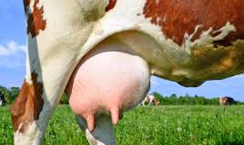
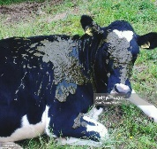
Extension concept
Does this cow have mastitis?
Cascade is one service
But when you supply customization it acts like many specialized services, one per application So it becomes a platform for new microservices, like these!
Is this cow clean enough to milk?
Which cow is this?
The Cascade Server is extensible
A single Cascade server can support multiple customized services

Slide 22
Key concept: Extensibility
What does it mean to be an “extensible platform as a service”?
Think about devices you plug into your computer. For example, Ken uses a Garmin GPS to track bike rides. When he plugs the Garmin into his Dell computer, it becomes an expert on all the bike rides he has taken since 2008.
In some sense, the Garmin+Dell pair is a “new thing”

Slide 23
How does a person extend Cascade?
We will look at this later in the class, but the idea is to plug in new software written in C++, and to tell Cascade when this software should run.
The new code watches for IoT events specific to the application, by monitoring keys. Updates will trigger the λ to run.
For example, your plug-in could handle “cow-washing events”

Slide 24
The Cascade Storage Model
How should Cascade data be managed?

Slide 25
File System “extension”
User sees scalable, “private” object pools
Cascade has a built-in file system extension:
Every object has a pathname.
The file system extension supports normal file operations.
You can access it just like any file system.
Yet Cascade isn’t a file system. It is a key-value get/put/watch store. Moreover, it is automatically sharded for scalability.

Slide 26
Updates: Create a new file or Appending to an existing file
User sees scalable, “private” object pools
Any key-value object lives in one shard (but that same shard may have many keys that map to it!).
A key is a string. A value is an object serialized as a byte vector.
Updates are log appends using Paxos. Each object has a log of versions that evolved over time.
Queries run on the stable prefix of the log.

Slide 27
Versioned updates
Each time you write to an object, Cascade creates a new version, with a unique (incrementing) version number.
If you read an object, modify it, and then write it back, you can tell Cascade which version you modified. The put will double check to be sure that this is still the current version before replacing it, and otherwise returns an error (then you can loop)

Slide 28
Versioned/Temporal queries
Accessed via get.
In the volatile case, Cascade only keeps the most recent version. With persistent objects, Cascade keeps a log of past versions.
By default, applications see the most current version
Indexed access allows the application to query any version (by version number or time), or fetch any data range.

Slide 29
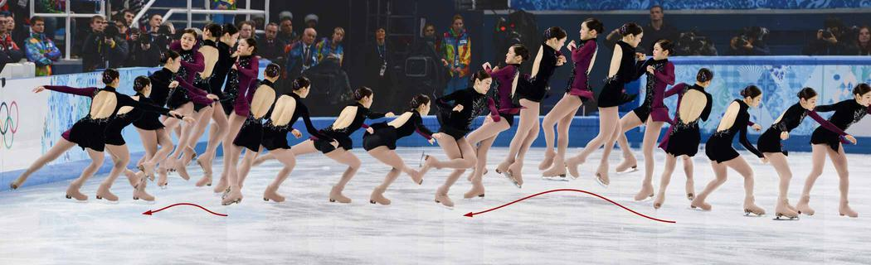
Versioned objects
We configure the object store to track versions. put creates a new version:
key: The object store always tracks information on a per-object basis
version-number: Just an integer
time: If the object itself lacks a timestamp, we just use “platform” time.
Now get can lookup most current version, or a specific one, even by time.
The object store is optimized to leverage non-volatile memory hardware.

Slide 30
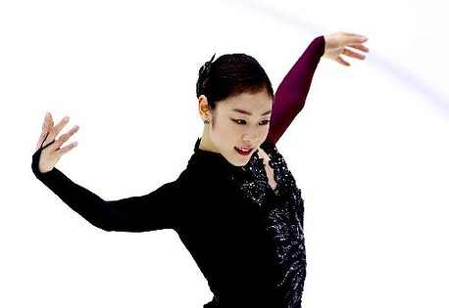
Storing deltas
Existing DHTs lack support for versioned data.
We implemented a highly optimized versioned data structure
We implement a temporal index, and cache frequently accessed data.
A server still manages a map (since many keys map to it), but you can think of the values for a specific key as being versioned.
Sometimes deltas are more efficient. If you have a function to compute the delta, we won’t even create a new version unless you tell us to.
Values (or deltas) are saved on NVMe & replicated for fault-tolerance.
Notes:
This is just a slide on a question of efficiency.
Sometimes a delta is MUCH smaller than the versions themselves would be.

Slide 31
The Cascade compute Model
Lambdas, coded in your favorite language

Slide 32
The central puzzle
The very fastest data paths require compilation, ideally in languages like C++.
But we want Cascade to run as a service, so it would often already be running when a new user comes along and wishes to create and launch some completely new service.
How can we extend a running system? Actually… it isn’t so hard

Slide 33
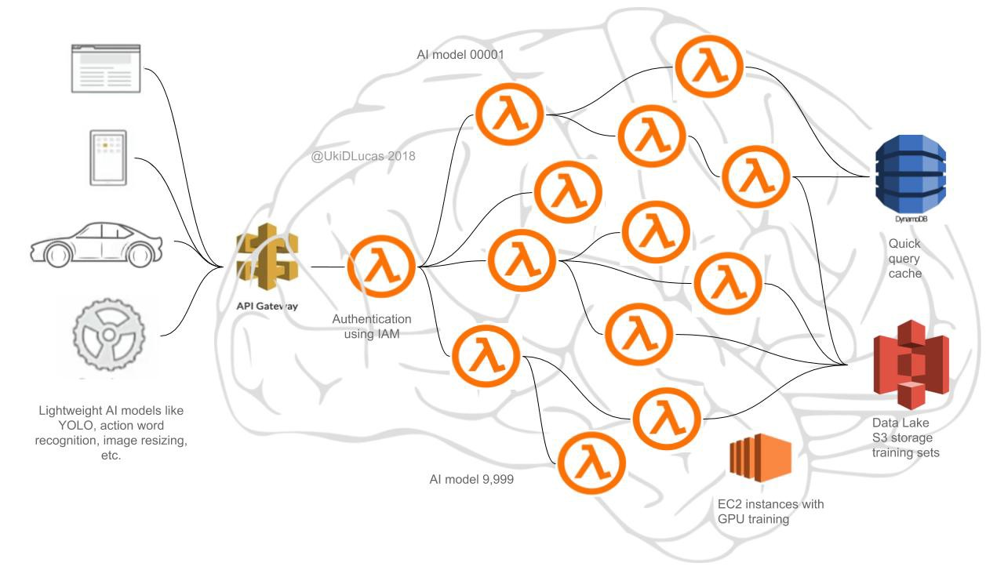
First question: What’s in a λ?
We support many languages. Native APIs are Python with various packages (including LINQ) and C++ with LINQ.
Code is concise – LINQ pioneered a style that mixes “kernel” invocations with embedded SQL. Maps cleanly to GPU, FPGAs.
Cascade manages GPUs and can cache data in GPU memory.

Slide 34
How can a key-value store “be” a classifier service or an analytic service?
Flowers
We run Cascade on a set of nodes. Here we see nine nodes in three shards.
A shard identically replicates (key,value) tuples, using Paxos. Here, an object with the key “Flowers” was stored in shard 0. “Vegetables” ended up in shard 2.
Vegetables

Slide 35

… Enabling this kind of solution
Vegetables
Flowers
Flower p=.85 Vegetable p=.6
Sunflower p=.97
Most likely a sunflower!
Zucchini blossom p=.04
Sunflower
First tier: inexpensive computation on meta-data
Key-value object store holds specialized knowledge models for categories (flowers, birds, dogs, trees…)
IoT Cloud Infrastructure

Slide 36
How does “watch” work?
On a given Cascade server node, it will issue an upcall to user-specified code if the key(s) the user wants to watch change.
Cascade’s name space is best understood as a global file system namespace. The keys are the file pathnames.
Watch thus is monitoring a file or directory…

Slide 37
So… a λ is just a program designed for parallel execution Inside a key-value store
Our idea:
Cascade hosts the key-value data (or file system, like Ceph)
The user’s code is treated like a dynamically linked library.
The user creates this DLL, saves it into Cascade, then tells us where to run it. Cascade loads and launches it there.
DLLs have zero overhead, once loaded. So now the user’s logic is efficiently callable from Cascade!
And we use the watch feature to initiate those upcalls!

Slide 38

Creating and Installing a new λ on some Cascade Nodes
On the designated compute nodes, Cascade loads the DLL and activates it. The DLL initializes itself and register some “watch” upcalls.
Recall that a key-value store is sharded. Each node will host a different set of keys.
GPU
Developer builds a new ML program, designed for parallel execution directly “in” a key-value store. Cascade is already running in the cloud. She tells Cascade to load this DLL.
Hyperparameters, models, cloud data

Slide 39
D-AI pipelinEs will be common
One way to trigger a lambda is with a (key,value) put.
Each of these lambda stages potentially runs on a pool of machines.
Downstream action
Many lambdas depend on persistent objects, fetched with get
Downstream action
GPU
Input event
GPU
GPU
Hyperparameters, models, cloud data
Hyperparameters, models, cloud data
Hyperparameters, models, cloud data

Slide 40
Anything, anywhere, any time
With permissions, any code can access any object, or the associated time-series if the object is a persisted history.
Obviously, performance is best if we can minimize data movement and compute instantly when new events occur.
This all yields a sophisticated programming model

Slide 41
Cascade λs execute in consistent cuts
Recall: Cascade has a built-in temporal indexing feature. Suppose our distributed AI is triggered by event ε at time τ.
We run all the lambdas triggered by ε along a consistent cut “optimally close” to time τ (and selected deterministically).
Effect: The lambda won’t see platform-induced inconsistencies.

Slide 42
Visualization of Cascade consistency
HDFS Cascade using Consistent Cascade With cuts but trusting Server clocks SENSOR Time
Cascade consistent cuts + GPS-timestamped sensor data result in clean input to the D-AI algorithm (in this case, a simple visualization)

Slide 43
Central conceptual insight
One event may trigger many lambdas.
These lambdas may need to run on multiple nodes… yet will share the same temporal index (τ from the trigger event ε).
A Cascade query always sees a “consistent state snapshot.”

Slide 44
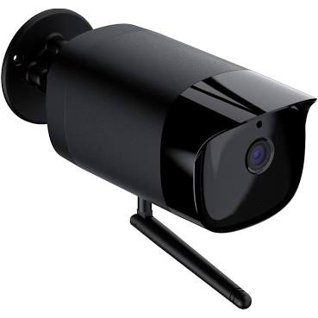

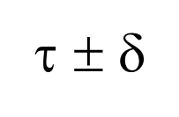
Visualizing the consistency Model
Put(k,v)
Each Cascade shard has its own Paxos-based log
Put(k,v)
Put(k,v)
(ε, τ)
Stable portion
Put(k,v)
λ
Put(k,v)
λ
λ
time
λ
Each λ is triggered by an upcall from a “watcher” monitoring some key (or pattern)
Unstable tail
A temporal query for time τ sees a consistent cut at τ ± δ_{clock}.
Queries to unstable data must wait, but updates are stable within 50us.

Slide 45
Visualizing the consistency Model
Even if δ is small, there could be a few events at each process in the t ± δ time window. By selecting a consistent cut, Cascade avoids the “mashup” issue we saw in the HDFS animation.
Put(k,v)
Put(k,v)
Put(k,v)
Each Cascade shard has its own Paxos-based log
Put(k,v)
Put(k,v)
Stable portion
(ε, τ)
Stable portion
Put(k,v)
λ
λ
Put(k,v)
λ
λ
time
λ
λ
time
λ
Each λ is triggered by an upcall from a “watcher” monitoring some key (or pattern)
λ
Unstable tail
Unstable tail
A temporal query for time τ sees a consistent cut at τ ± δ_{clock}.
Queries to unstable data must wait, but updates are stable within 50us.

Slide 46
But the job is still hard!
Cascade makes it easy to extract a tensor with a temporal dimension: A stack of frames
But writing ML code that can recognize patterns over time is not easy! Even identifying movement trajectories is a hard vision task.
Cascade is just the platform. You need to write the application!

Slide 47
Cool object oriented idea
Suppose that you have a device that captures images of size w,h and you want to form a 3-D tensor for times t0 .. t1.
You can define your sensor as an object with getter methods that turn around and fetch the appropriate images. Now your code is written in terms of my_tensor[x,y,t] and yet Cascade handles fetching and caching the data.
You can even use LINQ to do this in one line of Python or C++ code (we will see this later in the semester)

Slide 48

Cool object oriented idea
Now, if you have a computer vision algorithm that can recognize the orientation of the skater frame by frame, you can write a function that will “represent” the pattern of how her body is spinning over time.

Slide 49
“Machine learning” a spin
In this model, we can think of a trajectory as the “motion trace” of some key points such as the skater’s hands, arms, face, etc.
Each traces out a path in time and space.
In effect, our system is learning a collection of high dimensional splines that fit the observed data, and can be used to predict future movement

Slide 50
Realistic “use cases?” for skating
A skating judge might be interested in measured properties of the spin, like speed, number of spins, steadiness.
A coach might be trying to diagnose the root cause of a small wobble.
The skater may be wondering what would have happened if her left hand was just a tiny bit higher

Slide 51
How would your code work?
First retrieve a tensor: one axis for time, and then 3 spatial axes.
Now you can write code that finds the best match layer by layer relative to the prior layer. That tells you the trajectory of her hand movements.
Last, you might apply a model to this and highlight small errors.

Slide 52
Grouping objects
Often a lambda will need to access several objects that should ideally all have their own keys, yet you want them grouped on the same shard.
For this, Cascade supports “affinity grouping”. Each object has a second key, used for placement.
Even if A and B have different keys – “names” – they will be stored on the same shard if you assign them the same affinity key.

Slide 53
How to create a new λ
Cascade is an extensible service!

Slide 54
Triggered actions: The code itself
The lambda is created as code that implements a static API.
User places the DLL (or the source file) in a Cascade object
A command tells Cascade which nodes should load it.
The DLL has an initialize method. Cascade calls it.
Notice that the user-supplied code can define new object types. We only require that all Cascade objects be byte-serializable.

Slide 55
Triggered actions: API is simple
Cascade implements has three primary APIs
The main Cascade APIs: (key,value) put and get.
watch upcalls to trigger user logic when some key is updated.
Watch can do exact key match, or path-prefix match, or arbitrary regular-expression matches.

Slide 56
Triggered actions: The code itself
The initialize method calls watch to register the user’s lambdas
A lambda is a closure. This associates “context” with the lambda.
Example: keys identifying hyperparameter and model objects.
Watch monitors for keys that match.
If a match occurs, Cascade passes the matching key to the lambda.

Slide 57
Pattern matching
Just like with file names (key == file name)
/data-center/instance/users/Alicia/SmartDairy/ImageRec/cow2716/model
Many watch patterns will seek exact match.
Some are a prefix followed by a glob-style pattern, like “trigger if any change occurs in this folder”

Slide 58
What does a real application look like today?
Example, courtesy of Weijia, Alicia and Thompson

Slide 59
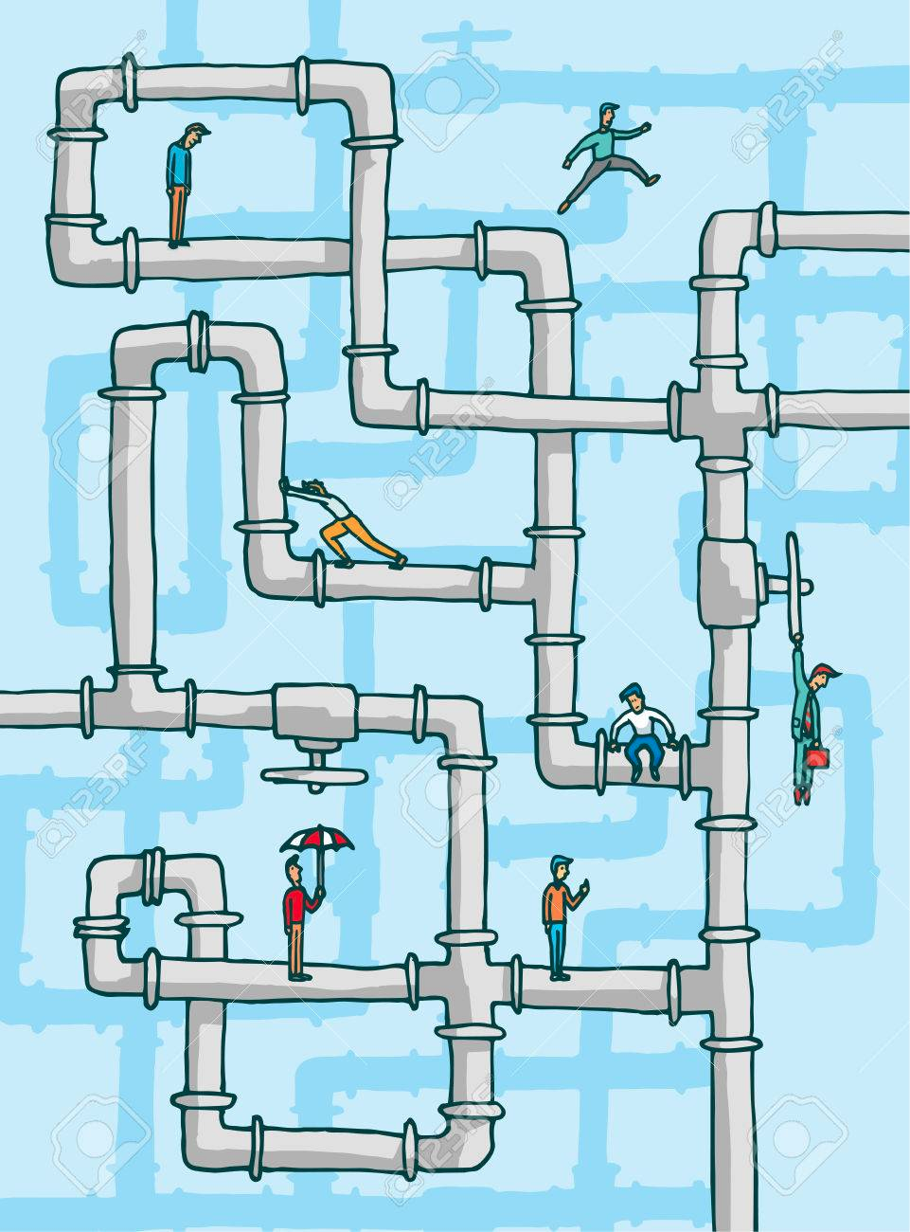
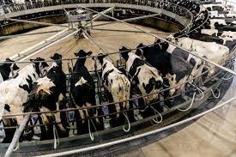

Dairy Image Pipeline: Front End
Dairy Farm
Data Center
Image Pipeline
Front End
(As an external client)
The Farm Server (IoT Edge)
Cascade Image pipeline
Frame
Extractor
Frame
Sampler
WAN
Video clip
store
Frame
Server

Slide 60


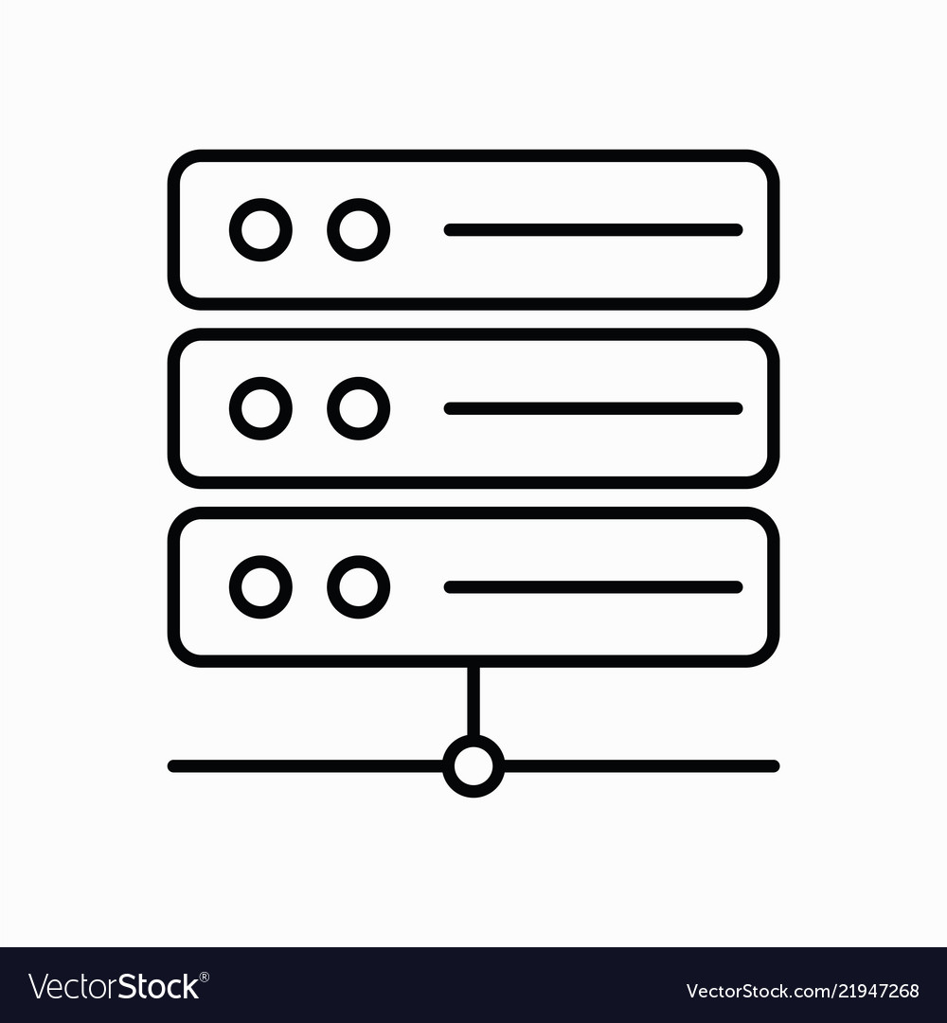
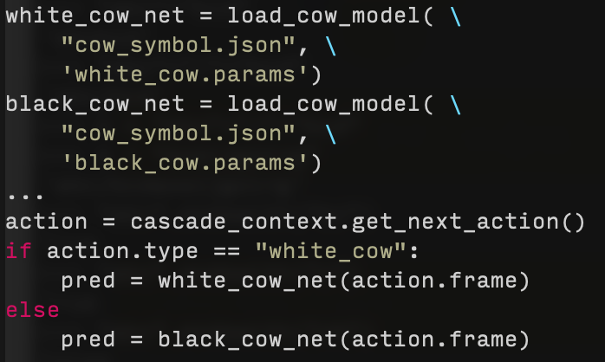

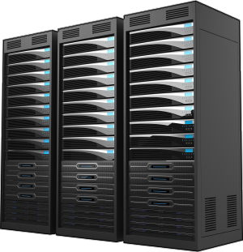



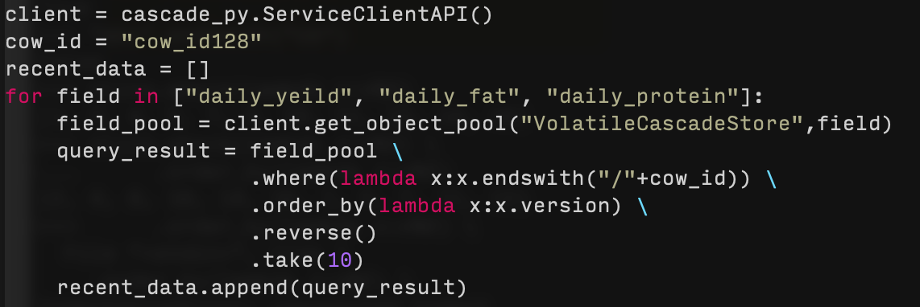
… DETAILED VERSION (PyLINQ ON MSFT AZURE)
Date | cow_id | daily_yield | daily_fat | … | daily_protein
12/3/20 | 1 | 14 | 3.96 | … | 2.89
… | … | … | … | … | …
1/10/21 | 237 | 20 | 4.42 | … | 4.55
<field>/<cow_id>{<ts(ver)>}
daily_protein/cow_id1{ver_1} = 2.89
Integrate daily data
Download blobs from Azure &
Store to Cascade VCSS subgroup
Upload daily date to Azure Blob Storage
Date | cow_id | …
12/3/20 | 1 | …
… | … | …
12/3/20 | 237 | …
daily_fat/cow_id237{ver_38} = 4.42
Cascade backend
Filtered image frames
Store to subgroup VCSS
Trigger image analysis
Farm server
Action = black_cow_infer
Streaming image frames through TCP portal
External Client to Cascade
CV model
Image analysis
cow id: 127
LINQ query to retrieve data of most recent 10 days from Cascade about cow 128
Probability of calving in next 8h is: 80%
ML Model
birth prediction

Slide 61
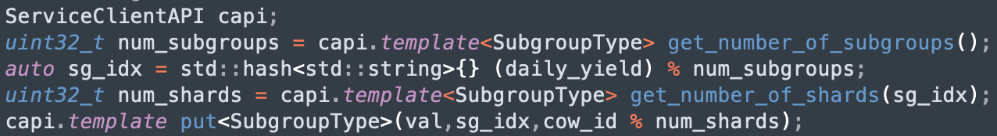
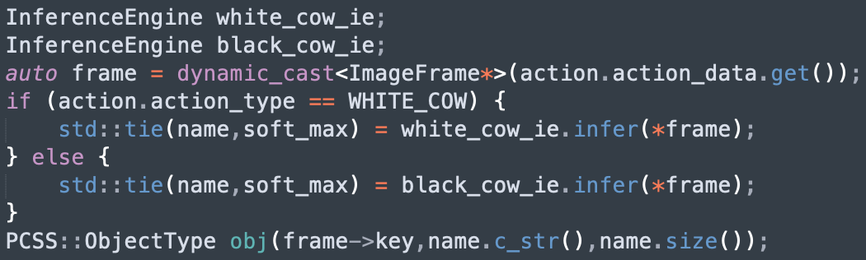
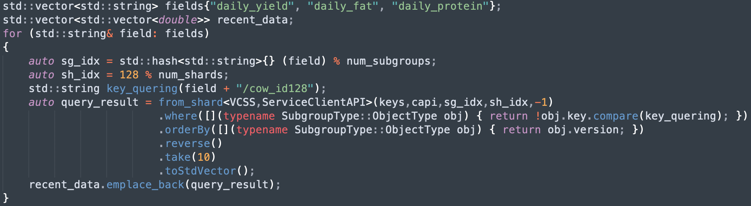
C++ IS SIMILAR (BUT MORE EFFICIENT)
Date | cow_id | daily_yield | daily_fat | … | daily_protein
12/3/20 | 1 | 14 | 3.96 | … | 2.89
… | … | … | … | … | …
1/10/21 | 237 | 20 | 4.42 | … | 4.55
<field>/<cow_id>{<ts(ver)>}
daily_protein/cow_id1{ver_1} = 2.89
Integrate daily data
Download blobs from Azure &
Store to Cascade VCSS subgroup
Upload daily date to Azure Blob Storage
Date | cow_id | …
12/3/20 | 1 | …
… | … | …
12/3/20 | 237 | …
daily_fat/cow_id237{ver_38} = 4.42
Cascade backend
Filtered image frames
Store to subgroup VCSS
Trigger image analysis
Farm server
Action = black_cow_infer
Streaming image frames through TCP portal
External Client to Cascade
CV model
Image analysis
cow id: 127
LINQ query to retrieve data of most recent 10 days from Cascade about cow 128
Probability of calving in next 8h is: 80%
ML Model
birth prediction

Slide 62


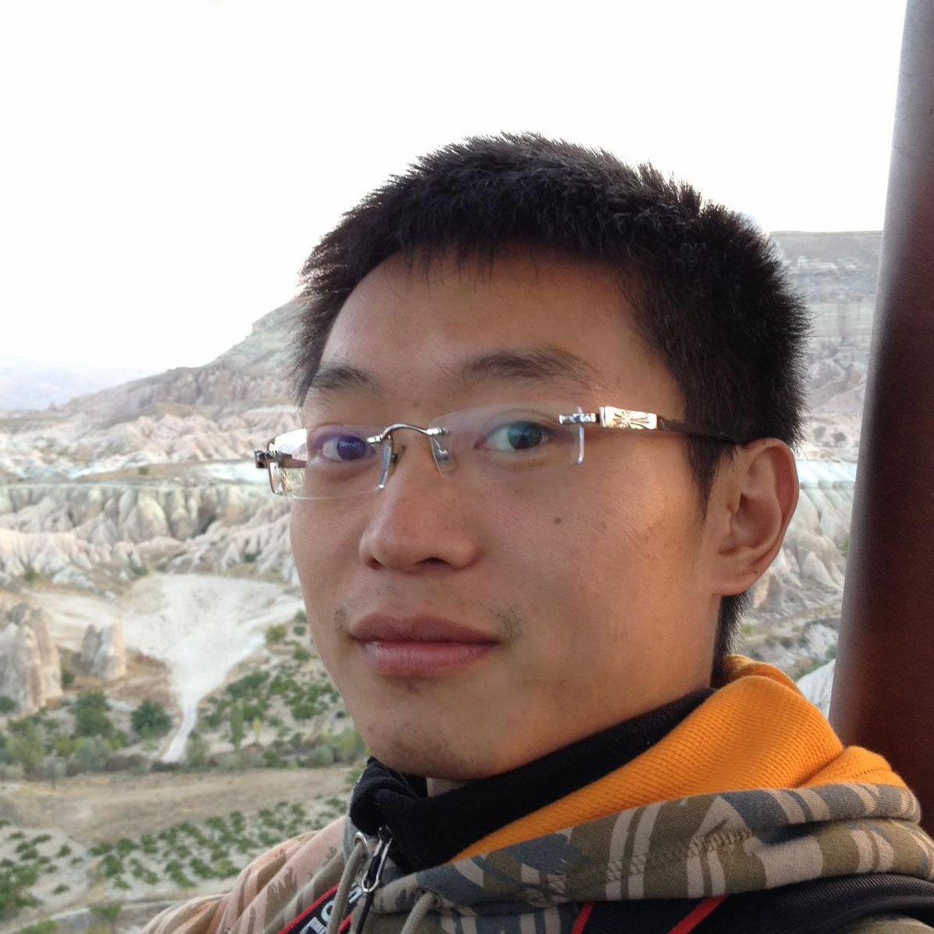

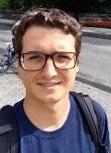

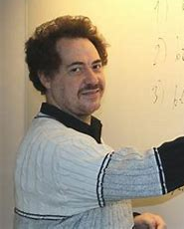

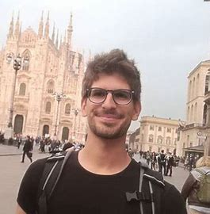
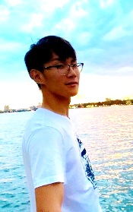
The Cascade and Derecho team
Weijia Song
Lorenzo Rosa
Ken Birman
Alicia Yang
Sagar Jha
Mae Milano (post-doc at Berkeley)
Andrea Merlina
Cornell undergrads: Aahil Awatramani, Ben Posnick, Max Charlamb, Archishman Sravankumar, Aaron Weiss, Peter Zheng
Edward Tremel (faculty at Augusta Univ.)
Roman Vitenberg
Thompson Liu

