Slide 1
CS5412 / Lecture 8
Replication and Consistency (Part II: Practical Options)
Ken Birman
Fall, 2022

Slide 2
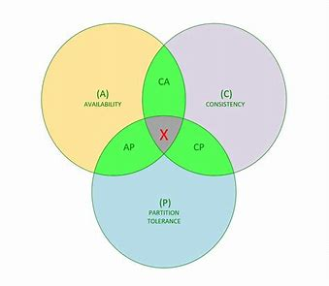
Recap
Eric Brewer told us that stale data and inconsistency is fine. Why worry? CAP and BASE work for many cloud computing web sites, like Amazon.com
But we realized that if a μ-service does the whole job – it holds its own state and also does the computing, and uses the primary-partition membership approach – then P won’t matter. We can opt for C+A.
So we introduced state machine replication and virtual synchrony.
Notes:
Today we’ll look at building a new μ-service using Derecho as a tool to simplify some of the really hard steps.

Slide 3
Recap: State Machine Replication
This is a model in which we have deterministic programs
They see one update at a time and apply the updates in the same order. There is a communications version of this (atomic multicast) and a log-append version (persistent replicated logging).
If our replicas start up in sync, they stay in sync.

Slide 4
Recap: Atomic Multicast and Durable Replication
Both ideas center on applying the same updates in the same order
With atomic multicast updates are carried in messages, and delivered to all receivers (or none), in the identical order, even despite failures.
With durable replication each receiver also keeps a log of updates or of the result after applying them.
In some solutions each replica (each log) is itself a complete history.
In other solutions logs must be merged to know the full update sequence.

Slide 5
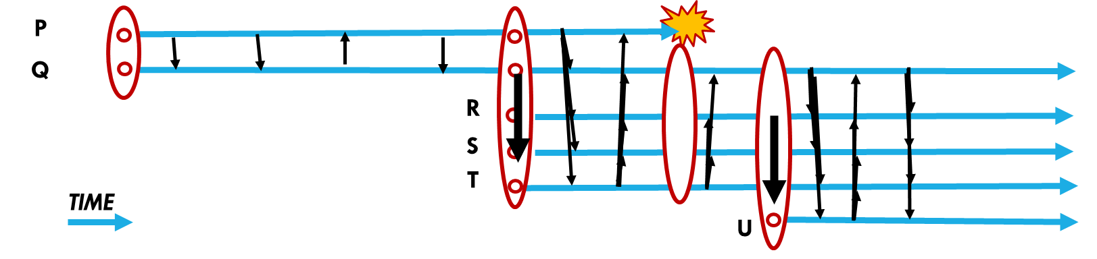
Recap: Virtual
Synchrony
The idea was to break down a distributed systems into a
Multicast or durable update protocol. Sends only while membership is stable.
Updates every current member. This differs from classic Paxos: no log merge is
needed, because every member sees every update (like Paxos with QW=N, QR=1).
Membership service. Tracks which processes are in the system, and what role each
is playing (like which shard it is in). Automatically drops failed members. Never
can experience a split-brain outage.
State transfer mechanism. Uses checkpointing to initialize a joining process.
In virtual synchrony, membership changes only when updates are frozen and vice-versa. The multicast and state transfer logic becomes much simpler.

Slide 6
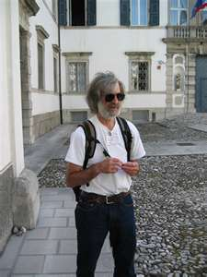
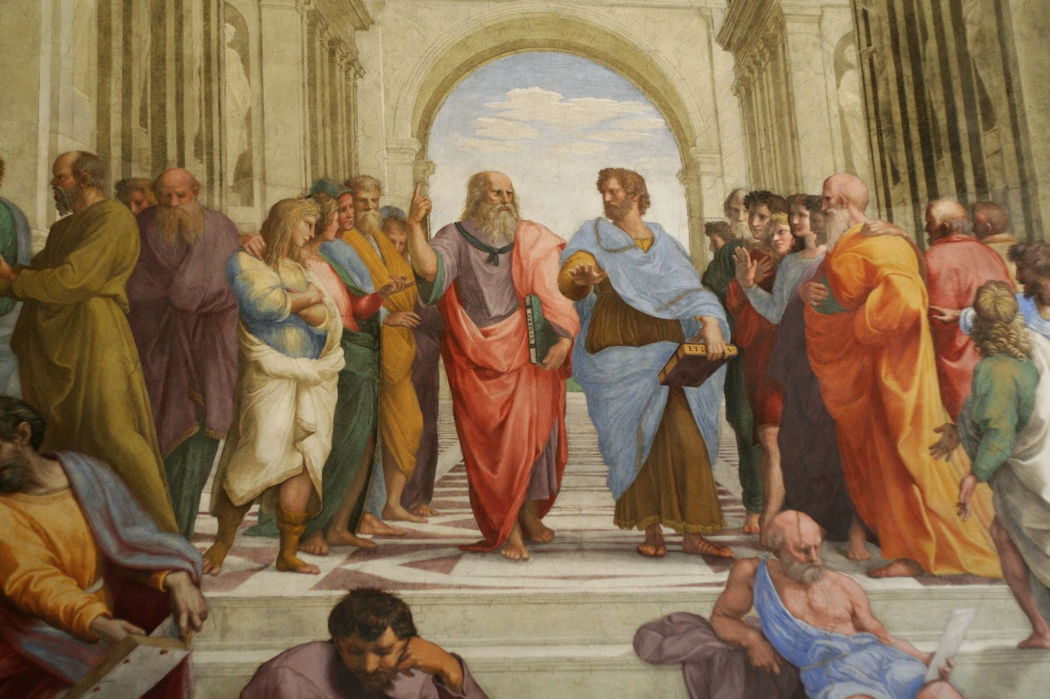

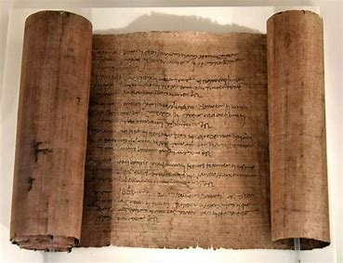
Leslie Lamport:
Classic Paxos
Greek philosophers
debating a proposed law
The senate in the lovely town of Paxos debated laws. A majority is required
to enact (“decide”) a proposed new law. Laws were enacted in sequential order.
A senator who was present will never forget an enacted law
Periodically, a scribe would reconstruct the complete
sequence of laws and copy any newly enacted ones to the
last page in the great scroll of the law in the town square.
The scroll of the law

Slide 7
We can formalize this mathematically
We have some set of processes, N of them in total. Fixed membership.
But within this membership, some processes may be unresponsive
Each new proposal must be voted by the processes, and requires majority consent (but the processes in Paxos don’t try to modify the proposals).
If the process making a proposal doesn’t fail, it will eventually be adopted

Slide 8
Notice: Paxos does not use virtual synchrony
At the time, he wasn’t familiar with my model. Much later he and Dahlia Malkhi suggested that virtual synchrony + Paxos would be the way to go.
In the original “classic” version of Paxos, because the processes can come and go, not every process will “know” about each decided proposal.
To actually learn the sequence of decided proposals, we need to merge the logs managed by the individual processes.

Slide 9
Quorum policy: Updates (writes)
To achieve high availability, allow an update to make progress without waiting for all the copies to acknowledge it.
Require that a “write quorum” (QW) must participate in the update
Easy to implement this requirement using a 2-phase commit protocol
Basic approach: Leader asks the loggers (“acceptors”) to log an update. But it won’t commit unless QW respond “success”. So we have a request phase and then a commit phase: a 2-phase commit.

Slide 10
Assume N members, F potential failures
We want to be sure that any two write quorums overlap:
QW+QW > N
We also want any read to “see” all the prior committed writes
QW+QR > N
For fault-tolerance, we need QW ≤ N-F and QR ≤ N-F.
For maximum speed, QR should be as small as possible

Slide 11
Example with 5 servers
N=5, QW=3
N = 5
Suppose F = 1: We want to tolerate 1 failure
QW must be 3 or 4.
QR would be 3 if QW=3, and 2 if QW=4.
… cloud systems normally are read-intensive, so QR=2, QW=4 is best
N=5, QW=4
… QR=2

Slide 12
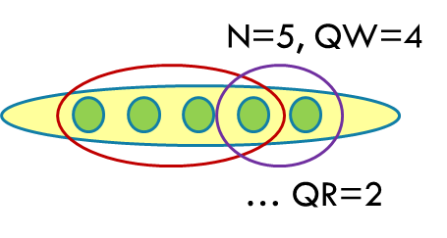
Thought questions
1. We happen to know that in cloud computing systems, almost all
accesses to a DHT will be pure reads (queries). 99.999% is common!
What does that statistic tell us about picking values for QW and QR?
2. Consider the case where N=5, QW=4. QR could be 2, 3 or 4.
The illustration shows QR=2. Would QR=3 or 4 be better or worse?

Slide 13

Visualizing Paxos setup
A1
A2
A3
leader
Acceptor
Acceptor
Acceptor
learners
client
Logs, one per acceptor
The client asks the leader to add a message to the Paxos logs. Paxos is like a “postal system”. The leader will be in charge of this request.
The system “discusses” the letter for a while (the first phase, which picks the slot in the log, stores the letter in the log, and reaches QW acceptors).
Once the update is “committed” the learners can execute the command

Slide 14

Logs
leader
Acceptor
client
Log
The log lives on a disk – Paxos is used for persistent updates, not atomic multicast. Each log holds a series of updates, like a stack of paper.
An acceptor has its own log. Updates are appended at the end of the log
Any single logs can have gaps because QW < N! This differs from atomic multicast, where every receiver gets every message.

Slide 15
Note: Classic Paxos ≠ Virtually Synchronous Paxos
With classic Paxos, individual logs can be incomplete because the acceptor might have been unavailable when the update committed.
… so this forces us to merge logs: Because QW < N, QR > 1.
With virtual synchrony, we dynamically adjust the membership. This allows us to set QW=N_{v,} where N_{v} is “The size of the current view v”. With virtual synchrony no updates are missing, hence QR=1 becomes possible

Slide 16
Classic Paxos runs in stages
In the first stage, the leader asks the acceptors to “reserve” a slot in their logs.
This can take a few tries because there could be multiple concurrent leaders running, and there could be some crashes as they run

Slide 17
Paxos Ballot numbers
This leads to the idea of “ballots” – the first phase loops, with the leader trying to get QW successes on a series of proposals, with an increasing ballot numbers
Leader X to acceptor 4:
“This is my ballot number 1. Can you reserve slot 1 for me?”
Acceptor 4 to leader X:
“Ack: Slot 1 ballot 1 reserved for you.”
or,
“Nack: Slot 1 ballot 1 has already been reserved for leader Y.”

Slide 18
What leader “learns” from a quorum
Every write quorum will overlap with every other write quorum, so the leader will learn about any prior write that could have gained a quorum and begun its commit stage on the same slot/ballot.
Also, because acceptors only can vote once per slot/ballot, if one write proposal gains a quorum, no other proposal can gain a quorum in the same slot.
Finally, the leader learns that it has, in fact, reached a quorum.

Slide 19
What about a skipped acceptor?
The leader might give up on some acceptor. It will have a gap in its log
We usually just denote it with a ? or a symbol like ⊥. The Paxos read protocol will merge Q_{R} logs, which is enough to ensure that if a slot contains a committed write, it learns about that write.
Note: There is a rare error case where a slot commits to φ

Slide 20
Stage two: Leader gets a quorum
To move from stage one to stage two, a leader needs QW acks for some ballot. Perhaps, 4 out of the 5 acceptors agree: Leader X reserved slot 7 on ballot 1.
The way the Paxos rules are designed, no other leader can “win” once this condition is achieved, although more ballots may be required for the leader to discover that it has a quorum because messages could be lost or acceptors could crash.
Now leader X sends the actual data:
“In slot 1 (ballot 1), please write value v into your log”

Slide 21
Stage three
Once QW acceptors have written v into the slot, they acknowledge and then the leader can commit (finalize) the new entry
Leader sends:
“Commit pending update v in slot 7, ballot 1.”

Slide 22
Tolerating faults
The actual protocol has to tolerate leader crashes…
… and acceptor crashes
… and work correctly even with concurrent leaders fighting for some slot, even if crashes occur

Slide 23
Proving that Paxos “really” works?
The idea wasn’t super complex, but it is very hard to prove correct
You should review Robbert van Renesse’s paper “Paxos made moderately complex” to understand all the possible failure cases and how they are addressed in Paxos.
The actual full protocol is very complicated!

Slide 24
Example: Paxos three-stage protocol
(“prepare”, ⟨1,1⟩)
(“accept”, ⟨1,1⟩ ,v₁)
1
1
1
1
1
Process 1 is the leader.
2
2
2
.
.
.
.
.
.
.
.
.
(“ack”, ⟨1,1⟩, ⟨0,0⟩,⊥)
n
n
n
(“accept”, ⟨1,1⟩ ,v₁)
decide v₁
See Robbert van Renesse’s paper to understand the notation

Slide 25
Criticisms of Paxos
The original paper was very hard for people to understand.
The protocol is very slow in the original form. Later work improved it,
but until 2019 we didn’t have an “optimal” solution.
The classic Paxos protocol wasn’t even invented by Lamport! The same
idea can be found in several papers from the 1985-1990 period. But
Lamport’s proof techniques were very original, and important.

Slide 26

Leslie Lamport’s Reflections
“Inspired by my success at popularizing the consensus problem by describing it with Byzantine generals, I decided to cast the algorithm in terms of a parliament on an ancient Greek island.
“To carry the image further, I gave a few lectures in the persona of an Indiana-Jones-style archaeologist.
“My attempt at inserting some humor into the
subject was a dismal failure.

Slide 27

Derecho System

Slide 28
Goals for Derecho
Project started in 2014. We wanted to build a fully useable virtually synchronous atomic multicast and Paxos durable logging feature for Linux.
Embed it into a simple, practical, programming model that scales well.
Achieve the highest possible performance using C++ 17 and modern
hardware of the kind founded in data centers.
Use the formal techniques to prove it correct and verify (check) the proof

Slide 29
What had changed in 2014?
The first cloud-style data centers were huge, but used identically the same hardware and software we had seen in small clusters
But by 2014 all the components had evolved. For example, there was a new way to “offload” TCP into optical ethernet hardware, called RDMA.
RDMA 100x faster than standard TCP, but when people took a Paxos library (LibPaxos) and ported it to RDMA, they saw little speedup.

Slide 30
Derecho target: fancy μ-services
Load balancer
Scalable storage layer
Warm-started
spare processes
File names, metadata
Cascade FS
This example shows a file system constructed as one big μ-service that internally consists of three “sub-services”. With Derecho we can use state machine replication to create a version that runs at high speeds yet is self-contained and offers strong consistency.

Slide 31
Derecho vision
A Derecho is a powerful wind
Derecho implements a new version of Paxos.
It can support atomic multicast or durable (logged) Paxos.
It runs on standard TCP but also supports RDMA. When setting up
Derecho, a configuration file tells it which to use (not every system
has RDMA hardware).
Our goal was to run Paxos at “the speed of light”

Slide 32
Derecho is a software library
Derecho is a C++ library that handles membership, atomic multicast and persistent logging. It uses a virtually synchronous Paxos model. Every group member will see every update to the data replicated in that group.
It is designed specifically to support sharded micro-services in modern datacenter settings.
The developer builds a new microservice by linking against the library.
Notes:
Derecho currently covers most but not all aspects of launching and registering a new μ-service on Azure or AWS. The missing elements relate to the way that you actually tell Azure or AWS to install the thing: right now this must be done by hand-editing a JSON file. Someone needs to write code to auto-generate the JSON file. Not hard, very valuable, but we need someone to just do it.
You also have to build a Derecho “configuration” file. Same comment: this is done by hand right now, and perhaps could be auto-generated someday in the future. But the file is easy to edit and understand.
Then there is a question of running the Azure or AWS command that causes this JSON file to get read by the cloud manager layer. Reading it will trigger creation of the μ-service (Azure will automatically launch the N program instances, and the rest is automated by Derecho).
And once all of this is done, you would create ANOTHER such file, in JSON, to tell the Azure IoT Hub (or its AWS cousin) to run your event-triggered functions and to “bind” them to the new μ-service. By doing so, the event-triggered function gets permission to issue requests to the μ-service using RESTful RPC. Whew!

Slide 33
Derecho was a real success!
As much as 10,000x faster than standard Paxos protocols.
In fact we can even prove that Derecho is an optimal Paxos solution: no Paxos protocol can eliminate any delays from Derecho. Decisions occur as early as they safely can be performed.

Slide 34
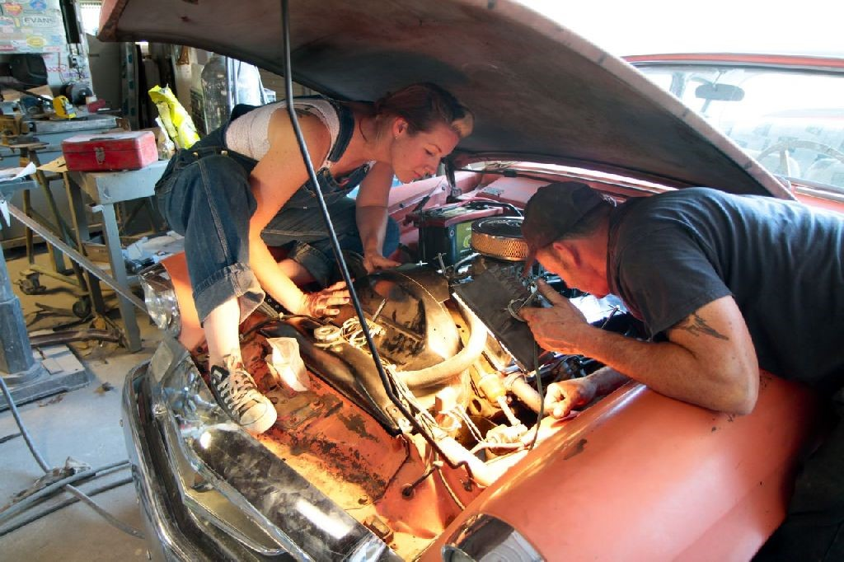
Derecho Internals

Slide 35
Motivation: Consider Paxos on a fast network
P
Q
R
“Ack”
“Ack”
“Here is 100B message m”
“Are you till prepared to commit m?”
“Commit m”

Slide 36
Motivation: Consider Paxos on a fast network
P
Q
R
TIMELINE, PROCESS P
“Ack”
“Ack”
“Here is 100B message m”
“Deliver m”
“Garbage collect m”
P
1.5us
0.75us + 100B/12.5GB/s = 0.750000008us
1.5us
1.5us
4.5us + 12 messages (limit: 75M/s)

Slide 37
Motivation: Consider Paxos on a fast network
P
Q
R
TIMELINE, PROCESS P
“Ack”
“Ack”
“Here is 100B message m”
“Deliver m”
“Garbage collect m”
Peak possible performance?
P
Time to perform one 100B reliable multicast? 4.5us + “noise”
… based on time expended, limited to 222,222/s
12 network operations out of 75M: limited to 6.25M/s
This network could have transferred 56KB of data in 4.5u
… we left 99.8% capacity “unused”!
0.75us + 100B/12.5GB/s = 0.750000008us
1.5us
1.5us
1.5us
4.5us + 12 RDMA messages (limit: 75M/s)

Slide 38
A few ideas
Have all the 3 members perform concurrent updates… now we might get some overlap and push our efficiency… to 0.6% ☹
Run lots of threads… maybe 10 per process. We aim for 6% efficiency (but locking and scheduling delays will cut this sharply) ☹
Batch 1000 messages at a time. ☺ But now the average message waits until 500 more have turned up. Latency soars to 2.25ms ☹

Slide 39
At Best, You get something like this…
P
Q
R
Messy and unpredictable with sudden bursts of data movement… Unlikely to perform well ☹

Slide 40
Better: Separate Data Plane and Control Plane, make them lock-free
Data plane: The actual data messages. Send them continuously, as soon as new updates show up
Control plane: Responsible for deciding when it is safe to deliver (“commit”). Receivers continuously report their acks, in an all-to-all pattern. This way every process can deduce that messages are deliverable.

Slide 41
Better: Separate Data Plane and Control Plane, make them lock-free
P
Q
R

Slide 42
Better: Separate Data Plane and Control Plane, make them lock-free
P
Q
R
P
Q
R

Slide 43
Better: Separate Data Plane and Control Plane, make them lock-free
P
Q
R
P
Q
R
Data plane runs steadily
Control information exchanged continuously

Slide 44
Data/CONTROL SPLIT
Data plane
Control plane
Like TCP, but instead of 1-to-1, 1-to-many
Carries messages with user-provided data, such as “decrement the inventory of X-box units” or “help me understand this video snippet”
Some messages are small… some huge!
All to all communication pattern
Control data is in the form of counters, like “process Q has received 22 multicasts from process P”
In Derecho the control plane does not use state machine replication. Data is asynchronously streamed, and there are no ordering guarantees.

Slide 45
How to put these into order?
Q
P
R
Contention for “slots” is one factor that slows standard Paxos down. Derecho uses round-robin order: one message from P, then one from Q, etc.
If a process has nothing to send, Derecho generates a “null message” from it, so that the others won’t have to pause.
This rule allows processes to stream data at high speeds without pausing.

Slide 46
how Derecho gets its speed
By “aligning” the flow of information with the network and not waiting for round-trip responses, it can run at the full network speed continuously.
Derecho never pauses unless the application no longer has data to send.
Analogous real-world situation: filling a series of buckets from a steady stream of water (Derecho), versus filling one cup at a time, then pausing to drink it before filling the next cup (Paxos).

Slide 47

How fast is Derecho?
On RDMA networking (100Gbits/s) and on a typical Intel server:
Derecho can perform 8M “small” replicated updates per second in each
shard. Delay from sending until delivery is as low as 3us
Derecho can transport very large messages, like photos (1MB) or even
videos (100MB or more) between 110Gbits/second for a small number
of replicas and ~85 Gbits/second for a large number
Scaling is almost flat. Whether you need 5 replicas or 25, the speed
and delay are similar… and 3-5x faster than memcpy on our servers.
This is thousands of times faster than LibPaxos or Zookeeper

Slide 48
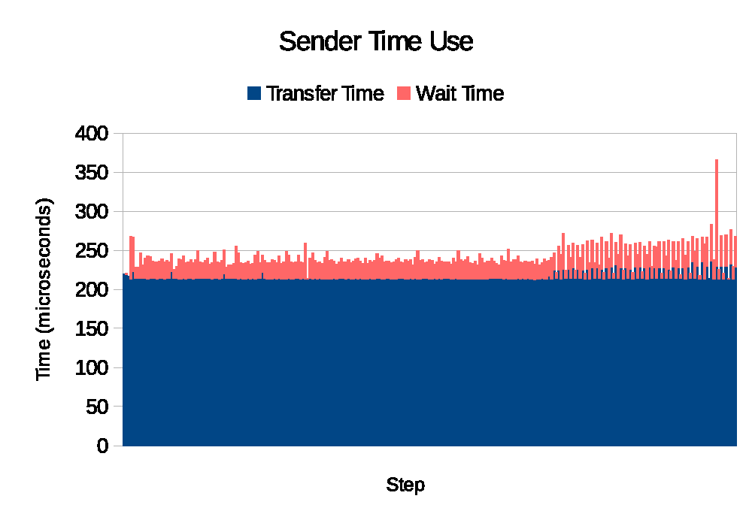
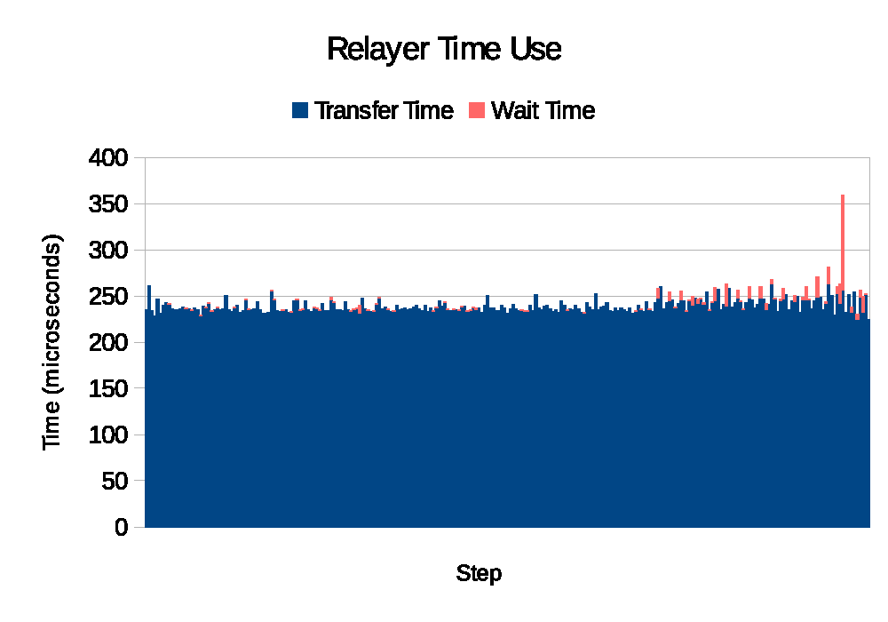
By offloading work to the the network Derecho frees host computers to do other useful tasks
This snapshots a heavy load scenario. Blue shows time (“work”) being done by the network hardware. Pink is work done on the host computers running Derecho

Slide 49
Derecho’s Epoch Mechanism in action
Copies state from some active member
Warm-started
spare processes
…. If a failure occurs, Derecho automatically repairs it.

Slide 50
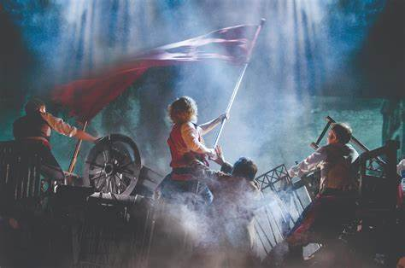
Is this revolutionary?
… kind of.
Companies were extremely interested in Derecho when it was first published. Some big cloud vendors discussed adopting it
But they concluded that really effective use of Derecho would force them to recode many core systems that work pretty well. Plus, Derecho was created at Cornell. As of today, none has decided to bet heavily on it.

Slide 51

Cornell decided to use
Derecho to create Cascade
Cascade is an ML-hosting platform built on Derecho
The idea of Cascade is to support standard ML platforms but also host ML lambda methods (lecture 3). Your code lives right inside Cascade.
Cascade will be the topic of Lecture 10, on Sept. 26, but let's take a peek

Slide 52



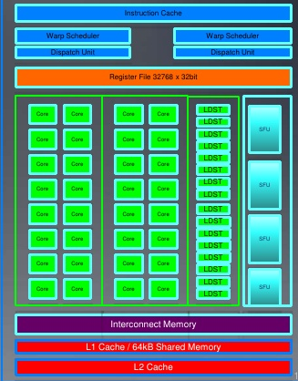
This shows one Cascade instance with some user-supplied logic (λ)
User code for making sense of traffic photos
Sample application: A smart
traffic intersection
Key-Value Storage Layer
Accelerator Layer
GPU

Slide 53
CASCADE used to create a μ-service
Request for classification triggers a C++ lambda in the Cascade address space
Fast-path logic (DLL)
Ideally, these are cached on GPU
Key-Value Storage Layer
RDMA directly into GPU memory
Image to classify
ML model, configuration, parameters
Accelerator Layer
Upload “instructions”
GPU
GPU-accelerated kernel initiated from the lambda

Slide 54
… So, how is Consistent replication actually used?
Now that we have it, what good is it?

Slide 55
Historically, consistent replication was used to create ultra-reliable services
Systems Ken worked on that actually require strong guarantees
Air traffic control system (France, 1995-present)
Stock exchange trading platforms and notification infrastructures
Control systems for highly automated VLSI fabrication and other forms
of industrial factories, like refineries
US Navy AEGIS battle station information support
Northeastern US electric power grid “smart” monitoring infrastructure

Slide 56
What do these have in common?
Use of state machine replication as a root source of consistency
For the ATC example, this entails three important elements:
There can only be on official version of the current flight plan
There needs to be agreement on which consoles are active in the system
to ensure that updates reach all the controllers who need to see them
Planes and controllers need to agree on who is in charge of what

Slide 57
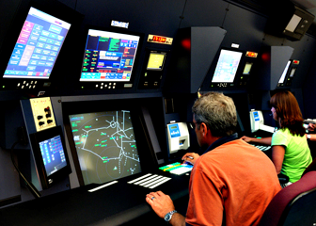

French Air Traffic Control (1995)
Flight plan manager tracks current and past flight plan versions
Message bus
. . .
Microservices for various tasks, such as checking future plane separations, scheduling landing times, predicting weather issues, offering services to the airlines
Air traffic controllers
update flight plans
Flight plan update broadcast service
WAN link to other ATC centers

Slide 58
… not shown
There is also a wide-area architecture, for sharing between ATC centers, and several replicated databases for “detail” data
And there is a fail-safe mechanism so that if one center or even a whole country has a sudden outage, control can seamlessly shift to a neighboring system in some other region or country
There are also elaborate security mechanisms to protect against attack by hostile intruders who might want to disrupt the system in various ways

Slide 59
Having platform-level consistency doesn’t make it trivial
Building consistency mechanisms into a system doesn’t ensure that your applications, layered over the consistent framework, will be correct.
You still need very careful specifications and detailed justifications (proofs) that each element satisfies its requirements!
Speed matters too: Air traffic systems aren’t exactly “real-time” (deadlines are quite long, when you look closely), but do need quick actions!

Slide 60
Future needs for consistency?
But any system that reacts to the outside world while controlling things needs consistency to avoid causing accidents or damage.
It is easier to build IoT systems that simply capture and monitor the outside world. Those can store data first, then process it much later.
Snappy but correct actions are more and more important as the edge of the cloud is integrated into the outside world of sensors and actuators

Slide 61
Summary
We actually can have C+A if P isn’t needed – the key is to have the microservice hold the needed state in replicated objects, and then to align the Paxos protocol with the properties of the hardware
The resulting performance is amazing, and important in many settings
Today, people work with higher level AI packages like Tensor Flow and Databricks, and those run on DHTs. This is why Cornell is now building Cascade: An extensible, customizable DHT that leverages Derecho.

