Slide 1
CS5412 / Lecture 6 Replication and Consistency (Part I: Theory and Protocols)
Ken Birman
Fall, 2022

Slide 2
In lecture 5, we saw CAP in Action
In that example, some sort of DHT update was delayed or disrupted and my “click” on an article (apparently about an election poll in 2020) couldn’t find some of the content (apparently some sort of graphic)
The DHT put must have been done asynchronously and not yet finished, or maybe the DHT was recovering from a crash or in the middle of an elastic resize event.
This resulted in a visible form of inconsistency

Slide 3
Can we build continuously consistent, highly available μ-services?
Just like in any μ-service, the data and computation will be sharded.
Suppose the data needed is a mix of the data in the request, and data hosted right in the shards that do the computation. This enables CAP: P won’t matter because our service is self-sufficient!
Each shard will need multiple members for availability (2 or 3 replicas, on machines selected to not fail simultaneously), and should “self-repair”.
Notes:
Today we’ll look at building a new μ-service using Derecho as a tool to simplify some of the really hard steps.

Slide 4
Can we build continuously consistent, highly available μ-services?
Reminder: P was about “partition tolerance”, meaning “the μ-service never has to pause and fetch data from any other μ-service, like a database or file system. It can reply purely using data it “holds”.
Eric Brewer pushed for soft-state only, but if we can solve this problem, we can actually have a hard-state μ-service.
Just like in any μ-service, the data and computation will be sharded.
Suppose the data needed is a mix of the data in the request, and data hosted right in the shards that do the computation. This enables CAP: P won’t matter because our service is self-sufficient!
Each shard will need multiple members for availability (2 or 3 replicas, on machines selected to not fail simultaneously), and should “self-repair”.
Notes:
Today we’ll look at building a new μ-service using Derecho as a tool to simplify some of the really hard steps.

Slide 5
Some Tasks that require Consistent Replication
IoT applications where we need to make sure all our actions are correct and reflect the most recent information
Replication of configuration parameters, input settings, patches or other updates.
Replication for fault-tolerance, within the datacenter or at geographic scale.
Replication so that a large set of first-tier systems have local copies of data needed to rapidly respond to requests
Replication for parallel processing in the back-end layer.
Data exchanged in the “shuffle/merge” phase of MapReduce
Interaction between members of a group of tasks that need to coordinate
Locking
Leader selection and disseminating decisions back to the other members
Barrier coordination
Notes:
A process == a program running on some computer. Named by the computer’s IP address and the process id on that machine. Maybe a bit more like which TCP port it is listening on, maybe not.
Membership == a list of which processes are in the system, and perhaps, what role they will play (in many μ-services, the set of members are split into subsystems).
Role: complex systems often have subsystems, like running the DHT or doing load balancing or keeping the TAO database. Those are roles. The full membership might include ALL the processes and machines. The roles are for individual members: this process is a DHT member. That process has a TAO graph in a database.
The developer would need to design and control all of this. None of it is free or automated or magic. It can take years to design these systems. Membership management is just a way to provide help – a tool for that developer.
The tools have complex APIs. We’re talking here about what the thing does, not the API.

Slide 6
Today’s outline
Understanding our broad goal: how to build a μ-service (or set of interconnected μ-services) to be “self-sufficient” and offer CA and not need Brewer’s P (they will need a different kind of Partition tolerance, to avoid split-brain crashes, but this is different from what Brewer meant)
Overview of the important models: crash-failure, Byzantine failure, virtual synchrony for self-managed membership
Deep dive on one simple example: Chain replication, using Zookeeper for configuration (membership) management

Slide 7
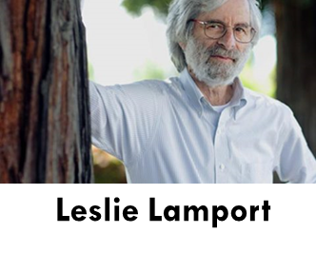
Leslie Lamport started the areA!
This is Leslie Lamport, who was a pioneer in bringing rigorous models and reasoning to distributed computing systems.
For Leslie, our question relates to replicating state. If we have replicas of the state of a μ-service, it can tolerate failures, and if we can make it consistent, we get C+A.
State machine replication is the name Lamport proposed for this new model

Slide 8
How does state machine replication work?
We start with some set of processes (like servers in a DHT shard)
Initialize them into the identical starting state.
Then make sure each process sees the identical events in the identical order. If the code is deterministic, they will remain consistent.
From this idea we can build up abstractions like fault-tolerant computing.

Slide 9
There are Many new ideas here!
Can we really build “deterministic” computer programs?
What does it really mean to build a program that can be replicated this way? How does this even fit with an IoT setting using μ-services?
Anyhow, how did we know which servers should do this replication? And what if one of them fails, but the others keep running?

Slide 10
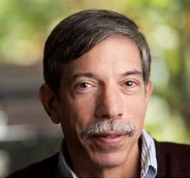
Fred Schneider to the rescue!
Superman
When people first became confused about how to put all of this theory into practice, Leslie didn’t really respond.
Leslie explained that at the end of the day, he prefers to be seen as a theoretical computer scientist… not an engineer.
Leslie felt that although his work does define “building blocks” for state machine replication, software engineering tradeoffs were beyond his scope.

Slide 11
Fred Schneider to the rescue!
Superman
But Fred Schneider saw this as an opportunity
Working with Leslie, he gradually identified a wide range of ways to actually implement state machine replication solutions. He didn’t implement them, but he created a tutorial on how to approach the issue.
This work showed that state machine replication could be useful

Slide 12
Determinism
The idea here is to think of each program as code that reads inputs, then computes on the input, then produces outputs.
A non-deterministic program might do various different things even with the identical inputs.
A deterministic program will always behave identically.

Slide 13
Why might a program not be deterministic?
Think about a program that reads the clock.
If I make two copies, they won’t see the same value because computer clocks advance at such high rates (nanosecond increments) that you basically can’t read two clocks in parallel and see the same time!
So even if you just print the time, your program is non-deterministic.

Slide 14
More issues…
Most modern programs are multithreaded.
But this implies that the thread scheduling order is random and unpredictable. The only way to be fully sure of the order is to use locking in some very rigid way.
Since most programs don’t use locking in such a rigid way, the scheduling order can’t be controlled, and so each copy behaves differently.

Slide 15
More Issues…
Some programs read input from more than one potential source, like more than one client on a network.
Those programs could get two inputs more or less at the same time – in which case one replica might see A, then B. But the other might see B first.
In fact this could even happen if we have one network connection to a multithreaded client.

Slide 16
Leslie’s answer? “Meh.”
When people first raised these concerns, Leslie didn’t really respond.
He said that at the end of the day, he is a theoretical computer scientist and not an engineer. He said his role is to “inspire” not “implement”.
Leslie saw his role as being the definition of “building blocks” for state machine replication. Engineers should deal with practical issues.

Slide 17
Fred Schneider’s tutorial?
In fact it didn’t dive into implementation issues either.
Fred’s work was more focused on showing how state machine replication could be deployed to solve higher level objectives of various kinds.
So his tutorial, although hugely impactful, still didn’t somehow make state machine replication “practical” in cloud settings.

Slide 18
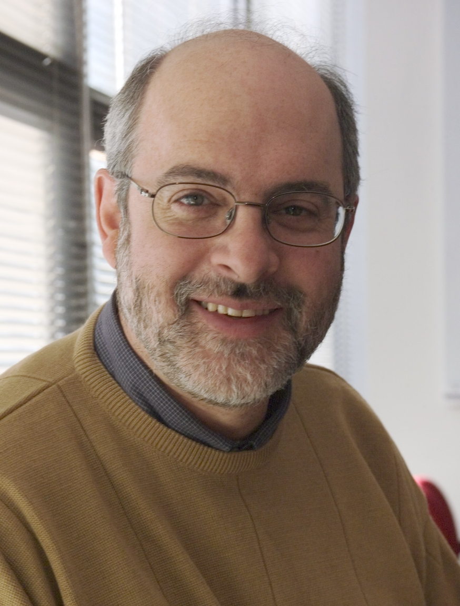
Ken to the Rescue!
Early in my research career I became interested in this
My idea was simple: Build non-deterministic programs that can run as groups, with subsystems where the state-machine replicated data lives
The “replicated objects” holding the data do need to be deterministic
But the application as a whole doesn’t need to be deterministic
This became a widely accepted way around the limitation. It was first implemented in a 1985 system we called “Isis” (more on it later)

Slide 19
Isis: main building blocks
One is called atomic multicast. The other is a form of atomic multicast that has a built in form of durable logging.
Both implement state machine replication, but in different settings.
Atomic multicast is a pure networking concept. It doesn’t save data into storage of any form.

Slide 20
Atomic multicast
We have a sender, and a group of receivers.
In some situations, this group of receivers is just a list of processes.
In others, the group is some form of “name” for the group, and a group membership service is used to track the mapping from the name to the current list of members.
Now we can offer the sender an atomic multicast API
outcome = atomic_multicast(destinations, message);

Slide 21
Atomic multicast
With an atomic multicast, we usually just say that the message is a vector of bytes. From last week (and in the homework) you’ve learned that actually we can represent all sorts of objects as byte vectors, using serialization.
Atomic multicast normally requires some form of protocol that implements the sending (just like TCP, which implements reliable one-to-one data streams over the more basic network hardware).

Slide 22
Atomic multicast
The requirements are:
The atomic multicast is all or nothing. If any receiver delivers a message, then every receiver must do so (unless it crashes, obviously).
If a crash does occur, this can’t break the delivery guarantees. Worst case? A sender crash after just one copy was sent. This must be self- repaired inside the protocol that implements the primitive.
Additionally, messages must be delivered in the identical order at all the receivers. If A and B are simultaneously sent, the order can be A B or B A, but everyone must “agree”.

Slide 23
In-Memory replication limitation
The one issue with using atomic multicast is that our solution will be doing in-memory replication.
But if all the members fail, the state of that shard is wiped out. In many systems this is acceptable, and we just try to be sure it would be rare.
But there are many services that need persistent memory.

Slide 24
Persistent logging
This idea starts with atomic multicast but assumes that each receiver will be saving messages in an append-only file: a log.
In the early days, data was smaller and the actual “state” could still fit in memory. The logs were used mainly for recovery.
Modern cloud systems have such big data objects that today, the data might not all fit in memory, and reading the logs has become frequent

Slide 25
Failure models
Most cloud computing systems worry about crash failures and network link failures (partitioning).
These are relatively easy to detect and protect against.
With accurate detection we just need F+1 processes to tolerate F failures. But can we detect failures accurately?

Slide 26
Timeout can deceive you!
Confusion about who is dead (and who looks dead, but isn’t) causes Romeo and Juliette to end tragically…
In a distributed setting, we can never be sure if a crashed program is really dead, or only seems dead.
If we have enough healthy members, the system can tolerate a few crashes. If one or two processes become unresponsive we can exclude them and “move on”
Trying to be certain is impractical, unless you just press “reset” for any machine that seems at all faulty. Some datacenters actually do that!

Slide 27
James Hamilton
“Reboot. Reimage. Replace.”
Cloud leader at Microsoft, then Amazon. James was focused on datacenters with huge numbers of computers
Don’t sit around waiting to figure out if one of them is faulty.
Just reboot it. If that doesn’t work, reimage it (reinstall the software). If it fails repeatedly, replace it. We call these the “three Rs”

Slide 28
More extreme models
Crash faults aren’t the only model Leslie considered. In fact, there are many models that capture extreme behavior, such as a hacking attack.
These are generally called Byzantine fault models.
With Byzantine faults, we usually need 3F+1 processes to overcome F failures – a single Byzantine process can cause big trouble!

Slide 29
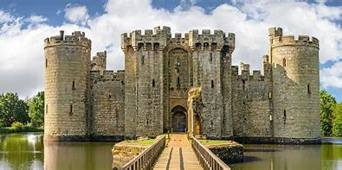
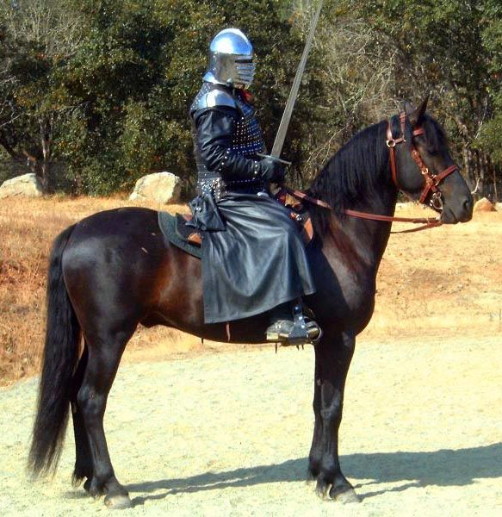
Byzantine Agreement
Leslie devised a story to motivate this model. He set the story during the Byzantine empire, a war-torn period in southern Europe
A group of knights lead small armies towards a castle. Inside, the besieged King has an army too, but he would be defeated if the armies all attack. However, if he can split them, he will win.
So, he bribes a knight. Obviously, the knight’s own army won’t attack. But the knight also needs to block at least one additional attacker…

Slide 30
The Byzantine Model in Action
Attack!
Retreat!
Attack!
Retreat!
Arthur sees Retreat, Attack, Retreat | Retreats
Lancelot sees Attack, Attack, Retreat | Attacks
Phillip is a traitor, unimportant what he does | ---
No solution works for 3 knights, 1 round

Slide 31
Some problems to think about
The basic issue is when the knights don’t agree. If some attack and some retreat, the force will be defeated and the king in the castle wins!
But the traitorous knight is motivated to lie. It could say retreat to some knights and attack to others – to split their forces.
We need a form of majority voting that works even when some knight tries to confuse and disrupt! This is solvable but explains the 3F+1 rule.

Slide 32
The Byzantine Model in Action
Retreat!
Retreat!
Retreat!
Attack!
With four knights and 2 rounds, we can untangle the puzzle (they all retreat)

Slide 33
Basic idea for one simple protocol
Byzantine agreement requires multiple rounds of “voting”
“ I am Lancelot. In round 3 I heard attack, retreat, retreat, retreat”.
“ Therefore, in round 4, Lancelot votes retreat”.
After F+1 rounds, the non-faulty knights will converge. The single faulty knight cannot stop them from overwhelming his confusing inputs.

Slide 34
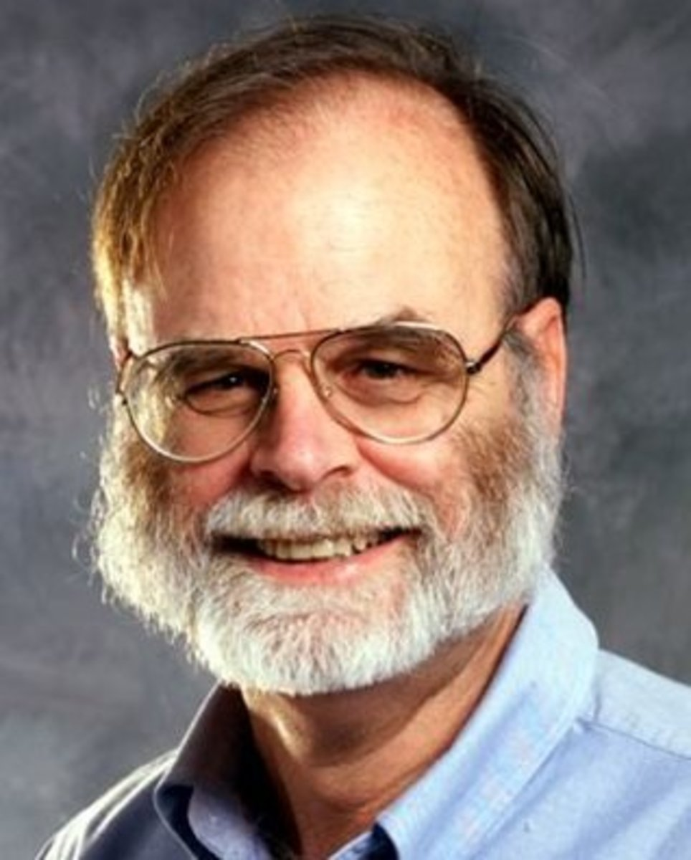
Jim Gray: But failures aren’t Byzantine!
Around when people were discussing this, Jim Gray did a famous study: “How do programs fail, and what can be done about it?”
Mostly, the issue was software bugs, causing crashes. He argued for much better testing and quality assurance.
With this, failures still occur, but they usually cause programs to halt (crash).

Slide 35
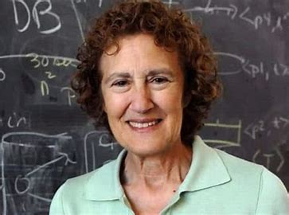
Is Byzantine Agreement ever needed?
Barbara Liskov and her student Miguel Castro created tools for Byzantine state-machine replication for objects and services.
The protocols are costly, but evolved into the ones used in blockchain systems, where Byzantine attacks are a common and real issue
Barbara Liskov won a Turing Award in 2008 for her many contributions to programming languages and systems

Slide 36
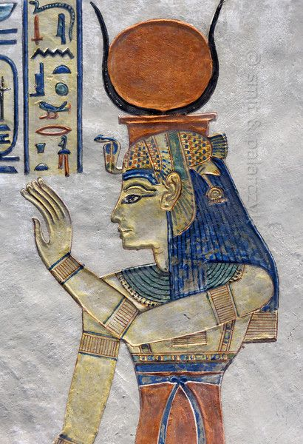
… back to Isis!
When I first came to Cornell in 1982, my initial research project focused on implementations of state machine replication in object oriented computing frameworks – like Java. We used the technique in individual objects.
The Isis Toolkit (1995) was the first practical solution in this area.

Slide 37
Why “Isis”?
Reference to Egyptian mythology.
In the Book of the Dead, Osiris is torn to pieces by Set. Isis gathered all the pieces and wrapped them in linen. Osiris came back to life. Their son, Horus, went on to defeat Set, who was then banished from Egypt and the underworld.
The Isis Toolkit picks up the pieces of your system and brings it back to life.

Slide 38
Virtual Synchrony
Isis does use atomic multicast and persistent replication, to support state machine replication, but it innovated by first addressing self-management.
This feature tracked who is in each group and shard. Then data was replication by the members in the list.
We called this model virtual synchrony.

Slide 39
Virtual synchrony: Managed Groups
Epoch: A period from one membership view until the next one.
Joins, failures are “clean”, state is transferred to joining members
Multicasts reach all members, delay is minimal, and order is identical…
P
Q
R
S
T
TIME
U
Notes:
As illustrated here, the job of the membership system is to make it all seem magically clean and simple. Processes join or leave or crash and the manager reports these events in a clean way. It even initializes joining processes (heavy arrows).
How? By asking some process to make a checkpoint, then asking the new guy to load it. How? Using upcalls to the software: event notifications. How? Through an API a lot like a GUI designer tool might offer.
Failures are usually sensed by timeout or by the OS, if a process crashed (but honestly, solid software rarely crashes. Computers crash, though. Remember those three R’s?)

Slide 40
Split-brain concern
Tes.com
Suppose your μ-service plays a key role, like air traffic control. There should only be one “owner” for a given runway or airplane.
But when a failure occurs, we want to be sure that control isn’t lost. So in this case, the “primary controller” role would shift from process P to some backup process, Q.
The worry: What if P thinks Q has failed, and Q thinks P has failed?
Notes:
The issue of a system forming a logical partition is quite real – this has actually been seen in real systems!
It can be very dangerous. The two halves might take inconsistent actions, like allowing two different planes to land simultaneously on the same runway.

Slide 41
Split-brain concern
In fact, a split-brain worry is a kind of partitioning tolerance concern!
In CAP, Eric Brewer used the term partition tolerance, but he meant “μ-service A must reply to requests even if μ-service B is unreachable”.
Here, we are worrying about a partition within the members of the μ-service itself, not between two different μ-services.

Slide 42
Split-brain concern
In fact, a split-brain worry is a kind of partitioning tolerance concern!
In CAP, Eric Brewer used the term partition tolerance, but he meant “μ-service A must reply to requests even if μ-service B is unreachable”.
Here, we are worrying about a partition within the members of the μ-service itself, not between two different μ-services.

Slide 43
What caused the problem?
A split service could leave us with two distinct “views” of the service, each having different members.
What we really want is to be sure that at all times, there is just one official membership.
Isis solved this using a majority rule: a majority of the members from view k must approve membership for view k+1. Members can only vote once.

Slide 44
Now we can see how virtual synchrony works, and why it solves the issue!
Epoch: A period from one membership view until the next one.
Joins, failures are “clean”, state is transferred to joining members
Multicasts reach all members, delay is minimal, and order is identical…
P
Q
R
S
T
TIME
U
Notes:
As illustrated here, the job of the membership system is to make it all seem magically clean and simple. Processes join or leave or crash and the manager reports these events in a clean way. It even initializes joining processes (heavy arrows).
How? By asking some process to make a checkpoint, then asking the new guy to load it. How? Using upcalls to the software: event notifications. How? Through an API a lot like a GUI designer tool might offer.
Failures are usually sensed by timeout or by the OS, if a process crashed (but honestly, solid software rarely crashes. Computers crash, though. Remember those three R’s?)

Slide 45
Now we can see how virtual synchrony works, and why it solves the issue!
Epoch Termination
Epoch Termination
State Transfer
Epoch: A period from one membership view until the next one.
Joins, failures are “clean”, state is transferred to joining members
Multicasts reach all members, delay is minimal, and order is identical…
P
Q
R
Active epoch: Totally-ordered multicasts or durable Paxos updates
S
T
U
Epoch 1
Epoch 2
Epoch 3
Epoch 4
Notes:
As illustrated here, the job of the membership system is to make it all seem magically clean and simple. Processes join or leave or crash and the manager reports these events in a clean way. It even initializes joining processes (heavy arrows).
How? By asking some process to make a checkpoint, then asking the new guy to load it. How? Using upcalls to the software: event notifications. How? Through an API a lot like a GUI designer tool might offer.
Failures are usually sensed by timeout or by the OS, if a process crashed (but honestly, solid software rarely crashes. Computers crash, though. Remember those three R’s?)

Slide 46
Back to today’s goals from slide 6
Understanding our broad goal: how to build a μ-service (or set of interconnected μ-services) to be “self-sufficient” and offer CA
Overview of the important models: crash-failure, Byzantine failure, virtual synchrony for self-managed membership
Deep dive on one simple example: Chain replication, using Zookeeper for configuration (membership) management

Slide 47
Chain Replication
Assumes you have a way to manage the membership of your shard or replication group, but need a simple fault-tolerant way to do updates and queries.
For example, maybe you use the popular Zookeeper management service
Professors Van Renesse and Schneider proposed the following solution

Slide 48
Chain Replication
Ok: Do It
A (head)
B
C (tail)
Update
Update
Update
A common approach is “chain replication”, used to make copies of application data in a small group. It assumes that we know which processes participate.
Once we have the group, we just form a chain and send updates to the head.
The updates transit node by node to the tail, and only then are they applied: first at the tail, then node by node back to the head.
Queries are always sent to the tail of the chain: it is the most up to date.
Notes:
Even before we solve those problems, it can be helpful to see an example of K processes cooperating.
Here, K=3. A, B and C are the three processes (in reality, A would be a machine where A is running, and a process id, and a port number).
In this image, A discovered B and C and connected to B. B connected to both A and C. We would use TCP for the connections. TCP connections can carry messages: like email, but sent from computer to computer in binary format.
Now we can tell people to send updates to A, and they can be relayed to B, then C. Later “ok” messages relay from C to A. This is called “chain replication”.
But you can probably see right away that this would be hard to implement even if the chain idea is easy to understand.
Another concern is that the updates travel node by node down the chain, and the queries are all done at the tail. This is slow and means that we have 2 or 3 replicas yet are limited to the compute power of just 1.

Slide 49
Does chain replication satisfy State machine Replication?
It needs Zookeeper: Unless you model the membership management layer, the protocol alone is an incomplete story.
This is actually why Lamport felt that a formal model (a mathematical one) and a methodology for proving things about protocols was needed.
But with a correct membership management service, used correctly by the protocol, chain replication solves state machine replication

Slide 50
Other famous tools that exist today
We will learn about Zookeeper later in the course. This is a modern solution based on an approach very similar to the Isis one.
Many people have worked with a library called RaFT. RaFT was proposed as a practical software solution for modern programs that need reliability
In our next lecture we will hear about Paxos and Derecho.

Slide 51
Summary:
CAP says “relax consistency and don’t stress about it” but in IoT settings, we do worry about consistency. The air traffic control example illustrates the concern. Many systems need consistency.
In a key-value store we might see this when replicating updates in a shard.
With Leslie Lamport’s state machine replication model as a building block we can work from. Virtual synchrony is a model for managing dynamically evolving system membership. Given these conceptual tools there are simple solutions, like chain replication, that implement consistency.

