Slide 1
CS5412 / Lecture 27 The Challenges of Introducing RDMA into cloud datacenters
Ken Birman
Fall, 2022

Slide 2
Context for this lecture
We saw how the need for performance has pushed some very fancy machine learning components closer to the edge, like Facebook TAO. Hardware accelerators improve performance and reduce costs for these components.
As we connect the cloud to sensors, we’ll get an even greater demand for real-time updates (hence replication), consistency and coordination at the edge. Cascade and Derecho are examples of a response to that need.
Notes:
So Derecho wins using RDMA. But is RDMA really working in the cloud?
Bad news: only “sort of”. It works at Microsoft in Azure, and at Google. But nowhere else.

Slide 3
Context for this lecture
Then we learned about how accelerators of all forms are central to performance and also eco-cost-effectiveness in the cloud.
In the case of Derecho this speed centered on RDMA.
But the real edge with the actual sensors will be 5G. And even inside the cloud itself, Derecho would often live on an edge-cloud, like Azure IoT. Can we just deploy RDMA everywhere?
Notes:
So Derecho wins using RDMA. But is RDMA really working in the cloud?
Bad news: only “sort of”. It works at Microsoft in Azure, and at Google. But nowhere else.

Slide 4
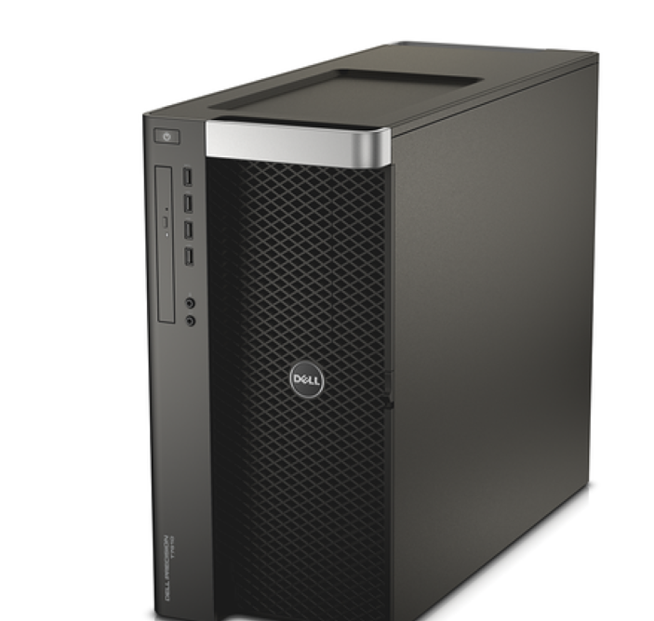
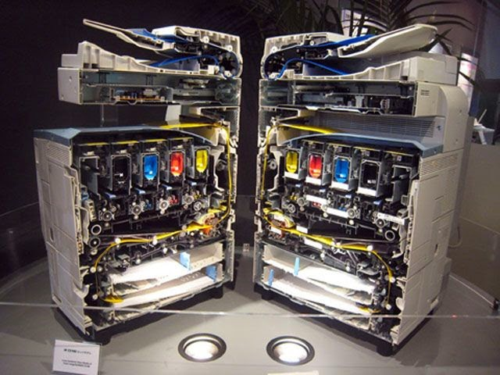
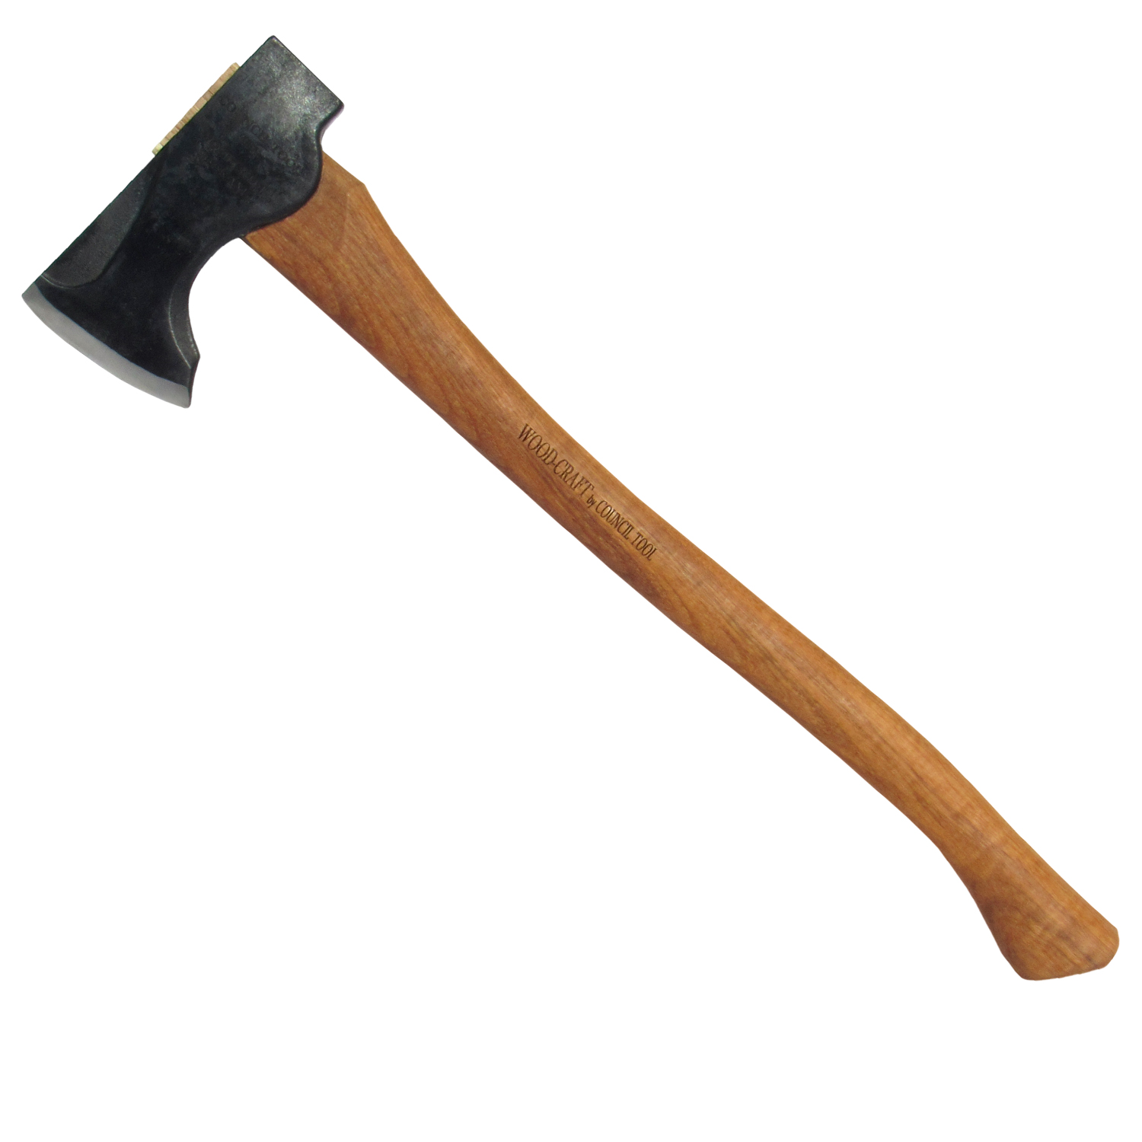
Life on the edge
“Cut through the stack for speed!”
The edge demands disruptive changes.
… early adopters tend to experience a lot of pain.
Nothing works… the hardware may lack programming tools… is undocumented… may even have hardware bugs. And “cutting through the stack” may have unexpected consequences elsewhere.
None of the rosy predictions are as easy to leverage as you might expect.
Hint: Start by duplicating some reported result for the same setup!
Notes:
This isn’t uncommon. Rollouts are surprisingly painful and slow. We’ll see why today.

Slide 5
Recap of some (old) lectures
By now we’ve seen accelerators a few times, such as Derecho on RDMA
We’ll do a quick refresh just to remind ourselves how hard it was to move Paxos to an RDMA framework.
Not a new lecture on Derecho, just a quick peek at some slides from early in the semester

Slide 6
intuition: Consider A Simple Reliable Barrier Protocol on RDMA
P
Q
R
“Ack” “Ack”
“Here is 100B message m” “Deliver m” “Garbage collect m”

Slide 7
A Simple Reliable Protocol on 100G RDMA
P
Q
R
TIMELINE, PROCESS P
“Ack” “Ack”
“Here is 100B message m” “Deliver m” “Garbage collect m”
P
1.5us
0.75us + 100B/12.5GB/s = 0.750000008us
1.5us
1.5us
4.5us + 12 RDMA messages (limit: 75M/s)

Slide 8
A Simple Reliable Protocol on 100G RDMA
P
Q
R
TIMELINE, PROCESS P
“Ack” “Ack”
“Here is 100B message m” “Deliver m” “Garbage collect m”
Peak possible performance?
P
Time to perform one 100B reliable multicast? 4.5us + “noise”
… based on time expended, limited to 222,222/s
12 RDMA verb operations out of 75M: limited to 6.25M/s
RDMA could have transferred 56KB of data in 4.5u … we left 99.8% capacity “unused”!
0.75us + 100B/12.5GB/s = 0.750000008us
1.5us
1.5us
1.5us
4.5us + 12 RDMA messages (limit: 75M/s)

Slide 9
A few ideas
Have all the 3 members perform concurrent updates… now we might get some overlap and push our efficiency… to 0.6% ☹
Run lots of threads… maybe 10 per process. We aim for 6% efficiency (but locking and scheduling delays will cut this sharply) ☹
Batch 1000 messages at a time. ☺ But now the average message waits until 500 more have turned up. Latency soars to 2.25ms ☹

Slide 10
At Best, You get something like this…
P
Q
R
Messy and unpredictable with sudden bursts of data movement… Unlikely to perform well ☹

Slide 11
Better: Separate Data Plane and Control Plane, make them lock-free
Send continuously, as soon as new updates show up
Receivers continuously report their acks, in an all-to-all pattern. This way every process can deduce delivery/garbage collection.

Slide 12
Better: Separate Data Plane and Control Plane, make them lock-free
P
Q
R

Slide 13
Better: Separate Data Plane and Control Plane, make them lock-free
P
Q
R
P
Q
R

Slide 14
Better: Separate Data Plane and Control Plane, make them lock-free
P
Q
R
P
Q
R
Data plane runs steadily (Derecho’s RDMC or SMC multicast)
Control information exchanged continuously (one-sided RDMA writes via SST)

Slide 15
Derecho’s Data Plane = RDMC/SMC. Derecho’s Control plane = SST
Derecho group with members {A, B, C} in which C is receive-only
A
B
C
A
B
C
A
B
C
m_{A:1}
m_{A:2}
m_{A:3}
m_{A:4}
m_{A:5}
m_{B:1}
m_{B:2}
m_{B:3}
m_{B:4}
 | Suspected |  |  | Proposal | nCommit | Acked | nReceived |  | Wedged
A | F | T | F | 4: -B | 3 | 4 | 5 | 3 | T
B | F | F | F | 3 | 3 | 3 | 4 | 4 | F
C | F | F | F | 3 | 3 | 3 | 5 | 4 | F
B fails, resulting in an uncertain state
Data moved on RDMA multicast
Control is done using knowledge programming on the SST

Slide 16
This is not an obvious way to program!
Notice how the hardware forced us to program differently:
The hardware is very fast, but only if used in a certain way
To use it in that way, at that speed, we couldn’t do “normal” things, like sending messages and waiting for acknowledgements, or votes
So we had to invent this new shared table abstraction, and had to rewrite the standard Paxos protocols in a totally new way
Notes:
Real point? The hardware is forcing us to rethink how we write code. It isn’t terribly hard to do, but if you don’t do it you are in the old “pause during round-trip interactions” model that was so slow. RDMA won’t turn out to help.
A good mental image is this: Imagine that you are driving a car with an infinite speed button. But each time you press it, you just get as far as the next group of cars and then have to slow down (you aren’t supposed to crash into them). The button won’t help much. You won’t get home earlier.
The new programming style has given us a way to get rid of these pause events, by using the SST. We actually could have programmed the SST to exchange real messages (Derecho has this, called the SSTMC layer), but that would use a lot of space. So the mixture here is of direct overwriting of cells in the SST, no pauses, and batch reasoning. It wasn’t so hard to do, but is a bit mind-twisting when you first see it.
This is one reason RDMA is slow to enter the cloud. It is a harder technology to use than you may expect. Easy to use just like message passing, but the ideal value requires programming with it in a new way.

Slide 17
… Not unusual with new hardware!
New hardware often results in ideas like Derecho
Specialty hardware can be extremely fast, but often requires that you use it in some very unfamiliar way.
If we just run the old style of algorithm on the new hardware, but in the old way, we wouldn’t benefit
Notes:
And this story is seen again and again!

Slide 18
… or even some old hardware
After building it, we realized that Derecho is actually faster on TCP too, although not quite as fast as with RDMA.
This is because modern TCP in a datacenter is incredibly fast, only about 4x slower than RDMA if you use it “just right” (TCP won’t hit this rate out of the box, it takes a lot of tweaking the application to get those speeds)
Also, TCP has pretty high “lowest delay” numbers (latency)

Slide 19
Initial conclusion
We managed to make Derecho very fast, but to do so:
Had to come up with a way to move bytes at crazy speed.
Then had to come up with a “control plane” that can run separate from the data plane.
Turned out it needed a lot of 2PC kinds of mechanism. To get those to be fast we invented this whole way to program the SST.
A lot of work, but the payoff was extreme speed.

Slide 20
Derecho: The remaining puzzles
To get the full speed of the technology
You need to work in C++. But many people prefer Python, Java…
Programs need to be “zero copy”. But most people have no idea if the packages they use do copying
Your code needs to be nearly lock free and rather pipelined. Few people are used to coding this way
Is it worth it? Derecho is as much as 15,000x faster than other options… but only if you use it properly!

Slide 21
Zero Copy requirement
Moreover, to get the full possible speed of Derecho, you need to write code that won’t involve any copying (even using memcpy, or even automated copying done in the programming language runtime).
Copying is slower than RDMA!
This is quite tricky: Your application needs to use RDMA “everywhere” for large objects where performance will be critical.

Slide 22
Zero copy opportunity
This shows two runs of the Cascade DDS (message bus) with various numbers of servers (shard size) and various messages sizes.
In each case we just measured delay from when a message is published to when it is received.
Yellow and red used a zero-copy approach. This one change dropped 1MB delay from 3.1ms to just 230us: a 13.5x speedup!

Slide 23
… there are more puzzles, too
Modern DRAM is internally concurrent: each cache line is independent.
If we write, say, 1MB we are writing into 156,000 cache lines. Intel guarantees “total store order” (TSO) but ARM and AMD are different.
When the RDMA sender is told “send complete”, have these writes really finalized? And will the remote system’s cache coherency hardware ensure that if an application looks at that message, it will see the new bytes?

Slide 24
Memory fencing
A memory fence tells the CPU that memory may have been updated and cached data must be refreshed.
An example: lock acquire and release are memory fenced. Suppose Y is data in the Derecho SST, and X guards Y. We update Y, then flip X to true
The reader sees X become true. Will it see the new Y? Without a fence, the reader might see a corrupted version of Y due to old cached data.

Slide 25
Other accelerators: Similar stories
GPU units require entire special programming languages (CUDA) and a really peculiar programming style (move object into GPU, load program, press “run”, move results back into CPU memory)
FPGA accelerators have to be coded in a gate-level language, like the ones used for VLSI chip design.
Network interfaces can be programmed, but the run a very strange kind of code focused on moving messages (P4, but it isn’t yet a standard).

Slide 26
Now we know all about Derecho.
Should everyone switch to it in all their edge systems?
Notes:
Well, we don’t really know all about it. You can read the paper for more information.
The point is: to build Derecho we invented a whole new multi-TCP thing, and a whole new way of coding Paxos. This is insane but to really leverage the hardware we had no choice!

Slide 27
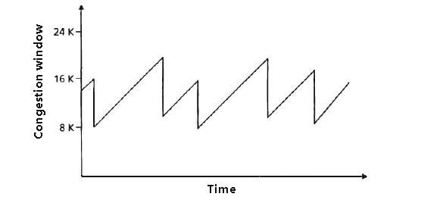
There is a small issue…
Not so fast… RDMA doesn’t really work in datacenters! A long history…
RDMA was invented in connection with a novel networking approach called Infiniband. It competes with optical ethernet
In ethernet, senders send packets, and packets are dropped if congestion (overload) occurs.
This causes loss if the packets are part of UDP messages, but TCP retransmits missing chunks.
It “backs off” (slows down) if loss occurs
Additive increase, multiplicative backoff
Notes:
Now the thing is… RDMA also would need to coexist with TCP. That isn’t so easy either!

Slide 28
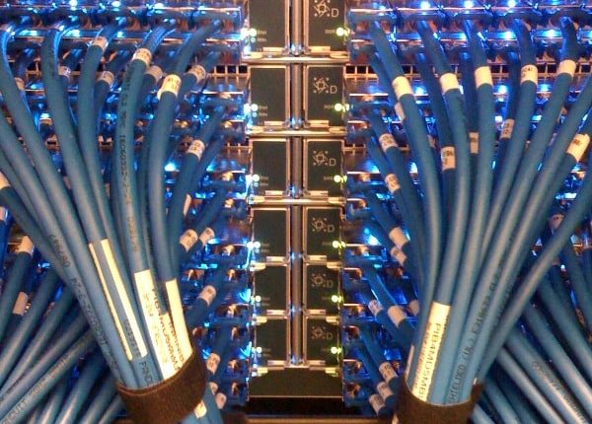
Infiniband isn’t Ethernet
In Infiniband, no device sends unless it has permission to send from the receiving device first
So when a router transmits a packet to another router, for example, the receiver has granted “credit” for the sender to send B bytes.
This is true for every step along the route!
Hop by hop, no data is moved without assurance of a place to put it
The optical network layer is so reliable that Infiniband is lossless!
More precisely: Loss is incredibly rare and usually caused by some form of crash
Notes:
We could run both side by side. But that uses a lot of extra power and cables.

Slide 29
Supercomputers love Infiniband
The “market share” for Infiniband in HPC systems is extremely high
Ethernet is unpopular because those packet drops aren’t rare, and this causes erratic performance.
So we now have 15 years of experience with Infiniband with as many as hundreds of thousands of datacenter computers!
RDMA was born in this world: DMA transfer over Infiniband works because hop by hop, no loss ever occurs. Every piece of data is moved reliably at “optical network” speed. Today: 200Gbps (bi-directional) is available
In contrast, memcpy with a single core is more like 36 Gbps for large transfers that can’t leverage the L2 cache.

Slide 30
RDMA on Converged Ethernet: RoCE
The idea emerged of running RDMA over optical ethernet, around 2010
Puzzle: RDMA doesn’t do retransmits over Infiniband, and a full TCP-style solution wouldn’t be nearly as fast
So, how to get RDMA to run in a setting without sender credits?
They introduced a concept of “Priority Pause Frames”

Slide 31
RDMA on Converged Ethernet: RoCE
The idea emerged of running RDMA over optical ethernet, around 2010
They introduced a concept of “Priority Pause Frames”
An overloaded router or switch or NIC sends PPFs to the sender of a flow if it becomes overloaded by incoming data
The RDMA NIC pauses, then restarts the transfer (the entire transfer) if it receives even a single PPF
… but unfortunately, PPF didn’t work very well
It can generate PPF “storms” and RDMA performance collapse
Notes:
Sadly, just running RDMA on Ethernet has not been a simple thing. It is just starting to work now, in 2018.

Slide 32
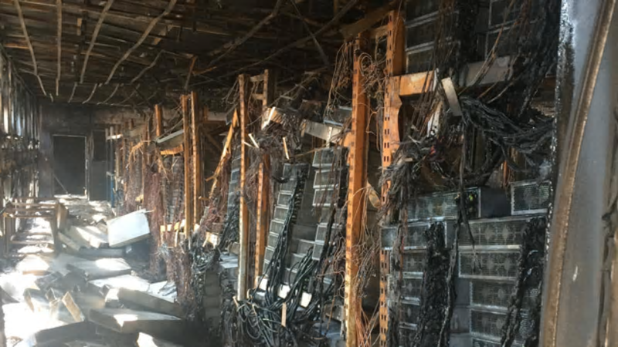
“But Does ROCE work??”
There are many stories of datacenter technologies that didn’t work well
They include optical Ethernet multicast (broadcast), early web server technologies, early packet routing solutions, early ways of connecting browsers to web servers, early DDoS attack filters
Often, they disabled entire datacenters when they malfunctioned!
… so datacenter operators are not eager to embrace RoCE yet, because “a little unstable” can mean “my datacenter could be toast”

Slide 33
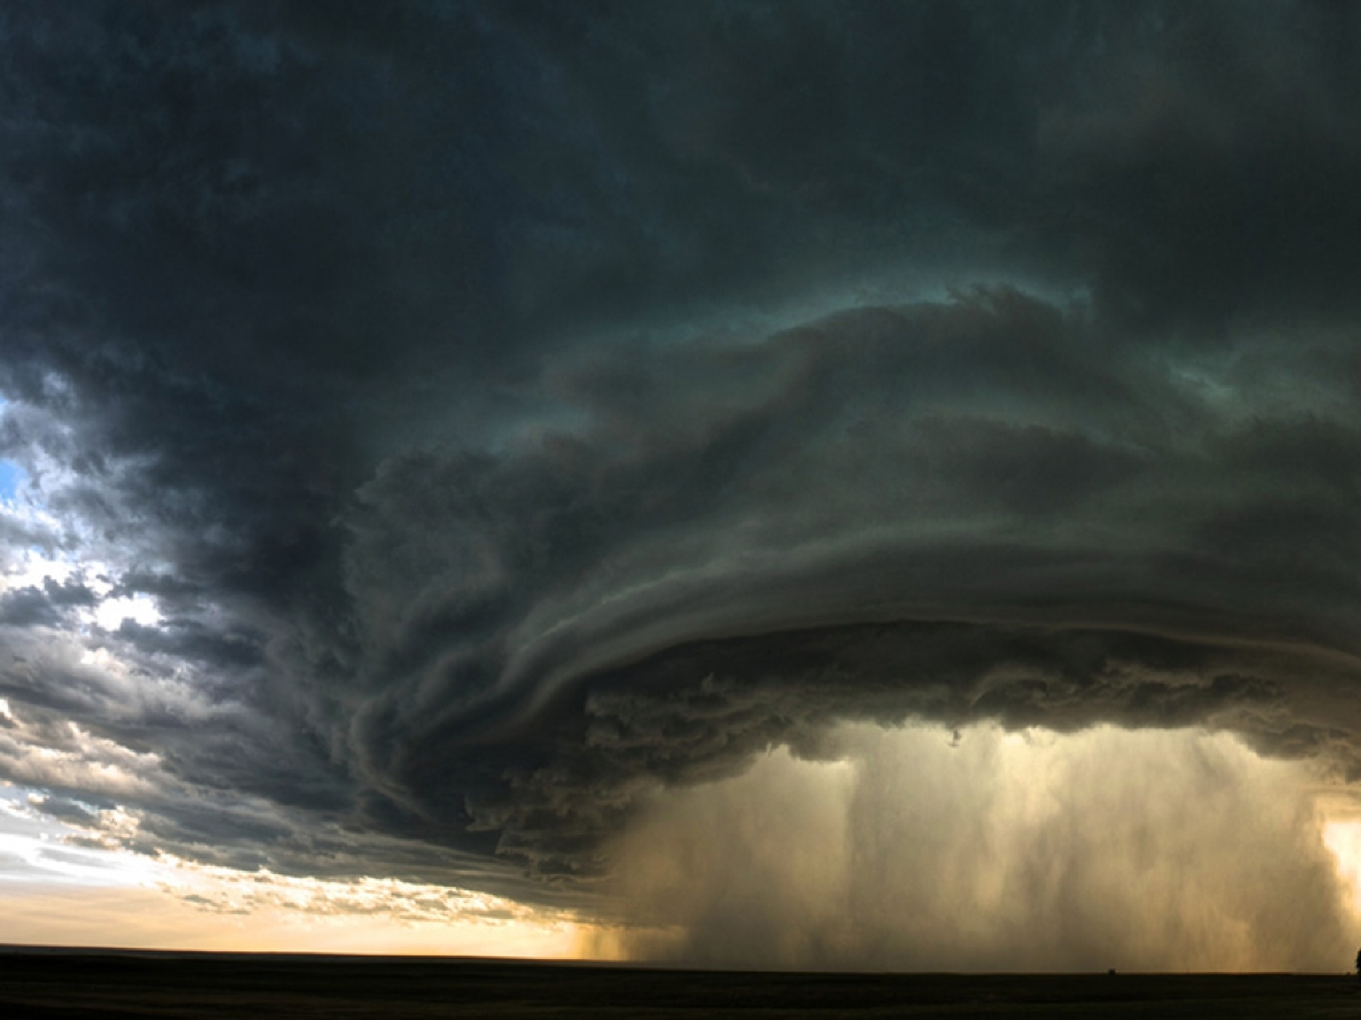
Reminder: Broadcast storms
This is another slide related to an old topic
When we talked about Bimodal Multicast, we asked whether UDP multicast could accelerate gossip. But a hardware “bug” blocks can trigger meltdowns that wipe out the whole data center
Kind of like this storm over Austin Texas…
Every machine suddenly receives 50,000 msgs/s
Notes:
It is hard to even imagine how horrible these events were.
You had all of Google or something, and you run some app, and the whole data center collapses and nobody understands why.
Basically, the hardware broke. It didn’t work properly at scale.

Slide 34
Could RDMA trigger such a storm?
No, not in a literal sense
The multicast storm was caused by a feature of routing and NICS specific to the way that Ethernet class-D multicast forwarding is done
In fact the “cause” is that a hardware hash-table fills up and overflows (underlying limitation: “Bloom filter” hash tables are too small)
But in the larger sense, the story is about how a technology used by one subsystem can overwhelm the whole datacenter and disrupt other systems
So you need to ask: “Could enabling use of RDMA disrupt the cloud?”
Notes:
Back on message: RDMC isn’t Ethernet broadcast. Yet it is normal to worry: could it be harmful in this way, too? Is there some issue nobody noticed?

Slide 35
Turning this into a technical question
The cloud is stable because TCP congestion control is stable.
RDMA doesn’t use TCP congestion control.
Does this imply that if we use RDMA heavily, our TCP traffic will be starved and our data center will become unstable?
In fact… yes. RDMA can be destabilizing in this way! Enter… DCQCN

Slide 36
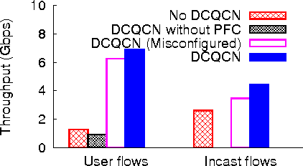
DCQCN
Data Center Quantum Congestion Notification is a new idea from Microsoft and Mellanox that uses end-to-end congestion notification
Basically, these are the same as credits in Infiniband
Experiments on modest datacenter clusters worked well!
RDMA + DCQCN enabled RDMA to work in normal datacenters!
A disruptive and transformational development!
Not so fast… does it really work? At full scale?
Notes:
Ok, now recently, people claim to have figured out how to run RDMA on RoCE next to TCP/IP without PPF storms. Cool. But should we trust them?
If so, we have an amazing breakthrough! But… if not… we have a disaster in the making.

Slide 37
Microsoft Azure Set up a red team
Goal: Deploy DCQCN side by side with normal TCP/IP in a new Microsoft datacenter, during the burn-in testing period (about six weeks long)
Test aggressively – try and see if they can trigger problems.
Includes misconfiguration, but not “breaking the logic”
They want to know: are we getting into trouble here?
Guess what? It didn’t work!

Slide 38
Issues that were identified
RDMA and normal TCP/IP interfered with each other.
PPF standard requires “Enterprise VLAN” feature on switches. Azure doesn’t use this technology.
But they solved these
They repurposed another (also unused) feature called “DiffSrv”
There was a DiffSrv packet format that could be reused for PPFs
DiffSrv also allowed TCP/IP to run side-by-side with RDMA, isolated

Slide 39
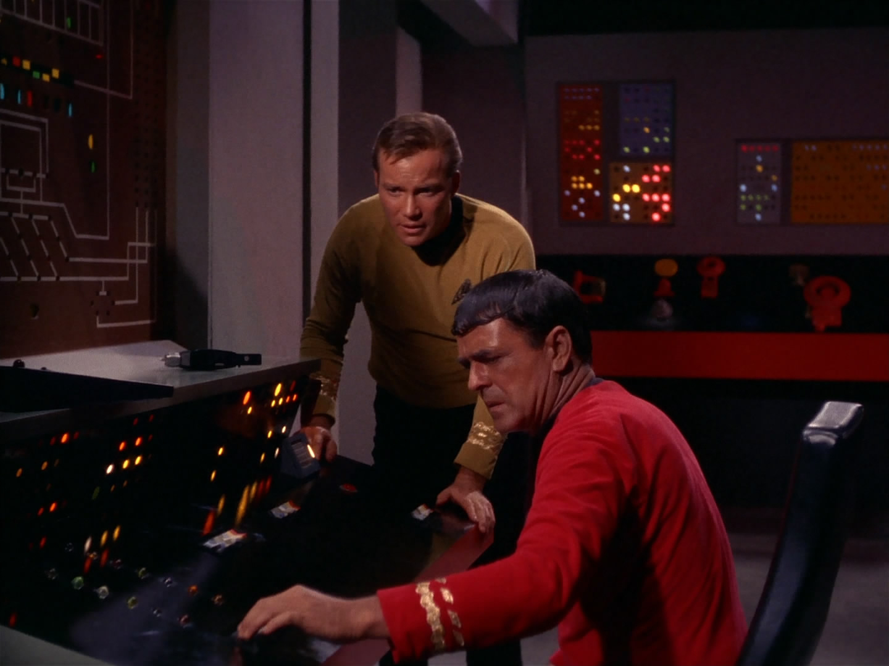
… it still didn’t work
“Jim, it dinna work. Antimatter containment will fail in 3 minutes!”
They discovered that RDMA + DCQCN + DiffSrv + PPF could cause a new kind of routing / congestion loop
It was triggered by a form of resource exhaustion because the TCP/IP layer and the RDMA layer were sharing buffers inside NICs, switches and routers.
By dividing the resources into pools, this could be solved. But their hardware lacked a way to do that. They solved it by “overprovisioning”
They bought more memory for the routers and switches than needed
Then configured to make sure that the memory never gets used up

Slide 40
More limitations
RDMA only works if the application is working from “pinned” memory pages, and works best if the memory pages are huge.
Seems to be at odds with virtualization
Advances in RDMA hardware may help reduce these issues
When an RDMA transfer finishes, the program can definitely access the data. But if you instantly do a DMA transfer to disk, or try to display it on a graphics device, caches and pipelines may need to be flushed first.
There is no standard way to actually do this.

Slide 41
More limitations
RDMA NIC is directly accessed from user-space code, and has direct visibility into the datacenter network.
But very little user-space code can be trusted! Cloud vendors are in a continuous state of attack by hackers and even naïve users just after speed
So the very idea of trusting RDMA applications is a big source of stress! Vendors are hoping to do encryption/decryption at line rate and to virtualize RDMA within a few years – but this is hard for them to do!

Slide 42
In the end, they got it running! ☺
Today, Azure uses RDMA, but only for system services (for now)
Azure HPC actually does have application-layer RDMA, but only for people who use a package called MPI.
In fact, MPI doesn’t share the devices with normal TCP/IP
Instead, Azure HPC computers have an entire extra Infiniband network
In the future, Microsoft may expand use of RDMA to allow some trusted subsystems to also use it. Probably it will never be free for general use.
Notes:
Long story short: they did get it all working, they think.
The general mood is to wait a year or so more and see what happens.
But apparently RDMA in the cloud on ROCE may be a reality soon. At least at Google and Microsoft.

Slide 43
… So, can you use Derecho on Azure?
Yes, over TCP or DPDK, but not with RDMA except on Azure HPC.
Today, virtualization seems to be incompatible with RDMA
And even where Microsoft has RDMA, they don’t allow you to access it yet. AWS does offer an accelerated data path, similar to RDMA, but we haven’t experimented with it. So this is coming, but not there yet!

Slide 44
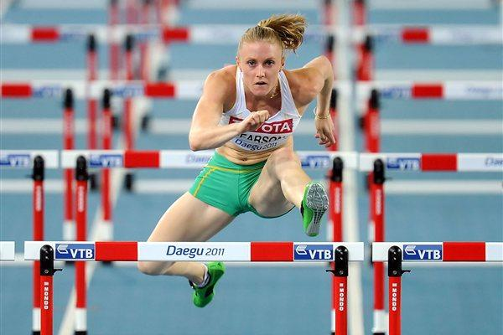
RDMA is just one of many “players”
This story of RDMA as an accelerator in the cloud is just one of a few
Each technology has many hurdles to overcome!
Is it way faster than not using it?
Will it save the cloud owner money?
Is it stable? Really stable?
How hard will it be to “manage”?
How hard is it to program?
Notes:
And it isn’t even just RDMA.

Slide 45
Edge version of this
The actual sensors are on 5G platforms. We can use a layer called the data plane developer’s toolkit, DPDK, to uniformly talk to the network whether it is 5G or other technology.
And there are ways to simulate RDMA on DPDK such as “urdma”, which is a library some graduate student built in Switzerland a few years ago.
But would Derecho run on such a layer? And would it make sense?

Slide 46
Moral of our story?
Modern hardware enables big steps
… but when you take them you potentially stumble.
… and even after the big step many questions still remain open!

Slide 47
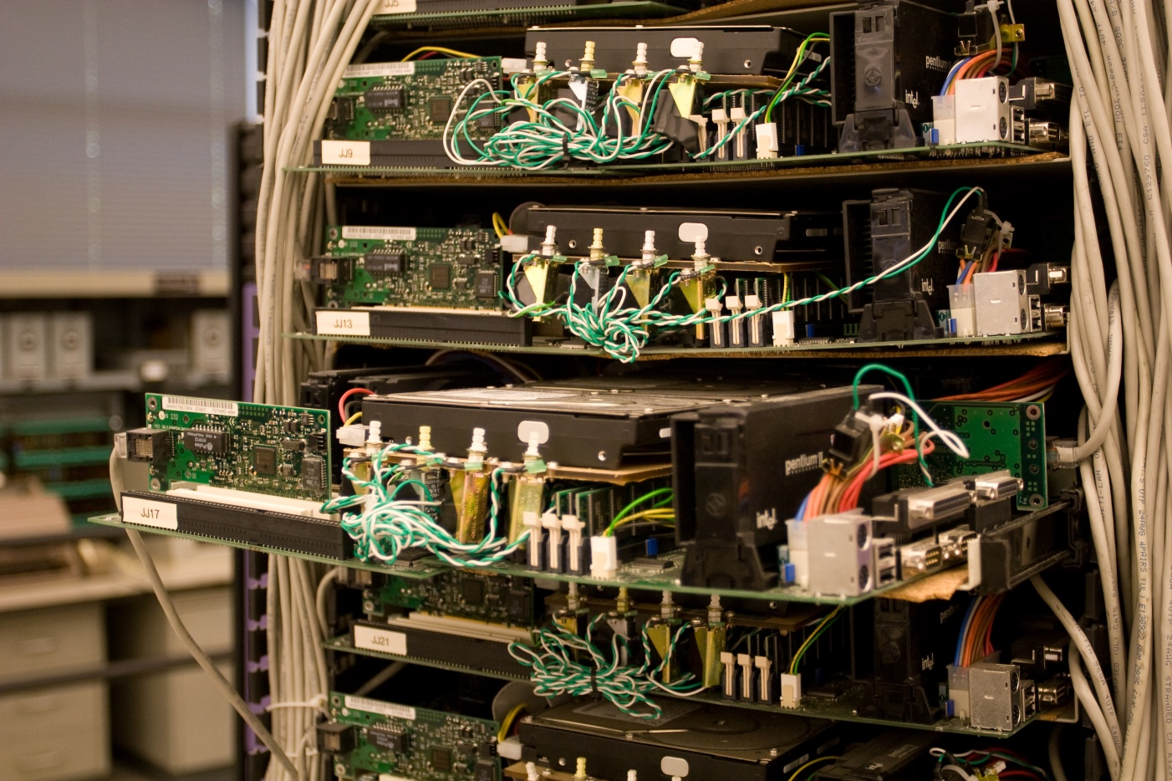
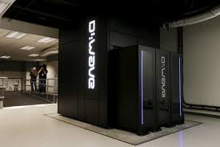
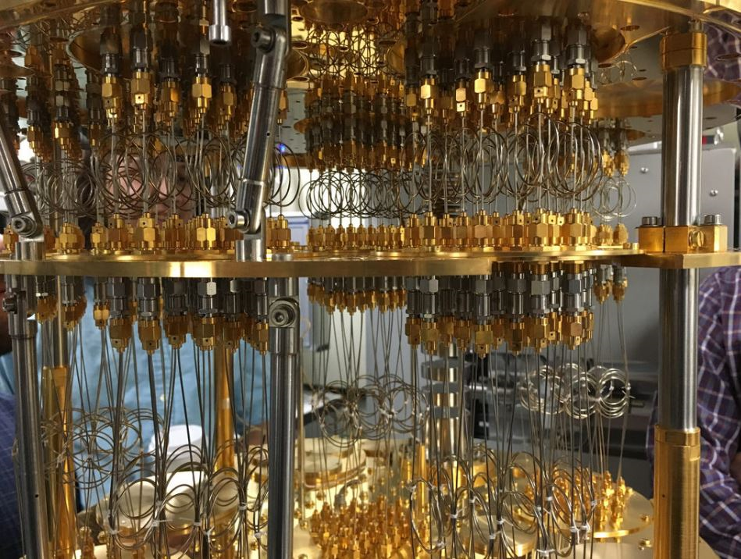
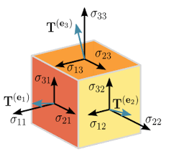
Programmable components
General purpose cores on NUMA machines
Network Interface Card (NIC) for modern RoCE (RDMA-capable Converged Optical Ethernet). Optical network itself.
Storage components (SSD)
Network Switches and Routers
Field Programmable Gate Array (FPGA), FPGA clusters, ASICs.
GPU (graphics accelerator) and GPU clusters.
TPU (tensor processor unit) and TPU clusters.
Quantum computing hardware
Notes:
Tons of hardware promises breakthroughs yet could be damaging…

Slide 48
Each would have a similar story
Every one of these has amazing potential, but to leverage it can require changing all sorts of things that used to be standard in Linux
As the modern data center evolves, we will run into that issue often.
Yes, we want accelerators. But the pain level is substantial!

Slide 49
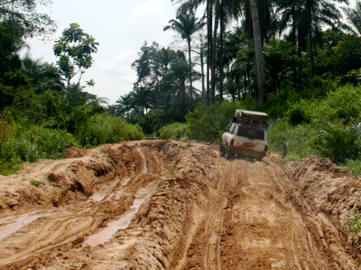
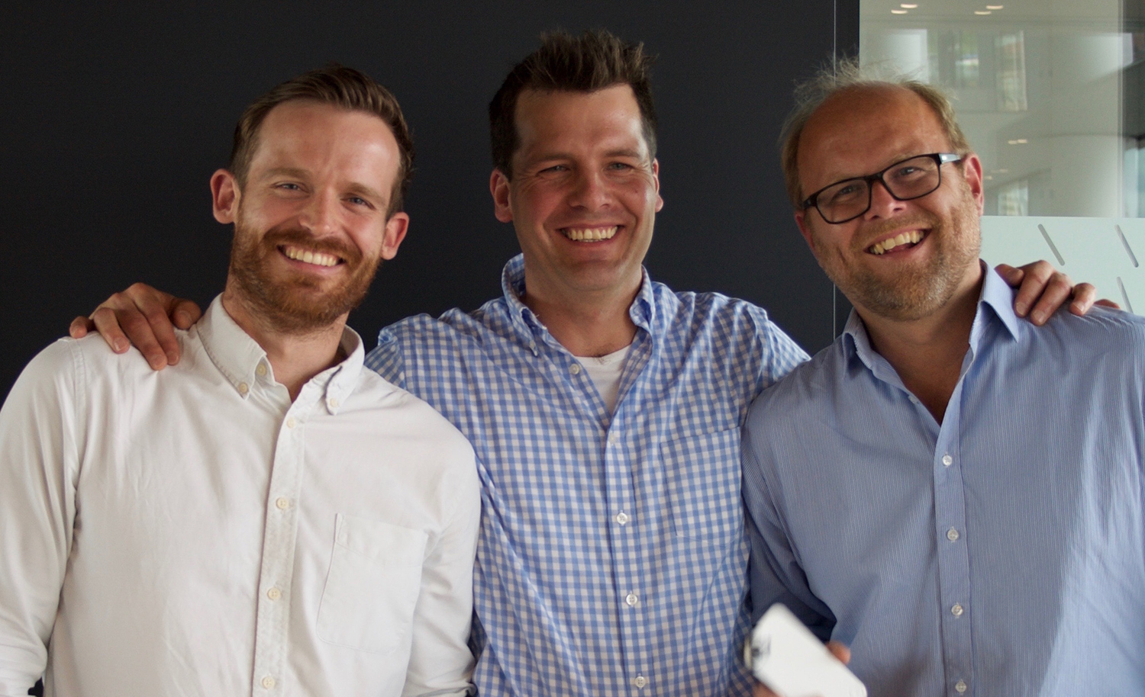
Rough Road Ahead!
The latest new thing always sounds amazing…
100x Speedups have a chance of adoption, if your pain tolerance is high!
Paradise awaits!
The boss: Paid to say “no”!
The pitch. What could go wrong?
Road to Paradise
Notes:
It will be so awesome once we just get past this muddy patch….

