Slide 1
CS 5412/Lecture 24 Fault Tolerance in Practice
Ken Birman
Fall, 2022

Slide 2
How do Apache Services handle failure?
We’ve heard about some of the main “tools”
Zookeeper, to manage configuration
HDFS file system, to hold files and unstructured data
HBASE to manage “structured” data
Hadoop to run massively parallel computing tasks
Hive and Pig to do NoSQL database tasks over HBASE, and then to create a nicely formatted (set of) output files
Notes:
Reminder of the apache tools we’ve discussed

Slide 3
Basic steps
Detecting the failure
Reporting the failure to the elements of the application software
Synchronizing so that each layer is fully self-repaired before any other layer manages to “see” it or tries to update it

Slide 4
How to detect a failure
It isn’t as easy as you might expect

Slide 5
Reminder: Failures and “transients” look the same
A network or scheduling delay can mimic a crash
FLP was built around the idea of always needing to be certain. If a process was healthy, FLP insists that its vote must be considered.
In “real” systems like Apache, we don’t want the to wait while one machine deals with a broken link. We need to move on!

Slide 6
Ways to detect failures
?
Something segment faults or throws an exception, then exits
A process freezes up (like waiting on a lock) and never resumes
A machine crashes and reboots
Notes:
Failures can show up in many ways. Some are more trustworthy than others (is that critter really dead, or just stunned?)

Slide 7
Some really weird “failure” cases
When clocks “resynchronize” they can jump ahead or backwards by many seconds or even several minutes.
What would that do to timeouts?
Could TCP connections “instantly” break?
Clocks can also freeze up and not move at all during resynchronization.
Notes:
Clock synchronization is a famous source of weird failure behaviors!

Slide 8
Some really weird “failure” cases
Suppose we just trust TCP timeouts, but have 2 connections to a process.
What if one connection breaks but the other doesn’t?
… can you think of a way to easily cause this?
This actually can happen!
FTP uses two connections, one for control and one for data movement
It will crash if either of them goes down
Notes:
Clock synchronization is a famous source of weird failure behaviors!

Slide 9
Useful perspective from studies
Why Do Computers Stop and What Can Be Done About It? Written around 1980 by Jim Gray.
He blamed operator errors and software bugs. Hardware crashes were rare! This triggered a lot of work on software engineering for reliability in complex distributed systems

Slide 10
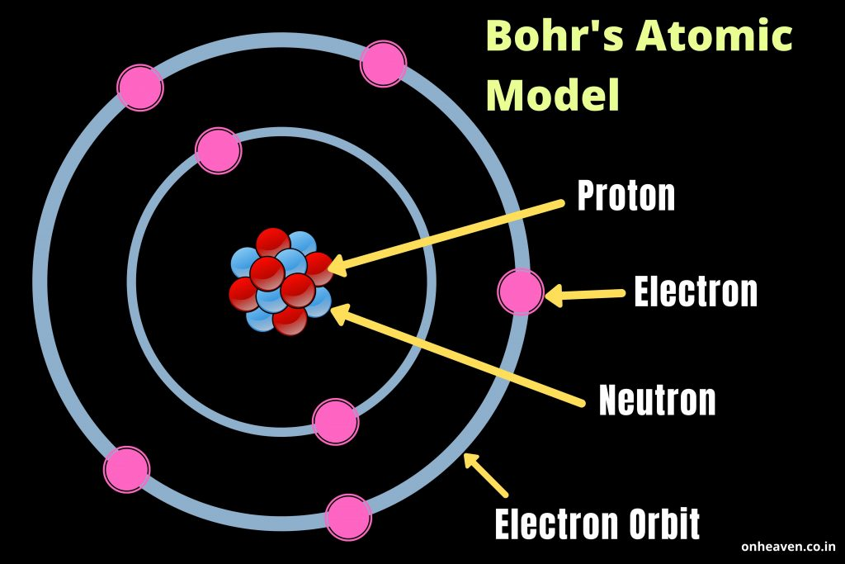
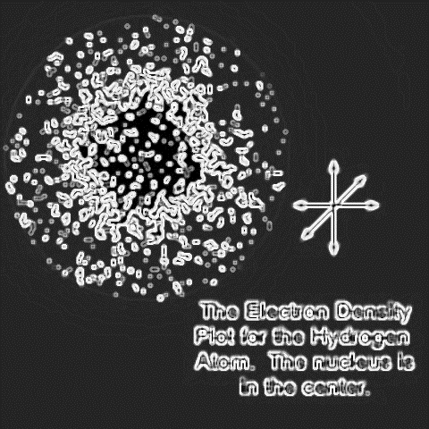
Bohrbugs and Heisenbugs
Bruce Lindsay
Bohrbug is a solid mistake. Easy to reproduce and hence to fix
Cloud of protons, neutrons surrounded by cloud of electrons
Heisenbug is often a side-effect of some error earlier in the execution. Shifts due to concurrency. Hard to pin it down and fix it.
Heisenberg’s Atomic model

Slide 11
Saved by software engineering!
The “clean room” development and testing process helps a lot
Design patterns for correct concurrent programming also make a huge difference, such as the “monitor” coordination model in Java and C++
With these methods, software (and even hardware) bug rates have dramatically improved

Slide 12
More insight from Jim Gray’s study
He also found that operators often make errors. Leads to a lot of modern attention on automated self-configuration and cleaner GUIs
And he found that the people who patch software often introduce new bugs! Leads to a modern focus on regression testing to make sure patches don’t create issues, or just “shift” issues.

Slide 13
More recent paper
Study of datacenter failures by Yahoo: BFT for the Skeptics. 2009 SOSP, Flavio Junqueira, Yee Jiun Song, Benjamin Reed
The authors discovered that Byzantine faults basically never occur in datacenters. Similarly, FLP-style problems never occur
But they often saw network outages that caused transient partitioning

Slide 14
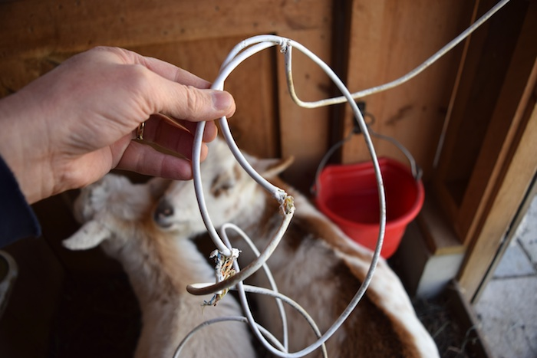
Bottom line?
For better reliability, don’t route your internet through a goat pen
Software bugs used to cause most crashes, but are less and less of an issue.
Improvement due to a “cleanroom” coding style, unit testing, release testing, quality assurance team, acceptance testing, integration testing.
Hardware reliability is better too. Operator error and physical events such as roof leaks remain common causes of major outages

Slide 15
Keep-Alive messages
The idea here is to have healthy systems do something actively to report “still ok”. They could even run an internal self-check first, periodically.
We call these “keep-alives”, meaning “I am still alive, keep me in your list of healthy members.
Each server could send a keep-alive to every other server, or to just a few neighbors. When we talked about gossip, we saw this in Kelips.

Slide 16
what if a timeout goes off “incorrectly?”
Recall James Hamilton’s 3 R’s
Reboot, then
Reimage, then
Replace
Most data centers today offer a way that one machine can toggle the power switch for some other machine! This guarantees a reboot

Slide 17
Dueling Reboots
Obviously, we could have a shoot-out
But this won’t happen often
James Hamilton would say that if something like this occurs, there is probably a root cause like a broken network connection, and very likely we actually should exclude those machines in any case!

Slide 18
Broader philosophy: The cloud must stay on
Never let the fate of one or two machines somehow control the cloud!
A cloud system is replicated and elastic and large
We should always keep the majority up and running, even if this trims away a bunch of machines because they seem to be broken. Their “opinion” that they are healthy is not relevant!

Slide 19
As a time-line
New work will have to wait!
Healthy system doing work
Healthy
again!
Failure occurs and is detected
Healthy system resumes normal work
Any system needs to go through a series of stages to deal with failues
If the failure could have damaged data or left an execution in a disrupted state, cleaning up will be important.

Slide 20
Three kinds of issues to think about
How does each element work when things are healthy?
How does each element detect failures, and if needed, repair itself to recover from damage the fault might have caused (such as a file that wasn’t fully written, and should be deleted and regenerated)?
How do the layers synchronize? If layer A lives on layer B, when layer A is ready to restart after a crash, can it be sure that B is already repaired?

Slide 21
Zookeeper Role
One ring to rule them all

Slide 22
Zookeeper “reminder”
Zookeeper is an implementation of a virtual-synchrony service (they don’t use these words, but they do use this model!) to track system state and configuration data.
The basic idea is that your application processes connect to Zookeeper via TCP. It monitors their health. And it reports membership via a small file.

Slide 23
Zookeeper files
Limited size (currently 1MB). Version replacement feature eliminates the need for costly locking.
Notification when a file you are watching is updated.
Zookeeper itself has a file holding membership data (process IP addresses). Detects failures if a TCP connection breaks, auto-updates.
Applications can also create files. They store configuration data in them.
Files are held in memory.

Slide 24
Guarantees?
Zookeeper is a lot like any virtual synchrony system
The service itself is replicated over 3-5 nodes for availability
It will never suffer split-brain problems
State machine replication for the files it manages.
In effect, a POSIX file system but just used for configuration data

Slide 25
Two forms of membership!
Zookeeper tracks its own membership… in this example, the five servers
When the Zookeeper service itself is not reconfiguring from failure, Zookeeper is tracking the status of clients (≡ members of the application)
Client joins? Zookeeper uses atomic multicast to update the list of active client processes and to track any metadata the client supplies
Client fails? Zookeeper learns this (as we discussed) and then notifies all healthy clients that the membership file has been updated

Slide 26
Clients will see these updates
They reread the file and adjust their internal data structures
For example, any client with a TCP connection to a failed client closes that connection.
During this transitioning period, some clients might have switched to the new membership and others could be lagging. Developers must plan for this and tolerate this period of asynchronous switchover!

Slide 27
Atomic MulticaSt: Weaker than Paxos!
Paxos also has a durability guarantee… and it applies to every update.
Zookeeper doesn’t have true durability. It does periodic checkpoints once every K seconds, where K must be ≥ 5s.
For their protocols, making each update durable immediately is slow
Derecho doesn’t have this issue, but our protocol is more efficient.

Slide 28
Key insight
Atomic multicast protocols are designed to:
Send copies of messages to all participants… but they won’t yet be delivered to anyone. Called pending messages
Wait until every healthy receiver has a copy
This status might be detected by a leader: the 2-phase commit pattern
Or it might be independently/directly sensed by members: Derecho SST approach
Only at when all have a copy do deliveries occur.

Slide 29
Contrast with Paxos
Paxos does durable log updates, but has also been proposed as the basis of multicast protocols. In Paxos, pending messages arise in phase 1
Recall that in this phase leader(s) contend to get their proposed message into a quorum Q_{W} of slots using a series of ballots
Phase 2 commits the successful message, but at this point it is already certain to be in Q_{W} logs, saved to disk.

Slide 30
Failure disrupts a multicast?
Virtually synchronous systems like Zookeeper and Derecho “self-repair, then advance” with no real rollback (no delivered message is ever withdrawn)
Pattern seen in these:
Freeze everything. Leader collects current status from healthy members
For each pending multicast, decide if it should be delivered or not. Leader commits this outcome via 2-phase protocol involving healthy members.
Pending multicasts that were not delivered are resent in the next epoch (view)

Slide 31
Failure disrupts a multicast?
In Cascade, layered over Derecho, the effect is that failures are “erased” and completely hidden from higher-level application logic.
But more complex outcomes can still arise because the failure may also have disrupted applications running on other nodes.
Apache examples illustrate this and how it is resolved.

Slide 32
What if a failure disrupts Paxos?
This can become extremely complex! Not a topic for CS 5412
But there are quite a few cases one must consider. In the worse case, Paxos can “commit” to leave a log entry empty – it commits ⊥ in that slot
Requires a case-by-case analysis and proofs. Paxos was so hard to reason about that it led Lamport to create the TLA+ theorem prover! At Cornell, we favor Coq/VST, Dafny/Z3 or Ivy/Z3 for this kind of protocol verification.

Slide 33
Layered Recovery
Unfortunately, this is very complex

Slide 34
The puzzle
Suppose that Zookeeper notifies HDFS, HBASE, Hadoop and Apache SQL that some nodes have failed. They might all need to self-repair.
But HBASE can’t self-repair until HDFS has finished! And Hadoop can’t restart jobs until HBASE is self-repaired, etc.
In effect, we need a layer-by-layer recovery

Slide 35
The apache self-repair logic is tricky
A good explanation of HDFS self-repair can be found here.
It is many pages long, and very detailed, requires a lot of internal knowledge about how HDFS is implemented.
We won’t do a deep dive…. Layer by layer synchronization isn’t standardized in Apache. The HDFS version involves “refreshing” something called a “block lease” and is integrated with the HDFS replication logic

Slide 36
It centers on a concept called a “lease”
The term means “time-bounded lock”
HDFS has an internal design in which data actually is stored into replicated blocks. While doing a write, the application must have a block write lease. To read the block, the application must have a read lease.
HDFS uses leases as its main tool to buy time for self-repair when a crash disrupts it.

Slide 37
How would HDFS self-repair? HBASE?
HDFS learns that a failure has occurred when Zookeeper updates the map of system components and roles. HDFS then invalids active leases while it repairs any damaged blocks.
Now, think about HBASE. All HBASE state is stored in HDFS, so if HBASE is running and HDFS has a crash, HBASE must refresh its block leases.
This refresh waits until HDFS self-repair completes. HBASE itself is stateless (HBASE state lives in HDFS files), so at this point HBASE has been self-repaired too.

Slide 38
What about Hadoop?
Hadoop itself is stateless too, like HBASE. So in some sense the same policy works for Hadoop.
But now we have layers of higher level applications! Each needs services from layers below it. This stack “terminates” in HDFS leases.
In more complex systems, we might have more than one stateful service. That makes recovery trickier!

Slide 39
Example of a complex recovery
Hadoop job disrupted by a crash when HDFS itself was also disrupted by the crash

Slide 40
Rememinder: HDFS Checkpoints
HDFS adds a “checkpoint” feature to what POSIX normally can support.
The checkpoint is just a file that contains the names, version numbers and lengths of the files your Hadoop application is using. To “roll back” it just truncates files back to the size they had and restores any deleted files.
This doesn’t work for files you deleted or replaced. So Hadoop jobs need to delay deleting or replacing files until the very end – the last action.

Slide 41
Visualizing Hadoop failures in images
job
Mapped tasks: A B C D E …
Normal case: A, B… E just run, create output (key,value collections in HDFS files), then the reduce step can run.
Failure case (B crashes). Now Hadoop just rolls back any files B was appending to and runs B’, to repeat the task.
C.out
A.out
D.out
E.out
B’
B.out
B.out

Slide 42
Other aspects of rollback
Hadoop also has to worry about jobs that might be running exactly when the failure occurred.
Very often such a job could be disrupted in some way, hence active tasks shouldn’t be allowed to continue running “as is”.
Hadoop kills all the user-generated tasks, removes any files they may have created and restores any then deleted, then reruns the failed tasks.

Slide 43
This concept works in all of Apache
The whole Apache infrastructure centers on mapping all forms of failure handling to Zookeeper, HDFS files with this form of “rollback”, and task restart!
It has similar effect to an abort/restart in a database system, but doesn’t involve contention for locks and transactions, so Jim Gray’s observations wouldn’t apply. Apache tools scale well (except for Zookeeper itself, but it is fast enough for the ways it gets used).

Slide 44
Air Traffic Control Fault Tolerance
A non-Apache example

Slide 45
What about air traffic control?
These systems have a system-wide virtual synchrony view manager.
The role of the view manager is to atomically report to all components when any failure disrupts any component. When a view changes, all components instantly “wedge” and adjust to the new view
The system briefly (seconds… not minutes) freezes up and repairs itself, and when it resumes, every component is back to a healthy state.

Slide 46
What about air traffic control?
These systems have a system-wide virtual synchrony view manager.
The role of the view manager is to atomically report to all components when any failure disrupts any component. When a view changes, all components instantly “wedge” and adjust to the new view
Rollback is not an option!

Slide 47
What about air traffic control?
These systems have a system-wide virtual synchrony view manager.
The role of the view manager is to atomically report to all components when any failure disrupts any component. When a view changes, all components instantly “wedge” and adjust to the new view
The system briefly (seconds… not minutes) freezes up and repairs itself, and when it resumes, every component is back to a healthy state.

Slide 48
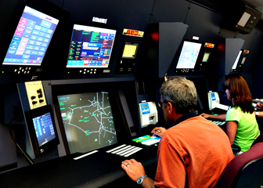
Failure in an ATC System
A modern air traffic control system might have a structure like this:
Flight plan manager tracks current and past flight plan versions
Message bus
. . .
Microservices for various tasks, such as checking future plane separations, scheduling landing times, predicting weather issues, offering services to the airlines
Air traffic controllers update flight plans
Flight plan update broadcast service
WAN link to other ATC centers

Slide 49
Compare with Apache?
Air traffic control might have state in a few places, but it helps that the flight plan records reside in a single database that every other process simply mirrors, read-only.
The key thing is to ensure that we never have parts of the system using one set of flight plans, or one set of configuration files, while the remainder is using a different set. And this property is very carefully verified.

Slide 50
Connection with Derecho/Cascade
The ATC architecture we are looking at was literally built using the Isis Toolkit, an older version of Derecho
So Derecho can be viewed as using this exact same approach!
Failure sensing via timeouts or “application detected issues”
Spread-the-word: Uses a gossip approach, “shun” the failed process
Freeze and self-repair, then restart and reissue any requests that got wiped out by the rollback

Slide 51
Wrapup
Sense failures, force reboots if needed. Do a clean rollback, resume from checkpoint

Slide 52
Bottom line?
The cloud is highly available, because it has layers of backups – even backup datacenters and backups at geographic scale.
IoT data managed by the cloud can be strongly consistent. This doesn’t really reduce availability and in fact doesn’t even reduce performance.
It leads to a style of coding in which membership is managed for you. But many parts of the existing cloud are using weaker consistency today, and you need to be aware of the risks when you use those tools.

Slide 53
Effects of bottom line?
Today’s cloud is remarkably robust.
We use CAP and weaken consistency in outer layers, but this is partly because doing so actually simplifies the solutions we create. Fault tolerance is easy when you don’t worry about consistency.
Systems that do need consistency use the “timeline”: they have a standard way to detect failure. Every component learns of any fault relevant to it. Disrupted components pause their work queues while they self-repair.

