Slide 1
CS5412 / Lecture 22
Apache Architecture
Ken Birman
Kishore Pusukuri

Slide 2

Apache: A Big Data Archicture
Batch Processing
Analytical SQL
Stream Processing
Machine Learning
Other Applications
Resource Manager (Workload Manager, Task Scheduler, etc.)
Data Ingestion Systems
Data Storage (File Systems, Database, etc.)
Popular BigData Systems: Apache Hadoop, Apache Spark
Notes:
These layers show how one component might be built upon a different component.

Slide 3
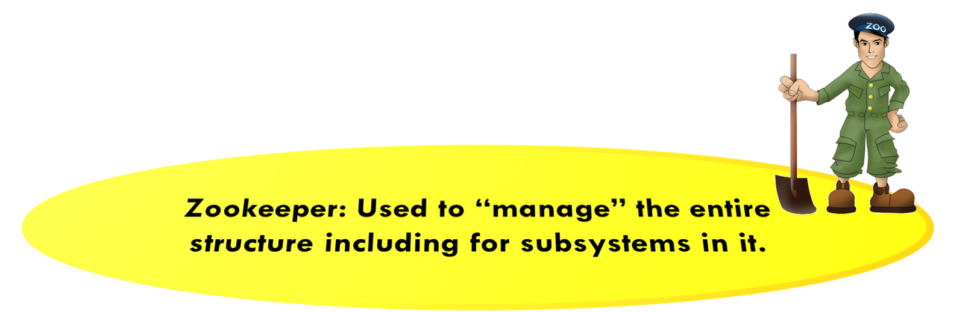
Actual Apache Tool Names
Hadoop MapReduce
Hive
Pig
Other Applications
Yet Another Resource Negotiator (YARN)
Data Ingest Systems
e.g., Apache Kafka, Flume, etc
Hadoop NoSQL Database (HBase)
Hadoop Distributed File System (HDFS)
Cluster

Slide 4
Apache Zookeeper
Zookeeper manages small files holding configuration information for your application
It automatically tracks IP addresses of application components, and health status.
The step count for an iterative calculation.
Notes:
Despite limitations it can be used for many purposes!

Slide 5
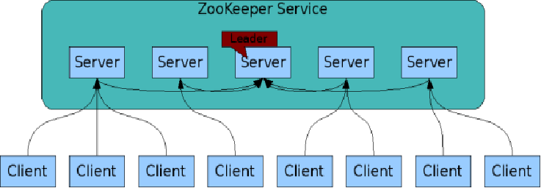
The ZooKeeper Service
Each μ-service has a leader that talks to Zookeeper. Its other nodes have connections too, but just passive (for fault detection)
Zookeeper is itself an interesting distributed system
ZooKeeper Service is replicated over a set of machines, usually 5 or 7.
All machines store a copy of the data in memory (!). Checkpointed to disk if you wish but at a limited pace (1/5 secs).
A leader is elected on service startup
Clients only connect to a single ZooKeeper server & maintains a TCP connection.
Client can read from any Zookeeper server.
Writes go through the leader & employ virtual synchrony atomic multicast with majority consensus on membership
https://cwiki.apache.org/confluence/display/ZOOKEEPER/ProjectDescription

Slide 6
Hadoop Distributed File System (HDFS)
HDFS is similar to Ceph, so we won’t do a deep dive on it.
Supports append-only updates, whole-file delete/create/replace.
Offers a form of “checkpoint”
It records file versions and lengths.
Rollback is done by truncating files to earlier lengths
HDFS doesn’t retain old versions, so it can’t undo a file delete/replace.

Slide 7
Hadoop Database (HBase) is a thin layer directly over HDFS
HBASE is used like a NoSQL database.
It maps directly to HDFS
It holds relations (tables).
Supports large amounts of data and high throughput
Notes:
Once we have files in a file system we can layer a database over it.

Slide 8
HBase: Data Model (1)
Notes:
The concept is insanely scalable. We shard the rows, the columns and even can shard a single value in a single (row,column) cell! This is the most ambitious use of key-value sharding in the cloud today (this, and BigTable, on which it was based).

Slide 9
HBase: Data Model (2)
  Sorted rows: support billions of rows
  Columns: Supports millions of columns
  Cell: intersection of row and column
    Can have multiple values (which are time-stamped)
    Can be empty. No storage/processing overheads

Slide 10
HBase: Table

Slide 11
HBase: Horizontal Splits (Regions)

Slide 12
HBase Architecture

Slide 13
HBase Architecture: Column Family (1)

Slide 14
HBase Architecture: Column Family (2)

Slide 15
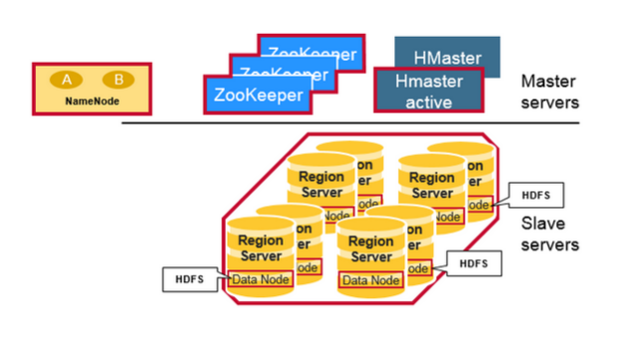
HBase Architecture (1)
HBase is composed of three types of servers in a leader/worker type of architecture: Region Server, Hbase Master, ZooKeeper.
Region Server:
      Clients communicate with RegionServers (workers) directly for accessing data
      Serves data for reads and writes.
      These region servers are assigned to the HDFS data nodes to preserve data locality.
Leader
Servers
Worker
Servers

Slide 16
HBase Architecture (2)
HBase Leader (HMaster): coordinates region servers, handles DDL (create, delete tables) operations.
Zookeeper: HBase uses ZooKeeper as a distributed coordination service to maintain server state in the cluster.

Slide 17
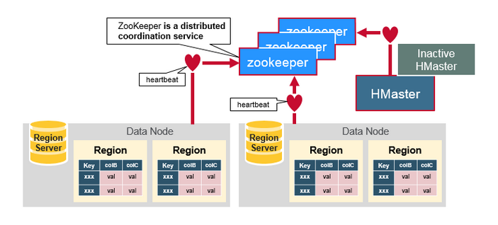
HDFS uses ZooKeeper as its coordinator
Maintains region server state in the cluster
Provides server failure notification
Uses consensus to guarantee common shared state

Slide 18
HBase vs HDFS
Hbase is a way of “talking to” HDFS. We use it for massive tables that wouldn’t fit into a single HDFS file.
HBase
Stores data as key-value objs in column-families. Records in HBase are stored according to the rowkey and sequential search is common
Provides low latency access to small amounts of data from within a large data set
Provides flexible data model
HDFS
Stores data as flat files
Optimized for streaming access of large files -- doesn’t support random read/write
Follows write-once read-many model
Supports log-style files (append-only).

Slide 19
Hadoop Resource Management
Yet Another Resource Negotiator (YARN)
YARN is a core component of Hadoop, manages all the resources of a Hadoop cluster (CPUs, memory, GPUs, networking connections, etc).
Using selectable criteria such as fairness, it effectively allocates resources of Hadoop cluster to multiple data processing jobs
  Batch jobs (e.g., MapReduce, Spark)
  Streaming Jobs (e.g., Spark streaming)
  Analytics jobs (e.g., Impala, Spark)

Slide 20
Hadoop Ecosystem (Resource Manager)
YARN decides where the steps in your job should run
Hadoop
Hive
Pig
Other Applications
Spark Stream
Resource manager
Yet Another Resource Negotiator (YARN)
Hadoop Distributed File System (HDFS)
Hadoop NoSQL Database (HBase)
Notes:
In this picture “resource manager” means “scheduler”. YARN decides which tasks to run, on which machines, and when to do that. It also tracks cache contents and controls what cached data to keep around. And it even decides how much memory to give each task, and how much disk storage.

Slide 21
YARN Concepts (1)
YARN focuses on a generalized concept based on a virtual machine container. In YARN, a container is an abstraction for managing resources -- an unit of computation of a resource node, i.e., a certain amount of CPU, Memory, Disk, etc., ASIC resources. Tied to Mesos container model.
A single job may run in one or more containers – a set of containers would be used to encapsulate highly parallel Hadoop jobs.
The main goal of YARN is effectively allocating containers to multiple data processing jobs.
YARN competes with Kubnetes (the Docker container manager) but covers cases that don’t involve executable VMs. Kubnetes is focused on Docker

Slide 22
YARN Concepts (2)
Three Main components of YARN:
Application Leader, Node Manager, and Resource Manager (a.k.a. YARN Daemon Processes)
Application Leader:
  Single instance per job.
  Spawned within a container when a new job is submitted by a client
  Requests additional containers for handling of any sub-tasks.
Node Manager: Single instance per worker node. Responsible for monitoring and reporting on local container status (all containers on worker node).

Slide 23
YARN Concepts (3)
Three Main components of YARN: Application Master, Node Manager, and Resource Manager (aka The YARN Daemon Processes)
Resource Manager: arbitrates system resources between competing jobs. It has two main components:
  Scheduler (Global scheduler): Responsible for allocating resources to the jobs subject to familiar constraints of capacities, queues etc.
  Application Manager: Responsible for accepting job-submissions and provides the service for restarting the ApplicationMaster container on failure.

Slide 24
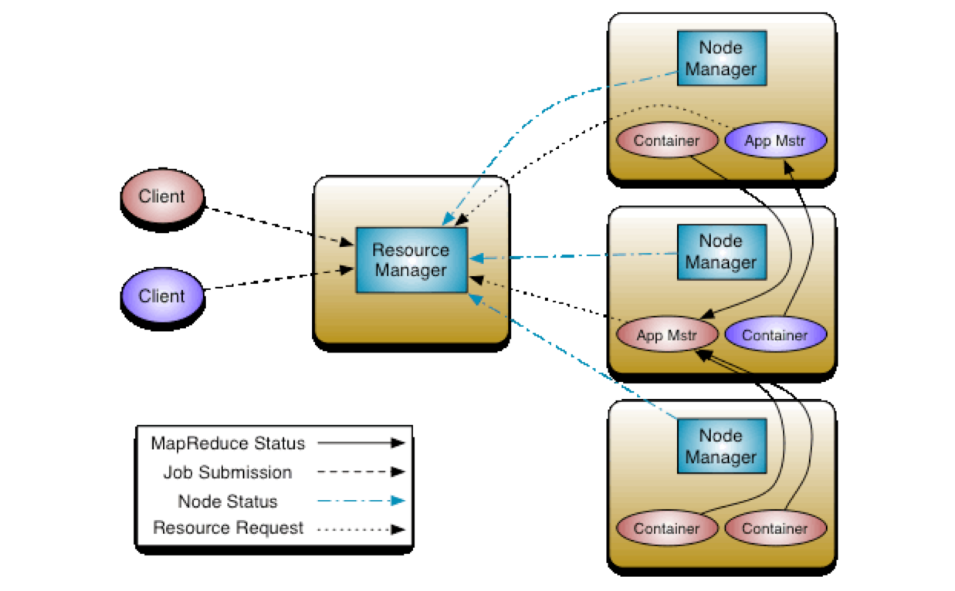
YARN Concepts (4)
How do the components of YARN work together?
Image source: http://hadoop.apache.org/docs/r2.4.1/hadoop-yarn/hadoop-yarn-site/YARN.html

Slide 25
Hadoop Ecosystem (Processing Layer)
Processing
Map Reduce
Hive
Pig
Other Applications
Spark Stream
Totally unrelated tools run on the same machines. YARN needs to decide where to schedule each task.
Yet Another Resource Negotiator (YARN)
Hadoop Distributed File System (HDFS)
Hadoop NoSQL Database (HBase)

Slide 26
Recall: MapReduce generates lots of tasks as it runs!
Reduce
Reducer Output
Result
aardvark 1
aardvark 1
cat 1
mat 1
on 2
sat 2
sofa 1
the 4
Intermediate Data
Reduce
cat 1
aardvark 1
cat 1
mat 1
on 1,1
sat 1,1
sofa 1
the 1,1,1,1
Reduce
mat 1
Reduce
on 2
Reduce
sat 2
sofa 1
Reduce
the 4
Reduce

Slide 27
Example YARN challenge
YARN has to decide which machines to schedule each map and reduce step on. Some have RDDs cached for reuse
Those same machines are in demand by other Apache tools as well, such as Pig and Hive and even the HDFS meta-data service
Some tasks might have special needs, like “a node with 8 GPUs” or “at least 20GB of RAM memory.”

Slide 28
How does YARN do this?
YARN loops, collecting a batch of tasks that need to be scheduled.
For each batch it runs a form of constrained optimization. First, it identifies tasks with special needs (for example, a task that needs two GPUs can only run on a node with two GPUs available)
Next it runs a form of minflow/maxcut algorithm to assign tasks to available nodes in a best fit manner. Like bin packing.

Slide 29
Slight topic shift…
Away from YARN and focusing now on what the other tools do

Slide 30

Apache Hive: SQL on MapReduce
Hive is an abstraction layer on top of Hadoop (MapReduce/Spark)
Use Cases:
  Data Preparation
  Extraction-Transformation-Loading Jobs (Data Warehousing)
  Data Mining

Slide 31
Apache Hive: SQL on MapReduce
Hive is an abstraction layer on top of Hadoop (MapReduce/Spark)
Hive uses a SQL-like language called HiveQL
Facilitates reading, writing, and managing large datasets residing in distributed storage using SQL-like queries
Hive executes queries using MapReduce (and also using Spark)
  HiveQL queries → Hive → MapReduce Jobs

Slide 32
Apache Hive
Structure is applied to data at time of read → No need to worry about formatting the data at the time when it is stored in the Hadoop cluster
Data can be read using any of a variety of formats:
  Unstructured flat files with comma or space-separated text
  Semi-structured JSON files (a web standard for event-oriented data such
  as news feeds, stock quotes, weather warnings, etc)
  Structured HBase tables
Hive is not designed for online transaction processing. Hive should be used for “data warehousing” tasks, not arbitrary transactions.

Slide 33

Apache Pig: Scripting on MapReduce
Pig is an abstraction layer on top of Hadoop (MapReduce/Spark)
Use Cases:
  Data Preparation
  ETL Jobs (Data Warehousing)
  Data Mining

Slide 34
Apache Pig: Scripting on MapReduce
Pig is an abstraction layer on top of Hadoop (MapReduce/Spark)
Code is written in Pig Latin “script” language (a data flow language)
Facilitates reading, writing, and managing large datasets residing in distributed storage
Pig executes queries using MapReduce (and also using Spark)
  Pig Latin scripts → Pig → MapReduce Jobs

Slide 35

Apache Hive & ApachePig
Instead of writing Java code to implement MapReduce, one can opt between Pig Latin and Hive SQL to construct MapReduce programs
Much fewer lines of code compared to MapReduce, which reduces the overall development and testing time

Slide 36
Apache Hive vs Apache Pig
Declarative SQL-like language (HiveQL)
Operates on the server side of any cluster
Better for structured Data
Easy to use, specifically for generating reports
Data Warehousing tasks
Facebook
Procedural data flow language (Pig Latin)
Runs on Client side of any cluster
Best for semi structured data
Better for creating data pipelines
  allows developers to decide where to checkpoint data in the pipeline
Incremental changes to large data sets and also better for streaming
Yahoo

Slide 37
Apache Hive vs ApachePig: example
Job: Get data from sources users and clicks is to be joined and filtered, and then joined to data from a third source geoinfo and aggregated and finally stored into a table ValuableClicksPerDMA
insert into ValuableClicksPerDMA
select dma, count(*)
from geoinfo join (
select name, ipaddr
from users join clicks on (users.name = clicks.user) where value > 0;
) using ipaddr
group by dma;
Users = load 'users' as (name, age, ipaddr);
Clicks = load 'clicks' as (user, url, value);
ValuableClicks = filter Clicks by value > 0;
UserClicks = join Users by name, ValuableClicks by user;
Geoinfo = load 'geoinfo' as (ipaddr, dma);
UserGeo = join UserClicks by ipaddr, Geoinfo by ipaddr;
ByDMA = group UserGeo by dma;
ValuableClicksPerDMA = foreach ByDMA generate group, COUNT(UserGeo);
store ValuableClicksPerDMA into 'ValuableClicksPerDMA';

Slide 38
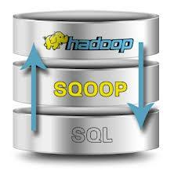

Data Ingestion Systems/Tools
Apache Sqoop
  High speed import to HDFS from Relational Database (and vice versa)
  Supports many database systems,
  e.g. Mongo, MySQL, Teradata, Oracle
Apache Flume
  Distributed service for ingesting streaming data
  Ideally suited for event data from multiple systems, for example, log files

Slide 39

Apache Kafka
Functions like a distributed publish-subscribe messaging system (or a distributed streaming platform)
  A high throughput, scalable messaging system
  Distributed, reliable publish-subscribe system
  Design as a message queue & Implementation as a distributed log service
Originally developed by LinkedIn, now widely popular
Features: Durability, Scalability, High Availability, High Throughput
Check out the awesome Kafka “intro” video here.

Slide 40
What is Apache Kafka used for? (1)
The original use case (@LinkedIn):
  To track user behavior on websites.
  Site activity (page views, searches, or other actions users might take) is published to central topics, with one topic per activity type.
Effective for two broad classes of applications:
  Building real-time streaming data pipelines that reliably get data between systems or applications
  Building real-time streaming applications that transform or react to the streams of data

Slide 41
What is Apache Kafka used for? (2)
Lets you publish and subscribe to streams of records, similar to a message queue or enterprise messaging system
Lets you store streams of records in a fault-tolerant way
Lets you process streams of records as they occur
Lets you have both offline and online message consumption

Slide 42
Apache Kafka: Fundamentals
Kafka is run as a cluster on one or more servers
The Kafka cluster stores streams of records in categories called topics
Each record (or message) consists of a key, a value, and a timestamp
Point-to-Point: Messages persisted in a queue, a particular message is consumed by a maximum of one consumer only
Publish-Subscribe: Messages are persisted in a topic, consumers can subscribe to one or more topics and consume all the messages in that topic

Slide 43
Apache Kafka: Components
Logical Components:
Topic: The named destination of partition
Partition: One Topic can have multiple partitions and it is an unit of parallelism
Record or Message: Key/Value pair (+ Timestamp)
Physical Components:
Producer: The role to send message to broker
Consumer: The role to receive message from broker
Broker: One node of Kafka cluster
ZooKeeper: Coordinator of Kafka cluster and consumer groups

Slide 44
Apache Kafka: Topics & Partitions (1)
A stream of messages belonging to a particular category is called a topic (or a feed name to which records are published)
Data is stored in topics.
Topics in Kafka are always multi-subscriber -- a topic can have zero, one, or many consumers that subscribe to the data written to it
Topics are split into partitions. Topics may have many partitions, so it can handle an arbitrary amount of data

Slide 45
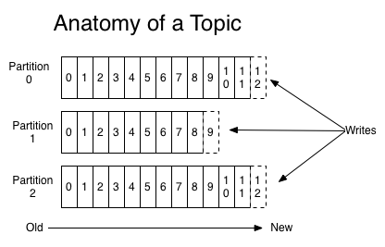
Apache Kafka: Topics & Partitions (2)
Each partition is an ordered, immutable sequence of records that is continually appended to -- a structured commit log.
Partition offset: The records in the partitions are each assigned a sequential id number called the offset that uniquely identifies each record within the partition.
For each topic, the Kafka cluster maintains a partitioned log that looks like this:

Slide 46
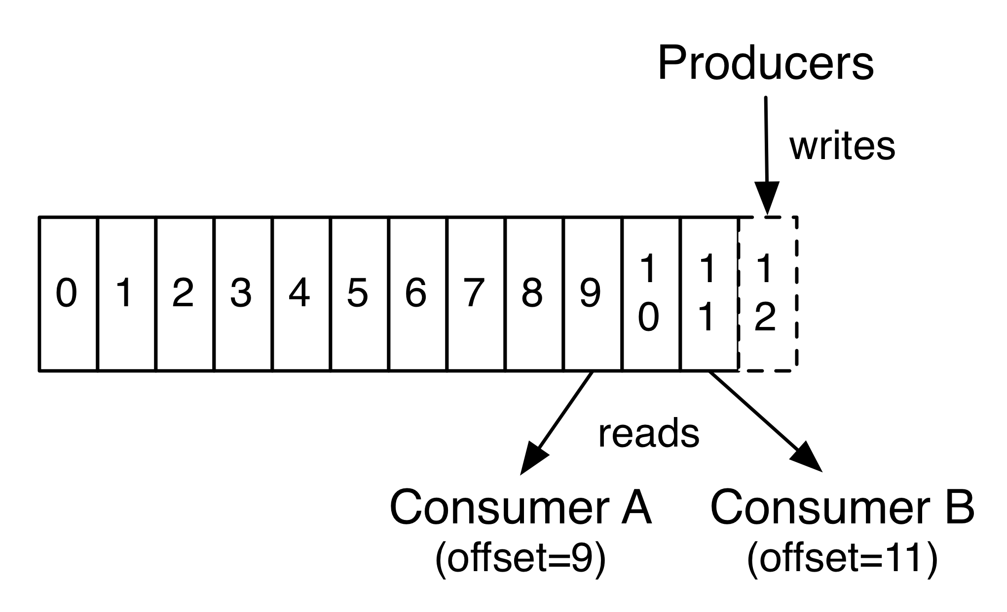
Apache Kafka: Topics & Partitions (3)
The only metadata retained on a per-consumer basis is the offset or position of that consumer in the log.
This offset is controlled by the consumer -- normally a consumer will advance its offset linearly as it reads records (but it can also consume records in any order it likes)

Slide 47
Apache Kafka: Topics & Partitions (4)
The partitions in the log serve several purposes:
Allow the log to scale beyond a size that will fit on a single server.
Handles an arbitrary amount of data -- a topic may have many partitions
Acts as the unit of parallelism

Slide 48
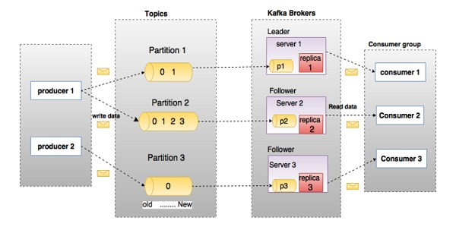
Apache Kafka: Distribution of Partitions (2)
Here, a topic is configured into three partitions.
Partition 1 has two offset factors 0 and 1.
Partition 2 has four offset factors 0, 1, 2, and 3.
Partition 3 has one offset factor 0.
The id of the replica is same as the id of the server that hosts it.

Slide 49
Apache Kafka: Components
Logical Components:
Topic: The named destination of partition
Partition: One Topic can have multiple partitions and it is an unit of parallelism
Record or Message: Key/Value pair (+ Timestamp)
Physical Components:
Producer: The role to send message to broker
Consumer: The role to receive message from broker
Broker: One node of Kafka cluster
ZooKeeper: Coordinator of Kafka cluster and consumer groups

Slide 50
Apache Kafka: Producers
Producers publish data to the topics of their choice.
The producer is responsible for choosing which record to assign to which partition within the topic.
Record to Topic: In a round-robin fashion simply to balance load or can be done according to some semantic partition function

Slide 51
Apache Kafka: Consumers
Consumer group: Balance consumers to partitions
Consumers label themselves with a consumer group name
Each record published to a topic is delivered to one consumer instance within each subscribing consumer group
If all the consumer instances have the same consumer group, then the records will effectively be load balanced over the consumer instances.
If all the consumer instances have different consumer groups, then each record will be broadcast to all the consumer processes.

Slide 52
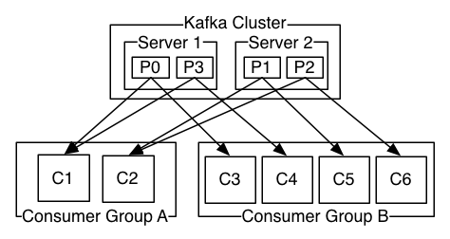
Apache Kafka: Producers & Consumers
Example:
A two server Kafka cluster hosting four partitions (P0 to P3) with two consumer groups (A & B). Consumer group A has two consumer instances (C1 & C2) and group B has four (C3 to C6).

Slide 53
Apache Kafka: Design Guarantees (1)
Records (or Messages) sent by a producer to a particular topic partition will be appended in the order they are sent.
A consumer instance sees records in the order they are stored in the log.
For a topic with replication factor N, we will tolerate up to N-1 server failures without losing any records committed to the log.

Slide 54
Apache Kafka: Design Guarantees (2)
Message Delivery Semantics:
At most once: Messages may be lost but are never redelivered.
At least once: Messages are never lost but may be redelivered.
Exactly once: Each message is delivered once and only once

Slide 55
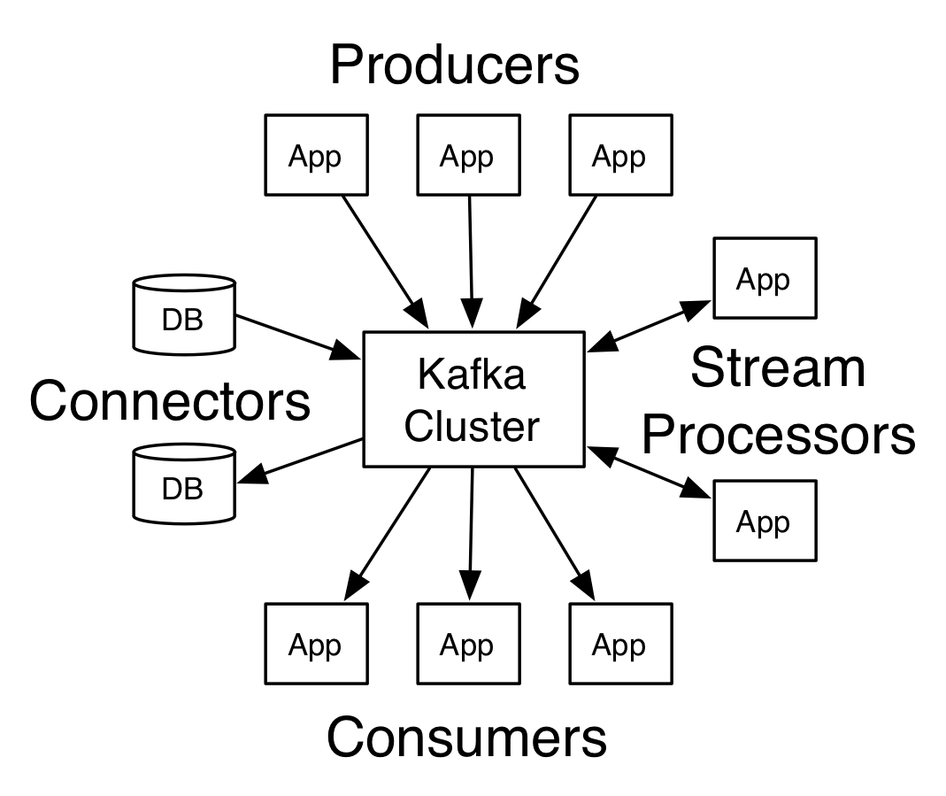
Apache Kafka: Four Core APIs (1)
Producer API: Allows an application to publish a stream of records to one or more Kafka topics
Consumer API: Allows an application to subscribe to one or more topics and process the stream of records produced to them
Streams API: Allows an application to act as a stream processor -- consuming an input stream from one or more topics and producing an output stream to one or more output topics

Slide 56
Apache Kafka: Four Core APIs (2)
Connector API:
Allows building and running producers or consumers that connect Kafka topics to existing applications or data systems.
For example, a connector to a relational database might capture every change to a table.

Slide 57
Summary
Apache ecosystem: A comprehensive big-data framework
All open source, very standard architecture at all levels
Widely popular, but not always blindingly fast. Understanding the intended styles of use is important for good performance.

