Slide 1
CS5412 / Lecture 21
MapReduce, Spark and RDDs
Big Data Tools in the Cloud

Slide 2
MapReduce pattern: Sharded data set
Leader
Worker threads
Shard A
Shard B
Shard C

Slide 3
MapReduce: Map step
The leader maps some task over the n workers. This can be done in any way that makes sense for the application.
Each worker performs its share of the work by applying the requested function to the data in its shard.
When finished, each worker will have a list of new (key,value) pairs as its share of the result.

Slide 4
MapReduce pattern: Sharded data set
Leader
Worker threads
Shard A
Shard B
Shard C

Slide 5
MapReduce pattern: Map (first step)
Leader
Worker threads
Shard A
Shard B
Shard C
Result A
Result B
Result C

Slide 6
MapReduce: Shuffle exchange
Each worker breaks its key-value result set into n parts by applying the sharding rule to the keys.
  Uses GroupBy to group the key-value results (one subset per shard)
  Recall that one member was picked to be responsible for each shard
  So, each worker sends each of its subsets to the responsible worker for that subset.
  Every worker waits until it has its one message from each worker. Now it runs GroupBy a second time. This time, we group subresults that had the same key.
  It now has a list of (key, {set-of-values}) tuples. It calls reduce to end up with (key, result) pairs

Slide 7
MapReduce pattern: Map (first step)
Leader
Worker threads
Shard A
Shard B
Shard C

Slide 8
MapReduce pattern: Map (first step)
Leader
Worker threads
Shard A
Shard B
Shard C
Result A
Result B
Result C

Slide 9
MapReduce pattern: Map (first step)
Leader
Worker threads
Shard A
Shard B
Shard C
Result A
Result B
Result C
Subset 3
Subset 2
Subset 1

Slide 10
MapReduce pattern: Shuffle
Leader
Worker threads
Shard A
Shard B
Shard C
Result A
Result B
Result C
Subset 3
Subset 3
Subset 3
Subset 2
Subset 2
Subset 2
Subset 1
Subset 1
Subset 1

Slide 11
MapReduce pattern: Sort
Leader
Worker threads
Shard A
Shard B
Shard C
Result A
Result B
Result C
Subset 1
Subset 2
Subset 3
Subset 1
Subset 2
Subset 3
Subset 1
Subset 2
Subset 3
Not shown: There are additional messages being sent from A to B and C, from B to A and C, and from C to A and B. This “shuffles” the data

Slide 12
MapReduce pattern: Map (first step)
Leader
Worker threads
Shard A
Shard B
Shard C
Result A
Result B
Result C
Subset 3
Subset 2
Subset 1

Slide 13
MapReduce pattern: Shuffle
Leader
Worker threads
Shard A
Shard B
Shard C
Result A
Result B
Result C
Subset 3
Subset 3
Subset 3
Subset 2
Subset 2
Subset 2
Subset 1
Subset 1
Subset 1

Slide 14
MapReduce pattern: Sort
Leader
Worker threads
Shard A
Shard B
Shard C
Result A
Result B
Result C
Subset 1
Subset 2
Subset 3
Subset 1
Subset 2
Subset 3
Subset 1
Subset 2
Subset 3

Slide 15
MapReduce pattern: reduce
Leader
Worker threads
Shard A
Shard B
Shard C
Result A
Result B
Result C
Reduced results A
Reduced results B
Reduced results C

Slide 16
Example: Word Count
The use case scenario: Start with standard WC for one file.
We have a large file of documents (the input elements)
Documents are words separated by whitespace.
Count the number of times each distinct word appears in the file.
… with MapReduce we can extend this concept to huge numbers of files.

Slide 17
Example: Word Count
Why Do We Care About Counting Words?
NLP systems train on n-grams: counts of n-word sequences
Word or n-gram count is challenging over massive amounts of data
  Using a single compute node would be too time-consuming
  Using distributed nodes requires moving data
  Number of unique words can easily exceed available memory -- would need to store to disk
Many common tasks are very similar to word count, e.g., log file analysis where we might look for the storage devices with the highest error rates, to service the ones that are most likely to fail soon

Slide 18
Word Count Using MapReduce
map(key, value):
// key: document ID; value: text of document
for (each word w in value)
emit(w, 1);
reduce(key, value-list):
// key: a word; value-list: a list of integers
result = 0;
for (each integer v on value-list)
result += v;
emit(key, result);

Slide 19
Word Count Using MapReduce
Result
Input
aardvark 1
cat 1
mat 1
on 2
sat 2
sofa 1
the 4
the cat sat on the mat
the aardvark sat on the sofa
Map & Reduce

Slide 20
Sharded Word Count: Map
We sharded the data when it was first stored.
MapReduce uses Zookeeper to look up the sharding pattern.
This lets it run compute tasks in a pattern matched to the shard pattern.
The machines on which it runs probably won’t be the ones holding the data, but each task focuses on a distinct portion of the data set.
Input
the cat sat on the mat
the aardvark sat on the sofa

Slide 21
Sharded Word Count: Map
the 1
cat 1
sat 1
on 1
the 1
mat 1
Map, focus on data in shard 1
Input
the cat sat on the mat
the aardvark sat on the sofa
the 1
aardvark 1
sat 1
on 1
the 1
sofa 1
Map, focus on data in shard 2

Slide 22
Shuffle & Sort
Intermediate Data
the 1
cat 1
sat 1
on 1
the 1
mat 1
aardvark 1
cat 1
sat 1, 1
sofa 1
Keys that mapped to shard 1 are still on shard 1. The sort was internal to shard 1
Shuffle & Sort
Mapper Output
the 1
aardvark 1
sat 1
on 1
the 1
sofa 1
on 1,1
mat 1
the 1,1,1,1
Keys that mapped to shard 2

Slide 23
Word Count: Reducer
aardvark 1
cat 1
sat 1, 1
sofa 1
Reduce
Result
aardvark 1
cat 1
sat 2
sofa 1
Reduce
Reduce
Reduce
on 1,1
mat 1
the 1,1,1,1
on 2
mat 1
the 4
Reduce
Reduce
Reduce

Slide 24
Notice that…
Data stays sharded at all times. Originally, or document names determined which document was on which shard. Now, after the shuffle exchange, the words themselves are the keys, and determined which shard that word count will be on
Keys are sorted and grouped shard-by-shard. We never merge and sort the full data set
Reduce runs on (key, {v₁, …. v_{k}}) and outputs (key,reduced-value), once per key
Output is never collected to one place: We retain it in a sharded form

Slide 25
Who uses MapReduce?
MapReduce is the workhorse of modern cloud computing.
Professor De Sa once commented that if a system can support MapReduce, every major AI and ML algorithm can be trained on it.
High performance computing was stalled (important but not growing) until the AllReduce package was released for a platform called MPI. Now HPC clusters are offered on every major cloud.

Slide 26
Spark Project
Undertaken at UC Berkeley
Goal was to speed MapReduce up, focusing on the Hadoop version
Part of the Berkeley “View from the clouds” vision for cloud computing research, authored by Ion Stoica

Slide 27
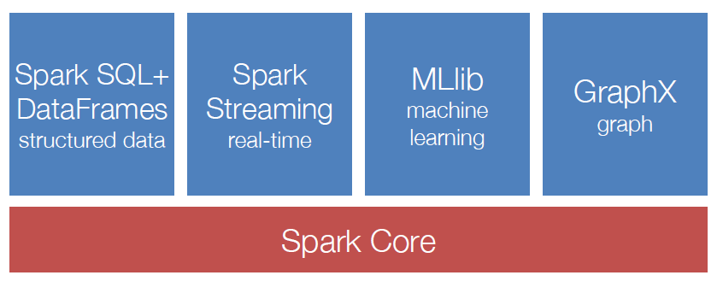
Spark Ecosystem: A Unified Pipeline
Note: Spark is not designed for IoT real-time. The streaming layer is used for continuous input streams like financial data from stock markets, where events occur steadily and must be processed as they occur. But there is no sense of direct I/O from sensors/actuators. For IoT use cases, Spark would not be suitable.

Slide 28
Key ideas
In Hadoop, each developer tends to invent his or her own style of work
With Spark, serious effort to standardize around the idea that people are writing parallel code that often runs for many “cycles” or “iterations” in which a lot of reuse of information occurs.
Spark centers on Resilient Distributed Dataset, RDDs, that capture the information being reused.

Slide 29
How this works
You express your application as a graph of RDDs.
The graph is only evaluated as needed, and they only compute the RDDs actually needed for the output you have requested.
Then Spark can be told to cache the reuseable information either in memory, in SSD storage or even on disk, based on when it will be needed again, how big it is, and how costly it would be to recreate.
You write the RDD logic and control all of this via hints

Slide 30
Spark Basics
There are two ways to manipulate data in Spark
  Spark Shell:
    Interactive – for learning or data exploration
    Python or Scala
  Spark Applications
    For large scale data processing
    Python, Scala, or Java
Notes:
We use some code snippets and spark shell in this class.

Slide 31
Spark Shell
The Spark Shell provides interactive data exploration (REPL)
REPL: Repeat/Evaluate/Print Loop
Notes:
We use some code snippets and spark shell in this class.

Slide 32
Spark Fundamentals
Example of an application:
Spark Context
Resilient Distributed Data
Transformations
Actions

Slide 33
Spark Context (1)
Every Spark application requires a spark context: the main entry point to the Spark API
Spark Shell provides a preconfigured Spark Context called “sc”

Slide 34
Spark Context (2)
Standalone applications → Driver code → Spark Context
Spark Context holds configuration information and represents connection to a Spark cluster
Standalone Application (Drives Computation)
Notes:
Cluster manager -- mesos, yarn, spark core standalone manager

Slide 35
Spark Context (3)
Spark context works as a client and represents connection to a Spark cluster
Notes:
Uses a directed acyclic graph of RDDs → create a schedule of spark tasks ..with the help of cluster manager assigns those tasks to worker nodes

Slide 36
Spark Fundamentals
Example of an application:
Spark Context
Resilient Distributed Data
Transformations
Actions

Slide 37
Resilient Distributed Dataset (RDD)
The RDD (Resilient Distributed Dataset) is the fundamental unit of data in Spark: An Immutable collection of objects (or records, or elements) that can be operated on “in parallel” (spread across a cluster)
Resilient -- if data in memory is lost, it can be recreated
  Recover from node failures
  An RDD keeps its lineage information → it can be recreated from parent RDDs
Distributed -- processed across the cluster
  Each RDD is composed of one or more partitions → (more partitions – more parallelism)
Dataset -- initial data can come from a file or be created

Slide 38
RDDs
Key Idea: Write applications in terms of transformations on distributed datasets. One RDD per transformation.
  Organize the RDDs into a DAG showing how data flows.
  RDD can be saved and reused or recomputed. Spark can save it to disk if the dataset does not fit in memory
  Built through parallel transformations (map, filter, group-by, join, etc). Automatically rebuilt on failure
  Controllable persistence (e.g. caching in RAM)

Slide 39
RDDs are designed to be “immutable”
  Create once, then reuse without changes. Spark knows lineage → can be recreated at any time → Fault-tolerance
  Avoids data inconsistency problems (no simultaneous updates) → Correctness
  Easily live in memory as on disk → Caching → Safe to share across processes/tasks → Improves performance
  Tradeoff: (Fault-tolerance & Correctness) vs (Disk Memory & CPU)

Slide 40
Creating a RDD
Three ways to create a RDD
  From a file or set of files
  From data in memory
  From another RDD
Notes:
Created by starting with a file in Hadoop Distributed File System (HDFS) or an existing collection in the driver program
Similar to map or reduce… Map is similar to map reduce map.. Group-by is kind of reduce function.. There are other functions
May be persisted in memory for efficient reuse across parallel operations (caching)

Slide 41
Example: A File-based RDD
Notes:
mydata is a RDD… sc– the context.. Count is an action…

Slide 42
Spark Fundamentals
Example of an application:
Spark Context
Resilient Distributed Data
Transformations
Actions

Slide 43
RDD Operations
Two types of operations
Transformations: Define a new RDD based on current RDD(s)
Actions: return values

Slide 44
RDD Transformations
Set of operations on a RDD that define how they should be transformed
As in relational algebra, the application of a transformation to an RDD yields a new RDD (because RDD are immutable)
Transformations are lazily evaluated, which allow for optimizations to take place before execution
Examples: map(), filter(), groupByKey(), sortByKey(), etc.

Slide 45
Example: map and filter Transformations
Notes:
Talk about lineage here

Slide 46
RDD Actions
Apply transformation chains on RDDs, eventually performing some additional operations (e.g., counting)
Some actions only store data to an external data source (e.g. HDFS), others fetch data from the RDD (and its transformation chain) upon which the action is applied, and convey it to the driver
Some common actions
  count() – return the number of elements
  take(n) – return an array of the first n elements
  collect()– return an array of all elements
  saveAsTextFile(file) – save to text file(s)

Slide 47
Graph of RDDs
A collection of RDDs can be understood as a graph
Nodes in the graph are the RDDs, which means the code but also the actual data object that could would create at runtime when executed on specific parameters + data. Reminder: Hadoop is a “read only” model, so we can “materialize” an RDD any time we like.
Edges represent how data objects are accessed: RDD B might consume the object created by RDD A. This gives us a directed edge A → B

Slide 48
Lazy Execution of RDDs (1)
Data in RDDs is not processed until an action is performed

Slide 49
Lazy Execution of RDDs (2)
Data in RDDs is not processed until an action is performed

Slide 50
Lazy Execution of RDDs (3)
Data in RDDs is not processed until an action is performed

Slide 51
Lazy Execution of RDDs (4)
Data in RDDs is not processed until an action is performed

Slide 52
Lazy Execution of RDDs (5)
Data in RDDs is not processed until an action is performed
Output Action “triggers” computation, pull model

Slide 53
Opportunities This Enables
On-demand optimization: Spark can behave like a compiler by first building a potentially complex RDD graph, but then trimming away unneeded computations that for today’s purpose, won’t be used.
Caching for later reuse.
Graph transformations: A significant amount of effort is going into this area. It is a lot like compiler-managed program transformation and aims at simplifying and speeding up the computation that will occur.
Dynamic decisions about what to schedule and when. Concept: minimum adequate set of input objects: RDD can run if all its inputs are ready

Slide 54
Example: Mine error logs
Load error messages from a log into memory, then interactively search for various patterns:
lines = spark.textFile(“hdfs://...”) HadoopRDD
errors = lines.filter(lambda s: s.startswith(“ERROR”)) FilteredRDD
messages = errors.map(lambda s: s.split(“\t”)[2])
messages.cache()
messages.filter(lambda s: “foo” in s).count()
Result: full-text search of Wikipedia in 0.5 sec (vs 20 sec for on-disk data)

Slide 55
Key Idea: Elastic parallelism
RDDs operations are designed to offer embarrassing parallelism.
Spark will spread the task over the nodes where data resides, offers a highly concurrent execution that minimizes delays. Term: “partitioned computation” .
If some component crashes or even is just slow, Spark simply kills that task and launches a substitute.

Slide 56
RDD and Partitions (Parallelism example)

Slide 57
RDD Graph: Data Set vs Partition Views
Much like in Hadoop MapReduce, each RDD is associated to (input) partitions

Slide 58
RDDs: Data Locality
Data Locality Principle
  Keep high-value RDDs precomputed, in cache or SDD
  Run tasks that need the specific RDD with those same inputs
  on the node where the cached copy resides.
  This can maximize in-memory computational performance.
  Requires cooperation between your hints to Spark when you build the RDD, Spark runtime and optimization planner, and the underlying YARN resource manager.

Slide 59
RDDs -- Summary
RDD are partitioned, locality aware, distributed collections
  RDD are immutable
RDD are data structures that:
  Either point to a direct data source (e.g. HDFS)
  Apply some transformations to its parent RDD(s) to generate new data elements
Computations on RDDs
  Represented by lazily evaluated lineage DAGs composed by chained RDDs

Slide 60
Lifetime of a Job in Spark

Slide 61
Anatomy of a Spark Application
Cluster Manager (YARN/Mesos)

Slide 62
Typical RDD pattern of use
Instead of doing a lot of work in each RDD, developers split tasks into lots of small RDDs
These are then organized into a DAG.
Developer anticipates which will be costly to recompute and hints to Spark that it should cache those.

Slide 63
Why is this a good strategy?
Spark tries to run tasks that will need the same intermediary data on the same nodes.
If MapReduce jobs were arbitrary programs, this wouldn’t help because reuse would be very rare.
But in fact the MapReduce model is very repetitious and iterative, and often applies the same transformations again and again to the same input files.
Those particular RDDs become great candidates for caching.
MapReduce programmer may not know how many iterations will occur, but
Spark itself is smart enough to evict RDDs if they don’t actually get reused.

Slide 64
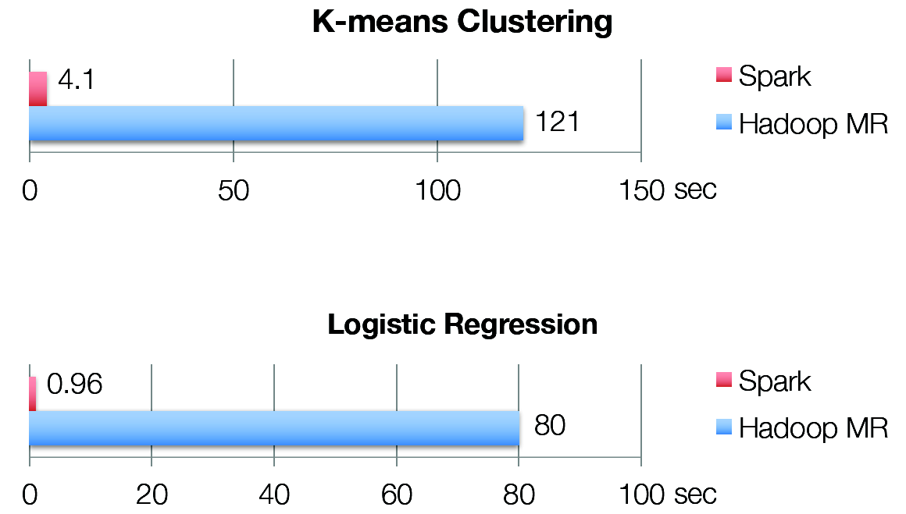
Iterative Algorithms: Spark vs MapReduce

Slide 65
Today’s Topics
Motivation
Spark Basics
Spark Programming

Slide 66
Spark Programming (1)
Creating RDDs
# Turn a Python collection into an RDD
sc.parallelize([1, 2, 3])
# Load text file from local FS, HDFS, or S3
sc.textFile(“file.txt”)
sc.textFile(“directory/*.txt”)
sc.textFile(“hdfs://namenode:9000/path/file”)
# Use existing Hadoop InputFormat (Java/Scala only)
sc.hadoopFile(keyClass, valClass, inputFmt, conf)

Slide 67
Spark Programming (2)
Basic Transformations
nums = sc.parallelize([1, 2, 3])
# Pass each element through a function
squares = nums.map(lambda x: x*x) // {1, 4, 9}
# Keep elements passing a predicate
even = squares.filter(lambda x: x % 2 == 0) // {4}

Slide 68
Spark Programming (3)
Basic Actions
nums = sc.parallelize([1, 2, 3])
# Retrieve RDD contents as a local collection
nums.collect() # => [1, 2, 3]
# Return first K elements
nums.take(2) # => [1, 2]
# Count number of elements
nums.count() # => 3
# Merge elements with an associative function
nums.reduce(lambda x, y: x + y) # => 6

Slide 69
Spark Programming (4)
Working with Key-Value Pairs
Spark’s “distributed reduce” transformations operate on RDDs of key-value pairs
Python: pair = (a, b)
pair[0] # => a
pair[1] # => b
Scala: val pair = (a, b)
pair._1 // => a
pair._2 // => b
Java: Tuple2 pair = new Tuple2(a, b);
pair._1 // => a
pair._2 // => b

Slide 70
Spark Programming (5)
Some Key-Value Operations
pets = sc.parallelize([(“cat”, 1), (“dog”, 1), (“cat”, 2)])
pets.reduceByKey(lambda x, y: x + y) # => {(cat, 3), (dog, 1)}
pets.groupByKey() # => {(cat, [1, 2]), (dog, [1])}
pets.sortByKey() # => {(cat, 1), (cat, 2), (dog, 1)}

Slide 71
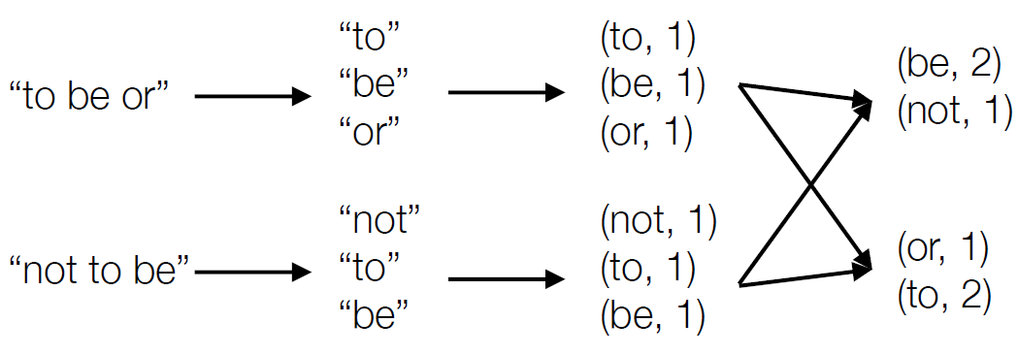
Example: Word Count
lines = sc.textFile(“hamlet.txt”)
counts = lines.flatMap(lambda line: line.split(“ “))
.map(lambda word: (word, 1))
.reduceByKey(lambda x, y: x + y)

Slide 72

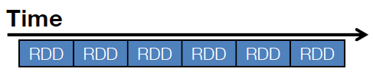
Example: Spark Streaming
Represents streams as a series of RDDs over time (typically sub second intervals, but it is configurable)
val spammers = sc.sequenceFile(“hdfs://spammers.seq”)
sc.twitterStream(...)
.filter(t => t.text.contains(“Santa Clara University”))
.transform(tweets => tweets.map(t => (t.user, t)).join(spammers))
.print()

Slide 73
Spark: Combining Libraries (Unified Pipeline)
# Load data using Spark SQL
points = spark.sql(“select latitude, longitude from tweets”)
# Train a machine learning model
model = KMeans.train(points, 10)
# Apply it to a stream
sc.twitterStream(...)
.map(lambda t: (model.predict(t.location), 1))
.reduceByWindow(“5s”, lambda a, b: a + b)

Slide 74
Spark: Setting the Level of Parallelism
All the pair RDD operations take an optional second parameter for number of tasks
words.reduceByKey(lambda x, y: x + y, 5)
words.groupByKey(5)
visits.join(pageViews, 5)

Slide 75
Summary
Spark is a powerful “manager” for big data computing.
It centers on a job scheduler for Hadoop (MapReduce) that is smart about where to run each task: co-locate task with data.
The data objects are “RDDs”: a kind of recipe for generating a file from an underlying data collection. RDD caching allows Spark to run mostly from memory-mapped data, for speed.
Online tutorials: spark.apache.org/docs/latest

