Slide 1
CS 5412/Lecture 20: Making The Cloud Friendlier for Object-Oriented Computing
Ken Birman
Fall, 2022

Slide 2
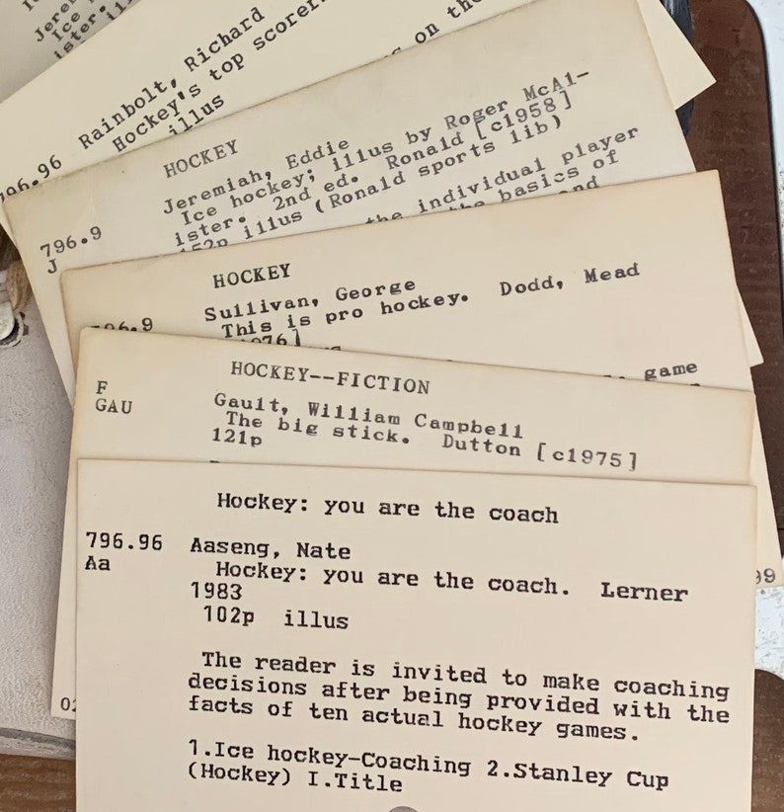
Today’s main topic
The cloud was built mostly from Linux systems, yet Linux was created to support interactive computing applications in offices and hospitals, databases (big files, but record-oriented), text editing.
Records are fixed size, format. Like an old-style library index with fixed fields and length limits. In the 1970’s, a data file often would be a vector of these fixed-sized records.
This explains the POSIX lseek operation: “read/update the middle of a file”

Slide 3
Today’s main topic
Over time, file abstractions evolved. Today we often memory-map files, using the mmap file system operation. lseek is rarely used and very few programs ever open a file, modify something in the middle, then close it.
A modern file system might be used to hold objects.
Serialize the object, then write the whole byte vector
For updates, replace one version with a new version
But in fact some applications do need “append” as an option, in order to add a row to a comma-separated value file (a CSV file is a common way to represent a spreadsheet or a database)

Slide 4
Questions this raises?
If objects, tuples with named fields, and relations with attributes are equivalent in some ways, which to pick for efficient code development?
If Linux is out of tune with object-oriented computing, what needs to be changed to make the match closer?
Should that old lseek option of reading or updating the middle of a file even be supported?

Slide 5
Objects in multi-lingual applications
There are hundreds of programming languages, and libraries – but often coded in specialized languages different from what the caller is using.
This creates yet another question: How to share objects between code written in different languages.
They could be separate programs, entirely coded in different languages
But they could also be one program using libraries in flexible ways

Slide 6
Today’s two Sub-topics
First half of the lecture: The Ceph object oriented file system. Looks like a normal POSIX file system, but optimized for object-oriented uses.
Second half: CORBA, and the costs of object-sharing in a complex setting (an actual air traffic control system Ken worked on many years ago)

Slide 7
Object-oriented file systems

Slide 8
If people store objects as files, what goes wrong?
With one file per object, we quickly have a LOT of files. Linux file systems aren’t so great for this (like a directory with a billion objects in it).
Objects tend to be very small or very large. The Linux file system is optimized for Linux file size distributions and lifetime distributions.
The POSIX API is designed for record-at-a-time file access. But with objects the application more often wants to read/write the whole file

Slide 9
CEPH project
Created by Sage Weihl, a PhD student at U.C. Santa Cruz
Later became a company and then was acquired into Red Hat Linux
Now the “InkStack” portion of Linux offers Ceph plus various tools to leverage it, and Ceph is starting to replace HDFS worldwide.
Ceph is similar in some ways to any standard cloud file system, but was created separately. Many big data systems are migrating to Ceph.

Slide 10
Three perspectives
First is the standard POSIX file system API. You can use Ceph in any situation where you might use GFS, HDFS, NFS, etc.
Second is the Ceph MetaData layer. This is a subsystem with its own API that manages objects… but doesn’t store data
Third is the RADOS object storage layer. It holds the data but doesn’t know about the folders (directories) in which data is organized.

Slide 11
Central concepts
Think of POSIX as a library: It has a standard set of file system operations but the storage system itself doesn’t need to use the identical API
In Ceph, both the file system name space (“meta data store”) and data plane (“object store”) ultimately map to key-value infrastructures!
POSIX is like an algorithm that “uses” key-value storage to mimic an old-style Linux file system
Used in the recommended ways, Ceph is just a very thin layer mapping between these two abstractions

Slide 12
object structures are “invisible” to Ceph
The objects stored in the system are defined and “owned” by applications, not by Ceph. Ceph itself doesn’t need the definitions. It cares about size
The application defines the actual layout of each object, and the logic to serialize objects to byte vectors, and later deserialize and construct objects

Slide 13
Ceph: A Scalable, High-Performance Distributed File System
Original slide set from OSDI 2006
Sage A. Weil, Scott A. Brandt, Ethan L. Miller, Darrel D. E. Long

Slide 14
Contents
Goals
System Overview
Client Operation
Dynamically Distributed Metadata
Distributed Object Storage
Performance

Slide 15
Goals
Scalability
Storage capacity, throughput, client performance. Emphasis on HPC.
Reliability
“…failures are the norm rather than the exception…”
Performance
Dynamic workloads

Slide 18
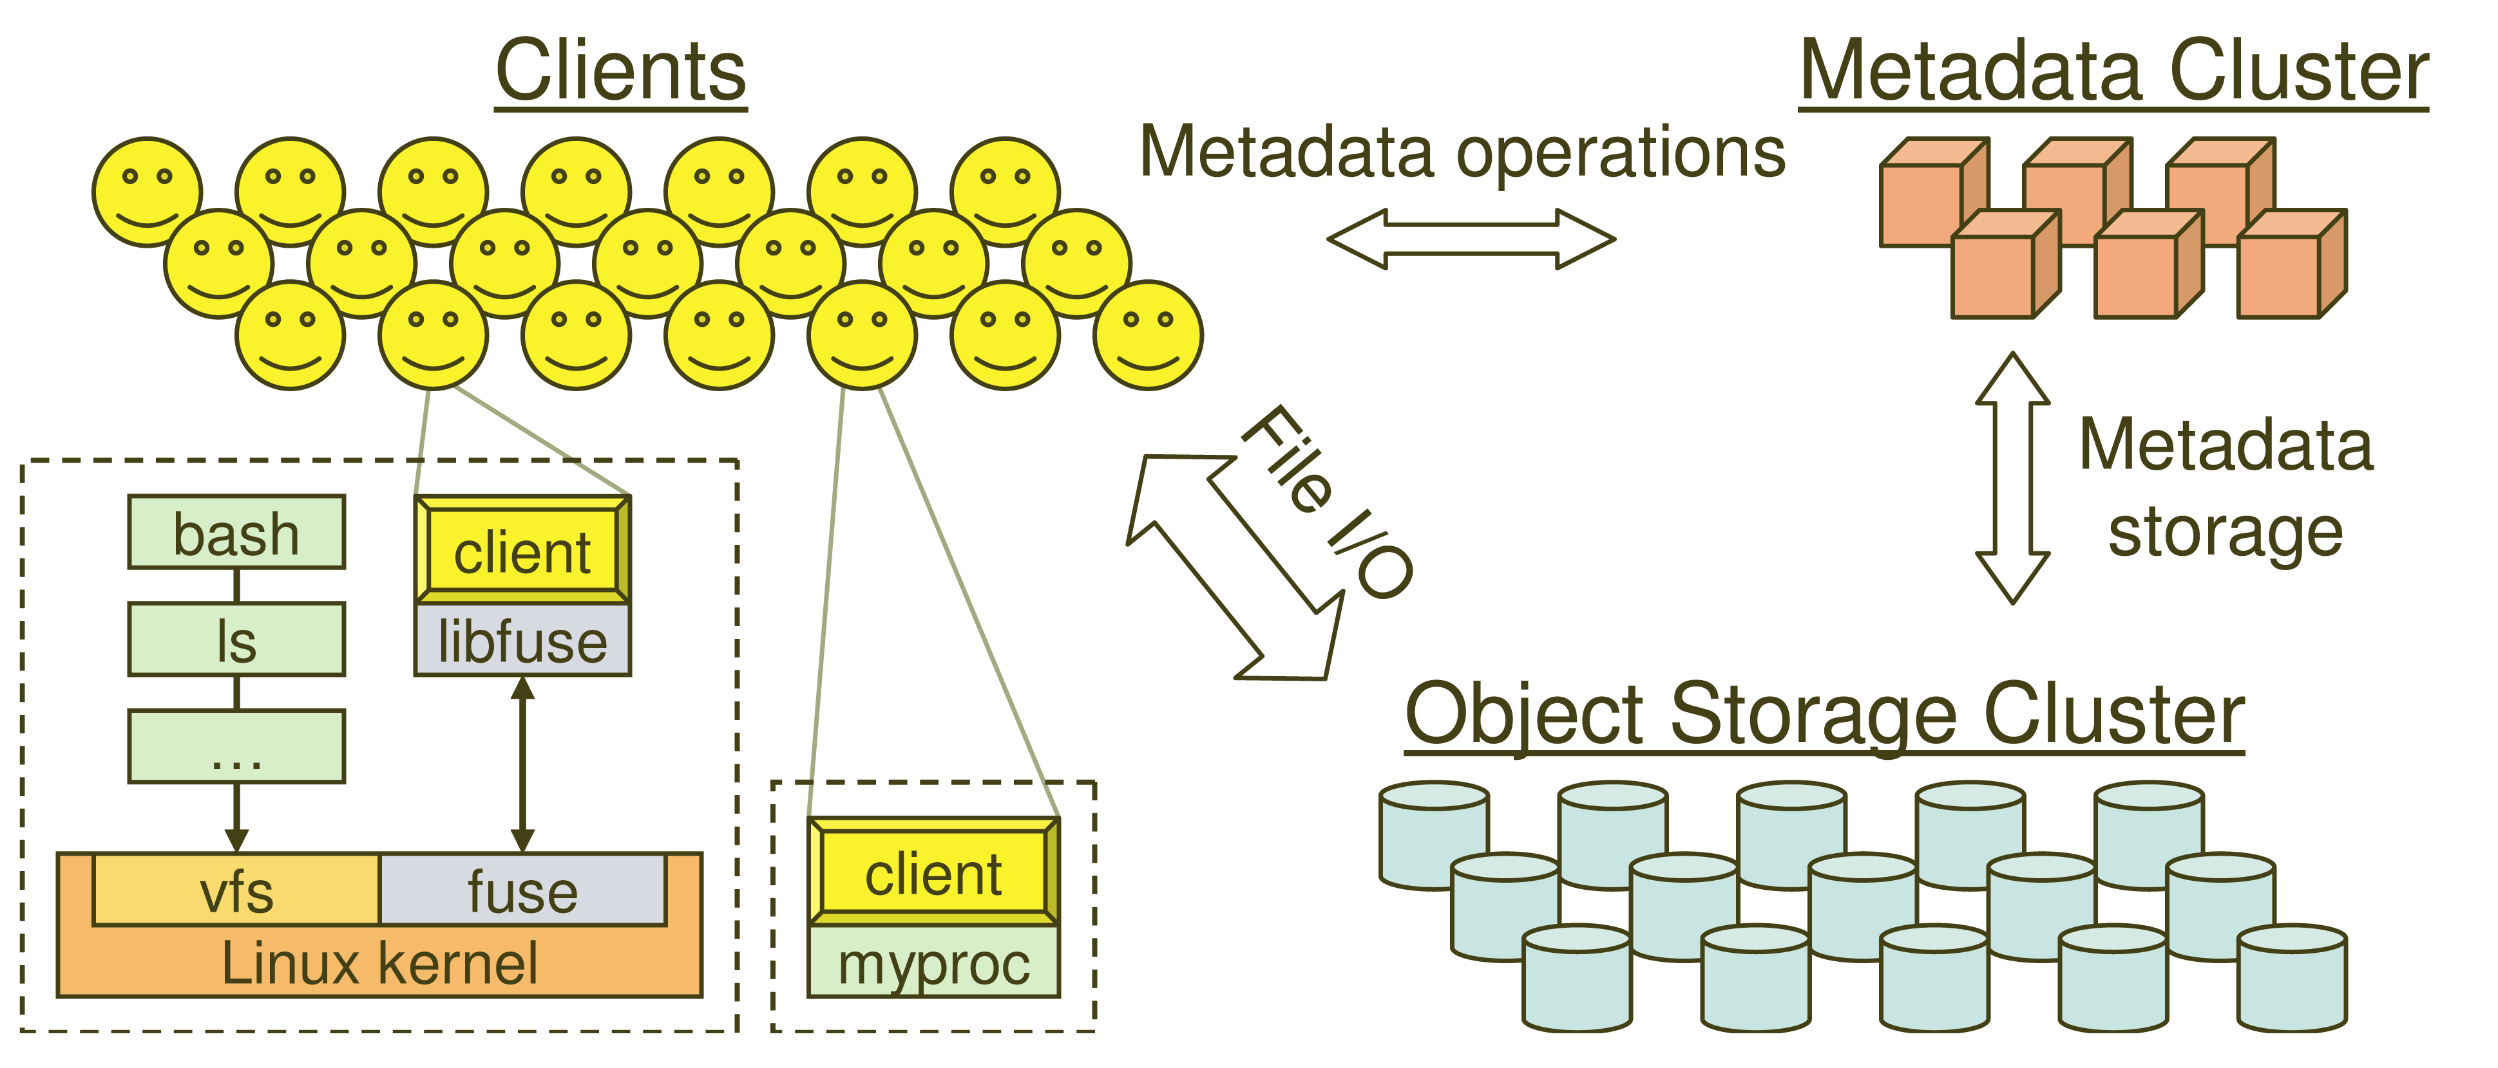
System Overview

Slide 19
Key Features
Decoupled data and metadata
CRUSH
Files striped onto predictably named objects
CRUSH maps objects to storage devices
Dynamic Distributed Metadata Management
Dynamic subtree partitioning
Distributes metadata amongst MDSs
Object-based storage
OSDs handle migration, replication, failure detection and recovery

Slide 20
Client Operation
Ceph interface
Nearly POSIX
Decoupled data and metadata operation
User space implementation
FUSE or directly linked
FUSE is a software allowing to implement a file system in a user space

Slide 21
Client Access Example
Client sends open request to MDS
MDS returns capability, file inode, file size and stripe information
Client read/write directly from/to OSDs
MDS manages the capability
Client sends close request, relinquishes capability, provides details to MDS

Slide 22
Synchronization
Adheres to POSIX
Includes HPC oriented extensions
Consistency / correctness by default
Optionally relax constraints via extensions
Extensions for both data and metadata
Synchronous I/O used with multiple writers or mix of readers and writers

Slide 23
Distributed Metadata
“Metadata operations often make up as much as half of file system workloads…”
MDSs use journaling
Repetitive metadata updates handled in memory
Optimizes on-disk layout for read access
Adaptively distributes cached metadata across a set of nodes

Slide 24
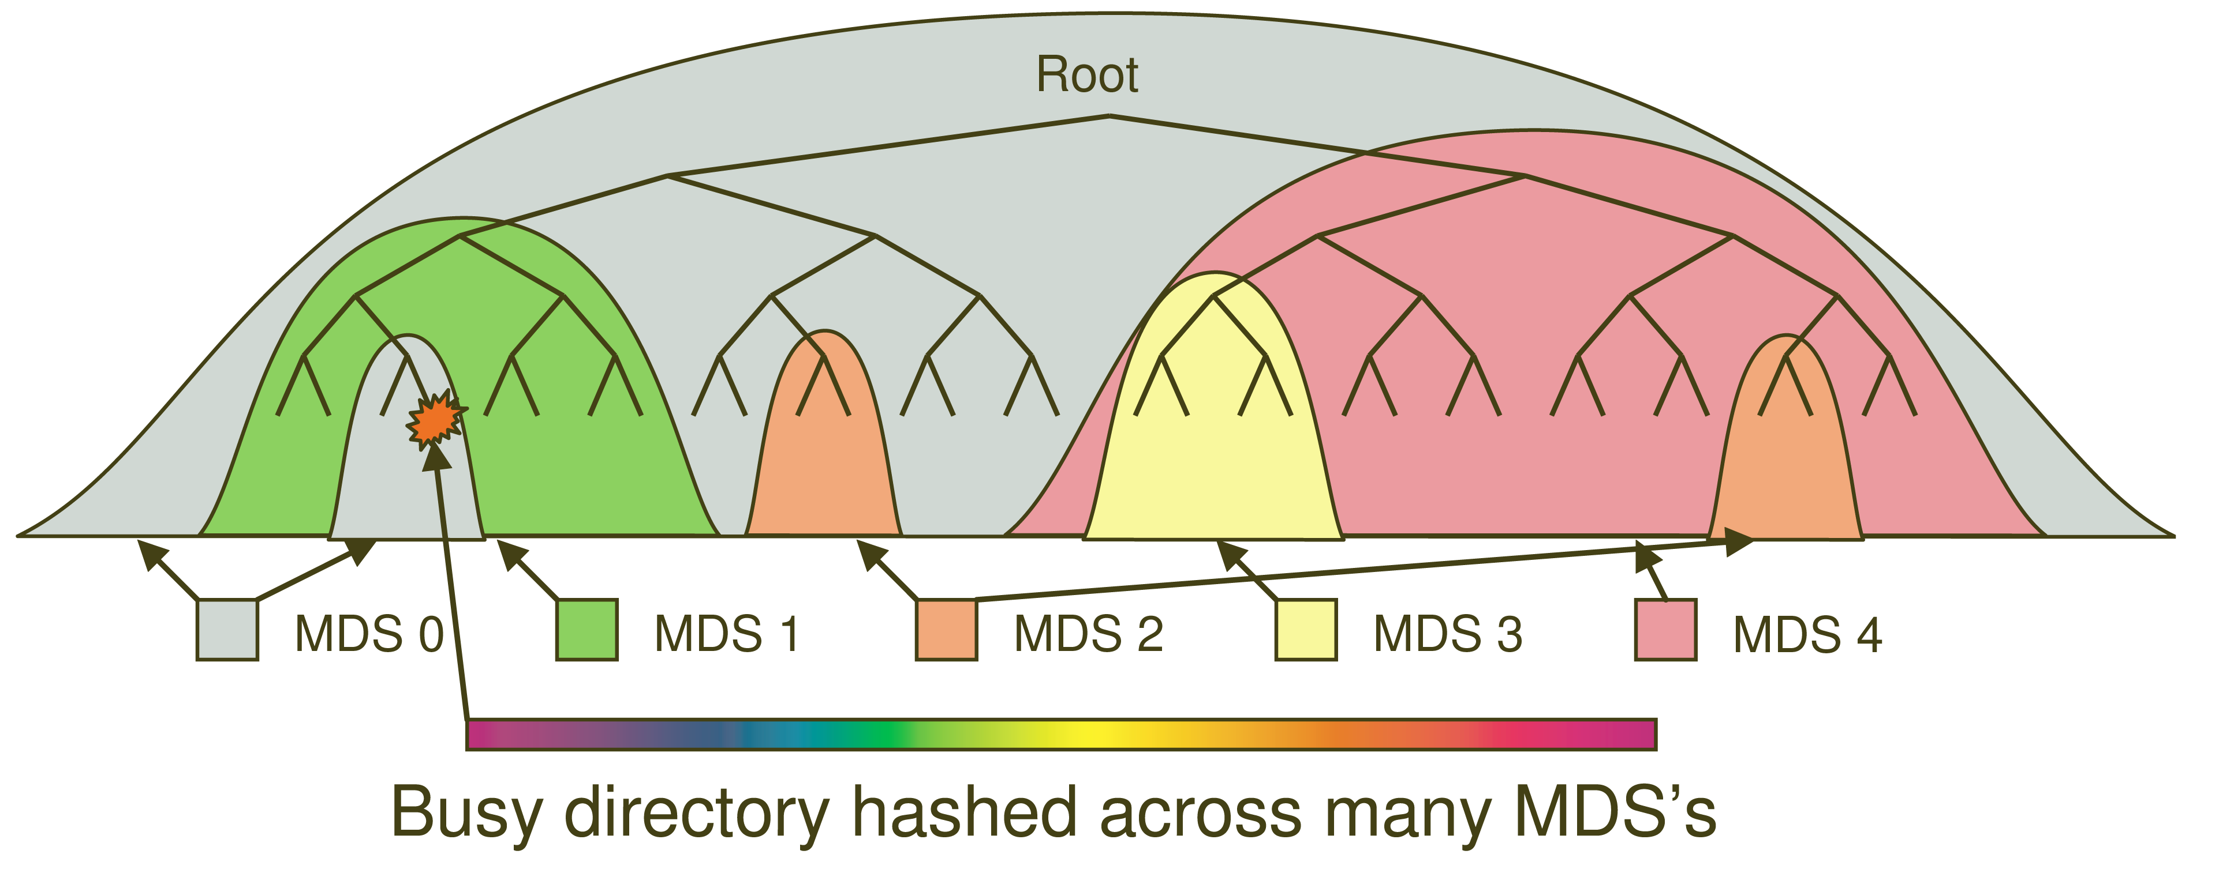
Dynamic Subtree Partitioning

Slide 25
Distributed Object Storage
Large files are split into a set of objects
Objects are members of placement groups
Placement groups are distributed across OSDs.

Slide 26
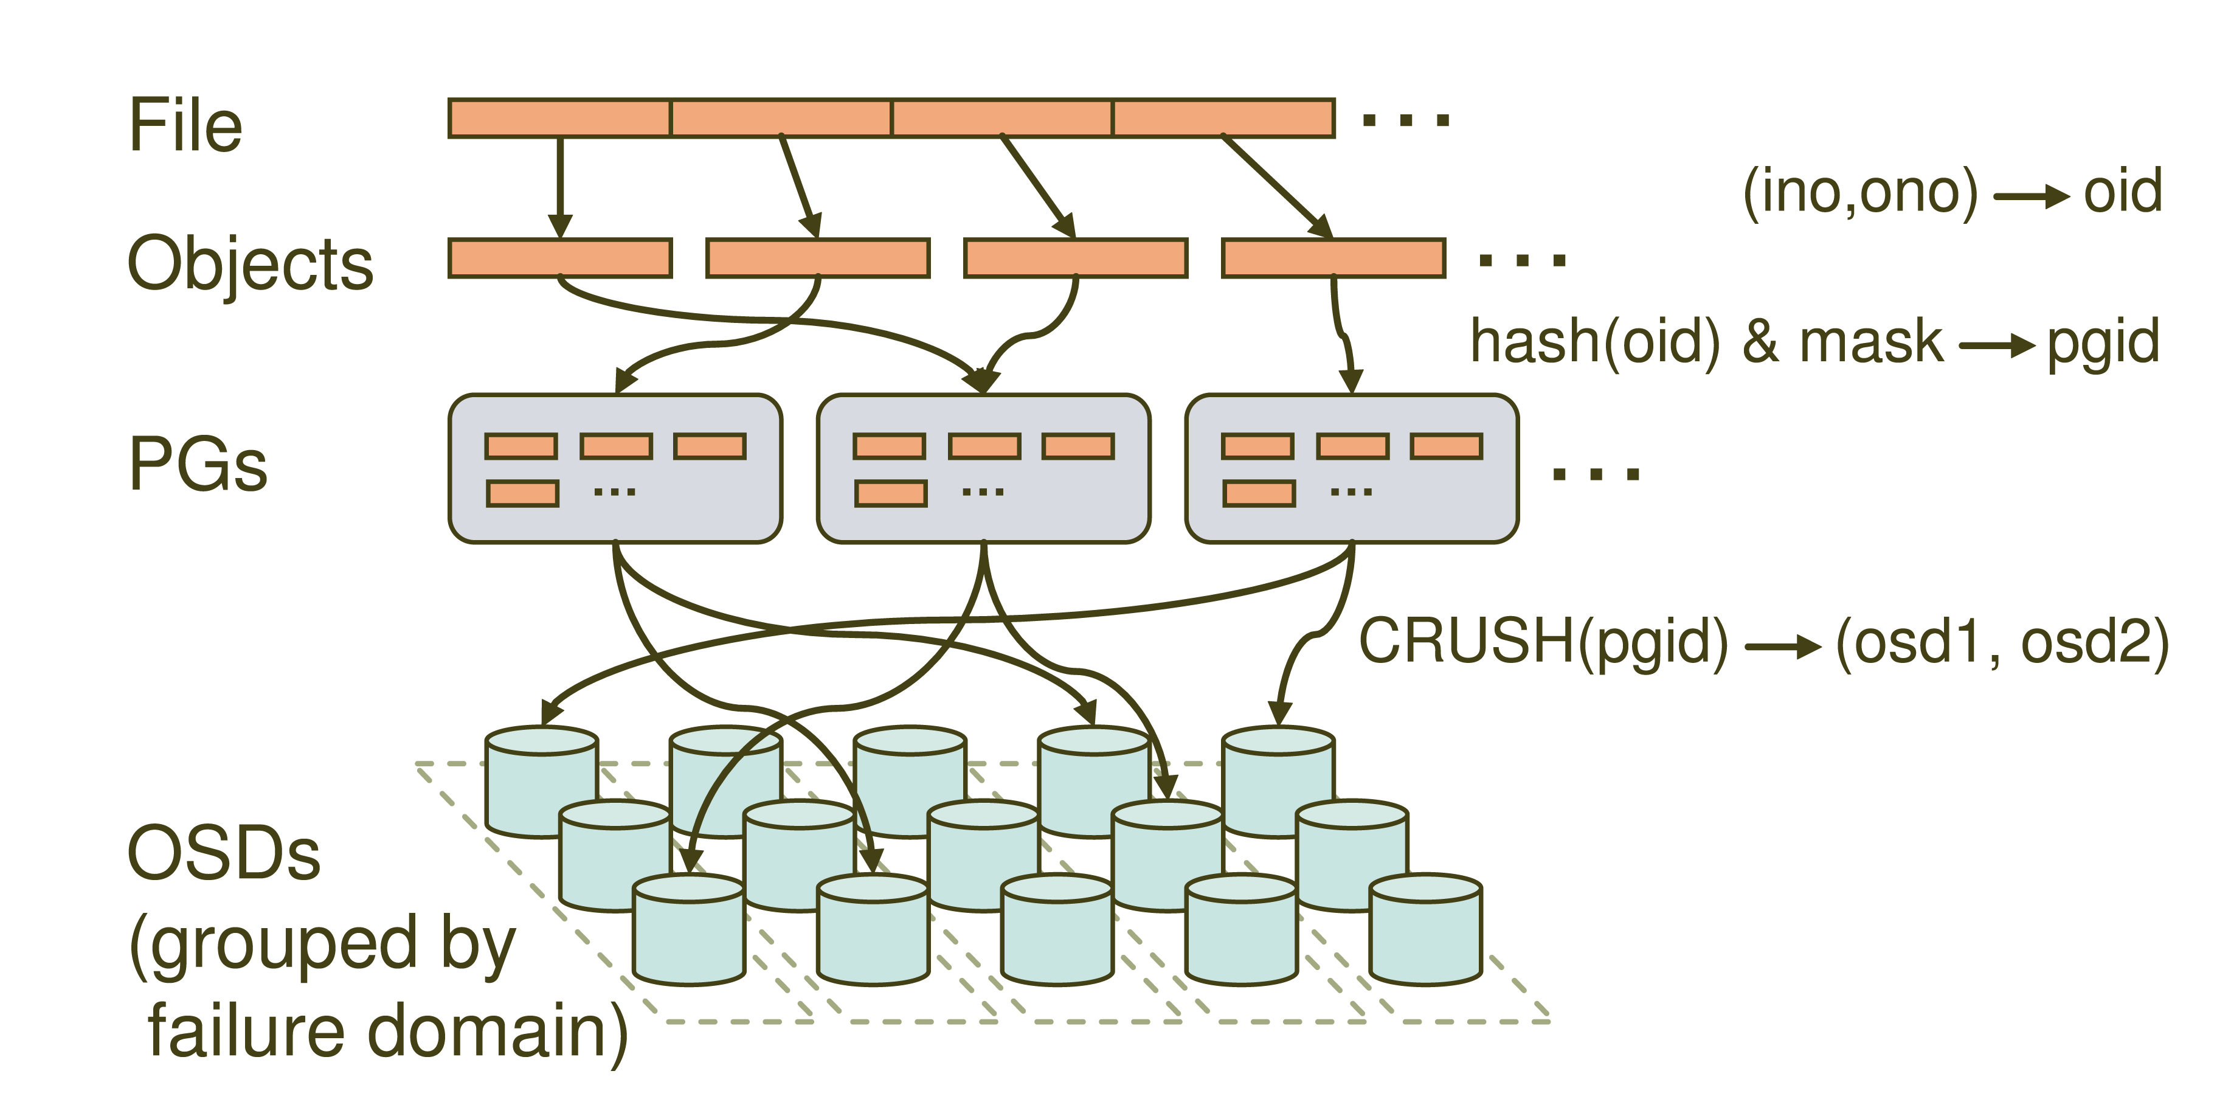
Distributed Object Storage

Slide 27
CRUSH: A specialized Key Hashing Function
CRUSH(x): (osdn1, osdn2, osdn3)
Inputs
x is the placement group
Hierarchical cluster map
Placement rules
Outputs a list of OSDs
Advantages
Anyone can calculate object location
Cluster map infrequently updated

Slide 28
Data distribution
(not a part of the original PowerPoint presentation)
Files are striped into many objects
(ino, ono) → an object id (oid)
Ceph maps objects into placement groups (PGs).
hash(oid) & mask → a placement group id (pgid)
CRUSH assigns placement groups to OSDs, using what seems to be a “shard”
CRUSH(pgid)→ a replication group, (osd1, osd2)

Slide 29
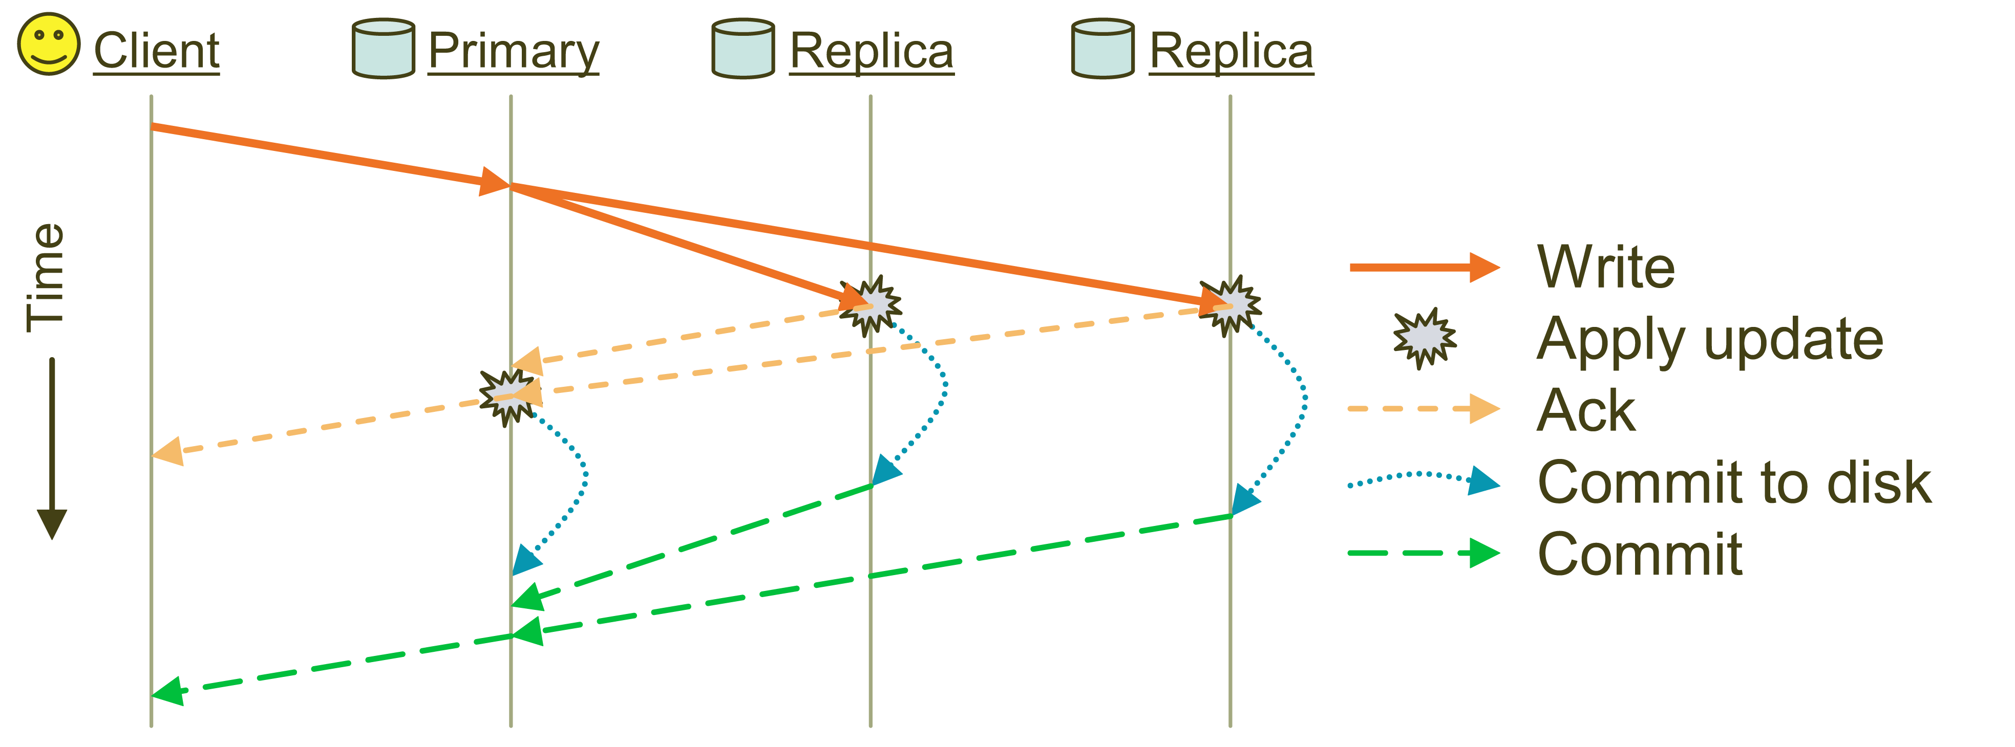
Replication: Reliable but not Paxos or chain replication
Objects are replicated on OSDs within same PG
Client is oblivious to replication

Slide 30
Failure Detection and Recovery
Down and Out
Monitors check for intermittent problems
New or recovered OSDs peer with other OSDs within PG

Slide 31
Acronyms Used in Performance Slides
CRUSH: Controlled Replication Under Scalable Hashing
EBOFS: Extent and B-tree based Object File System
HPC: High Performance Computing
MDS: MetaData server
OSD: Object Storage Device
PG: Placement Group
POSIX: Portable Operating System Interface for uniX
RADOS: Reliable Autonomic Distributed Object Store

Slide 32
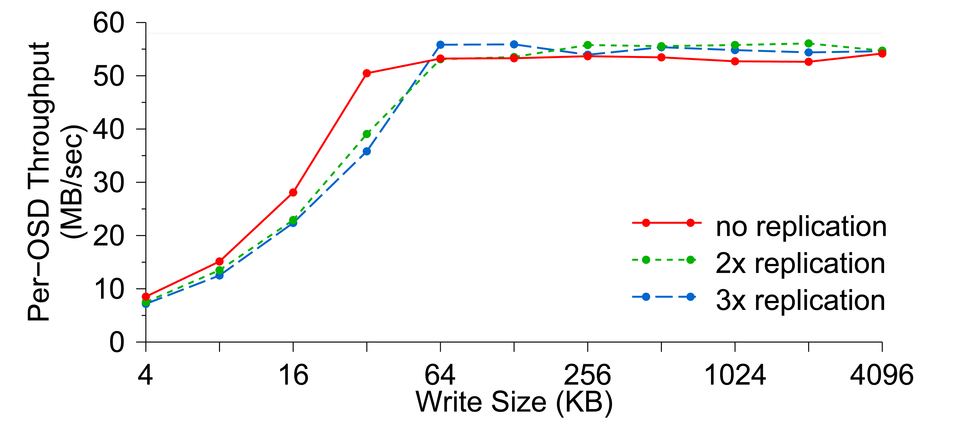
Per-OSD Write Performance

Slide 33
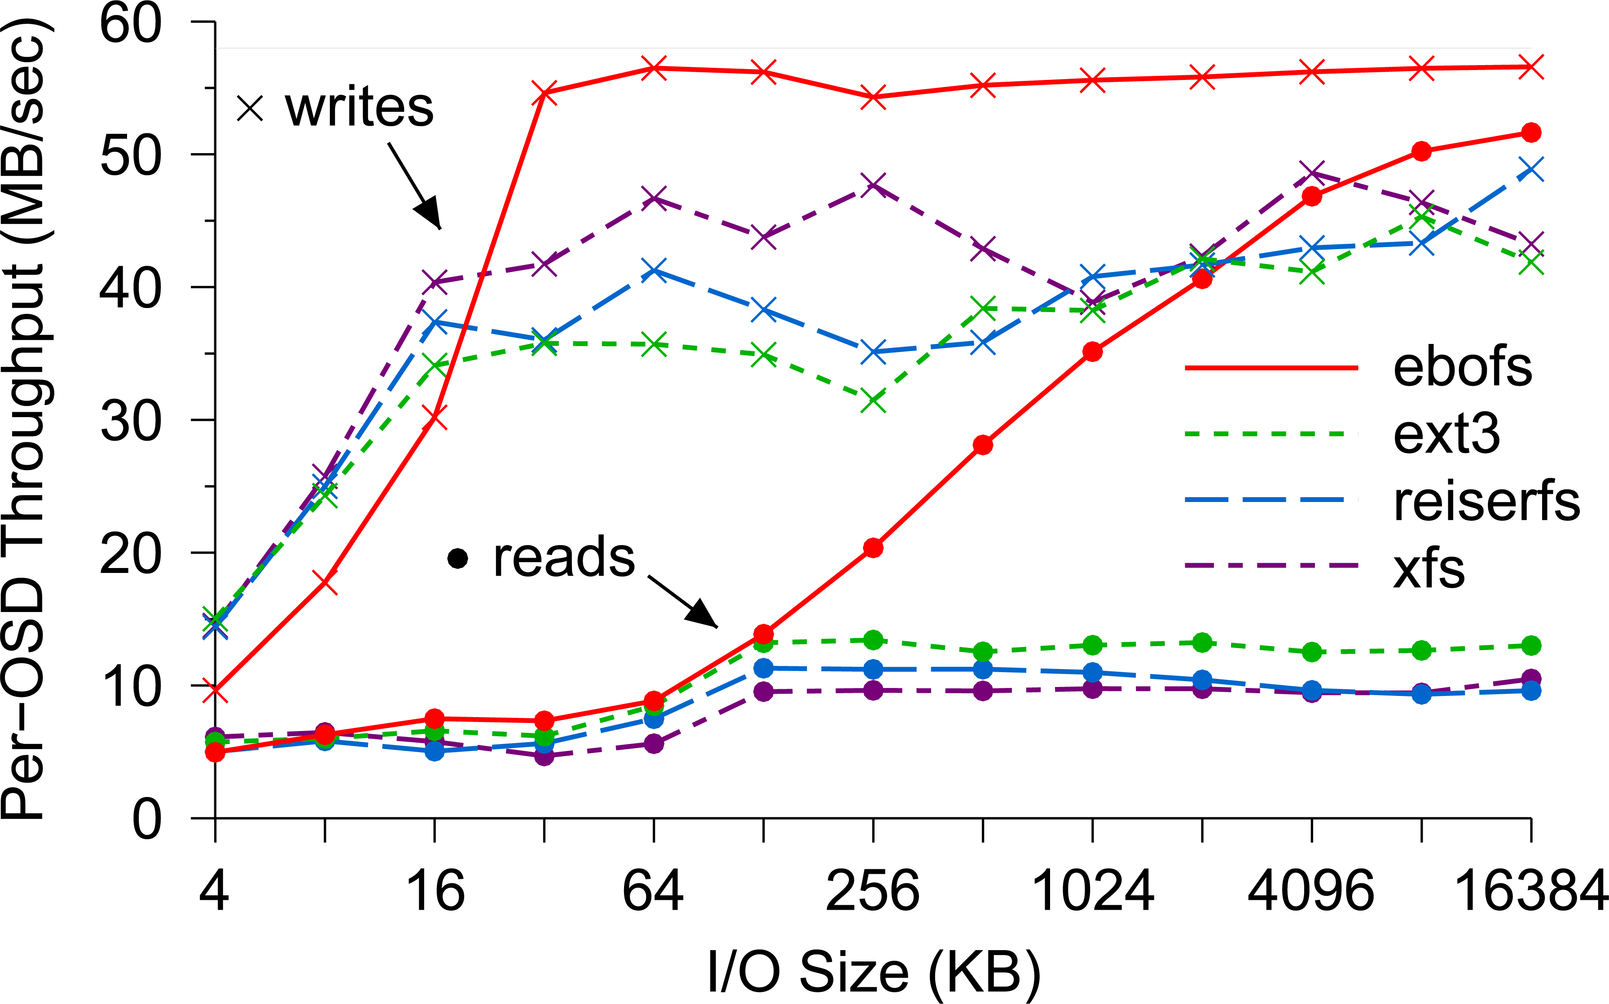
EBOFS Performance

Slide 34
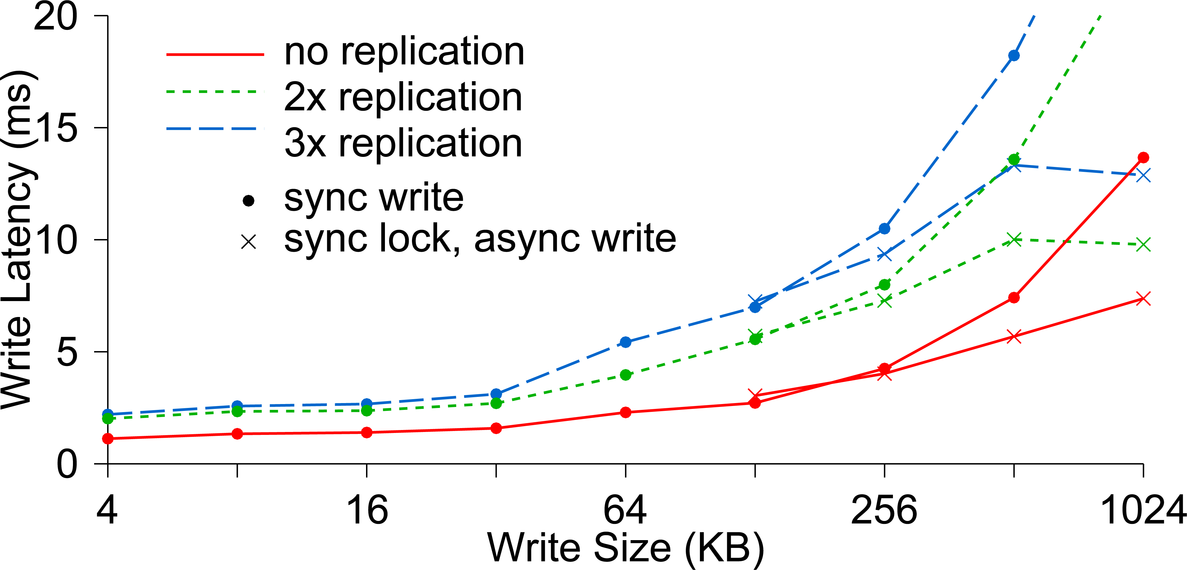
Write Latency

Slide 35
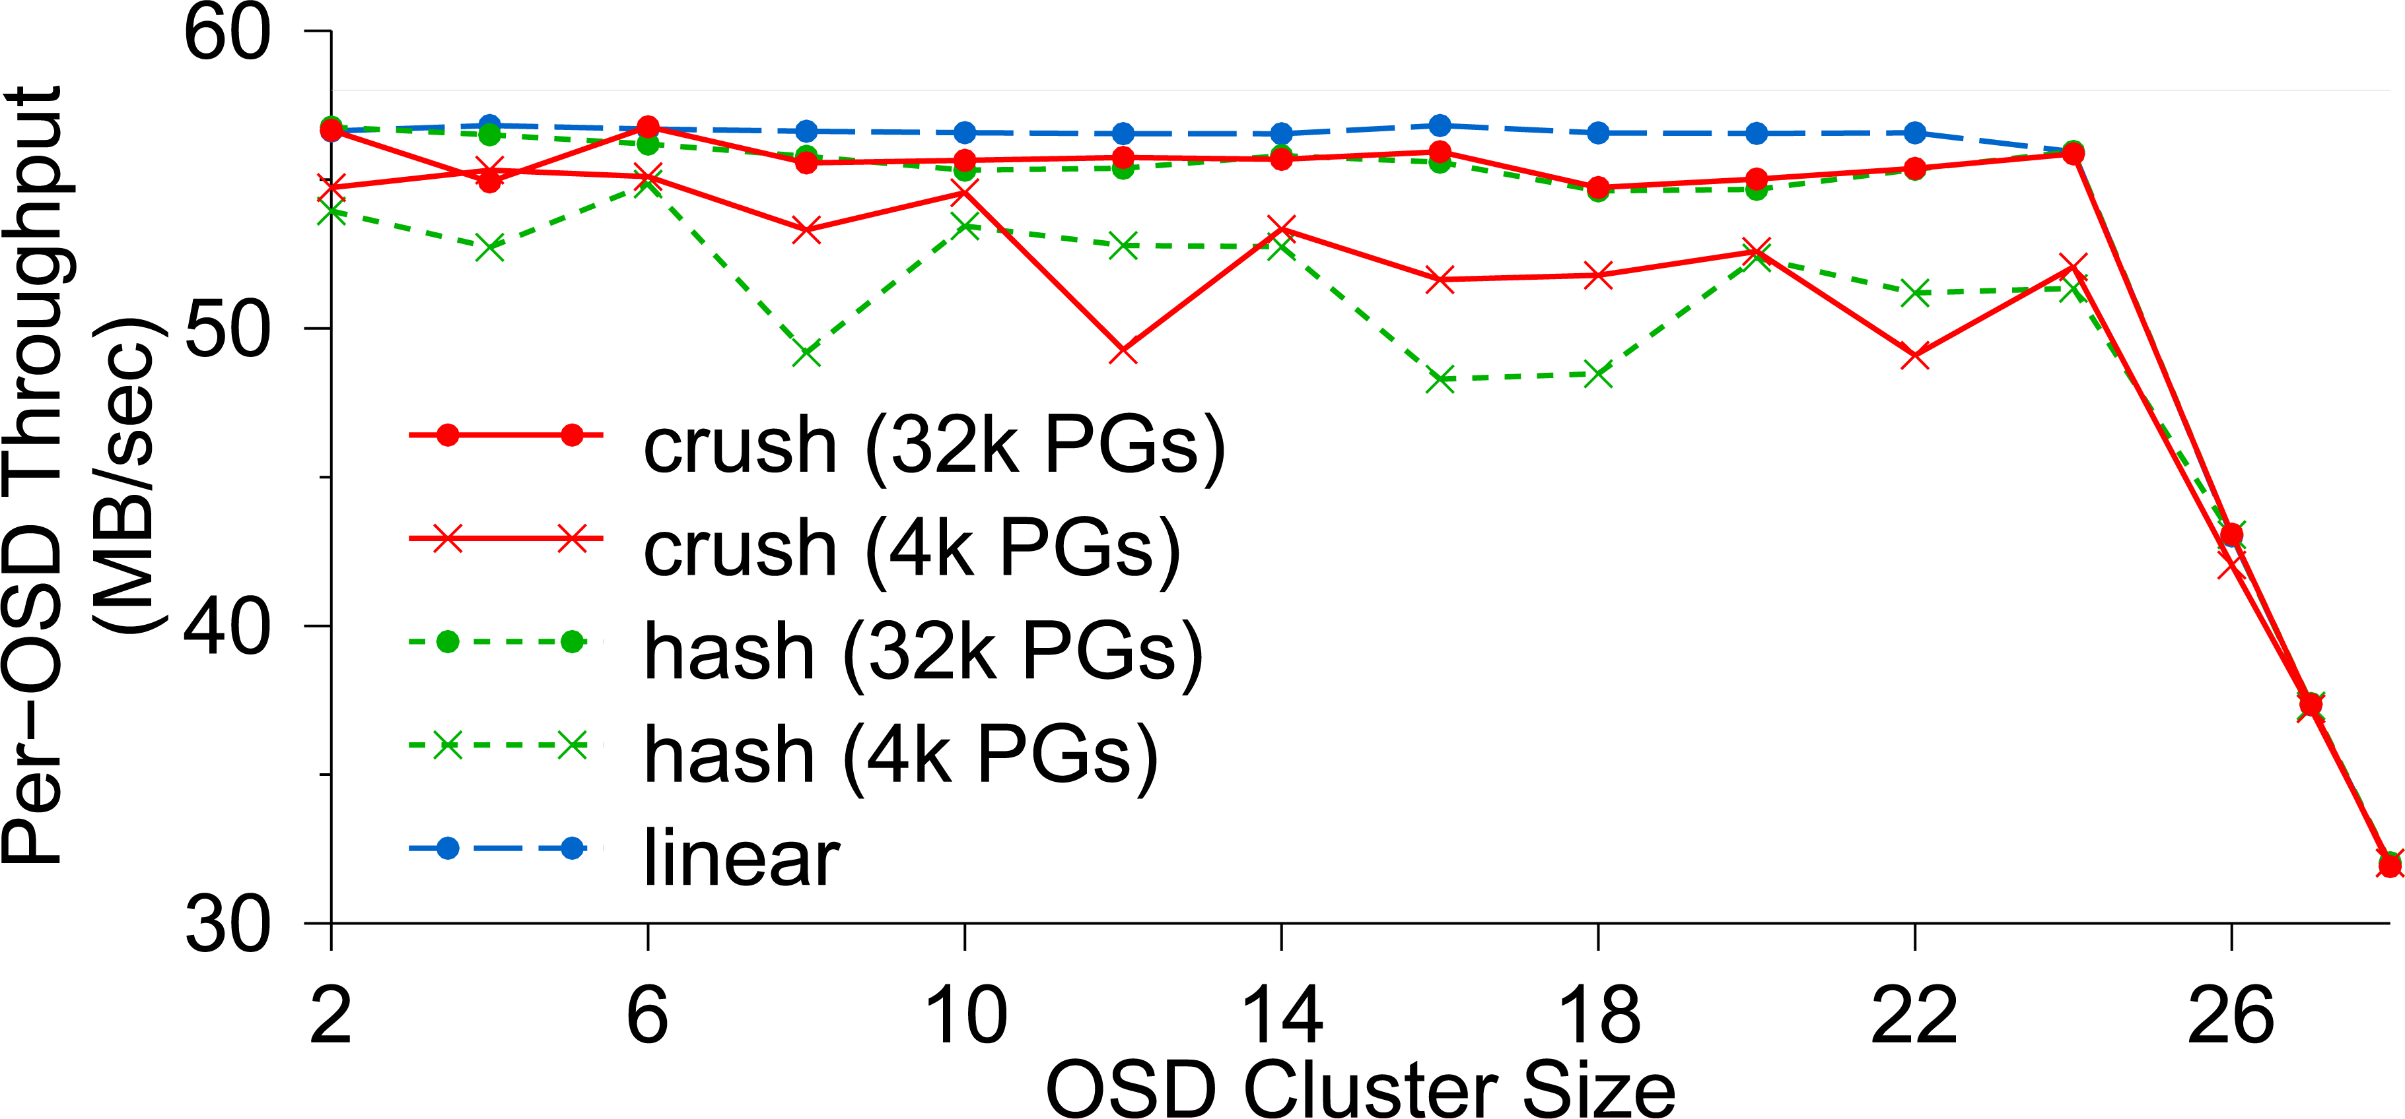
OSD Write Performance

Slide 36
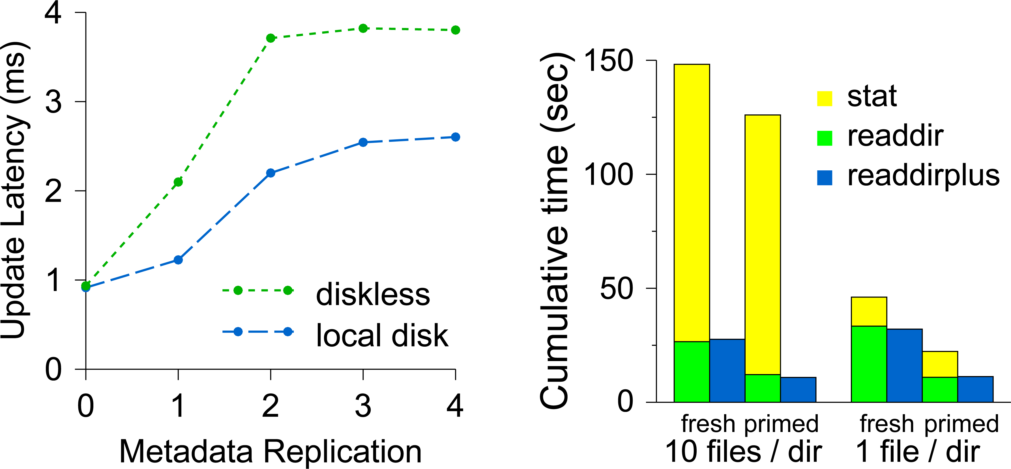
Diskless vs. Local Disk
Compare latencies of (a) a MDS where all metadata are
stored in a shared OSD cluster and (b) a MDS which has a
local disk containing its journaling

Slide 37
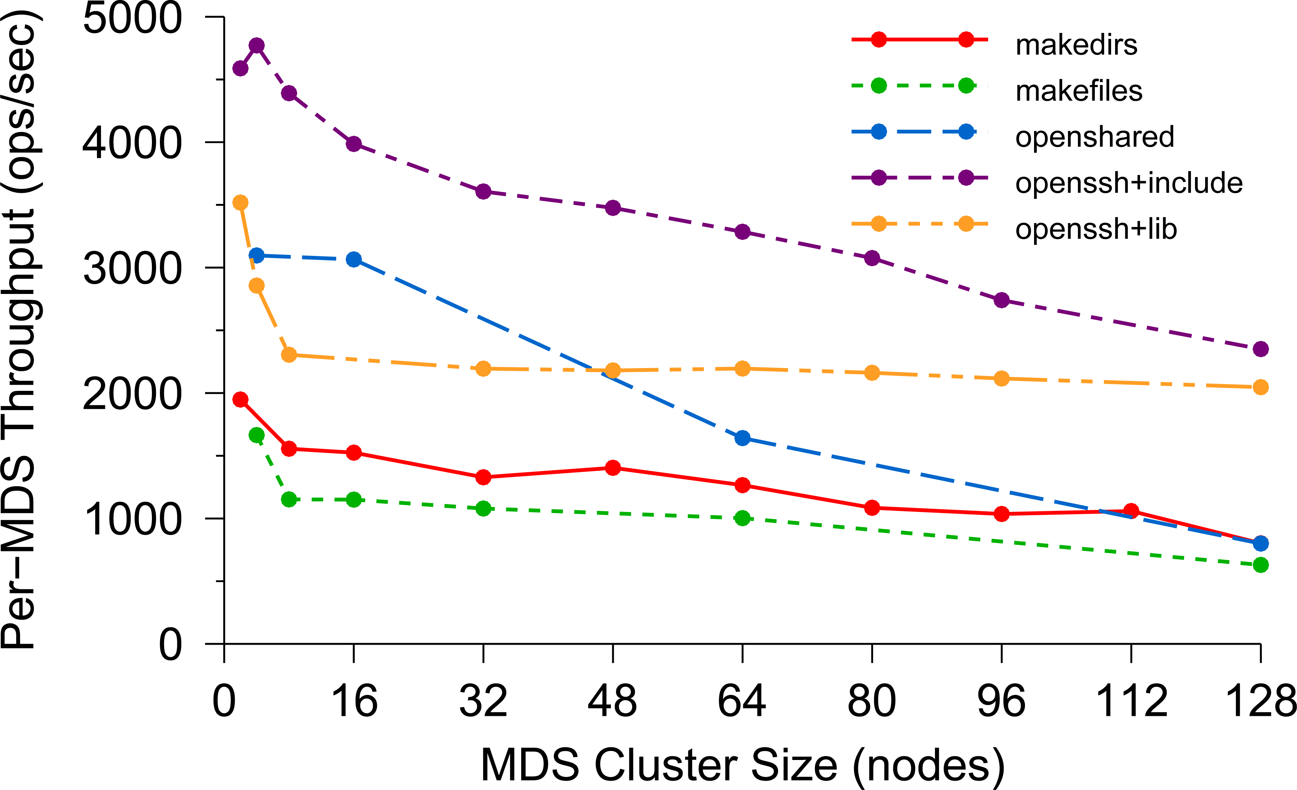
Per-MDS Throughput

Slide 38
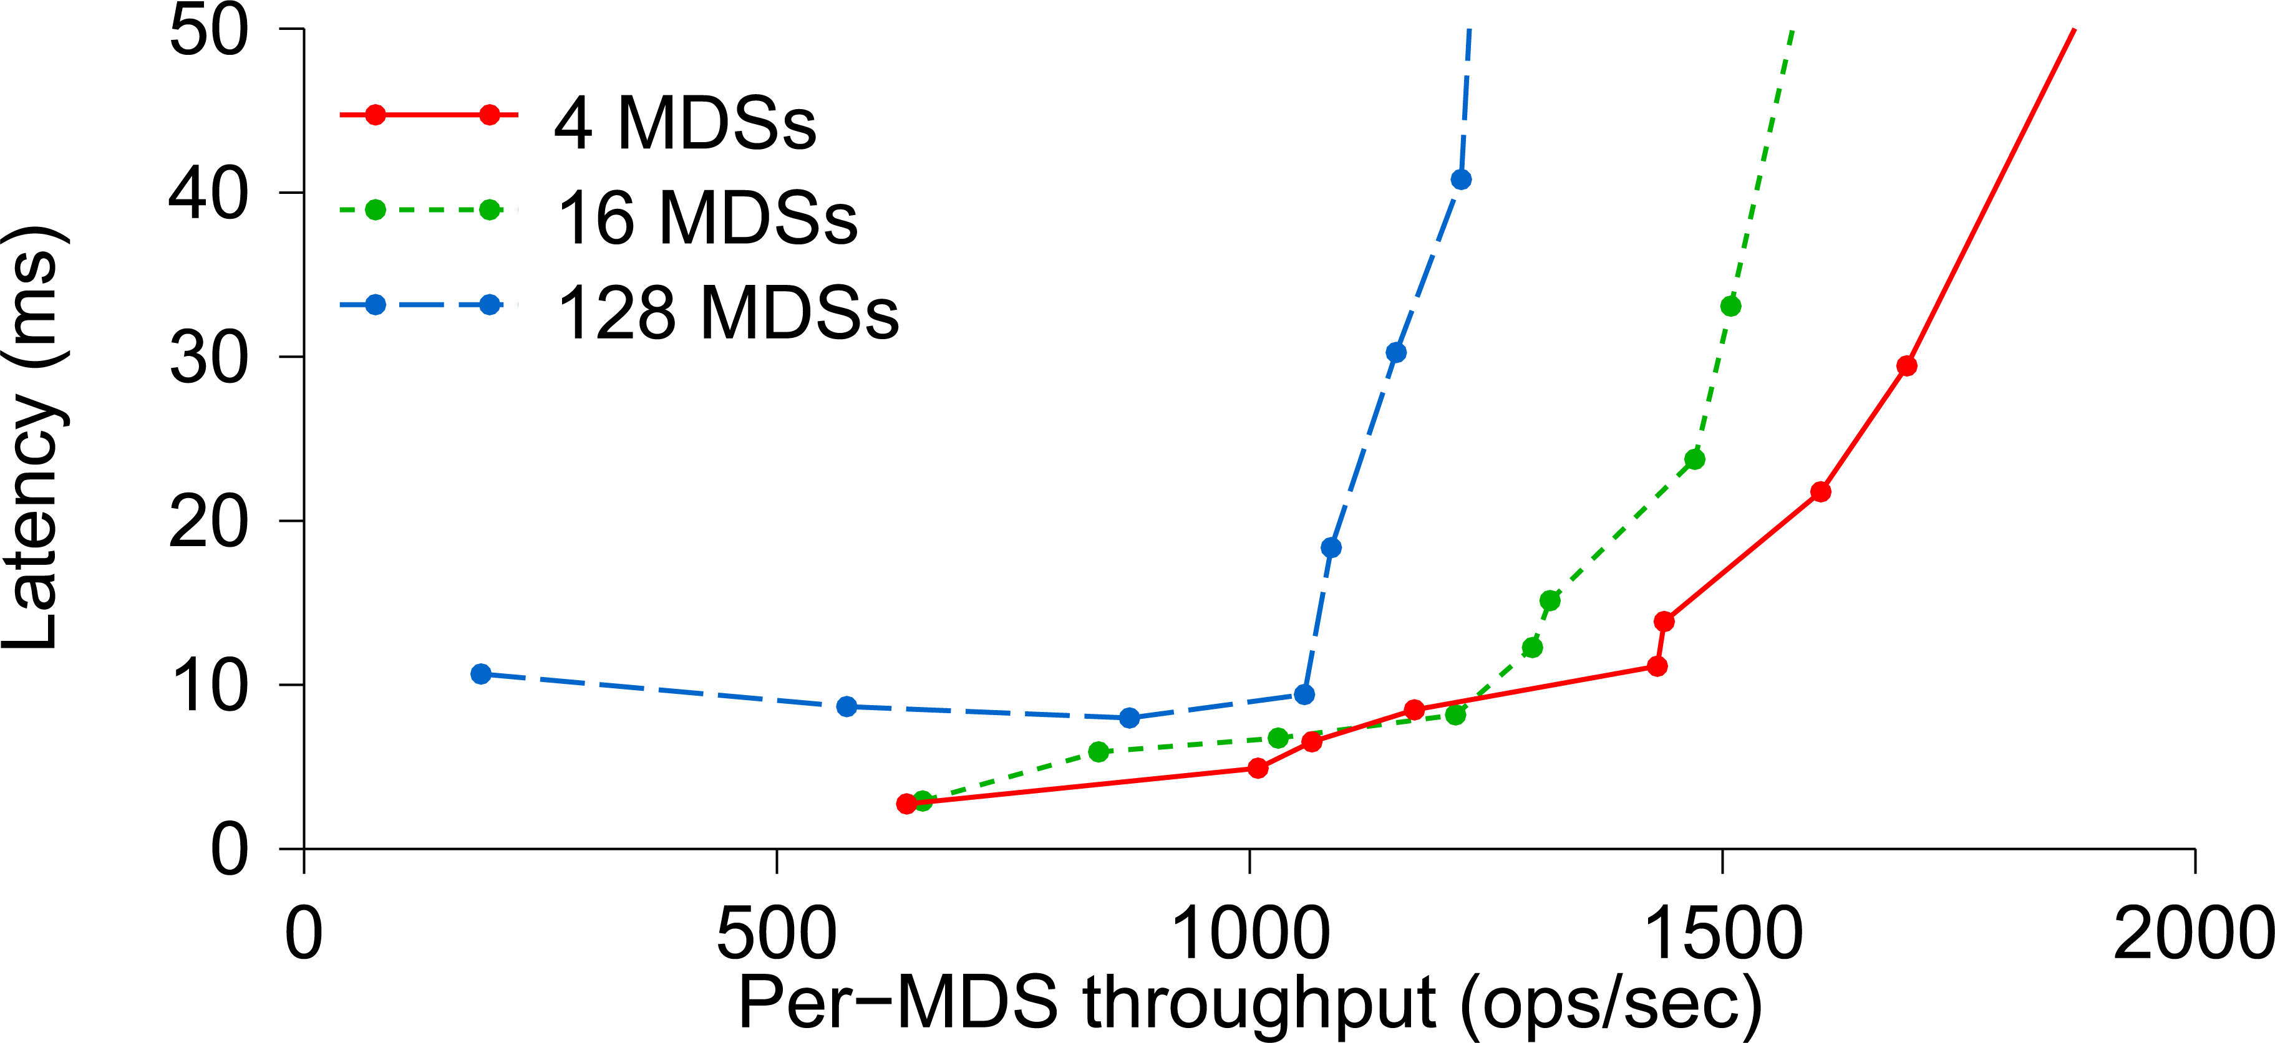
Average Latency

Slide 39
Lessons learned
If applications are object oriented, they will write huge numbers of variable-size records (some extremely large).
POSIX directories are awkward for large numbers of files, and POSIX is inefficient for whole-file read/write.
A B+ tree index works much better than directory
The library of POSIX API methods can “hide” the excess costs of open/close
Object-oriented code won’t use lseek, file “append” is all we really need
Ceph treats the records as byte arrays, track meta-data in one service and data in a second one. Both share the RADOS layer for actual data storage.

Slide 40
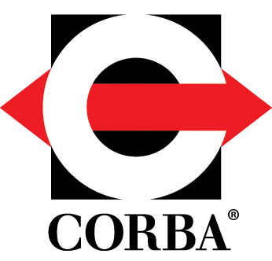
Interoperability for objects

Slide 41
OMG and CORBA
Like Ceph, CORBA is associated with the “Object Management Group” or OMG.
The original role of the OMG was to propose a standard way to translate between internal representations of objects and byte array external ones. They call this the Common Object Request Broker Architecture or CORBA.

Slide 42
Why adopt OMG/Corba?
Standardization is extremely valuable in large-scale settings, reduced vendor lock-in and increases options when searching for support
High quality software-engineering platforms, many tools and solutions
Easy of interoperation when object-oriented applications are created from subsystems coded in a variety of popular programming languages

Slide 43
Yet standards aren’t free
In the remaining section of this lecture we will focus on the overheads of using CORBA
We will see that they aren’t really a “gotcha” in the sense that if you understand them, you can avoid extremely costly designs
But if you use CORBA and ignore its overheads, you could design a solution that might have unnecessarily high overheads

Slide 44
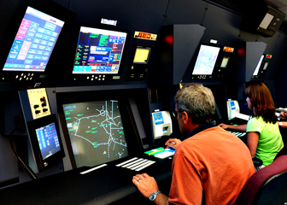
Understanding Costs for CORBA’s universal Representations: ATC System
A modern air traffic control system might have a structure like this:
Flight plan manager tracks current and past flight plan versions
Message bus
. . .
Microservices for various tasks, such as checking future plane separations, scheduling landing times, predicting weather issues, offering services to the airlines
Air traffic controllers update flight plans
Flight plan update broadcast service
WAN link to other ATC centers

Slide 45
Understanding Costs for CORBA’s universal Representations: ATC System
Think about objects in an ATC system:
Flight plans: these are elaborate objects that might hold 10MB of data and could have a great many internal fields
Many other kinds of objects are used too. Each microservice probably has a notifications channel of its own, and uses it to talk to individual controllers or sets of them about relevant issues
“Attention: In 2h 31m, BA 123 will approach US 654 on approach to CDG. Plan corrective action to avoid a violation of flight separation rules.”

Slide 46
Understanding Costs for CORBA’s universal Representations: ATC System
An ATC system has many components, far more than were shown.
Often these are based on high-quality legacy versions and hence there can be many programming languages in simultaneous use.
Often we will see C/C++, Java, C#, F#, O’Caml, etc.
Some use of Python and Fortran and Ada.
With CORBA, we can easily integrate many modules into a single system

Slide 47
But how often will we (DE)serialize?
Each time an object is read or written (from disk or network)
Each time an object is passed from one module to another
Time →
ATC controller
Version Mgr
Message Bus
ATC rules checker
. . .
Overhead →
Points at which we might do serialization/deserialization

Slide 48
CORBA serialization: Very elaborate
Some languages have “unique” data types. For example, Python integers are automatically implemented using BigNum arithmetic and have no size limit or risk of overflow/underflow.
But interoperability with C++ or Fortran, which have size-limited integers, becomes tricky: what format to use? What rules?
CORBA standardizes all such policies, at the cost of a fancy encoding

Slide 49
Universal representations are costly!
It is very easy for a CORBA application to spend all its time on this one action.
Ceph designers were aware of that, and decided it should only be done under application control.
This is one reason that Ceph forces the developer to serialize / deserialize objects: That policy eliminates the need for CORBA data representations

Slide 50
How do ATC systems avoid these costs?
If they aren’t careful… they will pay the high price! But there is a way around them, which is to use “lazy” record access.
The ATC record is the main object being shared. Suppose that we have two versions of an ATC object while in memory:
Version A: The object is fully resident in memory and you can access all fields, edit it to create a new version, etc.
Version B: All the same methods are offered, but the in-memory data is limited to a URL pointing to the record in the flight plan database

Slide 51
Why two “identical” object variants?
Notice how easy it is to switch from representation B to A (or back).
In an ATC system most components don’t really look at the data fields and for this reason, most components would be happy with representation B. But a small object with just a URL in it is very cheap to serialize!
With “lazy deserialization”, we would convert from form B to form A only when an application tries to touch the data.

Slide 52
Old Single version approach
Each time an object is read or written (from disk or network)
Each time an object is passed from one module to another
Time →
ATC controller
Version Mgr
Message Bus
ATC rules checker
Wasted work!
. . .
Overhead →
Points at which we might do serialization/deserialization

Slide 53
Dual version approach
We only do a costly action when the component will actually touch the inner data fields!
Time →
ATC controller
Version Mgr
Message Bus
ATC rules checker
Here we fetch the full data for the flight plan from the flight plan database
. . .
Overhead →
Dual scheme reduces overheads!
A A B B B B B B B B B A B B B

Slide 54
How should we store the flight plan records?
The need is for a very simple append-only log managed by the version manager.
It is easy to recognize this as a use case for state machine replication.
This situates the central safety question in one specific component, where we can formalize it and use mathematical tools to prove that each plan has just one sequence of versions, used consistently by all components.

Slide 55
How should we Implement the flight plan manager component?
A (key-value) sharded service built on Derecho would be an ideal choice.
Derecho has been proved correct in several ways: by hand, but also using a machine-verified proof in the Ivy protocol verification tool.
It is also scalable and extremely fast: important because this role is central.

Slide 56
Revisiting the structure
If this one component is correct, the whole system can be proved safe!
A modern air traffic control system might have a structure like this:
Flight plan manager tracks current and past flight plan versions
Message bus
. . .
Microservices for various tasks, such as checking future plane separations, scheduling landing times, predicting weather issues, offering services to the airlines
Air traffic controllers update flight plans
Flight plan update broadcast service
WAN link to other ATC centers

Slide 57
Summary – CEPH
Ceph is a file system that was created by taking the HDFS model, but then extending it to be better matched to properties of object-oriented code.
This is very popular, although it does bring overheads.
Ceph uses a simple but “weak” form of data replication. It doesn’t guarantee consistency.

Slide 58
Summary – corba
Here we saw a different form of object-oriented overhead, arising in applications that adopt the standard CORBA approach to interoperability.
CORBA buys flexibility but brings steep costs.
Those costs can be managed by understanding the architecture and designing the application to avoid triggering costly serialization/deserialization.

Slide 59
Broader Insight linking these subtopics
Innovation brings challenges. And object orientation was a big innovation.
Strongly typed object oriented languages like Java, C++, Python reduce errors and improve productivity. But they sometimes clash with very old APIs that predate this style of computing.
Modern services are evolving to enhance object-oriented support.
Tuples held in SQL relations, NoSQL key-value pairs, rows in CSV files and many other things can all be viewed as “objects”.

