Slide 1
CS 5412/Lecture 2 Elasticity and Scalability
Ken Birman
Fall, 2022

Slide 2
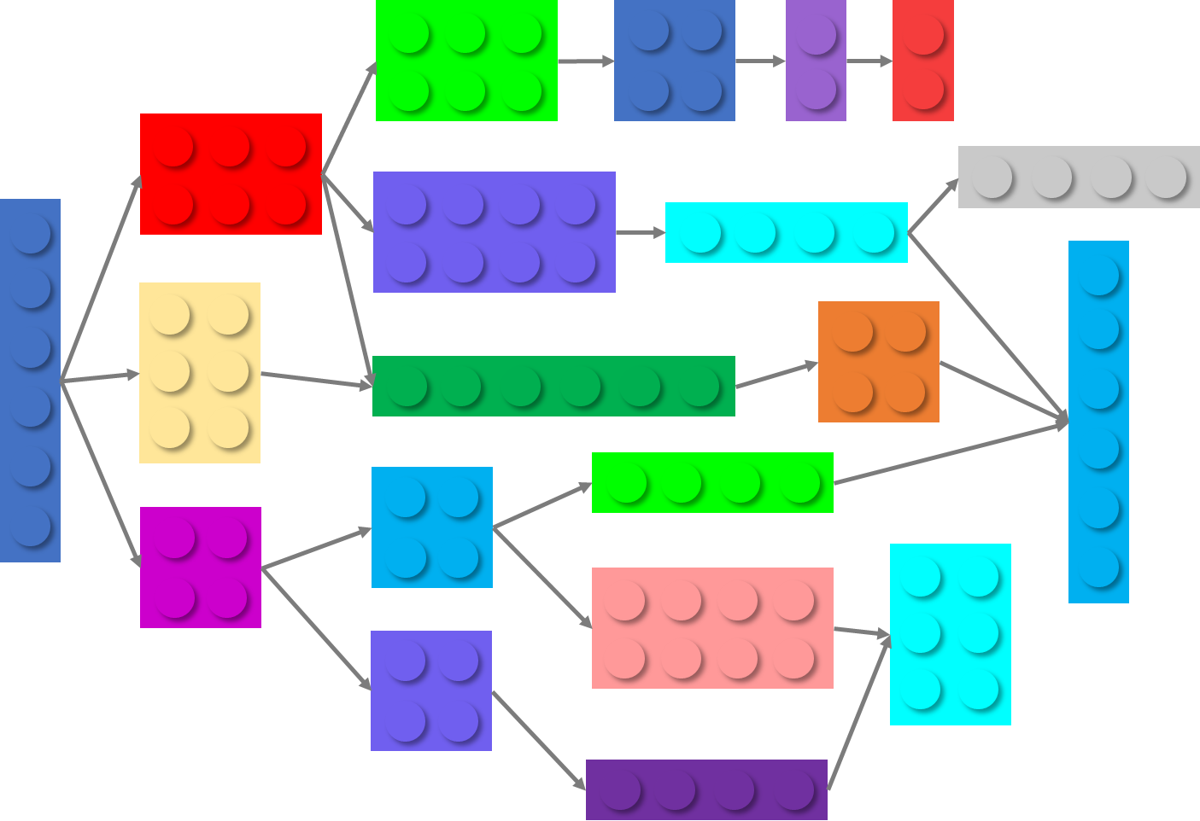
Reminder: What is a μ-service?
The little μ is short for “micro”.
posts
recommender
webserver
ads
photos
databases
Microservices

Slide 3
Each μ-service…
TCP network link
A client program
A database implemented by 3 “instances”. This requires a special coding style
Is just some program, packaged as a “docker container”
The software was written to run with multiple side-by-side copies (“instances”)
Some services are started on demand and shut down when not in use. Others are always running, and often we add or remove instances as needed
Client programs talk to service instances over the network. Looks just like a function call, but in fact a message is sent, and the reply is a message too
Cloud services keep data in files or databases or key-value storage, updating it as needed. This makes it easy to start/stop instances

Slide 4
Load swings are inevitable
People sleep in Seattle while they are waking up in New York.
People work in Mumbia when nobody is working in the USA
So any particular datacenter sees huge variation in loads.

Slide 5
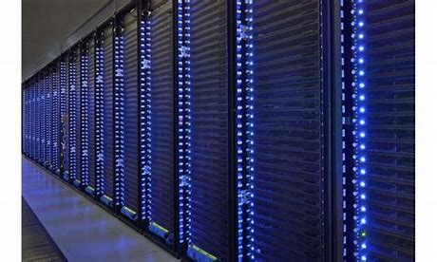
Concept of Elastic scalability
The pools of servers making up a μ-service must support having instances added or removed elastically, “on demand”.
We need to be sure that the performance of individual instances will remain good even if the number of instances suddenly doubles, or suddenly shrinks.
Notes:
For many people, learning about the cloud feels like a leap into the void.
Many things act very differently than you might expect because the scale at which our solutions need to be used is just so immense. So much of what you learned in computing doesn’t apply “easily”.
What we will discover is that your knowledge really does apply in the cloud, but simply that it takes a little while to learn the right mental models for the larger-scale cloud computing styles and approaches that work best.

Slide 6
The main problem: μ-service overloads
It is very common for μ-services to need to talk to other μ-services, or from a storage server. Those shared servers can easily become hot spots.
One big thing: we could implement big services as monolithic products running on clusters. The Oracle enterprise database product works this way. But there is a limit to how big the clusters can grow.
Many smaller things: Split services into an array of “mini-servers:” sharding. Very easy to scale, by adding shards, but imposes limitations.

Slide 7
Single big service performs poorly… why?
Until 2005 “one server” was able to scale and keep up, like for Amazon’s shopping cart. A 2005 server often ran on a small cluster with, perhaps, 2-16 machines in the cluster.
This worked well.
But suddenly, as the cloud grew, this form of scaling broke. Companies threw unlimited money at the issue but critical services like databases still became hopelessly overloaded and crashed or fell far behind.

Slide 8
Jim Gray’s Famous Paper
At Microsoft, Jim Gray anticipated this as early as 1996.
He and colleagues wrote a wonderful paper from their insights:
Basic message: divide and conquer is really the only option.
Jim Gray (Jan 1944 – Jan 2007)
The dangers of replication and a solution. Jim Gray, Pat Helland, Patrick O'Neil, and Dennis Shasha. 1996. In Proceedings of the 1996 ACM SIGMOD Conference. pp 173-182. DOI=http://dx.doi.org/10.1145/233269.233330
Notes:
In fact, almost nothing scaled. Jim studied this and tried to understand root causes.

Slide 9
How their paper approached it
The paper uses a “chalkboard analysis” to think about scaling for a system that behaves like a database.
It could be an actual database like SQL Server or Oracle
But their “model” also covered any other storage layer where you want strong guarantees of data consistency.
Mostly they talk about a single replicated storage instance, but look at structured versions too.
Notes:
Even with a pencil and paper analysis, he and his colleagues identified a huge issue!

Slide 10
The core issue
The paper assumes that your goal is some form of lock-based consistency, which they model as database serializability (in CS5412 we might prefer “state machine replication”, but the idea is similar).
So applications will be using read locks, and write locks, and because we want to accommodate more and more load by adding more servers, the work spreads over the pool of servers.
This is a very common way to think about servers of all kinds.
Notes:
He posed his analysis as an asymptotic cost question, like in an algorithms class where you study complexity. But here we have more moving parts.

Slide 11
Their setup, as a picture
Applications using the database: client processes
During the run, T concurrent requests are issued. Here, 3 are running right now, but T could be much larger.
The database
Notes:
The model starts with clients talking to a database. There are T transactions that need to run. They won’t run all at the same time, of course. Here, three are active.

Slide 12
Key parameters
N, the number of servers running the service. T, the number of concurrent transactions the service is asked to perform.
Goal: For larger T, use more servers (make N bigger).
Our beta test was a success with 1000 shoppers. But we will see as many as 100,000 at the same time. Can we just pay for extra cloud servers? Or must we redevelop the entire system from scratch?

Slide 13
Gray’s conclusion: It wont work
A scalable system needs to be able to handle “more T’s” by adding to N
Instead, they show that the work the servers must do will increase as T⁵ Worse, with an even split of work, deadlocks occur as N^{3,} causing feedback (because the reissued transactions get done more than once).
Example: we anticipate doubled low (T becomes 2T), so we deploy twice as many servers (N becomes 2N). But overhead rises by 2³2⁵ = 256x!

Slide 14
Why services slow down at scale
The paper pointed to several main issues:
Lock contention. The more concurrent tasks, the more likely that they will try to access the same object (birthday paradox!) and wait for locks.
Abort. Many consistency mechanisms have some form of optimistic behavior built in. Now and then, they must back out and retry. Deadlock also causes abort/retry sequences.
The paper actually explores multiple options for structuring the data, but ends up with similar negative conclusions except in one specific situation.
Notes:
Basically, you see higher and higher rates of transactions banging into each other and either waiting (which can be slow), or deadlocking (which causes a rollback), or in some “optimistic” scenarios, aborting.
The rate of growth of overhead is a polynomial, like the number of servers or the number of transactions raised to an exponent like 2 or 3.
Now this may sound very database-specific but in fact the same issues arise in any consistent cloud service because Jim’s model was so general it could apply even if you have never thought about databases in your life!

Slide 15
Sharding: Key Ideas
There is one API for talking to the customer accounts database
Sharding breaks the single database into mini-databases “transparently”
customer accounts database
Remote procedure calls are one way for code in one μ-service to invoke APIs in some other μ-service
K shards

Slide 16
shards have 2 (or more) nodes!
Each transaction accesses just one shard
Storage μ-service
The pairs of nodes here represent the idea of replication. Both of the purple nodes are individual servers, on different computers.
We use a model called state machine replication to keep them in sync.

Slide 17
Benefits of replication?
Gray’s formula doesn’t “kick in” for small N. We actually do get a speedup, if N is small enough.
Meanwhile, we gain fault-tolerance: if some server crashes, its replica can handle requests while it recovers

Slide 18
DefN: State Machine Replication
We have a set of servers: {P, Q, R, … }. Each server holds a replica of some data and has the identical logic (code).
Any server can handle a read: the code just reads the local replica.
Replicas see the same updates in the same order, hence stay in sync.
Notes:
With state machine replication we don’t have full transactions, so Jim’s issues don’t arise: there aren’t any locks, or any notion of deadlock/abort/retry.

Slide 19
But a transaction can only talk to one shard and does all its work in “one step”
If updates and queries are done entirely on one shard, Jim’s analysis does not apply. This is because we can actually avoid locking (the update order is enough to ensure sequential progress of the replicas, with consistency).
An application that needs to access multiple shards must treat the operations as concurrent, independent transactions.

Slide 20
Put operation
Key=“Ken”
Value=
Hash(“Ken”)%20
First, the put is sent to one member of the 12’th shard.
Then this member uses a state machine replication solution to replicate the update across the other shard member(s)
Notice that many keys map to shard 12. It uses an O(1) Hash object for quick lookups
Notes:
So one possible answer is to replicate the server handling each shard. Here we have two replicas per shard. In fact this model is common. Sharding with two replicas is very common, and sometimes for especially critical data we might have three copies. Even more would be used if we had a hot spot and wanted to spread the load, but not all key-value sharding solutions have that degree of sophistication.
If the management layer understands the fault-tolerance model and replication pattern, it can avoid shutting down both replicas simultaneously. So the owners of the FB cache would need to understand the management subsystem and configure it appropriately. Then their cache implementation would need to include a replication mechanism.
These aren’t such easy steps, which is one reason people tend to use existing μ-services rather than casually building their own: they could certainly implement a key-value cache, but would have way more trouble adding all these features needed in really serious deployments.

Slide 21
Some challenges for the developer
A key is like a “name”
Suppose your data doesn’t have an obvious “key” to use. How would you create a unique name for each data object?
What if we wanted to store a data structure, such as a table or tree, in our DHT? Would we put the whole thing on one shard with one key, or spread each object (each row, or each node) around, using one key per object?
What performance impact would these choices have?
Is a data structure one objects, or many objects?
If the application using the data is on machine P, and the data is in a DHT on machines {Q,R,S…}, what costs would it pay?

Slide 22
Elasticity Adds a Further dimension
If we expect changing patterns of load, the cache may need a way to dynamically change the pattern of sharding.
Since a cache “works” even if empty, we could simply shut it down and restart with some other number of servers and some other sharding policy. But cold caches perform very badly.
Instead, we would ideally “shuffle” data.

Slide 23
Elastic shuffle
Perhaps we initially had data spread over 4 shards.
We could drop down to 2 shards during low-load periods. Of course half our items (hopefully, less popular ones) are dropped.
Shard A
Shard B
Shard C
Shard D
Notes:
Elasticity forces us to think about what happens if the key-value sharded service needs to drop down from say 8 members to 4 or 2, perhaps at night.
This would be useful because the cloud could borrow the machines it frees up for other uses, like recomputing indices or product recommendations.

Slide 24
Elastic shuffle
Here, we shuffle data to map from 4 shards down to 2.
Shard A
Shard B
Shard C
Shard D
Shard A’
Shard B’
… later, we could shuffle it again to elastically expand the cache.
Notes:
A really high-quality μ-service cache would understand the elasticity event and would make deliberate choices of which cached items to retain in the new set of shards.

Slide 25
Fortunately, cloud platforms automate this!
Elasticity can be hard to implement
But AWS, Amazon and Google all did the hard work for us.
When we use CosmosDB, it automatically adjusts based on load, and the user isn’t even aware of it!

Slide 26
Example sharded DHT API?
The so-called MemCached API was the first widely popular example. We saw it on Christina’s slides on Tuesday.
Today there are many important DHTs (CosmosDB, Cassandra, Dynamo DB, MemCached, DB Rocks) and the list just goes on and on.
All support some form of (key,value) put, get, and (most) offer watch.
Some hide these basic operations behind file system APIs, or “computer-to-computer email” APIs (publish-subscribe or queuing), or database APIs.
Notes:
Get and put work as you would expect.
The watch API will notify you if an item is updated. Maybe not so useful for a blob service, but in other situations watch can be very valuable.

Slide 27
Use case: Facebook’s content-serving infrastructure
We are all aware of how amazingly fast Facebook can be
Internally, Facebook’s software for content serving is a heavily sharded service built with lots of μ-services that talk to each other.
The “transactions” are all very simple reads and writes. So they can be done in a single operation on a single shard at a time

Slide 28
Use case: FB Content Delivery Network
Facebook’s CDN is a cloud-scale infrastructure that runs on point of presence datacenters in which key-value caches are deployed.
Role is to serve videos and images for end-users. Weak consistency is fine because videos and images are immutable (each object is written once, then read many times).
Requirements include speed, scaling, fault-tolerance, self-management
Notes:
The rest of the lecture focuses on how Facebook does image caching (and now, video caching too). Huge thing for them since Facebook is at global scale.
The material is based on the following paper:
An Analysis of Facebook Photo Caching.Qi Huang, Ken Birman, Robbert van Renesse, Wyatt Lloyd, Sanjeev Kumar, Harry Li. The 24th ACM Symposium on Operating Systems Principles (SOSP, 2013). November1- 4, 2013, Pittsburgh.
We expect you to read this paper, because it covers the core material from this lecture. In general, readings are just recommendations, but anything specifically covered in lecture could appear on the prelim or even come up during project demos.

Slide 29
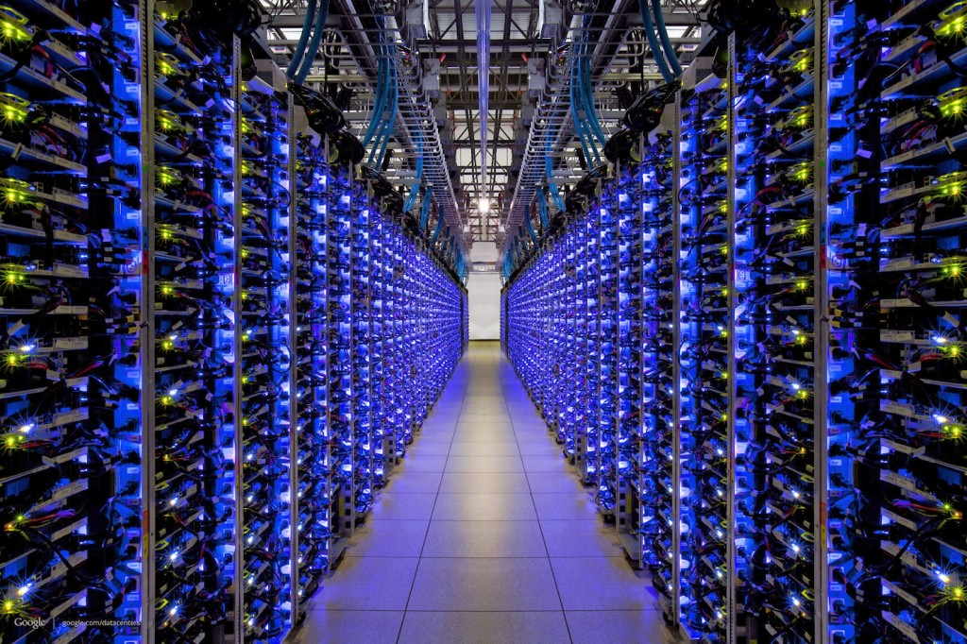
The FB BLOB cache is part of A hierarchy deployed at global scale…
Point of Presence mini-datacenters
Fully Capable datacenters
We think of Facebook as havine one core database or knowledge repository… but in fact the data is replicated
Notes:
The first thing to appreciate is that like any cloud-scale solution, Facebook’s caching infrastructure is hierarchical and “georeplicated”.
Facebook has a hierarchy of data centers: big ones that we can think of as serving data from a core database and smaller ones that mostly just are running the cache service.
The image shows a core database. This is actually a replicated data set shared among the Haystack servers (each has its own copy). As such, all of Facebook knows that there are several “last resort” systems with copies of the critical data. But unlike what the picture might seem to suggest, the core database isn’t in one place. It actually is duplicated at multiple Haystack locations, each with its own full replica.

Slide 30
Content cache goals
Support very fast lookup by any client from anywhere in the world
Minimize the number of requests that reach the database backend
Uses sharded KVS at every level!

Slide 31
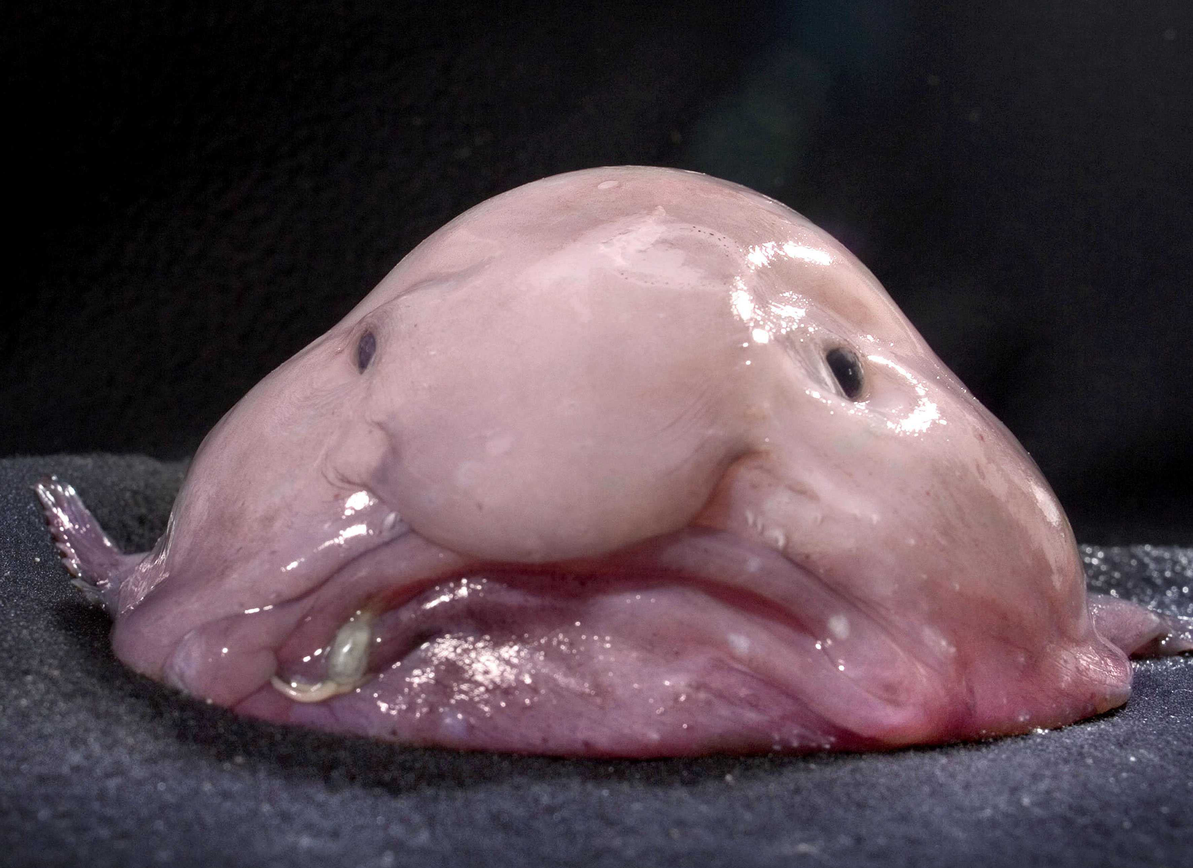
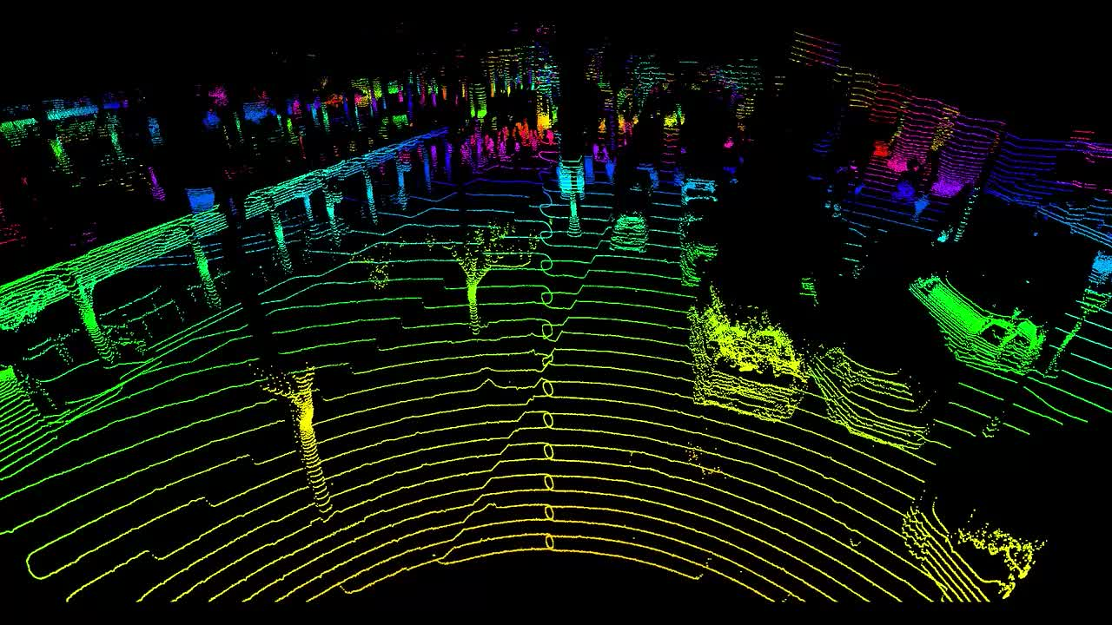
… the data is just “Blobs”
Facebook image data is stored in “blobs”: Binary Large Objects
This includes original images, videos
Resized versions, and ones with different playback quality
Versions that have been processed to tag people, augmented reality
Notes:
The actual content would be photos and videos. Blobs.
But any single blob can exist in multiple versions: we sized for various screens or different playback quality, or perhaps edited in various ways (those are “effects” on the left, not the real data). So from a single original blob in its full resolution there can be various derived versions that were computed by applying some recipe to the original raw data.
This will be important in the remainder of the lecture because it costs a surprising amount of compute time to do some of these operations. Facebook would rather not do them more than once.

Slide 32
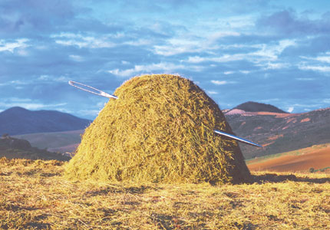
Haystack
Holds the real image and video data in huge “film strips”, write-once.
Designed to retrieve any object with a single seek and a single read. Optimized for SSD (these have good transfer rates but are best for write-once, reread many loads, and have a long delay for starting a write).
Facebook doesn’t run a lot of copies
One on the West Coast, one more on the East Coast
Each has a backup right next to it.
Main issue: Haystack would easily get overloaded without caching
Notes:
Think of Haystack as the ultimate photo album.
But it is at risk of being overloaded, so the single overarching goal is to try to serve all requests from copies of the photos, not the originals.

Slide 33
A cache for blobs?
$$$
Goal: a μ-service we can run anywhere, and that can adapt in size as loads vary.
The keys would be photo or video id’s.
For each unique blob, FB has a special kind of tag telling us the resized dimensions of the particular instance we are looking at.
Resizing takes time and requires a GPU. So FB wants to avoid recomputing them.
Notes:
The version issue is that we need to resize the image or video depending on the screen. FB does this work because otherwise your phone battery runs down too fast.

Slide 34
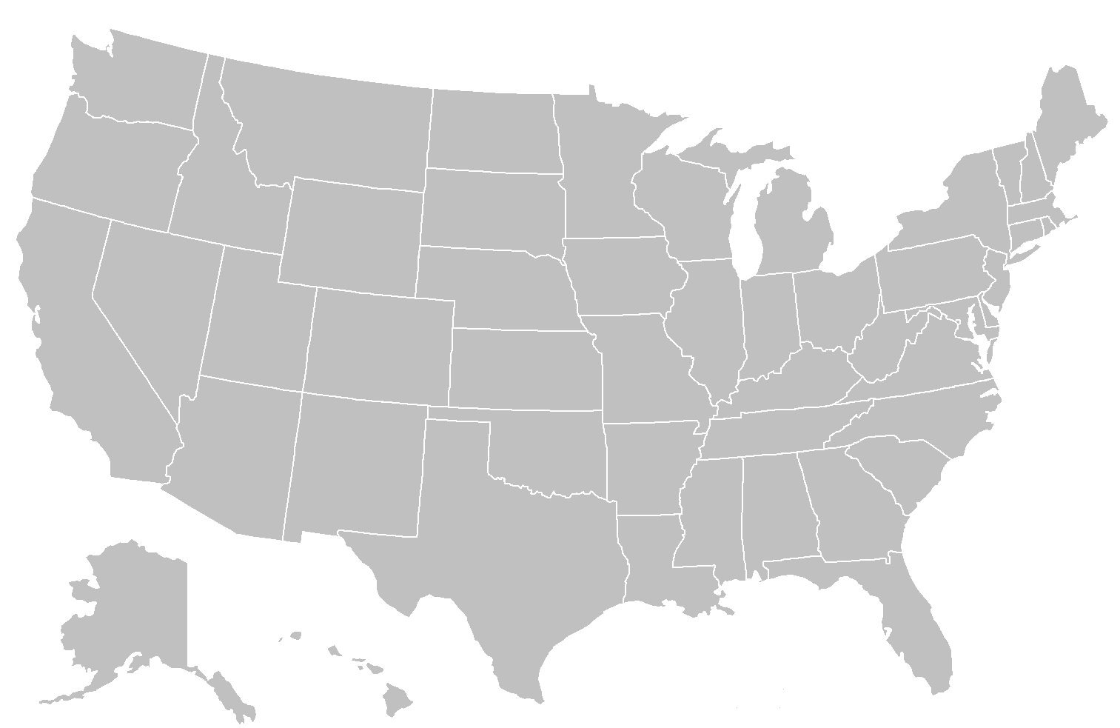
True data center holds the original photo in Haystack
First, FB fetches your feed. This will have URLs with the image ID embedded in them. The browser tells the system what size of screen it has.
Big Datacenter
Client
Facebook Edge Cache
Browser
Cache
Origin Cache
Haystack
If you’ve recently seen the image, Facebook finds the blob in a cache on your computer
Notes:
So here’s our picture at national scale.

Slide 35
With a UID and a target size, we can search for the blob in the nearest point of presence cache.
Big Datacenter
Client
Facebook Edge Cache
Browser
Cache
Origin Cache
Haystack
If the image wasn’t found in your browser cache, maybe it can be found in an “edge” cache
Notes:
So how does the caching structure work? Your computer has a cache right on your iphone. This is the browser cache.
Then we could go via Akamai (a big cache run by a caching company), or directly to Facebook. And Akamai itself talks to Facebook. So in some sense all routes lead into Facebook, unless the image is found in one of those first caches.
Then we get the edge which is where Facebook does resizing. As you’ll recall, CS5412 is an edge computing class.
Deeper inside is the Haystack layer and its own caching.

Slide 36
Origin:
Coordinated
FIFO
Main goal:
traffic sheltering
Datacenter
Client
Facebook Edge Cache
Browser
Cache
Origin Cache
Haystack
In the limit, fetch from Haystack. It has a cache too
Cache layers
Notes:
The origin cache is close to Haystack. So even at the last hop we use caching.

Slide 37
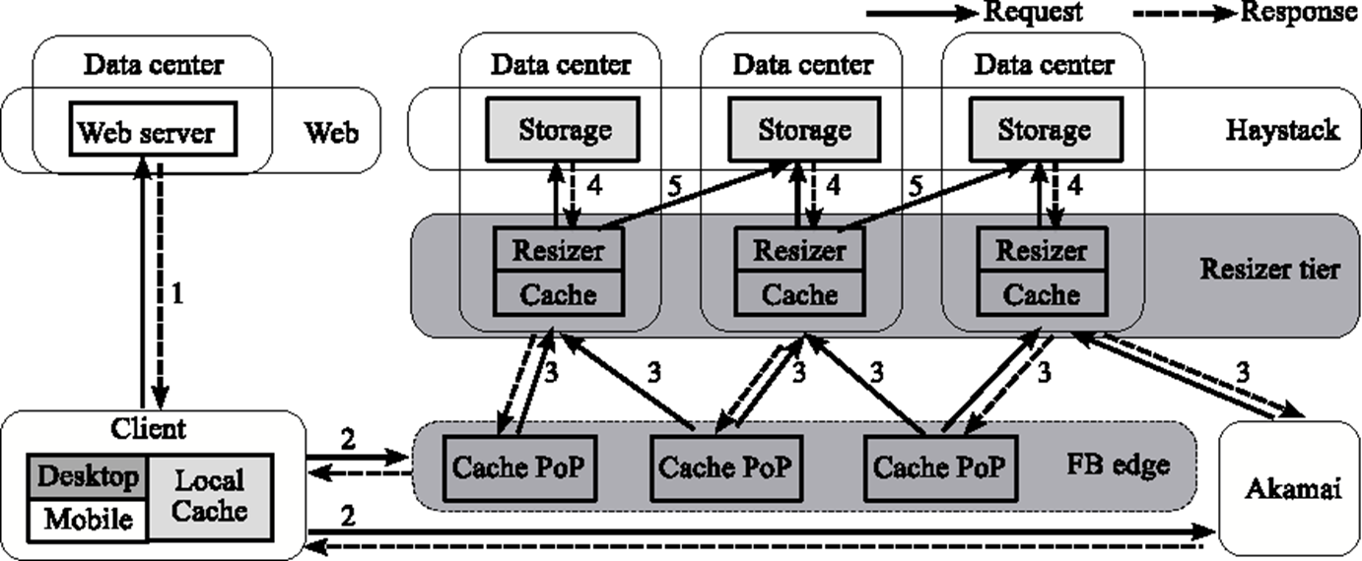
Architectural detail (Complex) Dark Gray: We instrumented it Pale Gray: We can figure out its behavior
Notes:
Our instrumentation lived in the dark gray places but we could deduce cache hits from the light gray ones.

Slide 38
Architectural detail (we weren’t able to instrument the pink part)
Notes:
We did our experiments during periods when Akamai wasn’t actually active, to make things a bit simpler.

Slide 39
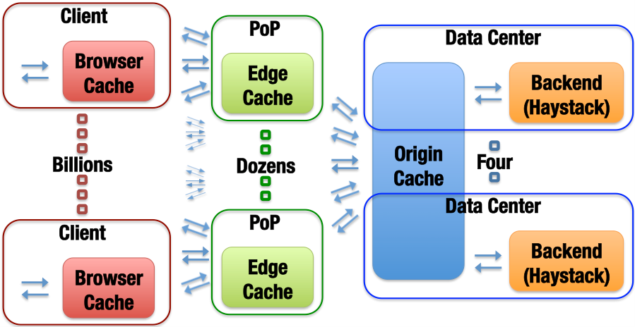
Blob-Serving Stack (the FB portion)
Notes:
Same structure, nicer image.

Slide 40
What we Observed
Month long trace of photo accesses, which we sampled and anonymized. Captures cache hits and misses at every level.

Slide 41
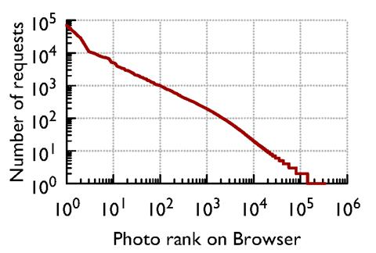
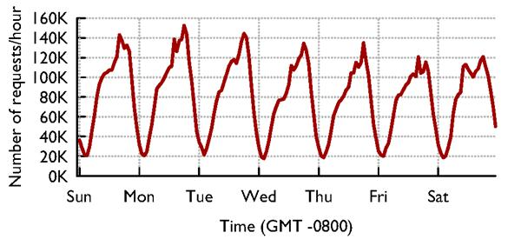
Caches see “circadian” Patterns
Accesses vary by time of day…
… and by photo: Some are far more popular than others

Slide 42
Photo cacheability by popularity
The main job of each layer is different.
This is further evidence that cache policy should vary to match details of the actual workload

Slide 43
GEO-Scale Caching
One way to do far better turns out to be for caches to collaborate at a WAN layer – some edge servers may encounter “suddenly popular” content earlier than others, and so those would do resizing operations first.
WAN collaboration between Edge caches is faster than asking for it from Haystack, and also reduces load on the Haystack platform.
Key insight: the Facebook Internet is remarkably fast and stable, and this gives better than scaling because the full cache can be exploited.
Notes:
Most people assume that fetching something from LA, if you live in Ithaca, is a stupid idea. Facebook’s Internet seems to work unexpectedly well!
For them, remote caches are close enough to be useful even cross country. And this gives a WAY bigger effective cache size.

Slide 44
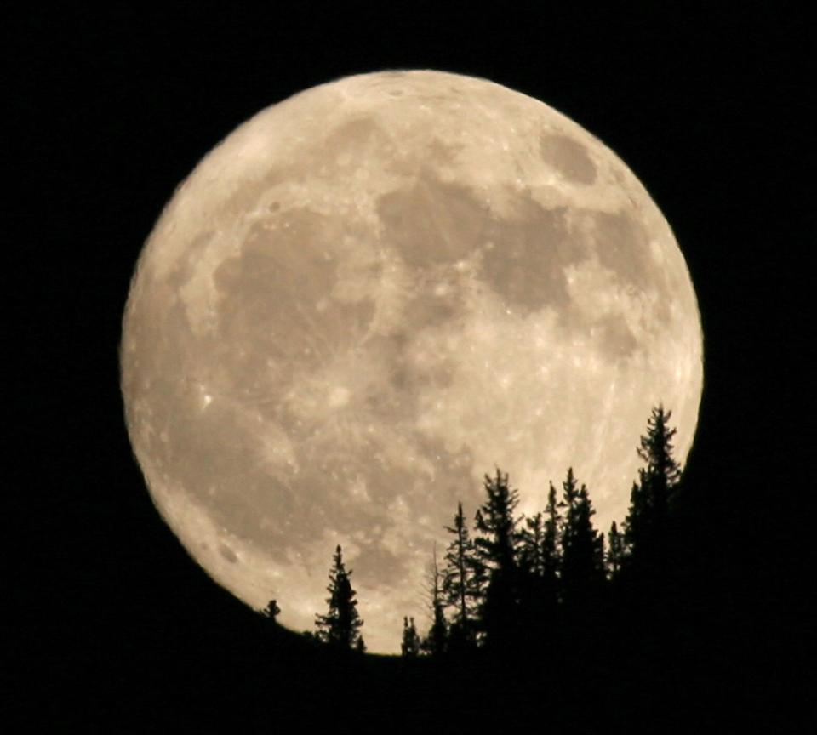
People are sleeping in Seattle
Remote fetch: cooperation between point-of-presence cache systems to share load and resources
People are having breakfast in Ithaca
In Ithaca, most of your content probably comes from a point of presence in the area, maybe the red one (near Boston)
But if Boston doesn’t have it or is overloaded, they casually reach out to places like Spokane, or Arizona, especially during periods when those are lightly loaded, like 5am PT!

Slide 45
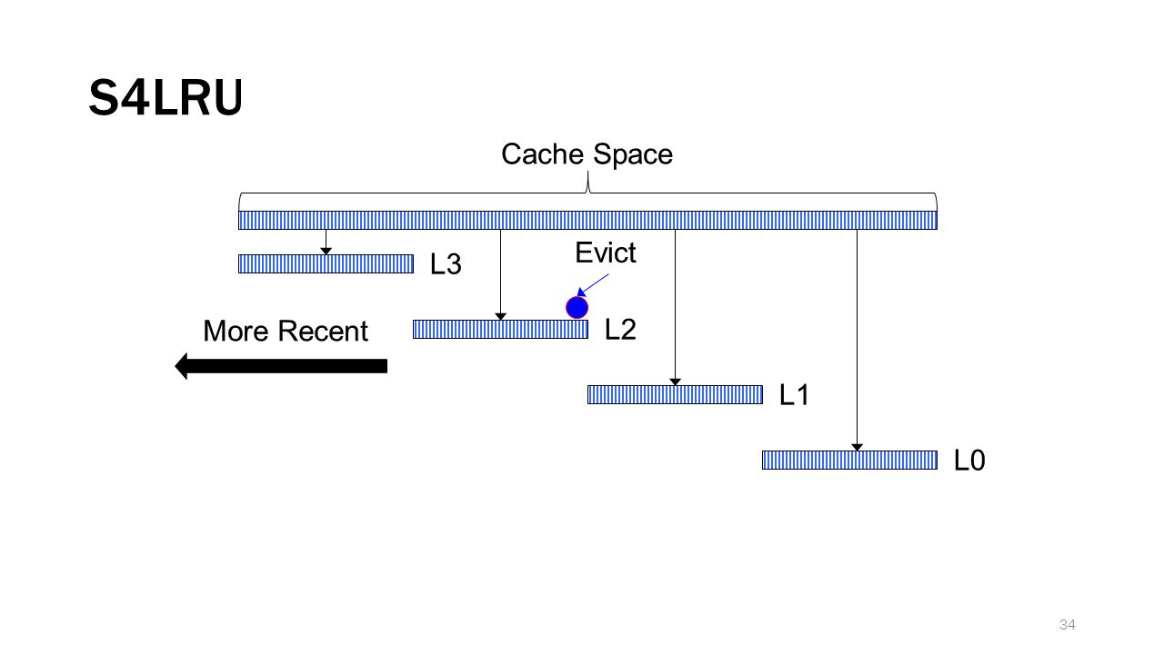
Cache retention/eviction policy
Facebook was using an LRU policy.
We used our trace to evaluate a segmented scheme called S4LRU
It outperforms all other algorithms we looked at
Notes:
The famous segmented LRU concept!
Each chunk kind of uses a different policy.
Think of the top chunk as being long-lived items that should stay in cache for a long time, and the bottom as a chunk for transient images needed just for a brief period.

Slide 46
Here we see that S4LRU is far better than normal LRU

Slide 47
So… switch to S4LRU, right?
They decided to do so…
Total failure!
Why didn’t it help?

Slide 48
S4LRU didn’t really work well!
It turned out that the algorithm worked well in theory but created a pattern of reads and writes that were badly matched to flash memory
Resulted in a whole two year project to redesign the “operating system” layer for big SSD disk arrays based on flash memory: the RIPQ project.
Once this change was made, S4LRU finally worked as hoped!
RIPQ will not be on exams
Notes:
S4LRU didn’t turn out to make efficient use of the hardware.
Core issue is like the NUMA thing from the last lecture: the hardware isn’t perfect and has limitations. S4LRU, used naively, has too much overhead. But with effort it was possible to invent a solution that uses S4LRU and also is hardware-friendly (uses the hardware closer to its sweet spot)

Slide 49
RIPQ: Key Innovations
Only write large objects to the SSD once: treats SSD like an append-only “strip of images”. Same trick was needed in Haystack.
SSD is quite good at huge sequential writes. So this model is good.
But how can they implement “priority”?
The cache is an in-memory data structure with pointers onto the SSD.
They checkpoint the whole cache periodically, enabling warm restart.
RIPQ will not be on exams
Notes:
The notion of ordering (priority, in the sense of “priority queue”) is important but they virtualize with one-level of indirection. The in-memory data structure, which they have a way to rebuild if the unit crashes and restarts, worries about ordering.
The actual workload seen by the SSD is in the form of huge segments that get written in one steady pass. They do garbage collect by rereading active data and then rewriting it, now and then, when a segment on SSD has lots of holes (no-longer-needed data that was previously cached but by now has been bumped from cache)
The bit I/O pattern becomes one of huge one-directional writes that treat the whole SSD like a massive tape drive. This works well.
Then the in-memory data structure has pointers to the SSD content (and to some stuff that is temporarily still in memory because it hasn’t yet been written).

Slide 50
RIPQ entries are pointers to SSD objects
RIPQ will not be on exams

Slide 51
Additional optimizations
They actually store data in long “strips” to amortize the access delay across a large number of reads or writes.
And they cache hot images, plus have an especially efficient representation of the lists of pointers (for the various levels of the cache)
All of this ensures that they run the SSD in its best performance zone.
RIPQ will not be on exams

Slide 52
RIPQ Has High Fidelity
Object-wise hit-ratio (%)
RIPQ achieves ≤0.5% difference for all algorithms
RIPQ will not be on exams
Notes:
Basically, they end up slightly cheating relative to LRU and GDSF but you won’t notice.

Slide 53
RIPQ Has High Fidelity
Object-wise hit-ratio (%)
+16%
+16% hit-ratio ➔ 23% fewer backend IOs
RIPQ will not be on exams
Notes:
… and those policies are worth using, because they do far better than FIFO (which happens to make great use of an SSD, but has this annoying tendency to dump things from the cache simply because they have been in it for a while, ignoring whether they are getting hits)

Slide 54
RIPQ Has High Throughput
Throughput (req./sec)
FIFO
RIPQ throughput comparable to FIFO (≤10% diff.)
RIPQ will not be on exams
Notes:
FIFO was ideal for SSD but had lousy cache hit behavior. Here we see that RIPQ has a nearly FIFO traffic pattern to the SSD even though it can support these policies with way better cache hit behavior.

Slide 55
What did we learn today?
A good example of a μ-service is a key-value cache, sharded by key.
The shard layout will depend on how many servers are running, and whether they are replicated. These are examples of configuration data.
Many μ-services are designed to vary the number of servers elastically.

Slide 56
More take-aways
A company like Facebook wants critical μ-services to make smart use of knowledge about photo popularity, and about patterns of access.
With this information it can be intelligent about what to retain in the cache, and could even prefetch data or precompute resized versions it will probably need.
Fetching from another cache, even across wide-area links, is advantageous.

Slide 57
Conclusions?
In a cloud setting, we need massive scalability. This comes from hierarchy, replication and sharding. But we also need to match solutions to the setting.
Sharing in a (key,value) model is a great way to deal with scale. But that only gets you to the next set of questions. At cloud-scale nothing is trivial!
Facebook’s caching “product” is an amazing global system. Even if it was based on simple decisions, the global solution isn’t simple at all!
Notes:
By now I’m hoping you are already seeing a pattern. In lecture 1 we started to think about NUMA and in no time realized that effective use of the hardware forces us to adopt a container model.
Today we looked at caching and realized that doing a professional job even for a simple key-value sharding layer is tricky! A professional-quality μ-service would get the details right but would be hard to build. A less professional version might be ineffective because it wouldn’t be elastic, or maybe it would glitch each time it reconfigures, or perhaps wouldn’t cooperate over geographic scale links and hence would just get a lower hit rate, or maybe wouldn’t use the hardware effectively.
The bottom line is to just use the key-value store the vendor provides, obviously. But understand a little about the issues will make you smarter in how you use it. Moreover, not every key-value store has all of these features and you might want to be smart when you select the one you’ll build on!

