Slide 1
Cascade: Full Details
Ken Birman
CS5412 Fall 2022 Lecture 10

Slide 2
The promise of edge intelligence
Can “real world” artificial intelligence be as accurate and as fast as human intelligence?

Slide 3
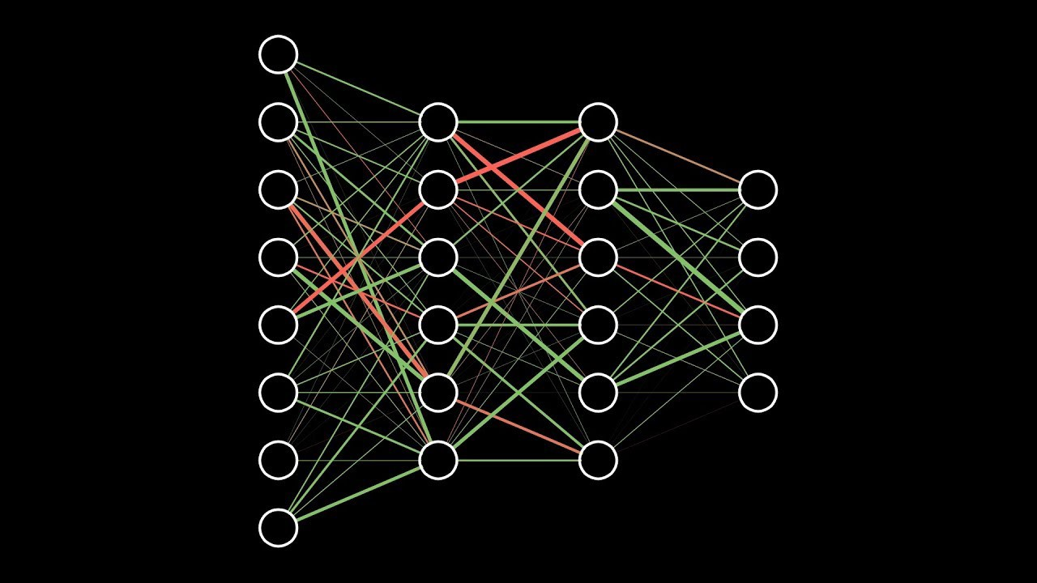
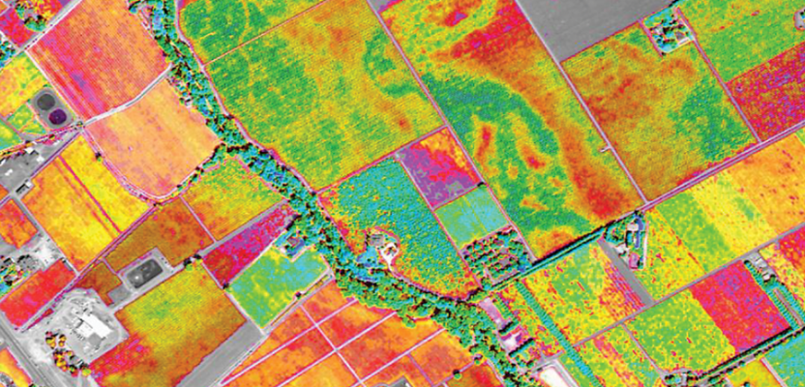
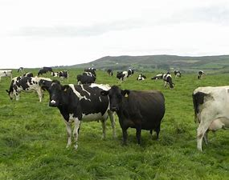
The world is generating a new wave of IoT/ML pipelines… there are many use cases
Data sources Cooperative ML Smart Distributed AI Queries
How much should I budget for raw milk purchases in March for my yoghurt factory?”

Slide 4
Cooperative ML?
One ML to rule them all? Not likely!
So we need to think about cooperation between MLs in robotics, smart homes, 5G, digital twin scenarios.
The application is a graphical collection of AI classifiers / learners
Nodes represent computational tasks.
Edges represent data flow between distinct tasks.

Slide 5
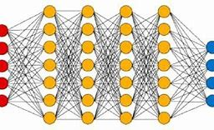
A single λ could be an entire distributed AI, on a collection of machines
Single λ may run on a pool of compute nodes.
Today’s cloud platforms have limited support for this model, lack the real-time and consistency guarantees needed for IoT.

Slide 6
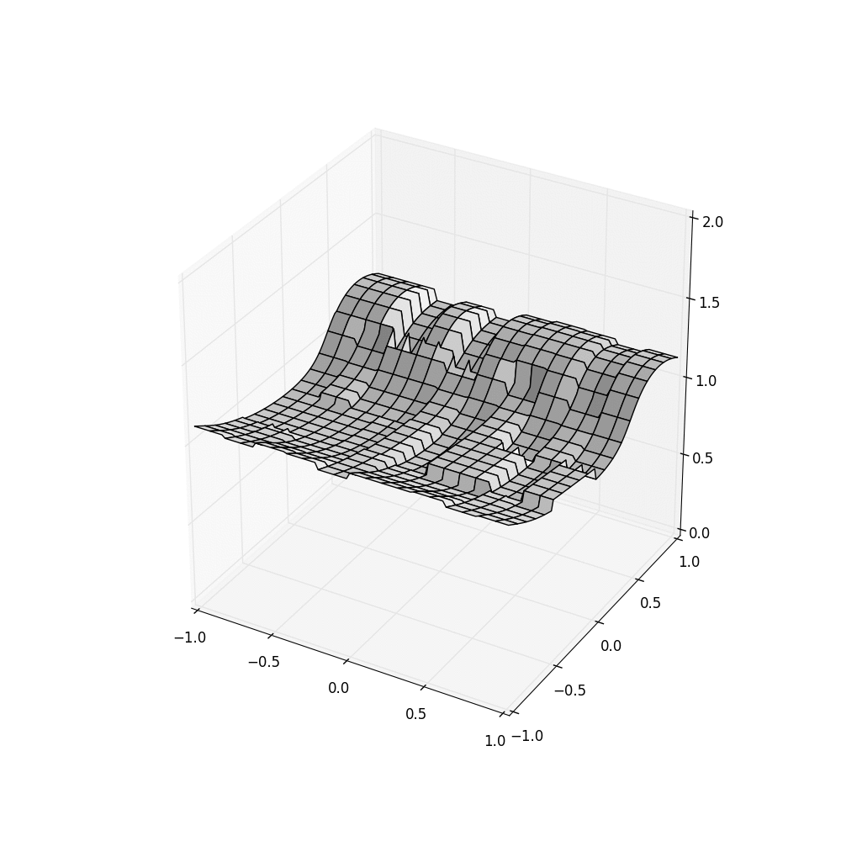
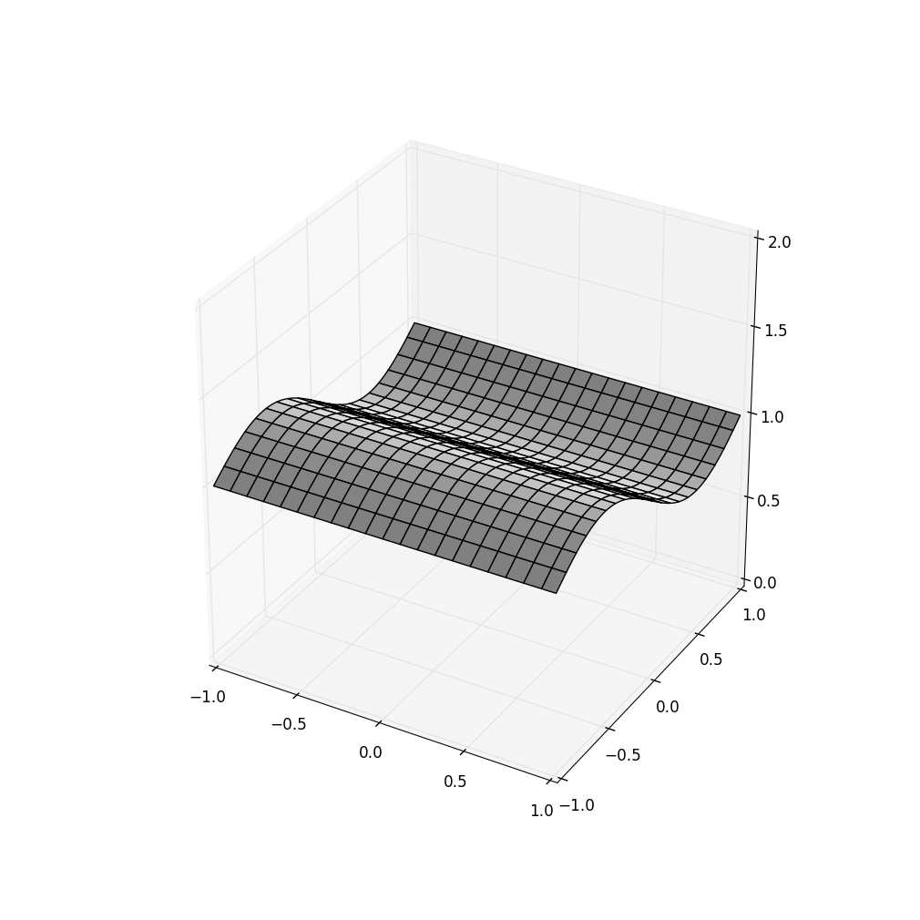
The need is for Time-Focused Edge Intelligence
In today’s cloud, AIs fight platform noise
IoT data arrives as a stream.
Edge intelligence must be instantly reactive
Get power grid data at 250ms intervals
Format it as 15 x 15 tensor by GPS location with a time axis from10:00:00 to 10:01:00
Run ML phase disruption analytic on the tensor
Cascade: Faster yet accurate

Slide 7
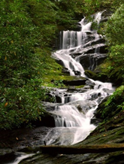
High level Cascade goals
Legacy support: Easy to use with no need to change your code
Much faster than standard platforms: low delay, high bandwidth
Stronger guarantees: Your ML doesn’t fight platform “noise”

Slide 8
But how will we guarantee consistency? How can it be so fast?
Let’s start by asking how to make it fast
Then we will see that we already know how to guarantee consistency: be smart about time (and time skew), and use Chandy-Lamport consistent cuts when we hit the limits of clock precision/accuracy!

Slide 9
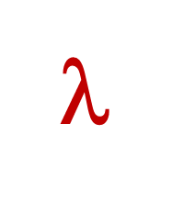
Traditional Approach
Request objects one by one
Your logic
File system or Key-Value Store
Runtime copies data into GPU
Accelerator Layer
Objects copied over datacenter TCP network
GPU
Your code is in its own address space, maybe on a different computer

Slide 10
Traditional Approach
Request objects one by one
Your logic
File system or Key-Value Store
Caching hides these costs, in iterative cases
$$$
Accelerator Layer
Objects copied over datacenter TCP network
GPU
Your code is in its own address space, maybe on a different computer

Slide 11
RDMA can help… a little
Request objects one by one
Your logic
File system or Key-Value Store
Runtime still copies data into GPU
RDMA
Accelerator Layer
$$$
Objects copied over datacenter TCP network
GPU
Your code is in its own address space, maybe on a different computer

Slide 12
Cascade Can be used this way...
Request objects one by one
Your logic
RDMA
Key-Value Storage Layer
Accelerator Layer
$$$
Objects copied over datacenter TCP network
GPU
Your code is in its own address space, maybe on a different computer
Cascade runtime environment

Slide 13
… but can also host user code
Fast-path logic (DLL)
Key-Value Storage Layer
Accelerator Layer
GPU
Cascade runtime environment

Slide 14
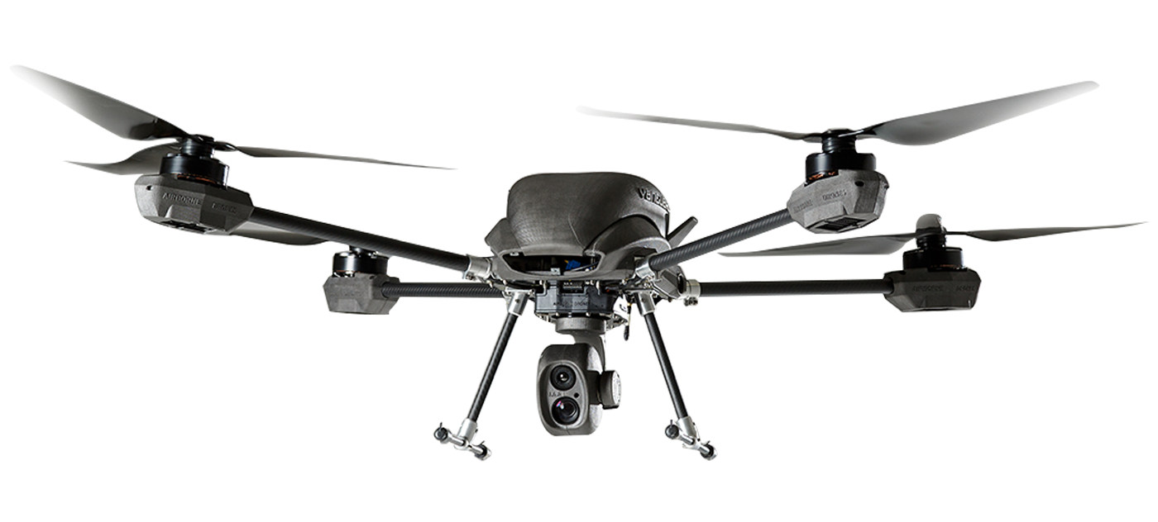
CASCADE: CUSTOMIZED SMART SERVICES
Request for classification triggers a C++ lambda in the Cascade address space
Fast-path logic (DLL)
Ideally, these are cached on GPU
Key-Value Storage Layer
RDMA directly into GPU memory
Image to classify
ML model, configuration, parameters
Accelerator Layer
GPU
GPU-accelerated kernel initiated from the lambda

Slide 15
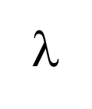
Fast-Path Performance
A simple federated ML pipeline
Cascade is close to ideal efficiency on our hardware and 100 to 10,000x faster than common options like Apache Flink
Downstream action
Downstream action
GPU
Input event
GPU
GPU
Hyperparameters, models, cloud data
Latency: 12us
Throughput: 8GB/s
Hyperparameters, models, cloud data
Hyperparameters, models, cloud data

Slide 16
The Cascade Model
Is it a service? A library?

Slide 17
Cascade is a service
Cascade Service running as a file system or DHT
External Client
Cascade runs on a set of nodes (machines or VMs) where it controls some resources (cores, RDMA interfaces, GPUs/FPGAs, memory).
Users can build applications that access Cascade from “outside”. We call those “external clients”. They would think of Cascade purely as a key-value storage system, accelerated by RDMA.

Slide 18
Cascade is an service
EXTENSIBLE
Which cow is this?
v
External Client
But the highest speed is achieved by extending the Cascade service by adding logic (λs) that will run inside Cascade.
Used this way, Cascade enables creation of a customized service: a “smart” service ideal for your purposes.

Slide 19
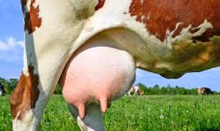
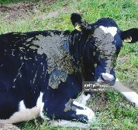
Recap: Extensibility (PaaS model)
Does this cow have mastitis?
Cascade+λ₂
Cascade is one service
But when you supply customization it acts like many specialized services, one per application So it becomes a platform for new microservices, like these!
Is this cow clean enough to milk?
Cascade+λ₁
Which cow is this?
The Cascade Server is extensible
A single Cascade server can support multiple customized services

Slide 20
The Cascade Storage Model
How should Cascade data be managed?

Slide 21
Cascade is a key-value store
… but it also supports a file system API
… and the key-value API itself has some fancy options, beyond the basic put/get/watch we learned about in lectures 1-4

Slide 22
In fact Cascade’s File System is an example of extensibilty
User sees scalable, “private” object pools
Cascade’s file system is implemented as a λ:
Every object has a pathname.
The file system extension supports normal file operations.
You can access it just like any file system.
Similar to Ceph file system, yet just a few lines of code to translate user requests (via the FUSE library) into Cascade put/get/watch

Slide 23
Updates: Create a new file or Appending to an existing file
User sees scalable, “private” object pools
Same model used in cloud file systems like HDFS and Ceph.
Updates are log appends using Paxos. Each object has a log of versions that evolved over time.
Reads run on the stable prefix of the log.

Slide 24
Versioned updates
Each time you write to an object, Cascade creates a new version.
If you read an object, modify it, and then write it back, you can tell Cascade which version you modified. The put will double check to be sure that this is still the current version before replacing it, and otherwise returns an error (then you can loop)

Slide 25
Versioned/Temporal queries
Accessed via get, but specify the version # or time desired
In the volatile case, Cascade only keeps the most recent version. With persistent objects, Cascade keeps a log of past versions.
By default, applications see the most current version
Indexed access allows the application to query any version (by version number or time), or fetch any data range.

Slide 26
Versioned objects
Versioning enables intelligence over a sequence of events
key: The object store always tracks information on a per-object basis
version-number: Just an integer
time: If the object itself lacks a timestamp, we just use “platform” time.
Now get can lookup most current version, or a specific one, even by time.
The object store is optimized to leverage non-volatile memory hardware.

Slide 27
The Cascade compute Model
Virtual synchrony, Atomic multicast, Paxos, consistent cuts…

Slide 28
The central puzzle
The very fastest data paths require compilation, ideally in languages like C++.
But we want Cascade to run as a service, so it would often already be running when a new user comes along and wishes to create and launch some completely new service.
How can we extend a running system? Actually… it isn’t so hard

Slide 29
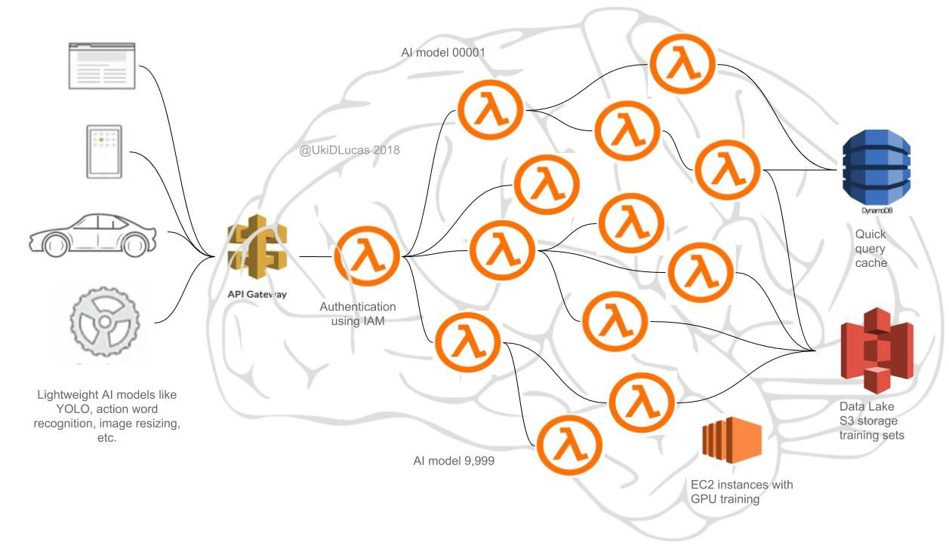
First question: What’s in a λ?
We support many languages. Native APIs are Python with various packages (including LINQ) and C++ with LINQ.
Code is concise – LINQ pioneered a style that mixes “kernel” invocations with embedded SQL. Maps cleanly to GPU, FPGAs.
Cascade manages GPUs and can cache data in GPU memory.

Slide 30
How can a key-value store “be” a classifier service or an analytic service?
Flowers
We run Cascade on a set of nodes. Here we see nine nodes in three shards.
A shard identically replicates (key,value) tuples, using Paxos. Here, an object with the key “Flowers” was stored in shard 0. “Vegetables” ended up in shard 2.
Vegetables

Slide 31
… Enabling this kind of solution
Vegetables
Flowers
Flower p=.85 Vegetable p=.6
Sunflower p=.97
Most likely a sunflower!
Zucchini blossom p=.04
Sunflower
First tier: inexpensive computation on meta-data
Key-value object store holds specialized knowledge models for categories (flowers, birds, dogs, trees…)
IoT Cloud Infrastructure

Slide 32
Cascade queries see consistent cuts
Suppose a cooperative AI is triggered by event ε at time τ. We run all the lambdas triggered by ε along a consistent cut “optimally close” to time τ (and selected deterministically).
Effect: The lambda won’t see platform-induced inconsistencies.

Slide 33
Visualization of Cascade consistency
HDFS Cascade using Consistent Cascade With cuts but trusting Server clocks SENSOR Time
Cascade consistent cuts + GPS-timestamped sensor data result in clean input to the D-AI algorithm (in this case, a simple visualization)

Slide 34
Central conceptual insight
One event may trigger many lambdas.
These lambdas may need to run on multiple nodes… yet will share the same temporal index (τ from the trigger event ε).
A Cascade query always sees a “consistent state snapshot.”

Slide 35
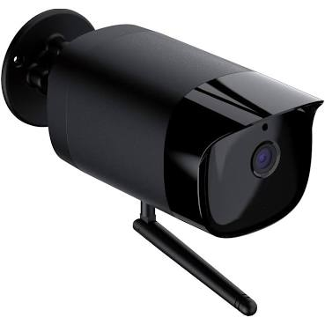
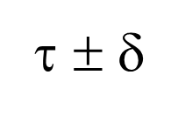
Visualizing the consistency Model
Put(k,v)
Each Cascade shard has its own Paxos-based log
Put(k,v)
Put(k,v)
(ε, τ)
Stable portion
Put(k,v)
λ
Put(k,v)
λ
λ
time
λ
Each λ is triggered by an upcall from a “watcher” monitoring some key (or pattern)
Unstable tail
A temporal query for time τ sees a consistent cut at τ ± δ_{clock}.
Queries to unstable data must wait, but updates are stable within 50us.

Slide 36
Visualizing the consistency Model
Even if δ is small, there is a choice to make: Which versions will be fetched? Cascade accesses data along a Chandy-Lamport Consistent Cut.
Put(k,v)
Put(k,v)
Put(k,v)
Each Cascade shard has its own Paxos-based log
Put(k,v)
Put(k,v)
Stable portion
(ε, τ)
Stable portion
Put(k,v)
λ
λ
Put(k,v)
λ
λ
time
λ
λ
time
λ
Each λ is triggered by an upcall from a “watcher” monitoring some key (or pattern)
λ
Unstable tail
Unstable tail
A temporal query for time τ sees a consistent cut at τ ± δ_{clock}.
Queries to unstable data must wait, but updates are stable within 50us.

Slide 37
Grouping objects
Often a lambda will need to access several objects that should ideally all have their own keys, yet you want them grouped on the same shard.
For this, Cascade supports “affinity grouping”. Each object has a second key, used for placement.
Even if A and B have different keys – “names” – they will be stored on the same shard if you assign them the same affinity key.

Slide 38
What does a real application look like today?
Example, courtesy of Weijia, Alicia and Thompson

Slide 39
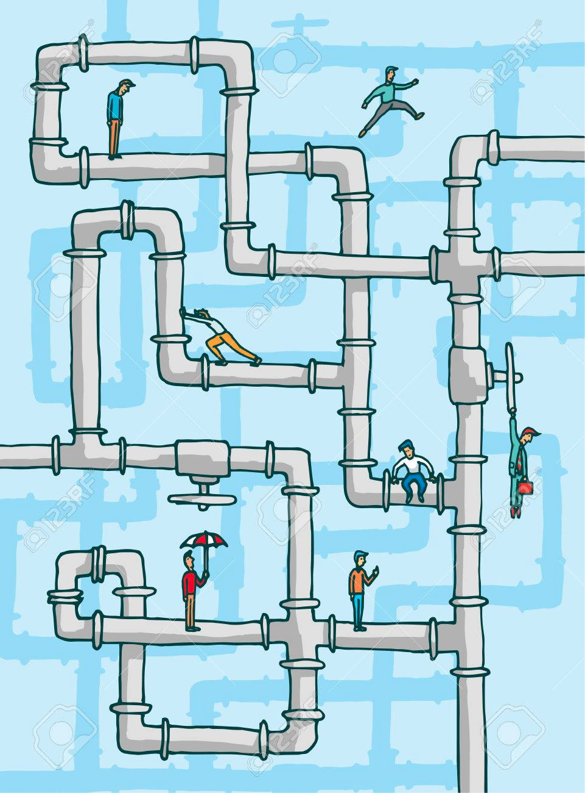
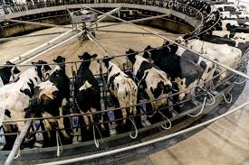
Dairy Image Pipeline: Front End
Dairy Farm
Data Center
Image Pipeline
Front End
(As an external client)
The Farm Server (IoT Edge)
Cascade Image pipeline
Frame
Extractor
Frame
Sampler
WAN
Video clip
store
Frame
Server

Slide 40
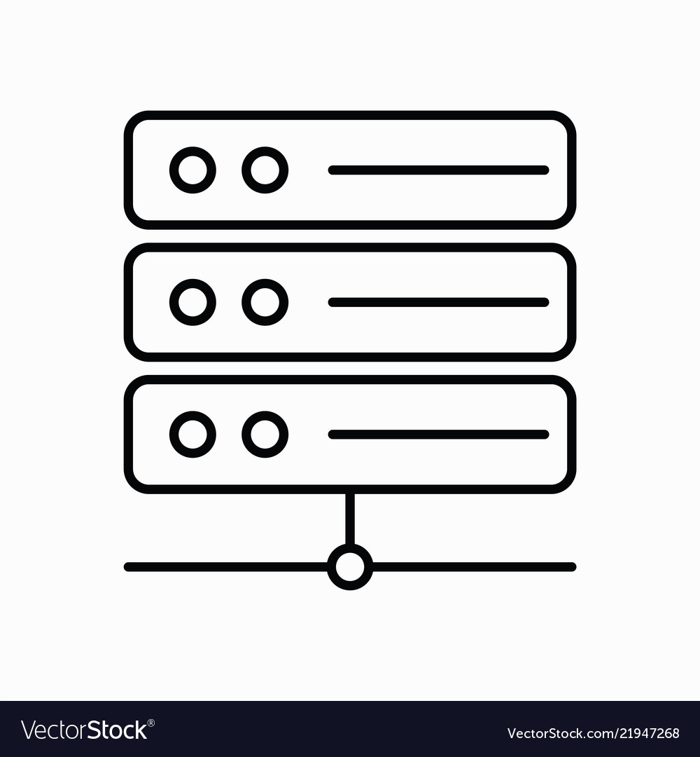
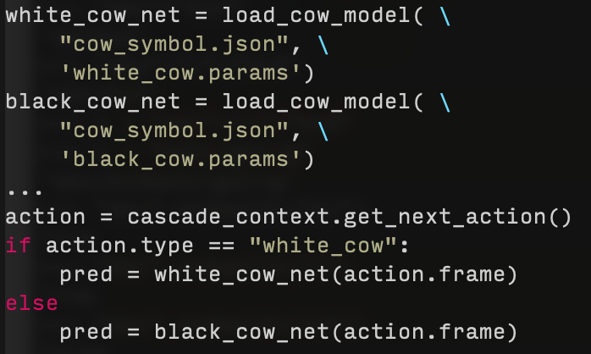
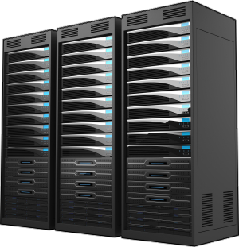
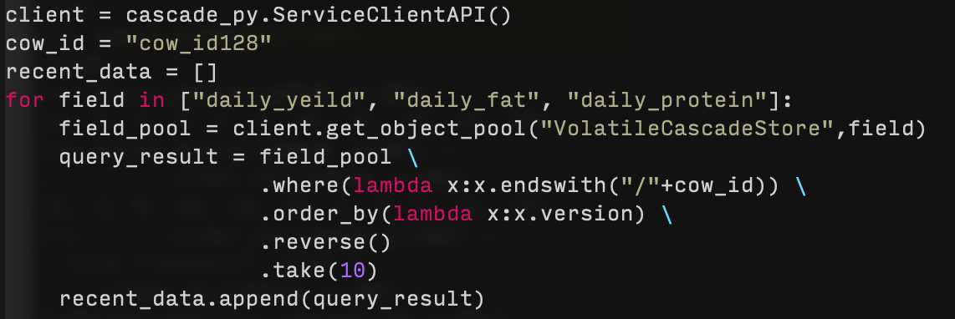
… DETAILED VERSION (PyLINQ ON MSFT AZURE)
Date | cow_id | daily_yield | daily_fat | … | daily_protein
12/3/20 | 1 | 14 | 3.96 | … | 2.89
… | … | … | … | … | …
1/10/21 | 237 | 20 | 4.42 | … | 4.55
<field>/<cow_id>{<ts(ver)>}
daily_protein/cow_id1{ver_1} = 2.89
Integrate daily data
Download blobs from Azure &
Store to Cascade VCSS subgroup
Upload daily date to Azure Blob Storage
Date | cow_id | …
12/3/20 | 1 | …
… | … | …
12/3/20 | 237 | …
daily_fat/cow_id237{ver_38} = 4.42
Cascade backend
Filtered image frames
Store to subgroup VCSS
Trigger image analysis
Farm server
Action = black_cow_infer
Streaming image frames through TCP portal
External Client to Cascade
CV model
Image analysis
cow id: 127
LINQ query to retrieve data of most recent 10 days from Cascade about cow 128
Probability of calving in next 8h is: 80%
ML Model
birth prediction

Slide 41
C++ IS SIMILAR (BUT MORE EFFICIENT)
Date | cow_id | daily_yield | daily_fat | … | daily_protein
12/3/20 | 1 | 14 | 3.96 | … | 2.89
… | … | … | … | … | …
1/10/21 | 237 | 20 | 4.42 | … | 4.55
<field>/<cow_id>{<ts(ver)>}
daily_protein/cow_id1{ver_1} = 2.89
Integrate daily data
Download blobs from Azure &
Store to Cascade VCSS subgroup
Upload daily date to Azure Blob Storage
Date | cow_id | …
12/3/20 | 1 | …
… | … | …
12/3/20 | 237 | …
daily_fat/cow_id237{ver_38} = 4.42
Cascade backend
Filtered image frames
Store to subgroup VCSS
Trigger image analysis
Farm server
Action = black_cow_infer
Streaming image frames through TCP portal
External Client to Cascade
CV model
Image analysis
cow id: 127
LINQ query to retrieve data of most recent 10 days from Cascade about cow 128
Probability of calving in next 8h is: 80%
ML Model
birth prediction

Slide 42
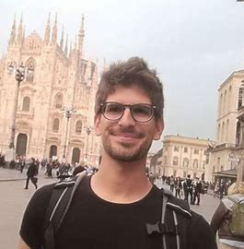
The Cascade and Derecho team
Weijia Song
Lorenzo Rosa
Ken Birman
Alicia Yang
Sagar Jha
Mae Milano (post-doc at Berkeley)
Andrea Merlina
Cornell undergrads: Aahil Awatramani, Ben Posnick, Max Charlamb, Archishman Sravankumar, Aaron Weiss, Peter Zheng
Edward Tremel (faculty at Augusta Univ.)
Roman Vitenberg
Thompson Liu

