Slide 1
CS5412 / Lecture 7 Replication and Consistency (Part I: Theory and Protocols)
Ken Birman
Spring, 2021

Slide 2
Can we build consistent, highly available μ-services?
When building μ-services everything needs to be sharded for scaling.
But so far, our shards have just a single member each.
If we also want fault-tolerance we would have two or more members per shard, not just one.
Notes:
Today we’ll look at building a new μ-service using Derecho as a tool to simplify some of the really hard steps.

Slide 3
Can we build consistent, highly available μ-services?
We also learned about the CAP folk-theorem.
It says that consistency is just not needed in the cloud and that we should build systems with weak consistency if they would be more available (responsive) even when partitioned.
Web sites tolerate staleness. We can hide many forms of staleness, or explain it away. Usually, our customer won’t even notice.
Notes:
Today we’ll look at building a new μ-service using Derecho as a tool to simplify some of the really hard steps.

Slide 4
Can we build consistent, highly available μ-services?
But in IoT settings, inconsistency is a big problem.
IoT systems monitor physical things, like motors and power grids.
Inconsistencies can be confusing – they might tell us the motor isn’t on, yet in fact it is on. We don’t want stale IoT data!
Many people think that IoT requires strong consistency.
Could we build μ-services that just replicate the entire state: CA but not P?
If they don’t depend on a second layer of services, P won’t arise.
Notes:
Today we’ll look at building a new μ-service using Derecho as a tool to simplify some of the really hard steps.

Slide 5
Other Tasks that require Consistent Replication
Copying programs to machines that will run them, or entire virtual machines.
Replication of configuration parameters and input settings.
Copying patches or other updates.
Replication for fault-tolerance, within the datacenter or at geographic scale.
Replication so that a large set of first-tier systems have local copies of data needed to rapidly respond to requests
Replication for parallel processing in the back-end layer.
Data exchanged in the “shuffle/merge” phase of MapReduce
Interaction between members of a group of tasks that need to coordinate
Locking
Leader selection and disseminating decisions back to the other members
Barrier coordination
Notes:
A process == a program running on some computer. Named by the computer’s IP address and the process id on that machine. Maybe a bit more like which TCP port it is listening on, maybe not.
Membership == a list of which processes are in the system, and perhaps, what role they will play (in many μ-services, the set of members are split into subsystems).
Role: complex systems often have subsystems, like running the DHT or doing load balancing or keeping the TAO database. Those are roles. The full membership might include ALL the processes and machines. The roles are for individual members: this process is a DHT member. That process has a TAO graph in a database.
The developer would need to design and control all of this. None of it is free or automated or magic. It can take years to design these systems. Membership management is just a way to provide help – a tool for that developer.
The tools have complex APIs. We’re talking here about what the thing does, not the API.

Slide 6
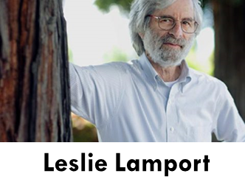
Leslie Lamport to the rescue!
Superman
This is Leslie Lamport, who was a pioneer in bringing rigorous models and reasoning to distributed computing systems.
For Leslie, our question relates to replicating state. If we have replicas of the state of a μ-service, it can tolerate failures, and if we can make it consistent we get C+A. Now we might not actually need P.
State machine replication is the name Lamport proposed for this new model

Slide 7
How does state machine replication work?
We start with some set of processes (like servers in a DHT shard)
Initialize them into the identical starting state.
Then make sure each process sees the identical events in the identical order. If the code is deterministic, they will remain consistent.
From this idea we can build up abstractions like fault-tolerant computing.

Slide 8
There are Many new ideas here!
Can we really build “deterministic” computer programs?
What does it really mean to build a program that can be replicated this way? How does this even fit with an IoT setting using μ-services?
Anyhow, how did we know which servers should do this replication? And what if one of them fails, but the others keep running?

Slide 9
Determinism
The idea here is to think of each program as code that reads inputs, then computes on the input, then produces outputs.
A non-deterministic program might do various different things even with the identical inputs.
A deterministic program will always behave identically.

Slide 10
Why might a program not be deterministic?
Think about a program that reads the clock.
If I make two copies, they won’t see the same value because computer clocks advance at such high rates (nanosecond increments) that you basically can’t read two clocks in parallel and see the same time!
So even if you just print the time, your program is non-deterministic.

Slide 11
More issues…
Most modern programs are multithreaded.
But this implies that the thread scheduling order is random and unpredictable. The only way to be fully sure of the order is to use locking in some very rigid way.
Since most programs don’t use locking in such a rigid way, the scheduling order can’t be controlled, and so each copy behaves differently.

Slide 12
More Issues…
Some programs read input from more than one potential source, like more than one client on a network.
Those programs could get two inputs more or less at the same time – in which case one replica might see A, then B. But the other might see B first.
In fact this could even happen if we have one network connection to a multithreaded client.

Slide 13
Leslie’s answer? “Meh.”
When people first raised these concerns, Leslie didn’t really respond.
He said that at the end of the day, he is a theoretical computer scientist and not an engineer. He said his role is to “inspire” not “implement”.
Leslie did define “building blocks” for state machine replication, but he didn’t worry much about those issues.

Slide 14
The main building blocks
One is called atomic multicast. The other is called durable logging.
Both implement state machine replication, but in different settings.
Atomic multicast is a pure networking concept. It doesn’t save data into storage of any form.

Slide 15
Atomic multicast
We have a sender, and a group of receivers.
In some situations, this group of receivers is just a list of processes.
In others, the group is some form of “name” for the group, and a group membership service is used to track the mapping from the name to the current list of members.
Now we can offer the sender an atomic multicast API
outcome = atomic_multicast(destinations, message);

Slide 16
Atomic multicast
With an atomic multicast, we usually just say that the message is a vector of bytes. From homework 1, 2 and 3 you’ve learned that actually we can represent all sorts of objects as byte vectors, using serialization.
Atomic multicast normally requires some form of protocol that implements the sending (just like TCP, which implements reliable one-to-one data streams over the more basic network hardware).

Slide 17
Atomic multicast
The requirements are:
The atomic multicast is all or nothing. If any receiver delivers a message, then every receiver must do so (unless it crashes, obviously).
If a crash does occur, this can’t break the delivery guarantees. Worst case? A sender crash after just one copy was sent. This must be self- repaired inside the protocol that implements the primitive.
Additionally, messages must be delivered in the identical order at all the receivers. If A and B are simultaneously sent, the order can be A B or B A, but everyone must “agree”.

Slide 18
Persistent logging
This idea starts with atomic multicast, but assumes that each receiver will be saving messages in an append-only file: a log.
We want all the receivers to either have identical logs, or we could allow the logs to have gaps but use a merge-and-repair protocol when reading data, to fill in any gaps.
With persistent logging, data becomes durable: After some point the protocol can guarantee “this information will not be lost.”

Slide 19
How many failures?
Leslie proposed many protocols to implement the state machine replication model using atomic multicast or durable logging.
He also pioneered the art of proving that his protocols would be correct if the number of non-faulty receivers is sufficiently large compared to the number of faulty ones.
Depending on the fault model we use, this can be easy… or quite hard…

Slide 20
Failure models
Most cloud computing systems worry about crash failures and network link failures (partitioning).
These are relatively easy to detect and protect against.
With accurate detection we just need F+1 processes to tolerate F failures.

Slide 21
More extreme models
In fact there are many models that try to capture extreme behavior, such as being under a hacking attack.
These are generally called Byzantine fault models.
With Byzantine faults, we usually need 3F+1 processes to overcome F failures – a single Byzantine process can cause big trouble!

Slide 22
Some problems to think about
The basic issue is when the knights don’t agree. If some attack and some retreat, the force will be defeated and the king in the castle wins!
But the traitorous knight might lie. It could say retreat to some knights and attack to others – trying to split their forces.
So we need a form of majority voting that works even when some knight tries to confuse and disrupt! This is solvable but explains the 3F+1 rule.

Slide 23
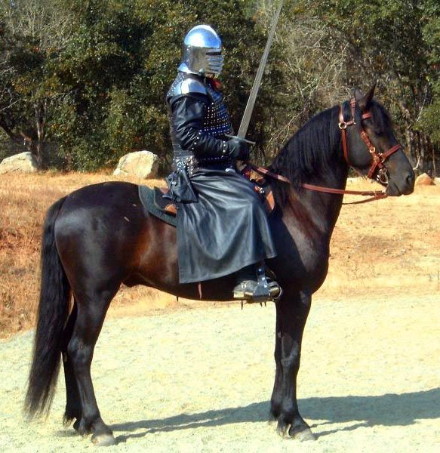
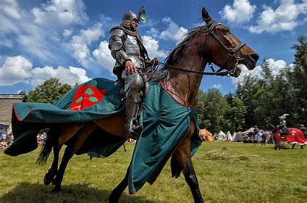
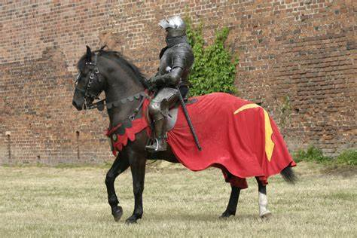
The Byzantine Model in Action
Attack!
Retreat!
Attack!
Retreat!
Arthur sees Retreat, Attack, Retreat | Retreats
Lancelot sees Attack, Attack, Retreat | Attacks
Phillip is a traitor, unimportant what he does | ---
No solution works for 3 knights, 1 round

Slide 24
The Byzantine Model in Action
Retreat!
Retreat!
Retreat!
Attack!
With four knights and 2 rounds, we can untangle the puzzle (they all retreat)

Slide 25
Basic idea for one simple protocol
The main concept is to run multiple rounds of “voting”
“ I am Lancelot. In round 3 I heard attack, retreat, retreat, retreat”.
“ Therefore, in round 4, Lancelot votes retreat”.
After T+1 rounds, the non-faulty knights will converge. The single faulty knight cannot stop them from overwhelming his confusing inputs.

Slide 26
Too many protocols!
Cloud engineers became overwhelmed
Even for simple cases with just crashes and network link failures, there are confusing scenarios to consider.
Cloud developers needed practical solutions.

Slide 27
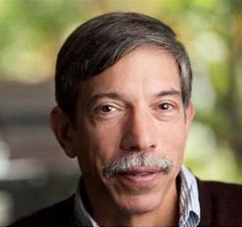
Fred Schneider to the rescue!
Superman
When people first raised these concerns, Leslie didn’t really respond.
Leslie explained that at the end of the day, he is a theoretical computer scientist… not an engineer.
Leslie felt that although his work does define “building blocks” for state machine replication, practical issues were beyond his scope.

Slide 28
Fred Schneider to the rescue!
Superman
But Fred Schneider saw this as an opportunity
Working with Leslie, he gradually identified a wide range of ways to actually implement state machine replication solutions.
Some were costly, and some were complex, but this work still showed that state machine replication could be useful

Slide 29
A few big takeways
One is that state machine replication is way more complex to actually deploy in a real system than anyone initially realized.
We can simplify some aspects by breaking out modules and applying the model only within those modules. A non-deterministic program could still have a state-machine replicated “component” inside it.
But the needed code can be quite substantial!

Slide 30
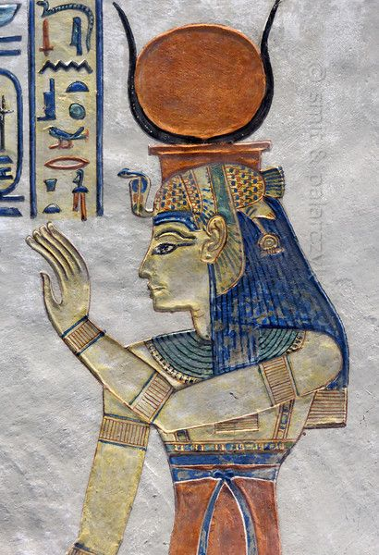
… which is where Ken came iN!
When I first came to Cornell my initial research project focused on implementations of state machine replication in object oriented computing frameworks – like Java.
The Isis Toolkit became widely used and pretty famous. This is how I earned tenure.

Slide 31
Why Isis?
Reference to Egyptian mythology.
When Osiris was torn to pieces by Set, Isis gathered all the pieces and wrapped them in linen. Osiris came back to life. Their son, Horus, went on to defeat Set, who was then banished from Egypt and the underworld.
The Isis Toolkit was created to pick up the pieces of your messed up system and bring it back to life.

Slide 32
Virtual Synchrony
One feature Isis introduced was a practical form of self-managed group and shard membership tracking.
We called this model virtual synchrony.
It addresses the split-brain problem that Leslie mentioned, but didn’t directly talk about (and Fred’s tutorial didn’t either).

Slide 33
Split-brain concern
Tes.com
Suppose your μ-service plays a key role, like air traffic control. There should only be one “owner” for a given runway or airplane.
But when a failure occurs, we want to be sure that control isn’t lost. So in this case, the “primary controller” role would shift from process P to some backup process, Q.
The issue: With networks, we lack an accurate way to sense failures, because network links can break and this looks like a crash. Such a situation risks P and Q both trying to control the runway at the same time!
Notes:
The issue of a system forming a logical partition is quite real – this has actually been seen in real systems!
It can be very dangerous. The two halves might take inconsistent actions, like allowing two different planes to land simultaneously on the same runway.

Slide 34
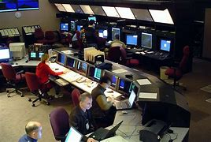
Why is this important?
Think about air traffic control (a setting that actually does use Isis!)
A plane needs permission to land. Suppose that the computer system tells two different air traffic controllers to take charge of the single runway.
One says “Flight US 270 you are cleared for landing.”
The other says “Flight US 270, wait. Flight Delta 110 clear for takeoff”.
This would be a very dangerous inconsistency!

Slide 35
What caused the problem?
This is an inconsistency related to who is the “leader”
It can be reduced to the same inconsistencies that CAP is introducing. So if we are going to do things “like” air traffic control, we need consistency.
Key idea: Maybe we can have C+A and not even need P. P matters if a service is really caching data from some other service. If each service is self-contained and fault-tolerant – and consistent – we won’t need P.

Slide 36
IoT Systems will have many issues like this example
With IoT we will need consistency from the start!
… drones, and cars, and smart power grids all need consistency!
Virtual synchrony membership eliminates the split-brain problem and makes it easier to implement state machine replication. In effect, by having “C” include agreement on membership, our job gets easier!

Slide 37
Solving the split brain problem
We use a “quorum” approach.
Our system has N processes and only allows progress if more than half agree on the next membership view. Example: if N=5, we say that after a failure, we need 3 or more of the original N to resume.
Since there can’t be two subsets that both have more than half, it is impossible to see a split into two subservices.
Notes:
With a majority-progress rule, our system would actually shut down (get stuck) if we had, say, 4 members, and a link broke and left us with two subsets of 2 members each. Neither would have a majority.
But it does ensure that we won’t have a split brain scenario.
The membership service needs to have this rule built in.

Slide 38
Group Membership Service inside Isis
In Ken’s Isis Toolkit, there was a special subsystem to keep track of group membership, using a quorum method to prevent split brain issues.
Members could join… leave… fail (crash), and Isis would track the state of the system automatically, reporting changes to all the remaining members.
This was enough to enable them to automatically reconfigure and even to self-repair. If too many members failed, the system gracefully shuts down.

Slide 39
Virtual Synchrony model
The term relates to how this was integrated with state machine replication.
In virtual synchrony, we use state machine replication when the membership is stable – not changing.
But we pause the state machine replication layer and reconfigure membership if a join, leave or failure occurs. This is done to make it look as if membership changes were atomic and instantaneous.

Slide 40
Virtual synchrony: Managed Groups
Epoch: A period from one membership view until the next one.
Joins, failures are “clean”, state is transferred to joining members
Multicasts reach all members, delay is minimal, and order is identical…
P
Q
R
S
T
TIME
U
Notes:
As illustrated here, the job of the membership system is to make it all seem magically clean and simple. Processes join or leave or crash and the manager reports these events in a clean way. It even initializes joining processes (heavy arrows).
How? By asking some process to make a checkpoint, then asking the new guy to load it. How? Using upcalls to the software: event notifications. How? Through an API a lot like a GUI designer tool might offer.
Failures are usually sensed by timeout or by the OS, if a process crashed (but honestly, solid software rarely crashes. Computers crash, though. Remember those three R’s?)

Slide 41
Virtual synchrony: Managed Groups
Epoch Termination
Epoch Termination
State Transfer
Epoch: A period from one membership view until the next one.
Joins, failures are “clean”, state is transferred to joining members
Multicasts reach all members, delay is minimal, and order is identical…
P
Q
R
Active epoch: Totally-ordered multicasts or durable Paxos updates
S
T
U
Epoch 1
Epoch 2
Epoch 3
Epoch 4
Notes:
As illustrated here, the job of the membership system is to make it all seem magically clean and simple. Processes join or leave or crash and the manager reports these events in a clean way. It even initializes joining processes (heavy arrows).
How? By asking some process to make a checkpoint, then asking the new guy to load it. How? Using upcalls to the software: event notifications. How? Through an API a lot like a GUI designer tool might offer.
Failures are usually sensed by timeout or by the OS, if a process crashed (but honestly, solid software rarely crashes. Computers crash, though. Remember those three R’s?)

Slide 42
A few famous ways of “putting it all together” into a platform
I’ll show you one: Chain Replication (Fred Schneider and Robbert van Renesse created this… it is very simple)
In the next lecture we will see others. They include
Paxos, a family of protocols Leslie designed for atomic multicast (he calls this “vertical Paxos”) and for persistent logging (“classic Paxos”)
Derecho, Cornell’s newest solutions. These are the world’s fastest!

Slide 43
Example: Chain Replication
Ok: Do It
A (head)
B
C (tail)
Update
Update
Update
A common approach is “chain replication”, used to make copies of application data in a small group. It assumes that we know which processes participate.
Once we have the group, we just form a chain and send updates to the head.
The updates transit node by node to the tail, and only then are they applied: first at the tail, then node by node back to the head.
Queries are always sent to the tail of the chain: it is the most up to date.
Notes:
Even before we solve those problems, it can be helpful to see an example of K processes cooperating.
Here, K=3. A, B and C are the three processes (in reality, A would be a machine where A is running, and a process id, and a port number).
In this image, A discovered B and C and connected to B. B connected to both A and C. We would use TCP for the connections. TCP connections can carry messages: like email, but sent from computer to computer in binary format.
Now we can tell people to send updates to A, and they can be relayed to B, then C. Later “ok” messages relay from C to A. This is called “chain replication”.
But you can probably see right away that this would be hard to implement even if the chain idea is easy to understand.
Another concern is that the updates travel node by node down the chain, and the queries are all done at the tail. This is slow and means that we have 2 or 3 replicas yet are limited to the compute power of just 1.

Slide 44
Does chain replication satisfy State machine Replication?
In some ways, but it is an incomplete story.
This is actually why Lamport felt that a formal model (a mathematical one) and a methodology for proving things about protocols was needed.
Chain replication is provably correct, but it assumes a membership mechanism, which it does not include. Without it, the chain replication scheme is not quite as strong as Paxos.

Slide 45
What about a Sharded DHT?
This is an image from one of our recent slide sets
Could we just use chain replication on a shard-by-shard basis? Some systems do this, but as noted, integration with membership tracking matters
One μ-service spanning many machines, split into shards with two machines per shard.

Slide 46
Summary:
Many systems need consistency.
CAP says “Hakuna Matata” but in IoT settings, we do worry about consistency. The air traffic control example illustrates the concern.
But Leslie Lamport’s state machine replication model is a building block we can work from. And there are simple solutions, like chain replication, that implement this model and can even integrate into a sharded DHT.

