Slide 1
CS5412/Lecture 15
Blockchains for IoT (Part 2)
Ken Birman
CS5412 Spring 2021

Slide 2
Summary of BlockChain Concerns
Permissioned or Permissionless? Energy cost of permissionless block mining.
If the BlockChain gets really large, costs of downloading a copy.
Cost of verifying that the BlockChain hasn’t been tampered with.
National-scale “disruption” scenarios that cause massive rollbacks, chaos.
Accidental loss of some chunk of the chain, making verification impossible.
Smart contracts might be too smart for their own good.

Slide 3
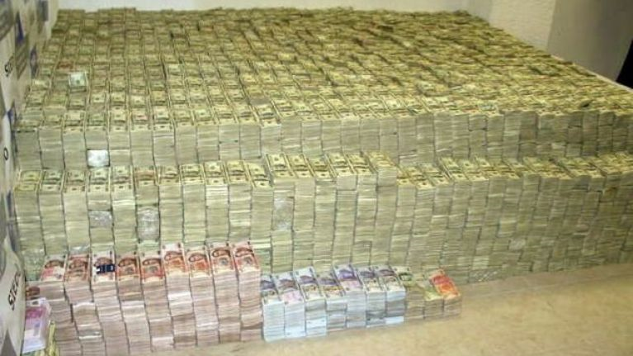
More concerns
https://www.joe.ie/news/pics-this-pile-of-cash-worth-22bn-was
-found-inside-the-insane-home-of-a-mexican-drug-lord-409313
Today’s most enthusiastic Blockchain use cases seem to center on a mix of illegal transactions, money laundering, and a gigantic technology boom but without much of a “market” for the associated products.
The model also depends on some hardness assumptions: finding a nonce, factoring RSA key. Quantum computers could shake up these assumptions.
Unresolved privacy concerns: “everything is on the table.”

Slide 4
Walking through the issues
Which issues would arise on a “smart farm”?
Would a BlockChain solve those issues? What new risks would it introduce?
What limits the speed of new technology adoption?
Notes:
In some ways this lecture recaps the one from Thursday, but it has some additional ideas too that we didn’t see on Thursday.
Partly our focus is on the aggressive uptake of Blockchain, but then we’ll be asking what elements need to be more mature in order to really use these solutions in a farming setting.

Slide 5
Blockchain on a farm
Main uses seem to be for audit trails of various kinds:
Capture data about something we are supposed to trace or record.
Write it digitally into the ledger, securely. Tamperproof and automatic
Auditors given access to the record.
But they will want to know:
Why should I trust this BlockChain record? Is the underlying data valid?
Notes:
Nonetheless there is keen interest in actually using BlockChain on farms. Why?

Slide 6
Blockchain for Sensors
A smart farm would store BlockChain records that include sensor data.
Very likely the sensors themselves would be securely connected to their host machines, for example using Azure’s IoT Hub or the AWS equivalent.
Reminder: With an IoT Hub model, the sensor itself uses security keys, and will only connect and talk to the hub. This enables a digital twin concept.

Slide 7
Trust with Sensors
… so we can assume the connection to the sensor is secure. But how would a digital twin for a farm work?
Azure IoT Hub will only allow authorized sensors to be part of the system, and it patches the software and configuration automatically. Feeds events to the Azure IoT function server, where functions consume them.
So presumably these functions log the event records to the Blockchain.
Notes:
This is a core issue. To trust that some particular record “tells me something” I need to know what device generated it and why it was the proper device to play that role at that time, and how the system authenticated it, and how it was calibrated, and maybe even whether the record is confirmed by redundant readings.
Without that information, it is just a number claiming to be relevant to my task, but with no real basis for trust in the underlying source of the data – yes, it wasn’t tampered with after being put in the chain but who knows about whether the sensor is even a legitimate part of the system?

Slide 8
Questions this might not answer
Is this sensor the correct one for the information the application claims to have captured?
Is the sensor working correctly?
Has the data the sensor generated been modified before it was logged?

Slide 9
Can we answer the questions an auditor might ask?
A sensor records shows that cow 2143 was milked on Tuesday at 10am. Later the milk turned out to have a dangerous bacteria in it, like Listeria. It got through and a consumer became quite sick.
Was she properly clean when she was milked? Had she been evaluated for mastitis as required by the health department? Was she periodically checked for overall health? Did she receive any “off records” meds?

Slide 10
Can we answer the questions an auditor might ask?
Realistically, an audit using sensor data would provide “evidence” but can’t answer these questions. Non-technical people might find this surprising, but in cloud computing we have seen why many either cannot be answered, or we can’t have confidence our answers will be correct.
BlockChain does protect against tampering, and does record what the sensors reported, and when. This is already valuable, as long as we are honest about the capabilities and limitations.

Slide 11
To have real confidence…
Azure IoT Hub would need to log management events too.
The audit-trail examination tool would need to visualize this information and be able to convince the auditor that yes, this is the proper sensor, it seems to be properly calibrated, the data wasn’t tampered with…
The mention of time suggests that we might also need to log events related to the way the system tracks time, or at least have a “story” there.
Notes:
Even the basis for believing time needs study.

Slide 12
Blockchain-specific form this takes?
We noted that early adopters are people with transactions to carry out anonymously, or maybe with money to launder. Strongly motivated mostly because for now, Blockchain feels like a way to evade oversight and taxes.
Business community has many people keen to adopt the next new thing. Startup frenzy and huge fortunes made on ICOs adds fuel to the flames.
But farming is a case for mainstream use and these questions need to be answered. This is why the mainstream technology community is more cautious.

Slide 13
Let’s look at a Blockchain created specifically for IoT
Cornell “smart farms” research effort (CIDA) is highly visible.
Led by Susan McCouch, Hakim Weatherspoon, Steve Wolf and Abe Strouck.
One early accomplishment: Vegvisir, a BlockChain specifically for agriculture.

Slide 14
Some issues they thought about
A lot of the “events” that matter in an agriculture or farming setting are in remote places, disconnected from the main system.
The BlockChain would probably be used primarily as an audit trace, to track events in the food chain from farm to table.
So this raises issues like intermittent connectivity, how we know that the sensor that generated a record is the “correct one” for that role, etc.

Slide 15
Connectivity: just one issue of many!
Vegvisir is a research project and a proof of concept, but not deeply integrated with Azure IoT Edge.
Any real product will need more ties to the Azure infrastructure.
But an Azure Blockchain would also benefit: as a part of the official Azure ecosystem, we might gain better answers to some of the trust issues!

Slide 16
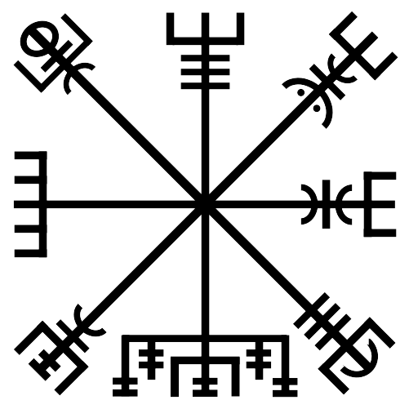
Vegvisir
Slides from Robbert van Renesse
Talk presented at ICDCS 2018

Slide 17
A Blockchain for the Food Supply Chain
Robbert van Renesse
joint work with Hakim Weatherspoon, Danny Adams,
Kolbeinn Karlsson, and Stephen B. Wicker
Initiative for Crypto-Currencies and Contracts (IC3)
Cornell Digital Agriculture Initiative

Slide 18
Blockchain’s Promise
Promises
Global currency
Smart contracts
Notarization
Accountability
…
BlockChain background: Repeats things we’ve discussed.

Slide 19

A Replicated Ledger of Transactions
Ledger
give 10 bitcoins to Jane
give 3 bitcoins to Judy
give 10 bitcoins to Joe
Judy
(owns 15
bitcoin)
Jane
Joe (owns 1 bitcoin)
BlockChain background: Repeats things we’ve discussed.
Notes:
Unstructured peer-to-peer network
Propagation by gossip
Talk about how transaction security prohibits theft.
Say we’re not going to deal with txns anymore.

Slide 20
Smart Contracts
Smart contracts are executable programs on the BlockChain, take input from the BlockChain, and produce output on the BlockChain
Main use: automated escrow, where disbursement depends on agreed upon conditions
Caution: Smart Contracts have been found to be prone to (very expensive) bugs
BlockChain background: Repeats things we’ve discussed.

Slide 21
Potential Use Cases
Killer app: cryptocurrencies
Other potential uses:
  Reduce opaqueness of supply chains
    One “trustless” place for all transactions along the way
    Improvements over paper-based systems and many disjoint databases
  Eliminate middlemen
    Why does farmer make so little and consumer pay so much?
  Reduce fraud
    India, Russia, Sweden, Georgia… are building blockchain-based land registries to fight “land fraud” and simplify international property transactions
BlockChain background: Repeats things we’ve discussed.

Slide 22
For the Food Supply Chain?
Supply chain management
  Walmart is building one for the food supply chain
    Food safety: fast identification of tainted foods
    Consumers are demanding more information about the products they buy (organic, fair trade, …)
  Simplify international transactions
Help farmers
  Want to know what happens to their products for fair pricing
  What products should they be producing?
Reduce food scandals
  illegal production, misrepresentation, loss and waste, …
BlockChain background: Repeats things we’ve discussed.

Slide 23
Industrial uptake?
ripe.io:
  A company that is building a “blockchain of food” with IoT interfaces
Walmart:
  partnered with IBM and Tsinghua to identify sources of contaminated products and speed up recall
But today’s blockchain technology may not be appropriate for all use cases
  too dependent on availability of plentiful power, networking, and storage

Slide 24
Desired Blockchain properties
Performance:
  High Throughput, Low Latency
  Energy-Efficient
Security:
  Always available for reading (verifying) and appending
  Fair
  Tamperproof (Integrity)
  Possibly confidentiality as well
No Single Administrative Domain
  no need to trust a single provider
Open membership (or not)

Slide 25
Open Membership is Hard
Traditional secure logs are based on voting
Members vote on which transactions to add to the log and in what order
Problem: “Sybil” or impersonation attacks
  a participant may try to vote multiple times
  with closed membership, cryptographic signatures can identify the source of a vote
  with open membership, anybody can create identities and that way vote many times

Slide 26
Permissionless vs Permissioned Blockchains
 | Permissionless | Permissioned
Approach | Competitive | Cooperative
Basic technique | Proof-of-Resource | Voting
Membership | Open | Closed
Energy-efficiency | Often terrible | Excellent
Transaction rate | At best hundreds / sec | Many thousands per second
Transaction latency | As high as many minutes | Less than a second

Slide 27
Bitcoin Blockchain
Permissionless, open membership
Proof-of-Work
There are thousands of Bitcoin miners
  they use ASIC hardware to compute SHA256 hashes
  use about more energy than the country of Denmark
Overall rate is a few transactions per second

Slide 28

The Blockchain
nonce
Ledger
$$t$$
HASH( ) < target
“cryptopuzzle”

Slide 29
The Blockchain

Slide 30
The Blockchain

Slide 31
The Blockchain
Exponentially distributed rate of new blocks, with
constant mean interval
target automatically adjusted every 2016 blocks so that mean interval is 10 minutes

Slide 32
Incentives for Mining
Prize:
  “Minting”
  Transaction Fees
Wins proportional to computation power
Notes:
Mining total: 21 million at 2140

Slide 33
Forks
Two blocks “mined” at approximately the same time by two different miners

Slide 34
Fork Resolution
Longest chain wins
Transactions on short chain are reverted

Slide 35
Fork Resolution
A transaction is confirmed when
it is buried “deep enough”
(typically 6 blocks – i.e., one hour)
Notes:
There is no DECIDE step as in classical consensus
Making it difficult enough for attacker to out-run.

Slide 36
Security Threat!
$$t$$

Slide 37
Security Threat!
$$t$$
Threat: attacker outruns good miners

Slide 38
Security Threat!
$$t$$
20%
Threat: attacker outruns good miners
➔ Security Assumption: good miners own >.5 of the total compute power
[blockchain.info, April 2015]

Slide 39
Permissionless Blockchains
Open membership, but inefficient
Vulnerable to 50% attacks
Examples include Bitcoin, Ethereum, IOTA

Slide 40
Permissioned Blockchains
Performance:
  High Throughput, Low Latency
  Energy-efficient
Security:
  No forks!
Closed membership
Examples include Ripple, Hyperledger

Slide 41
Blockchain for the Farm?
Blockchains require strong network connectivity and lots of storage
Permissionless blockchain are power-hungry
Sensors have limited resources
  Sensors for growing conditions, storage conditions, shipping conditions, …
Blockchain for a farm will generate records in a decentralized way, and hence it *must* work in a network-partitioned or -challenged environment

Slide 42
Vegvisir: tolerate branches
The key innovation is to allow branching as a feature.
Leads to DAG structure instead of linear blockchain
Still maintains full causal history of events (respect’s Lamport’s →)
Notes:
Something to understand is that a branch for them is not a fork. A branch occurs when a non-adversarial part of the system is temporarily disconnected and later able to reconnect. But it isn’t attacking their chain. They just want availability with partitioning events.

Slide 43

Proof-of-Witness to persist blocks securely
No more than k malicious nodes in any neighborhood
Valid block
Not yet valid block
At least one copy of a valid block will survive if <k malicious peers
Notes:
To make the branches more trusted they use this concept that so many nodes see the events that most of them must be trustworthy (under their assumptions)

Slide 44
The Support Blockchain reduces sensor storage needs
Support Blockchain
IoT Blockchain
Allows regular peers to discard old blocks when storage space is low
Notes:
The support chain holds pointers into the IoT chain.

Slide 45
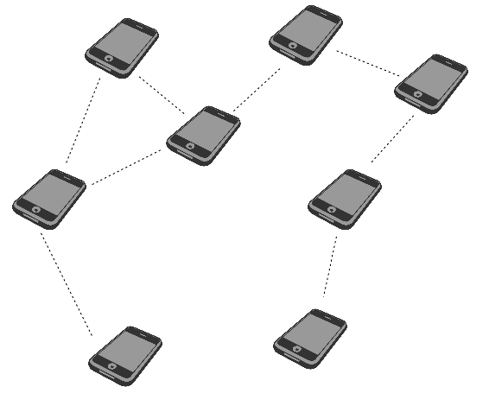
Blocks are gossiped over ad hoc network
Heterogeneous, opportunistic networking

Slide 46
CRDTs for strong semantics in partitioned world
Conflict-Free Replicated Datatype
Updates must be associative, commutative, idempotent
Replicas can be updated independently and concurrently
Basic CRDTs form registers, counters, sets
Notes:
By requiring conflict-freedom they rule out an issue we will discuss in a moment. Their CRDT language offers a form of programmability, like a restriction on Ethereum.

Slide 47
Transactions manipulate CRDTs
CRDT State Machine
CRDT ID
Operation
Argument
CRDT 1
ID: A
CRDT Type: <crdt type>
Element type: <type>
Permissions:
<OP>: <role>, <role>,…
<OP>: <role>, <role>, ...
Tx 1
A
add
x
Tx 2
A
add
y
Tx 3
B
remove
z
CRDT 2
CRDT 3
ID: B
CRDT Type: <crdt type>
Element type: <type>
Permissions:
<OP>: <role>, <role>,…
<OP>: <role>, <role>, ...
ID: C
CRDT Type: <crdt type>
Element type: <type>
Permissions:
<OP>: <role>, <role>,…
<OP>: <role>, <role>, ...
Notes:
They think of the chain as having a kind of state machine floating down it and evaluating data and transactional logic.

Slide 48
But some questions remain open
How would Vegsivir handle “double spending” (same coin spent in both branches), or other kinds of semantic conflicts that might not involve coins?
The actual meaning of the operation changes, or it becomes invalid.
This could cascade to impact subsequent operations, too.
We can’t simply merge the chains and walk away…
Also, although smart farms have many sensors, Vegvisir lacks an answer to the issue of trust: we need the IoT hub to log enough information to know why we should trust a sensor, but this topic is out of scope for the paper.
Notes:
Vegvisir’s answer right now is that “these kinds of things can’t occur” because of the CRDT rules, but in practical systems, that might be too strong an assumption. Maybe we can’t just outlaw conflicting events.
Also, they overlook the questions tied to sensor trust mentioned earlier. The ones involving sensor failure raised in Meta are also relevant here.

Slide 49
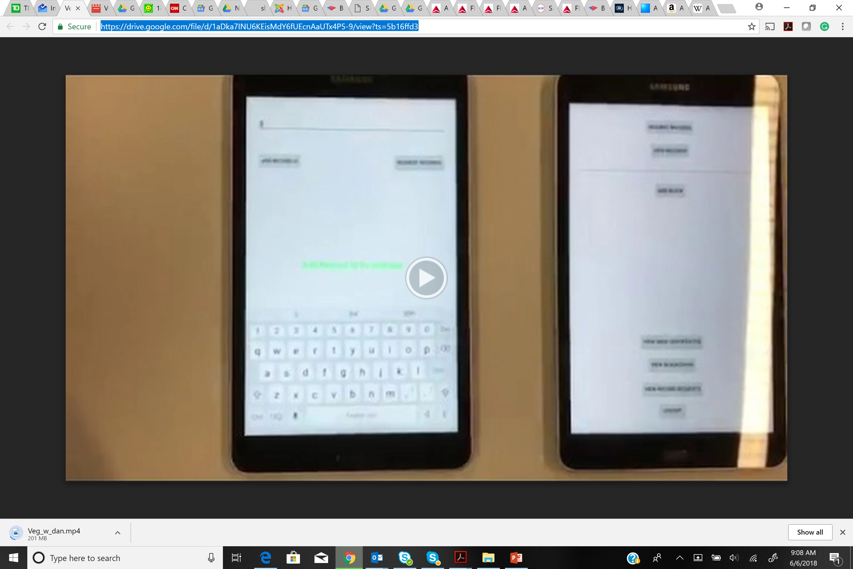
Demonstration Video
Proof of concept system
Notes:
We don’t have a working link to the demo, sorry!

Slide 50
Conclusion
Exciting possibilities for blockchains in the food supply chain
But current blockchain designs may not be compatible with some deployment scenarios in the food supply chain
Vegvisir supports partitioned operation and has low power/networking/storage requirements

