Slide 1
CS5412/Lecture 7
Consistent Storage For IoT
Ken Birman
CS5412 Spring 2019

Slide 2
Consider a Smart Highway
We have lots and lots of sensors deployed
Cars are getting some form of “guidance” and if they accept it (and maybe pay a fee) get to drive faster.
Would we run into consistency issues of the sort seen in Lecture 6?

Slide 3
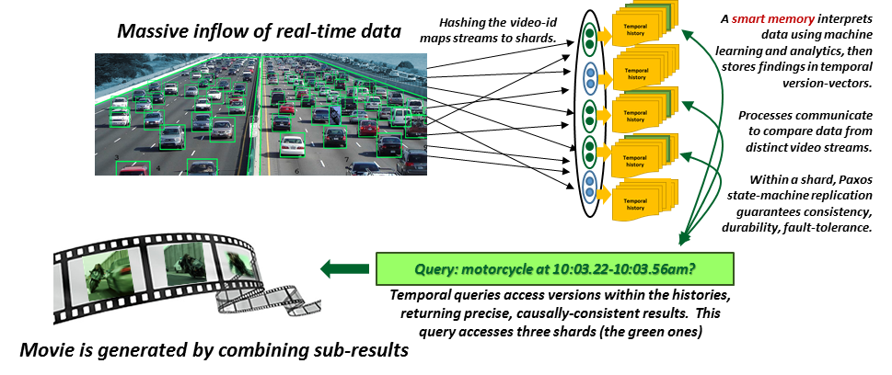
Smart Highway
Notes:
This image shows a smart highway with sensors (lots of them) that are able to identify cars (green boxes) and in this particular case, abnormal things too (like a motorcycle between the lanes). In fact that happens to be Trinity from the Matrix with the keymaker, and in fact she is driving the wrong way on the highway.
Data is being relayed to our cloud over connections (middle) and into a sharded storage layer (dots organized into shards of two processes per shard, five shards in total) that stores the data into a time-indexed storage layer, like a file system.
Then someone is trying to query the system to make a “film” showing every law that the motorcycle broke during this 30-second period. But of course we wouldn’t trust a film like that if it could be based on inconsistent data. It might show the same thing twice or some even not at all, or show cars in the wrong relative locations.

Slide 4


Tracking Trinity…
In this example, we are doing a few things in one picture
Data is being captured by IoT sensors.
We are relaying it into a key-value storage layer, and
saving it in some sort of sharded, replicated form
A “query” is pulling up images that show
Trinity with the KeyMaker on her motorcycle)

Slide 5

RemindeR: Flock of Geese
In the last lecture we saw how the concept of a causal snapshot can help us create consistent views of a distributed system.
Can we use that same idea here?
Goals: We want temporally precise and causally consistent data, and then will search it for clear images of Trinity’s ride.

Slide 6
Animation: A wave in an aquarium
To illustrate this point visually, we made a simulation.
Rather than a flock of geese, it simulates a wave in an aquarium, as if 400 cameras were watching the water, each sending 20fps. We captured this “IoT sensor data” into files.
Then we took snapshots at a rate of 5fps and made a movie.

Slide 7
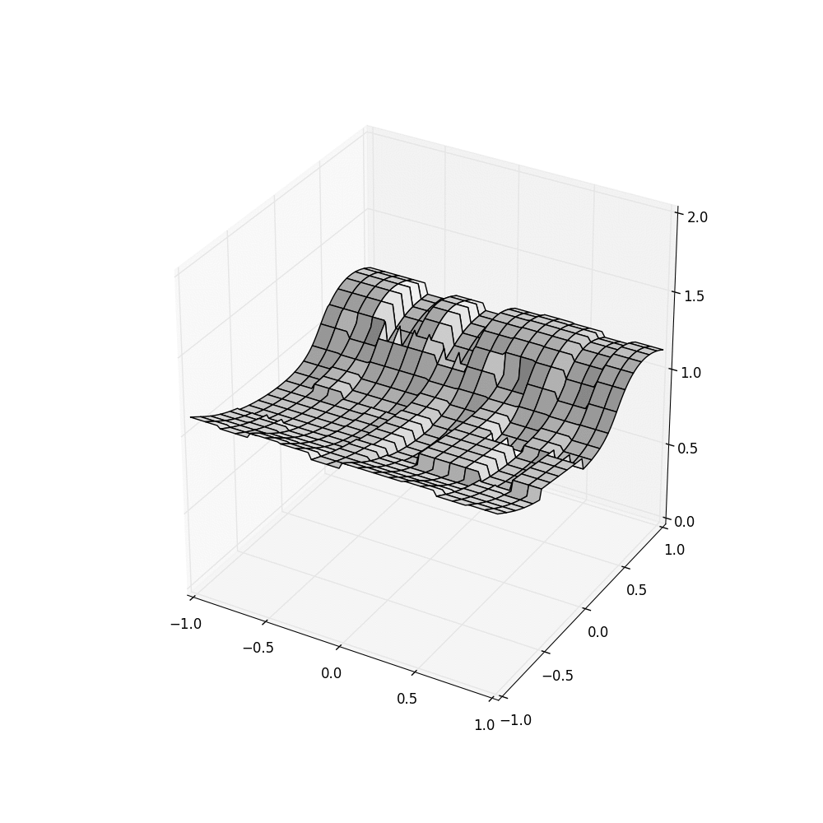
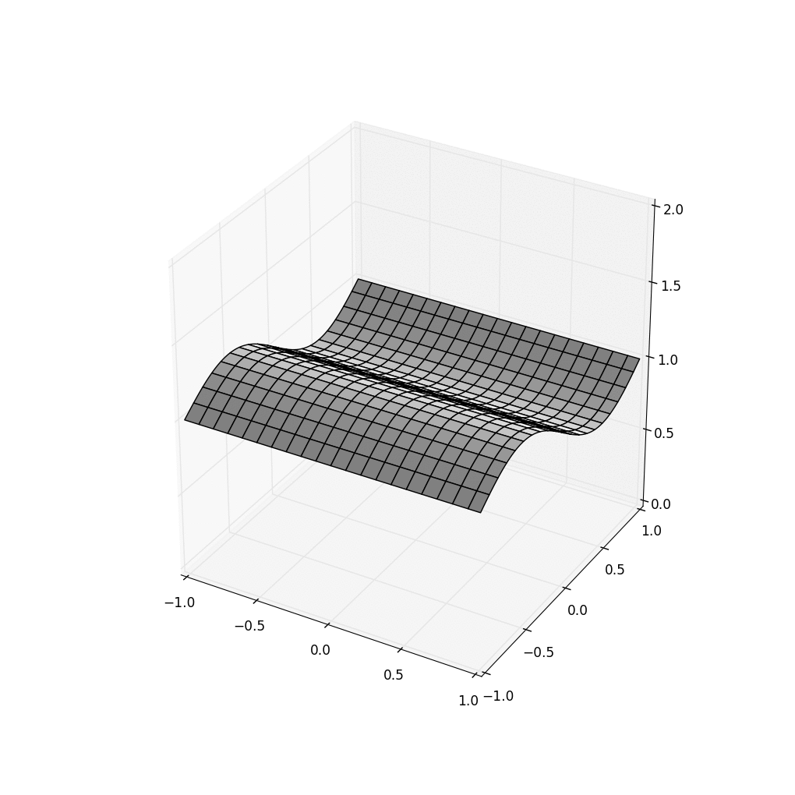

Consistency Problem: HDFS does badly!
HDFS
FFFS+Server Time FFFS+Sensor TIME
Existing file systems (like HDFS on the left) make mistakes when handling real-time data. But we can fix such problems (right).
Notes:
These animations actually show a “wave” photographed by 400 camera sensors. Each little box is one camera, and each camera shows a tiny area at a 20 fps rate.
Then we ask for data in snapshots at 5fps to make our animation.
You can see how badly today’s cloud file systems do! But we can do better (middle and right). The FFFS is a fancier file system that understands time and causality.

Slide 8
Why is the one on the right “best”?
Well… Garbage In, Garbage Out
Many machine learning systems are “tolerant” of noise, but HDFS was way worse than just noisy: it was inconsistent!
We might not trust the system when it tracks Trinity.
Inconsistent inputs can defeat any algorithm!

Slide 9
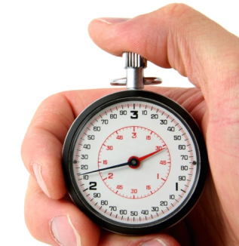

Smart Systems Need Consistency!
As we saw, one dimension concerns time
After an event occurs, it should be rapidly processed
Any application using the platform should see it soon
Another centers on coordination and causality
Replicate for fault-tolerance and scale
Replicas should evolve through the same
values, and data shouldn’t be lost
Notes:
This connects back to lecture 6.

Slide 10
Freeze FramE File System (FFFS_{v1})
This was created by our TA, Theo, with Weijia Song!
The idea was to bring ideas from Lamport’s models into a file system so that the end-user (you) could benefit without needing to implement the mechanisms.
He took advantage of the fact that HDFS has a snapshot API, even though it didn’t work. FFFS “reimplements” this API!

Slide 11
How does it work?
Normal file systems only store one copy of each file.
FFFS starts by keeping every update, as a distinct record. The file system state at a particular moment is accessed by indexing into the collection of records and showing the “last bytes” as of that instant in time.
So FFFS looks just like a normal file system to its users.
Notes:
Students in CS5412 sometimes are troubled that one system can have so many interfaces. FFFS was actually built, initially, by taking HDFS and modifying the internal implementation to track versions.
But there is also an object oriented layer, Ceph, that can run over HDFS. So it can run on FFFS too. It uses the file system as its “block store”. Through the Ceph API, the same file system suddenly looks object oriented. For structured data, Ceph is very popular because it handles a number of tasks the user would otherwise need to address.
HDFS or FFFS are file systems, and as such, may not seem like a distributed system in the Chandy/Lamport sense, but actually both are: the implementation of HDFS has a process to handle file names and other “meta data” like access times and seek pointer, and then a set of processes (sharded) to hold the data and replicate it for fault-tolerance. FFFS shares this identical model.

Slide 12
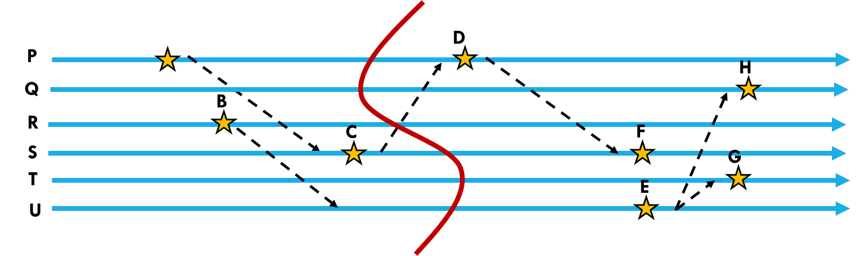
How does it work?
Next, just like in our space-time figures, FFFS tags every record with a special kind of timestamp.
In our examples we used logical clocks and vector clocks.
FFFS actually uses a hybrid clock. This includes the IoT timestamp from the sensor, the platform timestamp from a clock, and a causal timestamp from a logical clock.

Slide 13
How does it work?
Even though FFFS has multiple servers (in fact data spreads over them using the same key-value sharding discussed in Lecture 2), for an access at time T (you open “filename @ T”):
It accesses data accurate for time T, despite clock skew
It tracks causality, so that if it returns Y for some read, and
update X → update Y, then it also returns X.
In effect, FFFS does temporal reads along a consistent cut.

Slide 14
What if you do many
Reads? Consistent cuts!
T T’
In effect, each time your application does a read from a set of files, that operation occurs along a consistent cut that:
Is as accurate as FFFS_{v1} can make it, given clock precision limits
If T’ ≥ T, the cut for T’ includes everything the cut for T included
If you read multiple files, the results are causally consistent
Reads are deterministic (other readers see the same data)
Notes:
In this example we are showing how FFFS might handle requests for a snapshot at time T, and then at T’. Think of the 5fps data: time 10:00:00.000 and time 10:00:00.200
FFFS may not have perfect time accuracy but it does its best and also tracks causality and won’t give back data that seems to violate causal order. We get the green cuts shown on the left (in fact the red ones too, but T and T’ match the green ones). All of these cuts are consistent – FFFS only returns data on consistent cuts, and ones matched to the requested times. HDFS doesn’t have this property.
Notice also that each cut definitely includes the events from the prior cut. Time moves forward.
And this is how the video on the right was made!

Slide 15
In our Highway example?
When we query, we want the machine-learning tool to see data as a series of consistent snapshots across the full data set.
Then it can select data that includes video-snippets of Trinity with exactly one snippet per unit of time, no overlaps, no “lies”.
Thought question: How does the overlap issue relate to sensor overlap from the Meta system, discussed previously?

Slide 16
Revisit the Smart Highway
Notes:
Here the idea is that maybe we are using machine learning to figure out Trinity’s path on the highway (which was terrifying!) With good data, we can reconstruct a reasonable approximation, and then illustrate it with video snippets to make our film.

Slide 17
Beyond FFFS_{v1}
A file system is not a natural API to use if the way you think of the application is through key-value data.
So for Azure IoT, as part of a system called Derecho, also invented at Cornell, we are building FFFS_{v2}. It will be inside Derecho and looks like a key-value storage layer for “objects”.
But in fact it can do anything FFFS_{v1} could do.
Notes:
This can be a hard transition for our CS5412 students.
You’ve all refactored code you developed to separate out a reuseable module.
We did that too. Derecho is a developer’s tool for the IoT cloud and it includes the “core” of FFFSv1.

Slide 18
First, a tiny digression
Libraries, programs that link to libraries, and μ-services.
API
API
ObjStore<KT,VT>()
Put<KT,VT>(k,v)
VT Get<KT>(k)
Watch<KT>(k, λ)
ObjStore<KT,VT>()
Put<KT,VT>(k,v)
VT Get<KT>(k)
Watch<KT>(k, λ)
DLL = “Dynamically Linked Library”
Loaded on demand, but this is just a detail. What matters is that it lives in your program’s address space.
Puzzle: All this is obvious… but what “is” a μ-service?
ObjStore library
implements the API
ObjStore library
implements the API
ObjStore.h, ObjStore.dll
ObjStore.h, ObjStore.dll
A DLL is a compiled version of the library
If a program links to the library, it can use it at runtime
Tiny digression, not on exam
Notes:
If you are unfamiliar with modern systems, you might think of libraries and services as completely different concepts.
But in fact consider this: if I have a library, I can link it to a program and sometimes, that program could become a component of a μ-service. In this way, the ideas blurr.
Derecho, which includes a storage layer “like” FFFS_{v1} is able to play this role.
This is a recent development for Derecho but will be popular (we think).

Slide 19
First, a tiny digression
A μ-service is just an (elastic, stateful) group of processes.
All group members are instances of the identical program,
They cooperate to accept requests from (stateless) functions.
The (stateless) functions run in the function service tier.
RESTful RPC
A simple and standard way for a program (like a function) to
invoke a method in some other program (like a μ-service instance)
Based on HTTPS!
Tiny digression, not on exam
Notes:
The place to start is by understanding that a μ-service is just a set of processes that are linked to a library called REST (short for RESTful RPC), and automatically available if you build cloud apps with standard tools from Azure or AWS. Even Eclipse for Java has this (although in fact Java “favors” JNI, and you can use that too).
The members of this group cooperate to do whatever the μ-service supports.

Slide 20
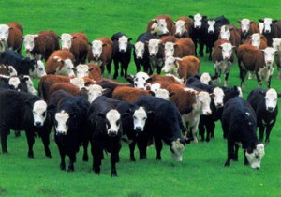

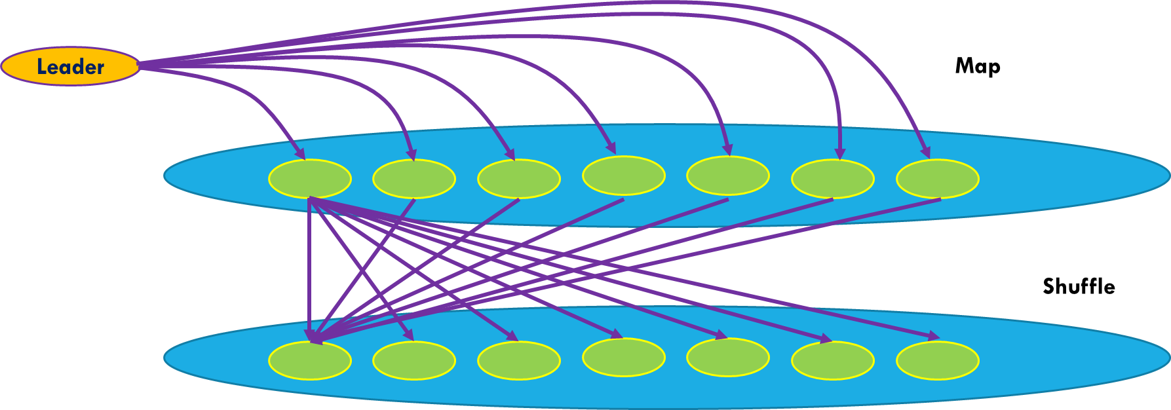

A machine-learning μ-service attached to Azure IoT, used to monitor some cows
Here we often use something more efficient than REST, like Azure Message Bus or Message Queue
REST RPC over HTTPS
(slow but universal)
Vast numbers of data sources live outside the cloud itself
The IoT Cloud uses a tier of lightweight stateless “functions” to absorb load
This example shows a μ-service running MapReduce.
Tiny digression, not on exam
Notes:
In this example we see how a function service (very elastic but entirely stateless) could be the front end to some new μ-service. This one is running MapReduce, which is one of a few famous “kernels” employed in machine learning.
In this image we don’t show the group members.

Slide 21
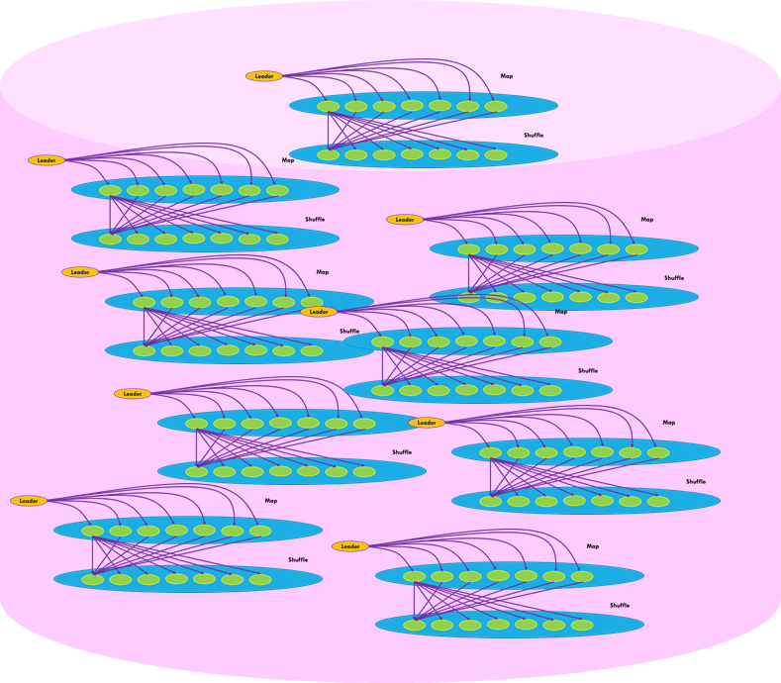
Inside that μ-service
We would find a group of Linux processes.
Some (or perhaps all) would accept REST RPC’s. Standard IDEs let you set this up automatically.
Then there would be processes to run the machine-learning logic, perhaps using MapReduce as shown here.
Tiny digression, not on exam
Notes:
In fact, inside the μ-service we would certainly find processes that accept REST RPCs, but we might find more structure than just that.

Slide 22
… State machine replication in groups (atomic multicast or Durable logging)
Requests from the function tier
This is just an example.
The developer defines subgroups, controls layout and “shard” pattern
Load-balancing key-value “router”
First tier absorbs much of the load
Back-end handles complex tasks
Tiny digression, not on exam
Notes:
In this example, we see three “subsystems” inside a single μ-service.
One is shown as a load-balancer and it handles REST. The others include a cache layer (but it could be anything you like), and a back-end (but again, any structure that makes sense to you could be supported).

Slide 23
… State machine replication in groups (atomic multicast or Durable logging)
Requests from the function tier
This is just an example.
The developer defines subgroups, controls layout and “shard” pattern
REST
Load-balancing key-value “router”
Derecho P2P message passing
Inside Derecho we avoid REST and use highly efficient point-to-point and multicast primitives, for performance reasons.
Derecho Multicast
First tier absorbs much of the load
Back-end handles complex tasks
Tiny digression, not on exam
Notes:
In this example, we see three “subsystems” inside a single μ-service.
One is shown as a load-balancer and it handles REST. The others include a cache layer (but it could be anything you like), and a back-end (but again, any structure that makes sense to you could be supported).

Slide 24
Map-Reduce On such a group
Map to k1, k2
Key-value pairs at “virtual time” T
We obtain a completely atomic MapReduce primitive within Derecho!
N x N Shuffle
AllReduce
Tiny digression, not on exam
Notes:
In particular, a subgroup with shards of size two, here) can implement MapReduce. This is shown here. Notice that the actual arrows would be a form of point-to-point message passing. Derecho supports both point to point and group multicast patterns.

Slide 25
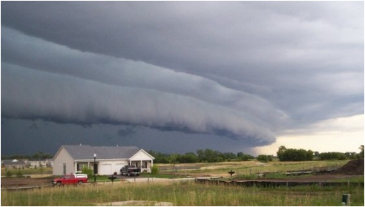
Derecho: But What is it?
A Derecho
Derecho is an open-source tool for developers creating new cloud μ-services. Download from GitHub.com/Derecho-Project
Derecho leverages RDMA to gain exceptional speed, but can map to TCP if RDMA isn’t available.
Currently targets C++ developers in Linux cloud environments like Azure IoT Edge, Azure Intelligent Edge, and Amazon AWS.
Notes:
Derecho is a general framework for building these kinds of sophisticated μ-services.
Right now you use it in C++, but we are starting to support Java APIs too, and in a way that could later also support Python and additional languages.

Slide 26
… Back to our example
Incoming traffic: RESTful RPC, WCF, other TCP-based protocols, etc.
Sensors, other external “clients”
Reminder: a μ-service can have any structure you like. You, the application developer, define the subgroups, controls the layout, tells us what pattern of sharding to use, etc.
Load-balancing key-value “router”
Notifications, cache-invalidations use multicast too.
First tier absorbs much of the load
Back-end handles complex tasks
Notes:
All the tiny dots are separate processes (probably on separate processors). The large ovals with the colorful ovals inside represent a service sharded to have two or three replicas per shard. Other subgroups are unsharded, like the three-member load-balancer and router at the top.
In Derecho, each subgroup is like a separate microservice that plays some distinct role. These roles correspond to logic defined by classes in your program.
Derecho instantiates objects for exactly the classes that each process is using --- the subgroups to which it belongs, or shards.
Thus if a process is assigned to role of “load balancer” (top subgroup) only that class is instantiated, and the object that results will have the logic it uses to play that role. Some other process playing “second member of third shard” instantiates that other class, and plays that role. Same code base, different configurations.
Derecho can support this sort of structure.

Slide 27
Roles Derecho is playing
Derecho:
Automates the “mapping” from processes to these roles using
layout parameters that you specify, like how many shards & how big.
Auto-instantiates C++ types for subgroups & shards
Fault-tolerant, repairs damage so data is always consistent.
Employs ultra-fast multicast (Paxos) for updates.
Offers a unique new read-only query mechanism that is consistent and can index in time, accurate to milliseconds.
Notes:
These are some of the many things Derecho automates for you. But you would need to read the programming manual and also the Derecho research paper (the one from ACM Transactions on Computer Systems) to understand it deeply.
If you do that reading, it would be easy to understand.

Slide 28
Drill down on “object store”
In the market, you find key-value stores like Cassandra, but with weak consistency and lacking these time-indexing capabilities.
Others, like Microsoft FaRM, are proprietary tools for specific needs (FaRM for example supports Bing’s transactional queries and updates in a massive shared memory).
You also find file systems implemented over a layer like Derecho (think of Zookeeper), but they are slow and used mostly for configuration management.
Derecho’s object store lives in this space, but is both simpler and more powerful.
Notes:
Derecho’s object story is basically just a key-value subsystem like we saw in Lecture 2.

Slide 29
Object Store API (FFFS_{v2})
Extremely simple: Stores any kind of “binary information”
Derecho::ObjectStore::put(key, value), or cput(key, value)
Derecho::ObjectStore::get(key[, time])
Derecho::ObjectStore::watch(key, Callback f)
The key could be a string, an integer, even a complex object.
The value could be a byte array, a photo, a video, and can be huge.
Notes:
The main APIs for the object store match those of a standard key-value store. But Derecho adds a “watch” callback that will do a call to a local function if the watched key changes. Obviously this callback occurs on the process where the key changed. But the function could then send a message or a multicast to other processes.

Slide 30
Simplest case
We take a subgroup, shard it (for example, 2 replicas)
  put maps your key to some shard. It holds the key,value pairs
    Replication uses an atomic multicast based on Paxos, so
    all copies are in a consistent state.
    There is just one “most current” value, held by the store.
  get will fetch this most recently stored value.
  watch uses multicast to inform any watchers each time value changes.
  cput is like put, but only replaces the prior value if the version # matches
Notes:
The main “fancy” API here is the conditional put. It works like Put but checks that the version numbering hasn’t changed since the get was done. So you do a get, update the version, then a cput, and if this is successful, you “avoided” using a lock and yet got an atomic effect. If cput fails, no change was done and you can iterate by doing a new get, then trying again.

Slide 31
Is it a library? Or a μ-service? Both!
You can link your code directly to it, like any library.
We also have a “demo” that sets it up as a service.
Warning: Our demo uses Derecho RPC, which is not available
from the function service layer.
Right now, the demo shows how to use it as a μ-service running as a
subgroup inside a larger Derecho group.
But we plan to extend the demo to use REST. Then functions could talk to it.
You could do this on your own, pretty easily
Notes:
So getting back to our point from earlier, the object store is a key-value library within Derecho, but if you use it in the intended way you end up building a key-value service. And then this can be called using REST. Like in that example figure we saw earlier.
One weird limitation: this is work in progress and oddly, we don’t yet have a demo in which we linked the object store, configured as a μ-service, to the Azure function layer. Obviously we do need such a demo. We’ll build one in the next few weeks.
Or you could help us by building it yourself. It isn’t hard.
The existing demo is for processes inside a big Derecho group that want to use the object store as a subgroup. The idea is identical, but instead of REST they use the Derecho built-in P2P mechanism, which maps to RDMA.
They do this for reasons of speed: RDMA is incredibly faster than REST.
And here is another useless and annoying glance into the future. Derecho RPC (on RDMA) will work soon from outside the group, and then could be used from the function tier. But that’s a bigger piece of work and “soon” won’t be soon enough for CS5412 in spring of 2019.

Slide 32
In what sense is it FFFS_{v2}?
First comment: You do not need to work with Derecho and its object store.
Theo can help you set up FFFS_{v1} as a file system for your project.
We think of the object store as a generalization of FFFS_{v1}.
File names and record numbers can be used as keys
The object store supports versioning, and indexed lookup
In this perspective, it has all the functionality of FFFS_{v1} except that
you talk directly to it (which is far faster!), not through a file API
Notes:
So we call it FFFSv2. Is this honest?
In fact it has all the same functionality… so yes, this is truth.
… but it lacks a file system API. So this is a lie!
And (sigh) we actually do plan to support the HDFS and Ceph APIs too. But (you guessed it) not soon enough for spring 2019.
You could use the actual FFFSv1 if you need something like that and prefer not to deal with these technology gaps. Theo can help set that up.

Slide 33
Storing the data
For the simple case, a normal C++ “Map” is used at each process running the object store.
There is a configurable replication factor. The members of a shard use this to keep identical replicas of the C++ map.
The map itself is a hashed lookup structure employing an efficient in-memory data layout.
A single key can only map to a single value. If you replace it, the old value is garbage-collected.
Notes:
Some details: each replica of a shard has the identical (key,value) map, hence has identical capabilities.

Slide 34

Speed? Breaks records!
Every data path uses RDMA transfers (100Gbps bidirectional)
Derecho multicast is exceptionally fast and even with multiple copies, the entire update runs at nearly 125Gbps
Note: In today’s Derecho, RDMA is offered inside a μ-service, but in 2019 we will also have RDMA for clients outside the service.
Notes:
On TCP Derecho is actually quite fast too, but not as fast as with the hardware RDMA device to accelerate data movement.

Slide 35
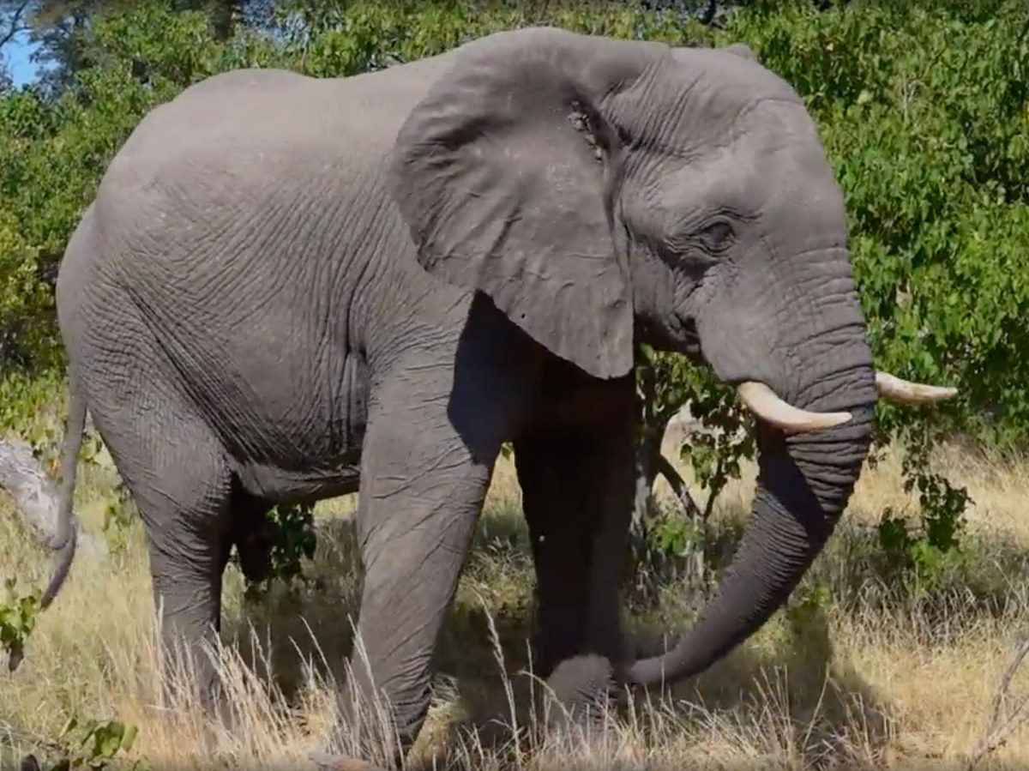
What about big objects?
If objects are large, and watchers just want “some” objects, we recommend a simple two step approach:
Create a uid, and put the (uid, obj) pair, first.
put a “meta-data” record that lists the uid.
Now, via get or watch, clients learn about the update from the
meta-data, which can list various attributes.
They call get a second time to fetch object, if desired.
Notes:
A single object store can store more than one kind of data. So for example, it could store photos (maybe with one kind of key) and also “reports that new photos are available” (with some other kind of key).
This avoids having you receive photos you don’t actually want. Instead your code can decide which photos to pull from the object store.

Slide 36
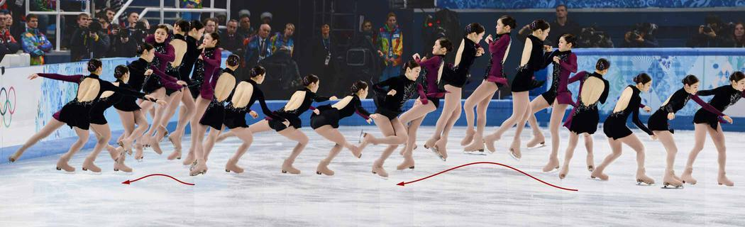
Versioned objects
We configure the object store to track versions. put creates a new version:
key: The object store always tracks information on a per-object basis
version-number: Just an integer
time: If the object itself lacks a timestamp, we just use “platform” time.
Now get can lookup most current version, or a specific one, even by time.
The object store is optimized to leverage non-volatile memory hardware.

Slide 37
Sequences of versions
With concurrent applications, you could worry that someone will do a get, then compute a new version, then put. But if some other process simultaneously does the same thing, one could overwrite the other.
In cput is a in the object store to address this kind of race condition. If an update races occurs, cput “fails” so that you can repeat the get and try again. You get consistency without locking.
Notes:
With versions people sometimes worry about transactions that do a get, think about it, then write an update. You can run into conflicts if somehow two processes try to update the same (key,value) version.
One option is to use locking if that would be a risk, but locking can slow things down.
So in Derecho’s object store we offer a conditional put that only updates a version if the correct prior version is still loaded. If someone else updated it while you were thinking, the conditional put fails (“sorry, version 17 is not the most current one”) and you can retry.
The version numbering is implicit (a header field associated with the value – get fills it in initially, and then cput checks that the version currently in the store matches what get previously fetched. For cases where conflicts would be rare you can avoid locking entirely and still be certain to get consistency.

Slide 38

Storing deltas
Existing DHTs lack support for versioned data.
We implemented a highly optimized versioned data structure
We implement a temporal index, and cache frequently accessed data.
A server still manages a map (since many keys map to it), but you can
think of the values for a specific key as being versioned.
Sometimes deltas are more efficient. If you have a function to compute
the delta, we won’t even create a new version unless you tell us to.
Values (or deltas) are saved on NVMe & replicated for fault-tolerance.
Notes:
This is just a slide on a question of efficiency.
Sometimes a delta is MUCH smaller than the versions themselves would be.

Slide 39
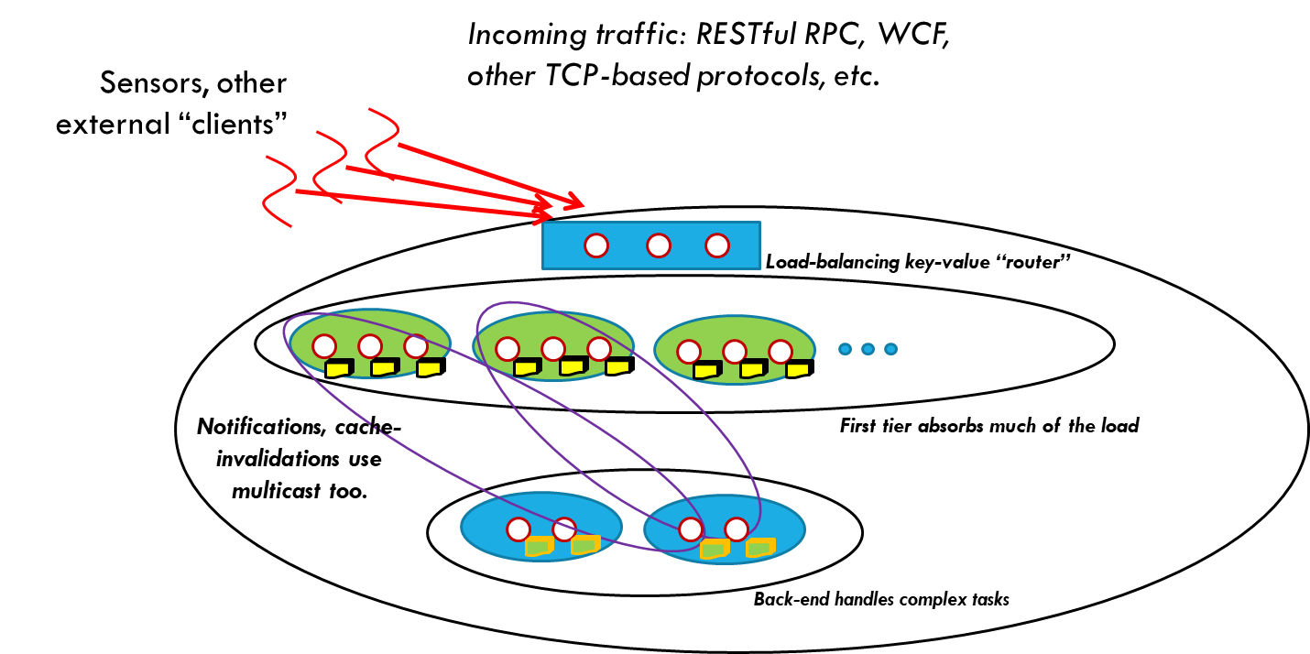
Object store as a file system
A file system is really an abstraction over a block store.
We plan to offer the Ceph object-oriented enhanced Posix API.
Here we configure the object store to be versioned and persistent.
Paxos for fault-tolerant updates, guaranteeing consistency.
This will offer back-compatibility, but for peak speed users should still use put/get/watch
Notes:
Once you have an object store you can turn it into a file system very easily by layering a file system API over the object layer.

Slide 40
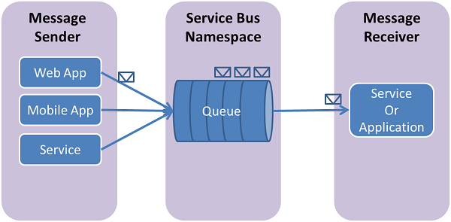
Object store as a “bus”
We can implement “publish” using put.
Acts as a message bus in the non-versioned case
Acts as a message queue in the versioned mode.
… and we can support “subscribe” using watch
Thus the object store can support pub-sub APIs such as the OMG DDS specification, Kafka, OpenSplice, etc. We can also offer message queuing APIs such as the Azure or AWS queuing services.
Notes:
Or a message bus (publish-subscribe system)

Slide 41
Stateful or Stateless?
Configured to not store anything, we get a pure notification, sometimes called “topic-based publish-subscribe.”
Configured to store the most recent value, a new subscriber can see the most recent posting, then gets notifications for updates.
Configured to track versions, we have a true “queuing” service, acting like a mailbox. A subscriber can replay old data, or we could use replay as a debugging/auditing tool. But the object store has a truncate API that can be used to force it to discard old data.

Slide 42
Some Performance Graphs
From our TOCS submission

Slide 43
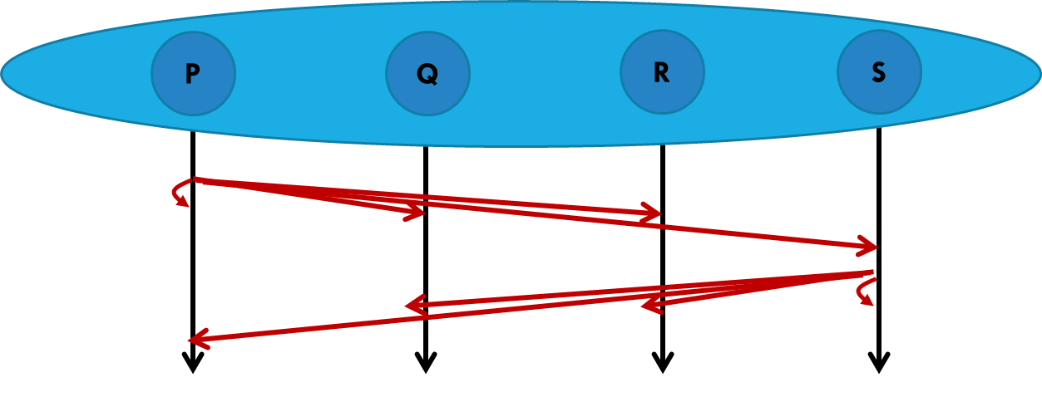
Derecho: small messages
Mellanox 100Gbps RDMA on ROCE (fast Ethernet)
100Gb/s = 12.5GB/s
Notes:
We can do lots of small updates per second. This shows a group of some size (X axis), and how many updates per second can be done (Y axis). Red is for “everyone is issuing updates”.
Blue for “half of them are doing updates”.
Green is “all updates originate in process 0”
The messages are tiny because this is the worst case for overheads.

Slide 44
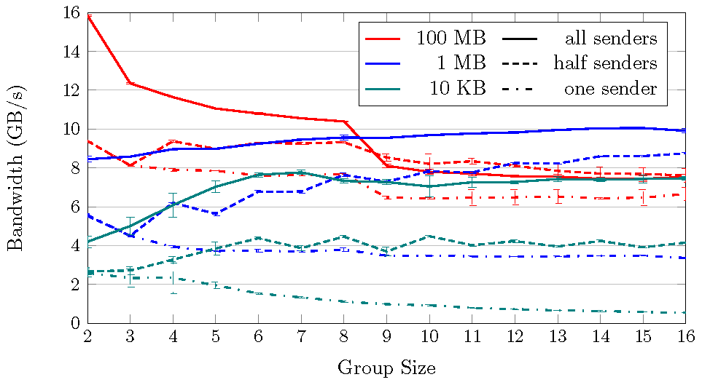
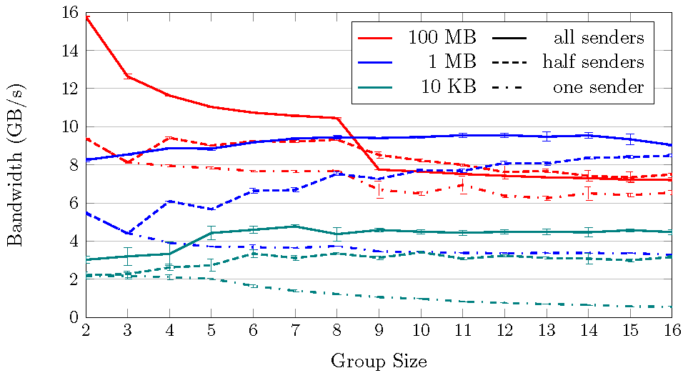
Derecho:
Large messages
Derecho can make 16 consistent replicas at 2.5x the bandwidth of making one in-core copy
Mellanox 100Gbps RDMA on ROCE (fast Ethernet)
100Gb/s = 12.5GB/s
Raw RDMC is faster, but performance loss is small
Raw RDMC is faster, but performance loss is small
RDMC: our cheapest 1:K reliable RDMA send Derecho Atomic Multicast (Vertical Paxos)
memcpy (large, non-cached objects): 3.75GB/s
Notes:
Here we look at bandwidth rather than events per second, but in a similar way. The colors represent object sizes now, but we still have a line for all issuing updates, then half, then one does the updates. Red is a video (100MB), blue is a photo (1MB), green is a web page (10KB).
On the left we see a simple reliable multicast on RDMA. On the right, same setup but now with super strong “Paxos” guarantees. They look similar: Derecho didn’t slow down much, except for the smallest message size.

Slide 45
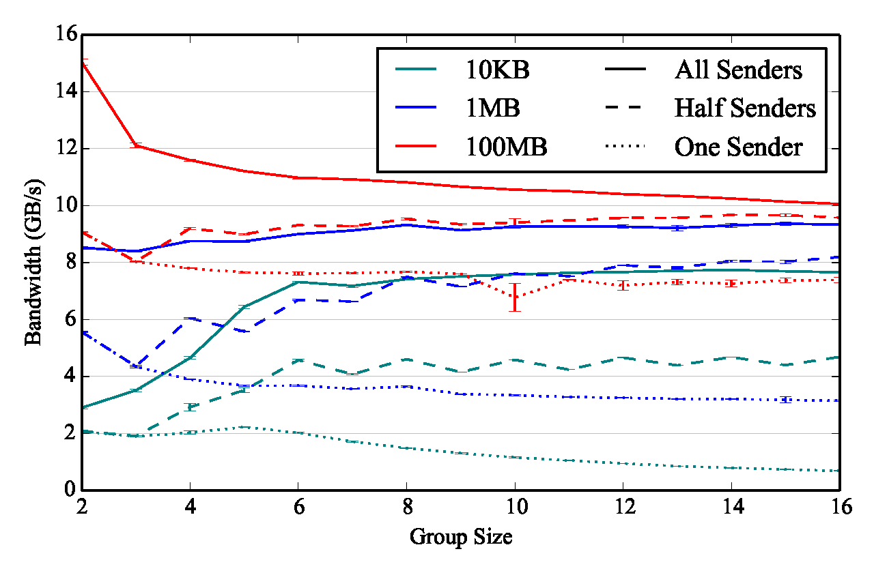
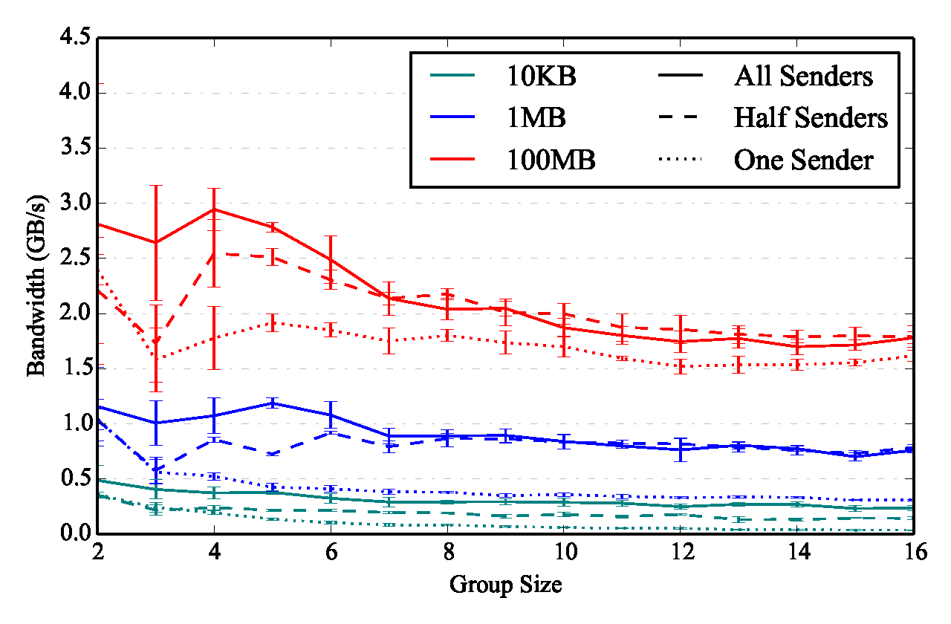
RDMA versus TCP: RDMA is 4x Faster
Derecho Atomic Multicast: 100G RDMA Derecho on TCP, 100G Ethernet
Notes:
With RDMA we do best, but even with just TCP we do very well.

Slide 46
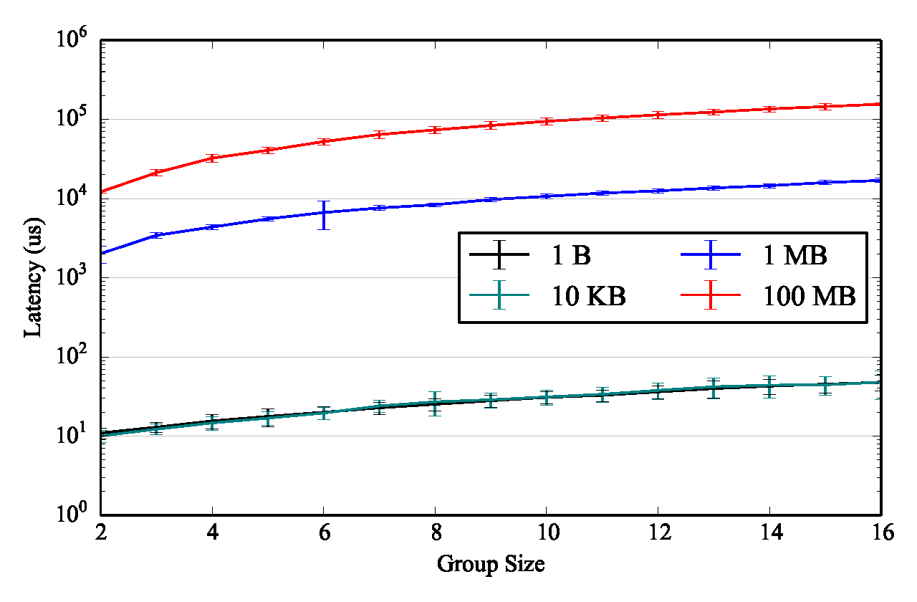
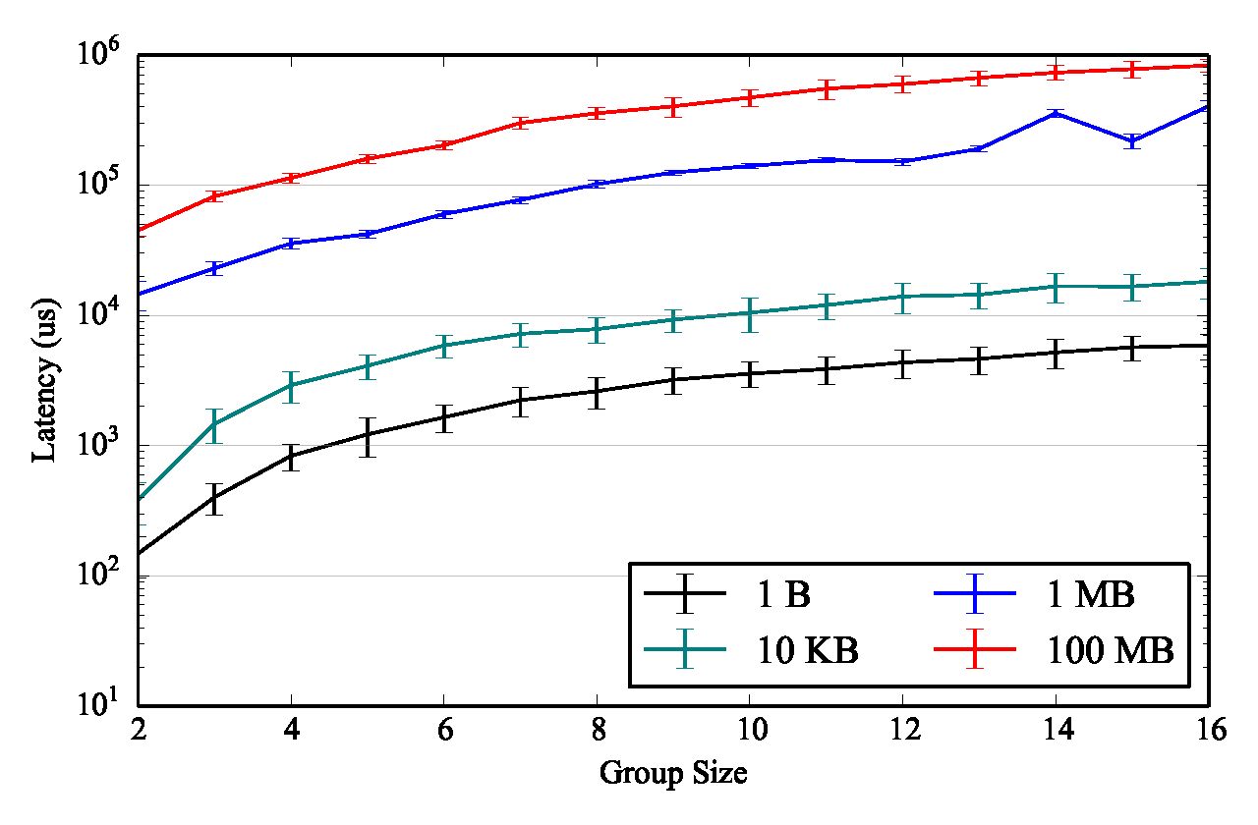
Latency: TCP is about 125us slower
Derecho Atomic Multicast: 100G RDMA Derecho on TCP, 100G Ethernet
Notes:
This time we look at delay from when a message is sent to when it has been fully delivered, in microseconds (us).

Slide 47

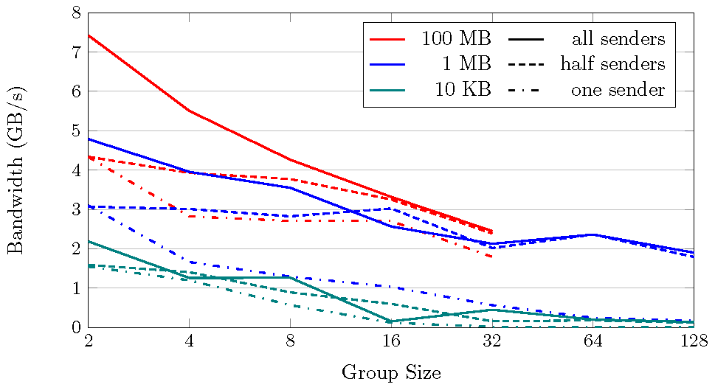
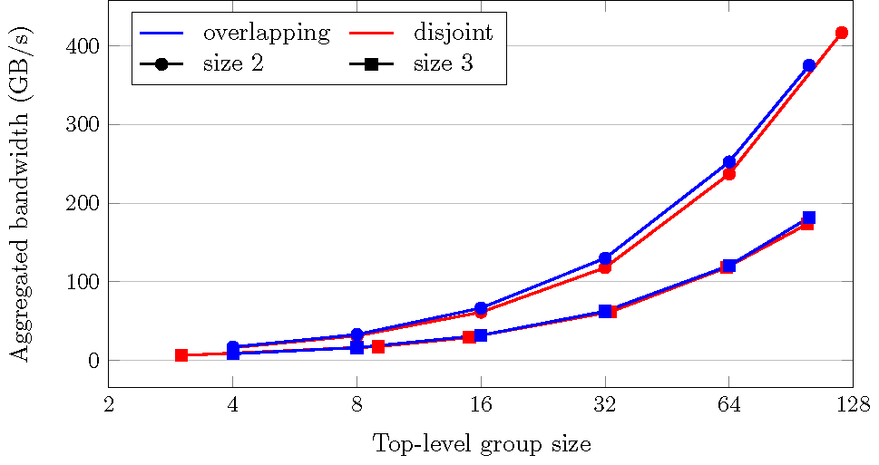
Derecho: Scaling (56Gb/s RDMA)
With lots of small groups we see linear capacity growth
Large groups scale while maintaining a substantial percentage of their peak bandwidth
Large Group of Size N (2…128) Broken into Shards of size 2 or 3
limit was memory for buffering Linear Aggregate Throughout
Notes:
Of course sharded systems have lots of processes but in shards of size 2 or 3. So we set that case up (we even considered setups with overlapping shards). We end up with insanely high “total work capacity” that increases linearly with the number of shards – we had to use this log-normal graph format or the graph is illegible.
So: “the capacity of a sharded system is just staggering.”
On the left we also looked at replication in really large groups, with up to 128 members (in other studies we pushed out to 1024 members). The system scales super well. (The video experiment ran out of DRAM buffering space in groups of size bigger than 32 members, because it needed one buffer per active sender, and 64 x 100MB is 6.4Gb, but our nodes were limited to 6GB of DRAM memory per process.)

Slide 48
Volatile<T> Persistent<T>
Performance is limited by the peak bandwidth possible with the SSD devices on our cluster…
Our (fairly old, slow) SSDs “maxed out”.
Derecho’s protocols are not a limiting factor.
Ramfs turns out to do several memcpy operations, and this limits performance
Notes:
With versioned data persisted to storage, the speed of the storage medium limits us.

Slide 49
Object Store: Versioned Takeaways
… in both cases, the storage medium was the limiting factor
Derecho can deliver bytes far faster than RamDisk or SSD can soak them up, so performance looks flat.
Note: In this mode, Derecho is the world’s fastest durable Paxos!

Slide 50
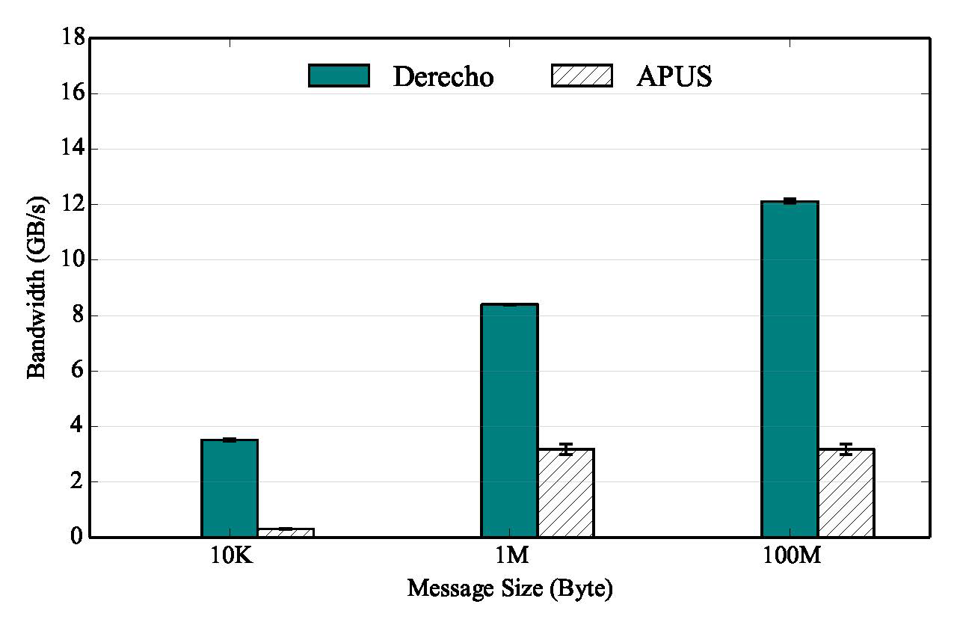
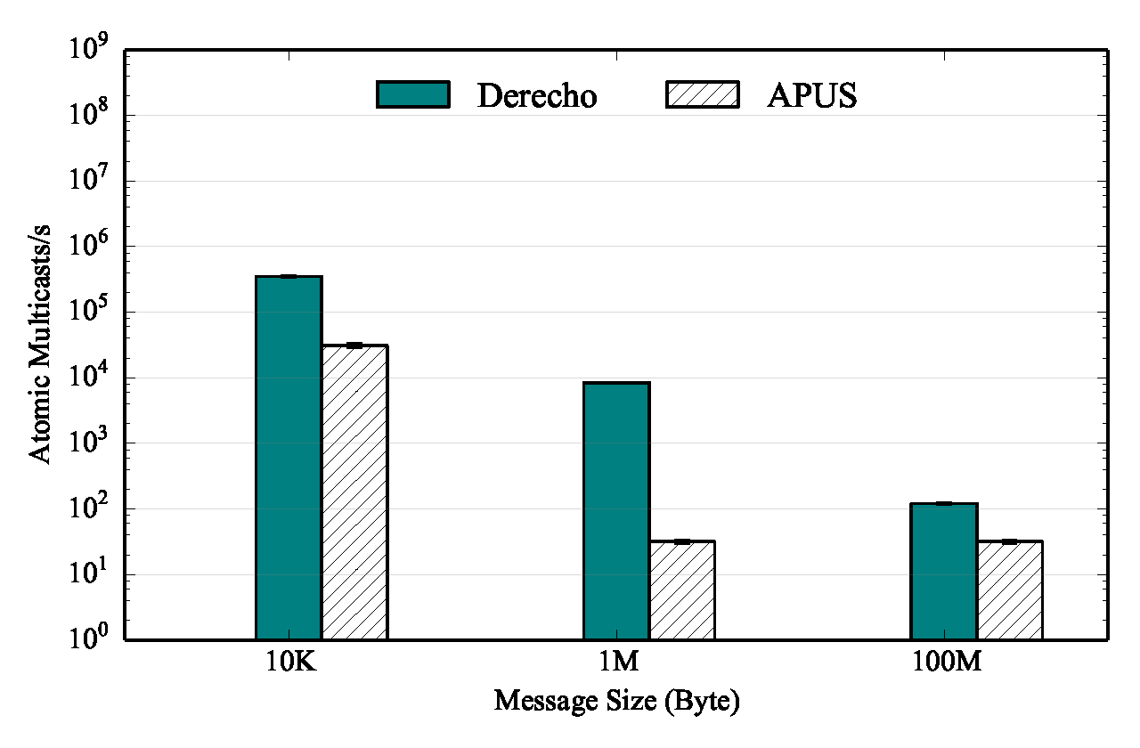
Derecho VS APUS (RDMA Paxos), N=3
Notes:
We blow APUS away in all cases. It was the previous record holder. (Higher is good)

Slide 51
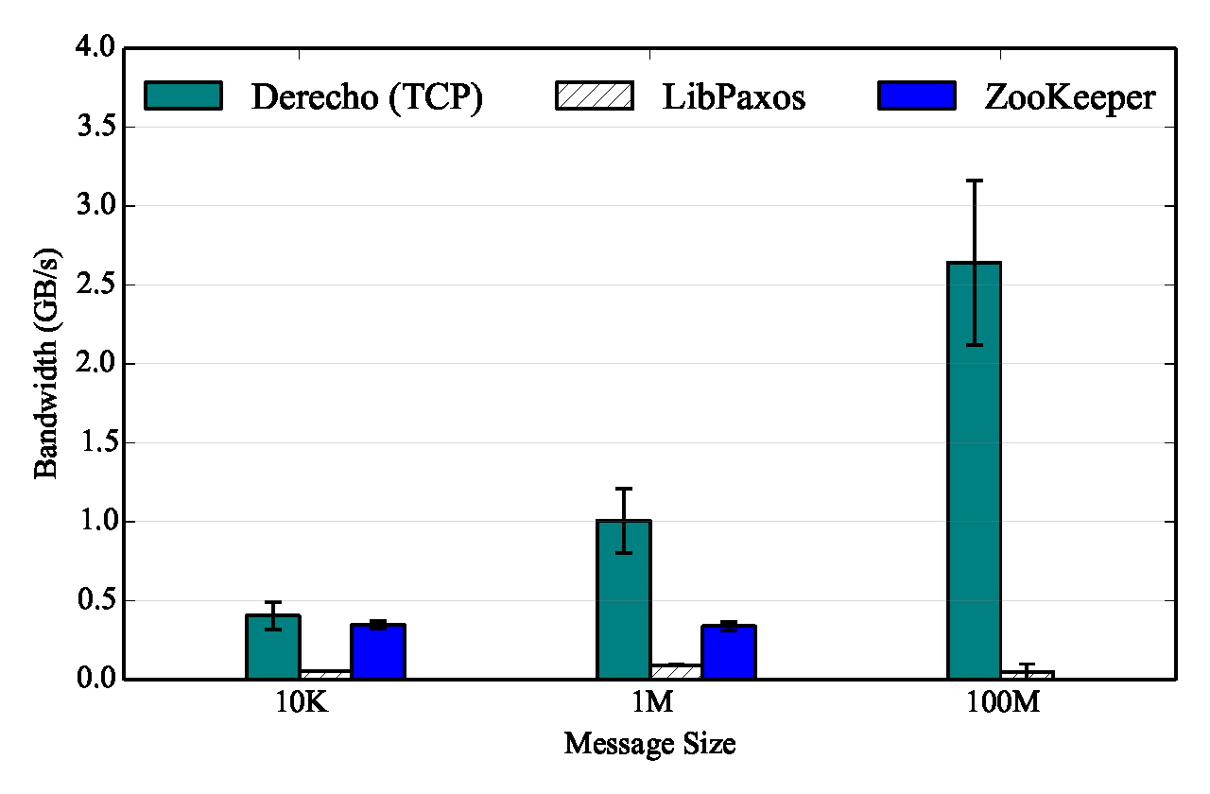
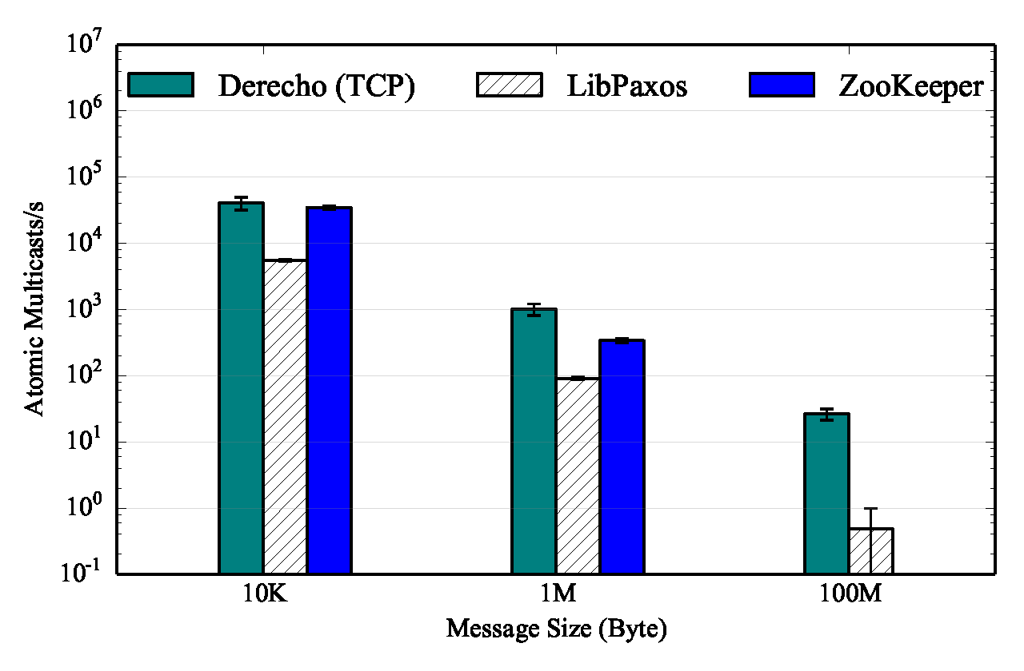
Derecho VS LibPaxos, ZooKeeper, N=3
(all three configured for TCP only)
Notes:
And we cream Zookeeper and LibPaxos to such a degree that it seems embarrassing, except in one specific case, where Zookeeper is nearly keeping up (10K messages/s). This is Derecho on TCP, though – we would have been 4x or 5x faster on RDMA, but Zookeeper can’t run on RDMA, so comparison would have been unfair.

Slide 52
Conclusions
Derecho is up and running solidly, and can be used on pure TCP systems as well as on RDMA-enhanced ones. Our project site and collaboration hub is GitHub.com/Derecho-Project/.
The new object store offers a very simple and flexible C++ API. It is gradually replacing FFFS_{v1}.
These are good examples of Lamport’s ideas applied in practice.

