Slide 1
CS 5412/Lecture 2 Elasticity and Scalability
Ken Birman
Spring, 2019

Slide 2
Concept of Elastic scalability
Not this kind of elastic!
The sheer size of the cloud requires a lot of resources. These are allocated elastically, meaning “on demand”.
Size: A company like Facebook needs to run data centers on every continent, and for the United States, has four major ones plus an extra 50 or so “point of presence” locations (mini-datacenters).
A single data center might deal with millions of simultaneous users and have many hundreds of thousands of servers.
Notes:
For many people, learning about the cloud feels like a leap into the void.
Many things act very differently than you might expect because the scale at which our solutions need to be used is just so immense. So much of what you learned in computing doesn’t apply “easily”.
What we will discover is that your knowledge really does apply in the cloud, but simply that it takes a little while to learn the right mental models for the larger-scale cloud computing styles and approaches that work best.

Slide 3
Load swings are inevitable in this model
People sleep in Seattle while they are waking up in New York.
People work in Mumbia when nobody is working in the USA
So any particular datacenter sees huge variation in loads.

Slide 4
Diurnal and seasonal Load Patterns
The cloud emerged for tasks like Google search and Amazon eCommerce, but people sleep. So there are periods of heavy human cloud use, but also long periods when many human users are idle.
During those periods the cloud wants to reschedule machines for other tasks, like rebuilding indices for tomorrow morning, or finalizing purchases.
So the cloud needs a programming model in which we can just give the service more resources (more machines) on demand.
Notes:
We will see some of these patterns a few slides into the lecture

Slide 5
Should these elastic services be built as one big thing, or many smaller things?
Much like our “how to implement a NUMA server topic”
Except here, we are scaling across nodes on a data center.

Slide 6
Single big service performs poorly… why?
Until 2005 “one server” was able to scale and keep up, like for Amazon’s shopping cart. A 2005 server often ran on a small cluster with, perhaps, 2-16 machines in the cluster.
This worked well.
But suddenly, as the cloud grew, this form of scaling broke. Companies threw unlimited money at the issue but critical services like databases still became hopelessly overloaded and crashed or fell far behind.

Slide 7
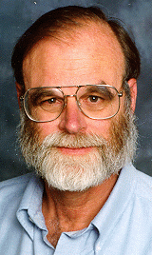
Jim Gray’s Famous Paper
At Microsoft, Jim Gray anticipated this as early as 1996.
He and colleagues wrote a wonderful paper from their insights:
Basic message: divide and conquer is really the only option.
Jim Gray (Jan 1944 – Jan 2007)
The dangers of replication and a solution. Jim Gray, Pat Helland, Patrick O'Neil, and Dennis Shasha. 1996. In Proceedings of the 1996 ACM SIGMOD Conference. pp 173-182. DOI=http://dx.doi.org/10.1145/233269.233330
Notes:
In fact, almost nothing scaled. Jim studied this and tried to understand root causes.

Slide 8
How their paper approached it
The paper uses a “chalkboard analysis” to think about scaling for a system that behaves like a database.
It could be an actual database like SQL Server or Oracle
But their “model” also covered any other storage layer where you want strong guarantees of data consistency.
Mostly they talk about a single replicated storage instance, but look at structured versions too.
Notes:
Even with a pencil and paper analysis, he and his colleagues identified a huge issue!

Slide 9
The core issue
The paper assumes that your goal is some form of lock-based consistency, which they model as database serializability (in CS5412 we might prefer “state machine replication”, but the idea is similar).
So applications will be using read locks, and write locks, and because we want to accommodate more and more load by adding more servers, the work spreads over the pool of servers.
This is a very common way to think about servers of all kinds.
Notes:
He posed his analysis as an asymptotic cost question, like in an algorithms class where you study complexity. But here we have more moving parts.

Slide 10
Their setup, as a picture
Applications using the database: client processes
During the run, T concurrent requests are issued. Here, 3 are running right now, but T could be much larger.
The database
Notes:
The model starts with clients talking to a database. There are T transactions that need to run. They won’t run all at the same time, of course. Here, three are active.

Slide 11
Their Basic setup, as a picture
Applications using the database: client processes
During the run, T concurrent requests are issued. Here, 3 are running right now, but T could be much larger.
Server 1
Server 2
Server N
For scalability, the number of servers (N) can be increased
Notes:
And there are N servers. We want to have N x the capacity, so the goal is to scale well and be able to throw more servers at the problem if the system overloads.

Slide 12
What should be The goals?
A scalable system needs to be able to handle “more T’s” by adding to N
Instead, they found that the work the servers must do will increase as T⁵ Worse, with an even split of work, deadlocks occur as N^{3,} causing feedback (because the reissued transactions get done more than once).
Example: if 3 servers (N=3) could do 1000 TPS, with 5 servers the rate might drop to 300 TPS, purely because of deadlocks forcing abort/retry.

Slide 13
Why do services slow down at scale?
The paper pointed to several main issues:
Lock contention. The more concurrent tasks, the more likely that they will try to access the same object (birthday paradox!) and wait for locks.
Abort. Many consistency mechanisms have some form of optimistic behavior built in. Now and then, they must back out and retry. Deadlock also causes abort/retry sequences.
The paper actually explores multiple options for structuring the data, but ends up with similar negative conclusions except in one specific situation.
Notes:
Basically, you see higher and higher rates of transactions banging into each other and either waiting (which can be slow), or deadlocking (which causes a rollback), or in some “optimistic” scenarios, aborting.
The rate of growth of overhead is a polynomial, like the number of servers or the number of transactions raised to an exponent like 2 or 3.
Now this may sound very database-specific but in fact the same issues arise in any consistent cloud service because Jim’s model was so general it could apply even if you have never thought about databases in your life!

Slide 14
What Was that one good option?
Back in 1996, they concluded that you are forced to shard the database into a large set of much smaller databases, with distinct data in each. Jim set out to do this for a massive database of astronomy data.
By the time he died in 2007, Jim had shown that for every problem he ran into, it was possible to devise a sharded solution in which transactions only touched a single shard at a time.
In 1996, it wasn’t clear that every important service could be sharded. By the 2007 period, Jim had made the case that in fact, this is feasible!
Notes:
What they argue for has a ton in common with our key-value μ-service story from the other day. The only real change is that in Lecture 2, we said “replicate to make your shard more reliable” but didn’t say how.
Jim is arguing for a form of consistent replication in which the replicas definitely follow the identical histories. There are many terms for this, and we will see some later – state machine replication is perhaps the most general one.
Transactional databases with replication at a sharding level work EXACTLY this way. The terminology may sound different but the ideas are the same.
But one thing to realize is that in Jim’s world we often have long transactions that do many things and end with a 2-phase commit. In the cloud, updates that perform just a single operation on a single shard would be far more common, like an event handler fetching some data, modifying it, and writing it back.

Slide 15
Sharding: This works… but carefully
A transaction
A read or write to some (key,value) tuple. Here, Hash(key)%K=1
A shard with 2 replicas handling Hash(key)%K=2
Sharded storage μ-service with 2 servers per shard
K shards
We will often see this kind of picture. Cloud IoT systems make very heavy use of key-based sharding. A (key,value) store holds data in the shards.

Slide 16
Sharding: This works… but carefully
Each transaction accesses just one shard
Storage μ-service
If a transaction does all its work at just one shard, never needing to access two or more, we can use state machine replication to do the work.
No locks or 2-phase commit are required. This scales very well.

Slide 17
DefN: State Machine Replication
This is a model in which we can read from any replica.
To do an update, we use an atomic multicast or a durable Paxos write (multicast if the state is kept in-memory, and durable if on disk).
The replicas see the same updates in the same sequence and so we can keep them in a consistent state. We package the transaction into a message so “delivery of the message” performs the transactional action.
Notes:
With state machine replication we don’t have full transactions, so Jim’s issues don’t arise: there aren’t any locks, or any notion of deadlock/abort/retry.

Slide 18
Sharding fails for arbitrary transactions
These transactions read and write multiple shards and need atomicity.
Storage μ-service
Transactions that touch multiple shards need locks and 2-phase commit. Jim Gray’s analysis applies: as we scale this case up, performance collapses.

Slide 19
Example: A μ-service for caching
Let’s look closely at the concept of caching as it arises in a cloud, and at how we can make such a service elastic.
This is just one example, but in fact is a great example because key-value data structures are very common in the cloud.
Notes:
So let’s look at how companies like Facebook use elastic caching to cache binary large objects: blobs.

Slide 20
Accessing Sharded Storage
Key=Birman
Value=
Hash(“Birman”)%100000
Each machine has a set of (key,value) tuples stored in a local “Map” or perhaps on NVMe
In effect, two levels of hashing!
Notes:
This is how a distributed cache might be implemented. This example caches data items in a single process (each blue circle is one process on some server), so it won’t tolerate failures: if a single cache element were to get shut down for some reason, we would lose the associated shard – a portion of the cache would go cold.
At FB, even a brief glitch can put back-end services under load spikes, so actually they compute the likely frequency of such events. Only a few would happen per day. Yet this is occurring at massive scale, and even a few per day may be enough that you wouldn’t want that frequency of cache failures.

Slide 21
Many systems use a second copy as a backup, for higher availability
Key=“Ken”
Value=
Hash(“Ken”)%100000
These two machines both store a copy of the (key,value) tuple in a local “Map” or perhaps on NVMe
In effect, two levels of hashing!
Notes:
So one possible answer is to replicate the server handling each shard. Here we have two replicas per shard. In fact this model is common. Sharding with two replicas is very common, and sometimes for especially critical data we might have three copies. Even more would be used if we had a hot spot and wanted to spread the load, but not all key-value sharding solutions have that degree of sophistication.
If the management layer understands the fault-tolerance model and replication pattern, it can avoid shutting down both replicas simultaneously. So the owners of the FB cache would need to understand the management subsystem and configure it appropriately. Then their cache implementation would need to include a replication mechanism.
These aren’t such easy steps, which is one reason people tend to use existing μ-services rather than casually building their own: they could certainly implement a key-value cache, but would have way more trouble adding all these features needed in really serious deployments.

Slide 22
Terminology
This is called a “key value store” (KVS) or a “distributed hash table” (DHT)
Each replica holds a “shard” of the KVS: a distinct portion of the data.
Hashing is actually done using a cryptographic function like SHA 256.
Notes:
On this question of hashing: In cloud computing, most companies favor SHA-256 (followed by a simple modulus operation) because SHA-256 is fast to compute but also very random looking. Not all hashing methods are good at really spreading data around in a uniform way.
Even so, people worry about hot spots. A common mistake is to imagine that random hashing somehow eliminates them, but random fluctuations in placement could cause a hot spot. Or some key might simply be far more popular than other keys, so that even with an even distribution of items we get a skewed load pattern.
One solution is to have 2N servers but maybe 8N shards, so each server ends up owning 4 “mini-shards”. This way if some shards host popular keys or something, the odds of being an unlucky server with an unfair load are a bit lower.

Slide 23
Elasticity Adds a Further dimension
If we expect changing patterns of load, the cache may need a way to dynamically change the pattern of sharding.
Since a cache “works” even if empty, we could simply shut it down and restart with some other number of servers and some other sharding policy. But cold caches perform very badly.
Instead, we would ideally “shuffle” data.

Slide 24
Elastic shuffle
Perhaps we initially had data spread over 4 shards.
We could drop down to 2 shards during low-load periods. Of course half our items (hopefully, less popular ones) are dropped.
Shard A
Shard B
Shard C
Shard D
Notes:
Elasticity forces us to think about what happens if the key-value sharded service needs to drop down from say 8 members to 4 or 2, perhaps at night.
This would be useful because the cloud could borrow the machines it frees up for other uses, like recomputing indices or product recommendations.

Slide 25
Elastic shuffle
Here, we shuffle data to map from 4 shards down to 2.
Shard A
Shard B
Shard C
Shard D
Shard A’
Shard B’
… later, we could shuffle it again to elastically expand the cache.
Notes:
A really high-quality μ-service cache would understand the elasticity event and would make deliberate choices of which cached items to retain in the new set of shards.

Slide 26
But how would other services know?
A second issue now arises: how can applications that use the cache find out that the pattern just changed?
Typically, big data centers have a management infrastructure that owns this kind of information and keeps it in files (lists of the processes currently in the cache, and the parameters needed to compute the shard mapping).
If the layout changes, applications are told to reread the configuration. Later we will learn about one tool for this (Zookeeper).
Notes:
OK, your program wants to do a “get” operation. Fine, a library implements it. But how does the library realize we just changed the server membership and sharding rule?
Systems like Azure and AWS use a service called Zookeeper for this.
We will learn about Zookeeper later but it would hold a file containing the μ-service members and also the policy. When changing the list, it would automatically notify current applications using the policy, and they would reread the list.
Things like this make the μ-service harder to implement, but more effective in real production use.

Slide 27
Typical DHT API?
The so-called MemCached API was the first widely popular example.
Today there are many important DHTs (Cassandra, Dynamo DB, MemCached, and the list just goes on and on).
All support some form of (key,value) put, get, and (most) offer watch.
Some hide these basic operations behind file system APIs, or “computer-to-computer email” APIs (publish-subscribe or queuing), or database APIs.
Notes:
Get and put work as you would expect.
The watch API will notify you if an item is updated. Maybe not so useful for a blob service, but in other situations watch can be very valuable.

Slide 28
Use case: FB Content Delivery Network
Facebook’s CDN is a cloud-scale infrastructure that runs on point of presence datacenters in which key-value caches are deployed.
Role is to serve videos and images for end-users. Weak consistency is fine because videos and images are immutable (each object is written once, then read many times).
Requirements include speed, scaling, fault-tolerance, self-management
Notes:
The rest of the lecture focuses on how Facebook does image caching (and now, video caching too). Huge thing for them since Facebook is at global scale.
The material is based on the following paper:
An Analysis of Facebook Photo Caching.Qi Huang, Ken Birman, Robbert van Renesse, Wyatt Lloyd, Sanjeev Kumar, Harry Li. The 24th ACM Symposium on Operating Systems Principles (SOSP, 2013). November1- 4, 2013, Pittsburgh.
We expect you to read this paper, because it covers the core material from this lecture. In general, readings are just recommendations, but anything specifically covered in lecture could appear on the prelim or even come up during project demos.

Slide 29
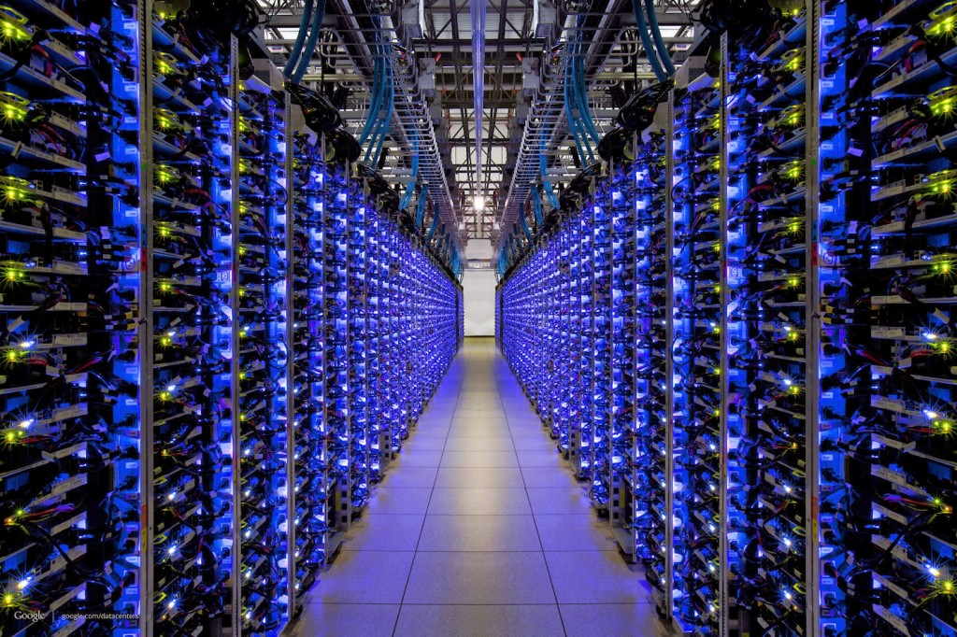
The FB BLOB cache is part of A hierarchy deployed at global scale…
Point of Presence mini-datacenters
Fully Capable datacenters
We think of Facebook as havine one core database or knowledge repository… but in fact the data is replicated
Notes:
The first thing to appreciate is that like any cloud-scale solution, Facebook’s caching infrastructure is hierarchical and “georeplicated”.
Facebook has a hierarchy of data centers: big ones that we can think of as serving data from a core database and smaller ones that mostly just are running the cache service.
The image shows a core database. This is actually a replicated data set shared among the Haystack servers (each has its own copy). As such, all of Facebook knows that there are several “last resort” systems with copies of the critical data. But unlike what the picture might seem to suggest, the core database isn’t in one place. It actually is duplicated at multiple Haystack locations, each with its own full replica.

Slide 30
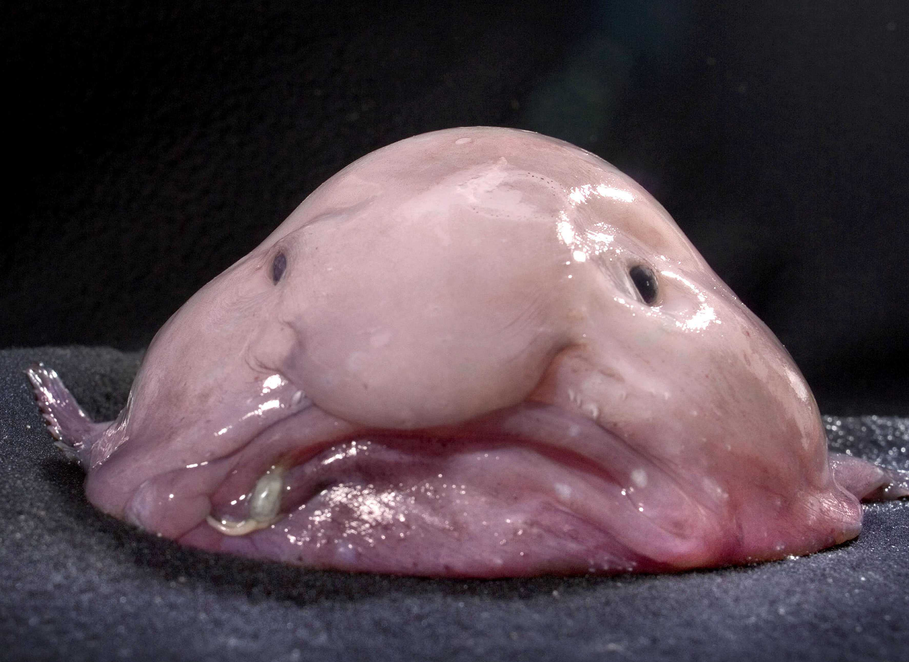
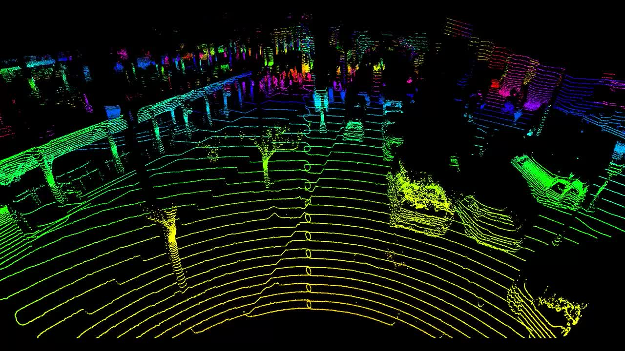
… the data is just “Blobs”
Facebook image data is stored in “blobs”: Binary Large Objects
This includes original images, videos
Resized versions, and ones with different playback quality
Versions that have been processed to tag people, augmented reality
Notes:
The actual content would be photos and videos. Blobs.
But any single blob can exist in multiple versions: we sized for various screens or different playback quality, or perhaps edited in various ways (those are “effects” on the left, not the real data). So from a single original blob in its full resolution there can be various derived versions that were computed by applying some recipe to the original raw data.
This will be important in the remainder of the lecture because it costs a surprising amount of compute time to do some of these operations. Facebook would rather not do them more than once.

Slide 31
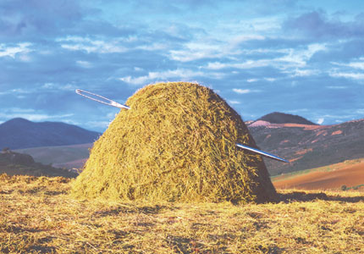
Haystack
Holds the real image and video data in huge “film strips”, write-once.
Designed to retrieve any object with a single seek and a single read. Optimized for SSD (these have good transfer rates but are best for write-once, reread many loads, and have a long delay for starting a write).
Facebook doesn’t run a lot of copies
One on the West Coast, one more on the East Coast
Each has a backup right next to it.
Main issue: Haystack would easily get overloaded without caching
Notes:
Think of Haystack as the ultimate photo album.
But it is at risk of being overloaded, so the single overarching goal is to try to serve all requests from copies of the photos, not the originals.

Slide 32
A cache for blobs?
$$$
Goal: a μ-service we can run anywhere, and that can adapt in size as loads vary.
The keys would be photo or video id’s.
For each unique blob, FB has a special kind of tag telling us the resized dimensions of the particular instance we are looking at.
Resizing takes time and requires a GPU. So FB wants to avoid recomputing them.
Notes:
The version issue is that we need to resize the image or video depending on the screen. FB does this work because otherwise your phone battery runs down too fast.

Slide 33
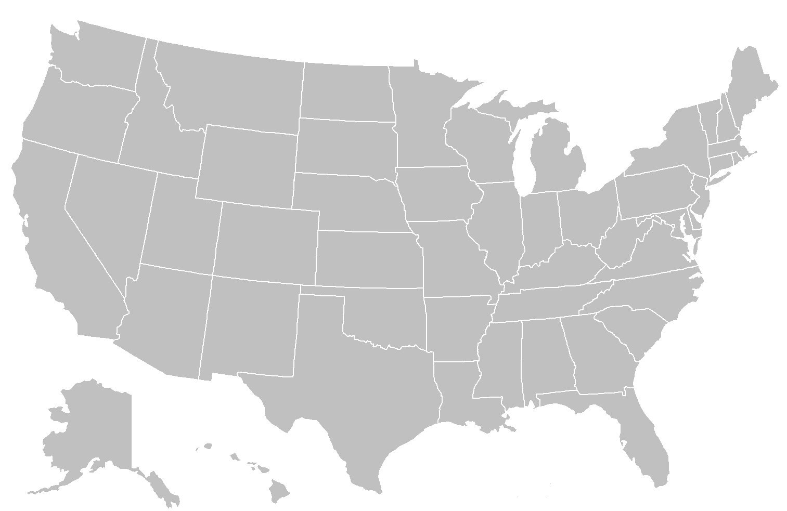
True data center holds the original photo in Haystack
First, FB fetches your feed. This will have URLs with the image ID embedded in them. The browser tells the system what size of screen it has.
Big Datacenter
Client
Facebook Edge Cache
Browser
Cache
Origin Cache
Haystack
If you’ve recently seen the image, Facebook finds the blob in a cache on your computer
Notes:
So here’s our picture at national scale.

Slide 34
With a UID and a target size, we can search for the blob in the nearest point of presence cache.
Big Datacenter
Client
Facebook Edge Cache
Browser
Cache
Origin Cache
Haystack
If the image wasn’t found in your browser cache, maybe it can be found in an “edge” cache
Notes:
So how does the caching structure work? Your computer has a cache right on your iphone. This is the browser cache.
Then we could go via Akamai (a big cache run by a caching company), or directly to Facebook. And Akamai itself talks to Facebook. So in some sense all routes lead into Facebook, unless the image is found in one of those first caches.
Then we get the edge which is where Facebook does resizing. As you’ll recall, CS5412 is an edge computing class.
Deeper inside is the Haystack layer and its own caching.

Slide 35
Origin:
Coordinated
FIFO
Main goal:
traffic sheltering
Datacenter
Client
Facebook Edge Cache
Browser
Cache
Origin Cache
Haystack
In the limit, fetch from Haystack. It has a cache too
Cache layers
Notes:
The origin cache is close to Haystack. So even at the last hop we use caching.

Slide 36
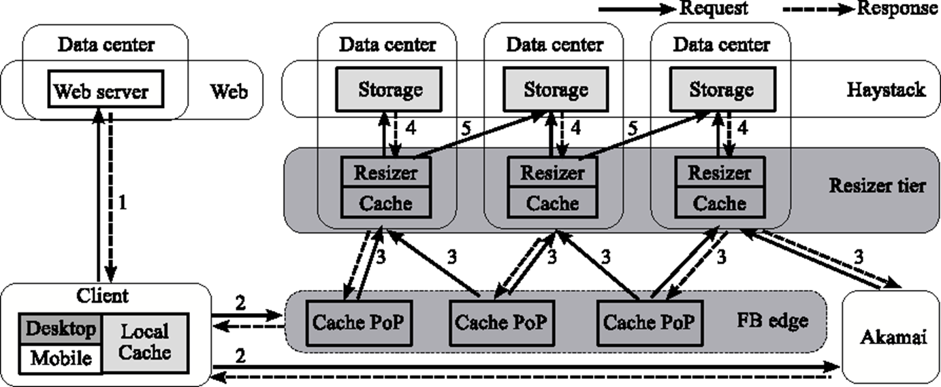
Architectural detail (Complex) Dark Gray: We instrumented it Pale Gray: We can figure out its behavior
Notes:
Our instrumentation lived in the dark gray places but we could deduce cache hits from the light gray ones.

Slide 37
Architectural detail (we weren’t able to instrument the pink part)
Notes:
We did our experiments during periods when Akamai wasn’t actually active, to make things a bit simpler.

Slide 38
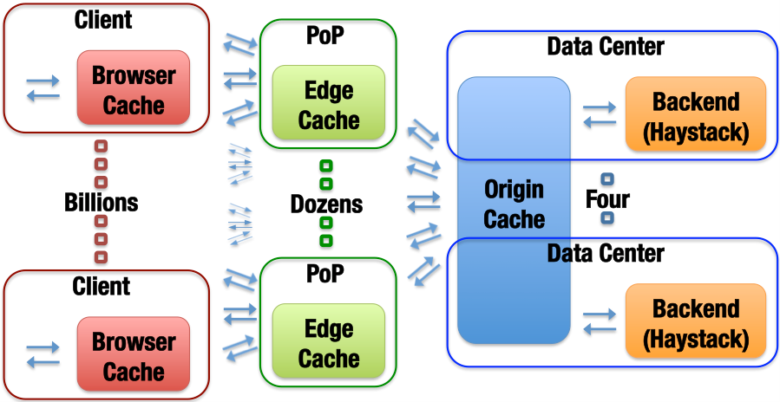
Blob-Serving Stack (the FB portion)
Notes:
Same structure, nicer image.

Slide 39
What we Observed
Month long trace of photo accesses, which we sampled and anonymized. Captures cache hits and misses at every level.

Slide 40
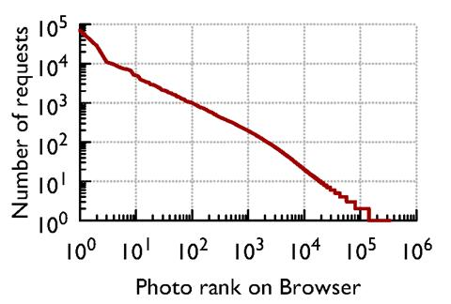
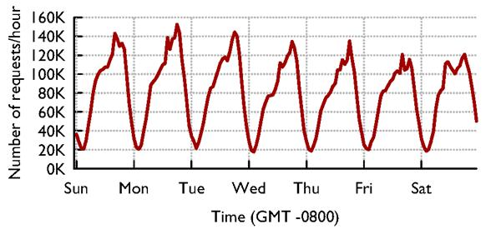
Caches see “circadian” Patterns
Accesses vary by time of day…
… and by photo: Some are far more popular than others

Slide 41
Photo cacheability by popularity
The main job of each layer is different.
This is further evidence that cache policy should vary to match details of the actual workload

Slide 42
GEO-Scale Caching
One way to do far better turns out to be for caches to collaborate at a WAN layer – some edge servers may encounter “suddenly popular” content earlier than others, and so those would do resizing operations first.
WAN collaboration between Edge caches is faster than asking for it from Haystack, and also reduces load on the Haystack platform.
Key insight: the Facebook Internet is remarkably fast and stable, and this gives better than scaling because the full cache can be exploited.
Notes:
Most people assume that fetching something from LA, if you live in Ithaca, is a stupid idea. Facebook’s Internet seems to work unexpectedly well!
For them, remote caches are close enough to be useful even cross country. And this gives a WAY bigger effective cache size.

Slide 43
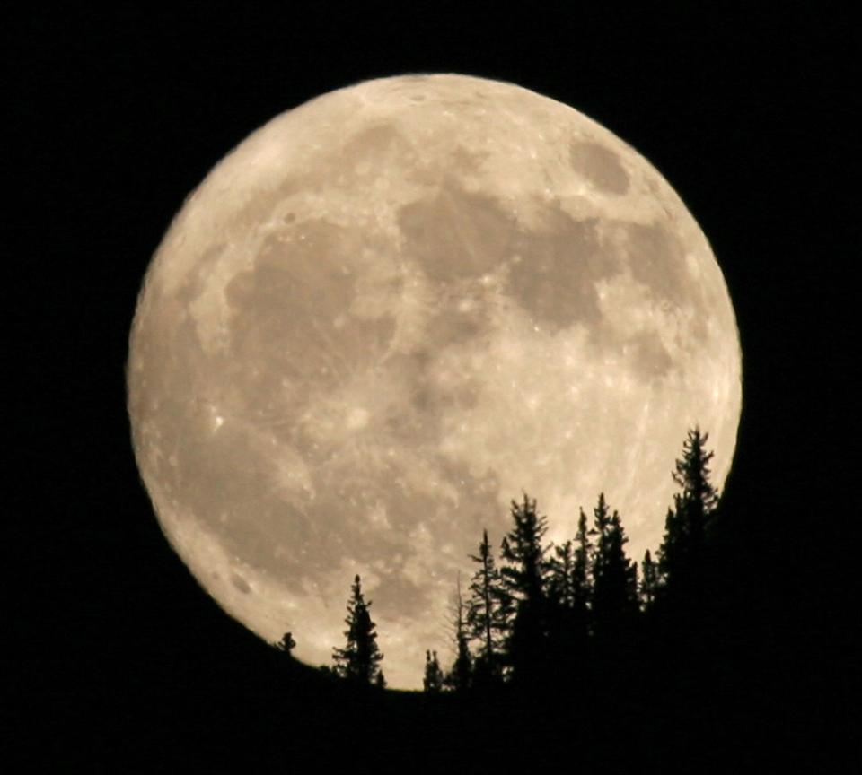
People are sleeping in Seattle
Remote fetch: cooperation between point-of-presence cache systems to share load and resources
People are having breakfast in Ithaca
In Ithaca, most of your content probably comes from a point of presence in the area, maybe the red one (near Boston)
But if Boston doesn’t have it or is overloaded, they casually reach out to places like Spokane, or Arizona, especially during periods when those are lightly loaded, like 5am PT!

Slide 44
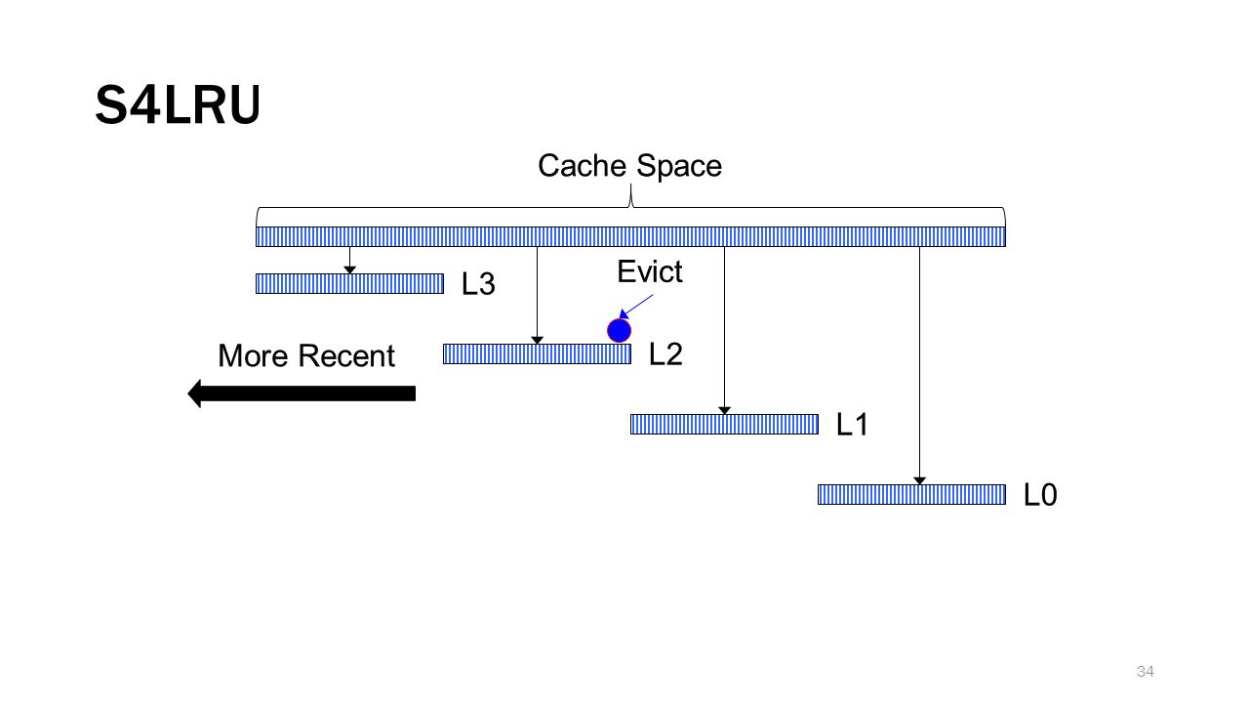
Cache retention/eviction policy
Facebook was using an LRU policy.
We used our trace to evaluate a segmented scheme called S4LRU
It outperforms all other algorithms we looked at
Notes:
The famous segmented LRU concept!
Each chunk kind of uses a different policy.
Think of the top chunk as being long-lived items that should stay in cache for a long time, and the bottom as a chunk for transient images needed just for a brief period.

Slide 45
Here we see that S4LRU is far better than normal LRU

Slide 46
So… switch to S4LRU, right?
They decided to do so…
Total failure!
Why didn’t it help?

Slide 47
S4LRU didn’t really work well!
It turned out that the algorithm worked well in theory but created a pattern of reads and writes that were badly matched to flash memory
Resulted in a whole two year project to redesign the “operating system” layer for big SSD disk arrays based on flash memory.
Once this change was made, S4LRU finally worked as hoped!
Notes:
S4LRU didn’t turn out to make efficient use of the hardware.
Core issue is like the NUMA thing from the last lecture: the hardware isn’t perfect and has limitations. S4LRU, used naively, has too much overhead. But with effort it was possible to invent a solution that uses S4LRU and also is hardware-friendly (uses the hardware closer to its sweet spot)

Slide 48
RIPQ: Key Innovations
Only write large objects to the SSD once: treats SSD like an append-only “strip of images”. Same trick was needed in Haystack.
SSD is quite good at huge sequential writes. So this model is good.
But how can they implement “priority”?
The cache is an in-memory data structure with pointers onto the SSD.
They checkpoint the whole cache periodically, enabling warm restart.
Notes:
The notion of ordering (priority, in the sense of “priority queue”) is important but they virtualize with one-level of indirection. The in-memory data structure, which they have a way to rebuild if the unit crashes and restarts, worries about ordering.
The actual workload seen by the SSD is in the form of huge segments that get written in one steady pass. They do garbage collect by rereading active data and then rewriting it, now and then, when a segment on SSD has lots of holes (no-longer-needed data that was previously cached but by now has been bumped from cache)
The bit I/O pattern becomes one of huge one-directional writes that treat the whole SSD like a massive tape drive. This works well.
Then the in-memory data structure has pointers to the SSD content (and to some stuff that is temporarily still in memory because it hasn’t yet been written).

Slide 49
RIPQ entries are pointers to SSD objects

Slide 50
Additional optimizations
They actually store data in long “strips” to amortize the access delay across a large number of reads or writes.
And they cache hot images, plus have an especially efficient representation of the lists of pointers (for the various levels of the cache)
All of this ensures that they run the SSD in its best performance zone.

Slide 51
RIPQ Has High Fidelity
Object-wise hit-ratio (%)
RIPQ achieves ≤0.5% difference for all algorithms
Notes:
Basically, they end up slightly cheating relative to LRU and GDSF but you won’t notice.

Slide 52
RIPQ Has High Fidelity
Object-wise hit-ratio (%)
+16%
+16% hit-ratio ➔ 23% fewer backend IOs
Notes:
… and those policies are worth using, because they do far better than FIFO (which happens to make great use of an SSD, but has this annoying tendency to dump things from the cache simply because they have been in it for a while, ignoring whether they are getting hits)

Slide 53
RIPQ Has High Throughput
Throughput (req./sec)
FIFO
RIPQ throughput comparable to FIFO (≤10% diff.)
Notes:
FIFO was ideal for SSD but had lousy cache hit behavior. Here we see that RIPQ has a nearly FIFO traffic pattern to the SSD even though it can support these policies with way better cache hit behavior.

Slide 54
What did we learn today?
A good example of a μ-service is a key-value cache, sharded by key.
The shard layout will depend on how many servers are running, and whether they are replicated. These are examples of configuration data.
Many μ-services are designed to vary the number of servers elastically.

Slide 55
More take-aways
Even a sharded cache poses questions about consistency.
In fact for a cache of images, CAP is a great principle.
But this doesn’t make the problem trivial, it just takes us to the next level of issues.

Slide 56
More take-aways
A company like Facebook wants critical μ-services to make smart use of knowledge about photo popularity, and about patterns of access.
With this information it can be intelligent about what to retain in the cache, and could even prefetch data or precompute resized versions it will probably need.
Fetching from another cache, even across wide-area links, is advantageous.

Slide 57
Conclusions?
In a cloud setting, we need massive scalability. This comes from hierarchy, replication and sharding. But we also need to match solutions to the setting.
Sharing in a (key,value) model is a great way to deal with scale. But that only gets you to the next set of questions. At cloud-scale nothing is trivial!
Facebook’s caching “product” is an amazing global system. Even if it was based on simple decisions, the global solution isn’t simple at all!
Notes:
By now I’m hoping you are already seeing a pattern. In lecture 1 we started to think about NUMA and in no time realized that effective use of the hardware forces us to adopt a container model.
Today we looked at caching and realized that doing a professional job even for a simple key-value sharding layer is tricky! A professional-quality μ-service would get the details right but would be hard to build. A less professional version might be ineffective because it wouldn’t be elastic, or maybe it would glitch each time it reconfigures, or perhaps wouldn’t cooperate over geographic scale links and hence would just get a lower hit rate, or maybe wouldn’t use the hardware effectively.
The bottom line is to just use the key-value store the vendor provides, obviously. But understand a little about the issues will make you smarter in how you use it. Moreover, not every key-value store has all of these features and you might want to be smart when you select the one you’ll build on!

