Slide 1
CS5412 / Lecture 10
Replication and Consistency
Ken Birman
Spring, 2019

Slide 2
Recap
We discussed several building blocks for creating new μ-services, and along the way noticed that “consistency first” is probably wise.
But what additional fundamental building blocks we should be thinking about? Does moving machine learning to the edge create new puzzles?
We’ll look at replicating data, with managed membership and consistency. Rather than guaranteed realtime, we’ll focus on raw speed.
Notes:
Today we’ll look at building a new μ-service using Derecho as a tool to simplify some of the really hard steps.

Slide 3
Tasks that require Consistent Replication
Copying programs to machines that will run them, or entire virtual machines.
Replication of configuration parameters and input settings.
Copying patches or other updates.
Replication for fault-tolerance, within the datacenter or at geographic scale.
Replication so that a large set of first-tier systems have local copies of data needed to rapidly respond to requests
Replication for parallel processing in the back-end layer.
Data exchanged in the “shuffle/merge” phase of MapReduce
Interaction between members of a group of tasks that need to coordinate
Locking
Leader selection and disseminating
decisions back to the other members
Barrier coordination
Notes:
A process == a program running on some computer. Named by the computer’s IP address and the process id on that machine. Maybe a bit more like which TCP port it is listening on, maybe not.
Membership == a list of which processes are in the system, and perhaps, what role they will play (in many μ-services, the set of members are split into subsystems).
Role: complex systems often have subsystems, like running the DHT or doing load balancing or keeping the TAO database. Those are roles. The full membership might include ALL the processes and machines. The roles are for individual members: this process is a DHT member. That process has a TAO graph in a database.
The developer would need to design and control all of this. None of it is free or automated or magic. It can take years to design these systems. Membership management is just a way to provide help – a tool for that developer.
The tools have complex APIs. We’re talking here about what the thing does, not the API.

Slide 4
Membership as a dimension of consistency
When we replicate data, that means that some set of processes will each have a replica of the information.
So the membership of the set becomes critical to understanding whether they end up seeing the identical evolution of the data.
This suggests that membership-tracking is “more foundational” than replication, and that replication with managed membership is the right goal.
Notes:
The first dimension to understand is concerned with membership.
Suppose you build some program P, compile it, and now you run it on N machines, one copy each. So there are N “instances” of P running. You can give each one a name, for example by taking the name of the computer it is on (an IP address), and then the process ID in Linux (or Windows), and maybe also a TCP port number, if this number isn’t “bolted down”.
So you have your N processes up and running. But they won’t have a way to get into contact with one-another, at least not automatically.
Moreover, perhaps your real goal is for them to behave in a coordinated way – you probably want the set of instances to function as a new μ-service. But how would they even find out about each other? And what if one of them crashes? How would a program that rejoins “catch up”?
So this simple concept starts to get really messy right away.

Slide 5
Example:
Chain Replication
Ok: Do It
A (head)
B
C (tail)
Update
Update
Update
A common approach is “chain replication”, used to make copies of application data in a small group. It assumes that we know which processes participate.
Once we have the group, we just form a chain and send updates to the head.
The updates transit node by node to the tail, and only then are they applied: first at the tail, then node by node back to the head.
Queries are always sent to the tail of the chain: it is the most up to date.
Notes:
Even before we solve those problems, it can be helpful to see an example of K processes cooperating.
Here, K=3. A, B and C are the three processes (in reality, A would be a machine where A is running, and a process id, and a port number).
In this image, A discovered B and C and connected to B. B connected to both A and C. We would use TCP for the connections. TCP connections can carry messages: like email, but sent from computer to computer in binary format.
Now we can tell people to send updates to A, and they can be relayed to B, then C. Later “ok” messages relay from C to A. This is called “chain replication”.
But you can probably see right away that this would be hard to implement even if the chain idea is easy to understand.
Another concern is that the updates travel node by node down the chain, and the queries are all done at the tail. This is slow and means that we have 2 or 3 replicas yet are limited to the compute power of just 1.

Slide 6
Common concerns
Where did the group come from? How will chain membership be managed? The model doesn’t really provide a detailed solution for this.
How to initialize a restarted member? You need to copy state from some existing one, but the model itself doesn’t provide a way to do this.
Why have K replicas and then send all the queries to just 1 of them? If we have K replicas, we would want to have K times the compute power!

Slide 7
Restarting a complex service
Imagine that you are writing code that will participate in some form of service that replicates data within a subset (or all) of its members.
How might you go about doing this?
Perhaps, you could create a file listing members, and each process
would add itself to the list? [Note: Zookeeper is often used this way]
But now the file system is playing the membership tracking role and if
the file system fails, or drops an update, or gives out stale data, the
solution breaks.
Notes:
Here we are listing other aspects of membership management.

Slide 8
Membership Management “library”
Ideally, you want to link to a library that just solves the problem.
It would automate tasks such as tracking which computers are in the service, what roles have been assigned to them.
It would also be also be integrated with fault monitoring, management of configuration data (and ways to update the configuration). Probably, it will offer a notification mechanism to report on changes
With this, you could easily “toss together” your chain replication solution!
Notes:
Today’s lecture is drawn from a 40 page paper you can read about Derecho. The link is http://www.cs.cornell.edu/ken/derecho-tocs.pdf
We won’t discuss the details in cs5412 and you are not responsible for them. But you might want to use Derecho, and if so, you might find it useful to have the big picture.

Slide 9
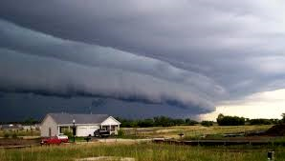
Derecho is a library, exactly for these kinds of roles!
You build one program, linked to the Derecho C++ library.
Now you can run N instances (replicas). They would read in a configuration file where this number N (and other parameters) is specified.
As the replicas start up, they ask Derecho to “manage the reboot” and the library handles rendezvous and other membership tasks. Once all N are running, it reports a membership view listing the N members (consistently!).
Notes:
Derecho currently covers most but not all aspects of launching and registering a new μ-service on Azure or AWS. The missing elements relate to the way that you actually tell Azure or AWS to install the thing: right now this must be done by hand-editing a JSON file. Someone needs to write code to auto-generate the JSON file. Not hard, very valuable, but we need someone to just do it.
You also have to build a Derecho “configuration” file. Same comment: this is done by hand right now, and perhaps could be auto-generated someday in the future. But the file is easy to edit and understand.
Then there is a question of running the Azure or AWS command that causes this JSON file to get read by the cloud manager layer. Reading it will trigger creation of the μ-service (Azure will automatically launch the N program instances, and the rest is automated by Derecho).
And once all of this is done, you would create ANOTHER such file, in JSON, to tell the Azure IoT Hub (or its AWS cousin) to run your event-triggered functions and to “bind” them to the new μ-service. By doing so, the event-triggered function gets permission to issue requests to the μ-service using RESTful RPC. Whew!

Slide 10
Other membership management roles
Derecho does much more, even at startup.
It handles the “layout” role of mapping your N replicas to the various
subgroups you might want in your application, and then tells each
replica what role it is playing (by instantiating objects from classes
you define, one class per role). It does “sharding” too.
If an application manages persistent data in files or a database, it
automatically repairs any damage caused by the crash. This takes
advantage of replication: with multiple copies of all data, Derecho
can always find any missing data to “fill gaps”.
It can initialize a “blank” new member joining for the first time.
Notes:
The key thing to think about is the idea that we have N copies of the identical program (or maybe docker container), so they all are identical when we start them up. Yet somehow we want them to self-organize.
Derecho does that for you. Of course you do need to link to the Derecho library, and you do need to tell it to “restart” when your program instances (“processes”) start up

Slide 11

Split brain concerns
Tes.com
Suppose your μ-service plays a key role, like air traffic control. There should only be one “owner” for a given runway or airplane.
But when a failure occurs, we want to be sure that control isn’t lost. So in this case, the “primary controller” role would shift from process P to some backup process, Q.
The issue: With networks, we lack an accurate way to sense failures, because network links can break and this looks like a crash. Such a situation risks P and Q both trying to control the runway at the same time!
Notes:
The issue of a system forming a logical partition is quite real – this has actually been seen in real systems!
It can be very dangerous. The two halves might take inconsistent actions, like allowing two different planes to land simultaneously on the same runway.

Slide 12
Solving the split brain problem
We use a “quorum” approach.
Our system has N processes and only allows progress if more than half are healthy and agree on the next membership view.
Since there can’t be two subsets that both have more than half, it is impossible to see a split into two subservices.
Notes:
With a majority-progress rule, our system would actually shut down (get stuck) if we had, say, 4 members, and a link broke and left us with two subsets of 2 members each. Neither would have a majority.
But it does ensure that we won’t have a split brain scenario.
The membership service needs to have this rule built in.

Slide 13
… Yielding structures like this!
External clients use standard RESTful RPC through a load balancer
Load balancer
Multicasts
used for cache invalidations, updates
Cache Layer
Back-end Store
Notes:
This particular example is one we use a lot, but there is nothing unique about it or special. It just shows 16 processes (small circles, white inside with red borders) that are organized as a single μ-service, but one with a substructure: a sharded cache layer with 3 nodes per shard and some state (shown as a pile of document pages), a load-balancing component that somehow sprays incoming work over the cache, and then a back-end storage layer. This example is sharded into two shards of size 2.
Then there are ovals that tell us where the subgroups live and also represent multicast patterns. Anyone in an oval can send a message to everyone in the oval.

Slide 14
A process joins a group
g.Join(“SomeGroup”)
… Automatically transfers state (“sync” of S to P,Q,R)
Now S will receive new updates
At first, P is just a normal program, with purely local private variables
P still has its own private variables, but now it is able to keep them aligned with track the versions at Q, R and S
P
Q
R
S
P
Q
R
Initial state
S
Notes:
These builds are to help you visualize the sequence even before we see the protocol.
Here we are starting up process S, in a state where P, Q and R were already running.

Slide 15
A process receiving a Multicast
All members see the same “view” of the group, and see the multicasts in the identical order.
R
S
P
Q
S
Notes:
Now we can do our multicasts – maybe even using Leslie’s protocol (although in fact Derecho’s is fancier). Anyhow, here is how that might look.

Slide 16
A process receiving an update
In this case the multicast invokes a method that changes data.
R
S
P
Q
S
Foo(1, 2.5, “Josh Smith”);
Foo(1, 2.5, “Josh Smith”);
Foo(1, 2.5, “Josh Smith”);
Foo(1, 2.5, “Josh Smith”);
Bar(12345);
Bar(12345);
Bar(12345);
Bar(12345);
Notes:
In Derecho you can actually pretend to be doing a “multiway method invocation”. As you can see, you get to give such a method a name (like Foo or Bar) and arguments.

Slide 17
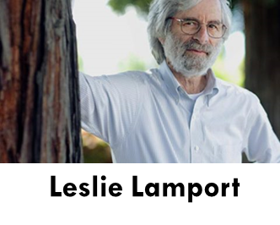
So, should we use chain replication In these subgroups and shards?
It turns out that once we create a subgroup or shard, there are better ways to replicate data.
A common goal is to have every member be able to participate in handling work: this way with K replicas, we get K times more “power”.
Derecho offers “state machine replication” for this
purpose. Leslie Lamport was first to propose the model.
Notes:
Would we just use chain replication?
Actually, no, because Derecho already has a way more powerful option for you.
But we’ll get there in a few steps that parallel the history of the field. We’ll start with a very old protocol Leslie proposed for doing totally ordered multicasts.

Slide 18
The “methods” perform state machine updates. You get to code these in C++.
In these examples, we send an update by “calling” a method, Foo or Bar.
Even with concurrent requests, every replica performs the identical sequence of Foo and Bar operations. We require that they be deterministic.
With an atomic multicast, everyone does the same method calls in the same order. So, our replicas will evolve through the same sequence of values.
Notes:
Where was the “state machine”?

Slide 19
Building an ordered multicast
Leslie proposed several solutions over many years. We’ll look at one to get the idea (Derecho uses a much fancier solution).
This is Leslie’s very first protocol, and it uses logical clocks.
Assume that membership is fixed and no failures occur
Notes:
So now we’ll dive in and look at Leslie’s protocol.

Slide 20
Leslie’s original proposal: Priority Queues and Logical Clocks
Pending updates occupy a slot but are not yet executed.
A:1
B:1
. . .
(1,X)
(2,X)
Replica X
B:1
A:1
Leader A
. . .
(1,Y)
(2,Y)
Replica Y
A:1
B:1
. . .
(1,Z)
(2,Z)
Leader B
Replica Z
Notes:
Each member of our group maintains a priority queue (an ordered list). Here we used X, Y and Z as our members. Each also has a logical clock.
To send a message, Leslie says you should run some code he calls “the leader protocol”. It could run in a separate thread in X or Y or Z. We’ll just say there are two leaders, A and B, and not worry about who runs the logic. But in practice this is all inside X, Y and Z.
When messages are created, we give them a unique message id. Then when they arrive, they are assigned a new logical timestamp. It will be the biggest one this replica has ever used, so they get added at the end of the priority queue.

Slide 21
Lamport’s rule:
Leader sends proposed message.
Receivers timestamp the message with a logical clock, insert to a priority queue and reply with (timestamp, receiver-id).
For example: A:1 was put into slots {(1,X), (2,Y), (1,Z)}
B:1 was put into slots {(2,X), (1,Y), (2,Z)}
Leaders now compute the maximum by timestamp, breaking ties with ID.
Notes:
Then the message id and timestamp values are sent back to our respective leaders. You can see this for two messages here: one called A:1, and one called B:1. Each got three “slots” (one priority queue slot in X, one in Y, one in Z).
We now compute the maximum, breaking ties using the replica id (X or Y or Z).

Slide 22
Lamport’s protocol, second phase
Now Leaders send the “commit times” they computed
Receivers reorder their priority queues
Receivers deliver committed messages, from the front of the queue
Notes:
The maximum became the “commit time”. So for example, A:1 commits at (2,Y). Check slide 19 to see this.
B:1 commits at time (2,Z).
Since we break ties using the replica name, if we were asked which has the larger commit time, you can see that A:1 has the smaller value and B:1 the larger value.

Slide 23
Leslie’s original proposal: Priority Queues and Logical Clocks
Notice that committed messages either stay in place, or move to the right.
Commit A:1 at (2,Y)
A:1
B:1
∅
∅
A:1
B:1
. . .
(1,X)
(2,X)
(2,Y)
(2,Z)
This is why it is safe to deliver committed messages when they reach the front of the queue!
Replica X
B:1
A:1
Leader A
A:1
B:1
∅
. . .
(1,Y)
(2,Y)
(2,Z)
Commit B:1 at (2,Z)
Replica Y
A:1
B:1
A:1
B:1
. . .
(2,Y)
(1,Z)
(2,Z)
Leader B
Replica Z
Notes:
The leaders each send the commit times (in any order – there is no certainty which messages arrive first).
We re-sort the priority queue using commit times.
The rule will be that “you can deliver a message if it is at the front of your priority queue and also has a committed time on it.”

Slide 24
Is this a “good” SMR protocol?
It isn’t dreadful. In fact the messages are delivered along consistent cuts!
But it can’t handle crashes if the state will be durable (on disk). And it doesn’t use modern networking hardware very well.
Also, adding logic to handle membership changes is tricky. Derecho uses an approach called “virtual synchrony” for membership changes.
Notes:
This is actually a very useful protocol, but in fact not ideal for modern cloud computing data centers because we have new kinds of hardware that we could leverage. The old protocol from Leslie doesn’t do so.
Also, we would need to know how to handle failures.

Slide 25

Durable State: Paxos Concept
Paxos (Greek Island)
Our SMR protocol puts messages into identical order (“total order”) but doesn’t address logging them to disk or cleanup during recovery.
Paxos is the name of a collection of protocols that Lamport created to solve ordering, durability and “non-triviality” all at once. Our SMR protocol actually can be turned into a version of Paxos.
We say “version” because there are many ways to implement Paxos.
Notes:
Paxos is a solution to the state machine replication problem.
We have a math statement (the state machine replication model and problem).
And we have a distributed algorithm: the Paxos protocol.
And it can be configured in various ways.

Slide 26
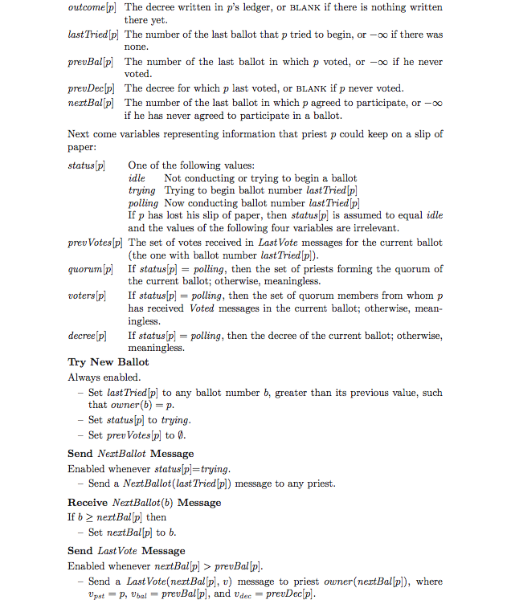
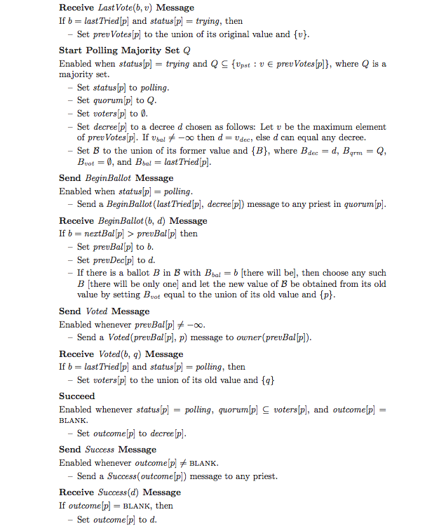
Actual Paxos Protocol: Very Complex
Paxos drilldown: If time permits (but we probably won’t cover this slide)
Notes:
In a distributed computing course we would probably cover Paxos in careful detail.
The protocol is not at all simple, and even the basic pseudo-code is hard to read.
The basic idea is this: there are a set of processes that have permission to run Paxos, and this set is specified in advance and “locked down” (Paxos does have a membership protocol, but it isn’t part of the basic solution). Some processes might be crashed at any moment in time, so in general, only a subset are available. Call these “acceptors”. They keep logs of the updates.
To add a new update to the acceptor logs, a “proposer” does a 3-phase (or more) commit: it sends out the proposal, waits for a quorum (majority) of acceptors to agree to the proposal, then sends out a “prepare to commit”, waits for a quorum to acknowledge it, and finally sends “commit”. Extra phases occur if there are two more more competing proposers and they try to propose different updates in the same “slot” – this can trigger repeated rounds (“ballots”) until someone gets a quorum. Failures can also cause extra rounds.
To read the logs, a “learner” must collect a quorum of logs and merge them.

Slide 27
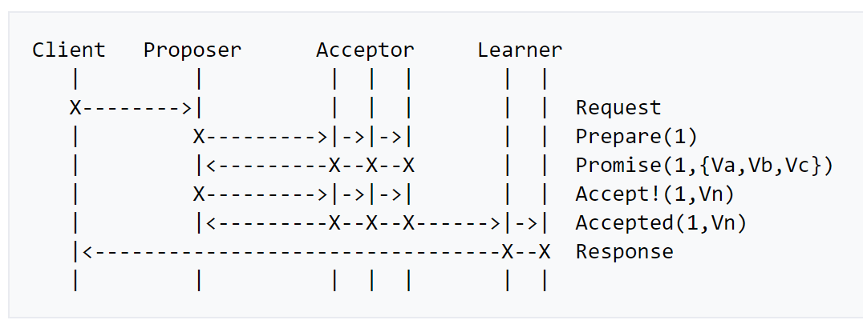
Paxos Message Flow
https://en.wikipedia.org/wiki/Paxos_(computer_science)
Paxos drilldown: If time permits (but we probably won’t cover this slide)
Notes:
Wikipedia has some very widely used illustrations of the proposal in action. Here we see a client (not part of the core system) asking a proposer to do some update on its behalf. You can see the three acceptors – here they agree to the proposal in the third “step”, which completes the first “phase” in this run. The proposer then sends out an “accept!” message (the second phase). They acknowledge (“accepted”), and then the protocol is finished. But in fact this is a best-case run. Often it takes additional phases to complete.

Slide 28
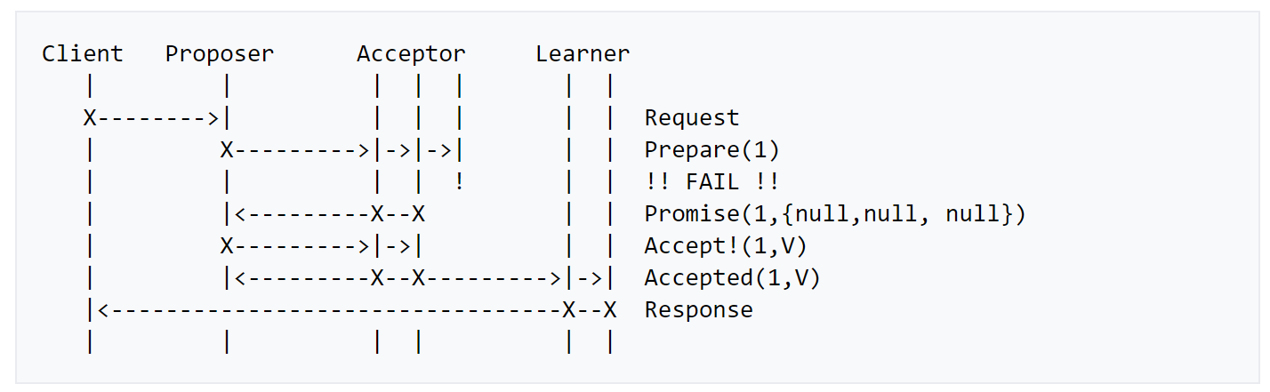
Message Flow: Failure of Acceptor
https://en.wikipedia.org/wiki/Paxos_(computer_science)
Paxos drilldown: If time permits (but we probably won’t cover this slide)
Notes:
Paxos can still complete even if a minority of the acceptors are unavailable. In this example, 1 out of 3 isn’t responsive but nothing really changes in the rest of the run. But the image is “deceptive” in the sense that the missing acceptor could reappear at any time, hence it isn’t really gone. In fact a learner could wander in and try to learn the state at any time, and could easily attempt to contact that missing acceptor. It won’t necessarily have completely vanished form the earth, the way the image makes it seem. In fact it might be back to life and perfectly responsive.
A learner thus must always collect a majority of logs and merge them, to be sure that it learns every committed update. Otherwise it might talk to an acceptor that missed some updates (like the third one, here), and it would end up with gaps in the update sequence.

Slide 29
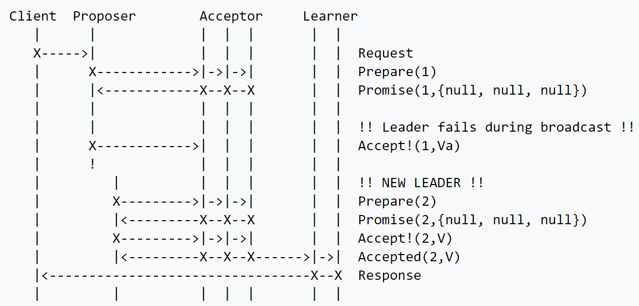
Message Flow: Failure of Proposer
https://en.wikipedia.org/wiki/Paxos_(computer_science)
Paxos drilldown: If time permits (but we probably won’t cover this slide)
Notes:
In this run, the proposer fails, but some other proposer later notices and “finishes” the prior proposal up as a kind of favor to the missing one. Paxos turns out to need that – without this mechanism, it could end up with unrepaired gaps in the log of updates at the acceptors and nobody would be able to learn the entire log.

Slide 30
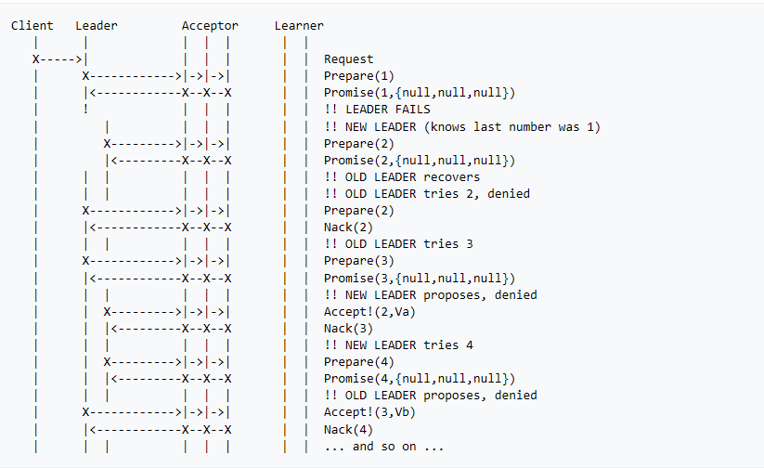
Message Flow: 2 Competing Proposals
Paxos drilldown: If time permits (but we probably won’t cover this slide)
Notes:
The real complications arise when there are multiple leaders that happen to be running all at once (two in this example, but there could be an arbitrary number, and they could experience any possible pattern of failures while competing to do the update).
With such a pattern, the first to obtain a quorum of “accepted” messages for some proposal with a given slot number and ballot number will win. But you could have many rounds in which a particular proposal fails to win a quorum of accepts on a particular ballot, and must retry with an incremented ballot number. There is no actual limit to how long this could go on.
If we had a fixed single leader this couldn’t occur, but then we would have to worry about that leader failing – some versions of Paxos tackle this issue (successfully), but it adds complexity. We could also pre-assign slots so that each leader has a sequence of slots of its own (like a “round robin” rule: leader A gets slot 1 and 3, leader B gets slots 2 and 4, etc). This has been done too. So these problems aren’t impossible to solve, but they add complexity to what was already a non-trivial protocol, and you have to think through every possible combination of failures, restarts, etc.

Slide 31
What makes Paxos complicated?
In some sense, the protocol is dealing with many issues all at once.
It has no agreed-upon “current membership” (although it does have a static list of members, some of which might currently be unavailable).
To compensate for not knowing which are up, it uses a competition to get a quorum of “acceptors” to agree on each update, and this is messy.
Tracking membership at a more basic level simplifies the logic dramatically!
Paxos drilldown: If time permits (but we probably won’t cover this slide)
Notes:
Leslie Lamport actually (famously) claimed that no protocol can be simpler than Paxos! But he probably meant “no strongly consistent and fault-tolerant replication protocol” and he was also probably bragging, in some subtle way (or not so subtle?)
Most normal mortals think Paxos is pretty complex. A great paper on this is:
Paxos Made Moderately Complex. R Van Renesse and D Altinbuken. ACM Comput. Surv. 47, 3, Article 42 (February 2015), DOI: 10.1145/2673577
In fact even Leslie ultimately decided that Paxos is quite tricky to prove correct, and built a whole automated theorem proving framework to help him automate checking his proof (you have to write the code and proof in TLA+ and then it searches for contradictions using “model checking”, which basically explores every reachable state and checks that the assertions continue to hold).
There are more powerful and more modern theorem provers and in many of today’s systems, we use them to reason about complex protocols or elements that worry us.

Slide 32
Virtual synchrony: Managed Groups
Epoch: A period from one membership view until the next one.
Joins, failures are “clean”, state is transferred to joining members
Multicasts reach all members, delay is minimal, and order is identical…
P
Q
R
S
T
U
Notes:
As illustrated here, the job of the membership system is to make it all seem magically clean and simple. Processes join or leave or crash and the manager reports these events in a clean way. It even initializes joining processes (heavy arrows).
How? By asking some process to make a checkpoint, then asking the new guy to load it. How? Using upcalls to the software: event notifications. How? Through an API a lot like a GUI designer tool might offer.
Failures are usually sensed by timeout or by the OS, if a process crashed (but honestly, solid software rarely crashes. Computers crash, though. Remember those three R’s?)

Slide 33
Virtual synchrony: Managed Groups
Epoch Termination
Epoch Termination
State Transfer
Epoch: A period from one membership view until the next one.
Joins, failures are “clean”, state is transferred to joining members
Multicasts reach all members, delay is minimal, and order is identical…
P
Q
R
Active epoch: Totally-ordered multicasts or durable Paxos updates
S
T
U
Epoch 1
Epoch 2
Epoch 3
Epoch 4
Notes:
As illustrated here, the job of the membership system is to make it all seem magically clean and simple. Processes join or leave or crash and the manager reports these events in a clean way. It even initializes joining processes (heavy arrows).
How? By asking some process to make a checkpoint, then asking the new guy to load it. How? Using upcalls to the software: event notifications. How? Through an API a lot like a GUI designer tool might offer.
Failures are usually sensed by timeout or by the OS, if a process crashed (but honestly, solid software rarely crashes. Computers crash, though. Remember those three R’s?)

Slide 34
Derecho’s version of Paxos
Derecho splits its Paxos protocol into two sides.
One side handles message delivery within an epoch: a group with unchanging membership.
The other is more complex and worries about membership changes (joins, failures, and processes that leave for other reasons).
Notes:
Derecho has a version of Paxos. It actually is a somewhat non-standard version, but it is provably Paxos even so.

Slide 35
How does Derecho transfer
Data? It uses “RDMA”.
Source
Dest
Optical link
Unicast
RDMA: Direct zero copy from source memory to destination memory. But it is like TCP: a one-to-one transfer, not a one-to-many transfer.
RDMA can actually transfer data to a remote machine faster than a local machine can do local copying.
Like TCP, RDMA is reliable: if something goes wrong, the sender or receiver gets an exception. This only happens if one end crashes
Notes:
Derecho uses remote direct memory access (RDMA) hardware.

Slide 36
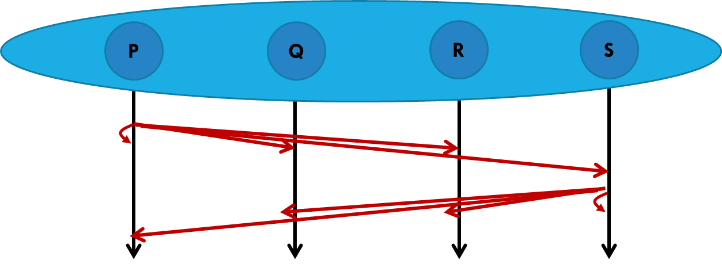
small messages Use a direct RDMA copying
Protocol we call SMC.
Mellanox 100Gbps RDMA on ROCE (fast Ethernet)
100Gb/s = 12.5GB/s
SMC Protocol, 1 byte messages

Slide 37
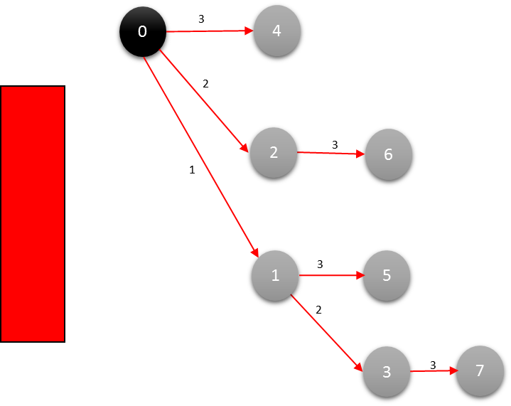
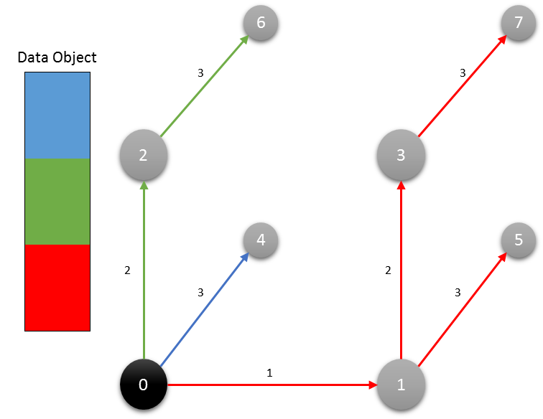
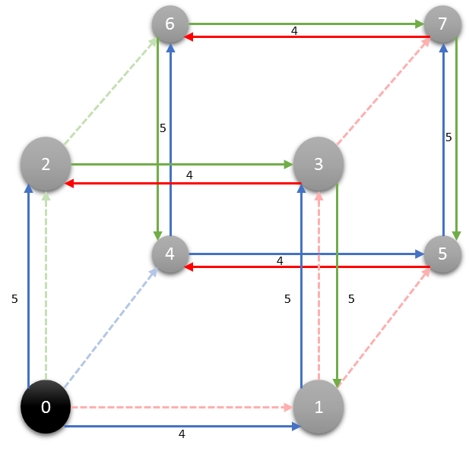
Large messages use a relaying method we call RDMC
Dest
Source
Dest
Dest
Dest
Multicast
Binomial Tree
Binomial Pipeline
Final Step
Notes:
To send large messages we don’t just send them point to point, like in Leslie’s protocol. Derecho relays them down a virtual tree it creates (left) and also breaks them into blocks, using one tree per block (middle) and wrapping the trees around a hypercube, all virtual. This yields ultra-high concurrency.

Slide 38
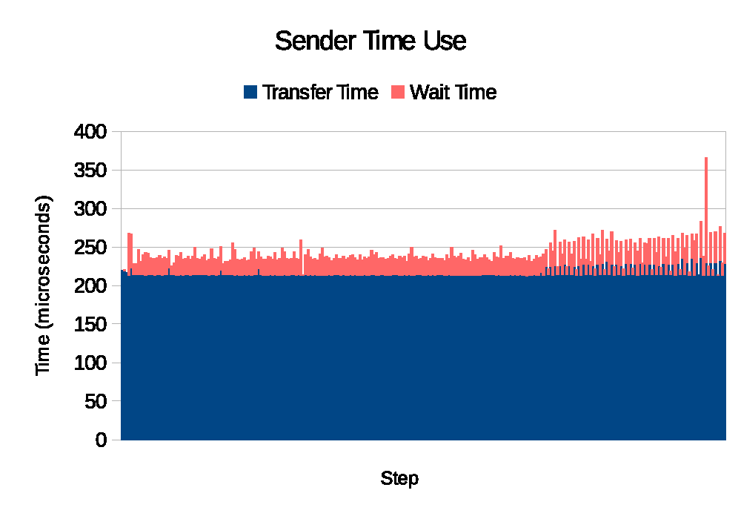
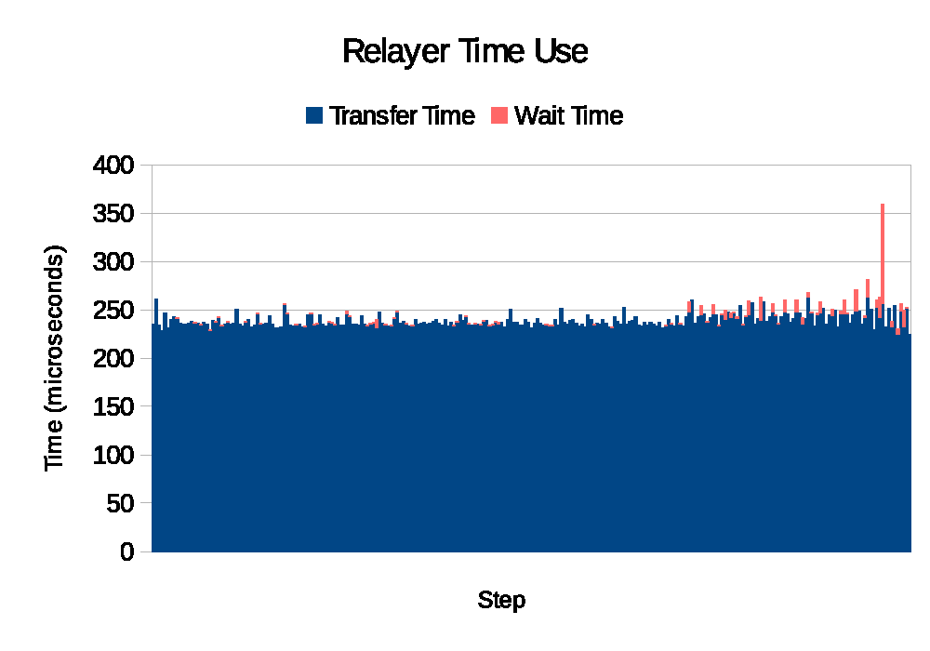
RDMC succeeds in offloading work to Hardware
RDMC (software)
RDMA (hardware)
Trace a single multicast through our system… Orange is time “waiting for action by software”. Blue is “RDMA data movement”.
Notes:
The RDMA hardware does all the heavy lifting.

Slide 39
How does Derecho put messages in order?
Recall that in virtual synchrony we know the membership for each epoch.
Derecho also knows which members are “senders”. The application tells it.
Within the senders, Derecho just uses round-robin order: message 1 from P. Message 1 from Q. Message 1 from R. Now message 2 from P…
If some process has nothing to send it can “pass” (it sends a null message).

Slide 40
Are we finished?
We still need to understand how to end one epoch, and start the next.
Derecho’s method for this is a bit too complex for this lecture, but in a nutshell it cleans up from failures, then runs a protocol (based on quorums) to agree on the next view (the next epoch membership), then restarts.
If a multicast was disrupted by failure, it then will be reissued.

Slide 41
A process FAILS
Committed
X₀
X₁
X₂
. . .
X_{k}
X_{k+1}
X_{k+2}
Now
Failure: If a message was committed by any process, it commits at every process. But some unstable recent updates might abort.
R
S
P
Q
S
Derecho “trims” disrupted updates, like X_{k+2}
Update X_{k+1}
Update X_{k+2}
R
S
P
S
Notes:
When a failure occurs, Derecho has a nifty little cleanup mechanism. We see it in action here. The failures are actually discovered by the RDMA hardware, or the user can say “Q has failed”.

Slide 42
How much cost does Ordering and
Paxos reliability of this kind add?
We can compare the “basic” RDMC multicast (the one seen earlier) with an ordered Paxos protocol layered on RDMC in Derecho.
Our next slide shows what we get for various object sizes and group sizes.
Red: “a video” (100MB), Blue: “a photo” (1MB), Green: “an email” (10K).
Again, 3 cases: all send (solid), half send (dashed), one sends (dash dot)

Slide 43
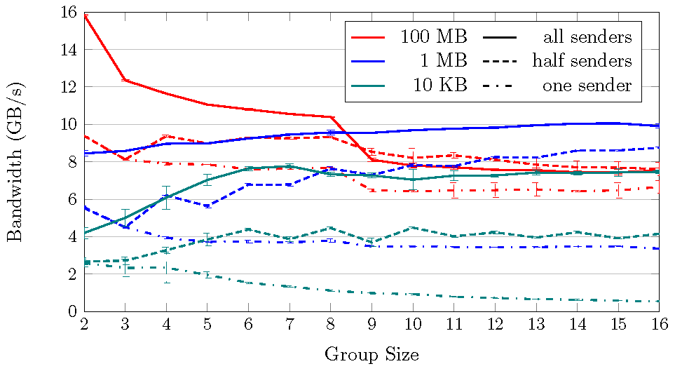
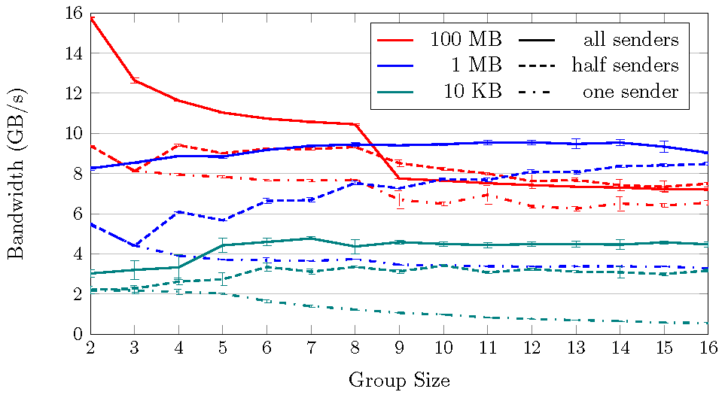
Derecho:
Large messages
Derecho can make 16 consistent replicas at 2.5x the bandwidth of making one in-core copy
Mellanox 100Gbps RDMA on ROCE (fast Ethernet)
100Gb/s = 12.5GB/s
Raw RDMC is faster, but performance loss is small
Raw RDMC is faster, but performance loss is small
Raw RDMC multicast via Derecho API Derecho Atomic Multicast (Vertical Paxos)
memcpy (large, non-cached objects): 3.75GB/s
Notes:
Performance is amazing! Seriously.

Slide 44
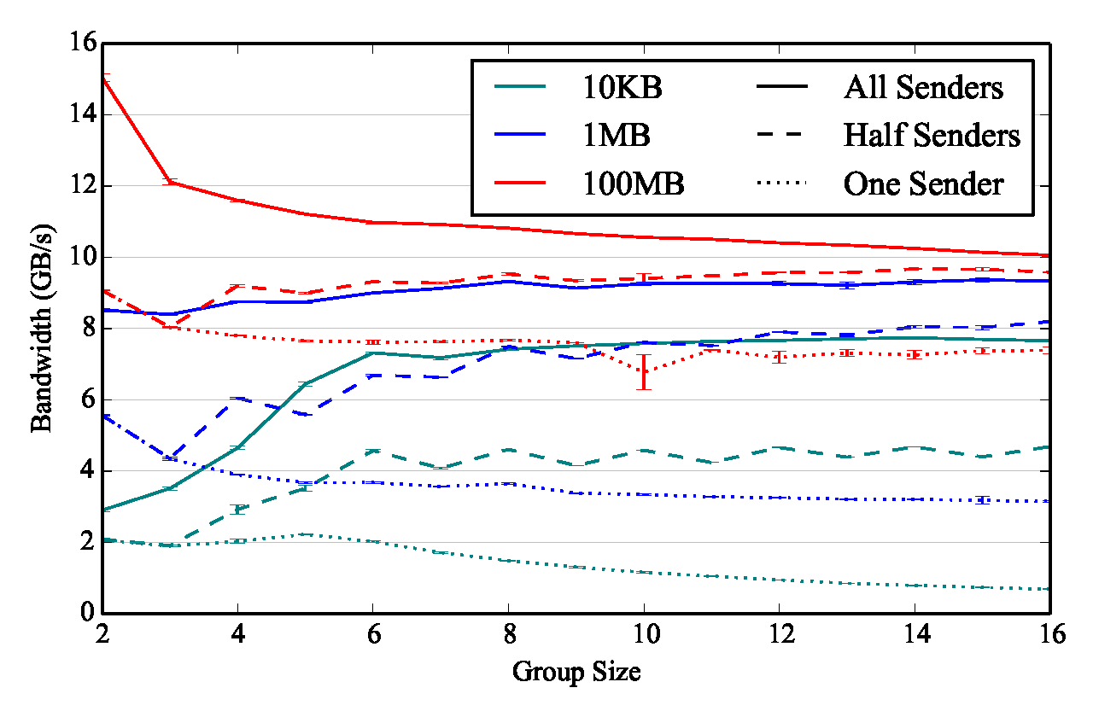
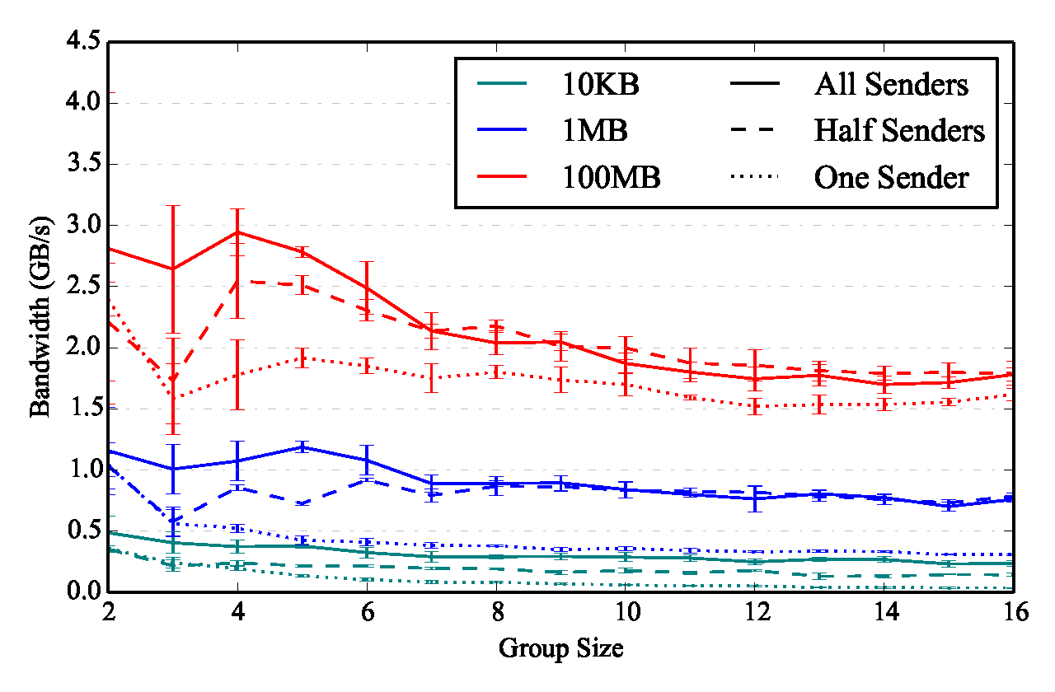
Derecho can Also run on TCP. We find that RDMA is 4x Faster
Derecho Atomic Multicast: 100G RDMA Derecho on TCP, 100G Ethernet
Notes:
Without RDMA, you can still use Derecho, configured to run on TCP. It slows down by about 4x.

Slide 45
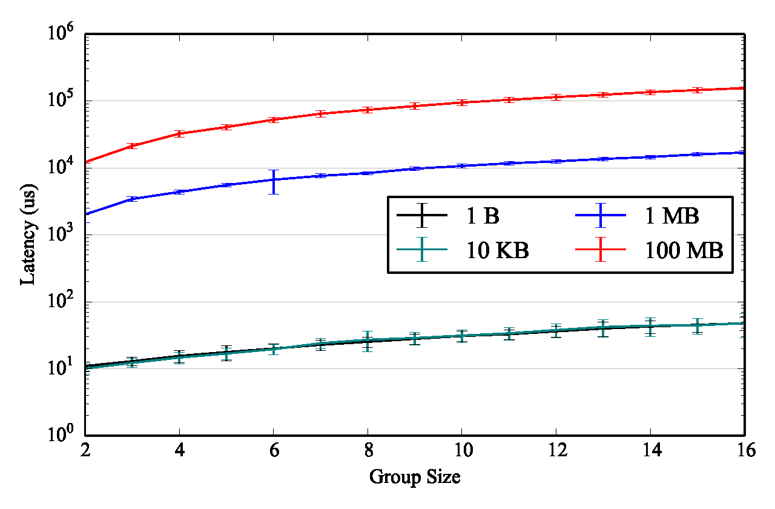
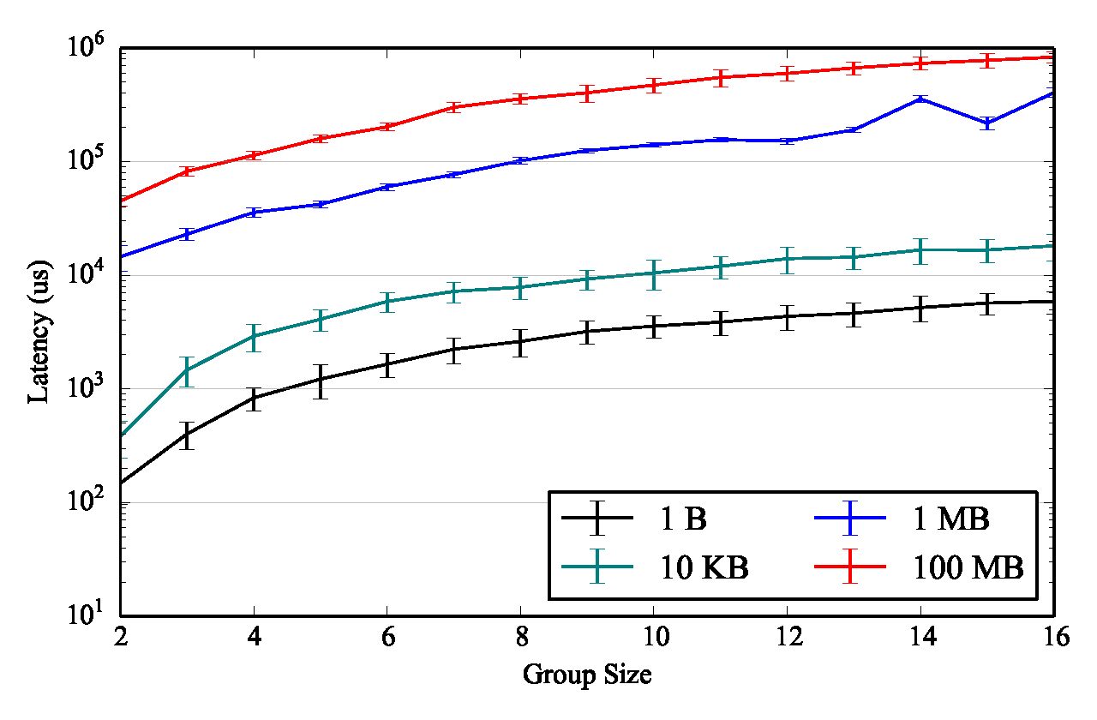
TCP increases Delays by about 125us
Derecho Atomic Multicast: 100G RDMA Derecho on TCP, 100G Ethernet
Notes:
The delay before a message is delivered (latency) grows by about 125us. Then it scales in a way that matches the transmission data rate.

Slide 46
Consistency: A Pervasive Guarantee
Every application has a consistent view of membership, and ranking, and sees joins/leaves/failures in the same order.
Every member has identical data, either in memory or persisted
Members are automatically initialized when they first join.
Queries run on a form of temporally precise consistent snapshot
Yet the members of a group don’t need to act identically. Tasks can be “subdivided” using ranking or other factors
Notes:
Reminders of our goals. We achieved them!

Slide 47
Four ways of getting to the same place!
Several of these solutions use Zookeeper to manage a file with membership data. Chain replication would do that. Then, it gets ordering and consistency by passing data in FIFO order down the chain.
Lamport’s original atomic multicast protocol would also use some other method to manage membership. It gets ordering via a 2-phase protocol with logical clocks.
Paxos also uses a 2-phase (at minimum) commit. The slots in the log determine the delivery ordering. Proposers compete to fill them in.
Derecho has a virtual-synchrony membership service, then uses a fixed order. Senders send messages (or a null) in round-robin order, based on the view.
Paxos drilldown: If time permits (but we probably won’t cover this slide)
Notes:
By now we have seen many examples of “Paxos protocols”.
Any Paxos protocol delivers messages:
Exactly once (unless the sender fails, in which case “or not at all”)
In an agreed order.
… and won’t “develop amnesia” after failures. In effect, delivery is durable, and once a message has been delivered, it can never be forgotten. To do this, any Paxos protocol will need to temporarily delay (buffer) received messages, and won’t deliver them until it is safe to do so. Thus delivery means “act upon”, not “receive from the network”. Some of these protocols might actually discard a received message because a failure somehow disrupts the protocol and deliver would not be safe. There is a case where Derecho does precisely this. Others might retry until safe delivery occurs (classic Paxos approaches it this way).
With virtual synchrony we just add some extra rules about membership:
Membership progresses through a series of agreed-upon views
These define epochs, and a multicast occurs entirely within some epoch. The epoch tells us who the receivers will be.
If a partitioning event somehow split the group, at most one side will have the majority of members, and only that side can make progress. “No split brain.”

Slide 48
What about the Derecho Object Store?
We heard about this in the lecture about the “Freeze Frame File System”.
It offers a (key,value) API with operations like put(k,v), get(k), watch(k).
Like FFFS, it understands time, and supports put(k,v,t) and get(k,t).
The object store is a library within a library: it was built on top of Derecho.
It can be used as a library “within Derecho”,
Or, you can set it up to run as a μ-service and talk to it from a function in the
Azure function server.
Notes:
Now this is a blast from the past. When we talked about the Freeze Frame File System, I mentioned that FFFS_{v2} is actually a component of Derecho called the object store (OSS). This is a kind of library over a library: we took the basic Derecho (that you just learned about) and then implemented OSS on it, but still as a library.
However there is a way to run it as a standalone blob store, too.

Slide 49
Layers on Layers!
Complete free-standing self-managed μ-service
Familiar APIs, like a file system or message bus or blob store
Higher level tools, like the versioned, temporally indexed Derecho object store (the key-value store)
Derecho’s version of atomic multicast and durable Paxos
Library you
link to
The shared state table (coordination)
Data replication: Streaming over RDMC
Fancy structures with subgroups and sharding
Virtual synchrony membership layer
Notes:
This gives some sense of the layering of components in the solution.
At the lowest level is the membership manager, which in fact was implemented as a small library.
Then a second set of library mechanisms are built over the basic one – first to support mapping of a top-level group into a structure with subgroups and shards (like in our images) and then to do multicast over those (RDMC is the one shown here, but Derecho also has a simple one called SMC, not show), and to coordinate tracking of the progress of each so that it can be safely delivered. That coordination is through the shared state table (SST) layer, which uses RDMA in a different way.
So none of this is really simple, not at all.
Then at a higher layer we see the object store and above that, someone really should implement clean plug-ins to use Derecho to build new services for Azure IoT or AWS, and also new versions of standard things like HDFS/FFFS, Zookeeper, etc. That will probably happen over the next few years.

Slide 50
Some practical comments
Derecho is very flexible and strongly typed when used from C++.
But people working in Java and Python can only use the system with byte array objects (size_t, char*).
You can’t directly call a “templated” API from Java or Python, so:
First you create a DLL with non-templated methods, compile it.
Then you can load that DLL and call those methods.
You still need to know some C++, but much less.
Notes:
Using Derecho from Java is feasible but a little tricky.

Slide 51
Conclusions?
A software library like Derecho automates many aspects of creating a new μ-service.
The Paxos model is used to ensure consistency, fault-tolerance. There are two cases: ordered multicast (non-durable) and persistent (on disk).
You code in an event-driven style.

