Slide 1
Data Replication and Consistency
Ken Birman
Spring, 2018

Slide 2
Another recap!
Lecture 1: We looked at the existing cloud edge, CAP, DHTs.
Lectures 2, 3: We drilled down on CAP, learned about “time” in clouds
Lecture 4: We applied this insight to the file system and ended up with FFFS, a file system that handles time and sensor data with time fields in the records, and offers very accurate, fast, time-indexed reads.
Lecture 5: We started to think about other aspects of the cloud pipeline. This got us interested in the “data structures” actually used to hold knowledge, so we looked closely at Facebook TAO (social network graph)

Slide 3
More Recap
Where do we stand?
Broadly, we are thinking about how smart sensors and real-time uses
disrupt the classic cloud model pioneered by Amazon and others
We concluded that the key is to move some aspects of knowledge to the
tier one/two layer. Facebook TAO already lives there.
We are thinking that some form of data concentrators could hold any
real-time machine learning roles like data classification, discarding dull
data, and also do quick responses and even small updates to the model
Today, focus on the issue of replication and updates for this new layer.

Slide 4
Data concentrators and smart memory
The future cloud will have technologies to help create various kinds of smart services.
Data concentrators to intelligently manage sensors
Storage systems that can intelligently decide what to keep, what to
discard, what “recipes” to run.
Machine-learned models designed to support quick edge updates with
reasonable consistency guarantees
What are the core technology requirements this poses?

Slide 5
Membership Management: One need
Automates tasks such as tracking which computers are in the service, what roles have been assigned to them.
May also be integrated with fault monitoring, management of configuration data (and ways to update the configuration).
Often has a notification mechanism to report on changes
Notes:
Today’s lecture is drawn from a 40 page paper you can read about Derecho. The link is right on our syllabus web page.
We won’t have a ton of notes because the lecture closely tracks the paper, so I’m kind of hoping you’ll just read the paper for details not on the slides.

Slide 6
Tasks that require replicas (membership) + Active Replication (continuous Updates)
Copying programs to machines that will run them, or entire virtual machines.
Replication of configuration parameters and input settings.
Copying patches or other updates.
Replication for fault-tolerance, within the datacenter or at geographic scale.
Replication so that a large set of first-tier systems have local copies of data needed to rapidly respond to requests
Replication for parallel processing in the back-end layer.
Data exchanged in the “shuffle/merge” phase of MapReduce
Interaction between members of a group of tasks that need to coordinate
Locking
Leader selection and disseminating
decisions back to the other members
Barrier coordination
Notes:
Membership == a list of which processes are in the system, and perhaps, what they do.
A process == a program running on some computer. Named by the computer’s IP address and the process id on that machine. Maybe a bit more like which TCP port it is listening on, maybe not.
Role: complex systems often have subsystems, like running the DHT or doing load balancing or keeping the TAO database. Those are roles. The full membership might include ALL the processes and machines. The roles are for individual members: this process is a DHT member. That process has a TAO graph in a database.
The developer would need to design and control all of this. None of it is free or automated or magic. It can take years to design these systems. Membership management is just a way to provide help – a tool for that developer.
The tools have complex APIs. We’re talking here about what the thing does, not the API.

Slide 7
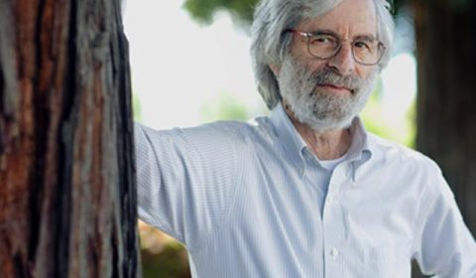
State Machine Replication Model
Leslie Lamport
Take some set of machines that are initially in the identical state.
Run a deterministic program on them.
If we present the replicas with the identical inputs in the identical order, the replicas remain in the same state.
This is a very general way to describe replicating a log or a file or a database, coordinating reactions when some event happens in a fog computing setting, locking and barrier synchronization, etc.
Notes:
The need for replication is common in complex and structured services.
Like replication of a machine learned model. Some set of processes may need the learned parameters for some part of the model (like the trajectory and identify of a particular car on a highway).
If that car changes speed, we would update the replicated data.
State machine replication is a simple definition for consistency. Guess who proposed it?

Slide 8
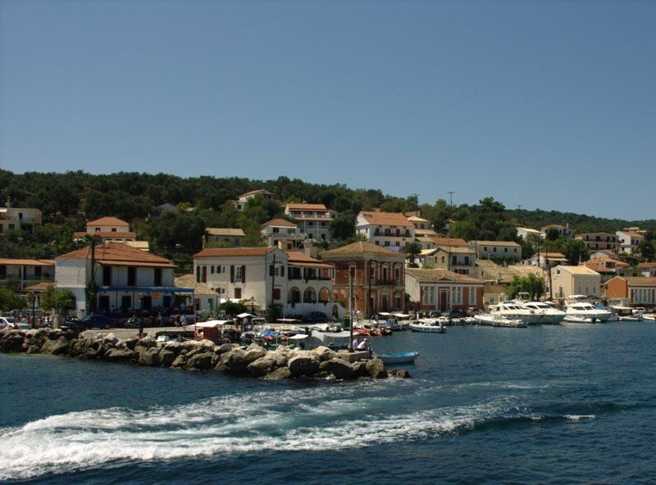
Paxos Concept
Paxos (Greek Island)
Leslie Lamport proposed the Paxos model as a way to
Express the state machine replication problem in a more formal way
Solve it, using the “Paxos protocol”. Now we call it the “classic” one:
  Over the years, many Paxos protocols have been developed
  All of them solve the Paxos specification, but the details vary widely
  One source of confusion with Paxos concerns storage of data
  Is Paxos “delivering messages” to an application that has the state/storage role?
  Or is Paxos itself a kind of “database of messages”? Leslie likes this model.
Notes:
Paxos is a solution to the state machine replication problem.
We have a math statement (the state machine replication model and problem).
And we have a distributed algorithm: the Paxos protocol.
And it can be configured in various ways.

Slide 9
How do these interpretations differ?
In the first interpretation, we are using Paxos as a form of “atomic multicast” protocol.
The application is supplied by a user of Paxos. Paxos has no “state”
When we want to update the replicated state, we multicast the update
In the second interpretation, Paxos “is” the storage system
Like an append-only log, and updates are appended
The application would read the log, but the log is durable.

Slide 10
VirtuaLLy Synchronous Membership
Manages a group of replicas that are using Paxos.
Members can join the group, leave it, crash (failed members are ejected).
“State transfer” to initialize the new members when they join
Updates occur entirely in a single epoch: during a period when membership is stable. Every replica receives the identical updates.
Notes:
This is a math specification for membership tracking.
Please see the Derecho paper or the textbook.

Slide 11
Virtual synchrony: Managed Groups
Epoch: A period from one membership view until the next one.
Joins, failures are “clean”, state is transferred to joining members
Multicasts reach all members, delay is minimal, and order is identical…
P
Q
R
S
T
U
Notes:
As illustrated here, the job of the membership system is to make it all seem magically clean and simple. Processes join or leave or crash and the manager reports these events in a clean way. It even initializes joining processes (heavy arrows).
How? By asking some process to make a checkpoint, then asking the new guy to load it. How? Using upcalls to the software: event notifications. How? Through an API a lot like a GUI designer tool might offer.
Failures are usually sensed by timeout or by the OS, if a process crashed (but honestly, solid software rarely crashes. Computers crash, though. Remember those three R’s?)

Slide 12
Not everything needs such an elaborate model and solution
In Cosmos, membership is pretty stable.
When Cosmos computes a new object, the system just picks a fault-independent node and copies it to that machine.
Transfers to Pelican can perhaps be done in parallel: one copy from
primary to Pelican, one from the backup to Pelican
But there are no conflicting updates or “decisions” to make in Cosmos
Notes:
Cosmos doesn’t use virtual synchrony… doesn’t really need it.
But Cosmos has never run a smart highway. Membership consistency matters once the smart memory is key to avoiding crashes.

Slide 13
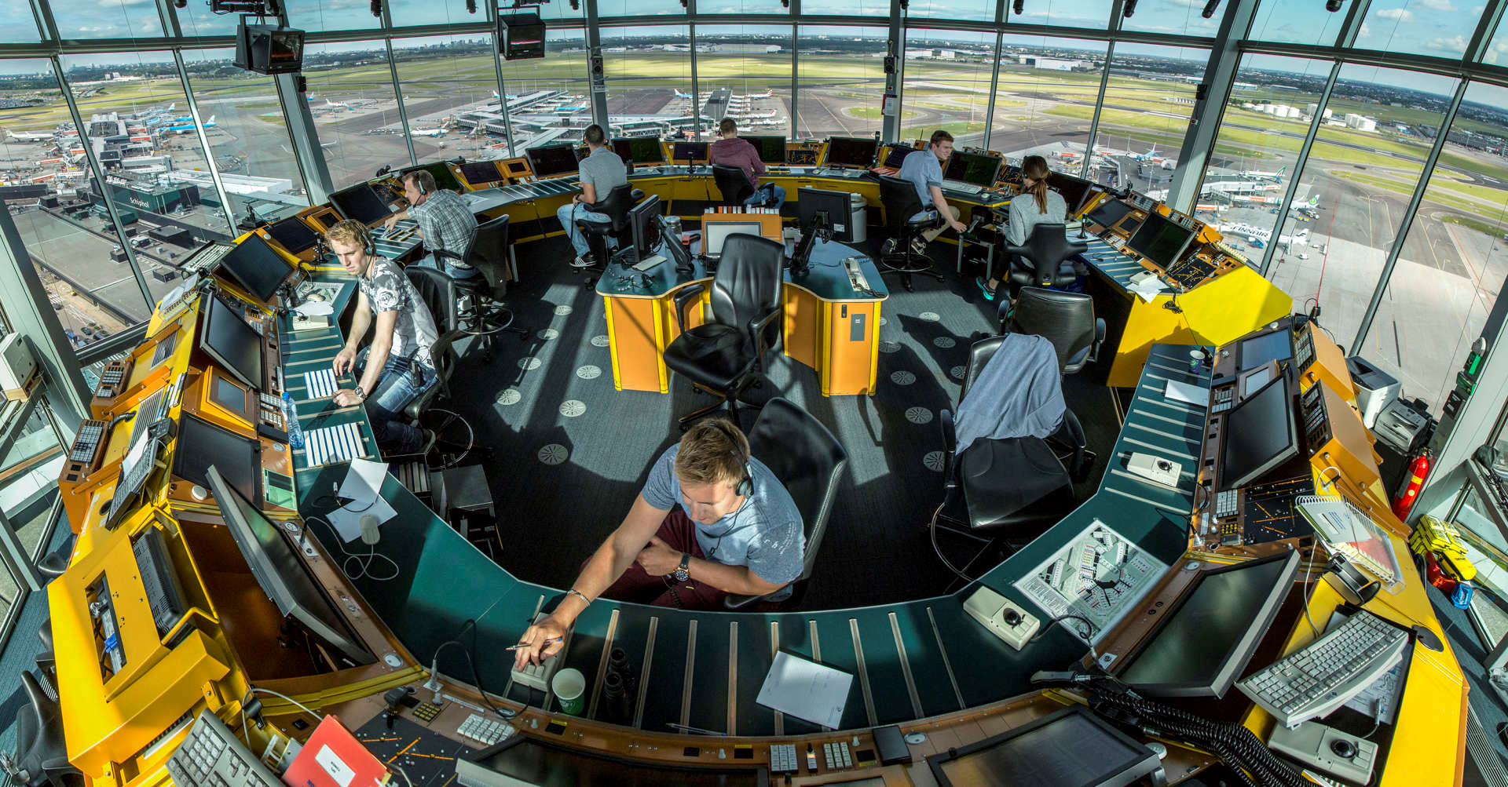
But some systems do: They are at risk of “Split brain” problems
Imagine an air traffic control computer, and a backup
Network fails, but just for a moment… both machines remain active.
Machine X never noticed the outage and thinks A is the active controller.
But machine Y “rolled over” to the backup, and is talking to B.
Now we have two controller computers for the same landing strip!
Partitioning (split brain) and similar inconsistencies can never happen with virtually synchronous Paxos solutions. Use virtual synchronous Paxos whenever you are at risk of unsafe behavior in the event of inconsistency.
Notes:
This is a famous worry: what if we end up with two controllers who think they both control the same runway? Same issue for a smart car, or highway.
Virtual synchrony never allows two processes to accidentally get the same role.
Cosmos has no such guarantee.
Paxos turns out to use this same virtual synchrony idea. Lately some people like a term Leslie proposed: virtually synchronous Paxos. Since I (ken) invented virtual synchrony, but Leslie is WAY more famous, I’ll take the credit where I can!

Slide 14
Let’s take a closer look
What might a service using these concepts be doing?
How would a person code such a service?

Slide 15
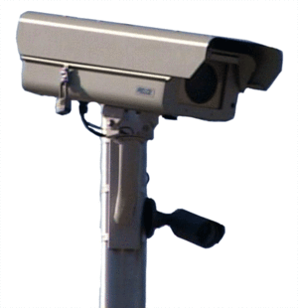
Example: Receive data, replicate, store
Sensor
(client device)
TCP
P
Q
R
This is an example of an atomic multicast pattern.
The membership of the group of replicas is {P,Q,R}.
P played a server role by relaying the image.
Notes:
The arrows are supposed to show messages sent over computer links. P and Q and R are just processes in a data collection role, or in Cosmos. Or they could be replicas of a data concentrator we replicated for fault-tolerance using state machine replication.

Slide 16
Example: Receive, Discard uninteresting content. If interesting, replicate and save.
Sensor
(client device)
TCP
Model
P
Q
R
Same pattern but now the server, P, needs to run additional machine-learning logic. It also draws on a previously replicated machine learned model.
Notes:
The bow tie is supposed to show some kind of filtering like “throw away the photo if dull, otherwise replicate it.”

Slide 17
Example: Receive, Discard uninteresting content. If interesting, Run a parallel algorithm to do edge extraction.
Sensor
(client device)
TCP
Model
Model
Model
P
Q
R
Now we also want Q and R to run some form of user-provided logic, to do the edge extracting (P probably runs it too)
Notes:
Or we might do classification. We might even use parallel processing for that.

Slide 18
What did our examples show?
For this, most people just use a REST library. It handles these standard steps and is easy to use.
We need a way to write a piece of code that can
Open a TCP connection endpoint. The sensor will connect to it.
Read in an image or video, over the connection.
Run some sort of “artificially intelligent” test procedure that makes use
of a machine-learned model that was uploaded previously (tier 2)
Then, if data is interesting, “ask” for it to be replicated
When replicas arrive at Q, R, write them to storage.
Notes:
As the developer you would ideally want to write as little new code as feasible.
These are examples of subtasks you can solve by using standard libraries.
The bad news? Every single cloud vendor has a library of their own and none of them are identical! The good news? Some are pretty standard. These are usually part of the “open stack” standards.

Slide 19

Example: Receive data, replicate, store
TCP
Sensor
(client device)
Model
Model
Model
TCP
P
Q
R
TCP
Here, all three are playing server roles, for different sensor devices. We will want to make sure they store the updates in identical order, keeping them consistent.
Notes:
It can be messy with multiple incoming data feeds that are handled by one data concentrator. State machine model says “apply the same updates in the same order” but how do we do that?

Slide 20
What about fault-tolerance?
Our replica group, {P,Q,R} could have crashes
We want the service to remain active while one or two nodes are down
Then we need to self repair
Notes:
Failures make it a zillion times harder.

Slide 21



self-repair example: Petstore.com
Suppose our service keeps a replicated inventory and machine Q crashes.
On restart, we must repair the log on Q before we let it resume activity.
Machine P
Machine Q
Machine R
Machine Q is running, but inconsistent
Machine Q
State
Transfer
Notes:
Example of repair: we need to transfer the missing puppy picture. But not the kitty, which was already there. And then all three get to see the new puppy.

Slide 22
Challenges that self-repair raises
If the state is large, how can we determine what subset to transfer?
With logs, this is easy: B says “I have everything up to event 188181” and A can send the delta.
But if files are updated in arbitrary ways, finding the delta is tricky!
A further puzzle: what if P and R receive new updates while Q is being repaired? We might get a race conditions in which P sends the delta but not the new update, yet the new update didn’t get to Q.
Notes:
So all of this is seeming very, very, very complicated.
We need help! We need… a library that can do it all automatically!

Slide 23
A complex situation!
To build this second class of systems we’ll need help
This is what the remainder of today’s lecture will focus on.
Notes:
Enter Derecho: Cornell’s library to do it all automatically. Whew!

Slide 24
Derecho: The Ultimate Paxos
Provably optimal. Incredibly fast
Built at Cornell!
Notes:
Optimal has a math sound to it. But we won’t do the math. We won’t even dive deep on Derecho. Just enough to get the idea.

Slide 25
This section of Today’s lecture
What do technologies for solving this problem look like?
How would you use them? How are they built?
How fast are they, compared to the hardware speeds?

Slide 26
effective tools are hard to find!
Linux does have a built-in copying mechanism, called the distributed replicated block device, but it is not integrated with other subsystems.
Many applications use remote file copying in scripts (rcp), or make ssh connections and then pipe output into a file as a way to make a copy.
There are popular solutions like BitTorrent, but they focus on specific kinds of data, such as massive videos or other very large objects.
The tools we will learn about now are less commonly used (except for Zookeeper, which gets a whole lecture by itself, later in the course).
Notes:
More background here about tools and libraries. We’ll see some, like Zookeeper, later. Others, like BitTorrent, we won’t have time to cover.

Slide 27
Discussion: Guarantees
Once we talk about guarantees, there are many we might want!
Consistency (every replica sees the same sequence of updates)
Durability (once an update has been persisted, it won’t be forgotten)
Fault-tolerance (keeps running even if a replica has crashed)
Recovery (repairs itself and restores full functionality)
Congestion/flow control (won’t overwhelm slow components)
Attack tolerance (costly, but hardens service against malicious attack)
Notes:
We saw most of these needs in slides 1-25

Slide 28
Three Perspectives On replication
Membership of the replica set, fault sensing
How do we send multicasts?
How can we customize the solution?
Notes:
Derecho sorts things into different aspects

Slide 29
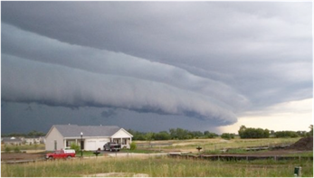
Library that you “extend”
Derecho is a C++ library that supports this model. It replaces a prior system we called Vsync that was coded in C# (still available too).
Derecho is able to run at very high speeds by leveraging a new cloud communication concept called LibFabrics
Originally was created in supercomputing settings
Has a very fast way to run “point to point” over TCP/IP
But can also leverage RDMA hardware.
How does Derecho take advantage of this new capability?

Slide 30
Derecho = RDMA Multicast + Control
Core idea:
Create a multicast using RDMA unicast to move the bytes.
Run the data stream asynchronously, out of band from the control layer. But superimpose a control plane that watches the data and notifies the application when it is safe to deliver messages.
The notifications will be in identical order at all replicas.
Notes:
So… how does it do this magic?
We built some subsystems and wired them together into one big library.

Slide 31
RDMA RELIABLE UNICAST
Source
Dest
Optical link
Unicast
RDMA: Direct zero copy from source memory to destination memory
Can actually transfer data to a remote machine faster than a local machine can do local copying.
Like TCP, RDMA is reliable: if something goes wrong, the sender or receiver gets an exception. This only happens if one end crashes
Notes:
We started with RDMA hardware. Big topic. Basically, though, hardware version of TCP with reliable data copying from a source to a destination. The software initiates the operation but the rest is all done by the hardware at very high speeds.
Way higher than anyone has ever imagined possible.
In fact even faster than the backplane bus in your computer CPU chip.

Slide 32
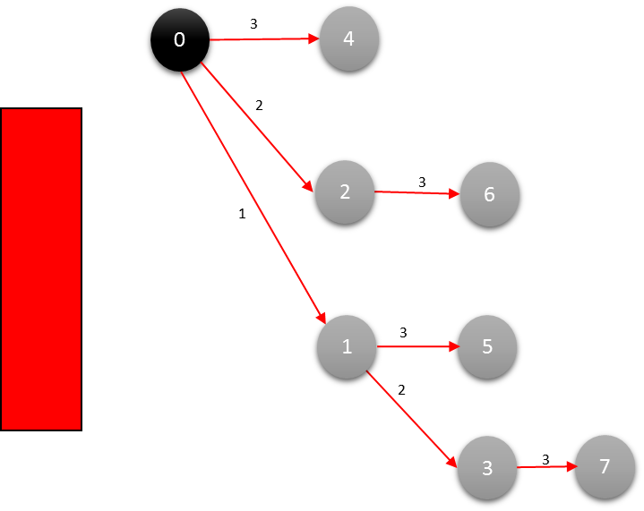
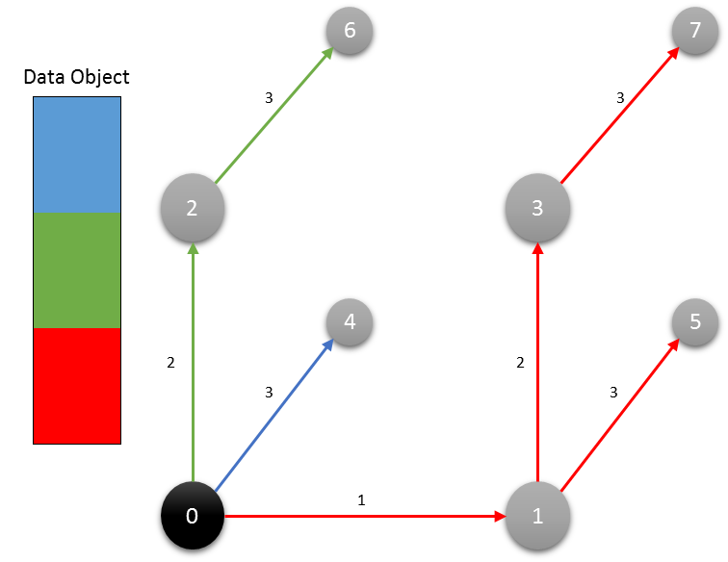
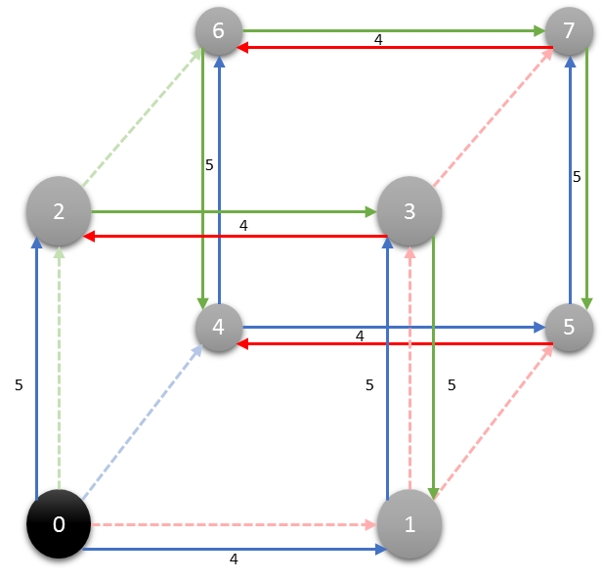
RDMC: AN RDMA Multicast
Dest
Source
Dest
Dest
Dest
Multicast
Binomial Tree
Binomial Pipeline
Final Step
Notes:
Derecho works by building a totally imaginary hypercube over RDMA. Many people find it hard to visualize this pattern. First, make sure you understand that the whole structure is just virtual. Really, we have an all-to-all network, but we are superimposing this pattern (a hypercube, seen in the middle) on the machines. Each node links to the ones around it: 3 links per node.
Next, ignore the illustrations and think about a bucket brigade. Sally, on your left, passes you the red bucket of water. In the next time step, she passes you a green bucket while you pass the red one to Fred, on your right. Then she gives you the blue one while you pass the green one: you are continuously busy, sending and receiving.
Now look at the binomial tree (left), and forget the bucket brigade for a moment. Suppose that Sally is the black node: the root, and that you were node 1. In time step 1 (seen on the red arrow) she gave you the red bucket. In time step 2 (again, see the tags on the arrow), she gives a red bucket (a copy of it) to Tim, while you give it to Fred. Like a binary tree.
In the middle, we’ve wrapped 3 binomial graphs around a virtual hypercube. The origin node hands a red bucket to you, then a green one to Tim, then a blue one to Fred. You and Tim and Fred act like the root nodes in 3 binomial trees, all wrapped on the hypercube. The effect will be very much like a bucket brigade, except that you might get a red bucket from Sally. Then a green bucket comes in from Tim, and you pass the red bucket to Fred. Then a blue bucket shows up from Fred while you pass the green one to Tim. Data fans out over the 3 binomial trees, and every node is busy sending and receiving, both at once, after a short startup period.
RDMC uses this technique to transmit very large objects as a series of smaller chunks (“buckets”), 3 at a time. If the size of the group isn’t a power of 2, we have a trick for filling out the missing “roles” to make things work.

Slide 33
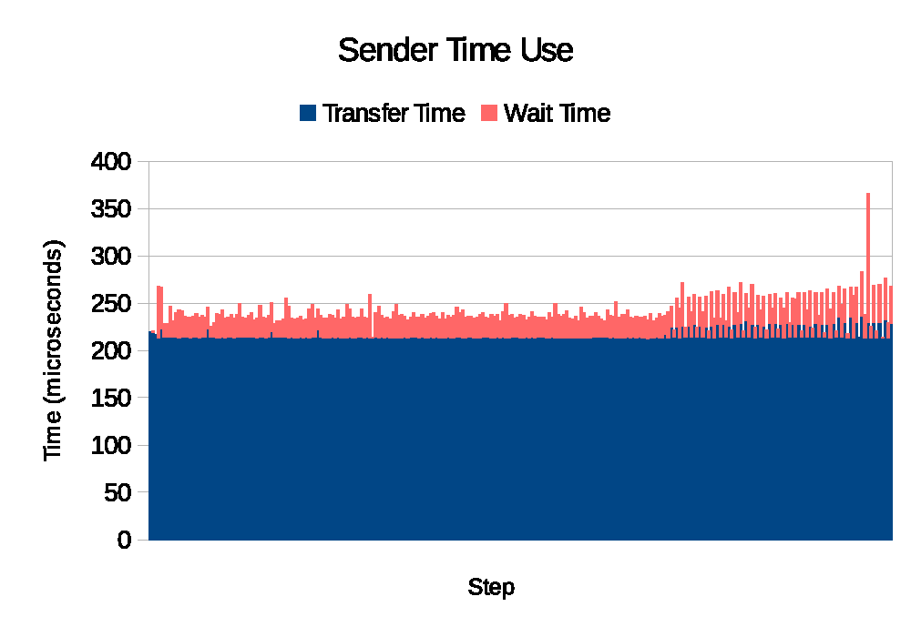
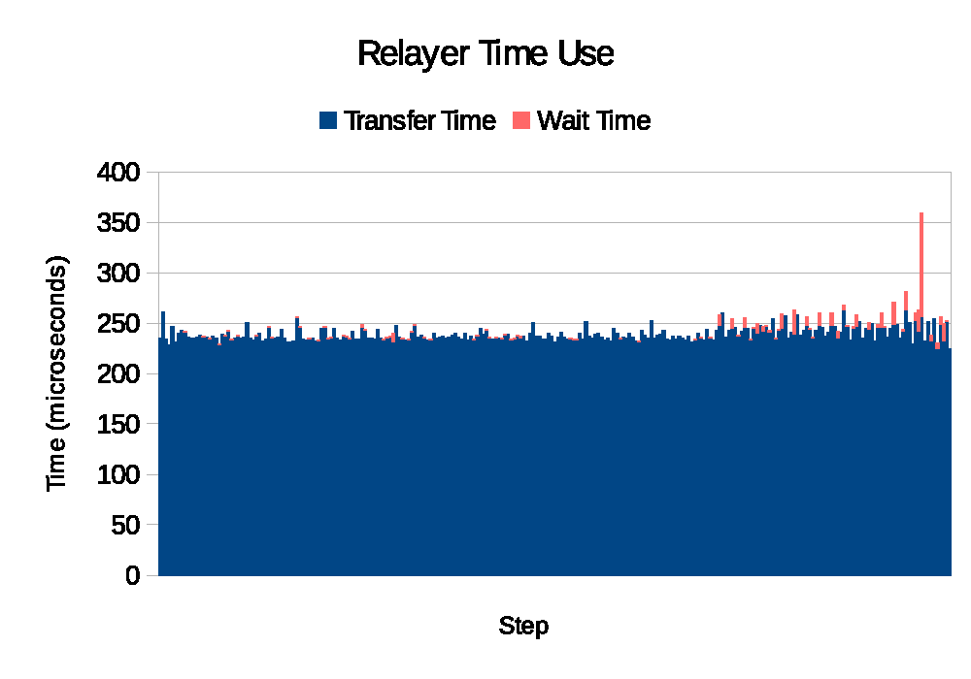
RDMC Mostly Spends Time “in” Hardware
Trace a single multicast through our system… Orange is time “waiting for action by software”. Blue is “RDMA data movement”.
Notes:
This is a picture of a transfer that moved thousands of data chunks (time goes left to right). We can see time spent with the hardware doing the work (blue) and time spent with software involved (orange). The sender is doing a little work in software, on the left. The other members hardly do anything in software at all.
Message: the endpoint machines can use their CPU cores for useful stuff. The data is moved over RDMA.
Ho hum? Maybe, if speed isn’t an issue to you, or CPU loads. But the thing is that because the hardware is blazingly fast, RDMC is too. And because the standard TCP approach puts huge load on the endpoint computers, we’ve recovered a lot of extra compute capacity. So for people who pay for computers, this is a great story: less time wasted, and more computing resources for useful tasks.

Slide 34
RDMC is incredibly fast, once the pipeline is full
Data streams continuously.
Hardware actually does all the hard work.
But RDMC doesn’t address most of the issues Paxos was invented to solve.
If a failure occurs, RDMC can freeze in a messy state.
Derecho provides total ordering, membership tracking, and “cleanup”

Slide 35
Challenge: Layering Paxos over RDMA
We use a novel “monotonic logic” programming approach
Coded using predicates that, once true, remain true
Enables a highly asynchronous style of coding
Implemented in an RDMA-based “shared state table”: the SST
Details beyond our scope in today’s talk
Notes:
This part gets hyper-technical and we’ll just brush over it.

Slide 36
Implementation: Derecho = RDMC + SST
Derecho group with members {A, B, C}
in which C is receive-only
V₃ = { A, B, C }
Current view, showing senders A and B
C is a “receive-only” member
A
B
C
A
B
C
A
B
C
m_{A:1}
m_{A:2}
m_{A:3}
m_{A:4}
m_{A:5}
m_{B:1}
m_{B:2}
m_{B:3}
m_{B:4}
 | Suspected |  |  | Proposal | nCommit | Acked | nReceived |  |  | Wedged
A | F | T | F | 4: -B | 3 | 4 | 5 | 3 | 0 | T
B | F | F | F | 3 | 3 | 3 | 4 | 4 | 0 | F
C | F | F | F | 3 | 3 | 3 | 5 | 4 | 0 | F
B fails, resulting in an
uncertain state
Notes:
Basically, Derecho treats RDMC like a multi-TCP channel from one sender to all the receivers in some shard. Since we have lots of shards and lots of senders, Derecho might make a lot of these RDMC sessions. We see two here.
Then it uses a second thing (we’ll discuss it in a different lecture) called the SST to coordinate and agree on delivery ordering and to handle failures. The SST is seen on the right here. (The table).
So we are building a very sophisticated system out of these pretty sophisticated components. But the data flows through RDMC.

Slide 37
Derecho is a Multicast AND a LogGing Tool
As a multicast, Derecho moves data from DRAM to DRAM at insane speeds
Reliable, totally ordered, can use the “view” to coordinate
Data purely in Volatile<T>
As a storage solution, the received data is saved to persisted storage
This yields an append-only log: Write once, read as often as you like.
Data in Persistent<T>
Notes:
By doing this, Derecho implements Paxos (remember slide 3?)
And Paxos can either be a one-to-many message solution, aka atomic multicast, or a way to update a log (a replicated append).
Derecho offers a way to manage those logs that it actually borrows from the freeze frame file system (remember lecture 5?)
Internally, the C++ programmer sees a new kind of array. We call it a version vector. Externally, the world sees what looks like a GFS (specifically, HDFS) with read-only files and temporal snapshots that are consistent. (remember Chandy/Lamport?)
So all these ideas come together.
And the Derecho develop can embed intelligence right into the data path. Remember Cosmos? Same concept. But now with better time handling, consistency, fault-tolerance, and way faster.

Slide 38
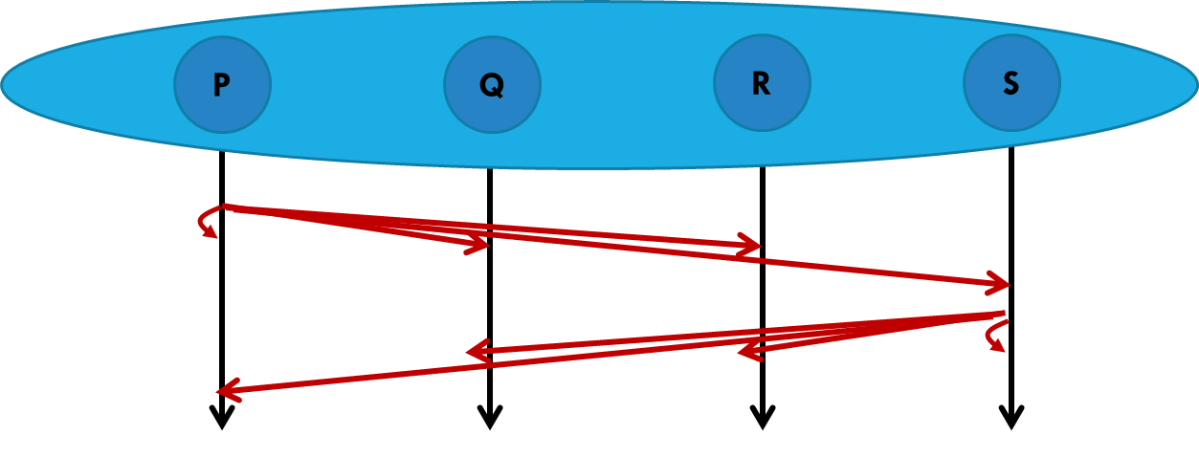
Derecho: small messages
Mellanox 100Gbps RDMA on ROCE (fast Ethernet)
100Gb/s = 12.5GB/s
Notes:
With small messages Derecho runs at about 8 million per second if everyone sends (red is all to all), half that if half of the members send (blue). The performance with just one sender (green) tails off from 3M/second with a group of size 2 to .5M/second with a group of size 16.
These are 1-byte messages but in fact up to about 1KB we see similar numbers. This is because RDMA itself actually is using fairly wide data paths. 1 byte leaves those paths mostly idle. So you don’t see a size-related loss of speed until objects get fairly big.
8M/second is very impressive, by the way, on a cluster of 16 machines. Wall Street firms doing high speed trading would love this stuff.

Slide 39
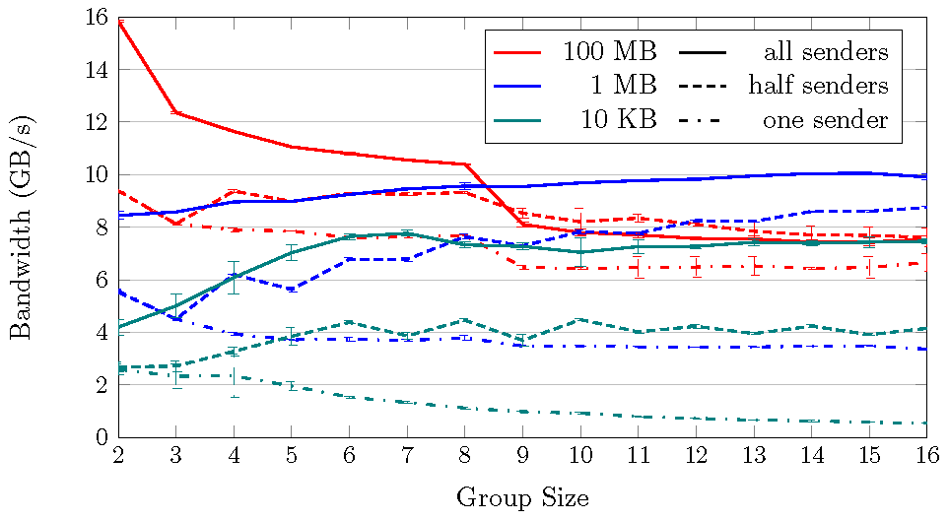
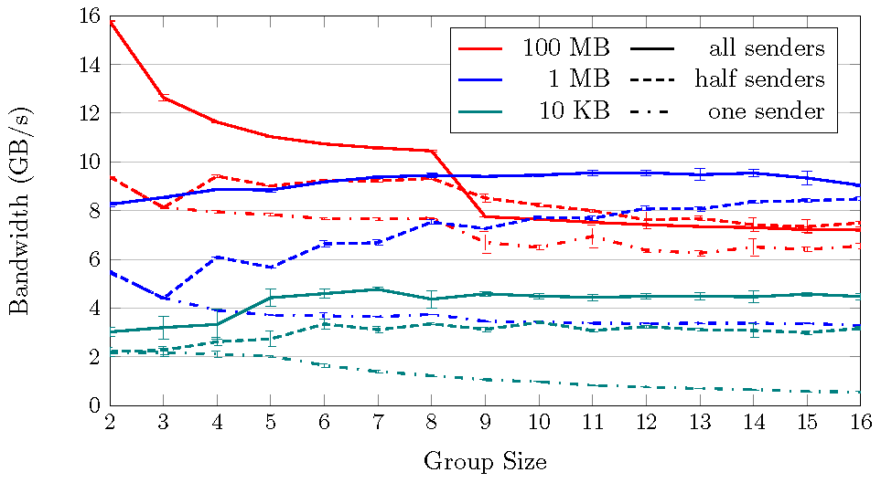
Derecho:
Large messages
Mellanox 100Gbps RDMA on ROCE (fast Ethernet)
100Gb/s = 12.5GB/s
Raw RDMC multicast via Derecho API Derecho Atomic Multicast (Vertical Paxos)
Notes:
Here we see Derecho moving videos (red), photos (blue) and emails (green). On the left, pure RDMC. On the right, Paxos – and we lost no performance at all. Again we have all-to-all, half-to-all and one-to-all, in groups of size 2-16.
The dashed line is the fastest possible speed for copying big objects (ones not in the L2 cache) from memory to memory. Derecho can make 16 remote copies of a video in 1/3 the time (or equivalently, 3x the bandwidth) that you could make one in-memory copy on your NUMA computer using the C++ memcpy primitive.
This is because with RDMA we have lots of DRAM memory units cooperating. With one NUMA machine, one core has to do all the fetch and stores, from one DRAM memory unit. But wow, it is fast.
Notice that the number of replicas has little impact on speed. This is because RDMC uses a tree (we saw that a few slides back). Each new level of depth adds one block-relay worth of delay, but that isn’t much at all. So until things get really big, we see nearly identical speed! Replication is free (well, not the memory impact, but at least the copying part).

Slide 40
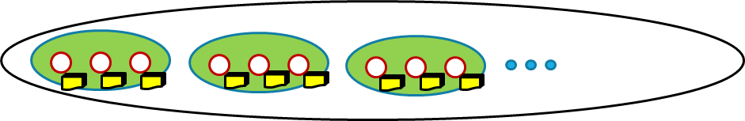
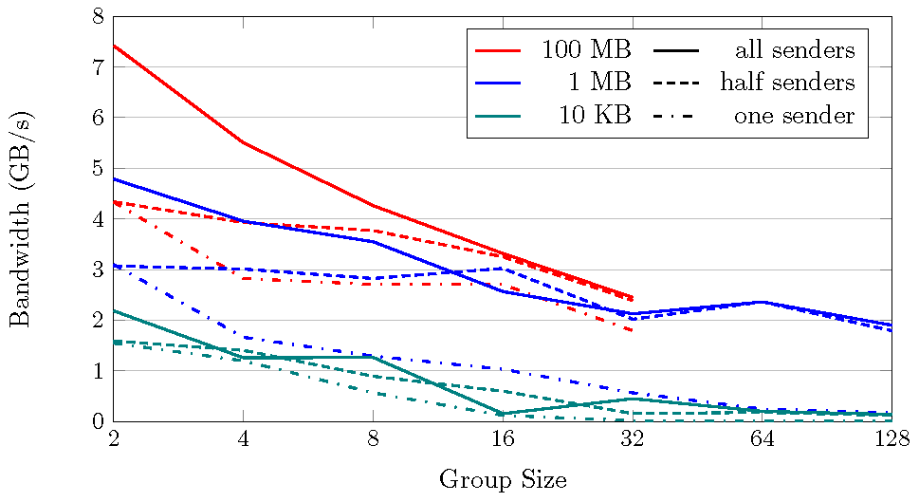
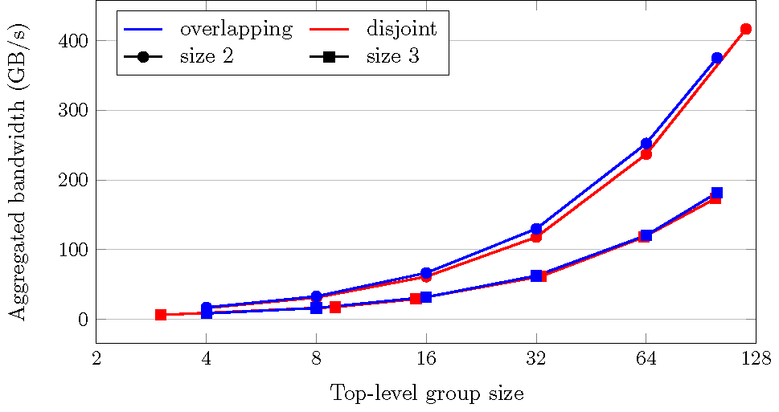
Derecho: Scaling
Large Group of Size N (2…128) Broken into Shards of size 2 or 3
Notes:
At really big scale we do see a little loss of speed (left). Here the video copying wasn’t feasible above 32 members because we didn’t have enough buffer space. But photos and emails are pretty flat, meaning “cost rises slowly, but very slowly.” In fact the video copying for one to all could have been carried to 128 nodes, but we didn’t run that particular experiment.
On the right, we have a group with lots of shards, all independently using Derecho. The aggregate capacity just keeps rising with the number of shards (this is a normal-log graph, so in fact this thing is a straight line). We are up to 400 GB/s of total traffic by 128 members. Compare that with the dashed line on the previous slide, which was at around 3.75GB/s. Basically: the performance here is like 100 simultaneous memcpy operations.
These are very impressive numbers, if you are unsure. In fact the speed is insane.

Slide 41
Version-Vectors with Persisted Data
The figures we saw on slides 35-38 used Derecho for atomic multicast
The next graphs show the performance when saving data into a Derecho version vector for longer storage.
Two cases: a memory-mapped vector, or one also written to SSD disk.
Notes:
As it happens, that data was for data just delivered in memory. What if we saved it to these versioned files (FFFS)?

Slide 42
Volatile<T> Persistent<T>
Notes:
Basically, if you toss a slow SSD store operation into the path, the whole system slows down to the speed of the SSDs.
Even the “memory file system” in Linux is surprisingly slow. Someone should check to see what the issue is. Maybe they don’t do copying in the best possible way? Anyhow, Derecho runs at the speed of the storage layer in this mode.

Slide 43
Other libraries
Paxos is actually a very famous “standard” for replication libraries.
So there are many that use this model.
Some of the most widely used are LibPaxos, ZooKeeper and APUs

Slide 44
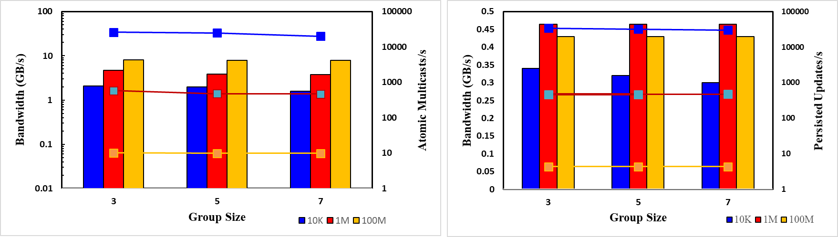
Derecho is much faster
LibPaxos atomic multicast
APUS: RDMA atomic multicast
Derecho atomic multicast
Zookeeper with in-memory files
LibPaxos Persisted to SSD
Derecho Persisted to SSD
Notes:
Hard to understand these but look closely at the axis labels and you will eventually realize that Derecho is 10x to 100x faster, 1000x faster in one case.
These graphs have double Y axis labels. Left is bandwidth (histogram bars). Right is messages per second or log appends per second (lines).
Color tells us which object sizes were used, but some libraries crash with big objects and only work for tiny ones.
Bottom line: Derecho crushes the best options out there today.

Slide 45
Programming with Derecho
Object oriented coding style
Code is written in C++ and can store data in version vectors
Version vectors can also be accessed through the standard Linux file system API, as a second way to read from them.
Exactly like the Cornell Freeze Frame File System.
Notes:
These next slides basically just show that the code looks like standard C++.

Slide 46
… Method Calls, Class Definition
class Foo: Replicated<Foo> {
// Variables that define state of the Replicated<Foo> object
// … Methods:
void put(string s, double v){code...}
const double get(string s){code...}
};
auto outcome = fptr.p2p_send<Foo::put>(who, “John Doe”, 22.7);
Notes:
Derecho replicates classes that the developer defines. The smart methods here are put and get (well, those might be kind of stupid methods). If there is some kind of machine learned model, it would just be in the variables replicated by the class.

Slide 47
Versioned Storage
Committed
X₀
X₁
X₂
. . .
X_{k}
X_{k+1}
X_{k+2}
Now
class Foo: Replicated<Foo> {
Volatile<T> myObj_V(“FileName”); // Declares an in-memory variable
Persistent<T> myObj_P(“FileName”); // Declares a persistent variable
}
// Program-level access to versioned storage:
auto x = myObj; // Default: most current (myObj[NOW])
auto x = myObj[n]; // Fetches version n
auto x = myObj[-1]; // Returns the previous version
auto x = myObj[time]; // Version that applied at specific time
myObj.Flush(); // Delays until prior updates commit (takes ~10us)
myObj.Truncate(n); // Discards versions 0..(n-1)
Notes:
This is how the FFFS files look from inside a Derecho C++ class. You can index by version or by time. Version number indexing gives standard Paxos. The real-time consistency guarantees are for time indexing.
From outside, these are available as read-only files under the name you supply.

Slide 48
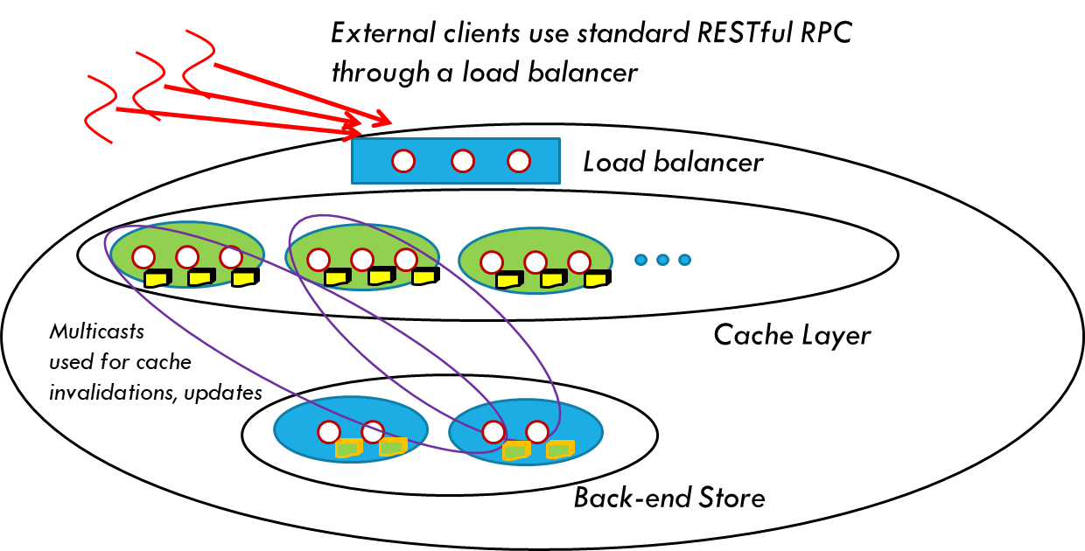
Same Service viewed as a file system
Version vectors opened as files
Posix “snapshot” feature used for indexing
Programs accessing data captured using Derecho via append-only files
Notes:
Picture showing a complex Derecho smart memory service, acting like a big file system via an HDFS API. Like Cosmos.

Slide 49
… Smart Services Can be complicated!
External clients use standard RESTful RPC through a load balancer
Load balancer
Multicasts
used for cache invalidations, updates
Cache Layer
Back-end Store
Notes:
Same service just to point out that the full set of members might span a bunch of distinct roles.

Slide 50
Client QuerY: State Machine Case
Client not in the group asks the group to do a query. A proxy forwards the query, collects the result, and forwards it back.
C
R
S
P
Q
S
RequestBar(12345);
Notes:
Ways of talking to a shard. As a multicast, you get no replies. But you can actually collect replies if you like.
From outside the shard you have to use P2P queries to some member. Paxos is available only inside the shard.

Slide 51
Client QuerY: Ad-HOC Case
Client constructs a target list, but also specifies the time
C
RequestBar(12345, Time = 10:31.05.476);
Cache Layer
Notes:
This guy is querying 3 members of 3 different shards, doing a real-time indexed query. He gets those cool FFFS consistency properties. Also cool: the Derecho update data path is totally different, so these accesses never slow updating down.

Slide 52
API summary: P2P Send, P2P Query
Replicated<MemCacheD>& cache = g.get_subgroup<MemCacheD>(0);
auto outcome = cache.p2p_send<MemCacheD::put>(who, “John Doe”, 22.7);
auto result = cache.p2p_query<MemCacheD::put>(who, “Holly Hunter”);
class MemCacheD {
Volatile<std::map<string,double>> quick_index;
Persistent<image::jpg> photo_archive;
void put(string s, double v){code...}
const double get(string s){code...}
auto register_functions(RPCManager& m, unique_ptr<MemCacheD>* this_ptr) {
return m.setup_rpc_class(this_ptr, &MemCacheD::put, &MemCacheD::get); }
enum class RPCTag { put, get };
};
Group<MemCacheD, CacheLayer ,…> g{sg_info, [MemCacheD factory], [CacheLayer factory] …};
Notes:
This illustrates the P2P version of the API.

Slide 53
API summary: Group Multicast/Query
Group<MemCacheD, CacheLayer…> g(group_leader_ip, subgroup_info);
Replicated<MemCacheD> cache = g.get_subgroup<MemCacheD>(0);
auto outcome = cache.ordered_send<MemCacheD::put>(“John Doe”, 22.7);
auto results = cache.ordered_query<MemCacheD::get>(“John Doe”);
for(auto future : results) { code… }
Notes:
And here we see the multicast case, and the multi-query case.

Slide 54
Paxos Guarantees are pervasive
Every application has a consistent view of membership, and ranking, and sees joins/leaves/failures in the same order.
Every member has identical data, either in memory or persisted
Members are automatically initialized when they first join.
Queries run on a form of temporally precise consistent snapshot

Slide 55
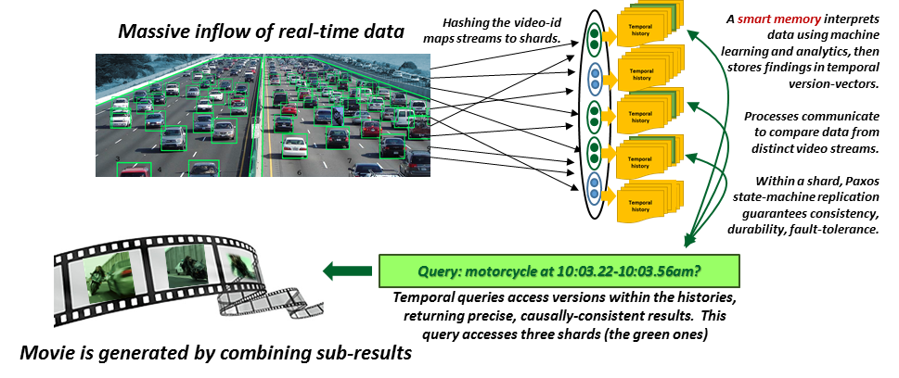


Smart Memories for Smart Highways
Derecho helps you build this kind of structured service, in C++
Notes:
Big picture again.

Slide 56
Conclusions (1)
Many cloud computing tasks reduce to membership tracking and data replication (sometimes trivial)
Leslie Lamport’s Paxos specification explains exactly how to ensure that your replication solution will be correct. Virtual synchrony adds membership flexibility.
Derecho implements this model and can support complex smart services, atomic multicast as well as durable Paxos, and has many other features.

Slide 57
Conclusions (2)
One caveat: Today’s Derecho requires special hardware (RDMA)
But in fact work is underway to port it to run on TCP too. That won’t be quite as fast (but it will still be pretty impressive)
Tomorrow’s Derecho could then fill the needed edge computing role.

