Slide 1
How Fog Computing And Fast-Changing DATA FORCES US TO RETHINK THE CLOUD
Ken Birman
Spring, 2018
Notes:
Despite the buzz-words, this lecture won’t actually be about far-fetched futuristic stuff.
First, “fog” doesn’t mean much more than “edge, plus sensors”. Facebook is already an edge computing company and is very keen to interface to a wider range of sensors (plus what is a sensor? Many people would say “a mobile phone”. Facebook is already there). Same with Amazon and Microsoft and you name it.
So put the fancy language to the side. What today’s lecture is about is basically “adding real-time to the cloud”.
But what about the 100ms thing? Wasn’t it already a real-time cloud??

Slide 2
Today’s Topic: Consistency + Big data
Goal was rapid responses (sub 100ms) for cloud-hosted apps.
CAP told us: To get fast response, have lots of servers that do the whole job
Cache data, don’t worry about staleness
The DHT approach lets us build huge caches shared among the servers.
Voila! Instant scalability! But we often serve up stale data.
Notes:
The question centers on data that changes. CAP was about photos and they don’t actually change over time. A cached photo can’t be stale: it is either in the cache (and correct) or not in the cache (and hence staleness is not relevant).
But something like “the trajectory of that car over there” is changing all the time. If you look it up and get old data, serious problems can occur.
That’s where fog issues arise (the sensors watching the highway, or onboard the cars, are smart sensors wired to the cloud edge). And CAP is terrible advice here. We can’t weaken consistency – it would kill people.

Slide 3
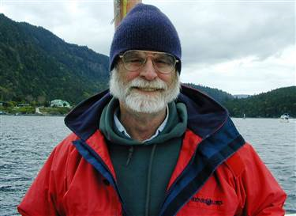
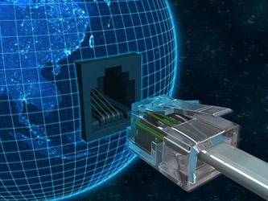
Connecting cloud to world…
Jim Gray (1944 –2007)
What happens as we connect the cloud to the world?
With more and more sensors in the environment, we are starting to do that
Jim Gray (Turing Award winner, super nice guy) explored this and realized that the main issue is data rates: huge rates of (mostly uninteresting) data.

Slide 4
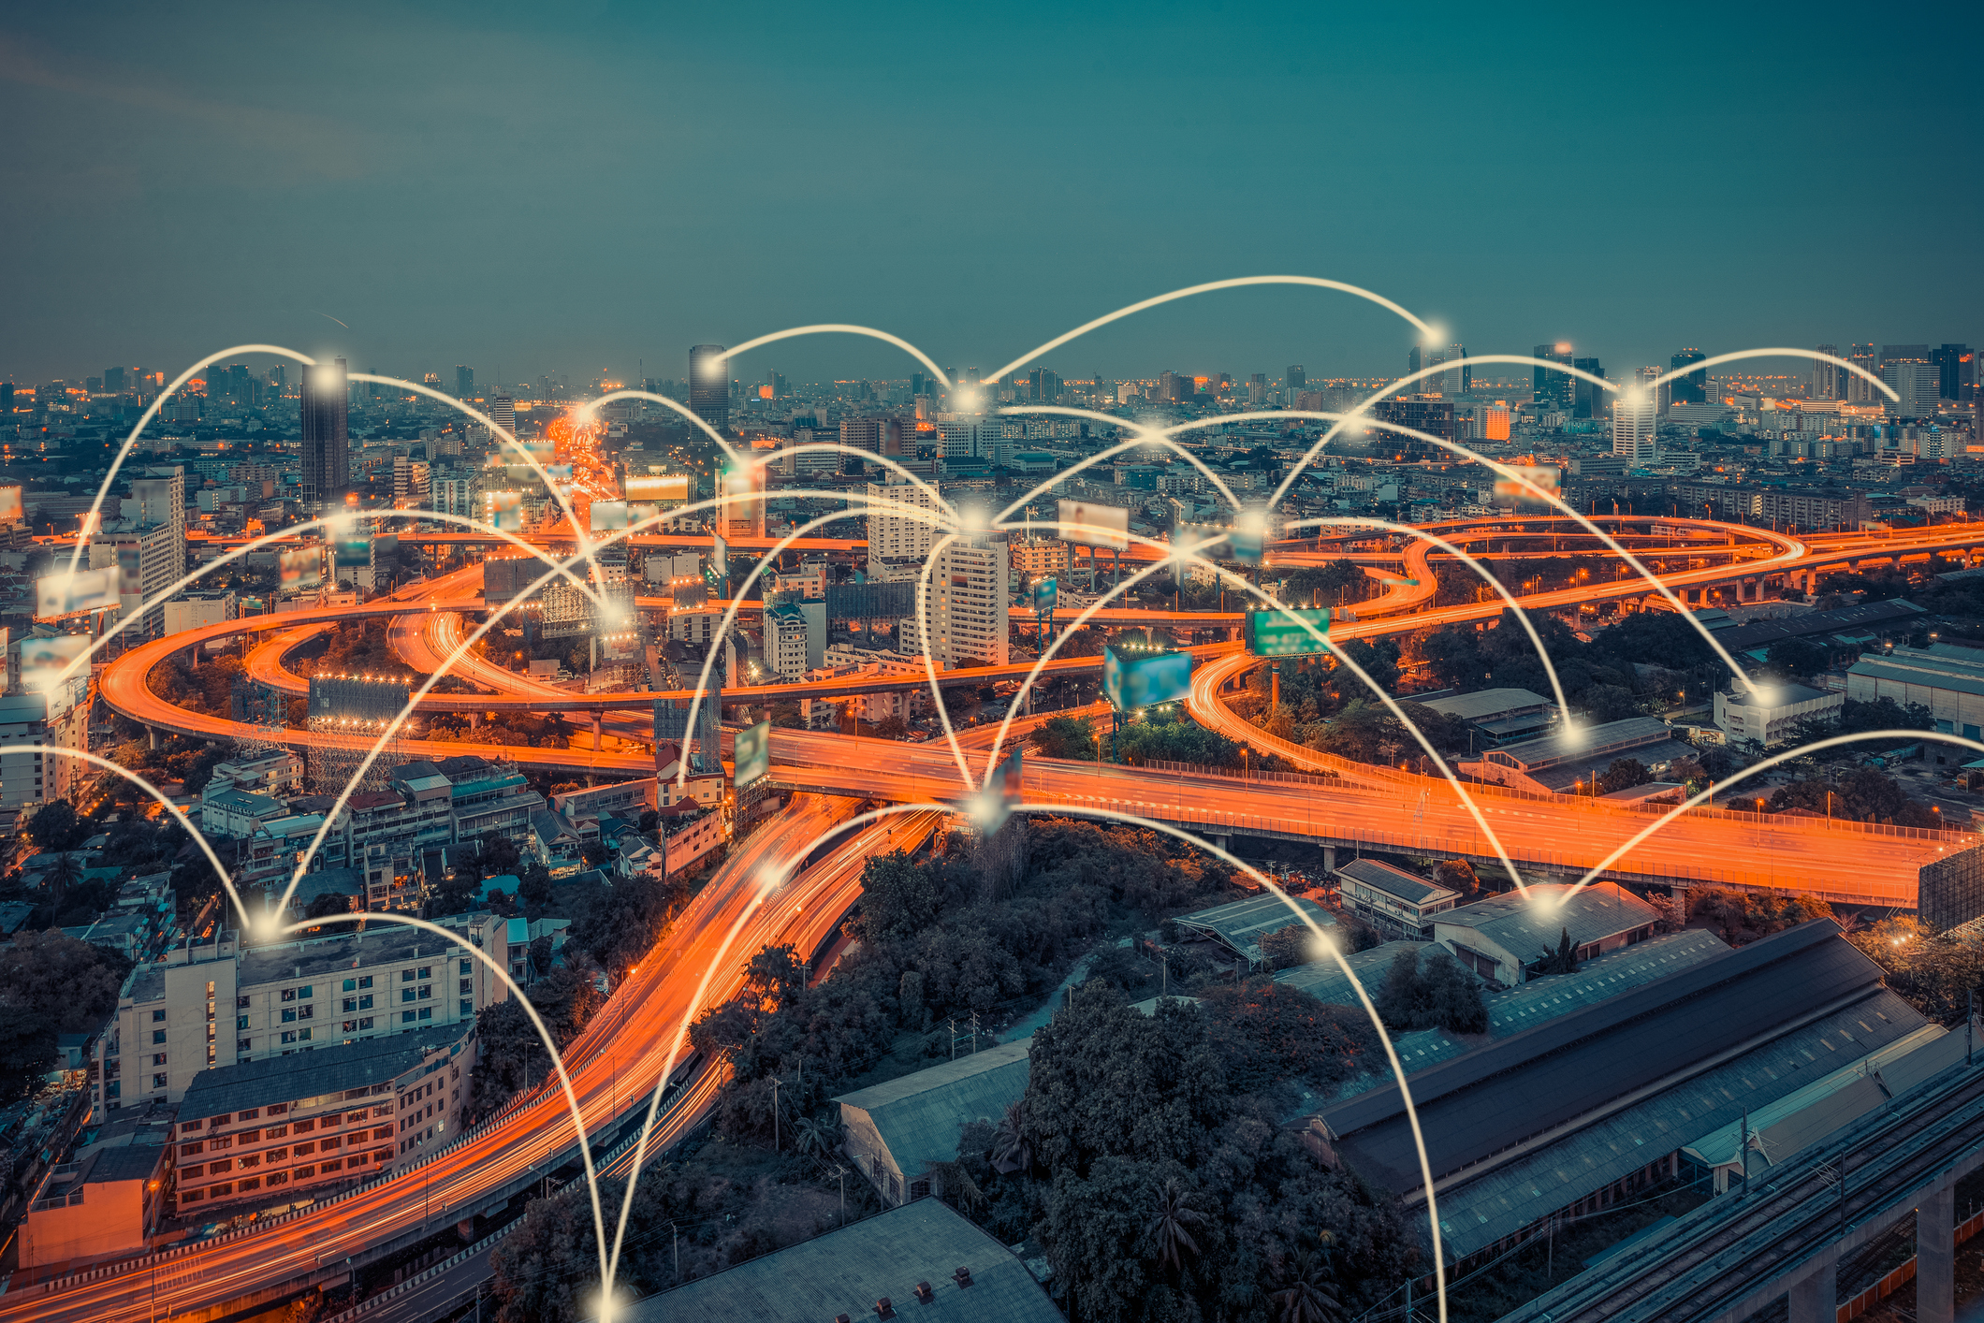
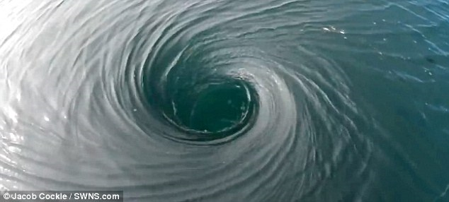
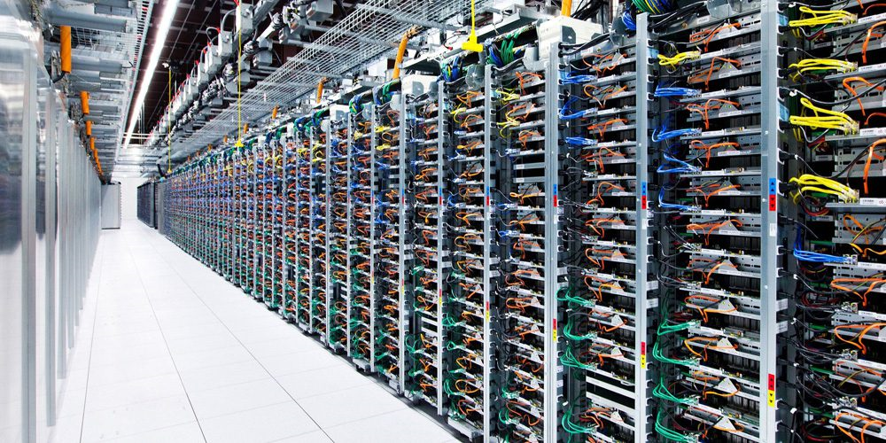
Push the heavy lifting to the edge?
We can probably build sensors smart enough to not send every single bit from the sensors back to the cloud.
But anything “non-obvious” probably does get transmitted
Leads to a vision of the cloud as a huge data sink

Slide 5
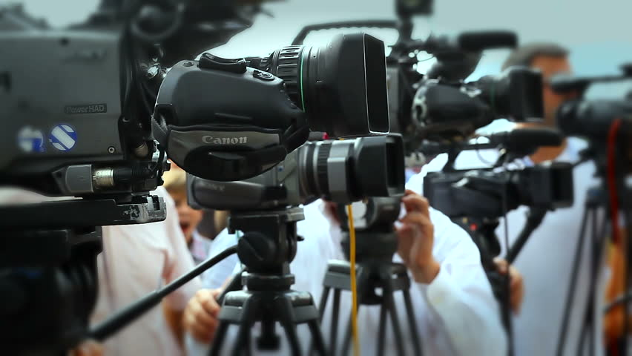
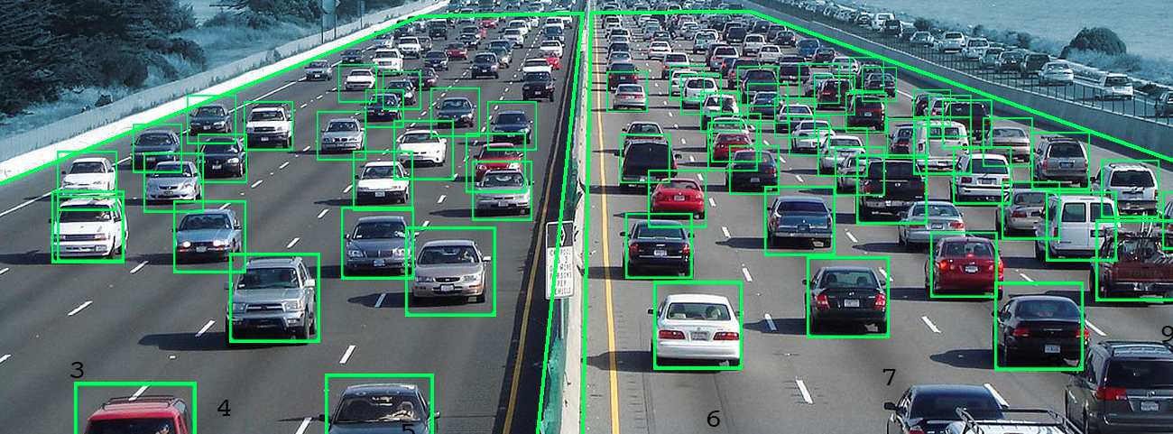
Update Delay leaps out as a worry
Cloud File System
Cloud File System
Delay: Seconds
Delay: Milliseconds
Cloud File System
Tier 1 Servers
Cloud File System
Tier 1 Servers
Cloud File System
Tier 1 Servers
Cloud File System
Tier 1 Servers
Cloud File System
Tier 1 Servers
Cloud File System
Tier 1 Servers
Cloud File System
Tier 1 Servers
Cloud File System
Tier 1 Servers
Tier 1 Servers
Tier 1 Servers
Data appended to files
Filter any “read-only” tasks out
Delay: Minutes
Tier 2 Services
Tier 2 Services
Delay: Many minutes or even hours
Tier 2 Services
Tier 2 Services
Tier 2 Services
Files
Machine-Learned Knowledge Models
Databases
Data Analytics (Parallel Processing)
Notes:
So the issue isn’t the 100ms. The problem is that running a fancy neural network machine learning tool can take a long time. Those systems live way deep in the cloud and run on batches of data after minutes or hours so their output isn’t current as of right now. It always reflects the past.
Does that make them useless? Absolutely not! They are valuable.
But they can’t do real-time intelligence.

Slide 6
But CAP Claimed that this is ok??!
It was ok with CAP only because we were generating Amazon web pages filled with images that don’t get updated. Caching is ideal for those.
In smart highways and cities and power grids, data changes. The state of the world is in constant flux.
For these cases, stale data is a big problem. It causes visible mistakes.

Slide 7
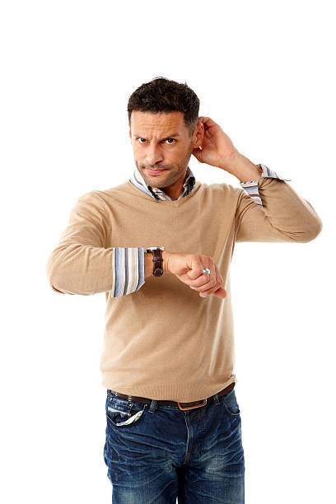
Problem: For “real world” tasks, The cloud is too slow!
A cloud for smart things will need to be faster about updating its knowledge
Right now, the first tier is often seconds, minutes or even hours out of date!
Puzzle: The techniques that let us scale to this degree seem to “need” a lot of time

Slide 8
Where is there room for improvement?
Lets look at each stage
Sensors, “edge” concentrators
First tier systems
Storage layer, data warehouse
Back-end parallel processing engines
Databases and other “knowledge bases”

Slide 9
Sensors: Lots of storage but not much compute capacity
For many purposes, we shouldn’t try to send all the raw data to the cloud
Instead, we capture video, voice, motion, lidar, etc, then store it locally
Think of the “cloud of sensor systems” as a giant file store
It can hold the last few hours of information. The cloud only needs the data relevant to the tasks we need the cloud to perform
Could sensors do more of the heavy lifting?
Can sensors “do more” than in current cloud systems?
Notes:
How smart can a sensor really be?

Slide 10
Why assume dumb sensors?
Computing consumes power and generates heat
Many sensors run in settings that are power and heat constrained.
Fancy tasks such as vision or speech recognition currently depend on specialized and rather expensive hardware.
Too costly to put GPU or FPGA clusters on cameras and microphones for now, and even if we could, the power and heat consideration arises.
Can sensors “do more” than in current cloud systems?
Notes:
Not so smart.
First, nobody wants a supercomputer under their seat in a car, at least in the summer.
Second, the car only knows what it sees. This is very limited. We would need to send it a huge amount of data about everything going on around it, and the bandwidth isn’t there, and the delay of sending it would be way too high.
So we’re forced to make the cloud edge smart. There is simply no other viable option. The way to approach this will be to try and understand how Facebook’s edge works, because that’s pretty much the fanciest edge around (at least if we consider the social network graph as part of the story), and then think about how one could go even further.
We’ll do that but not all at once. It will stretch over a few lectures and they won’t be entirely about Facebook’s edge. Still, that’s the mental model we’re working from. This is important partly because we really want to be sure that we stay rooted in reality and it can be easy to wander off and lose touch with how things really work.

Slide 11
Can we make “Brilliant sensors”?
Some people think we can!
But one issue is how to update the “world knowledge” on the sensors.
With stale world knowledge, they can only be brilliant about things they directly observe…
The world knowledge would need to come from this big cloud computing structure, so if we depend on it, we lose the speedup
This is the meaning of fog computing. Sensors that know enough to play part of the cloud computing role.
Conclusion: Sensors are getting smart, but will need to integrate with the cloud.
Can sensors “do more” than in current cloud systems?
Notes:
You read a lot of very speculative stuff about super smart sensors, for example. These are in the “way out there” category, no matter what the MIT technology review or Computerworld may seem to be claiming.

Slide 12
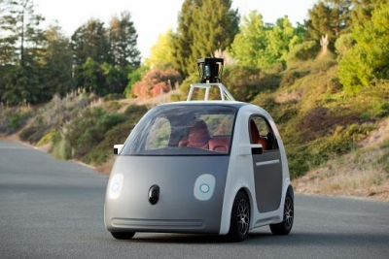
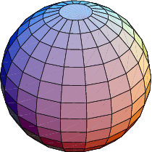
Cloud-hosted Brilliant Sensor
What if we move to a model in which each sensor has a cloud-hosted manager that lives in the cloud and does things on its behalf?
The “manager” role is sometimes called a “concentrator” or “aggregator” because one of these cloud services could handle many sensors
Back-End
Tier-1 Concentrator
Notes:
If the edge is smart, what name should we give for the portion of the edge that hosts the smartness for a particular set of sensors? We’ll go with data concentrator or smart memory or aggregator. Mostly the former.

Slide 13
New FOG-Capable Cloud Model
Cloud File System
Cloud File System
Delay: Seconds
Delay: Milliseconds
Cloud File System
Cloud File System
Cloud File System
Cloud File System
Cloud File System
Cloud File System
Cloud File System
Cloud File System
Back end isn’t changed, but because the concentrator responds instantly, is under less time-pressure.
Smart data concentrator tier reacts instantly!
Data appended to files
Delay: Minutes
Tier 2 Services
Tier 2 Services
Delay: Many minutes or even hours
Tier 2 Services
Tier 2 Services
Tier 2 Services
Files
Machine-Learned Knowledge Models
Databases
Data Analytics (Parallel Processing)

Slide 14
This would result in a new First tier
We would have the old first-tier architecture with servers focused on web interactions, supported by second-tier services like DHTs
But a new kind of first tier consisting of a vast array of concentrators, operating on behalf of sensors (each would “own” some set of sensors)
These concentrators would need to be “smart” enough to:
Perform real-time tasks, very quickly.
Reduce the data load so that less data needs to be saved and the back-end has less work to do when it runs.
Concentrators can do tasks sensors can’t
Notes:
These critters will live right in the edge like other first-tier things, but they might have extra help, like special hardware.
Don’t think of the first-tier as locked down. Yes, today’s first tier would be very lightweight containers in VMWare or Mesos. But if the real-time cloud pushes us to need FPGA accelerators or GPU units in the edge, we’ll just deploy those. So a data concentrator could be a heavy-weight, more capable kind of unit. Not necessarily a featherweight AWS instance with absolutely minimal resources.

Slide 15
Where should Data Concentrators store the mL model, and new data?
Storage and data warehousing is normally part of the back-end.
Should the concentrators just write data into files in the same bank-end storage servers used in today’s cloud?
To answer this, it helps to understand how cloud-scale file systems work
Evolving the storage and data warehousing layer
Notes:
One insight: these things won’t be stateless (recall from the last lecture).
They need a place to store data, like updates to where cars are located or heading, and the storage layer may need properties unlike what you see today.
Let’s look closely and try to understand the need.

Slide 16
GFS in a single data center
NameNode
NameNode
DataNode-1
DataNode-2
DataNode-3
DataNode-1
DataNode-2
DataNode-3
The GFS “Name Node” is responsible for “MetaData”
File names (still in the usual directory hierarchy)
Creation and access time, owner, permissions
List of where the data is actually stored.
The GFS “Data Nodes” hold the data itself, in large chunks.
Files can be huge: they are often “striped” over multiple data nodes
Both are replicated to ensure high availability and fault-tolerance
One or two backups suffice (we say the replication factor is 2 or 3).
Evolving the storage and data warehousing layer
Notes:
We’ll start by appreciating how standard GFS works today. There are a few GFS technologies (like Amazon S3, Google’s actual GFS, Azure fabric storage, etc). But they are all pretty similar.

Slide 17
Writing to GFS
Client opens the file via a remote method call to the NameNode (also called an RPC)
Response tells the client where to put the data (which data nodes and where they should store it)
Client talks directly to the data nodes
They mirror the updates to the replicas
1
NameNode
NameNode
2
DataNode-1
DataNode-2
DataNode-3
3
DataNode-1
DataNode-2
DataNode-3
Client Program
Evolving the storage and data warehousing layer
Notes:
The replication functionality is part of Linux and is easy to enable. It just shadows any updates to the backup.

Slide 18
HDFS, Ceph
These are examples of open-source cloud computing file systems that use a GFS-like architecture: different implementation, same idea
They employ the “POSIX” file system API. Very standard.
But they do have a form of “time based” snapshot
You can ask the system to remember the file system as of 10:13pm on Tuesday, and they create a read-only folder with that data in it.
Ceph goes a little further: it also extends POSIX with new object-oriented features. In Ceph, data isn’t just bytes, but is understood to be stored versions of objects.
Evolving the storage and data warehousing layer
Notes:
These are fancier “names” but just other kinds of GFS solutions. Ceph takes the basic Posix file system API and adds a way to do “object oriented” files. Many people like this idea because they find the normal file model (“bucket full of bits” with a seek/read/write API) to be annoying and hard to work with.

Slide 19
Issues for using these in Fog settings
Storing large amounts of data can take a long time.
Writing bytes to disk is limited by network and disk transfer speeds
One of the main reasons the back-end runs with long delays
But in fog settings, concentrators must respond with small real-time delays
Time matters when objects are in motion… we have deadlines…
A further issue: With GFS, HDFS and Ceph, files have low “temporal quality”
Gets back to Lamport’s ideas about consistent cuts and snapshots
Evolving the storage and data warehousing layer
Notes:
So now we bring real-time back in, and consistency too.

Slide 20
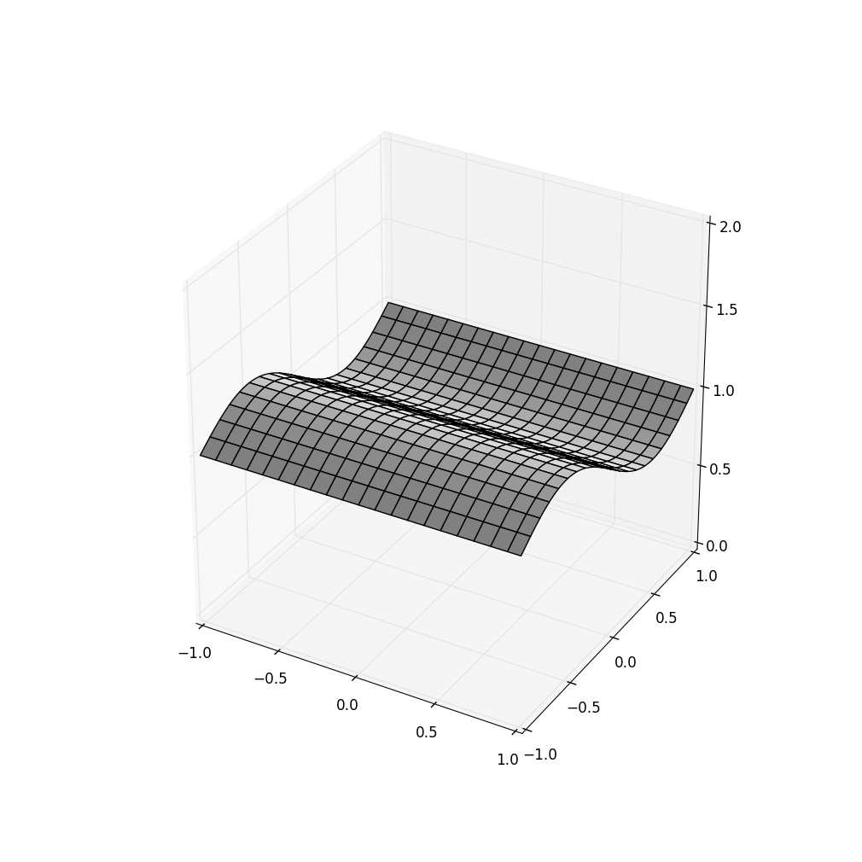
An Experiment we tried
Create a simulation of a wave in a fluid medium, like a lake (or a power grid), 20 frames/sec
Fragment into 400 “pixels”, and make a movie for each distinct pixel: 400 movies, each showing just that one tiny pixel.
Mimic 400 sensors streaming these to cloud
Store into files, 400 of them.
Assemble a “movie” using the file-system snapshot feature (“show me data at 10am”) and then gluing the data into 5 frames per/sec
Notes:
Understanding this experiment is important. Take the time to visualize it. Think of 400 mini-cameras sending one photo at a time, 20 per second each, carefully synchronized with ultra-good GPS clocks. So these photos are perfectly accurate in time.
In this example we simulate a wave in an aquarium and the cameras photograph cells of water as they bob up and down. Just a silly example, but it will make our point.
Notice that there is one wave, but we are getting 20 frames per second from 400 cameras, hence a total of 8000 photos per second are flowing into the cloud.

Slide 21
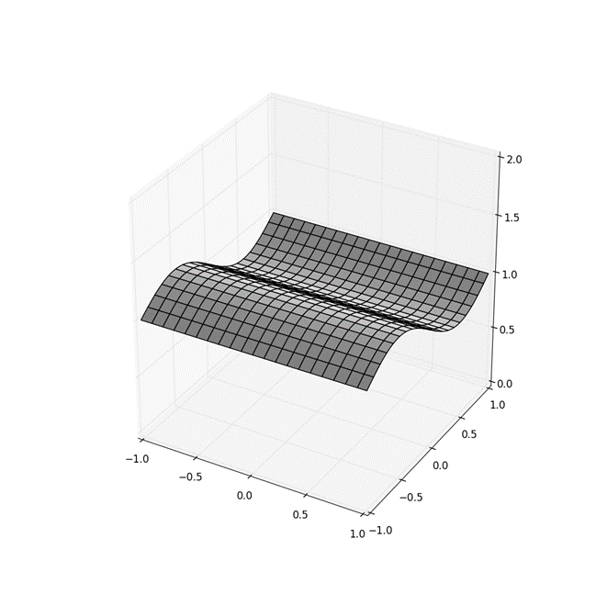
For example
5 fps… 20 fps
The file for this pixel might include these images. If you turned them into a movie, it would show a little box moving, like a floating piece of paper bobbing up and down in the lake.
With perfect timing accuracy and consistency, we would simply get every 4th frame
Notes:
Suppose we take every 4th frame, to make a movie with a 5fps rate.
We just glue the mini-photos together, all 400 for time 10:00:00.000, then all 400 for time 10:00:00.200, etc. We should get a nice clean image of the wave in the aquarium at some single instant in time, right?
Then we can just visualize the resulting movie.
Now, storing our data into one file per camera won’t matter, right? We can have 400 files, one for each.

Slide 22
What can go wrong?
A sloppy snapshot might not give us every 4th frame in a clean way.
Our floating piece of paper will seem to jump erratically.
Our example is very simple, and there are no “read-then-write” events.
But suppose a system reads X, then computes and saves Y. X → Y.
The file snapshot feature would need to compute a consistent cut.
Otherwise, we could see Y, but not the version of X on which it depends!

Slide 23
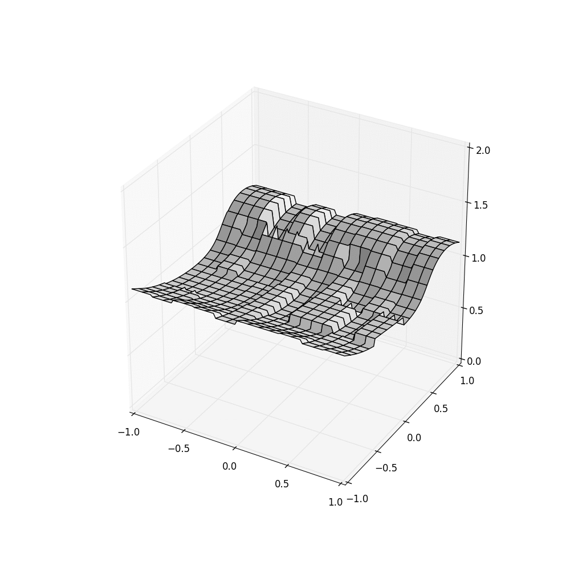
With Standard Cloud, both are issues!
HDFS FFFS+SeRver Time FFFS+Sensor TIME
Looks terrible!
Existing file systems (like HDFS on the left) make mistakes when handling real-time data. But we can fix such problems (right).
Evolving the storage and data warehousing layer
Notes:
Oops.
HDFS is massively screwed up.
Like a mashup. Data from different times is jammed together, and even inconsistency in the Chandy/Lamport inconsistent cuts sense. (See, this is why we learned about that idea a week ago!)
Middle picture shows a file system we created at Cornell called FFFS. It uses consistent cuts but in this image, was using server time on the file server units. That isn’t where the cameras were located, so some inaccuracies sneak in due to TCP being a little erratic and sometimes taking too long just to get the photo from the camera to the server.
On the right we see FFFS but now it is also taking time directly from the photo metadata. Perfect.

Slide 24
What are the two FFFS animations?
The Freeze Frame File System was created at Cornell recently. Open source and available on GitHub. Very fast!
FFFS is specialized for sensors with timing embedded in the data.
And it understands Lamport’s consistent snapshot concept.

Slide 25
“inconsistent” fog computing
If a machine-learning system pushed into a data concentrator tries to figure out car motion paths using inaccurate timing, it might think cars are moving in strange ways!
In general, we will “learn” a noisy version of the situation
So clearly, for any kind of fog computing scenario where we want correct behavior, accurate time will be important
Notes:
The thing being… if we used HDFS in the fog (the real-time cloud edge), we would be running our smart car control system on this very low-quality data!
The noise is huge and will mess it up. No system can work with this level of noise (a little noise is less of an issue).
We want better input… because we’ll get better output.

Slide 26
How can FFFS gain such good accuracy?
Internally, FFFS keeps files in a log format even if the application does random seeks and writes to the middle of a file.
Each update is timestamped using both “sensor time” and “server time”
The timestamps themselves contain a mixture of a real-time clock value and a Lamport logical clock value (we called these CausalClock values)
When reads occur, FFFS automatically reads along a consistent cut.
Evolving the storage and data warehousing layer

Slide 27
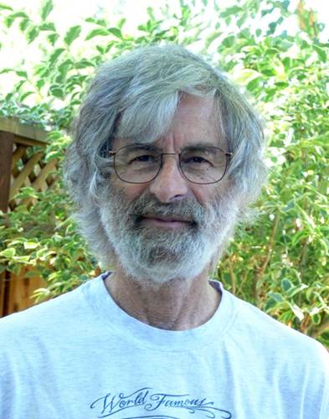
Recall: Consistent Cuts
A cut is consistent if no “message arrows” go backwards through it
… this cut is a consistent one.
D
P
H
Q
B
R
C
F
S
G
T
E
U
Drill down: CAP Consistency

Slide 28
Recall: INConsistent Cuts
A cut is inconsistent if “message arrows” do go backwards through it
… this cut is inconsistent. C → D, and the cut included D, yet it omits C.
A backwards message
D
P
H
Q
B
R
C
F
S
G
T
E
U
Drill down: CAP Consistency

Slide 29
Intuition: A consistent cut is a state that actually could have arisen!
Timelines for different processes are “elastic”
A process could have run faster, or slower
By simply slowing or speeding some timelines, we can straighten a cut!
D
P
H
Q
B
R
C
F
S
G
T
E
U

Slide 30
FFFS: Finds a Consistent cut…
It guarantees several properties:
Temporal precision: if the application is reading at time T, data should be as close to time T as feasible.
Consistency: if we read from multiple storage nodes or files, our reads occur as close to time T as feasible, but also form a consistent cut.
If different programs read at time T, they get the same result – the method is deterministic.

Slide 31
FFFS: Finds a Consistent cut…
Time T “must” be within this region.
Given clocks synchronized to accuracy Δ, find a window around time T
T-Δ
T
T+Δ
D
P
H
Q
B
R
C
F
S
G
T
E
U

Slide 32
How does FFFS learn about time?
Two issues
When you write sensor data to a file, how does it know when the data was captured by the sensor?
When you read from a file, and the data in the file is sensor data, how does it know what time you want to read at?

Slide 33
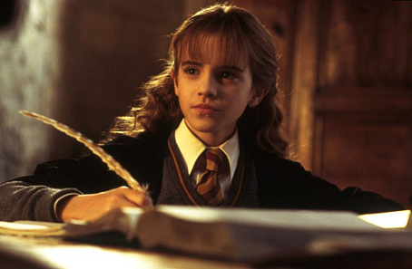
Updates (Writes)
FFFS needs a little module to let it recognize time fields in sensor records
We tie this to the file name extension. You can define time formats for specific file types, and provide the logic for extracting the time field.
Lacking time from the data record itself, it uses closely synchronized clocks, but this means that any lag from sensor into our platform adds imprecision
Notes:
The issue here is that everyone agreed on the file system API back 20 years ago, and it didn’t include getting time from the incoming photo or whatever.
We can do better if we have a way to know where the time field is, but the moment we do this, we aren’t POSIX compliant anymore. Such is life.

Slide 34
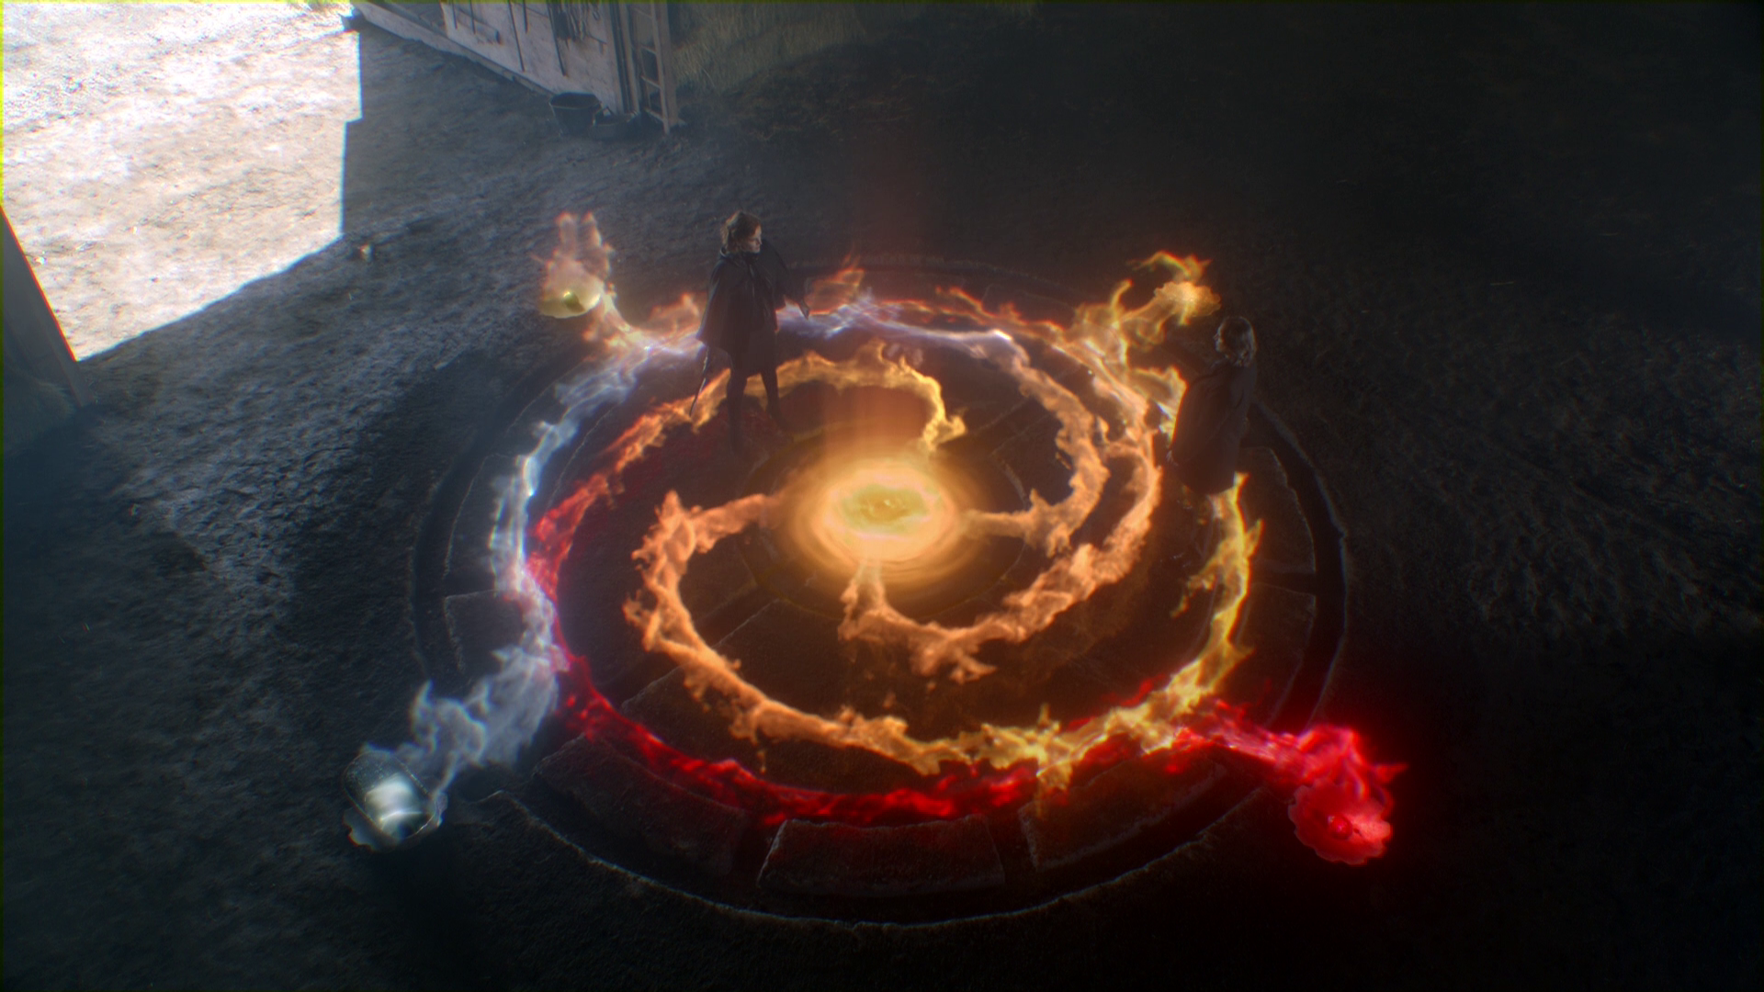
Reads (and Snapshots)
There are several ways to “surf time” when you read files in FFFS.
We support a special file “open” operation with time in the file name path. In effect, open “xyz.dat @ 10:00:03.475”.
We offer millisecond accuracy… you’ll see the data as of that time.
There is also a way to create a directory snapshot, covering lots of files.
Last is a new form of “temporal seek” option you can use directly.
FFFS is like a database of updates optimized for fast temporal search.
Notes:
Reads are easier. There happens to be a POSIX API for doing reads from snapshots.
Unfortunately, this particular POSIX API is disallowed for writes. Otherwise we could use it to find out the sensor time, by having the sensors write through a file name tied to the time. We’re actually thinking we should maybe do this, but it wouldn’t be POSIX compliant if we do.

Slide 35
FFFS is a better file system for FOG Computing!
Super fast. In fact, faster than HDFS, GFS and Ceph.
It drops into the same “role” in the cloud that was previously played by GFS, HDFS and Ceph, but can also be used by the data concentrators in real-time, not only by the backend. Existing code is unchanged.
But because fog systems use time more intensively, it responds to that need with better temporal quality (accuracy) and stronger consistency
Evolving the storage and data warehousing layer
Notes:
Point being: here we have a case where we posed a need (“storage at the edge, for smart data concentrators”), found a problem (“oops: the normal GFS solutions will mess up at high rates with real-time”), proposed an answer (“Chandy/Lamport consistent cuts, plus temporal accuracy”) and were able to create FFFS, a version of HDFS that solves our need.
This illustrates how the edge can evolve by a tiny amount and just like that, work far better for real-time uses.
We think there are a few such needs, and with them solved, we would have a great real-time edge computing story for this new world of smart sensors tied to the cloud.

Slide 36
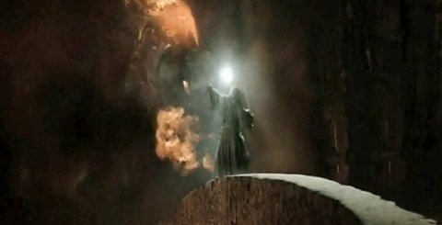
Next steps for FFFS?
Cornell is working now to extend it into a WAN solution with multiple data centers.
We are also connecting it to big data / data analytics frameworks.
Our goal is to make it easy to create a new generation of wide-area time-based computing systems where “time travel” is easy and fast.

Slide 37
FFFS illustrates how the “job” of the cloud is evolving!
Until recently, the job centered on serving content to human consumers
Amazon: They want to shop! Fast!
Facebook: People want to see pictures of kittens! Lots! Fast!!
Netflix: They want to watch TV! Lots of TV!
All of these were focused on rarely-changing data. So caching is extremely effective as a scaling and performance tactic.
Evolving the storage and data warehousing layer

Slide 38
In the future cloud, needs will differ
Smart highways and cars, smart homes and cities, smart grid… These:
Generate huge amounts of data, even if the sensors do basic preprocessing
Will still need to be rapidly reactive, like today’s cloud
And will need to base those actions on the most up-to-date data. . . . This part is the new challenge!
Evolving back-end processing and machine-learning

Slide 39
But FFFS is also about compatibility
Solutions need to co-exist with the current cloud, because it is very painful to modify existing code base, or to just stop using it.
The puzzle is to retrofit new things where previous old things were used, in a way that looks compatible, but has properties needed for new uses!
Notes:
One can’t be too quick to toss out standard APIs, or standard code bases.
There are hundreds of millions of lines of code in systems like AWS, Google, Azure. We want to be compatible with them. We want to preserve absolutely as much of that code as possible.

Slide 40
FFFS highlights that delay has been ignored, and needs attention!
Think about this sequence:
Something happens in the real world. Sensors notice and tell the cloud
The cloud responds instantly, and takes actions
What currently limits delay for “smart” applications?
Delay is very low in the data concentrator and first-tier layer
But it takes too long to store data and “learn” new big-data models
Evolving back-end processing and machine-learning

Slide 41
Evolving Machine Learning
The answer is to move some parts of machine learning to the first tier!
But we don’t want to discard things that already work well.
So this will be a form of “refactoring”
Some things that currently live in the back-end will stay there
Other elements might be migrated to the concentrators and first-tier
Evolving back-end processing and machine-learning

Slide 42
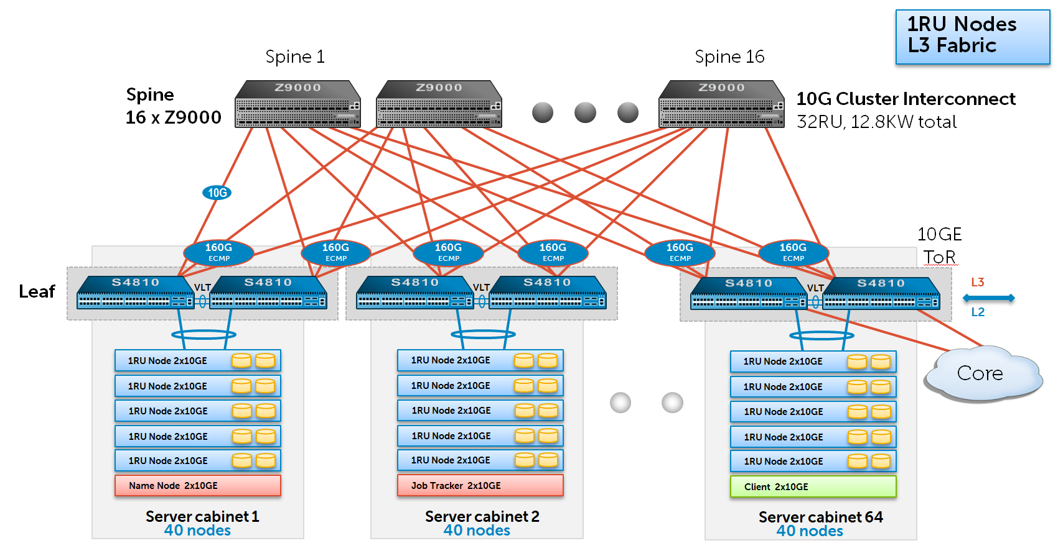
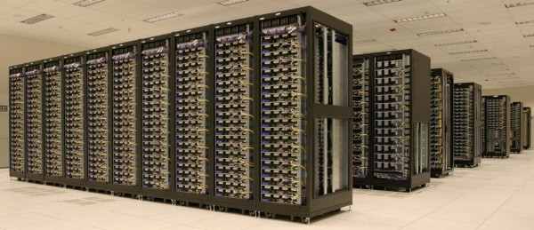
Today: a very “long” pipeline
Data acquisition…. Global File System… Hadoop jobs
GFS
Machine learning typically lives here, at the back
Delay: milliseconds… Seconds…. Hours

Slide 43
New: Move ML to the edge Of the cloud
Data acquisition…. Global File System… Hadoop jobs
ML was at the back
We create a smart data concentrator tier and it runs here, at the edge of the datacenter
GFS
Machine learning typically lives here, at the back
Delay: milliseconds… Seconds…. Hours
Delay: milliseconds…

Slide 44
What gets moved?
Data concentrators in the first tier
We create a pool of “concentrators” at the edge
We provide them with something like the FFFS storage layer
We put machine-learned models into the concentrators
Now, they can classify and interpret data without delay!
The concentrators can even do fine-tuning of the model
Ken’s car is moving at 63.5mph. It was “predicted” to be 65.

Slide 45
Conclusions?
Time out!
Enough for today!
On Thursday we will look at other needs created by this evolution.
But hopefully we can already see that fog computing is solvable!
The challenge is to make as few changes as feasible, so that we preserve the huge body of technology that exists.
Yet must also evolve elements (like FFFS) to do a better job of managing time, consistency, and supporting rapid response!

