Slide 1
CS 5412: Tradeoffs in the Cloud
Ken Birman
Spring, 2018

Slide 2
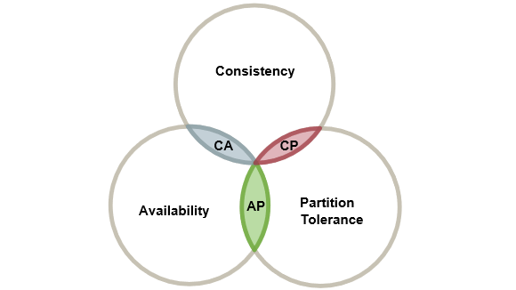
We heard about CAP
Many view the CAP “2 out of 3” rule as a statement about caching!
When we make very heavy use of cached data without checking the back-end systems to make sure the data isn’t stale, we’re assuming that either
Cached items don’t become invalid, or
… staleness doesn’t matter: Nobody will notice.
CAP urges us to just go all-in on caching.

Slide 3
So… what’s CAP?
Reminder: CAP is Eric Brewer’s conjecture that there are unavoidable tradeoffs between consistency, availability and partition tolerance.
But what exactly did Eric mean by these terms?
Is CAP a universal limitation? Are there limits we need to know about?
What is “consistency”, anyhow? Who cares if a cache is “consistent”?

Slide 4
Let us be precise
Fascinating!
The place to start is with definitions.
Consistency is the hard one, so we’ll do it last.
By Availability Eric means “able respond instantly”. Many people assume he means “fault tolerant” but in fact that is not how he uses the term.
He is envisioning a continuously available cloud service, like Amazon.com, and it responds to your queries all the time, 24x7.
Drill down: CAP Availability
Notes:
In a way, he means “real time” even though he uses the term “availability”

Slide 5
How “available” is Amazon.com?
Each Amazon data center has hundreds of thousands of servers to handle incoming web requests.
A browser normally connects to one same server while you browse. But if the connection breaks, it silently reconnects (to a different one).
So for Amazon, first-tier servers are completely interchangeable
Any server can actually handle any request!
Eric used the term “soft state” meaning that the server has no important per-session state local to it (if needed, any state can be recreated)
Drill down: CAP Availability
Notes:
This is that 100ms thing, but now we are talking about being able to send any request to any first-tier system.
So for example your browser could send some request, wait 25ms, and then if no reply starts coming back, could just resend the request as a new one. If you know that 99% of all replies should at least start to show up after 5ms, then that sort of strategy could be one way to get the page rendered within the 100ms deadline.

Slide 6
Soft State or Stateless?
The terms are synonyms. A stateless server might still have local file, local data.
In fact it is just a program running on a Linux image!
So what makes it “stateless”?
All the data it holds locally can be discarded safely, e.g. to make room for other data, or after a crash (we can restart in a clean state).
The term “soft state” captures the idea that we can regenerate needed data from databases and other stateful services. (Those have “hard state”)
Drill down: CAP Availability
Notes:
A ton of students assume that a stateless system can’t have variables – they confuse the concept with functional programming.
But stateless just means “no persistent” data – no files that will be there next week. You can definitely have programs with variables like normal, and they can have files too. The issue is simply that the cloud isn’t backing the data up. Next time the server reboots it will be back to the original state.
So you can save any kind of temporary data you like. But don’t fool yourself into thinking it is permanent. You would have to move it to a longer term storage service (some other micro-service) to make it persist.

Slide 7
James Hamilton’s Three R’s
James is a world expert on massive datacenters
His speciality: hands-off self-management solutions. Nobody wants to rush back to work at 3am to reboot an application.
So cloud systems monitor themselves, watching for anything strange.
The three R’s: If something goes wrong, Reboot. If that doesn’t work, Reimage the whole computer. And if it still fails, Replace it.
Drill down: CAP Availability
Notes:
Jim is very into automated reboot.
The guy also has an amazing motorcycle and a very cool leather jacket. Looks like James Dean, albeit a little older.
Total rock star, to the extent that cloud computing has rock stars. Works for Werner Vogels, another rock star.

Slide 8
Formula for High Availability
Your browser sends web requests, but never trusts that they were received
If the server it was connected to dies, the TCP connection breaks and this resets the HTTP or HTTPS session. The browser just resubmits the page (or for some classes of requests, gives a “server timed out” error)
On the Amazon side, the system monitors various health metrics, automatically, for all tier-one servers.
If a server seems unhealthy, it uses Jim’s three R’s to automatically fix it.
Drill down: CAP Availability

Slide 9
Back to CAP
… So a highly available system, for Eric Brewer, is one with a large number of tier-one servers that are all interchangeable
Your browser connects (or reconnects), and for HTTPS, also exchanges security credentials and constructs a secret session key to encrypt data
On initial connection, it then sends the “cookie” for this site.
Any request can be sent to any server, and most can be reissued.
A request that has the identical “effect” on datacenter state if reissued, is “idempotent” even if the client sees slightly different responses.
Drill down: CAP Availability
Notes:
CAP is all about the idea that instead of the platform enforcing consistency, it can often do a bit less, but do it way faster and more scalably and reliably. Then you can maybe retrofit the amount of consistency you need over this.
Can’t always be done. But sometimes it works.

Slide 10
On to the “P”
Partition Tolerance. What a strange term!
The terminology relates to network connections, but is actually focused on the network inside a data center (or perhaps between two data centers).
We say that a web server is “partition tolerant” if it can respond to new requests without talking to back-end servers first. Thus if a back-end server cannot be reached due to a network problem, it won’t wait.
So, a highly available and partition tolerant service is one that can generate a web page for a client purely from the soft-state local to it.
Drill down: CAP Partition Tolerance
Notes:
P just means “even if disconnected from the back-end databases.”
We prefer to avoid having the edge of the cloud talk to the back-end, ever, even for things like reads.
So in the cloud today, almost everything is in the cache and the outer edge is very focused on cached access.
Works great for photos. The photo of me with my family from Thanksgiving back in 2015 hasn’t changed in a while. Any cached version will be consistent.
Eric’s point is that there is WAY more data like that photo than there is data that changes all the time. So you don’t need to have the platform worry so much about consistency for things like photo caches. All that work would be a waste of compute time and resources. If you have the photo, it is the right version. There aren’t other versions of that particular image.

Slide 11
A and P are crucial properties
They tell us that you can shop Amazon 24x7, even if something has crashed or the network is being repaired.
Your request can be shifted to some other machine, even in a different data center.
Notice that an “AP” system would work best for data that doesn’t change.
Think about movie playback. “AP” are the properties you would want!
Drill down: CAP Partition Tolerance

Slide 12
Why Amazon won (after 2006)
We talked about how web systems changed drastically in 2006.
That was exactly when everyone focused on massive caching, weak consistency, and automated self-management.
The core value proposition centers on…
Scalability. From CAP!
Turn-key automation. Turn it on, and it just runs itself.
Drill down: CAP Partition Tolerance
Notes:
Amazon was first to apply these ideas.

Slide 13
But we can’t always ignore consistency
When we weaken consistency, we end up with systems that might act in strange ways (kind of like delivery of a new car, but with the engine of last year’s model, and forgetting to include the tires).
CAP is a great rule of thumb for stuff like photos of books, or videos.
But what if we actually need consistency? What is consistency?
Notes:
But Eric is, technically speaking, also wrong. If you ignore consistency you get wrong answers for things that do care about changing values. Very unwise.

Slide 14
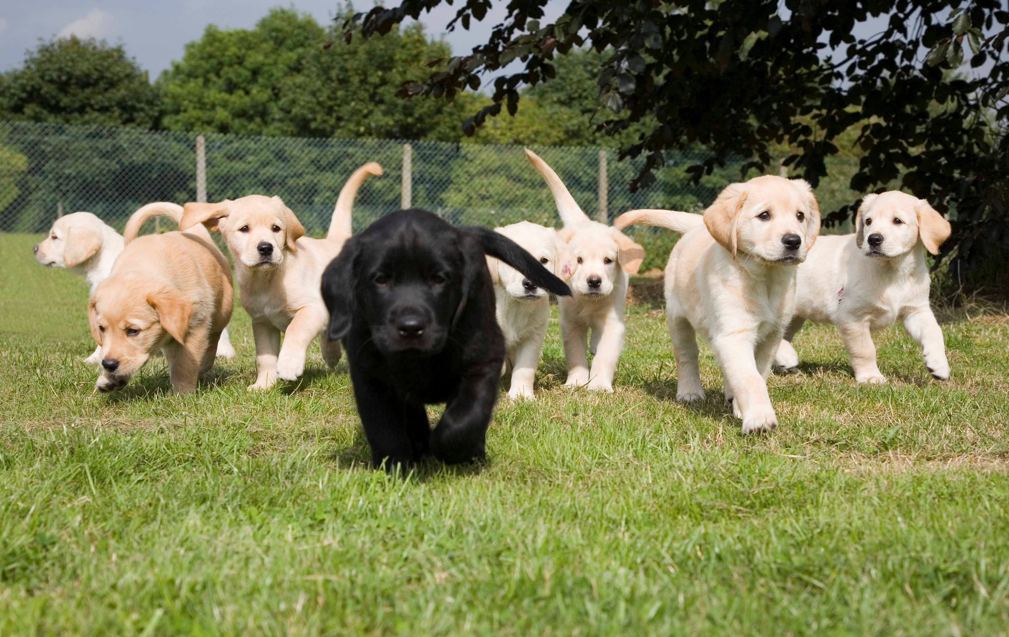
What is Consistency?
This has many definitions, and in fact debates about CAP center on them
One simple idea of consistency is to focus on replicated data.
Here, you could say that the replicas are consistent if they are updated in the same way, so that all go through the same value sequence
But even this simple concept has some complications
If we make replicas in a setting where we use the 3-R’s, how can we know which machines have copies, and are supposed to be updated?
If someone reads data, which version do they need to see?
Drill down: CAP Consistency
Notes:
That black puppy? He is probably not really from the same litter.
The others might be genetic clones, more or less, but the black puppy is not going to look identical to them.

Slide 15
What is Consistency?
In summary: what we need to do is…
Replicate something (data, configuration, a lock…)
Agree on who currently is in the set of replicas.
Initialize them in the same state. If something “joins”, copy state to it
Apply the same updates, in the same order, preserving the order they were requested in (many systems “stream” updates)
Detect failures and handle them in a coordinated way

Slide 16
Consistency poses tough questions…
Some topics are really about software engineering
But others touch on theoretical issues.
Consistency is ultimately about ordering:
The forms of ordering meaningful in a distributed system.
The best ways of agreeing on, representing and using ordering.
Notes:
This would be a great time to go all theoretical.
But we won’t. We’ll stay focused on what cloud companies actually do.

Slide 17
Remainder of today’s lecture
We will discuss
Where update order “originates” and how to track it
How to talk about “the state” of a distributed system
What consistency can feel like in a practical sense, and especially, what inconsistency can feel like. When would it matter.
This material is a building block we will use in the next lectures.

Slide 18
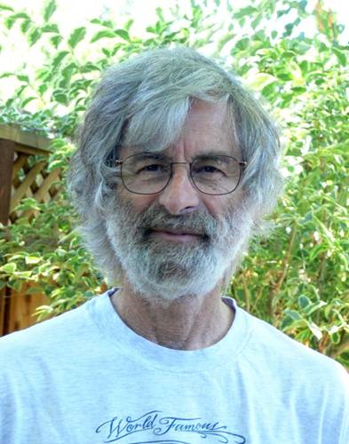
Lamport’s Causal Order
Leslie Lamport is a famous distributed computing researcher
Won the Turing Award
Primarily a theoretician, but he also was the author of Latex
Especially good at elegant ways of posing problems and solving them
He suggested that an important aspect of consistency should involve “consistency with respect to past events”. He calls this “causal” consistency
Drill down: CAP Consistency
Notes:
Oops, we’re doing theory after all. But just in a very specific way.

Slide 19
How does he define causality?
Suppose that event A occurs in a data center, and then later event B.
Did A “cause” B to happen?
What if A was at 10am, and B at 11:30pm. Does knowing time help?
What if A was a command to register a new student, and B was an internal action that creates her “meal card” account?
What if A was an email from the department asking me about my teaching preferences, and B was my reply?
Drill down: CAP Consistency

Slide 20
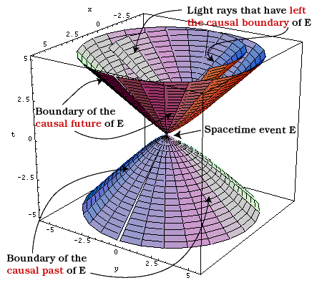
How does he define causality
For Leslie, event A causes event B if there was a computation that somehow was triggered by A, and B was part of it. Inspired by physics!
But this is hard to discover automatically.
Instead, Leslie focused on potential causality: A “might” have caused B.
Under what conditions is this possible?
Somehow, information must flow from A to B.
Drill down: CAP Consistency

Slide 21
Notation for representing causality
Leslie proposes that we write A → B if A potentially caused B.
He suggests that we use the words “happened before” for →
Now the question arises: is → just a mathematical concept, or can we build a practical tool for tracking causality in real systems?
Drill down: CAP Consistency

Slide 22
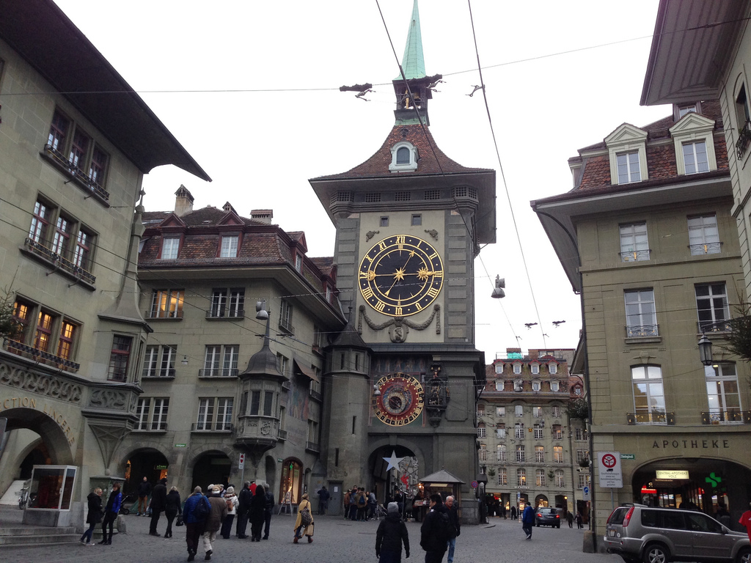
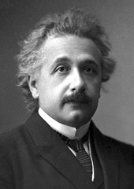
Tracking A → B
Leslie first considered normal clocks. But they don’t track →
Here, he took his inspiration from Einstein (relativity)!
“Time is an illusion.”
So Leslie asked: “Can we build a new kind of “causal clock”? Desired:
If A → B, then CausalClock(A) < CausalClock(B)
If CausalClock(A) < CausalClock(B), then A → B
Drill down: CAP Consistency
Notes:
Help! Math! I’m dying!
Seriously, this is just words and notation for the idea that “A happened before B”. Leslie is just showing us how to write that down as a mathematical equation.
Don’t let it freak you out. Some math is easy.

Slide 23
Developing a solution
Suppose that every computer (P, Q, …) has a local, private integer
Call these CausalClock_{P} and CausalClock_{Q} etc.
Each time something happens, increment the clock.
Now, if A and B happen at P, the CausalClock_{P} can tell us that A → B.
But what if A is on machine P, and B happens on Q?
Drill down: CAP Consistency
Notes:
More terminology.

Slide 24
A space-time Diagram for this case
X
A
P sends M
P
Q receives M
B
Q
Drill down: CAP Consistency
Notes:
Here you can see that X is before A, and A is before B. So X is before B. Just illustrates a few examples of ways happens-before can arise.

Slide 25
A space-time Diagram for this case
Uncoordinated counters don’t solve our problem
Here, A and B end up with the identical Time, so we incorrectly conclude that A did not happen before B
X
A
P sends M
P
CausalClock_{P}
0 1 2 3
Q receives M
B
Q
CausalClock_{Q}
0 1 2
Drill down: CAP Consistency
Notes:
Now if we just count events, we can’t use those counters to track happens before.
We get nonsense.
So Leslie said this won’t do the job.

Slide 26
Aha!
But notice that in the diagram, the “receive” occurs when CausalClock_{B} = 1.
Yet the “send” of M was at CausalClock_{A} = 2.
So Lamport proposes this fix:
Each time an interesting event occurs at P, increment CausalClock_{P}
If P sends M to Q, include CausalClock_{P} in M. When Q receives M, CausalClock_{Q} = Max(CausalClock_{Q}, CausalClock_{M}) + 1
Drill down: CAP Consistency

Slide 27
A space-time Diagram for this case
X
A
P sends M
P
CausalClock_{P}
0 1 2 3
CausalClock_{M} = 3
Q computes:
CausalClock_{Q} = max(0, 3) + 1
Q receives M
B
Q
CausalClock_{Q}
0 4 5
Drill down: CAP Consistency
Notes:
Now the “causal clocks” work properly. If A happens before B, B will have a bigger causal clock time than A.

Slide 28
We now have a cheap partial solution!
With Lamport’s causal clocks, we pay a small cost (one integer per machine, to keep the clock, and some space in the message)
Let’s use Time(X) to denote the relevant CausalClock value for x. We can time-stamp events and messages.
If A → B, then Time(A) < Time(B)
But… if Time(A) < Time(B), perhaps A didn’t happen before B!
Drill down: CAP Consistency
Notes:
But just because B has a bigger time, don’t automatically assume that A happened first. Leslie’s clocks only let us make one kind of inference, not both.

Slide 29
A space-time Diagram for this case
Even if P and Q never talk, we might have Time(A) < Time(B)
If we assume that Time(A) < Time(B) means A → B, we are incorrect
A
P
CausalClock_{P}
0 1
X
Y
B
Q
CausalClock_{Q}
0 1 2 3
Drill down: CAP Consistency
Notes:
P and Q never talk, yet A has time 1, and B has time 3. So you can see that 1 < 3, but also that there was no way that A caused B, or influenced B.

Slide 30
So…. Causal clocks only work in one direction.
They approximate the causal happens-before relationship, but not fully accurately.
Lamport shows many cases were this is good enough.
We actually can do better, but at the “cost” of higher space overhead.

Slide 31
Aside: Vector Clocks Fix this Limitation
A vector clock has one entry per machine. VT(A) = [3, 0, 7, 1]
If an event occurs at P, P increments its own entry in the vector
When Q receives M from P, Q computes an entry-by-entry max.
Vector time comparison rule:
Define VT(A) < VT(B) if VT(A) ≤ VT(B), Now, VT(A) < VT(B) iff A → B but VT(A) ≠ VT(B)
Drill down: CAP Consistency
Notes:
These are a fancier kind of clock that do solve the problem we just saw, but usually we don’t need to work with them. In fact in cs5412 we will never mention them again. In contrast we actually will use CausalClock counters.

Slide 32
Back to our real topic: Consistency
Recall that we were thinking about a replicated data item, and two replicas were updated in the same order. But the question arose: if process Q reads from the replicated data, what version should it see?
Lamport:
Suppose that Q has read value B from variable Y
Further, suppose that there was some update A to variable X, and A → B
… then if Q reads from X, call this event C, make sure that A → C
Drill down: CAP Consistency

Slide 33
What does this mean in English?
In effect, the system must never develop amnesia about the causal past.
Example:
Cornell registrar assigns you student ID 161993 and says “put money in”
Now you go online to deposit money into your meal plan.
It asks you to enter your student ID, so you type in 161993
The system should not tell you that “student ID 161993 is invalid”
A
B
Drill down: CAP Consistency
C

Slide 34
Write this in Lamport’s Formalism
We had event A
Then there was an event B, A → B
And then there was an event C, B → C.
From this we can conclude that A → C, hence it was inconsistent for the system to reply as if A had not occurred: “amnesia” about A
Drill down: CAP Consistency

Slide 35
More fun with Causality
Lamport also showed that you can use → to define “now” in a way that makes sense even for a fully distributed system
He draws a complex space-time picture, perhaps this one:
A
D
P
H
Q
B
R
C
F
S
G
T
E
U
Drill down: CAP Consistency
Notes:
The issue here is how to read the data at “wall clock” (like your watch) 10am and get a sensible answer.
Machines have so-so clock synchronization. If they just write something down at 10am you can get nonsense because messages are flying around at microsecond speeds, which is way finer resolution than clock synchronization.

Slide 36
Consistent Cuts and Snapshots
Lamport asked: Suppose I visit each node, each at some point in time. Can we extend consistency to cover such a case (“consistent cut”)
Or even fancier: what if each node makes a checkpoint for me when I visit it along a cut. Can we end up with a “consistent snapshot”, like a photo?

Slide 37
Consistent and inconsistent snapshot
Truth: 7 Geese in a V formation
Imagine taking photos of our geese one by one and creating a tiled mashup
Notes:
Leslie and Mani Chandy thought about this and realized that the issue is a bit like assembling one sensible photo by stitching together a set of sub-photos. Like this one.

Slide 38
Consistent and inconsistent snapshot
Truth: 7 Geese in a V formation
Imagine taking 28 photos one by one and creating a tiled mashup
Without coordination, some vanish, some are duplicated!
Notes:
… and NOT like this other one. Here the same goose sometimes shows up in several photos.

Slide 39
Consistent Snapshot
If we do it while the flock is passing over us, we should never see any goose twice. The cameras are the processes in this case.
Goal of a consistent snapshot is to let us combine data from multiple processes (machines) in a distributed system, but only count each thing once, with no causal gaps or duplication.
Notes:
Leslie and Mani found a way to map that snapshot question to causal clocks!

Slide 40
Consistent Cuts and Snapshots
Recall: Lamport looks at “pictures” of such a system, like these
A “cut” across the system
D
P
H
Q
B
R
C
F
S
G
T
E
U
Drill down: CAP Consistency
Notes:
Here is how they say to do it. You tell the machines to run an algorithm (I won’t have time to explain how it works, just assume you can look it up if you ever need it) and it makes photos at times that are consistent with each other.
Guaranteed: you won’t end up with a mashup of different geese.
Of course not everyone worries about photos of flocks of geese. But their trick is actually also useful for things like auditing a bank or checking for deadlock.
A bad audit might count some money twice, or miss some. A bad deadlock detector might sense deadlocks that aren’t real. With a consistent cut, if you audit along the cut, you compute the proper bank state. And you can package this up into a simple library method that cloud computing builders can work with.
So this is one case where we don’t agree with CAP. If you are auditing a bank, you need the C in CAP. But you can use Leslie’s ideas to get consistency of this kind, at low cost, and with great scaling. Eric just isn’t always right. Still, CAP makes sense as a starting place. The trick is to know that when you need consistency, there are ways to get it, and they aren’t always hugely costly.

Slide 41
Consistent Cuts and Snapshots
A cut is consistent if no “message arrows” go backwards through it
… this cut is a consistent one.
D
P
H
Q
B
R
C
F
S
G
T
E
U
Drill down: CAP Consistency

Slide 42
Consistent Cuts and Snapshots
A cut is inconsistent if “message arrows” do go backwards through it
… this cut is inconsistent. C → D, and the cut included D, yet it omits C.
A backwards message
D
P
H
Q
B
R
C
F
S
G
T
E
U
Drill down: CAP Consistency
Notes:
Mani and Leslie’s algorithm would never take a picture of machine S before it sent some message, but then mash it with a picture of machine P after that message arrives. And this, in fact, would have been inconsistent behavior, so we should be glad it won’t make that mistake.
For geese: we won’t show the same goose twice: at place S, and at place P.
For money, we won’t show the same money in two accounts, even though really it was just being moved.
For deadlock, we won’t show P waiting for a lock Q holds, and Q waiting for P, unless there is a genuine locking cycle.
Consistent cuts and snapshots are awesome this way. A cut is just what happens if you compute “along” the red line. A snapshot is what happens if you checkpoint all the computers, along the red line, then combine the checkpoints.

Slide 43
A consistent Cut is like a photo
It shows a state the system might actually have been in
You could use that state for garbage collection, or to do an audit of a bank, or to detect deadlocks.
But an inconsistent cut is broken. It omits parts of the past and any conclusion from it would be incorrect.
Drill down: CAP Consistency

Slide 44
Linearizability
One popular definition of causality for CAP is to say that Eric is talking about linearizability.
In a very simplified form, this is the property that the system has no causal gaps or causal inconsistencies.
As it happens, CAP is false if this is your only goal.
Drill down: CAP Consistency
Notes:
I mention this just because a lot of people love this term. It has a lot to do with database ACID properties, so they kind of latch onto it.
But this is a tangent.

Slide 45
Transactional Properties
Database systems offer much fancier guarantees
They allow you to define “transactions” which are complicated programs that read lots of different data, or that do a mix of reads and writes.
Transactions end by committing or aborting.
A transaction is consistent if it sees a database state that reflects all the prior committed transactions, executed one by one in some order.
Drill down: CAP Consistency
Notes:
…. Same thing. Transactions are how you get ACID properties.
The analogous statement: happens-before is how to think about ordering. And consistent cuts guarantee that you won’t double count things.

Slide 46
In fact Eric was talking about Database consistency
If you look closely at his claims, he had database consistency in mind
Eric is saying that in tier one of the cloud, you can’t actually have database transactions if you also want availability and partition tolerance.
As it happens, this is false too! It is only true if the system allows updates while it is partitioned from the underlying database, and even then, is only true if those updates can access the same data items (variables) from different locations during the partitioning failure!
Drill down: CAP Consistency
Notes:
Eric really didn’t like ACID properties and transactions.
Nothing personal. He just thought that these were way too expensive and that the database vendors had been trying to fool everyone into using ultra-costly methods that they didn’t even need.
And he was right. The reality is that for a decade or more, college students were taught to just use three-tier databases. And this is exactly why Amazon basically crashed and burned with that model in 2005. And because Amazon experienced this first, they were first to realize that they had to abandon that in favor of a new model, and this one that Eric promoted has a lot to do with what Amazon picked.

Slide 47
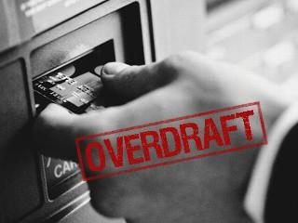
CAP in action (the Actual CAP Theorem)
Mom deposits $150 into Andy and Sam’s shared bank account
Andy withdraws $100 from the ATM in Collegetown
Sam withdraws $100 from the ATM in Willard Straight Hall
… the bank should refuse Sam’s transaction: the balance is down to just $50 after Andy’s transaction.
Drill down: CAP Consistency
Notes:
So, how can we “see” inconsistency from weakening the C to benefit A+P?

Slide 48
CAP in action (the Actual CAP Theorem)
Mom deposits $150 into Andy and Sam’s shared bank account
Andy withdraws $100 from the ATM in Collegetown
Sam withdraws $100 from the ATM in Willard Straight Hall
Cut the wire from the ATM to the bank. The last balance the ATM heard about was $150.
Now insist that we want availability.
… the ATM lets Sam withdraw $100. An “inconsistent” action.
Drill down: CAP Consistency
Notes:
Sam is an idiot.

Slide 49
Life with Inconsistency
Sam might manage to overdraw the bank account.
eBay auctions might sometimes show transactions in different orders, or gaps in the sequence, for a hotly contested item.
Amazon might sell something when the inventory of that item is really zero
A lottery might say “you are the sole winner!” when really, there were twenty-five other winners.
… This is why BASE talks about “eventual consistency”
Drill down: CAP Consistency

Slide 50
Eventually, Sam has to Pay up!
There are lots of ways to handle inconsistency
The bank would definitely want its money back.
Some Amazon systems “tolerate” inconsistency, and the company just figures out how to deal with it
Maybe you end up with two copies of the same book, and they tell you to just keep the spare copy.
Or they sold an extra X-box at the discount price, and they just send it to you at a loss.
Drill down: CAP Consistency
Notes:
Sam is out of luck. Poor Sam. Don’t be Sam.

Slide 51
What a weird case!
If the CAP theorem requires such a weird case, why is it popular?
The key is to appreciate that CAP is really a “folk theorem”
Like a fairy tale: it isn’t true, but you tell it to children so that they won’t do foolish things.
In cloud settings, always checking for consistency can overload the back-end databases and cause scalability collapse.
If you pretend that CAP is a theorem, and accept that data is often stale, and “hide” the consequences, your cloud solution will scale better
Drill down: CAP Consistency
Notes:
CAP works for things like photo caching. But not for things like bank balances. This is because banks care about consistency, at least relative to overdrawn accounts.
The bank might be ok with weakened C if you could promise that it never overdraws an account but sometimes blocks a withdrawal it should have allowed.
So even a bank could find ways to scale, perhaps. They wouldn’t exactly weaken C. They would weaken synchronization to improve performance and scaling.

Slide 52
BASE Methodology
It was invented at eBay as a way to hire people with transactional database experience but get them to write cloud code that scales.
They can start by coding normal database transactions:
Begin… read/write (and lock!)… Commit
But then they modify their code to try and pull operations out of the transaction as much as possible, or to break the transaction into mini-transactions with fewer operations in them.
The trick is to have the web page “work correctly” even so.
Drill down: CAP Consistency
Notes:
BASE is kind of a step-by-step way to do this. It doesn’t really break correctness. Instead, people weaken synchronization and make use of weaker cache guarantees, with the goal of maintaining some form of correct behavior but getting better scaling and performance.

Slide 53
BASE Methodology
Developers start with a correct, transactional application, hence easier to implement and debug.
But then as they relax consistency, the challenge is to anticipate all the stale data cases and race conditions and “hide the dirt under the rug”
A good job of hiding inconsistency won’t harm users.
Relaxing consistency benefits scaling & performance!
It also offers a way to guarantee faster responses
Drill down: CAP Consistency
Notes:
Sometimes people say that BASE sweeps mistakes under the rug.
But I tend to think of it as encouraging you to think harder about locking. Did you really need that lock? Did you really need the very most current version of this photo? Sometimes a recent cached copy is definitely fine, even without checking for a more recent updated one. And BASE (and CAP) urge us to go down that path. Think about asking for less from the cloud, to scale more.

Slide 54
Is Base “wrong”?
Not really!
If an application behaves in a satisfactory way with weaker consistency then why should we insist that strong consistency is somehow better?
The puzzle is to figure out all the bad things that could happen
The big cloud companies have test suites designed to help their developers check all the forms of data staleness they might encounter, so that they can hard-code safe actions no matter what happens. This really works!
Drill down: CAP Consistency

Slide 55
CAP “motivates” Base. And Base improves scalability!
Can we have consistency, availability and partition tolerance at scale?
In fact, yes we can. Systems like Ken’s Derecho library do this.
You need to do consistent replication in tier one or two.
But should you do this?
Only if absolutely necessary!
Consistency should be used rarely, and for very good reasons.
Drill down: CAP Consistency

Slide 56
More concepts of consistency
Locking is usedful in threaded programs, and in distributed ones too
So CAP could be understood as a warning to “not use locks” even when updating things shared by a set of programs running on distinct machines
Not many people think much about this interpretation of CAP, because that style of locking isn’t so common, but it does arise.
If you use a file locking and coordination tool called Zookeeper (very popular!), this form of consistency is relevant to you!
Drill down: CAP Consistency
Notes:
Now we’ll kind of list a bunch of related ideas.

Slide 57
More concepts of consistency
Agreement, or “consensus”
This topic extends beyond today’s lecture, but many distributed systems need to coordinate on things, at least now and then.
Such as “Who will be responsible for giving directions and roadway warnings to such-and-such a car on the smart highway?”
CAP can be understood as a warning that “Consensus will be a bottleneck, and should be used as rarely as possible”.
Drill down: CAP Consistency

Slide 58
CAP is best viewed as “useful folklore”
KISS: Keep it simple, stupid!
E2E: Networks should be simple and fast; endpoints can worry about guarantees
99%: 1% of the code accounts for 99% of development time, bugs, and runtime.
Critical path: Find the performance-limiting code path, make it simple and fast
RR buffers: Concurrent tasks should interact via simple, circular, FIFO buffers.
2nd system syndrome: Build one to throw away. Then make v2 simpler than v1!
CAP: Cache stuff. Unless staleness really matters, don’t burden the back-end
Notes:
Bottom line: we use a lot of rules of thumb. CAP is one of them. But it isn’t a bad suggestion, when it works.

Slide 59
Summary
CAP is an oversimplification
More like a folk-theorem than a mathematical truth
Further, there are many different concepts of consistency (all depend on “agreed ordering” for conflicting updates, but the details differ)
Basically, CAP is a rule of thumb for shielding the back-end from load.
Consistency does introduce possible bottlenecks and complexity.
Useful to think of CAP as a warning that complexity is dangerous.
At scale, even simple systems have complex behavior
Notes:
Clouds are pretty complicated… like that Swiss watch. Sometimes you can simplify things and not break them.
But lots of people go one step too far and simplify things that really need better properties.
Don’t be that guy Sam who thought you can get free money. Sam had to pay in the end. If you relax consistency so much that your system is kind of broken, it will malfunction, and you will regret it. Don’t go there!

