Slide 1
CS 5412: Facebook’s Photo and Image “Content Delivery” System
Ken Birman
Spring, 2018

Slide 2
Concept: A Content Delivery Network
Widely called CDNs
Role is to serve videos and images for end-users
Requirements include speed, scaling, fault-tolerance, self-management
Notes:
This whole lecture focuses on how Facebook does image caching (and now, video caching too). Huge thing for them since Facebook is at global scale.
The lecture is entirely based on a paper I linked to the web page (the syllabus page). You can definitely read this paper to learn more. I recommend it because there is nothing very hard to understand here, nothing you can’t just learn in more detail that way. In class we sort of do the big picture story, but for detail, we expect you to read the paper (if you wanted to learn the detail).
Our prelim doesn’t test on deep details, but we do expect you to understand the larger picture so this lecture is definitely part of what we test on, even if the details of how we ended up recommending the S4LRU caching strategy are never going to show up on any test. Or even how it works (see the paper, or Wikipedia, if you are curious).

Slide 3
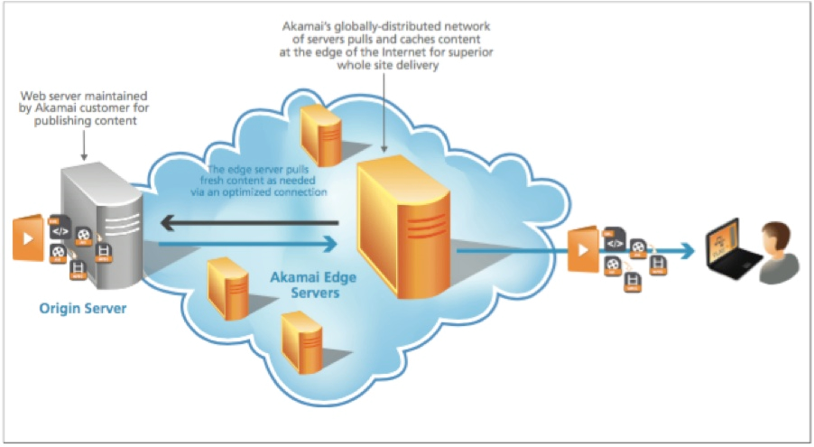
Origin of the CDN concept
Akamai’s globally-distributed network of servers pulls and caches content at the edge of the Internet for superior web page performance.
The original images are maintained by the Akamai customers on their own sites.
The earliest web pages had a lot of images. Companies emerged with the role of caching the images, and then serving them up, like Akamai.
Akamai operates “mini datacenters” worldwide, a network of them.
Customers of Akamai create special URLs that Akamai uses to upload the desired images. This works really well for any kind of rarely changing image data, but less well for webcams or other things that change fast.
Akamai’s CDN system pulls fresh content as needed over an optimized connection. It caches anything that seems popular
2
0
3
Akamai Edge Servers
Origin Server
(1) End user starts by downloading a web page from some web site. (2) Instead of images, it has empty boxes with “Akamized” URLs: content locators. (3) To render the page it fetches those images from the Akamai CDN instead of from the origin web site. Often, they have been fetched previously (0), and are already cached.
1
Notes:
This part is about how Akamai works. Many cloud providers use the Akamai CDN.

Slide 4
From Akamai to Facebook
Akamai is best for relatively stable web page layouts, where we can predict days in advance that certain images or advertisements will be popular in certain places.
Facebook is a big customer of Akamai, one of the largest!
But Facebook is so dynamic that the Akamai solution wasn’t (nearly) enough to provide their required performance levels.
Notes:
But Facebook needs to deal with its original content, Akamai doesn’t do that for them. And it has to worry about resizing images and anticipating need for videos and images of specific kinds.
These questions shape the real costs of the Facebook infrastructure.
Don’t care about money? That’s fine, actually, but for Facebook’s senior execs, money is a big deal. So this whole question is a very big deal.

Slide 5
Facebook’s Remarkable Speed
Think about the amazing performance of Facebook’s CDN …
You can scan up and down at will, and it renders instantly, at the perfect size
… or search for things, or click links, and those render instantly too!
How do they do it?
Today we will learn about Facebook’s global architecture, caching.
Haystack server, where all the data lives forever.
TAO, the graph representing its “knowledge” about social networks
Notes:
Back to that 100ms thing.

Slide 6
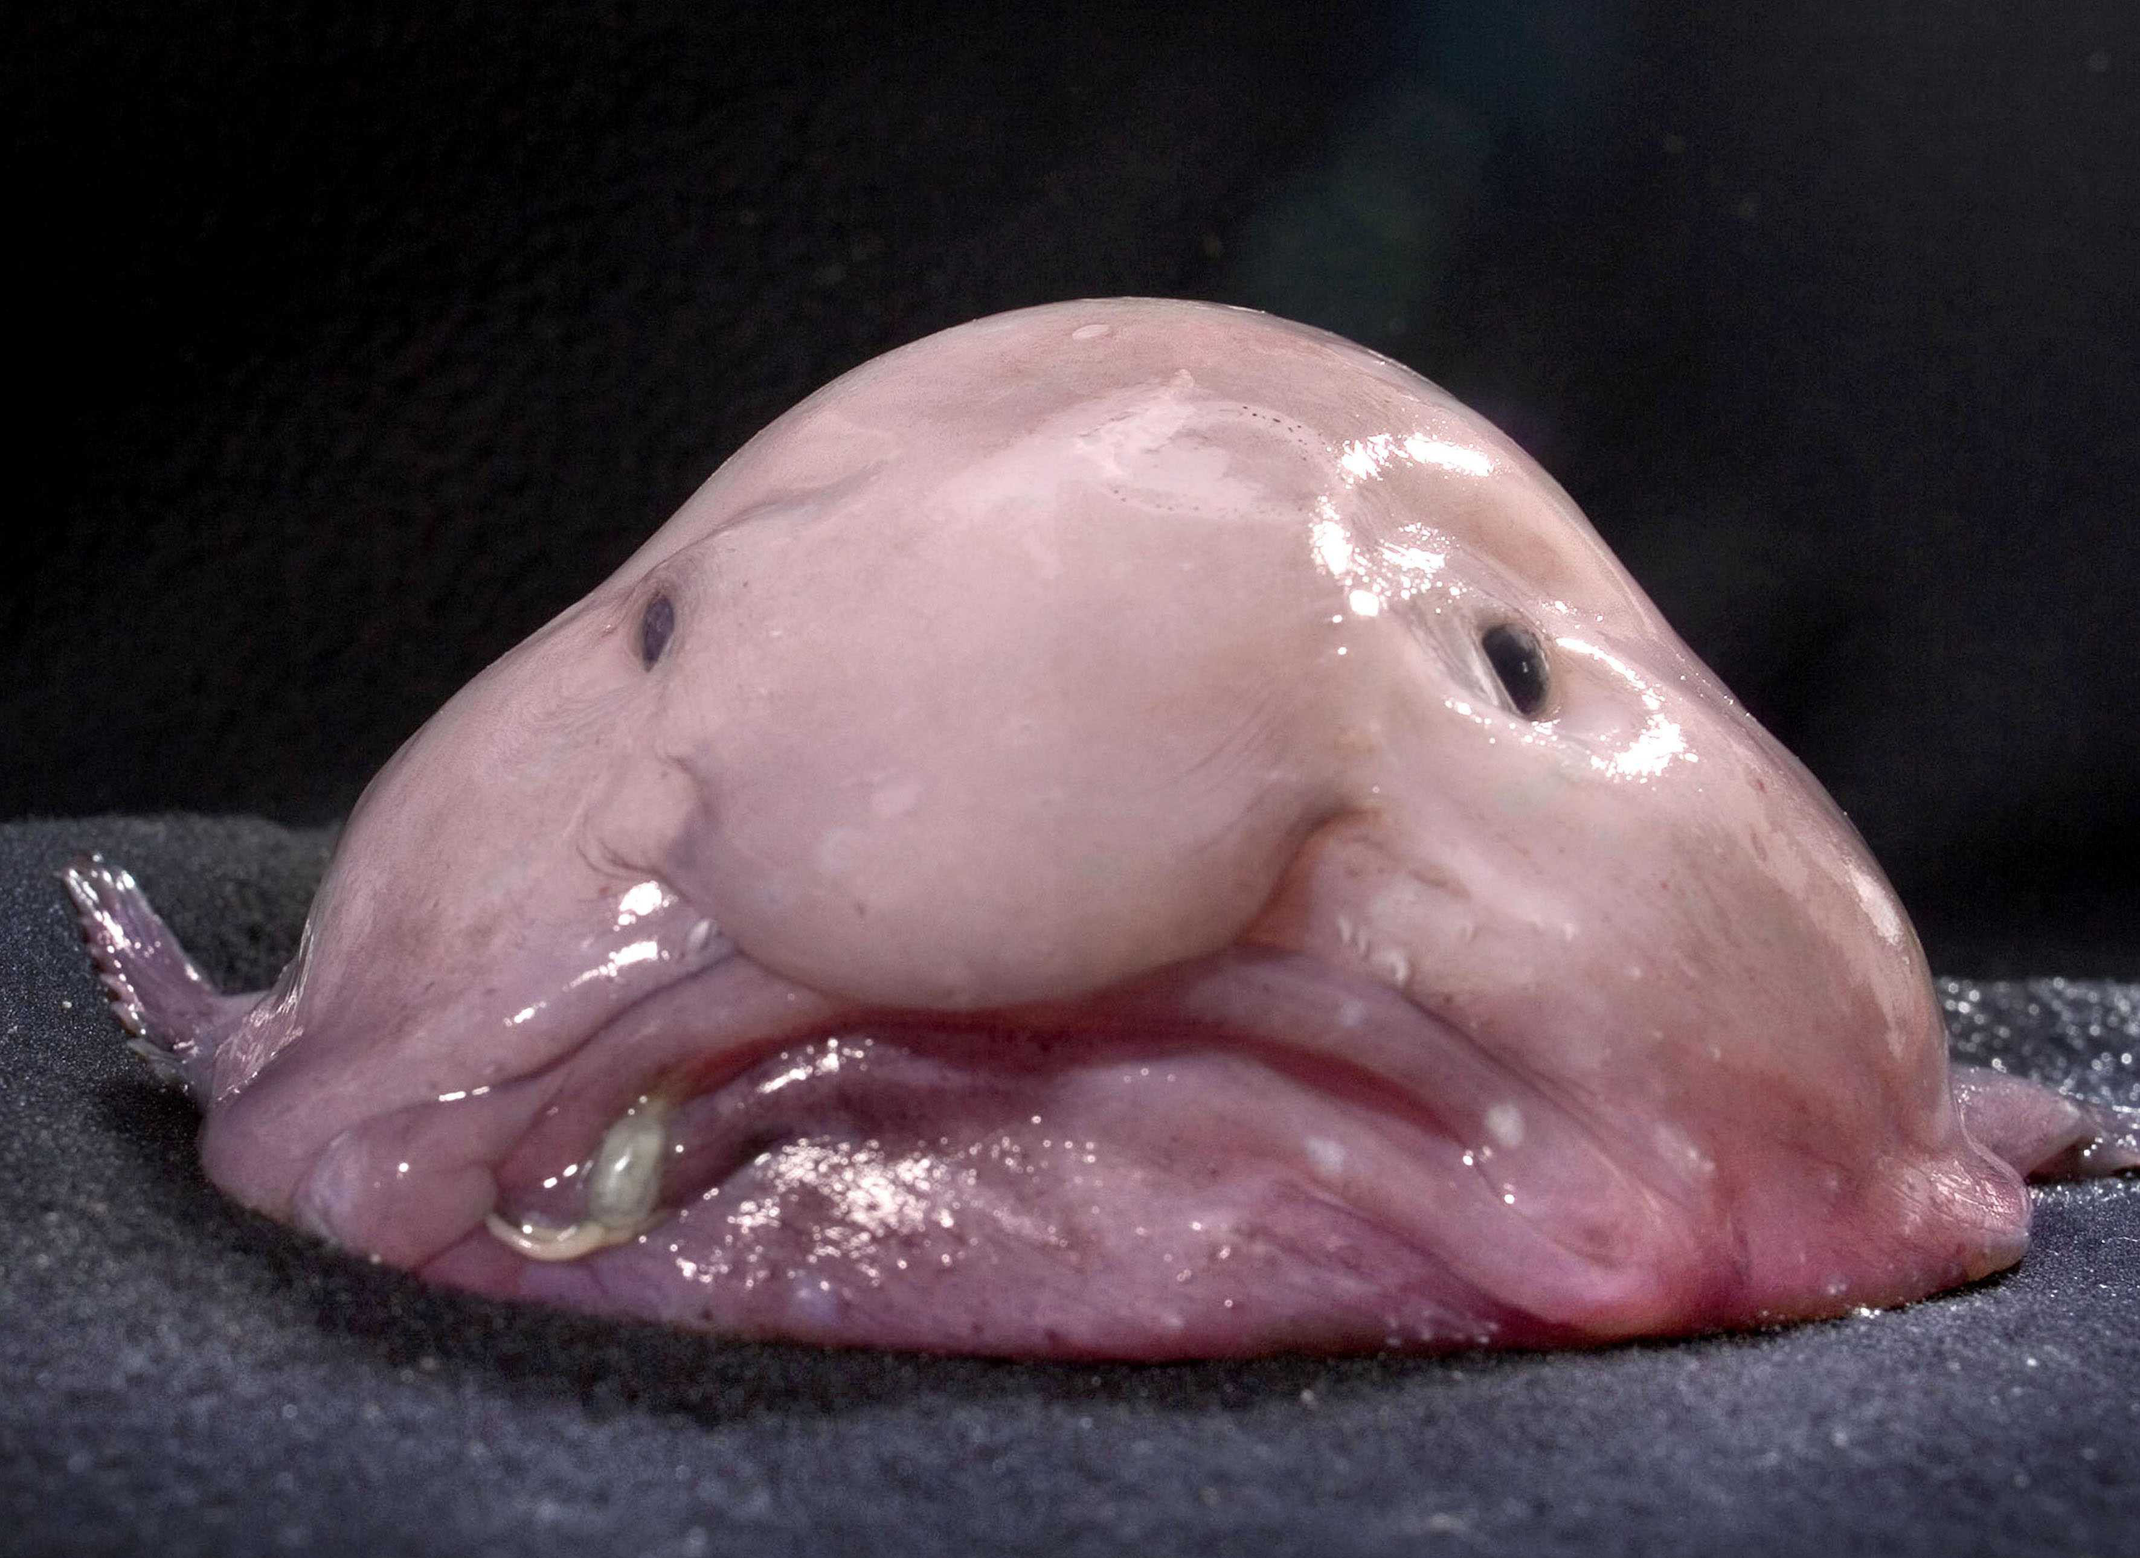
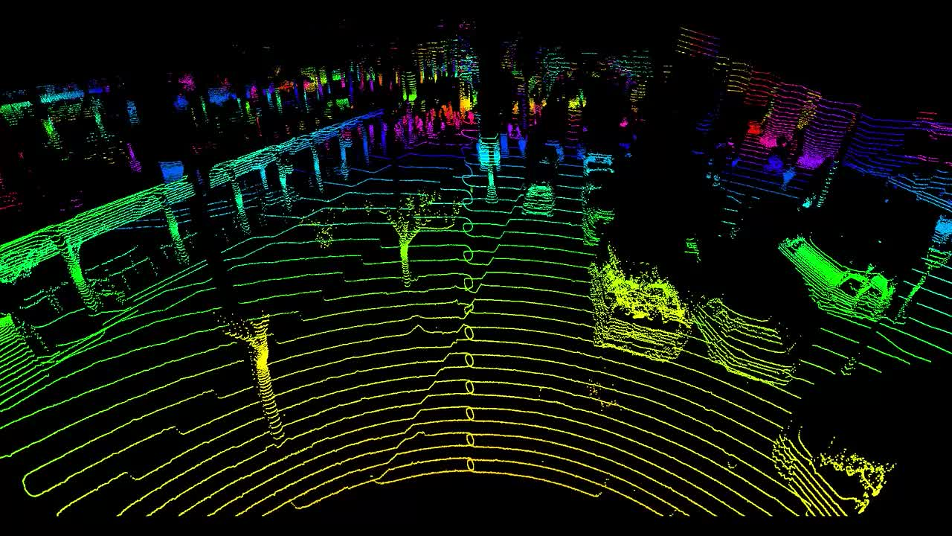
… the data is just “Blobs”
Facebook image data is stored in “blobs”: Binary Large Objects
This includes original images, videos
Resized versions, and ones with different playback quality
Versions that have been processed to tag people, augmented reality

Slide 7
DataCenters versus Points of Presence
Facebook doesn’t really have a huge number of data centers that hold the main copies of things like image data and the social network graph
But it does have a very large number of smaller datacenters that do tasks like holding cached copies and computing “resized” versions
Called “points of presence”. They are datacenters too, but just not as large, and not playing as broad a range of roles.
Notes:
Basically, there are a few BIG datacenters (4 in the US, in 2 sets of 2: 2 on the east coast, and 2 on the west coast). Pairs because of the need for backup to guarantee high availability.
Then there are a whole lot of smaller datacenters. Those are the points of presence. They do a lot of stuff, but not everything.
Why? Well, the big ones cost 100x more. So this is about optimizing the use of limited money. Facebook spends on datacenters but wants the highest benefit from what it owns, and wants to spend the smallest amount possible to get the highest speed.

Slide 8
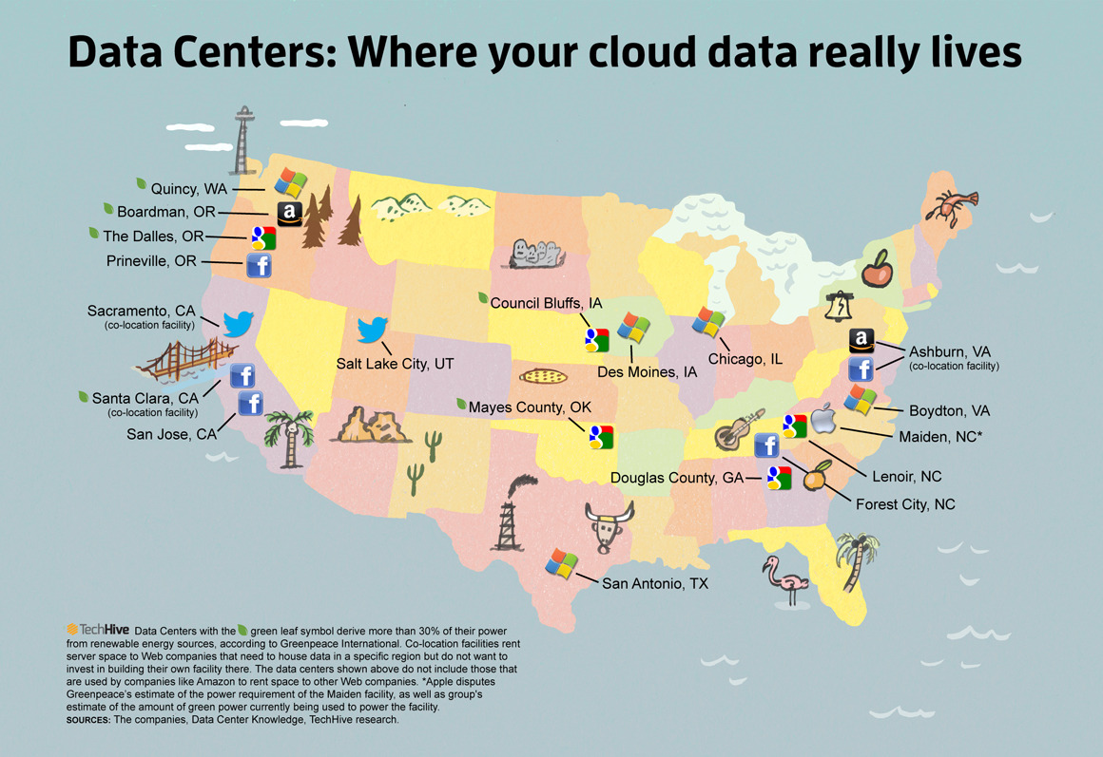
Largest US Data Centers as of 2014
Highlighting Facebook’s 4 main sites, where it hosts original photos

Slide 9
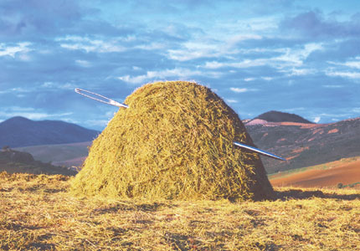
Haystack
Holds the real image and video data in huge “film strips”, write-once.
Designed to retrieve any object with a single seek and a single read. Optimized for SSD (these have good transfer rates but are best for write-once, reread many loads, and have a long delay for starting a write).
Facebook doesn’t run a lot of copies
One on the West Coast, one more on the East Coast
Each has a backup right next to it.
Main issue: Haystack would easily get overloaded without caching
Notes:
Think of Haystack as the ultimate photo album.
But we try to serve all requests from copies of the photos, not the originals.

Slide 10
Importance of caching
The job of the Facebook image and video (blob) cache is to rapidly find the version of an image or video when needed.
One thing that helps is that once captured, images and videos are immutable, meaning that the actual image won’t be modified.
Facebook often computes artifacts from an image, but it doesn’t discard original versions. Even deleted images live forever (in the Haystack)
Thus there is always a recipe to (re) create any needed object. But Facebook would rather not do that unless needed: it wastes resources.
Notes:
Caching is where the copies live – plural because the same image can end up in many of these caches.

Slide 11
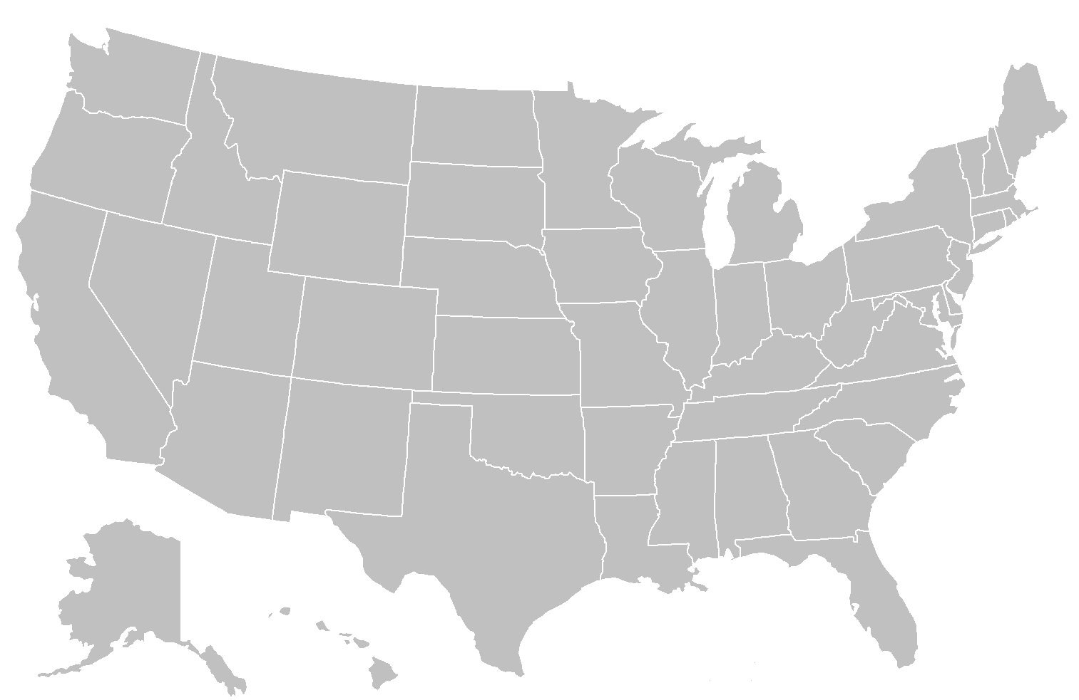
True data center computes personalized content for each user
Web page is fetched from an actual data center. It has URLs for all the image content
Big Datacenter
Client
Facebook Edge Cache
Browser
Cache
Origin Cache
Haystack
If you’ve recently seen the image, Facebook finds the blob in a cache on your computer

Slide 12
Points of presence:
Independent
FIFO
Main goal:
reduce bandwidth
Big Datacenter
Client
Facebook Edge Cache
Browser
Cache
Origin Cache
Haystack
If the image wasn’t found in your browser cache, maybe it can be found in an “edge” cache
Notes:
So how does the caching structure work? Your computer has a cache right on the disk.
Then we could go via Akamai (a big cache), or directly to Facebook. And Akamai itself talks to Facebook. So in some sense all routes lead into Facebook, unless the image is found in one of those first caches.
Then we get the edge which is where Facebook does resizing. As you’ll recall, CS5412 is an edge computing class.
Deeper inside is the Haystack layer and its own caching.

Slide 13
Origin:
Coordinated
FIFO
Main goal:
traffic sheltering
Datacenter
Client
Facebook Edge Cache
Browser
Cache
Origin Cache
Haystack
In the limit, check the origin (resizer) cache, then fetch from Haystack
Cache layers

Slide 14
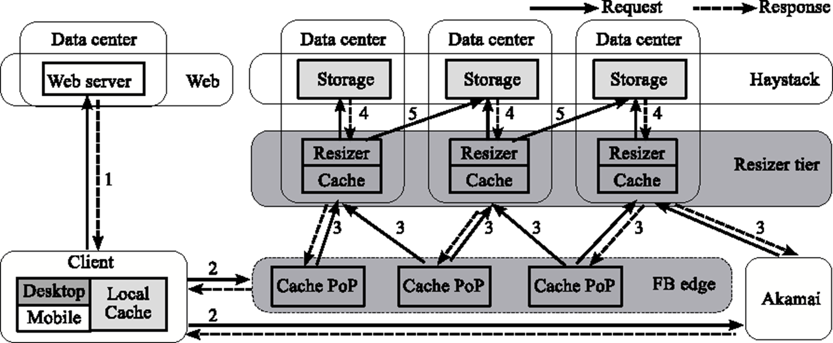
Architectural detail (Complex) Dark Gray: We instrumented it Pale Gray: We can figure out its behavior
Notes:
Our instrumentation lived in the dark gray places but we could deduce cache hits from the light gray ones.

Slide 15
Akamai puzzle
Facebook creates the web pages (with embedded URLs), hence decides if you will fetch photos via Akamai, and then to the Facebook origin sites, or via Facebook “directly”, without checking Akamai first.
But we have no way to instrument Akamai, and no way to directly instrument the client browser cache. This makes Akamai a black box for us.
There are times when Facebook temporarily doesn’t use the Akamai pathway in some regions. We did our experiments during such a period, to eliminate this confusion.

Slide 16
Architectural detail (Complex)
Notes:
We did our experiments during periods when Akamai wasn’t actually active, to make things a bit simpler.

Slide 17
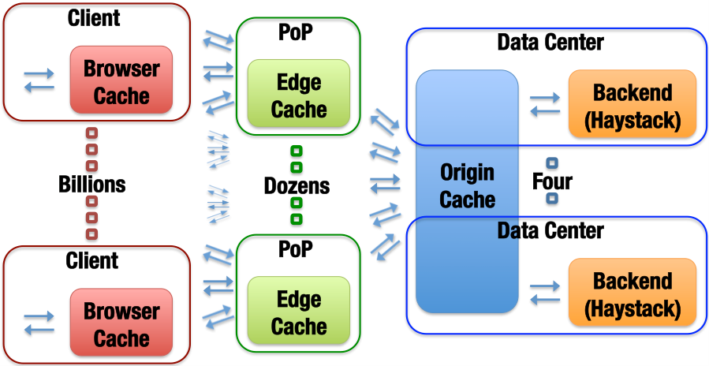
Blob-Serving Stack (Again)
Notes:
Same structure, nicer image.

Slide 18
What we Observed
Month long trace of photo accesses, which we sampled and anonymized. Captures cache hits and misses at every level.

Slide 19
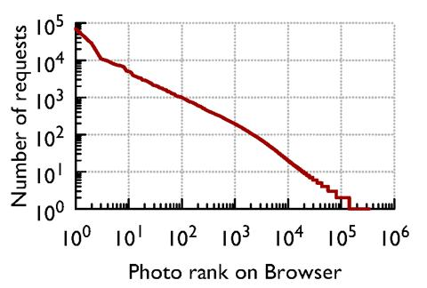
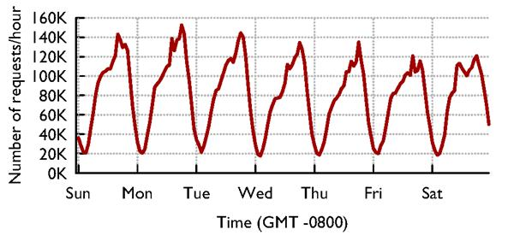
Caches see “circadian” Patterns
Accesses vary by time of day…
… and by photo: Some are far more popular than others

Slide 20
Different caches have slightly different popularity distributions
The most popular objects are mostly handled in the outer cache layers
Suggests that one caching policy might suffice, but it will need to be configured differently for each layer.
Notes:
These look very similar but in fact are different enough to suggest that cache policies are dealing with some very distinct populations of images. Paper explains in detail, and I’ll explain in lecture, but the big take-away is that even similar looking graphs can reveal important insights that add up to billions of dollars wasted or saved… We’ll see how by the end of the paper and the lecture (this S4LRU thing basically has each cache split into four chunks, kind of matched to the four classes of traffic, which relate to where each image is most likely to be successfully cached.

Slide 21
Photo cacheability by popularity
The main job of each layer is different.
This is further evidence that cache policy should vary to match details of the actual workload

Slide 22
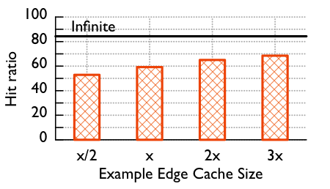
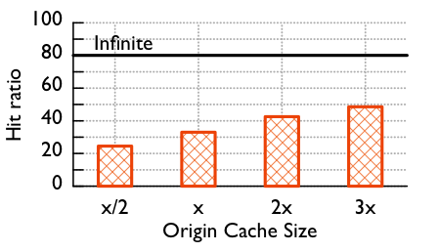
Larger Caches are better, but any realistic size is still far from ideal
Notes:
Interesting to realize that even an infinite cache wouldn’t catch everything.
This said, Facebook really does pretty poorly (or did poorly when we did our study). Can it do better?

Slide 23
GEO-Scale Caching
One way to do far better turns out to be for caches to collaborate at a WAN layer – some edge servers may find “flash popular” content earlier than others, and this would avoid regenerating it.
WAN collaboration between Edge caches is faster than asking for it from Haystack, and also reduces load on the Haystack platform.
Key insight: the Facebook Internet is remarkably fast and stable, and this gives better than scaling because the full cache can be exploited.
Notes:
Most people assume that fetching something from LA, if you live in Ithaca, is a stupid idea. Facebook’s Internet seems to work unexpectedly well!
For them, remote caches are close enough to be useful even cross country. And this gives a WAY bigger effective cache size.

Slide 24
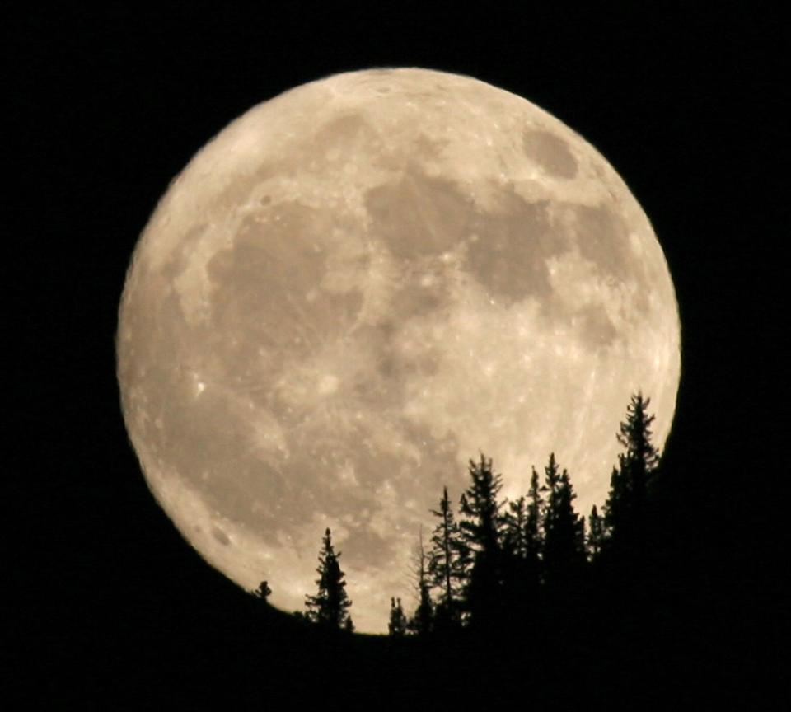
People are sleeping in Seattle
Remote fetch: cooperation between point-of-presence cache systems to share load and resources
People are having breakfast in Ithaca
In Ithaca, most of your content probably comes from a point of presence in the area, maybe the red one (near Boston)
But if Boston doesn’t have it or is overloaded, they casually reach out to places like Spokane, or Arizona, especially during periods when those are lightly loaded, like 5am PT!

Slide 25
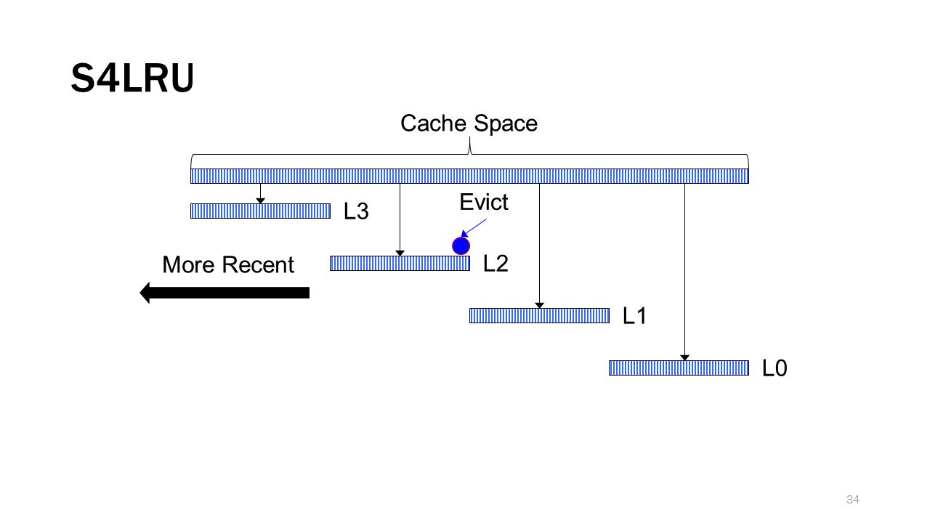
Cache retention/eviction policy
Facebook was using an LRU policy.
We used our trace to evaluate a segmented scheme called S4LRU
It outperforms all other algorithms we looked at
Notes:
The famous segmented LRU concept!
Each chunk kind of uses a different policy.
Think of the top chunk as being long-lived items that should stay in cache for a long time, and the bottom as a chunk for transient images needed just for a brief period.

Slide 26
Here we see that S4LRU is far better than normal LRU

Slide 27
So… switch to S4LRU, right?
They decided to do so…
Total failure!
Why didn’t it help?

Slide 28
S4LRU didn’t really work well!
It turned out that the algorithm worked well in theory but created a pattern of reads and writes that were badly matched to flash memory
Resulted in a whole two year project to redesign the “operating system” layer for big SSD disk arrays based on flash memory.
Once this change was made, S4LRU finally worked as hoped!
Notes:
S4LRU didn’t turn out to make efficient use of the hardware. We’ll have a look at this soon (it leads to a thing called restricted insertion priority queues, which they had to invent).
Core issue is like the NUMA thing from the last lecture: the hardware isn’t perfect and has limitations. S4LRU, used naively, has too much overhead. But with effort it was possible to invent a solution that uses S4LRU and also is hardware-friendly (uses the hardware closer to its sweet spot)

Slide 29
RIPQ Architecture (Restricted Insertion Priority Queue)
Advanced Caching Policy (SLRU, GDSF …)
Priority Queue API
Caching algorithms approximated as well
Approximate Priority Queue
Flash-friendly Workloads
Efficient caching on flash
RAM
Flash
RIPQ
Notes:
So the core issue is that flash memory (SSD) has slow initial access times, like a rotational disk that has to do a seek. Transfer rates are ok, but if you do too many random accesses you spend all your time waiting. There are also issues with overwriting segments (SSDs wear out if you do too much of that).
Basically, an SSD is almost like a tape drive. You need to spin it to the right spot, which takes time, and then can read or write. But rewriting more times than required will wear out the tape (reading is less of an issue). So we want policies that minimize spinning the tape or rewriting the bits.
A flash-friendly workload is one optimized for SSD.
S4LRU and similar policies aren’t very flash friendly.

Slide 30
RIPQ Architecture (Restricted Insertion Priority Queue)
Advanced Caching Policy (SLRU, GDSF …)
Priority Queue API
Restricted insertion
Section merge/split
Approximate Priority Queue
Flash-friendly Workloads
Large writes
Lazy updates
RAM
Flash
RIPQ
Notes:
In a nutshell, they build an in-memory layer to convert policies like S4LRU into flash-friendly versions.
This is done to have all the SSD writing be at the end of the segmented cache chunks.
Of course the in-memory structure doesn’t have any limitation at all, although we might want to minimize copying just because copying is wasteful.

Slide 31
RIPQ: Key Innovations
Only write large objects to the SSD once: treats SSD like an append-only “strip of images”. Same trick was needed in Haystack.
SSD is quite good at huge sequential writes. So this model is good.
But how can they implement “priority”?
They use an in-memory data structure with pointers onto the SSD. Focus on a model they call “restricted insertion points.” (No time to discuss details today)
They checkpoint the whole cache periodically. After a crash, the system can rapidly restart in a “warm” state.
Notes:
The notion of ordering (priority, in the sense of “priority queue”) is important but they virtualize with one-level of indirection. The in-memory data structure, which they have a way to rebuild if the unit crashes and restarts, worries about ordering.
The actual workload seen by the SSD is in the form of huge segments that get written in one steady pass. They do garbage collect by rereading active data and then rewriting it, now and then, when a segment on SSD has lots of holes (no-longer-needed data that was previously cached but by now has been bumped from cache)
The bit I/O pattern becomes one of huge one-directional writes that treat the whole SSD like a massive tape drive. This works well.
Then the in-memory data structure has pointers to the SSD content (and to some stuff that is temporarily still in memory because it hasn’t yet been written).

Slide 32
RIPQ Needs Small Number of Insertion Points
+16%
Object-wise hit-ratio (%)
+6%
Insertion points
Notes:
We do lose some performance with RIPQ, mostly because of the overheads associated with compacting data that got spread out and fragmented. But the benefit is that the hardware “match” is much closer.

Slide 33
RIPQ Needs Small Number of Insertion Points
Object-wise hit-ratio (%)
Insertion points
Notes:
Here we can see that the can get pretty close to the ideal behavior for S3LRU.

Slide 34
RIPQ Needs Small Number of Insertion Points
Object-wise hit-ratio (%)
Insertion points
You don’t need much RAM buffer (2GiB)!
Notes:
… and again, for something called GDSF-3, which is actually a pretty obscure policy. I’m not sure who uses GDSF-3. Maybe the paper explains why they focused on this as a second example.
The amount of in-memory storage for the RIPQ pointers is pretty small because pointers aren’t large and the big objects are mostly out on the SSD, except for the staging area used to assemble objects (which have a wide range of sizes) into bigger segments for DMA writes to the SSD.

Slide 35
RIPQ Has High Fidelity
Object-wise hit-ratio (%)

Slide 36
RIPQ Has High Fidelity
Object-wise hit-ratio (%)

Slide 37
RIPQ Has High Fidelity
Object-wise hit-ratio (%)
RIPQ achieves ≤0.5% difference for all algorithms
Notes:
Basically, they end up slightly cheating relative to LRU and GDSF but you won’t notice.

Slide 38
RIPQ Has High Fidelity
Object-wise hit-ratio (%)
+16%
+16% hit-ratio ➔ 23% fewer backend IOs
Notes:
… and those policies are worth using, because they do far better than FIFO (which happens to make great use of an SSD, but has this annoying tendency to dump things from the cache simply because they have been in it for a while, ignoring whether they are getting hits)

Slide 39
RIPQ Has High Throughput
Throughput (req./sec)
FIFO
RIPQ throughput comparable to FIFO (≤10% diff.)
Notes:
FIFO was ideal for SSD but had lousy cache hit behavior. Here we see that RIPQ has a nearly FIFO traffic pattern to the SSD even though it can support these policies with way better cache hit behavior.

Slide 40
Remaining puzzles
An unexplored issue involves interactions between Facebook and Akamai.
When Akamai upgrades or something fails and must restart, accesses “pour in” that normally are absorbed in Akamai. Like a massive rainstorm.
Facebook probably could develop a really good system for surge events, but when we worked with them, it wasn’t a priority.
Notes:
Now we are back to the starting point of the lecture. As you remember, we didn’t look at Akamai itself.
But actually there are very interesting puzzles up at that level too – maybe as interesting as this RIPQ thing needed to get S4LRU to actually work on SSD.
Open question: when entire cloud infrastructures talk to one-another, how well do they understand one-another?

Slide 41
Sounds Boring, doesn’t it?
Those LRU and S4LRU curves looked nearly identical. All of these cache pictures look kind of similar too.
If you looked really closely, you saw that S4LRU is only about 5% better than LRU (maybe 10% in some ranges). Who cares?
In fact all of the different studies and projects that looked at caching gave a total improvement of about 30% or 40% in terms of cache hit rates and speed of the actual solution (RIPQ, for example, lets Facebook use S4LRU, but also makes way better use of the hardware)
Notes:
A lot of people find caching and queuing to be about the lead interesting topic possible, but in fact the real insight is that this is about money.
Facebook saved billions by doing the work we just discussed. Billions.
So this may be dull, but it is about huge sums of money.

Slide 42
Sounds Boring, doesn’t it?
The real point: This is about actual money. Facebook has to serve billions of photos and videos daily. The cost of its system is proportional to load.
Switching to S4LRU reduces load by 5-10%, WAN collaboration by a further 10%
Improving the speed of the system allows Facebook to do more with less point of presence hardware
Bottom line: Switching algorithms saved Facebook easily a billion dollars per year. The people who discovered this got huge bonuses.

Slide 43
Still unconvinced?
Not everyone gets excited by huge computing infrastructures, but not everyone has to pay billion dollar rent checks.
Fortunately, modern cloud computing has “roles” for many kinds of people, and they do very diverse kinds of work.
In CS5412 we will definitely look hard at how things really work, but pick topics that often correspond to “cost/performance” tradeoffs.
Notes:
… well, if you don’t care about that either, there are always other jobs at the cloud computing companies!

Slide 44
Conclusions?
At Facebook, cache and image I/O performance shapes the web browsing experience. Optimizing this global system is a balancing act.
Issues include the nature of the content itself: some is more cacheable, some less.
Optimizing relative to the actual properties of the hardware is very important!
Sometimes your intuition deceives you. Ken was surprised that collaborative caching at geographic scale turns out to be a great idea.
Cost of the overall solution matters a lot too. Facebook wants to keep its hardware working “usefully”
This story is very common in the cloud. To work with cloud infrastructures at scale, we need to balance conceptual work with experiments

