Slide 1
Big Data Systems
Ken Birman & Kishore Pusukuri, Spring 2018

Slide 2
PUTTING IT ALL TOGETHER
We have seen a great deal of the structure at the edge of the cloud, and how it might “talk” to data sources of various kinds.
Tasks like machine learning and “big data” analytics occur at the back.
How are these connected together?
Some tier two μ-services store data into files or append-only logs
Periodically (delay depends on the use) we process in batches.
… we batch the operations because of the massive scale.
… idea is to compute “once” but answer many questions!

Slide 3
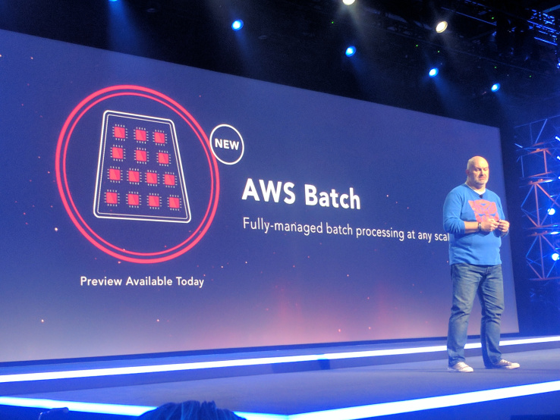
Batched computing
For example, imagine a smart city.
We could collect a batch of new location data, then update all the “people locations” in some database in a single (parallel) computation.
One computation reads a lot of files, and updates many data fields.
The pattern is typical of today’s cloud.
Due to delays, batched computing not ideal for instant reaction.
… But it is adequate for tasks where a short delay is fine.

Slide 4
Why batch?
The core issue is overhead. Doing things one by one incurs high overheads.
Updating data in a batch pays the overhead once on behalf of many events, hence we “amortize” those costs. The advantage can be huge.
But batching must accumulate enough individual updates to justify running the big parallel batched computation. Tradeoff: Delay versus efficiency.

Slide 5
Exponential Growth of Data (Big Data)
Petabytes of data need to be processed or accessed everyday
300 Billion Google searches per day
300 Million photos uploaded on Facebook per day
Nature of the data causes it to be massive: 3 V’s
Volume, Velocity, and Variety
The volume of unstructured data exploded in the past decade
By 2020, it will be 53 ZettaBytes (53 trillion gigabytes) -- an increase of 10 times in 15 years (it was below 5 ZB until 2003)

Slide 6
Common Big Data Use Cases
Extract/Transform/Load (ETL) – Huge Data Warehouses
Text Mining
Graph Creation and Analysis
Prediction Models
Analytics
To exploit batching, Google/Facebook etc., precompute the results for anticipated search queries. They analyze data in batches, then cache results.

Slide 7
Big Data Processing?
Nature of the data forces us to use massive parallelism
Recall: Huge Volumes, High Velocity, and Variety
Traditional Single Server Systems are far to weak for processing petabytes of data – insufficient compute and storage
The only option: Distribute data, obtain parallelism with multiple servers

Slide 8
Traditional Distributed Systems
The Data Bottleneck:
Data was historically first stored in a central location
… then copied to processors at runtime
Fine for limited amounts of data, breaks with massive data sets
Solution: A new style in which we process huge numbers of data files in parallel -- BigData Systems (e.g., Apache Hadoop, Apache Spark)

Slide 9
Big Data Systems
Two key ideas
Distribute data right from the outset, when the data is initially stored
Bring computation to the data rather than sending data to the computation
Scalable and economical data storage, processing and analysis
Distributed and Fault-tolerant
Harness the power of industry standard hardware
Heavily inspired by Open Source technologies (HDFS, HBase, etc.)

Slide 10
A Typical Big Data System
Batch Processing
Analytical SQL
Stream Processing
Machine Learning
Other Applications
Resource Manager (Workload Manager, Task Scheduler, etc.)
Data Ingestion Systems
Data Storage (File Systems, Database, etc.)
Popular BigData Systems: Apache Hadoop, Apache Spark

Slide 11

Apache Hadoop Ecosystem
Map Reduce
Hive
Pig
Other Applications
Spark Stream
Yet Another Resource Negotiator (YARN)
Data Ingest Systems
e.g., Apache Kafka, Flume, etc
Hadoop NoSQL Database (HBase)
Hadoop Distributed File System (HDFS)
Cluster

Slide 12
Hadoop Ecosystem
HDFS, HBase
Yet Another Resource Negotiator
MapReduce, Hive
Kafka

Slide 13
Hadoop Distributed File System (HDFS)
HDFS is the storage layer for Hadoop BigData System
HDFS is based on the Google File System (GFS)
Fault-tolerant distributed file system
Designed to turn a computing cluster (a large collection of loosely connected compute nodes) into a massively scalable pool of storage
Provides redundant storage for massive amounts of data -- scales up to 100PB and beyond

Slide 14
HDFS is for Batch Processing
Designed for batch processing rather than interactive
High throughput of data access rather than low latency
Notes:
Hadoop is for batch processing. HDFS is designed more for batch processing rather than interactive use by users. The emphasis is on high throughput of data access rather than low latency of data access.

Slide 15
HDFS
Must never lose any data (Resilience)
Sits on top of native file systems (e.g., xfs, ext3, ext4) -- HDFS is written in Java, i.e., JVM → OS (file system) → Storage (disks)
Write-once read-many (or append-only) paradigm → Batch Processing → High Troughput
Data is distributed when stored & move computation to the data
Minimizes network congestion and increases throughput

Slide 16
HDFS: Key Features
  Scalable: HDFS is designed for massive scalability, so you can store unlimited amounts of data in a single platform
  Flexible: Store data of any type -- structured, semi-structured, unstructured -- without any upfront modeling.
  Reliable: Multiple copies of your data are always available for access and protection from data loss (build-in fault tolerance)

Slide 17
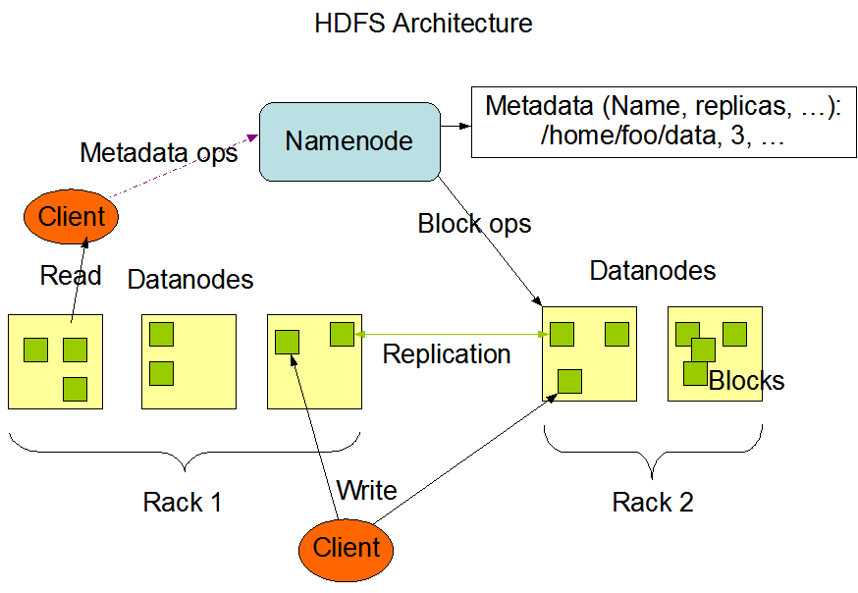
HDFS: Architecture
Master/slave architecture: NameNode (the master process -- one per cluster)
Availability of Name Node is critical -- single point of failure?
The NameNode executes file system namespace operations such as opening, closing etc.
The DataNodes (slaves) are responsible for serving read and write requests from the file system’s clients
Image source: https://hadoop.apache.org/docs/r1.2.1/hdfs_design.html

Slide 18
HDFS: How are Files Stored/Managed?
Data File is split into contiguous chunks, typically 64MB size, distributed at load time
Each chunk is replicated on multiple “data” nodes (usually 3x)
“Name” node for a file stores metadata, location of all chunks, etc.
Optimized for large, streaming reads of files (rather than random reads)
Files are “write once” -- No random writes to files allowed -- because of HDFS's batch roots, it was only designed to handle append-only formats

Slide 19
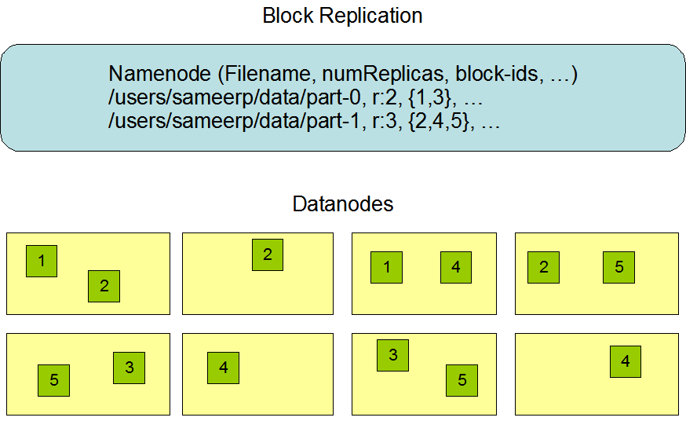
HDFS: Data Replication
How to choose number of replicas (replication factor)?

Slide 20
HDFS: Reading Data
The client sends a request to the NameNode for a file.
The NameNode determines which blocks are involved and chooses the most efficient access path.
The client then accesses the blocks using the addresses given by the NameNode

Slide 21
HDFS: Writing Data (1)
Get a Lease → Write Data → Close the Lease
Getting Lease:
    The client sends a request to the NameNode to create a new file.
    The NameNode determines how many blocks are needed, and the client is granted a lease for creating these new file blocks in the cluster.

Slide 22
HDFS: Writing Data (2)
Get a Lease → Write Data → Close the Lease
Write Data:
    The client then writes the first copies of the file blocks to the slave nodes using the lease assigned by the NameNode.
    As each block is written to HDFS, a special background task duplicates the updates to the other slave nodes identified by the NameNode.

Slide 23
HDFS: Writing Data (3)
Get a Lease → Write Data → Close the Lease
Close Lease:
    The DataNode daemons acknowledge the file block replicas have been created,
    The client application closes the file and notifies the NameNode
    NameNode closes the open lease. Updates become visible at this point.

Slide 24
HDFS: Some Limitations
Not appropriate for real-time, low-latency processing -- have to close the file immediately after writing to make data visible, hence a real time task would be forced to create too many files
Centralized metadata storage -- multiple single points of failures
The Persistence of File System Metadata?

Slide 25
Hadoop Database (HBase)
A NoSQL database built on HDFS
A table can have thousands of columns
Supports very large amounts of data and high throughput
HBase → Strong Consistency
Random access, low latency

Slide 26
HBase
HBase is based on Google’s Bigtable
A NoSQL distributed database/map built on top of HDFS
Designed for Distribution, Scale, and Speed
Relational Database (RDBMS) vs NoSQL Database:
RDBMS → vertical scaling (expensive) → not appropriate for BigData
NoSQL → horizontal scaling / sharding (cheap) → appropriate for BigData

Slide 27
RDBMS vs NoSQL (1)
  BASE not ACID:
    RDBMS (ACID): Atomicity, Consistency, Isolation, Durability
    NoSQL (BASE): Basically Available Soft state Eventually consistency
  The idea is that by giving up ACID constraints, one can achieve much higher availability, performance, and scalability
    e.g. most of the systems call themselves “eventually consistent”, meaning that updates are eventually propagated to all nodes

Slide 28
RDBMS vs NoSQL (2)
  NoSQL (e.g., CouchDB, HBase) is a good choice for 100 Millions/Billions of rows
  RDBMS (e.g., mysql) is a good choice for a few thousand/millions of rows
  NoSQL → eventual consistency (e.g., CouchDB) or strong consistency (HBase)

Slide 29
HBase: Data Model (1)

Slide 30
HBase: Data Model (2)
  Sorted rows: support billions of rows
  Columns: Supports millions of columns
  Cell: intersection of row and column
    Can have multiple values (which are time-stamped)
    Can be empty. No storage/processing overheads

Slide 31
HBase: Table

Slide 32
HBase: Horizontal Splits (Regions)

Slide 33
Hbase Architecture (Region Server)
Notes:
Analogous to data node of HDFS

Slide 34
HBase Architecture

Slide 35
HBase Architecture: Column Family (1)

Slide 36
HBase Architecture: Column Family (2)

Slide 37
HBase Architecture: Column Family (3)
  Data (column families) stored in separate files (Hfiles)
  Tune Performance
    In-memory
    Compression
  Needs to be specified by the user

Slide 38
HBase Concepts (1)
HBase is a key-value store designed for distribution, scale, and speed
  Data that is accessed together is stored together → faster for scaling
  Grouping the data by key (here rowkey) is central to running on a cluster and sharding -- the key acts as the atomic unit for updates
  Each record/row is indexed by a key (the rowkey) that you can use for lookup. The rowkey is like a primary key from a relational database.
  Records in HBase are stored in sorted order according to the rowkey. This is a critical semantic used in HBase schema design.

Slide 39
HBase Concepts (2)
Horizontal splits/sharding:
  Tables are divided into sequences of rows, by “key range”, called regions
  These regions are then assigned to the data nodes (HDFS) in the cluster called “RegionServers” → Preserving data locality
  Scales read and write capacity by spreading “regions” across the cluster.
  Here HBase maps (rowkey, column family, column, timestamp) to a “value”

Slide 40
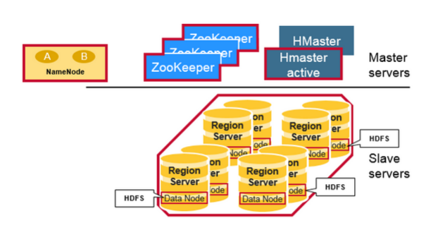
HBase Architecture (1)
HBase is composed of three types of servers in a master slave type of architecture: Region Server, Hbase Master, ZooKeeper.
Region Server:
      Clients communicate with RegionServers (slaves) directly for accessing data
      Serves data for reads and writes.
      These region servers are assigned to the HDFS data nodes to preserve data locality.

Slide 41
HBase Architecture (2)
HBase Master: coordinates region servers, handles DDL (create, delete tables) operations.
Zookeeper: HBase uses ZooKeeper as a distributed coordination service to maintain server state in the cluster.

Slide 42
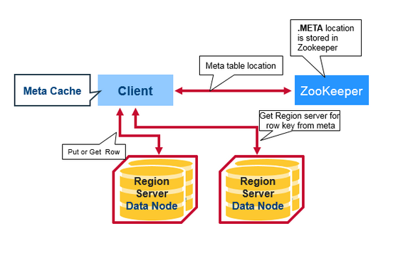
How do these components work together?
Region servers and the active HBase Master connect with a session to ZooKeeper
A special HBase Catalog table “META table” → Holds the location of the regions in the cluster.
ZooKeeper stores the location of the META table.
Notes:
There is a special HBase Catalog table called the META table, which holds the location of the regions in the cluster. ZooKeeper stores the location of the META table.

Slide 43
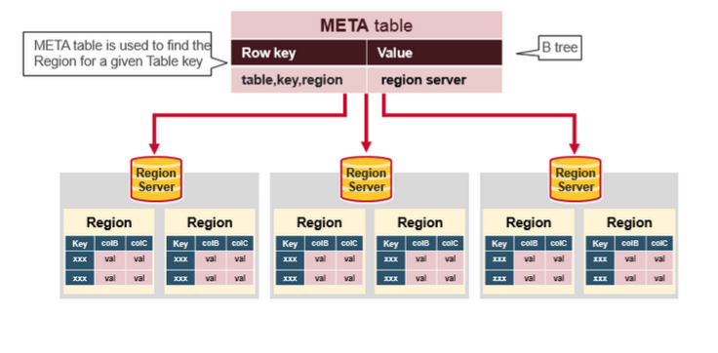
HBase: Meta table
The META table is an HBase table that keeps a list of all regions in the system.
This META table is like a B Tree

Slide 44
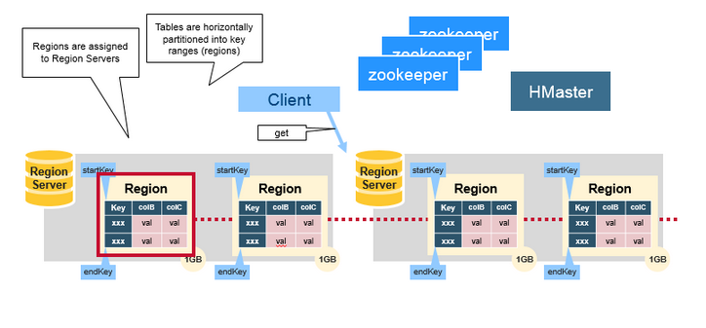
HBase: Reads/Writes
The client gets the Region server that hosts the META table from ZooKeeper
The client will query (get/put) the META server to get the region server corresponding to the rowkey it wants to access
It will get the Row from the corresponding Region Server.

Slide 45
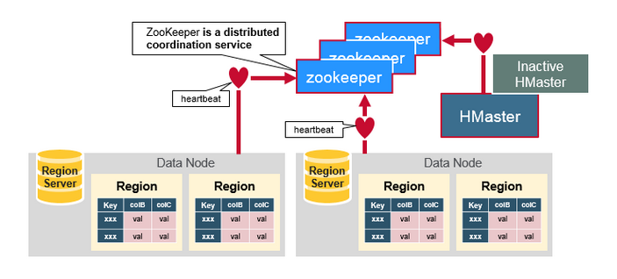
ZooKeeper: The coordinator
Maintains region server state in the cluster
Provides server failure notification
Uses consensus to guarantee common shared state

Slide 46
HBase: Some Limitations
Not ideal for large objects (>50MB per cell), e.g., videos -- the problem is “write amplification” -- when HDFS reorganizes data to compact large unchanging data, extensive copying occurs
Not ideal for store data chronologically (time as primary index), e.g., machine logs organized by time-stamps cause write hot-spots.

Slide 47
HBase vs HDFS
Hbase is a NoSQL distributed store layer (on top of HDFS). It is for faster random, realtime read/write access to the big data stored in HDFS.
HBase
Stores data as key-value stores in columnar fashion. Records in HBase are stored according to the rowkey and that sequential search is common
Provides low latency access to small amounts of data from within a large data set
Provides flexible data model
HDFS
Stores data as flat files
Optimized for streaming access of large files -- doesn’t support random read/write
Follows write-once read-many model

Slide 48
Hadoop Resource Management
Yet Another Resource Negotiator (YARN)
YARN is a core component of Hadoop, manages all the resources of a Hadoop cluster.
Using selectable criteria such as fairness, it effectively allocates resources of Hadoop cluster to multiple data processing jobs
  Batch jobs (e.g., MapReduce, Spark)
  Streaming Jobs (e.g., Spark streaming)
  Analytics jobs (e.g., Impala, Spark)

Slide 49
Hadoop Ecosystem (Resource Manager)
Map Reduce
Hive
Pig
Other Applications
Spark Stream
Data Ingest Systems
e.g., Apache Kafka, Flume, etc
Resource manager
Yet Another Resource Negotiator (YARN)
Hadoop Distributed File System (HDFS)
Hadoop NoSQL Database (HBase)

Slide 50
YARN Concepts (1)
Container:
YARN uses an abstraction of resources called a container for managing resources -- an unit of computation of a slave node, i.e., a certain amount of CPU, Memory, Disk, etc., resources. Tied to Mesos container model.
A single job may run in one or more containers – a set of containers would be used to encapsulate highly parallel Hadoop jobs.
The main goal of YARN is effectively allocating containers to multiple data processing jobs.

Slide 51
YARN Concepts (2)
Three Main components of YARN:
Application Master, Node Manager, and Resource Manager (a.k.a. YARN Daemon Processes)
Application Master:
  Single instance per job.
  Spawned within a container when a new job is submitted by a client
  Requests additional containers for handling of any sub-tasks.
Node Manager: Single instance per slave node. Responsible for monitoring and reporting on local container status (all containers on slave node).

Slide 52
YARN Concepts (3)
Three Main components of YARN:
Application Master, Node Manager, and Resource Manager (aka The YARN Daemon Processes)
Resource Manager: arbitrates system resources between competing jobs. It has two main components:
  Scheduler (Global scheduler): Responsible for allocating resources to the jobs subject to familiar constraints of capacities, queues etc.
  Application Manager: Responsible for accepting job-submissions and provides the service for restarting the ApplicationMaster container on failure.

Slide 53
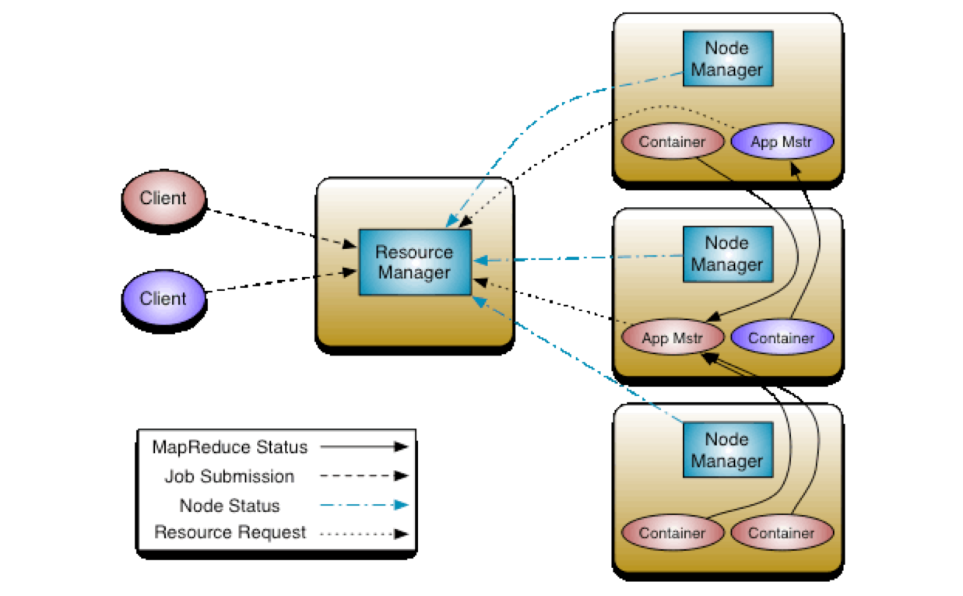
YARN Concepts (4)
How do the components of YARN work together?
Image source: http://hadoop.apache.org/docs/r2.4.1/hadoop-yarn/hadoop-yarn-site/YARN.html

Slide 54
Hadoop Ecosystem (Processing Layer)
Processing
Map Reduce
Hive
Pig
Other Applications
Spark Stream
Data Ingest Systems
e.g., Apache Kafka, Flume, etc
Yet Another Resource Negotiator (YARN)
Hadoop Distributed File System (HDFS)
Hadoop NoSQL Database (HBase)

Slide 55
Hadoop Data Processing Frameworks
Hadoop data processing (software) framework:
Abstracts the complexity of distributed programming
For easily writing applications which process vast amounts of data in-parallel on large clusters
Two popular frameworks:
MapReduce: used for individual batch (long running) jobs
Spark: for streaming, interactive, and iterative batch jobs
Note: Spark is more than a framework. We will learn more about this in future lectures

Slide 56
Map Reduce (“Just a taste”)
MapReduce allows a style of parallel programming designed for:
Distributing (parallelizing) a task easily across multiple nodes of a cluster
  Allows programmers to describe processing in terms of simple map and reduce functions
Invisible management of hardware and software failures
Easy management of very large-scale data

Slide 57
MapReduce: Terminology
A MapReduce job starts with a collection of input elements of a single type -- technically, all types are key-value pairs
A MapReduce job/application is a complete execution of Mappers and Reducers over a dataset
  Mapper applies the map functions to a single input element
  Application of the reduce function to one key and its list of values is a Reducer
Many mappers/reducers grouped in a Map/Reduce task (the unit of parallelism)

Slide 58
MapReduce: Phases
Map
Each Map task (typically) operates on a single HDFS block -- Map tasks (usually) run on the node where the block is stored
The output of the Map function is a set of 0, 1, or more key-value pairs
Shuffle and Sort
Sorts and consolidates intermediate data from all mappers -- sorts all the key-value pairs by key, forming key-(list of values) pairs.
Happens as Map tasks complete and before Reduce tasks start
Reduce
Operates on shuffled/sorted intermediate data (Map task output) -- the Reduce function is applied to each key-(list of values). Produces final output.

Slide 59
Example: Word Count (1)
The Problem:
We have a large file of documents (the input elements)
Documents are words separated by whitespace.
Count the number of times each distinct word appears in the file.

Slide 60
Example: Word Count (2)
Why Do We Care About Counting Words?
Word count is challenging over massive amounts of data
  Using a single compute node would be too time-consuming
  Using distributed nodes requires moving data
  Number of unique words can easily exceed available memory -- would need to store to disk
Many common tasks are very similar to word count, e.g., log file analysis

Slide 61
Word Count Using MapReduce (1)
map(key, value):
// key: document ID; value: text of document
FOR (each word w IN value)
emit(w, 1);
reduce(key, value-list):
// key: a word; value-list: a list of integers
result = 0;
FOR (each integer v on value-list)
result += v;
emit(key, result);

Slide 62
Word Count Using MapReduce (2)
Result
Input
aardvark 1
cat 1
mat 1
on 2
sat 2
sofa 1
the 4
the cat sat on the mat
the aardvark sat on the sofa
Map & Reduce

Slide 63
Word Count: Mapper
the 1
cat 1
sat 1
on 1
the 1
mat 1
Map
Input
the cat sat on the mat
the aardvark sat on the sofa
the 1
aardvark 1
sat 1
on 1
the 1
sofa 1
Map

Slide 64
Word Count: Shuffle & Sort
the 1
cat 1
sat 1
on 1
the 1
mat 1
Intermediate Data
aardvark 1
cat 1
mat 1
on 1,1
sat 1,1
sofa 1
the 1,1,1,1
Shuffle & Sort
Mapper Output
the 1
aardvark 1
sat 1
on 1
the 1
sofa 1

Slide 65
Word Count: Reducer
Reduce
Reducer Output
Result
aardvark 1
aardvark 1
cat 1
mat 1
on 2
sat 2
sofa 1
the 4
Intermediate Data
Reduce
cat 1
aardvark 1
cat 1
mat 1
on 1,1
sat 1,1
sofa 1
the 1,1,1,1
Reduce
mat 1
Reduce
on 2
Reduce
sat 2
sofa 1
Reduce
the 4
Reduce

Slide 66
MapReduce: Coping With Failures
MapReduce is designed to deal with compute nodes failing to execute a Map task or Reduce task.
Re-execute failed tasks, not whole jobs/applications.
Key point: MapReduce tasks produce no visible output until the entire set of tasks is completed. If a task or sub task somehow completes more than once, only the earliest output is retained.
Thus, we can restart a Map task that failed without fear that a Reduce task has already used some output of the failed Map task.

Slide 67
SUMMARY
With really huge data sets, or changing data collected from huge numbers of clients, it often is not practical to use a classic database model where each incoming event triggers its own updates.
So we shift towards batch processing, highly parallel: many updates and many “answers” all computed as one task.
Then cache the results to enable fast tier-one/two reactions later.

