Slide 1
Zookeeper
Ken Birman
Spring, 2018

Slide 2
Cloud systems have many “file Systems”
Before we discuss Zookeeper, let’s think about file systems. Clouds have many!
One is for bulk storage: some form of “global file system” or GFS.
At Google, it is actually called GFS
At Amazon, S3 plays this role
Azure uses “Azure storage fabric”
These often offer built-in block replication through a Linux feature, but the guarantees are somewhat weak.

Slide 3
How do they work?
A “Name Node” service runs, fault-tolerantly, and tracks file meta-data (like a Linux inode): Name, create/update time, size, seek pointer, etc.
The name node tells you which data nodes hold your file.
Very common to use a simple DHT scheme to fragment the NameNode into subsets, hopefully spreading the work around. DataNodes are hashed at the block level (large blocks)
Some form of primary/backup scheme for fault-tolerance. Writes are automatically forwarded from the primary to the backup.

Slide 4
How do they work?
NameNode
open
File MetaData
Copy of metadata
DataNode
DataNode
DataNode
DataNode
read
DataNode
DataNode
DataNode
DataNode
File data

Slide 5
Global File Systems: Summary
Pros
Cons
Scales well even for massive objects,
Works well for large sequential reads/writes, etc.
Provides High Performance (massive throughput)
Simple but robust reliability model.
Namenode (Master) can become overloaded, especially if individual files become extremely popular.
NameNode is a single-point of failure
A slow NameNode can impact the whole data center
Concurrent writes to the same file can interfere with one another

Slide 6
edge/fog USE case
Building a smart highway: Like an air traffic control system, but for cars
We want to make sure there is always exactly one controller for each runway at the airport.
We need to be reliable: if the primary controller crashes, the backup takes over within a few seconds.

Slide 7
Could we use a global file system?
Yes, for images and videos of the cars
We could capture them on a cloud of tier-one data collectors
Store the data into the global file system, run image analysis on the files.

Slide 8
What about the consistency aspect?
Consider the “configuration” of our application, which implements this control behavior.
We need to track which machines are operational, what roles they have.
We want a file that will hold a table of resources and roles.
Every application in the system would track the contents of this file.
So… this file is in the cloud file system! But which file system?

Slide 9
Cloud File System Limitations
A, B and C are running
A is primary, C is backup
D restarted
A has crashed
Consider this simple approach:
We maintain a log of computer status events: “crashed”, “recovered”…
The log is append-only. When you sense something, do a write to the end of the log.
Issue: If two events occur more or less at the same time, one can overwrite the other, hence one might be lost.

Slide 10
Overwrites cause Inconsistency!
We have discussed the concept of consistency many times, but haven’t really spent so much time on its evil nemesis, inconsistency.
If we are logging versions of flight plans, when one update overwrites a second one, some machines might have “seen” the lost one, and be in a state different from others. An example of a split-brain problem.
If we are logging status of machines, some machines may think that C crashed, but others never saw this message (worst case: maybe C really is up, and the original log report was due to a transient timeout… but now half out system thinks C is up, and half thinks C is down: another split brain scenario)

Slide 11
Avoiding “Split Brain”
The name is from the title of an old science-fiction movie
We must never have two active controllers simultaneously, or two different versions of the same flight plan record that use the same version id.
You can turn this one type of mistake into many kinds of risky problems that we would never want to tolerate in an ATC system. So we must avoid such problems entirely!

Slide 12
Root Issue (1)
The quality of failure sensing is limited
If we sense faults because of noticing timeout, we might make mistakes. Then if we reassign the role but the “faulty” machine is really still running and was just transiently inaccessible, we have two controllers!
This problem is unavoidable in a distributed system, so we have to use agreement on membership, not “apparent timeout”. The log plays this role

Slide 13
Root ISSUE (2)
In many systems two or more programs can try to write to the same file at the same time, or to create the same file.
In such situations the normal Linux file system will work correctly if the programs and the files are all on one machine. Writes to the local file system won’t interfere.
But in distributed systems, using global file systems, we lack this property!

Slide 14
How does a consistent log solve this?
If you trust the log, just read log records from top to bottom you get an unambiguous way to track membership. Even if a logged record is “wrong”, e.g. “node 6 has crashed” but it hasn’t, we are forced to agree to use that record.
Equivalent mechanisms exist in systems like Derecho (self-managed Paxos).
In effect, membership is managed in a consistent way. But this works only if we can trust the log And that in turn depends on the file system!

Slide 15
With S3 or GFS we cannot trust a log!
These file systems don’t guarantee consistency!
They are unsafe with concurrent writes. Concurrent log appends could
Overwrite one-another, so one is lost
Be briefly perceived out of order, or some machine might glimpse a written record that will then be erased a moment later and overwritten
Sometimes we can even have two conflicting versions that linger for extended periods.

Slide 16
Exactly what goes wrong?
“Append-only log” behavior
In our application using it
Machines A, B and C are running
2-a. Machine D is launched
2-b. Concurrently, B thinks A crashed.
2-b is overwritten by 2-a
A turns out to be fine, after all.
A is selected to be the primary controller for runway 7. C is assigned as backup.
C notices 2-b, and takes over. But A wasn’t really crashed – B was wrong!
Log entry 2-b is gone. A keeps running.
Now we have A and C both in the “control runway 7 role” – a split brain!

Slide 17
Why can’t we just fix the bug?
First, be aware that S3 and GFS and similar systems are perfectly fine for object storage by a single, non-concurrent writer.
If nervous, take one more step and add a “self-certifying signature”
SHA3 hash codes are common for this, very secure and robust. But there are many options, even simple parity codes can help.
The reason that they don’t handle concurrent writes well is that the required protocol is slower than the current weak consistency model.

Slide 18
Zookeeper: A Solution for this issue
The need in many systems is for a place to store configuration, parameters, lists of which machines are running, which nodes are “primary” or “backup”, etc.
We desire a file system interface, but “strong, fault-tolerant semantics”
Zookeeper is widely used in this role. Stronger guarantees than GFS.
Data lives in (small) files. Zookeeper is quite slow and not very scalable.
But even so, it is useful for many purposes. Even locking, synchronization.

Slide 19
Should I use Zookeeper for everything?
Zookeeper isn’t for long-term storage, or for large objects. Put those in the GFS. Then share the URL, which is small.
Use Zookeeper for small files used to do distributed coordination, synchronization or configuration data (small objects).
Mostly, try to have Zookeeper handle “active” configuration, so it won’t need to persist data to a disk, at all.

Slide 20
Zookeeper durability limitation
Zookeeper is mostly used with no real “persistency” guarantee, meaning that if we shut it down completely, it normally loses any “state”
There is a checkpointing mechanism, but not fully synchronized with file updates. Recent updates might not yet have been checkpointed.
The developers view this as a tradeoff for high performance.
Normally, it is configured to run once every 5s.
Many applications simply leave Zookeeper running and if it shuts down, the whole application must shut down, then restart.

Slide 21
How does Zookeeper Work?
Zookeeper has a layered implementation.
The health of all components is tracked, so that we know who is up and who has crashed. In Derecho, this is called membership status.
The Zookeeper meta-data layer is a single program: consistent by design.
The Zookeeper data replication layer uses an atomic multicast to ensure that all replicas are in the same state.
For long-term robustness, they checkpoint periodically (every 5s) and restart from checkpoint.

Slide 22
Details on Zookeeper (this is their slide set and repeats some parts of mine)
Hunt, P., Konar, M., Junqueira, F.P. and Reed, B., 2010, June. ZooKeeper: Wait-free Coordination for Internet-scale Systems. In USENIX Annual Technical Conference (Vol. 8, p. 9).
Several other papers can be found on http://scholar.google.com.

Slide 23
Zookeeper goals
An open-source platform created to behave like a simple file system
Easy to use, fault-tolerant. A bit slow, but not to a point of being an issue.
Unlike standard cloud computing file systems, provides strong guarantees.
Employed in many cloud computing platforms as a quick and standard way to manage configuration data fault-tolerantly.

Slide 24
How is Zookeeper used today?
Naming service − Identifying the nodes in a cluster by name. It is similar to DNS, but for nodes
Configuration management − Latest and up-to-date configuration information of the system for a joining node
Cluster management − Joining / leaving of a node in a cluster and node status at real time
Leader election − Electing a node as leader for coordination purpose
Locking and synchronization service − Locking the data while modifying it. This mechanism helps you in automatic fail recovery while connecting other distributed applications like Apache HBase
Highly reliable data registry − Availability of data even when one or a few nodes are down

Slide 25
Recall the Amazon
μ-Services example
Browser
HTTPS
Web Interface Server
Client SDK
In μ-Services, these need resource management and scheduling
HTTP or TCP/IP
Kafka or SQS
Server SDK
Application Server
Resource Plugins
Billing
Packing
Shipment Planner
Mailing Labels

Slide 26
A Simple μ-service System
Microservice 1
Microservice 1
Microservice 1
UI Server
API Gateway & Router
Microservice 2
Microservice 2
N Jobs
Microservice 2
Some questions that might arise:
Is Replica 2 of microservice 3 up and running?
Do I have at least one service running?
Microservice 3 uses Master-Worker, and the Master just failed. What do I do?
Replica 2 needs to find configuration information. How can it do that?
Microservice 3
Microservice 3
Microservice 3

Slide 27
Apache Zookeeper and μ-services
Zookeeper can manage information in your system
IP addresses, version numbers, and other configuration information of your microservices.
The health of the microservices.
The state of a particular calculation.
Group membership

Slide 28
Apache Zookeeper Is…
A system for solving distributed coordination problems for multiple cooperating clients.
A lot like a distributed file system...
As long as the files are tiny.
You could get notified when the file changes
The full file pathname is meaningful to applications
A way to solve μ-service management problems.

Slide 29
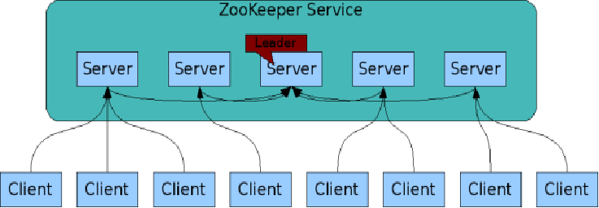
The ZooKeeper Service
Zookeeper is itself an interesting distributed system
These are your microservices
ZooKeeper Service is replicated over a set of machines
All machines store a copy of the data in memory (!). Checkpointed to disk if you wish.
A leader is elected on service startup
Clients only connect to a single ZooKeeper server & maintains a TCP connection.
Client can read from any Zookeeper server.
Writes go through the leader & need majority consensus.
https://cwiki.apache.org/confluence/display/ZOOKEEPER/ProjectDescription

Slide 30
Zookeeper Summary
ZooKeeper provides a simple and high performance kernel for building more complex coordination primitives.
Helps distributed components share information
Clients (your applications) contact Zookeeper services to read and write metadata.
Read from cache but writes are more complicated
Sometimes, just the existence and name of a node are enough

Slide 31
Zookeeper Summary (Cont.)
Tree model for organizing information into nodes.
Node names may be all you need
Lightly structured metadata stored in the nodes.
Wait-free aspects of shared registers with an event-driven mechanism similar to cache invalidations of distributed file systems
Targets simple metadata systems that read more than they write.
Small total storage

Slide 32
Zookeeper, More Briefly
Zookeeper Clients (that is, your applications) can create and discover nodes on Zookeeper trees
Clients can put small pieces of data into the nodes and get small pieces out.
1 MB max for all data per server by default
Each node also has built-in metadata like its version number.
You could build a small DNS with Zookeeper.
Some simple analogies
Lock files and .pid files on Linux systems.

Slide 33
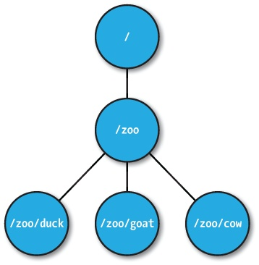
ZNodes
Maintain file meta-data with version numbers for data changes, ACL changes and timestamps.
Version numbers increases with changes
Data is read and written in its entirety

Slide 34
ZNode types
Regular
Clients create and delete explicitly
Ephemeral
Like regular znodes associated with sessions
Deleted when session expires
Sequential
Property of regular and ephemeral znodes
Has a universal, monotonically increasing counter appended to the name

Slide 35
Zookeeper API (1/2)
create(path, data, flags): Creates a znode with path name path, stores data[] in it, and returns the name of the new znode.
flags enables a client to select the type of znode: regular, ephemeral, and set the sequential flag;
delete(path, version): Deletes the znode path if that znode is at the expected version
exists(path, watch): Returns true if the znode with path name path exists, and returns false otherwise.
Note the watch flag

Slide 36
Zookeeper API (2/2)
getData(path, watch): Returns the data and meta-data, such as version information, associated with the znode.
setData(path, data, version): Writes data[] to znode path if the version number is the current version of the znode
getChildren(path, watch): Returns the set of names of the children of a znode
sync(path): Waits for all updates pending at the start of the operation to propagate to the server that the client is connected to.

Slide 37
Configuration Management
All clients get their configuration information from a named znode
/root/config-me
Example: you can build a public key store with Zookeeper
Clients set watches to see if configurations change
Zookeeper doesn’t explicitly decide which clients are allowed to update the configuration.
That would be an implementation choice
Zookeeper uses leader-follower model internally, so you could model your own implementation after this.

Slide 38
The Rendezvous Problem
Classic distributed computing algorithm
Consider master-worker
Specific configurations may not be known until runtime
EX: IP addresses, port numbers
Workers and master may start in any order
Zookeeper implementation:
Create a rendezvous node: /root/rendezvous
Workers read /root/rendezvous and set a watch
If empty, use watch to detect when master posts its configuration information
Master fills in its configuration information (host, port)
Workers are notified of content change and get the configuration information

Slide 39
Locks
Familiar analogy: lock files used by Apache HTTPD and MySQL processes
Zookeeper example: who is the leader with primary copy of data?
Implementation:
Leader creates an ephemeral file: /root/leader/lockfile
Other would-be leaders place watches on the lock file
If the leader client dies or doesn’t renew the lease, clients can attempt to create a replacement lock file
Use SEQUENTIAL to solve the herd effect problem.
Create a sequence of ephemeral child nodes
Clients only watch the node immediately ahead of them in the sequence

Slide 40
Zookeeper is popular in science-computing gateways
Browser
HTTPS
Web Interface Server
Client SDK
In micro-service arch, these also need scheduling
HTTP or TCP/IP
“Super” Scheduling and Resource Management
Server SDK
Application Server
Resource Plugins
Different archs, schedulers, admin domains,
…
Karst: MOAB/Torque
Stampede: SLURM
Comet: SLURM
Jureca:SLURM

Slide 41
With μ-Services we often replicate components.
API Server
Application Manager
Metadata Server
API Server
API Server
API Server
API Server
Application Manager
Metadata Server
Application Manager
Metadata Server
Application Manager
Metadata Server
Application Manager
Metadata Server
Application Manager
Metadata Server
Application Manager
Metadata Server

Slide 42
Why is this form of replication needed?
Fault tolerance
Increased throughput, load balancing
Component versions
Not all components of the same type need to be on the same version
Backward compatibility checking
Component flavors
Application managers can serve different types of resources
Useful to separate them into separate processes if libraries conflict.

Slide 43
Configuration Management
Problem: gateway components in a distributed system need to get the correct configuration file.
Solution: Components contact Zookeeper to get configuration metadata.
Comments: this includes both the component’s own configuration file as well as configurations for other components
Rendezvous problem

Slide 44
Service Discovery
Problem: Component A needs to find instances of Component B
Solution: Use Zookeeper to find available group members instances of Component B
More: get useful metadata about Component B instances like version, domain name, port #, flavor
Comments
Useful for components that need to directly communicate but not for asynchronous communication (message queues)

Slide 45
Group Membership
Problem: a job needs to go to a specific flavor of application manager. How can this be located?
Solution: have application managers join the appropriate Zookeeper managed group when they come up.
Comments: This is useful to support scheduling

Slide 46
System State for Distributed Systems
Which servers are up and running? What versions?
Services that run for long periods could use ZK to indicate if they are busy (or under heavy load) or not.
Note overlap with our Registry
What state does the Registry manage? What state would be more appropriate for ZK?

Slide 47
Leader Election
Problem: metadata servers are replicated for read access but only the master has write privileges. The master crashes.
Solution: Use Zookeeper to elect a new metadata server leader.
Comment: this is not necessarily the best way to do this

Slide 48
Under the Zookeeper Hood
ZAB

Slide 49
Zab Protocol

Slide 51
Zookeeper Handling of Writes
READ requests are served by any Zookeeper server
Scales linearly, although information can be stale
WRITE requests change state so are handed differently
One Zookeeper server acts as the leader
The leader executes all write requests forwarded by followers
The leader then broadcasts the changes
The update is successful if a majority of Zookeeper servers have correct state at the end of the protocol

Slide 52
Some Zookeeper Implementation Simplifications
Uses TCP for its transport layer.
Message order is maintained by the network
The network is reliable?
Assumes reliable file system
Logging and DB checkpointing

Slide 53
Some Zookeeper Implementation Simplifications
Does write-ahead logging
Requests are first written to the log
The Zookeeper DB is updated from the log
Zookeeper servers can acquire correct state by reading the logs from the file system
Checkpoint reading means you don’t have to reread the entire history
Assumes a single administrator so no deep security

Slide 54
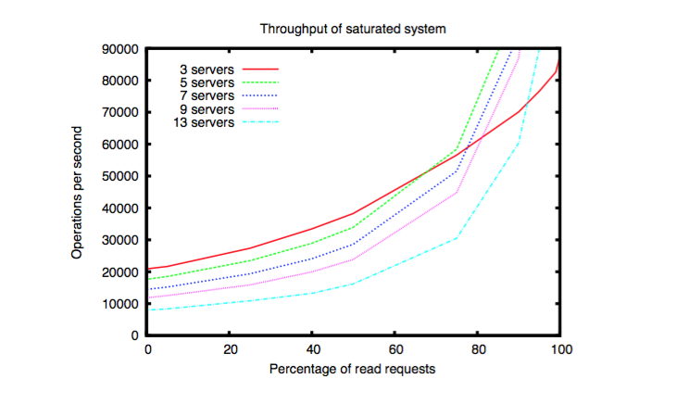
Speed isn’t everything. Having many servers increases reliability but decreases throughput as # of writes increases.

Slide 55
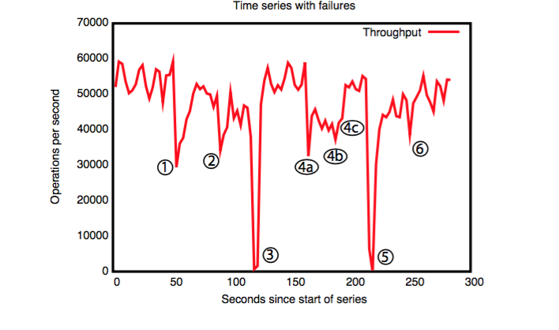
Failure and recovery of follower.
Failure and recovery of follower.
Failure of leader (200 ms to recover).
Failure of two followers (4a and 4b), recovery at 4c.
Failure of leader
Recovery of leader (?)
A cluster of 5 zookeeper instances responds to manually injected failures.

Slide 56
State of the Art today?
Zookeeper is solving a problem that Leslie Lamport formalized as the state machine replication problem. Much work has been done on this.
The “Paxos” protocols solve this problem. Zookeeper’s ZAB is similar to the Paxos concept of an “Atomic Multicast” (sometimes called “Vertical Paxos”)
But checkpointing is not the same as the true durable Paxos. Durable Paxos is like checkpointing on every operation. Zookeeper does so every 5s

Slide 57
Summary and Cautions
Zookeeper is powerful for system management/configuration data
Derecho is great for ultra-high-speed atomic multicast, replication
A message queue (Corfu) is also a powerful distributed computing concept
You could build a queuing system with Zookeeper, but you shouldn’t
https://cwiki.apache.org/confluence/display/CURATOR/TN
There are high quality queuing systems already
Where is the state of your system? Make one choice.

