Slide 1
Chain Replication
Ken Birman
Spring, 2018

Slide 2
Today: A “deep dive” on a topic mentioned in Lecture 14
In discussing Tango/Corfu, we were discussing logging and the need for data replication arose.
They mention, on one slide, that “Corfu solves this with chain replication”.
What exactly is chain replication? How does it work?

Slide 3
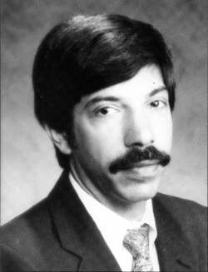
The Story Starts At Cornell: State Machine Approach: A Tutorial
Fred Schneider
Back in 1970’s
Now
Notes:
The concept of chain replication actually builds on an older story, one called state machine replication. It was invented by Fred Schneider, or more properly, suggested by Leslie Lamport, but then Fred picked up on it (young friend, seen to the left) and he really ran with it.

Slide 4
Why a Tutorial?
The “State Machine Approach” was introduced by Leslie Lamport in “Time, Clocks and Ordering of Events in Distributed Systems.”
But the treatment in that paper was very brief (like our treatment of the topic in prior lectures)

Slide 5
Fred’s Contributions
Carefully reviewed all aspects of the model and showed how to map real systems to that model.
Carefully identified limitations, such as these:
Many real systems aren’t deterministic: given the same input, they might not behave identically even so.
For example, might read clocks, generate random numbers, be sensitive to thread scheduling order, read “the next incoming message” from a set of possible sources, have code that lacks rigorous semantics
The methodology requires strict determinism!
Notes:
The idea is simple yet it leads to all sorts of insights and a very rich and interesting group of solutions, some of which are quite elaborate.
They do share a major issue: determinism. Not all systems easily can offer this (think of all the ways that you can be non-deterministic without even being aware of it). State machine replication works best in a single object at a time, in a non-concurrent method that does some simple thing like “insert a node in the AVL tree”. The moment we are looking at a complex application that uses libraries and interacts with lots of client systems and lives in a complex world, this concept becomes far harder to apply in part because non-determinism is so universal in modern systems, in so many ways we aren’t even aware of.
Anyhow, given that you can respect the limitation, Fred’s early paper showed a remarkable variety of ways to leverage the concept, which comes down to “same state, same updates in the same order, and we stay synchronized”.

Slide 6
Fred’s Contributions
Given programs that due satisfy the requirements, he then gives a formal (theoretically rigorous) treatment of the methodology
Categories of failures and extent to which they can be treated.
Ways to characterize expected quality of the solution.
Options for restarting a failed service, and for reconfiguring at runtime
Ways to build “attack-resistant” versions (Byzantine fault model)

Slide 7
… But Methodology lacked a “tool”
And this is where chain replication enters the picture.
For some purposes, a technology like Paxos or Derecho is overkill.
First, these were slow. Derecho is the first really fast replication tool.
And Derecho doesn’t yet run in settings lacking RDMA.
They are also complex to implement, and this makes them complex to “own”
Notes:
The work for today is much more recent: it transforms state machine replication into a practical solution, aiming for the simplest possible one.
In fact this is isomorphic to Derecho, but in a deeper way than you might realize. At a glance, chain replication is ultra-simple.

Slide 8
Goal of Chain Replication
What is the simplest possible way to obtain robustness?
The chain replication model is inspired by primary/backup fault-tolerance but tries to generalize it without adding complexity.
As a result it has become very popular in systems that do need reliability but don’t want the complexity of a Paxos-style tool.

Slide 9
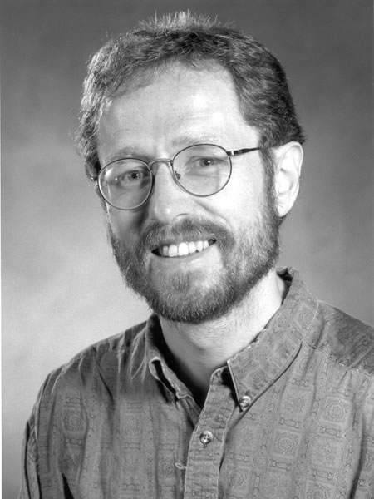
Chain Replication For Supporting High Throughput and Availability
Robbert Van Renesse
Fred Schneider
Operating Systems Design and Implementation (OSDI).
November 2014.
Notes:
Robbert is the other key person on this. Research professor at Cornell.

Slide 10
Primary-Backup
Different from State Machine Replication?
Serial version of State Machine Replication
Only the primary does the processing
Updates sent to the backups.
Notes:
A first observation: even primary-backup is basically forming a chain.

Slide 11
Chain Replication Assumes:
No partition tolerance.
Chain replication: Consistency, availability.
A partitioned server == failed server.
High Throughput.
Fail-stop processors.
A universally accessible, failure resistant or replicated Master, which can detect failures.
Notes:
The assumptions are pretty basic but worth understanding. The “master” normally is built using Zookeeper or Derecho or something similar.

Slide 12
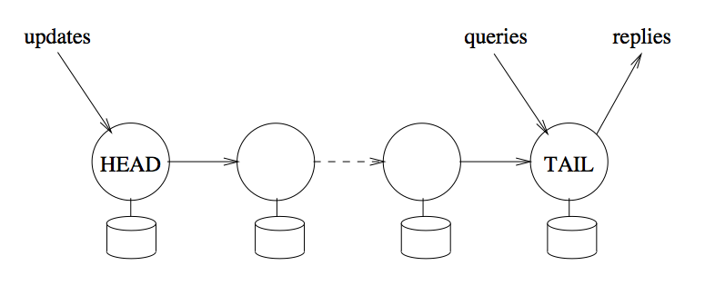
Serial State Machine Replication
Notes:
So the idea is to send updates to a “head” node which forwards them down a chain.
Queries go to the tail node.
Sometimes commits flow back from tail to head (not shown here).

Slide 13
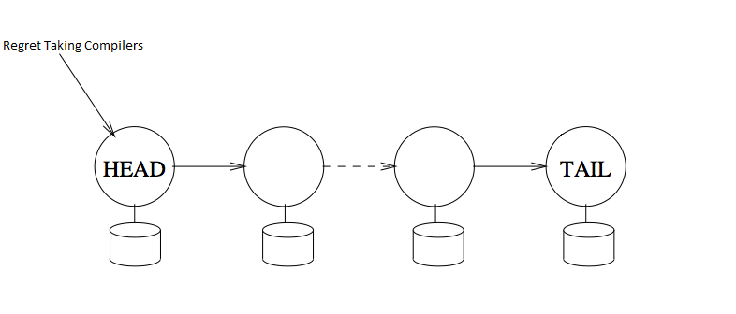
Serial State Machine Replication
update

Slide 14
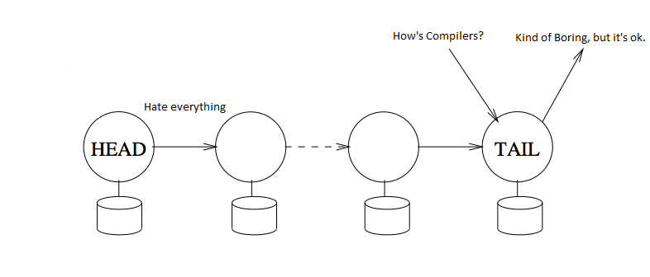
Serial State Machine Replication
update

Slide 15
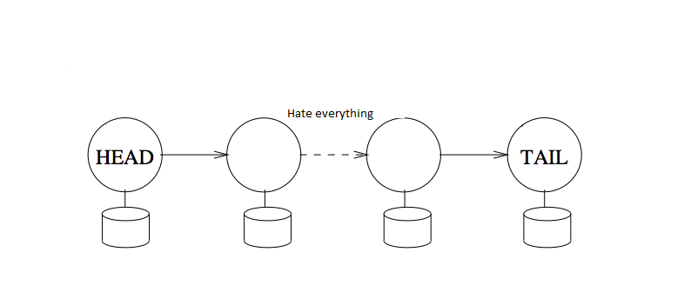
Serial State Machine Replication
update

Slide 16
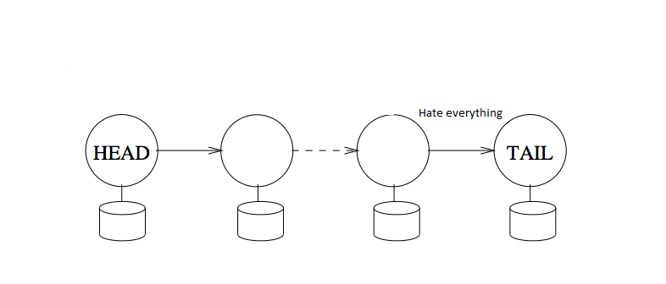
Serial State Machine Replication
update

Slide 17
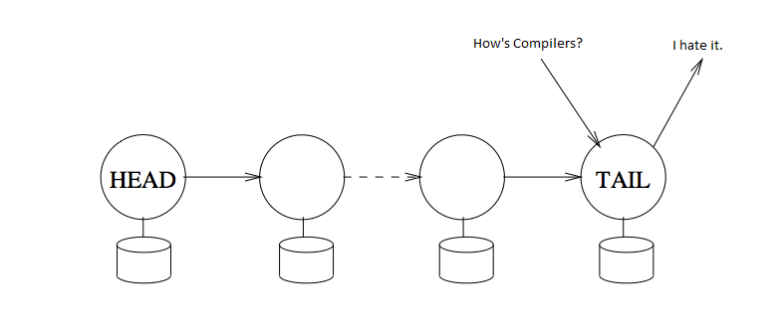
Serial State Machine Replication
update
reply
Notes:
Notice that a query won’t see the update until it works its way down the whole chain.
Updates sometimes are sent to the tail, which forwards them to the head, just to ensure that the query or update is sent to one place, and the reply comes from that place. If we will forward the update K-1 times, adding one more isn’t going to make a difference…

Slide 18
Reads and Writes
Reads go to any non-faulty tail.
Just tail, 1 server per chain
Assumes that failures can be detected accurately … in practice, this means that some sort of fault monitor is needed.
Writes propagate through all non-faulty servers.
If t machines might crash, uses the remaining N-t servers

Slide 19
Monitoring Service
Tracks the health of other servers.
Assumed to never fail or replicated w/ Paxos
If you “think” some service has crashed, report this to the manager, and it will later report back to you on the fault.
Notes:
So the monitor needs to know which nodes have crashed. Usually the deal is to have every element watch for signs of a crash, but notify the monitor.

Slide 20
Storage Systems often use chain replication.
Consider a service to store “objects”.
It also lets you read or “query” existing objects.
Perhaps, to update existing objects.
Usually offers strong consistency guarantees.
Request processed based on some order.
Effect of updates reflected in subsequent queries.
Notes:
You can “abstract” most aspects of the whole model. So we can have any kind of objects. This is a lot like Corfu, and in more ways that you might think – the two are “isomorphic”.

Slide 21
Handling failures
Failures are detected by timeouts.
Then reported to the monitoring service.
The monitoring service announces “node X has failed”.
Every node in the chain “rewires” to its new neighbor
On bootstrap, clients of the service go to the monitor and ask it for information regarding the head and the tail.

Slide 22
Adding a new replica
Current tail, T notified it is no longer the tail.
State, Un-ACK-ed requests now transmitted to the new tail.
Monitoring service is notified of the new tail.
Clients already active are notified of new tail.
Notes:
By adding new members at the tail, it is very easy to handle the needed synchronization.

Slide 23
Unavailability
Head failure:
Query processing uninterrupted,
update processing unavailable till new head takes on responsibility.
Middle failure:
Query processing uninterrupted,
update processing might be delayed.
Tail failure:
Query and update processing unavailable, until new tail takes over.

Slide 24
What systems use this model?
Many systems use primary/backup replication, and we can understand that as an instance of chain replication.
Systems like Microsoft’s Cosmos (mentioned in early lectures) often keep 3 copies of each data object. Here chain replication is a natural choice.
A very fancy use arises in “a large bank” on Wall Street that runs an electronic stock market for its internal use, and for some other banks.
Idea is to try and handle trades internally without going to the public markets, when possible, to save fees.
Notes:
So now I want to tell you about SMR in real use.
Cosmos is a system that uses this, and we could have focused on that case, but instead I’ll describe a use case in a banking environment. Chain replication is popular in banking systems.

Slide 25
The Banking use case
This big trading system runs at several locations
New York City: Primary site
New Jersey: Main backup
Chicago: A remote mirror site. Lower update rates, but accurate
London: A second remote mirror site.
Notes:
So these guys are after a property: “we never, ever, lose a trade”. They provide this by replicating every update at 3 or more locations.

Slide 26
Handling huge transaction volumes
They use a technique first reported in a paper by Marcos Aguilera
His system was called Sinfonia, and the technique uses “mini-transactions”
It starts by assuming a central database: a ledger of system state.
To update the central ledger, send it a self-verifying mini-transaction:
First, check the version numbers of various objects (a list).
Take no action unless the versions all match.
Then update a list of objects in failure-atomic manner (all or none).
Notes:
The chain replication layer would be unable to keep up with load, so they use an idea that traces to work done at Hewlett Packard. It adds read-only replicas “around” a core chain system.

Slide 27
Ordering
Sinfonia is like Corfu
It puts the mini-transactions into a fixed order, then executes them one by one, like when Corfu appends to its log.
In practice, some parallelism is feasible, if mini-transactions don’t touch the same variables, but even in this case fault-tolerance preserves ordering.

Slide 28
Example of a mini-transaction
Check to see that X is still version 4, Y is version 17, Z is version 22.
If so, then set X=9, Y=192010.11, Z=“Fred Schneider”.
Notice that the logic is very rigid!
One “if” statement, and it only checks version numbers.
One update, although it updates multiple objects.
In practice we would use a “write-ahead persistent log” for this step.

Slide 29
What good is this silly model?
The objects can be anything.
Spreadsheets, or individual cells in them, or database relations.
Lists of stocks you own, purchases and sales.
Loan documents.
MegaMillions ticket sales.
Company stock splits, or merges…
Notes:
The mini-transaction model looks absurd: “check versions, then update” but in fact it can really describe almost anything.

Slide 30
In fact Mini-transactions are general
They can be used to update any imaginable file or database system.
But where do they “come from”?
Leads to the next concept: a read-only replica of the entire bank state.
Every client system is permitted to keep a replica of anything.
The central system sends an initial checkpoint and then a stream of committed updates, which the client applies locally.

Slide 31
Sinfonia model
CENTRAL SYSTEM (non-replicated)
Self-Verifying
Mini-Transactions
Read-Only Replica
Notes:
So here we see our replica. The concept is to do any read-only work on the blue copy, and only send updates to the green copy. Blue shields green.

Slide 32
Where do Mini-Transactions “arise”?
This is the clever part.
Sinfonia actually supports fully general SQL transactions! Anything you might wish to run, in a full relational database model.
You run these transactions against a read-only replica.
… so the system actually scales easily: just add more replicas.
Notes:
Now, the mini-transactions aren’t read-only queries: these do actual updates. To run them, you first run locally on a blue replica, read-only, and then send the updates and version numbers to the green one. The idea is to soak up the work of running SQL or some other application and let the green copy only see block reads and writes, basically. It can run way faster.

Slide 33
Wait! The replica is read-only!
Correct!
Sinfonia makes all read and write accesses via a kind of updatable cache.
So, anything read will actually be copied into this cache.
Any updates are made to the cache, not the read-only replica.

Slide 34
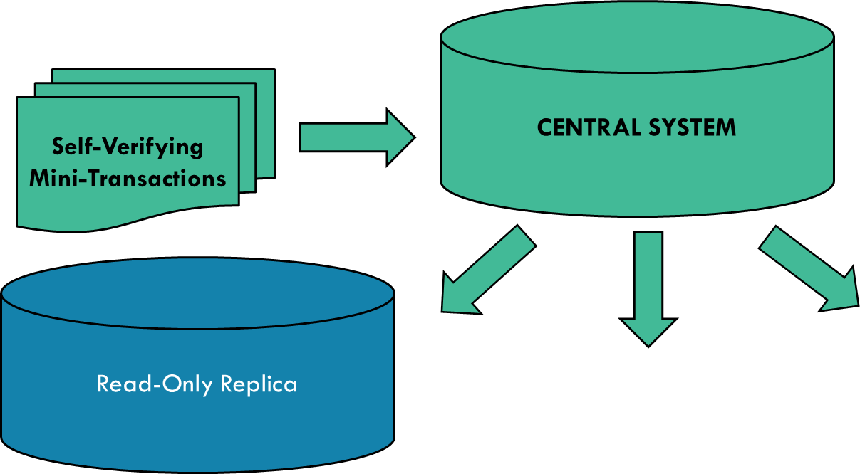
Sinfonia model
SQL Application
Updateable Cache
Reads: X(v4), Y(v17), Z(v22)… Updates: X=9, Y=192010.11, Z=“Fred Schneider”
Notes:
For example, maybe our SQL code ran on the blue thing and wanted to do these changes, after looking at these versions.

Slide 35
Where do Mini-Transactions “arise”?
When ready to commit, create a list of objects read or written.
This gives us the version numbers to validate in the mini-transaction.
Next, create a list of updates. This is the update part.
This idea is exactly the same as for a software transactional memory.
Notes:
First we finish the transaction, but at the commit point, instead of committing, we package it up and enqueue it for the green server to examine.

Slide 36
Sinfonia model
SQL Application
Updateable Cache
Reads: X(v4), Y(v17), Z(v22)… Updates: X=9, Y=192010.11, Z=“Fred Schneider”

Slide 37
We get a super-scalable solution!
All the heavy lifting occurs out on the edges where the read-only replicas exist. They work hard, running full versions of SQL.
But we can have as many of those as we like.
Use a chain or tree of TCP connections to send the database updates to them, or even a fancy multicast like Derecho for ultra-high speed.

Slide 38
Now add Chain Replication
We want our central database to tolerate failures.
So… we create a chain of replicas and each mini-transaction travels down the chain, just like in chain replication.
Notes:
Then (the real trick) we turn the green thing into a chain-replication layer!

Slide 39
… And this is how it works!
Notice how these simple mechanisms add up to give us a sophisticated functionality.
We still are limited by the performance of our central database, which should ideally be sharded for speed
For example, we could have all the stock transactions in one shard
… all the mortgage transactions in some other shard
… etc. We would want every mini-transaction to run entirely on a single shard at a time.

Slide 40
Issues observed?
High-conflict-rate transactions would tend to abort frequently.
Suppose that in one unit of time, 20 transactions all try to update Z.
Now 19 will fail, and only one will succeed, so 19 will try again, etc.
Quickly builds up to a huge load
These transactions end up running very slowly.
Solution? These particular transactions should probably run directly on the central database, not on a read-only replica.
Notes:
The solution isn’t perfect, although it works pretty well. You can see high abort rates if the blue copies quickly become stale.

Slide 41
Issues Observed?
Potentially high latency.
When you submit a request, first it runs locally.
Then it gets enqueued for central validation and updates
Then the updates get passed back to your local replica
And then the local replica finally can “catch up”.
Solution? Sharding helps (shorter queue lengths). RDMA helps too…
Notes:
With high load you might also start to see more and more delay.

Slide 42
Summary
Not every replication problem requires a super-complex software library.
Chain replication is a particularly simple concept.
Corfu uses it, but in fact with a “chain length” of 2 (simplest case imagineable)
Integrates nicely with a Sinfonia-like approach to transactions.
But it does have a number of limitations, like any technology.
The biggest worry is that because of determinism restrictions, one wants to replicate small “objects” within programs, not entire programs.
The need for a monitoring tool brings complexity back into the picture.

Slide 43
Main limitation?
With more replicas, you have more and more work generating the copies, yet the extra machines aren’t doing more transactions for you.
In this model, all the replicas “do” the same work, in the same order.
So this does make the database or object fault-tolerant, but if your goal was to have extra compute capacity and overcome Jim Gray’s concern about scalability, you won’t solve that problem this way.

