Slide 1
Tension: Simplicity vs. Consistency
Ken Birman
Spring, 2018

Slide 2
Today’s lecture will be short
We’ll spend 30-45 minutes on CAP versus consistency.
Then remainder of the class will deal with any questions you may have about material from lectures 1-15, before the prelim becomes available.
Notes:
These slides have very few notes because the actual slide text is pretty self-explanatory (if you saw the prior lectures).

Slide 3
Some rules of thumb we’ve learned
The key to the cloud is linear scalability: with more customers, throw more machines at them! Automate the three-R’s: reboot, reimage, replace.
For steady performance and responsiveness “no matter what”, edge servers should respond using cached data even if it might be stale (CAP).
Massive parallelism via tier-2 μ-Services offers further gains in speed.
The pipeline to the back-end is deep and slow. Batching is key here.
Optimize the performance-critical path by making it simple, clean.
Leverage modern hardware features, such as SSD storage [and RDMA]

Slide 4
Some rules of thumb we’ve learned
Once you accept CAP, an easy way to deal with an unresponsive server is to just reissue the request to some other server.
This leads to the concept of a simple message queuing service, which is popular as a way to mediate between the first tier and second tier
“Locking, transactions, other forms of consistency are expensive.”
Why is this in quotes?
… because it may not be correct!

Slide 5
Sharding is the answer!
Twice we touched on Jim Gray’s paper about scalability.
The key takeaway was that the database (SQL) style of system hits a maximum capacity and you can’t speed it up by adding more machines.
As passive backups, extra machines won’t be a problem
But as soon as they handle part of the work, everything slows down due to lock contention, replicated consistency, transactions that conflict/abort
Argues for breaking big services into fragments: shards.

Slide 6
Sharding introduces other problems!
But we also saw that sharding is problematic in many ways.
A sharded DHT is easy to build, but will have weak consistency.
A transactional DHT is much trickier to build, requires flattened data structures, and often forces us to create shards of irregular size.

Slide 7
Logs are sometimes the answer
In systems like Derecho and FFFS and Corfu/Tango, the key is that data ends up in append-only logs, and fast indexing allows quick access.
This definitely is a better model in many ways: simpler, offers consistency, decouples the “update path” from the “query path”.
But we need one-shot (single step) transactions to really maintain the full speed of such a model.
Notes:
This is the first slide worth including some notes on. The point here is that when we do an append to a log in Corfu, or create a new version in Derecho, that’s a form of transaction – a genuine transaction, just like in any database.
For this particular scenario, Paxos and transactions are really the very same model. I’m calling this a one-shot transaction to underscore that it happens in one step – sort of like writing
Begin Txn;
Do one operation (and I mean just one, not two)!
Commit;
Not everything can be done with a one-shot transaction. I’m not claiming that this is general. I’m saying that in this narrow, specific, subclass of transactions, we end up with an exact equivalence of Paxos and transactions.

Slide 8
A deeper perspective
No software system “behaves correctly” without a good reason!
CAP would not be a success if it wasn’t matched to an underlying insight about requirements for correctness for web systems…
Many datacenter systems run on mostly static data, “read-only”
For these, consistency comes for free: if you have the data, it is correct
Many others don’t get “upset” if some subsystem temporarily uses stale data even after an update occurred. For those, use of stale data isn’t really a problem, either.
Notes:
I’m trying to build up an argument now that “C” in CAP doesn’t really mean consistency and that CAP isn’t saying “weaken consistency” in the sense of “run incorrectly”. Rather, I’ll argue, CAP means “don’t demand the absolutely freshest version of a data item for every single read. Sometimes, if you have a reasonably fresh cached version, the application will be correct even using that item, even it is slightly stale.
So in this sense, we didn’t weaken consistency: we decided that a stale item that was recently consistent is just fine for correctness. We changed our specification of the required behavior to include serving up a cached item that might be a tiny bit out of date.
Thus the application can still be said to be “fully correct”. This is very different than running on weird, crazy, totally incorrect data that was pulled out of thin air. In one case we say “We can still be correct with less stringent staleness requirements.” In the other case we would say “Any ancient data that was ever used by the system, even during an aborted transaction, is fine.” But in fact we don’t really mean that second thing.

Slide 9
Viewed from this perspective…
CAP is more of an optimization insight: It tells us that for some kinds of data, no need to check for staleness because some forms of data never really become stale.
CAP doesn’t weaken consistency, it optimizes to address read-only uses
You could never use CAP in a true database with updates occuring

Slide 10
What is the best form of consistency?
We’ve again seen several perspectives. Is consistency about…
Totally ordered multicast, with messages delivered to replicas?
A totally ordered and persistent log? [Or even, a blockchain?]
For the first two cases, Paxos suffices. But there are also database cases:
Transactions on individual shards (“one-shot” atomic operations)?
Complex transactions on data spread over many places, with 2PC?
Notes:
My point here is that everything is really the same concept, except for long transactions that touch data spread widely. Jim Gray’s point, though, applies only to that fourth case. We can have transactions that run fast if we simply focus on the other three cases, and they are all Paxos, even the one-shot transactions.

Slide 11
What is the best form of consistency?
In fact consistency mechanism must match the needs of the application.
But don’t be overly fussy.
People used to think that every aspect of these mechanisms is costly.
In fact now the general view is that there are a few overall techniques. … when you need consistency, use a tool matched to the “use case” … don’t try to fine-tune it in very subtle ways.

Slide 12
Fog/Edge “pressure” on the Cloud
Why does fog (or Facebook edge) change the game?
… Because these are cases with rapidly evolving “external state” … Such systems should never take actions using stale information.
In a smart highway, conditions change constantly.
In fact this is also so in Facebook’s social network.
So these are examples where a “read-only” perspective won’t work.

Slide 13
All forms of consistency center on…
Membership: Who belongs to the system at this time (in this “view”), and what roles does each process hold?
Many systems fold two aspects into one: failure detections trigger membership updates
In others, failures are sensed independently, in an uncoordinated way
Ordering: In what order should conflicting actions be performed?
Durability: At what point has data become stable and “persistent”?

Slide 14
These reduce to deeper building blocks
Ordering reduces to concepts of “happens before”, plus protocols to agree on ordering when order isn’t already known.
In non-quorum systems, agreement on ordering ultimately reduces to agreement on failures and membership: a majority-based action. … and this reduces to Paxos: a protocol built from 2-phase commit.
In quorum-based systems, membership is pre-specified, yet fault- tolerant agreement on ordering still requires Paxos
Notes:
The quorum comment is aimed at people who know how Paxos really works.

Slide 15
Uses of Happens Before: →
To understand the order in which the application did things.
With asynchronous actions, we still desire “FIFO” order. … “Yes, they were asynchronous. But if A → B, please do A before B”.
If a state shows the effect of B, it should also show the effect of A.
Yields a definition of “now” that can be used to make “consistent cuts”
A cut looks at the system at a consistent instant in time.
A snapshot is a checkpoint of the full state ending along a consistent cut

Slide 16
What about transactional systems?
Most either use atomic multicast to carry out state machine replication.
But others use 2-phase locking (obtain all locks before releasing any).
Then they terminate using 2-phase commit
In complex failure cases, they depend up on an “outcomes log”. You can find a Paxos-like pattern if you stare at the logic that results.

Slide 17
So is Paxos the ultimate story?
Most theory people would point to a problem called “uniform agreement”
The Paxos specification is actually one possible way to specify the uniform agreement problem. (The term “consensus” is also sometimes used).
In this sense, yes, Paxos really is the ultimate story!
And Derecho is the ultimate version of Paxos
It matches the predicted minimal costs for such a protocol.

Slide 18
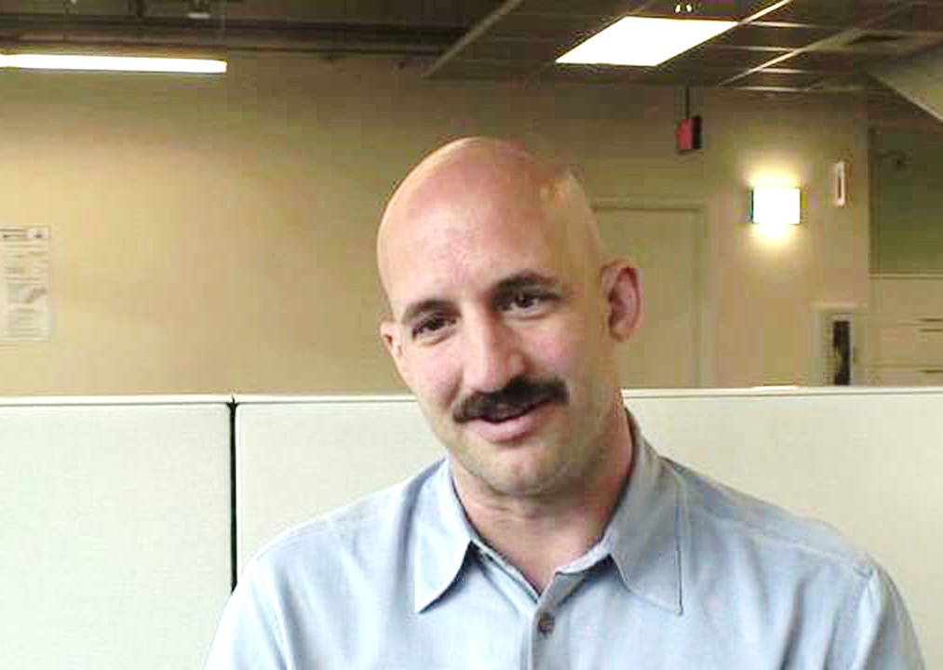
A tug of war!
Brewer/CAP: Simplicity!
Lamport/Paxos: Consistency!
The key to cloud computing is simplicity.
Clouds deal mostly with read-only data. Failures just reset a node to an initial state
CAP promotes simplicity. Developers don’t find it hard; it just forces them to think about what they really need.
You rarely need consistency at massive scale.
Consistency responds to the need for correctness. A system must not violate requirements imposed on it.
CAP just optimizes an easy case: read-only data. Even if “most” data is read-only, some is updated.
And failures happen, hence the replica set changes.
This forces us to solve uniform consensus (fault-tolerant agreement), hence use Paxos.

Slide 19
Is there a winner?
Correctness always wins!
Eric is right when he suggests that with read-only data, we can optimize to gain scalability by leveraging this property.
But when data does change, and in some applications this is inevitable… we’ll need either Paxos, or a transactional layer.
But this reveals a second tradeoff, and a second tug of war!

Slide 20
Complexity is our enemy
Even very simple mechanisms can interact in extremely complex ways
It is easy to say “find the critical path and optimize it.” At cloud scale, finding the critical path becomes very hard, in itself.
Even with CAP, we end up with strange performance puzzles, including problems as severe as multicast storms and datacenter-scale deadlocks.
With complex mechanisms, like Derecho, we take on a complex management challenge, and this won’t reduce that complexity.

Slide 21
Is simplicity attainable at cloud scale?
I've looked at clouds from both sides now From up and down and still somehow It's cloud's illusions I recall I really don't know clouds at all
Joni Mitchell (1969)
Everyone says “keep it simple…”
But clouds just aren’t simple.
At best, we have a platform layer that creates the illusion of simplicity, but encapsulates inevitable complexity!
Notes:
I love that song, and the lyrics seem strangely relevant.

Slide 22
Conclusion
Even the simplest technologies get complex when we scale them up and deploy them with other technologies. Interference is common.
At cloud-scale, we are forced to deal with complex puzzles. Even identifying the performance-limiting component or critical path is hard!
Second-tier systems often need complex consistency mechanisms, but they frequently can hide these from developers who use the resulting services.
“Everything should be made as simple as possible, but no simpler.”
Notes:
Einstein’s remarks also seem totally apropos here.
What we conclude is basically that with edge systems, we can get a lot of parallelism via the u-services model, and can trim a lot of dumb overheads, like we saw in the lecture Tuesday (where those CORBA overheads were killing us). Then things get harder.
Today’s talk basically is saying that even those cleaned-up u-services systems can be sped up by relaxing our staleness worries. By tolerating slightly stale data, in a safe way, we gain a lot of flexibility and can perform way better.
We don’t need to abandon correctness for performance. Our systems don’t even need to look very complex, to carry out these steps.

