Slide 1
MicroService Architectures
Ken Birman
Spring, 2018

Slide 2
Putting it all together
We’ve seen many elements of tier two, and discussed how those work in today’s CAP-dominated cloud, and how they might need to evolve.
And we discussed the concept of a web-page creation tier-one service, and a machine-learning oriented version we called a “smart data concentrator” or “smart memory” as well.
Yet we haven’t really looked closely at how companies like Netflix, eBay, Amazon and Google actually generate the web pages you see!
Notes:
In our early lectures we discussed the evolution towards today’s u-service approach. Today we’ll look more closely at the underlying elements, and at the places where unexpected costs can creep in.

Slide 3
Concept: Microservices (μ-Services)
Earliest web servers
Were hand-coded in languages like Python, or even home-brew scripting languages a bit like shell scripts with string substitutions.
People built them without a lot of experience to draw on…
… unsurprisingly, they were slow, hard to extend, hard to maintain
Led to a burst of work on how to build better web page generating systems, and “μ-Services” were the outcome of that work.
Notes:
Story: In fact these early systems were kind of like interpreters, with specialized libraries (DLLs) that they would dynamically load for specific tasks, like 3-D rendering. The issue is that it is far easier to load a library than the “unload” it, and they would effectively leak memory: each new class of web page had its own weird library needs, and before you knew it, the server might have loaded 50 DLLs and be totally out of memory. Only real option at that point is to reboot it.
So early systems spent a LOT of time rebooting and “warming up” after a cold start!

Slide 4
… And it was costly in other ways, too
Everyone had to operate their own server farm or datacenter.
Often, those machines were mostly idle: you need a lot of machines for peak load situations, yet peak loads occur rarely.
And “peak load day” differs for different companies.
Rent-on-demand has an obvious economic appeal.

Slide 5
A confluence of trends
Today’s “cloud edge” reflects a swirl of economic and practical motives:
Standardization: Reusable subsystems enhance productivity
Scalability: Imperative to absorb load at the edge.
Cost: Resource sharing amortizes costs. Pay for what-you-use.
Automation: Everything needs to ride out any imaginable mishap!

Slide 6
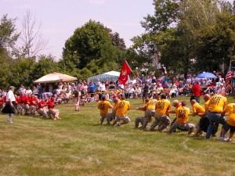
Puzzle: Latency versus Throughput
End users want fast response: low latency is what matters!
Notice the tug of war: you can’t optimize both!
End users measure system quality in terms of end-to-end delay for their web actions, like browsing or clicking to purchase.
But the system benefits from batching: this maximizes throughput!
Servers want to maximize throughput. Batching helps!
Notes:
This tension is very interesting.
As it happens, the 100ms goal helps. Once you get latency down to 100ms, you can optimize for high request rates, as long as you don’t break the 100ms limit.

Slide 7
Puzzle: Elasticity
Cloud loads can vary dramatically over short periods.
So the elements of our solution needs to be elastic
More load? The cloud will run more instances.
Load drops again? It will shut some down.
Cloud systems lack standard ways to inform your application when this happens! So expect sudden elasticity events with no real warning or notice.

Slide 8
Absorb load at the edge
Back-end servers easily overload, and it is very hard to scale them up.
With elasticity, the outer tiers can shield the back-end.
Leads to the idea that μ-services should operate independently:
They handle read-only load with minimal server interactions,
Cache results and send updates to the back-end servers via pipelines.
Always respond to the end-user right away, don’t wait for back-end.

Slide 9
Enables a massive outer layer
Composed of the tier-one and tier-two systems we’ve discussed.
Tier one systems build web pages, so they don’t need a lot of “oomph”
A single server can really host many instances of web-page-builders.
Recall “lots of threads” versus “containers” versus “virtual machines”. … no more debate. Today, containers have won.

Slide 10
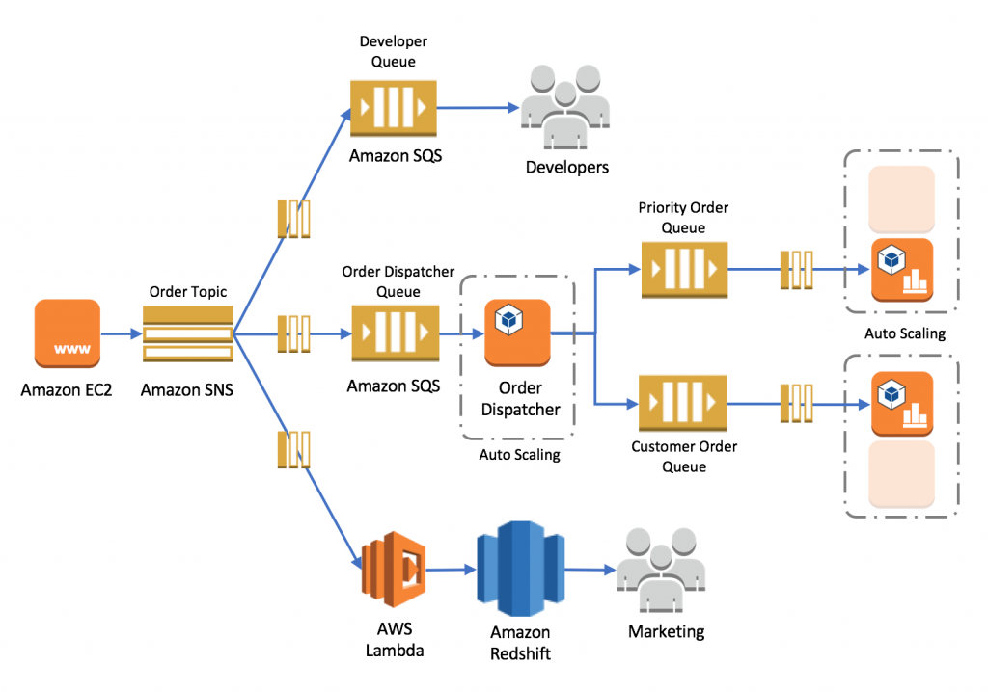
… in pictures
All of these are μ-Services. Most are really elastic pools of service instances that grow or shrink dynamically.
SQS
End-users on browser or app
Tier-1 server
Lots of containers running Apache or a similar server
Notes:
Notice that SQS shows up many times on this image, yet each time with a different name. Many u-services are like this: they can be specialized and you instantiate them many times, specialized in various ways. Beyond that, every single component is probably really a collection of servers cooperating to provide the desired function.

Slide 11
Batching: Used for high rate updates
In traditional database or OLTP systems we think of each update as a separate thing: you get a request, do an update, respond to client.
In today’s cloud, we send updates down long “asynchronous” pipelines: nobody waits for the responses or actions to occur.
They aggregate into big batches.
Back-End Server
Batched Requests

Slide 12
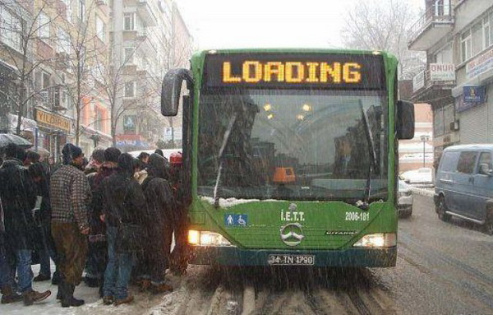
Why batching helps
Consider the path a request takes through a complex system
It may travel from service to service down a pipeline
It certainly is stored to disk, reloaded, sent on the network, received
Each I/O is costly: must move data through the device, O/S is involved, there may be a device queuing or access delay, scheduling, interrupts…
If a single “object” contains many “requests” we pay these costs once, on behalf of the many. The costs are “amortized” and hence smaller.

Slide 13
But batching hurts latency!
But when we batch, we often delay a request
A common model: some layer might buffer.
Each time it accumulates 10, or 100 requests, it sends a new message
Thus an average request will wait until half the average delay!
So batching reduces overheads, yet increases wait time, hence latency.

Slide 14
So… systems often do both!
It isn’t uncommon for web systems to respond before the job is completed.
This reduces end-user wait time. But a failure could disrupt the task.
But it means that some tier-two services take on an obligation to not lose those pending requests before they are handed off to back-end!
Hence we see some stateful tier-two components, even though in the early web systems, tiers one and two were generally stateless.
Notes:
In fact many systems have one behavior for the outermost tier 1 servers, a second behavior for quickly responsive tier 2 servers, and then get more and more batched as we plunge deeper in. Not all elements use the same rules, and not all of them are configured identically. When we look at a cloud we need to keep this in mind: it isn’t a single system, like a single database. It is a federation of many systems, and even the identical role (like the SQS) may be configured in varied ways.

Slide 15
Core question was posed around 2005
Once you decide to build a cloud with a massive outer tier, creating web pages using parallel subtasks, how aggressively should we subdivide the work?
Leads to a view that:
The web server the client talks to is an engine for navigation, and for requesting content, which it “prepares” for later rendering by the client
Its whole world is dominated by a request arriving, dispatch of these subtask requests, collecting responses, and streaming them to client
The client will use a rendering “order” optimized around human perception of speed, fluidity, etc.

Slide 16
Original tier-two μ-Services: Storage/Caching
Today we think in terms of two categories of μ-Services
One is concerned with storage caching, and we know a lot about those: DHTs. In this category we might also find a global file system, and even some forms of transactional database APIs.
We’ve learned from CAP that if you can manage with weakly consistent caching, doing so benefits performance!
Write as little to the global file system as possible

Slide 17
Other tier-two services: μ-Services
The second category of μ-Service are built to play specialized roles:
Fetch images of products for sale as 2-D images sized for client screen
Fetch zoomable and rotatable 3-D images of the products
Fetch product detail information
Look up product reviews from professional reviewing organizations
Look up product reviews from other customers
Look up vendor reputation information, … etc. (lots and lots more)

Slide 18
These μ-Services are layered
We don’t talk about them by numbers (there isn’t a “tier three, four…”)
Yet in fact, we generally see a flow graph from the end-user into tier-one services that build interactive web pages, then deeper into layer after layer of tier-two μ-Services.
The real rule is that tier-two μ-Services are involved in interactive tasks.
Tiers one and two must also be scalable: not a single server, but a pool.
Back-end services run later, off the critical path, may be less scalable.
Some database people call this the third tier, but back-end is better.

Slide 19
Amazon page depends on 1000 μ-Services
Why so many?
In fact the page generating server probably only talks directly to a much smaller number for a typical page, maybe 20 or fewer
But these in turn depend on other μ-Services, and the total ecosystem for a company like Amazon has 100,000+ and the number is growing!
What in the world could all of these be doing?
Amazon deliberately redesigned its systems in 2005 to break them into small pieces for many reasons

Slide 20
Benefits of “divide and conquer”
We are familiar with the single-machine concept
But in a distributed system, the same idea is useful for other reasons
Create a pool of workers to handle scalable request flows.
Obtain parallelism by splitting work among many such worker pools.
Each subtask is doing something very different, owned by a distinct developer team, perhaps using very different technologies.
These μ-Services in turn depend on other μ-Services

Slide 21
The Fascinating story of NetFlix
The company ran out of compute capacity early in its growth.
Rather than build its own datacenters, it decided to rent everything!
They rent content storage from Amazon, even though Amazon competes with them! Both companies make more money by cooperating…
They rent networking resources and network-layer caching services, too.
Many Netflix μ-Services run on Amazon: billing, movie recommendations, web page construction, etc.

Slide 22
Why Doesn’t Amazon crush Netflix?
Netflix insists on “most favored nation” status: performance at least as good as the best of Amazon’s cloud users, including itself.
Amazon sees more benefit in having massive datacenters and keeping them busy, to respond to surge loads (like on Cyber Monday).
Anyhow, if Amazon attacks Netflix, Netflix can move to some other cloud.
Bottom line… Amazon actually gains more by hosting Netflix.
… even though Amazon video competes against Netflix!
Notes:
People genuinely were surprised by this when it occurred, back in the 2007 period. Now Netflix is overwhelmingly the winner, although Amazon Video is chasing them and could catch up.

Slide 23
Amazon cloud hosts Many companies
A first insight is this:
A fairly small set of cloud vendors actually host most of the clouds!
Amazon is the largest. Beyond them, Microsoft and Google. Then Apple, Force (SalesForce), IBM, HP, Oracle, Liquid Metal, RackSpace, …
By opening their μ-Services infrastructure for use by outside developers, companies increase efficiency!
Customers fear “vendor lock-in”
Solved by standards: OpenStack alliance.

Slide 24
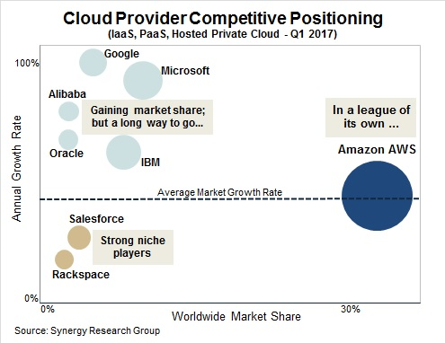
Notes:
Microsoft is growing very fast and already at 15% market share. AWS is growing too but not as fast… Google’s growth is even more rapid than Microsoft, but it only recently offered this product, so they benefit from an early “boost”

Slide 25
Why is Amazon dominant?
Early in the cloud game, Amazon was first to simultaneously
Create and use its own microservices architecture
Open that architecture so third-party customers can build on it.
Organize developer resources to assist in creating cloud-hosted systems
In effect, Amazon was an early provide of the entire story, and used its own tools, which helped the company discover issues and fix them first.

Slide 26
Explosive growth
Some of the Amazon μ-Service infrastructure consists of Amazon’s own services for building its own web pages.
But much of it consists of general purpose tools that customers share and benefit from: like a “cloud computing toolkit”, with huge coverage
And beyond this, one sees huge numbers of non-Amazon μ-Services created exclusively for customers, who then run them.
In reality the 100,000 number is probably very low: Amazon has no actual count of the number of things that are running, and the tiers are “loose”

Slide 27
eBay semi-Private Cloud
eBay operates its own cloud software, using OpenStack, then runs on cheapest cloud vendor offering a high quality of service.
IaaS model of cloud computing: eBay rents containers or bare metal
Avoids dependency on any vendor, lets eBay benefit from multitenancy
Container model really emerged from cases like this:
To efficiently share servers we need multiple users per server
Virtualization proved to be too expensive. Containers isolate but with lower overheads.
Container environment is very standard (and open source!)
Notes:
Ebay uses OpenStack and Mesos containers to be highly flexible. They run on AWS but aren’t locked into AWS tools – and they can equally run on Liquid Metal, or IBM cloud. For them, a cloud is a host for many tenants, and they simply rent space from the provider, ignore most of the provider-specific tools, and then run their own tools in the space they occupy…

Slide 28
How do μ-Services talk to one-another?
Point to point communication: normally via remote method invocation using a standard such as REST (widely popular, even used by smart sensors)
Encodes requests as web pages, using “SOAP” encoding
Replies come back on the same HTTP/HTTPS session, also in SOAP.
Works even from cloud to cloud.
Inside the cloud, especially when dealing with a pool of servers, “message oriented middleware” products are popular
Example: Kafka pub/sub system, Amazon’s “Simple Queue Service” (SQS)
Notes:
SOAP is a remote method invocation encoding scheme. REST uses SOAP to generate requests and replies.

Slide 29
Features of SOAP as used in REST
Simple Object Access Protocol: Layered over web page standards.
Server exports an interface (as a web page), and it defines methods (as web pages with form-fill).
Client imports the interface when it binds to the server via HTTP/HTTPS. Then it encodes each request into SOAP format.
All of this is hidden: developers see method stubs
But in fact the encoding is quite expensive. Can bloat data by 10-100x

Slide 30
Features of a tool like Kafka or SQS
Caller treats the whole set of microservers as a group.
A microserver loops, asking for a request to process.
Dequeues and processes the next request
Responds
The response triggers the client to wake up and dequeue the response
This garbage collects the whole request-response object
Notes:
These are like request-reply systems, but the request enters a pool and any of a set of servers (or many, or all) can see it.

Slide 31
Variations
Kafka offers
Publish-subscribe API
Optional persistence: a “history” of each topic
Various fault-tolerance features, timing guarantees
Scales pretty well

Slide 32
Variations
SQS is really the same concept, but has more elaborate options:
Fault-tolerance features that could be very simple, or fancier (a simple one might simply track server health and if a server crashes, reassign its jobs to other servers).
Semantics can include at-least-once, at-most-once, transactional.
Some use “leases”: if a request has not been processed within some given time delay, it times out and the client gets an error, and the queuing subsystem cleans itself up.

Slide 33
In effect, tier two can be stateful!
If a RESTful request times out, you know nothing about status.
In contrast, tier-two tools, like Kafka and SQS, often provide guarantees that clients within the same datacenter can exploit.
This forces the tier-two service itself to persist data.
They may even replicate data, using Paxos for consistency, or employ transactions like in FaRM. But such details are “hidden” by the API.
Permits “safe handoff” between μ-Services, when appropriate.
Notes:
The state in Kafka is like a file containing “active requests” and “replies that have yet to reach the client”

Slide 34
So, up to now…
We’ve seen a large-scale picture of how modern cloud systems work, but not a very detailed one (because the details are too “big” a topic)
We’ve looked at some of the more interesting technology options for fancier interactions between things (omitting trivial ones, like REST, HTML)
We’ve starting to see how these add up to a full story in which simple building blocks combine to give highly reliable big-picture solutions

Slide 35
What limits performance?
This is one of the major questions we face as cloud system developers!
Rules of thumb:
Identify the critical path. Focus on speeding up the code on this path, even if code off the critical path becomes more costly!
90% or more of delay will be determined by just one “bottleneck”
Avoid second-system syndrome! … Make the critical path as simple and as “linear” as you can. … Ruthlessly remove useless features… optimize for common cases!

Slide 36
Issues seen with μ-Services
Because there are many hand-offs, we often see
“Admission control” delays: the subsystem is busy, so some mechanism is used to pause introduction of new requests
Network delays: The network itself can ask senders to slow down (TCP)
Message coding delays, like for REST or other standards (CORBA, etc)
Scheduling and boundary-crossing delays. Task start-up delays.
… the list is very long

Slide 37
Finding the bottleneck: Single-machine options
Measuring the system clock time can be very useful, but don’t try to print anything while actually on the measured path
It may be wise to warm your system up by letting it do 100 operations
During testing, store the time at various spots into in-memory arrays … Use the high-resolution system clock … It may help to turn instrumentation on, “sample”, then off again, rather than tracking every single operation
Finally, print the arrays out in a nice format after the test is finished.
Notes:
Surprisingly many people don’t realize how expensive simply printing something is!

Slide 38
Finding the Bottleneck: Single-machine options
Artificially looping and measuring time for key elements of your code is also very helpful.
For example, if you suspect that a particular data structure is slow, you could isolate it and just do one-million operations on it
This enables you to run a profiler, like “gprof”, that will highlight slow spots
Be aware that in NUMA settings, memory layout and L2 cache hit rates can have a huge (25x) performance impact

Slide 39
Finding the Bottleneck: Distributed options
There are tools to help you profile complex distributed systems.
… but they can be hard to learn to use.
Common techniques:
Color coded visualizations that show idle/working/hot-spots.
Pipeline measurement tools that can track some form of tagged events and post the times at which each reaches various stages of the system.

Slide 40
Debugging μ-Services Performance
Ken worked on the French air traffic control system, many years ago
The system worked well, and is still active in Europe.
As a result, the developers of a more modern air traffic control system turned to him for help when a new design was unexpectedly slow.

Slide 41
The system had a μ-Services structure
Semi-automated system manager watches system health, reboots failed elements, assigns ATC controller “roles”.
Backup
Message Queuing Middleware
Primary
Proximity alerts
Weather avoidance
Routing Assistance
Gate Scheduling
Fuel Optimization
Report flight plan updates to other ATC Centers
Air traffic controllers revise flight plans, creating versions
Primary/Backup logging service, like Corfu, records the updated flight plans
Microservices analyze the new system state and report recommendations / alarms. Each has a specialization.
Each ATC console keeps a cache of flight plans to limit load on logging service.
Updated flight plans, alarms, radar images and other events are reported back to the air traffic controllers via reliable multicast
Notes:
Obviously we saw this a while ago as an example, but I wanted to show you the same image again because it illustrates this u-services model in such a clear way.

Slide 42
Core consistency argument?
Each flight plan version is immutable: if a controller sees “AA 271 v17” this is a unique object. A robust checksum prevents data corruption errors.
So, if a controller wishes to take an action, it is expressed first as a proposed change to some version of some flight plan.
The system only accepts such a proposed change (“commit”) if it was based on the most current version (otherwise, controller tries again).
System management layer ensures that there is always one controller for each flight, and for each segment of airspace (failures sensed within 30s).
Notes:
We need Paxos (“we need Derecho!”) for the primary-backup component. But the rest benefits from the fact that the data really never changes once it is created and logged by the primary-backup service.
Nobody ever modifies a flight track. They just create new versions that replace the prior ones.

Slide 43
Examples of μ-services
With this new flight plan, will planes be too close sometime in the future?
Is there a better routing that might save fuel?
Will customers miss connections and require rebooking?
Is a plane running low on fuel and in need of expedited landing priority?
Should the flight plan change be reported to some other ATC center?
If a plane may need service, notify the relevant company.
Allocate a parking gate based on new arrival time…

Slide 44
Decisions they made
The entire architecture used a standard message representation, CORBA
The only “stateful” portion was the primary/backup database of flight plans. Everything else is basically read-only and can be regenerated.
Each new flight plan was computed from a specified prior version. Impossible to generate two “version 17” records because the database rejects a new flight plan as invalid if it isn’t based on the proper prior one
… it was much too slow.

Slide 45
Why do you think it was too slow?
Some ideas:
Maybe the datacenter network was too slow, or dropping messages
Maybe the message queuing middleware was very slow
Perhaps the primary/backup solution wasn’t fast enough
Maybe everything was getting bottlenecked waiting for actions by the manager component, or some other overloaded element?
Perhaps there were other overheads?

Slide 46
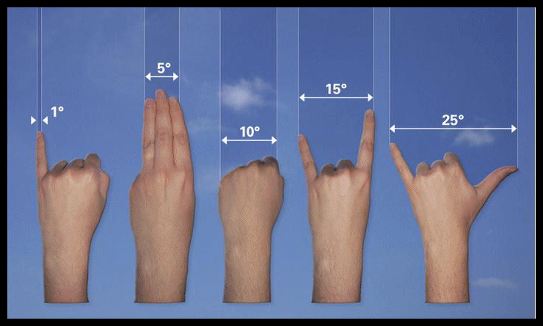
Apply rules of thumb
We used a white board and made a flow diagram: from when a controller changed a flight plan, to when the change was confirmed to her and other controllers, along with advice, notifications, warnings, etc.
Question: how costly might each of these steps be?
Developers wanted to measure lots of things and give exact answers.
We proposed just using coarse guesses and performance numbers they already had from other experiments, as a starting point.
Notes:
Think about that 90% rule of thumb

Slide 47
We ended up with a picture like this
Corba I/O requires encoding, and also waits for the I/O to finish, so the memory consumed by the object can be reused by the application.
Encoding/decoding also occurs each time a request crosses a module or service boundary, even on the same machine. This is because modules were in different languages and often running in different processes
Our best guess at the associated delay
Steps along the critical path, estimated from the system design
Notes:
90% is a big percentage. It usually is something being done often – for us, CORBA encoding and decoding.

Slide 48
Was it hard to discover this?
Remember that rule of thumb: 90% of the time (or more) tends to be spent in one little portion of the code, 10% (or less)
In our case this was definitely so.
Something soaking up 95% of the compute time tends to stand out.
So it was actually not very hard to identify the real issue!

Slide 49
prior knowledge of overheads helped!
In CORBA, object format translations are necessary. Everyone knows this.
CORBA encodings are bloated and slow to manipulate. Common concern.
As it happens, flight plans are very large, complex, structures.
When we asked, we also learned that … many μ-Service components don’t actually look at the data. … other components interact repeatedly about a single flight plan version.

Slide 50
Are μ-services and CORBA a disaster?
Each flight plan was about 1MB-10MB in size, a complex record
Encoding and decoding it into the CORBA marshalled format was slow!
This transition occurred often because the system was using μ-Services and each time they talked to one-another, format conversions occurred.
But this approach let them write numerical code in MatLab, and other elements of the system in Java, C++ or even Fortran.

Slide 51
Don’t blame the design!
The quality of system engineering was incredibly high!
This form of split into small services is standard and useful.
Permits use of the very best language for each task.
Reuses mature components from prior systems.
Permits sophisticated unit testing.

Slide 52
Some ideas for fixing the cost
It is easy to suggest drastic remedies… Recode the whole system
in C or C++, eliminate CORBA. Use RDMA.
… but we only had 10 weeks to fix the problem!
It took them years to build the prototype
It had hundreds of thousands of lines of code
Any fix must preserve this huge investment.
Notes:
Our angle was inspired by teaching low level Java classes: the concept of a getter and a setter method, which can “hide” extra work associated with access to data.

Slide 53
Impossible!
I’m sorry Captain, but I canna change the laws of physics!
Scotty, I have an idea

Slide 54
Approach we proposed
Suppose we could eliminate all these CORBA delays. They seem to account for 95% of the total end-to-end cost!
Notice that flight plans are read-only objects.
To change a flight plan, the system creates a new version – the old one is never modified in place.
A flight plan is fully identified by the flight number, and the version.
Notes:
So even though a flight plan is 10MB, in fact you can always represent it in an object with just a tiny little string: “AA Flight 227, version 2” for example.
This won’t cost much to pass around.
Then we can build getters that do “lazy fetch” of the data. Here we are making use of the insight that relatively few library modules actually look at the data.

Slide 55
It worked: 20x speedup!
We were able to (almost) completely eliminate those costs!
First step: create a “wrapper” layer for flight plan objects. … mimic the original API for the flight plan object … recompile the applications, but don’t modify any existing code at all.
On the wire, a flight plan is “represented” by [flight#, version] … no need to include data when sending between components.
Load flight-plan data on demand only when the application accesses it.
Cache loaded records, so that subsequent load operations will be ultra-fast.

Slide 56
Main insight?
The problem was actually fairly simple, and so was the fix
The hard part is understanding where the bottleneck actually resides
With these wrappers, the performance problem vanished!
Only new code was the fetch-on-demand logic.
So it was easy to unit test, and no bugs were introduced.
Developers were tempted to do more performance tuning… … but the ATC organization felt that it was fast enough.

Slide 57
Summary
Modern cloud systems use the tools we learned about in the context of highly concurrent μ-Service architectures.
Result: surprisingly complex systems that may have many layers, many subsystems, many instances of each, non-trivial connections between them
All of this can cause overhead, especially if the μ-Services use many languages and programming models. Yet we gain simplicity by letting developers reuse existing code and by picking languages that match use!
Only fix bottlenecks that really arise… focus your fix on the problem…

