Slide 1

Where did the cloud come from?
Prior to ~2005, we had “data centers designed for high availability”.
Amazon had especially large ones, to serve its web requests
This is all before the AWS cloud model
The real goal was just to support online shopping
Their system wasn’t very reliable and the core problem was scaling
Like a theoretical complexity growth issue.
Amazon’s computers were overloaded and often crashed
Notes:
2005 was really the year when scalable database solutions hit their limits.

Slide 2
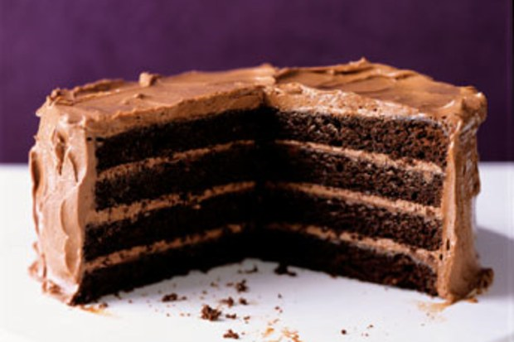
Tier one / Tier Two
We often talk about the cloud as a “multi-tier” environment.
Tier one: programs that generate the web page you see.
Tier two: services that support tier one. We will see one later (DHT/KVS storage used to create a massive cache)
Notes:
There are a lot of layers but we tend to just talk about tiers 1, 2 and the back end. It would be confusing to have some concept of precisely what tier 13 should mean.

Slide 3
Original tier-two μ-Services: Storage/Caching
Today we think in terms of two categories of μ-Services
One is concerned with storage caching, and we know a lot about those: DHTs. In this category we might also find a global file system, and even
some forms of transactional database APIs.
We’ve learned from CAP that if you can manage with weakly consistent
caching, doing so benefits performance!
Write as little to the global file system as possible

Slide 4
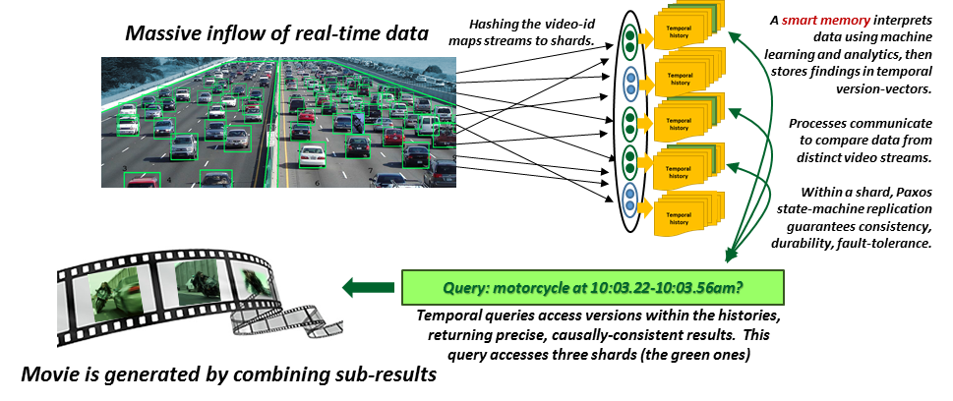


Smart Memories for Smart Highways
Derecho helps you build this kind of structured service, in C++
Notes:
We’ll do a whole lecture on this topic!

Slide 5

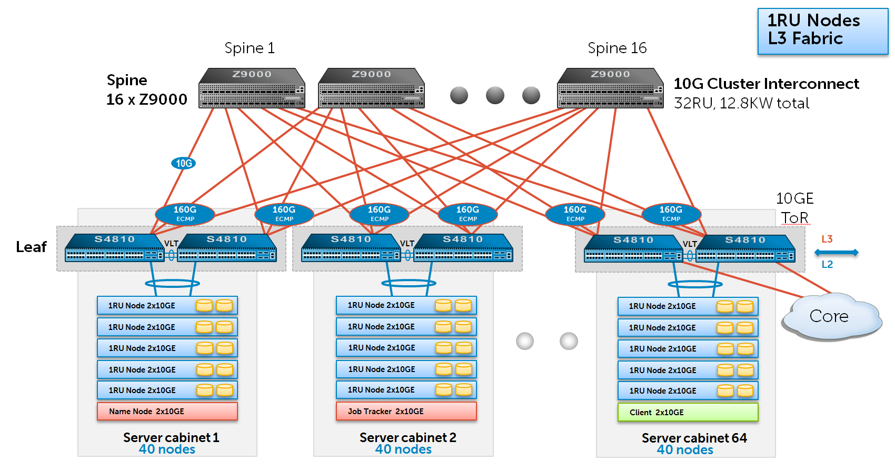
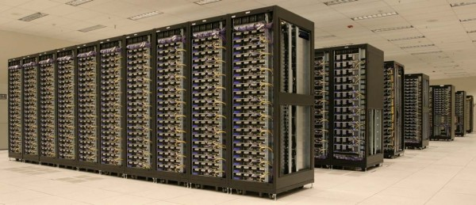
New: Move ML to the edge Of the cloud
Data acquisition…. Global File System… Hadoop jobs
ML was at the back
We create a smart
data concentrator
tier and it runs
here, at the edge
of the datacenter
GFS
Machine learning typically lives here, at the back
Delay: milliseconds… Seconds…. Hours
Delay: milliseconds…

Slide 6
Today: a very “long” pipeline
Data acquisition…. Global File System… Hadoop jobs
GFS
Machine learning typically lives here, at the back
Delay: milliseconds… Seconds…. Hours

Slide 7
Which subtopics will we focus on?
Scalability: If we build something and test with 10 machines, will it still be stable and working with 10,000 machines and a million users?
Fault-tolerance: Can we build systems that self-repair
Consistency: If we query data replicas, can we be sure the data is valid?
Speed: How fast can all of this run, using modern hardware accelerators?

Slide 8
Batching: Used for high rate updates
In traditional database or OLTP systems we think of each update as a separate thing: you get a request, do an update, respond to client.
In today’s cloud, we send updates down long “asynchronous” pipelines: nobody waits for the responses or actions to occur.
They aggregate into big batches.
Back-End
Server
Batched Requests

Slide 9
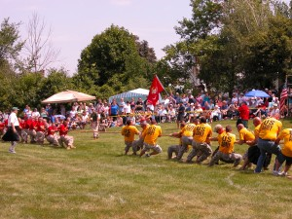
Puzzle: Latency versus Throughput
Notice the tug of war: you can’t optimize both!
End users measure system quality in terms of
end-to-end delay for their web actions, like
browsing or clicking to purchase.
But the system benefits from batching: this maximizes throughput!
End users want fast response:
low latency is what matters!
Servers want to maximize throughput. Batching helps!

Slide 10
Importance of caching
The job of the Facebook image and video (blob) cache is to rapidly find the version of an image or video when needed.
One thing that helps is that once captured, images and videos are immutable, meaning that the actual image won’t be modified.
Facebook often computes artifacts from an image, but it doesn’t discard
original versions. Even deleted images live forever (in the Haystack)
Thus there is always a recipe to (re) create any needed object. But
Facebook would rather not do that unless needed: it wastes resources.
Notes:
Caching is where the copies live – plural because the same image can end up in many of these caches.

Slide 11
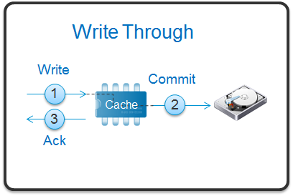
Concept: Write-through cache
In fact, TAO behaves like an extremely sophisticated write-through cache.
Such a cache allows both reads and writes, and it retains a copy of the new data from a write.
Then it passes the write to the back-end. This presumes that all writes will be successful, so there is no concept of an “abort”.
Even so, if the cache is ever inconsistent, the front-end could temporarily show some sort of evidence of inconsistency, and the write might even make this worse. Later, it will self-correct. Applications must be careful!

Slide 12

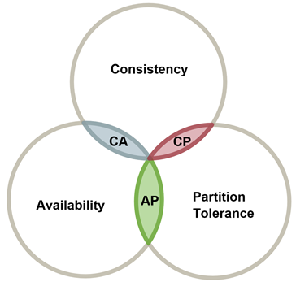
Eric Brewer’s Cap Theorem
At Berkeley, Eric Brewer captured this insight with a “theorem”
CAP stands for “Consistency, Availability and Partition Tolerance”
Basically, Eric argues that:
There is a tradeoff between these properties
You can’t get all of them at once (simple example: conflicting database
updates are issued when the network is temporarily partitioned)
He concluded that one has to be weakened, and suggested that using
stale cached data isn’t such a terrible thing. Many web pages won’t care
Notes:
Eric to the rescue! A false theory, as it turns out, treated mathematically. But it was true anyhow, viewed as a practical rule of thumb.
Basically, he said to cache everything and to heck with consistency. This is not what you learn in a ugrad DB course.

Slide 13
Formula for High Availability
Your browser sends web requests, but never trusts that they were received
If the server it was connected to dies, the TCP connection breaks and this
resets the HTTP or HTTPS session. The browser just resubmits the page
(or for some classes of requests, gives a “server timed out” error)
On the Amazon side, the system monitors various health metrics, automatically, for all tier-one servers.
If a server seems unhealthy, it uses Jim’s three R’s to automatically fix it.
Drill down: CAP Availability

Slide 14

On to the “P”
Partition Tolerance. What a strange term!
The terminology relates to network connections, but is actually focused on the network inside a data center (or perhaps between two data centers).
We say that a web server is “partition tolerant” if it can respond to new
requests without talking to back-end servers first. Thus if a back-end
server cannot be reached due to a network problem, it won’t wait.
So, a highly available and partition tolerant service is one that can generate a web page for a client purely from the soft-state local to it.
Drill down: CAP Partition Tolerance
Notes:
P just means “even if disconnected from the back-end databases.”
We prefer to avoid having the edge of the cloud talk to the back-end, ever, even for things like reads.
So in the cloud today, almost everything is in the cache and the outer edge is very focused on cached access.
Works great for photos. The photo of me with my family from Thanksgiving back in 2015 hasn’t changed in a while. Any cached version will be consistent.
Eric’s point is that there is WAY more data like that photo than there is data that changes all the time. So you don’t need to have the platform worry so much about consistency for things like photo caches. All that work would be a waste of compute time and resources. If you have the photo, it is the right version. There aren’t other versions of that particular image.

Slide 15
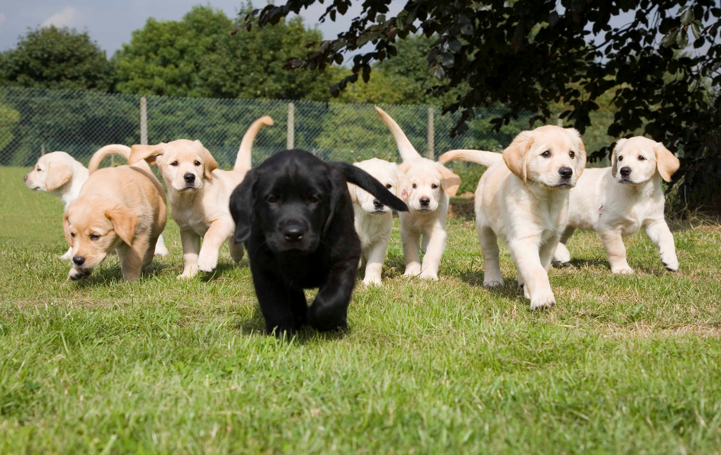
What is Consistency?
This has many definitions, and in fact debates about CAP center on them
One simple idea of consistency is to focus on replicated data.
Here, you could say that the replicas are consistent if they are updated
in the same way, so that all go through the same value sequence
But even this simple concept has some complications
If we make replicas in a setting where we use the 3-R’s, how can we
know which machines have copies, and are supposed to be updated?
If someone reads data, which version do they need to see?
Drill down: CAP Consistency
Notes:
That black puppy? He is probably not really from the same litter.
The others might be genetic clones, more or less, but the black puppy is not going to look identical to them.

Slide 16
Transactional Properties
Database systems offer much fancier guarantees
They allow you to define “transactions” which are complicated programs that read lots of different data, or that do a mix of reads and writes.
Transactions end by committing or aborting.
A transaction is consistent if it sees a database state that reflects all the prior committed transactions, executed one by one in some order.
Drill down: CAP Consistency
Notes:
…. Same thing. Transactions are how you get ACID properties.
The analogous statement: happens-before is how to think about ordering. And consistent cuts guarantee that you won’t double count things.

Slide 17

The ACID properties
One common way to explain transactions is to say that they offer
Atomicity: Executes to commit, or rolls back (aborts).
Consistency: Database respects invariants after commit.
Isolation: Even if transactions run concurrently, no interference occurs.
Durability: A committed update won’t later be lost.
People first explored this concept during the 1960s.

Slide 18
Two Phase Commit
Execute
Prepare
Commit
C
P1
B1
P2
B2
Two round-trip message passing
Requires all machines’ CPU
Notes:
Notice how the prepare request to P1 triggered a message to B1, and an ack. That was how the primary (P1) made sure the backup (B1) was in sync.
Same for P2 and B2.
The commit also needs to reach the backups.

Slide 19

Serializability
R:w
R:z
W:x
z = x + y;
y += x;
x = z-y;
w = 2*w+x=1;
R:w
R:z
W:y
Read x
Read y
z = x+y
R:x
R:y
W:z
R:x
R:y
W:z
Serializability: Consider a set of (committed) transactions.
Define a serial execution to be the result of executing those transactions
one by one, as if each happened to run at a time (in an idle system).
A transactional execution is serializable if it runs concurrently and yet
leaves a result indistinguishable from some possible serial execution.
… in effect, we can’t tell that the execution was concurrent.
… If you ask “is it serializable” while transactions are active, you just
roll back any active transactions, and consider only committed ones.
Notes:
In the textbook I show how these examples can be reduced to a math notation.

Slide 20
Membership Management: One need
Automates tasks such as tracking which computers are in the service, what roles have been assigned to them.
May also be integrated with fault monitoring, management of configuration data (and ways to update the configuration).
Often has a notification mechanism to report on changes
Notes:
Today’s lecture is drawn from a 40 page paper you can read about Derecho. The link is right on our syllabus web page.
We won’t have a ton of notes because the lecture closely tracks the paper, so I’m kind of hoping you’ll just read the paper for details not on the slides.

Slide 21
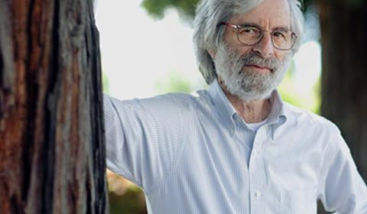
State Machine Replication Model
Leslie Lamport
Take some set of machines that are initially in the identical state.
Run a deterministic program on them.
If we present the replicas with the identical inputs in the identical order, the replicas remain in the same state.
This is a very general way to describe replicating a log or a file or a database, coordinating reactions when some event happens in a fog computing setting, locking and barrier synchronization, etc.
Notes:
The need for replication is common in complex and structured services.
Like replication of a machine learned model. Some set of processes may need the learned parameters for some part of the model (like the trajectory and identify of a particular car on a highway).
If that car changes speed, we would update the replicated data.
State machine replication is a simple definition for consistency. Guess who proposed it?

Slide 22
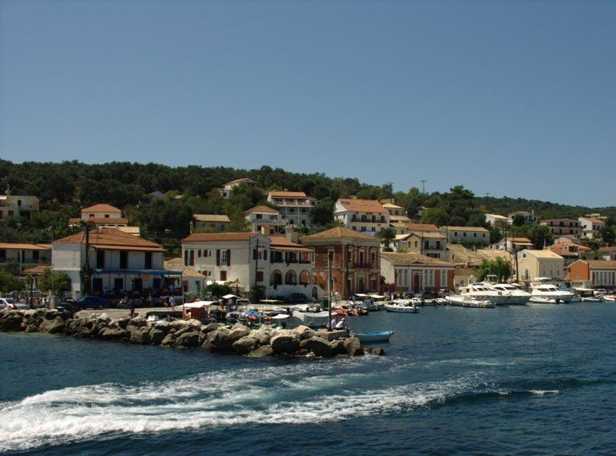
Paxos Concept
Leslie Lamport proposed the Paxos model as a way to
Express the state machine replication problem in a more formal way
Solve it, using the “Paxos protocol”. Now we call it the “classic” one:
  Over the years, many Paxos protocols have been developed
  All of them solve the Paxos specification, but the details vary widely
  One source of confusion with Paxos concerns storage of data
  Is Paxos “delivering messages” to an application that has the state/storage role?
  Or is Paxos itself a kind of “database of messages”? Leslie likes this model.
Paxos (Greek Island)
Notes:
Paxos is a solution to the state machine replication problem.
We have a math statement (the state machine replication model and problem).
And we have a distributed algorithm: the Paxos protocol.
And it can be configured in various ways.

Slide 23
Derecho = RDMA Multicast + Control
Core idea:
Create a multicast using RDMA unicast to move the bytes.
Run the data stream asynchronously, out of band from the control layer. But superimpose a control plane that watches the data and notifies the application when it is safe to deliver messages.
The notifications will be in identical order at all replicas.
Notes:
So… how does it do this magic?
We built some subsystems and wired them together into one big library.

Slide 24
Challenge: Layering Paxos over RDMA
We use a novel “monotonic logic” programming approach
Coded using predicates that, once true, remain true
Enables a highly asynchronous style of coding
Implemented in an RDMA-based “shared state table”: the SST
Details beyond our scope in today’s talk
Notes:
This part gets hyper-technical and we’ll just brush over it.

Slide 25
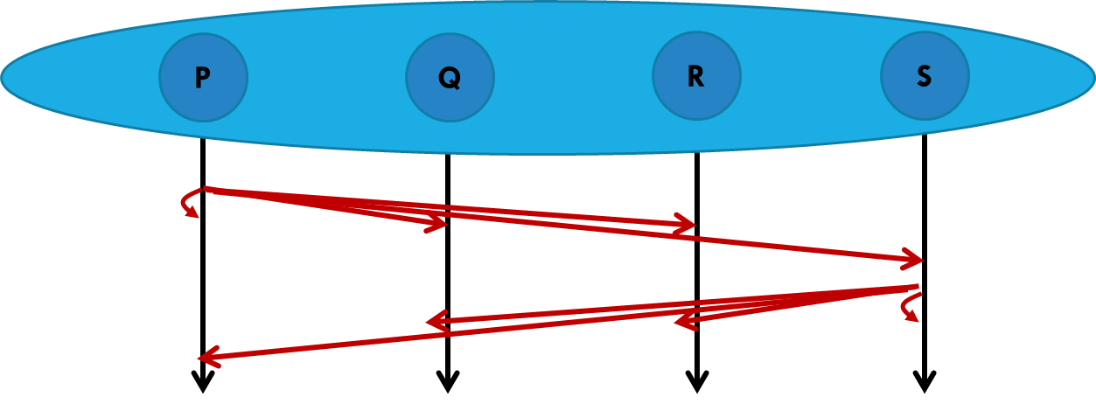
Derecho: small messages
Mellanox 100Gbps RDMA on ROCE (fast Ethernet)
100Gb/s = 12.5GB/s
Notes:
With small messages Derecho runs at about 8 million per second if everyone sends (red is all to all), half that if half of the members send (blue). The performance with just one sender (green) tails off from 3M/second with a group of size 2 to .5M/second with a group of size 16.
These are 1-byte messages but in fact up to about 1KB we see similar numbers. This is because RDMA itself actually is using fairly wide data paths. 1 byte leaves those paths mostly idle. So you don’t see a size-related loss of speed until objects get fairly big.
8M/second is very impressive, by the way, on a cluster of 16 machines. Wall Street firms doing high speed trading would love this stuff.

Slide 26
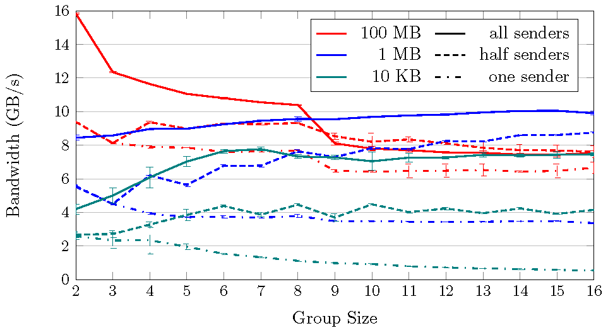
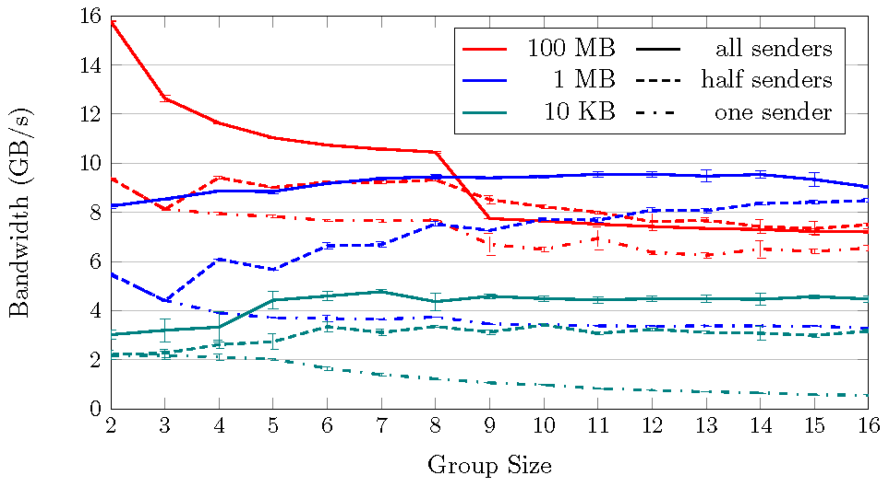
Derecho:
Large messages
Mellanox 100Gbps RDMA on ROCE (fast Ethernet)
100Gb/s = 12.5GB/s
Raw RDMC multicast via Derecho API Derecho Atomic Multicast (Vertical Paxos)
Notes:
Here we see Derecho moving videos (red), photos (blue) and emails (green). On the left, pure RDMC. On the right, Paxos – and we lost no performance at all. Again we have all-to-all, half-to-all and one-to-all, in groups of size 2-16.
The dashed line is the fastest possible speed for copying big objects (ones not in the L2 cache) from memory to memory. Derecho can make 16 remote copies of a video in 1/3 the time (or equivalently, 3x the bandwidth) that you could make one in-memory copy on your NUMA computer using the C++ memcpy primitive.
This is because with RDMA we have lots of DRAM memory units cooperating. With one NUMA machine, one core has to do all the fetch and stores, from one DRAM memory unit. But wow, it is fast.
Notice that the number of replicas has little impact on speed. This is because RDMC uses a tree (we saw that a few slides back). Each new level of depth adds one block-relay worth of delay, but that isn’t much at all. So until things get really big, we see nearly identical speed! Replication is free (well, not the memory impact, but at least the copying part).

Slide 27
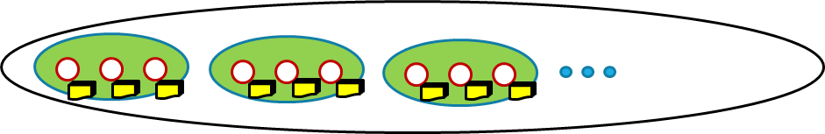
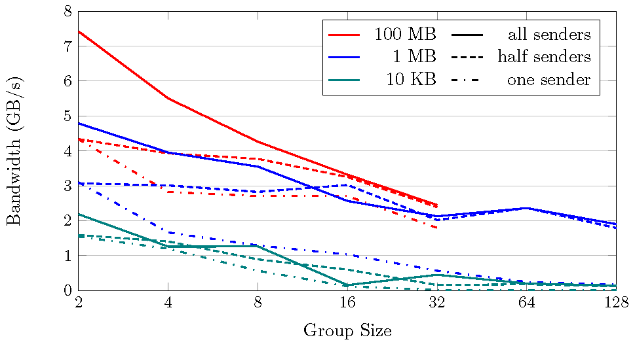
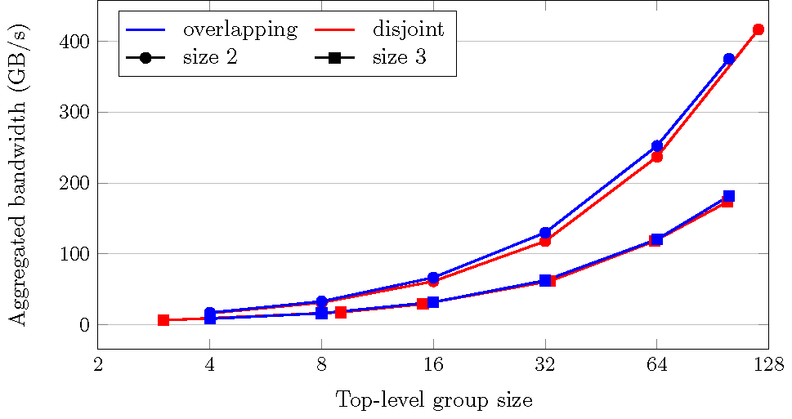
Derecho: Scaling
Large Group of Size N (2…128) Broken into Shards of size 2 or 3
Notes:
At really big scale we do see a little loss of speed (left). Here the video copying wasn’t feasible above 32 members because we didn’t have enough buffer space. But photos and emails are pretty flat, meaning “cost rises slowly, but very slowly.” In fact the video copying for one to all could have been carried to 128 nodes, but we didn’t run that particular experiment.
On the right, we have a group with lots of shards, all independently using Derecho. The aggregate capacity just keeps rising with the number of shards (this is a normal-log graph, so in fact this thing is a straight line). We are up to 400 GB/s of total traffic by 128 members. Compare that with the dashed line on the previous slide, which was at around 3.75GB/s. Basically: the performance here is like 100 simultaneous memcpy operations.
These are very impressive numbers, if you are unsure. In fact the speed is insane.

Slide 28
Version-Vectors with Persisted Data
The figures we saw on slides 35-38 used Derecho for atomic multicast
The next graphs show the performance when saving data into a Derecho version vector for longer storage.
Two cases: a memory-mapped vector, or one also written to SSD disk.
Notes:
As it happens, that data was for data just delivered in memory. What if we saved it to these versioned files (FFFS)?

Slide 29
SST Programming
Because the SST is lock-free, values can change “under your feet”.
But this is also good, in the sense that threads don’t disrupt one-another.
It motivates us to program the SST in an unusual way
Notes:
We don’t want to add locks because with RDMA, those are very expensive.
So we have a pattern of all-to-all updates flowing constantly from every machine to every other machine. (In actual fact the flow occurs only within individual shards, not within the entire group, but that’s a detail we don’t need to worry about: for today the pattern of traffic is more important than whether there are n² SST connections or a smaller number… in actual fact there are a total of n² connections, but SST is only using small subsets of them in an active way. This is getting very technical so we won’t fuss about it today).
So what’s the key idea? It goes back to that 2-phase commit from the prior slide. Suppose that P’s messages to Q were passed through the SST. And Q,R,S, etc responded through the SST. We can perhaps replace all the messages with smaller transfers of just updates to rows: a few integers at a time.
Then P can send continuously and can actually launch Paxos “votes” continuously. Responses continuously flow back. And Paxos commit decisions can occur in batches. We eliminate the pauses and also the message structure overheads, which can be large (a message has to be formatted, parsed, and interrupts occur… very costly in Linux. SST just moves the data and has zero overheads in these senses!)

Slide 30
Stable and Monotonic predicates
A deduction (a predicate) is stable if, once it becomes true, it remains true
Suppose counter is a column in the SST, and is monotonic
min(counter) = v is not stable in the SST: if the counters grow, min grows
… but min(counter) ≥ v, in contrast, remains true once it becomes true
Notes:
Idea: if values change under your feet, at least have them change is just one direction. Like counters that only get bigger.
This makes it way easier to code those if statements.

Slide 31
Basics of all DHTs
Goal is to build some “structured” overlay network with the following characteristics:
  Node IDs can be mapped to the hash key space
  Given a hash key as a “destination address”, you can route through the network to a given node
  Always route to the same node no matter where you start from
127
111
13
97
33
81
58
Notes:
The ring is conceptual. It is just a way of making a picture of the DHT machines and key-value pairs, like the round-robin buffers we used last week in NUMA and RDMA settings. In practice these are just integers and we think of it as a circular space.

Slide 32
Insertion/lookup for any DHT
Hash name of object to produce key
  Well-known way to do this
Use key as destination address to route through network
  Routes to the target node
Insert object, or retrieve object, at the target node
127
111
13
24
97
33
81
58
foo.htm→93

Slide 33

What is a range query?
Consider a smart car on a smart highway.
The car might ask “What objects are within 500m at this time?”
This is best understood as a portion of the highway
My current location, +/- 500m.
A “range” of space, within which a list of vehicles can be found

Slide 34
Hot and Cold spots
DHT keys are supposed to be hashed to a “random” number.
Question: will randomness give us even spacing and even loads?
(k,v) tuples
(k,v) tuples
(k,v) tuples
(k,v) tuples
(k,v) tuples
(k,v) tuples
(k,v) tuples
(k,v) tuples
(k,v) tuples
(k,v) tuples
Node
X
Node
Y
Node
Z
Key space

Slide 35
Remote Direct Memory Access (RDMA)
Read/ write remote memory
  NIC performs DMA (direct memory access) request
Great performance
  Bypasses the kernel
  Bypasses the remote CPU

