Slide 1
CS5412: Dangers of Consolidation
Lecture XXIII
Ken Birman

Slide 2
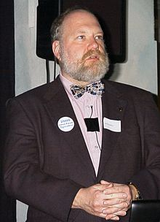
Are Clouds Inherently Dangerous?
Gene Spafford, famous for warning that the emperor has no clothes fears
that moving critical information
to the cloud could be a catastrophe
His concern?
  Concentration of key resources creates
  a “treasure chest” that adversaries can
  focus upon and attack
  Risk of a virus spreading like wildfire
Core issue: Clouds create monocultures

Slide 3


What Constitutes a “Monoculture”?
monoculture: An environment in which the predominance of systems run apparently identical software components for some or all services.
  Such systems share vulnerabilities, hence they are at risk to rapid spread of a virus or other malware vector.
Cloned plants
Cloned babies

Slide 4
Forms of monocultures
Large numbers of instances of identical programs or services (includes applications, not just the O/S)
Wide use of the same programming language or scripting tool
Any standard defines a kind of monoculture

Slide 5
Current example: OpenSSL
SSL (renamed Transport Layer Security: TLS) is a standard used to negotiate security keys for secure TCP communication
  Involves use of keys from certificate authorities to encrypt communication, including passwords
  Used for connections to https websites
Issue: OpenSSL was an open source effort
  And open development: anonymous contributors
  One of those contributors introduced a bug in ~2012

Slide 6
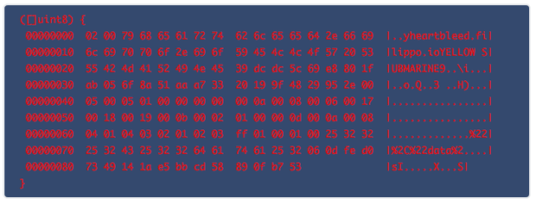
What was the bug?
OpenSSL has a heart beat protocol
  “If you are still there, send me XX bytes to prove it”
  Normally XX was small, like 16, but the client could actually specify the value. Like 64. Or 128K
  With big values a buffer-read overrun caused OpenSSL to send back a snapshot of XX bytes of its memory…
And, in that memory area, one could sometimes find decrypted data including passwords
YELLOW SUBMARINE

Slide 7
Central lesson learned?
In the cloud community, majority solutions often dominate and become de-facto standards
Everyone then uses them: They are “presumed to be the best (because widely used), hence widely used...
And if one of those shared elements is buggy, every system using them is at risk of compromise

Slide 8
Taking the larger view
Three categories of attack
Configuration attacks.
    Exploit aspects of the configuration. Vulnerability introduced by system administrator or user who installs software on the target.
    Includes compiling SNDMAIL with the back door enabled
Technology attacks.
    Exploit programming or design errors in software running on the target. Vulnerability introduced by software builder.
    Here hacker breaks in via buggy code
Trust attacks.
    Exploit assumptions made about the trustworthiness of a client or server. Vulnerability introduced by system or network architect.
    Hacker abuses legitimate access, like a hospital worker who peeks at Lindsey Lohan’s medical records

Slide 9
Monoculture: A defense for configuration attacks.
A carefully constructed, fixed, system configuration would be an effective defense against configuration attacks.
  System configuration (today) is hard to get right and thus is best done by experts. Having one or a small number of “approved” configurations would allow that.
  Configuration attacks are considered “low hanging fruit” and thus likely are the dominant form of attack today.
  Configurations change not only because a system administrator installs software but also from a user visiting web sites or interacting with web services that cause software downloads.
    To rule-out such downloads could be a serious limitation on system functionality. Such downloads often bring vulnerabilities, though.

Slide 10
So monocultures help… for one case
Question becomes: what percent of attacks leverage configuration mistakes?
  … nobody knows!
  But gray-hat hackers assure us that things like standard passwords are a very common problem

Slide 11
Viruses love monocultures
Earliest Internet Worm was launched at Cornell!
  A brief episode of notoriety for us
  Worm exploited variety of simple mechanisms to break into computer systems, then used them as a springboard to find other vulnerable systems and infect them
  It had a simple trick to prevent itself from reinfecting an already infected system: checked for a “lock” file
    But even if present, reinfected with a small probability
    Idea was to jump back onto systems that might have been fixed by system admin team but who left the lock in place

Slide 12

Monocultures are a known risk
Vast majority of computer viruses and worms operate by exploiting software bugs
  For example, failure to check boundaries on arrays
  Very common in code written in C++ or C because those languages check automated boundary checks
  Nothing stops an input from overrunning the end of the array
What lives beyond the end
of an array?

Slide 13
Beyond the end...
Two cases to consider
  Array is on the stack (local to some active method)
  Array is in the program’s data or BSS area, or was allocated from the heap

Slide 14
Stacks grow “downwards...”
registers, return PC
locals
foo(1, 2, 3)
registers, return PC
direction of stack growth
Other locals
Target array

Slide 15
Stacks grow “downwards...”
registers, return PC
locals
foo(1, 2, 3)
registers, return PC
unreasonably long input string overwrites the locals and registers and the return PC
Other locals
Target array

Slide 16
Stacks grow “downwards...”
registers, return PC
locals
foo(1, 2, 3)
PC points into data on the stack
Compromised content
includes virus code
Attacker replaced the return PC with an address in the middle of the injected string

Slide 17
Why does this attack work?
Attacker needs to be able to predict
  Where the target string lives in memory
  How the stack is arranged
  What the code that reads the string will do
Trick is to get the code to jump into the data read from the attacker

Slide 18
Bootstrapping concept
The hacker doesn’t have much “room” for instructions
So typically this logic is very limited: often just code to read a longer string from the network and then execute that longer code
  In effect, the initial attack is a bootstrap program
  It loads and launches a more serious program

Slide 19
Example
String loads code that simply allocates a much bigger object, reads from the same input source into it, and jumps to the start
Allows the attacker to send a multi-GB program that would be way too large to “fit” within the stack
  Trick is to take over but not trigger exceptions
  If the attack causes the program to throw an exception, someone might notice

Slide 20

What about data/heap?
Here attacker might be in a position to overwrite other adjacent variables on which the program is dependent
  This does assume some “predictability” in memory layout!
  We could perhaps replace a filename it reads or one it writes with filenames the attacker would prefer that it use instead, or with network URLs
  Of course the program will now be a very sick puppy but it might last just long enough to do the I/O for the attacker
  That I/O becomes a “point of leverage” that the attacker exploits like the first domino in a long line...

Slide 21
Example “attack opportunity”
Any program that works with strings in C or C++ is at risk even if we length-check inputs
    void unsafe(char *a, char *b)
    {
    char tmp[32];
    strcpy(tmp, a);
    strcat(tmp, b);
    return(strcmp(tmp, “foobar”));
    }
Problem here isn’t with the input length per-se but with the assumption in “unsafe” that the combined string fits in tmp

Slide 22
Why not just fix the compiler?
People have modified C to check array bounds
  This only helps in limited ways
C and C++ and Fortran are unsafe by design because of pointer aliasing
  They let us treat an object of one type as if it was of some other type
  And they impose no real boundary checking at all
Fixing the language would break many programs that are in wide use: we would need to fix them too

Slide 23
Other examples of attacks
Back doors, such as debug or maintenance features
Passwords left with their default values
Automated file or patch download features that can be tricked into overwriting system files
Code that has built-in features that can be misused to trick the program into executing unusual logic
… in fact the list is really endless!

Slide 24

Broader problem
We simply don’t have a good way to create things that are correct, by construction, ground up
  Lacking those, trying to find problems in existing code is like trying to plug a leak in a dam
At best we can prove properties of
one thing or another but the
assemblage invariably has holes!
  Or they sneak in over time

Slide 25
Cloud “permissiveness”
Anyhow, it makes no sense to imagine that we would tell people how to build cloud applications
With EC2 we just hand Amazon an executable
  How will it know if the binaries were compiled using the right compiler?
  What if the version of the compiler matters?
  Generally not viewed as a realistic option
In fact when C and C++ run on .NET many of these overflow issues are caught, but “managed” C or C++ will reject all sorts of classic programs as buggy

Slide 26
How to attack a cloud
A good firewall can block many kinds of attacks
But something will get through eventually, we can’t avoid every possible risk and close every possible virus exploit
And once the virus breaks in, it compromises every single accessible instance of the same code

Slide 27
What can we do about these issues?
Today: Focus on these kinds of viral attacks
Thursday: Look at the bigger picture

Slide 28
First, let’s stop the stack attack...
How can we do that?
  The attacker is taking advantage of knowledge of the program behavior and flaws
  An “unpredictable” program would have crashed but not been so easy to compromise
  Can we take a program written in C or C++ and make it behave less predictably without causing it to crash?

Slide 29
Stack randomization
Idea is simple:
  Modify the runtime to randomly allocate chunks of memory (unpredictable size) between objects on stack
  We can also add a chunk of unpredictable size to the bottom of the stack itself
Attacker countermeasures?
  May be possible to use a “block” of jump instructions, no-ops to create code that can run in a “position independent manner”
  Or might guess the offset and try, try again... If the datacenter doesn’t notice the repeated crashes a few hundred tries might suffice to break in

Slide 30
.NET has automated diversity
If enabled, a wide variety of randomization mechanisms will be employed
Just a bit in the runtime environment you can set
But important to retest programs with stack randomization enabled
  Some programs depend on bugs, other issues!

Slide 31
More recent work on diversity
Diverse OS can scramble the number of system calls
Placement of segments in memory can be varied
Code can be dynamically relinked to reorder the placement of compiled code and data elements

Slide 32
But this can’t stop all attacks
For example, database “code injection” attacks have a similar approach and yet don’t rely on array overflow:
  Intended code
    SELECT * FROM users WHERE name = '" + userName + "';"
    Limits query to data for this user
  Attacker sends a “faulty” name argument:
    ' or '1'='1
    SELECT * FROM users WHERE name = ` ’ or ‘1’=1;
There are many examples of this kind because many programs exchange messages that involve application-specific programming languages

Slide 33
Blocking SQL query injection?
This is easy:
  Read the input
  Then “clean it up”
  Then pass it in to the application
As long as the developer uses the right tools these issues don’t arise
  But not every developer cooperates

Slide 34
Other ideas: Castro and Costa
One project at Microsoft monitors program crashes
  Each time a crash happens they look to see what input caused the program to fail
  In one project they create virus “signatures”
  In another they automatically combine these to create a pattern, more and more selective, for blocking the input strings that cause the problem
  Use gossip, rapidly and robustly disseminate the fix together with a “proof” of the bug that triggers it
Manuel Costa, Jon Crowcroft, Miguel Castro, Antony Rowstron, Lidong Zhou, Lintao Zhang, and Paul Barham, Vigilante: End-to-End Containment of Internet Worms, in ACM Symposium on Operating Systems Principles (SOSP), Brighton, UK, Oct 2005

Slide 35

What kind of “proof”?
Before installing a patch, verify that problem is real
  Proof: Example of an input that will cause a crash or some other form of compromise
  Verification: Try it inside a virtual machine
One issue: if the filter is too broad, it might block legitimate inputs that wouldn’t cause a crash
We want to block the attack but not legitimate users

Slide 36
Back door attacks
Some attacks don’t actually compromise a program
  For example, the early Internet worm operated by exploiting a feature in the original SNDMAIL program
  Code was written by Eric Allman and was unstable for the first few years
    So he needed ways to see what the problem was
    Included a debug feature allowing him to use SNDMAIL as a kind of remote FTP program to access files on remote system… and SNDMAIL runs with elevated priority…
    Internet worm used this “feature” as one of its attack vectors

Slide 37
Stack diversity doesn’t stop these…
Backdoor attacks use legitimate features of a program, or perhaps debug features, to ask program to do things it was programmed to do!
  The program isn’t really malfunctioning or compromised
  But it still does things for us that allow breakin
  For example, can use SNDMAIL to copy a modified program on top of /etc/init in Linux
  This modified program might work normally, but always allow logins from Evil.Hacker with password “Gotcha”
  Better compiler won’t help…

Slide 38
Neither would better checking tools
A back door is a problem with the specification
  The program shouldn’t have functionality that replaces arbitrary files with code downloaded from the network, or copied from other places, or even with code “created” within the program itself
  Yet it is very hard to pin down the rules we need to check to achieve confidence!

Slide 39

The ultimate back door
Who is this man?
Do you trust his
Software?
Photo from http://culturadigitalbau.wikispaces.com/
file/view/thompson.c1997.102634882.lg.jpg/212982274/thompson.c1997.102634882.lg.jpg

Slide 40
The ultimate back door
Ken Thompson
Co-Creator of
UNIX and C
Turing Award: 1983

Slide 41
The ultimate back door
Ken Thompson discussed hidden back doors in a famous Turing Award lecture
  He considered the Unix login program
  Showed how a macro substitution could insert a back door
  Then pointed out that the macro preprocessor could have a back door that does the macro substitution
  Then he applied this to the macro preprocessor itself
  Ended up with a vanilla-looking Unix system that would always allow him to log in but where those lines of code could only be discovered by examining the byte code

Slide 42

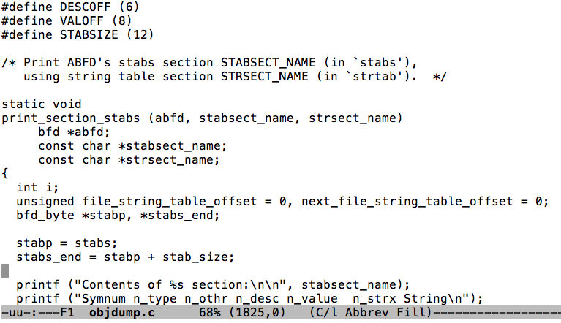
The ultimate back door
Compiler
011001001111010

Slide 43
The ultimate back door
Compiler
...
if(program == “login”)
add-login-backdoor();
if(program == “compiler”)
add-compiler-backdoor();
011001001111010

Slide 44
The ultimate back door
Ken Thompson
Co-Creator of
UNIX and C
Turing Award: 1983
Hacker

Slide 45
The ultimate back door
In general, covert “virtualized” platforms lurk in many settings
  Virus could virtualize your machine
  Attacker with serious resources could sneak a monitoring component into your printer or the disk drive itself
  Even the network could potentially “host” a covert computing device and its own stealth network!
Very hard to really secure modern computing systems. Cloud actually helps because many operators have resources to build their own specialized hardware

Slide 46
Recent concern
Even common devices can have backdoors
  Line printers often have a wide variety of network APIs
  Network routers and firewalls
  The virtualization platforms that operate the cloud
  Web browsers…
We seem to be surrounded by insecure components

Slide 47
What about virtualization as a tool?
By running the user’s code in a virtual machine the cloud gives us a way to firewall the user from other users
  We share a machine but I can’t see your work and you can’t see mine
  Virtualization code needs to block things like putting the network into promiscuous mode (“monitoring” mode)
  Forces us to trust the VM hypervisor and the hardware that supports virtualization, but gives “containment”
Now a virus can only harm the user that “let it in”

Slide 48
Other forms of diversity
Run different products that offer equivalent functionality, like two versions of an email server
  Strange finding: researchers have shown that for many applications, even versions created separately share bugs!
Consider morphing the system calls: code would need to be compiled on a per-instance basis but would protect against attacks that require attacker to know local system call numbering
Vary thread scheduling order dynamically

Slide 49
Combining multiple methods
This is sometimes called “defense in depth”
The first line of defense is the dynamically managed firewall: ideally, attack won’t get in
  But if it does, randomization has some chance of defeating the attack one step later
  Each new obstacle is a hurdle for the attacker
Will this stop attacks? Only simple ones... but most attacks use simple methods!

Slide 50


Defense in depth

Slide 51

… but talented attackers still win

Slide 52

How can anyone trust the cloud?
The cloud seems so risky that it makes no sense at all to trust it in any way!
Yet we seem to trust
it in many ways
This puts the fate of your
company in the hands of
third parties!

Slide 53

For all its virtues, the cloud is risky!
Categories of concerns
  Client platform inadequacies, code
  download, browser insecurities
  Internet outages, routing problems,
  vulnerability to DDoS
  Cloud platform might be operated by an untrustworthy third party, could shift resources without warning, could abruptly change pricing or go out of business
  Provider might develop its own scalability problems
  Consolidation creates monoculture threats
  Cloud security model is very narrow and might not cover important usage cases

Slide 54
But the cloud is also good in some ways
With a private server, DDoS attacks often succeed
  In contrast, it can be hard to DDoS a cloud
  The DDoS operator spends real money and won’t want to waste the cash
  Thus because cloud is hard to DDoS, cloud emerges as a very good response to DDoS worries

Slide 55
More good news
Diversity can compensate for monoculture worries
Elasticity is a unique capability not seen in other settings
Ability to host and compute on massive data sets is very valuable
  Obviously, only of value if task is suited this style of massive parallism, but many do fit the model
... the list goes on

Slide 56
So the cloud is tempting
And cheaper, too!
What’s not to love?
  Imagine that you work for a large company that is healthy and has managed its own story in its own way
  Now the cloud suddenly offers absolutely unique opportunities that we can’t access in any other way
  Should you recommend that your boss drink the potion?

Slide 57
To cloud, or not cloud…
… maybe that’s the question
… or maybe there is no other choice anymore

