Slide 1
CS5412:
Transactions (I)
Lecture XVI
Ken Birman

Slide 2
Transactions
A widely used reliability technology, despite the BASE methodology we use in the first tier
Goal for this lecture and the next one: in-depth examination of topic
  How transactional systems really work
  Implementation considerations
  Limitations and performance challenges
  Scalability of transactional systems
Transactions live “deeper” in the cloud, not tier1/2.

Slide 3


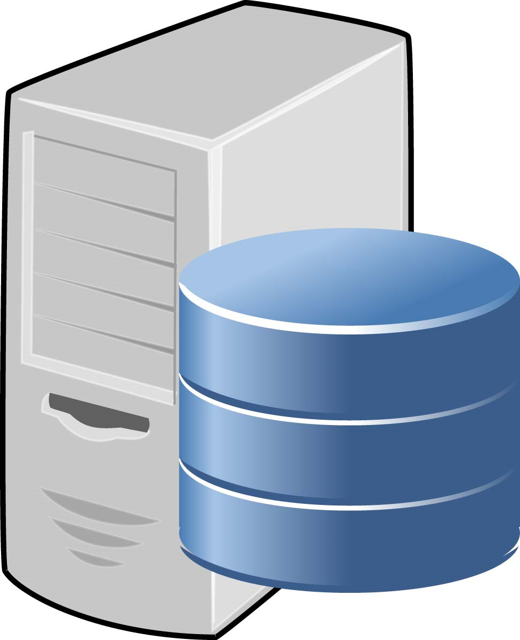
3-Tier Architecture
A question of terminology
  Client application: Runs on a smart phone, etc.
  Tier1: Your code that receives client system requests.
    Those requests are customized by you: a procedure-call API
    So you provide tier1 logic to carry out those requests
  Tier2: Services tightly bound to tier1 code that often run as libraries right in the tier1 program’s address space. Examples: Vsync, Dynamo, Cassandra
Tier3: global file system and transactional services

Slide 4
Things to notice
There could be a lot of clients, maybe millions
There can be a lot of tier1/tier2 instances
  Lightweight, they run in the “soft state” layer of the cloud, it launches or shuts them down on demand
  As casual as starting or stopping a normal program
Tier3: relatively few servers, they run continuously and don’t get launched or stopped so casually

Slide 5
How can t1/t2 talk to t3?
As you know, when a client application talks to t1, it looks like a procedure call
  Under the surface request is encoded in a web page, sent via HTTP or HTTPS, then decoded. Same for reply.
If t1 code talks to t3, similar mechanisms are used.
  Requests don’t use a web page encoding, but they are put in a message that leaves the computer and crosses the data center network, and the reply similarly comes back
  This is somewhat costly and slower than calling a method in a library linked to your program

Slide 6
Transactions
There are several perspectives on how to achieve reliability
  We’ve talked at some length about non-transactional replication via multicast
  Another approach focuses on reliability of communication channels and leaves application-oriented issues to the client or server – “stateless”
  But many systems focus on the data managed by a system. This yields transactional applications

Slide 7
Transactions on a single database:
In a client/server architecture,
A transaction is an execution of a single program of the application(client) at the server.
  Seen at the server as a series of reads and writes.
We want this setup to work when
  There are multiple simultaneous client transactions running at the server.
  Client/Server could fail at any time.

Slide 8
The ACID Properties: Reminder
Atomicity
  All or nothing.
Consistency:
  Each transaction, if executed by itself, maintains the correctness of the database.
Isolation (Serializability)
  Transactions won’t see partially completed results of other non-commited transactions
Durability
  Once a transaction commits, future transactions see its results

Slide 9

CAP conjecture
Recall Brewer’s CAP theorem: “you can’t use transactions at large scale in the cloud”.
We saw that the real issue is mostly in t1/t2: highly scalable and elastic outer tiers (“soft state tiers”).
In fact cloud systems use transactions all the time, but they do so in the “back end”, and they shield that layer as much as they can to avoid overload

Slide 10
Transactions in the real world
In cs5142 lectures, transactions are treated at the same level as other techniques
But in the real world, transactions represent a huge chunk (in $ value) of the existing market for distributed systems!
  The web is gradually starting to shift the balance (not by reducing the size of the transaction market but by growing so fast that it is catching up)
  On the web, we use transactions when we buy products
So the real reason we don’t emphasize them is this issue of them not working well in the first tier

Slide 11
The transactional model
Applications are coded in a stylized way:
    begin transaction
    Perform a series of read, update operations
    Terminate by commit or abort.
Terminology
  The application is the transaction manager
  The data manager is presented with operations from concurrently active transactions
  It schedules them in an interleaved but serializable order

Slide 12
A side remark
Each transaction is built up incrementally
  Application runs
  And as it runs, it issues operations
  The data manager sees them one by one
But often we talk as if we knew the whole thing at one time
  We’re careful to do this in ways that make sense
  In any case, we usually don’t need to say anything until a “commit” is issued

Slide 13
Transaction and Data Managers
Transactions
Data (and Lock) Managers
read
update
read
update
transactions are stateful: transaction “knows” about database contents and updates

Slide 14
Typical transactional program
begin transaction;
x = read(“x-values”, ....);
y = read(“y-values”, ....);
z = x+y;
write(“z-values”, z, ....);
commit transaction;

Slide 15
What about locks?
Unlike some other kinds of distributed systems, transactional systems typically lock the data they access
They obtain these locks as they run:
  Before accessing “x” get a lock on “x”
  Usually we assume that the application knows enough to get the right kind of lock. It is not good to get a read lock if you’ll later need to update the object
In clever applications, one lock will often cover many objects

Slide 16
Locking rule
Suppose that transaction T will access object x.
  We need to know that first, T gets a lock that “covers” x
What does coverage entail?
  We need to know that if any other transaction T’ tries to access x it will attempt to get the same lock

Slide 17
Examples of lock coverage
We could have one lock per object
… or one lock for the whole database
… or one lock for a category of objects
  In a tree, we could have one lock for the whole tree associated with the root
  In a table we could have one lock for row, or one for each column, or one for the whole table
All transactions must use the same rules!
And if you will update the object, the lock must be a “write” lock, not a “read” lock

Slide 18
Transactional Execution Log
As the transaction runs, it creates a history of its actions. Suppose we were to write down the sequence of operations it performs.
Data manager does this, one by one
This yields a “schedule”
  Operations and order they executed
  Can infer order in which transactions ran
Scheduling is called “concurrency control”

Slide 19
Observations
Program runs “by itself”, doesn’t talk to others
All the work is done in one program, in straight-line fashion. If an application requires running several programs, like a C compilation, it would run as several separate transactions!
The persistent data is maintained in files or database relations external to the application

Slide 20
Serializability
Means that effect of the interleaved execution is indistinguishable from some possible serial execution of the committed transactions
For example: T1 and T2 are interleaved but it “looks like” T2 ran before T1
Idea is that transactions can be coded to be correct if run in isolation, and yet will run correctly when executed concurrently (and hence gain a speedup)

Slide 21
Need for serializable execution
T₁: R₁(X) R₁(Y) W₁(X) commit₁
T₂: R₂(X) W₂(X) W₂(Y) commit₂
DB: R₁(X) R₂(X) W₂(X) R₁(Y) W₁(X) W₂(Y) commit₁ commit₂
Data manager interleaves operations to improve concurrency

Slide 22
Non serializable execution
T₁: R₁(X) R₁(Y) W₁(X) commit₁
T₂: R₂(X) W₂(X) W₂(Y) commit₂
DB: R₁(X) R₂(X) W₂(X) R₁(Y) W₁(X) W₂(Y) commit₂ commit₁
Unsafe! Not serializable
Problem: transactions may “interfere”. Here, T₂ changes x, hence T₁ should have either run first (read and write) or after (reading the changed value).

Slide 23
Serializable execution
T₁: R₁(X) R₁(Y) W₁(X) commit₁
T₂: R₂(X) W₂(X) W₂(Y) commit₂
DB: R₂(X) W₂(X) R₁(X) W₂(Y) R₁(Y) W₁(X) commit₂ commit₁
Data manager interleaves operations to improve concurrency but schedules them so that it looks as if one transaction ran at a time. This schedule “looks” like T₂ ran first.

Slide 24
But our serializable example has issues
Our serializable example shows T₁ reading from T₂ before T₂ commits.
  In practice, if T₂ had aborted, T₁ would also have to abort, so T₁ can’t commit until we learn the outcome for T₂
  We say that T₂ has become “dependent” on T₁
  In general, database systems that are aggressive about allowing interleaving can make their commit decisions complex.
Are there simple ways to allow interleaved executions but also be sure it will be easy to commit?

Slide 25
Atomicity considerations
If application (“transaction manager”) crashes, treat as an abort
If data manager crashes, abort any non-committed transactions, but committed state is persistent
  Aborted transactions leave no effect, either in database itself or in terms of indirect side-effects
  Only need to consider committed operations in determining serializability

Slide 26
Components of transactional system
Runtime environment: responsible for assigning transaction id’s and labeling each operation with the correct id.
Concurrency control subsystem: responsible for scheduling operations so that outcome will be serializable
Data manager: responsible for implementing the database storage and retrieval functions

Slide 27
Transactions at a “single” database
Normally use 2-phase locking or timestamps for concurrency control
Intentions list tracks “intended updates” for each active transaction
Write-ahead log used to ensure all-or-nothing aspect of commit operations
Can achieve thousands of transactions per second

Slide 28
Strict two-phase locking: how it works
Transaction must have a lock on each data item it will access.
  Gets a “write lock” if it will (ever) update the item
  Use “read lock” if it will (only) read the item. Can’t change its mind!
Obtains all the locks it needs while it runs and hold onto them even if no longer needed
Releases locks only after making commit/abort decision and only after updates are persistent

Slide 29
Why do we call it “Strict” two phase?
2-phase locking: Locks only acquired during the ‘growing’ phase, only released during the ‘shrinking’ phase.
Strict: Locks are only released after the commit decision
  Read locks don’t conflict with each other (hence T’ can read x even if T holds a read lock on x)
  Update locks conflict with everything (are “exclusive”)

Slide 30
Strict Two-phase Locking
T₁: begin read(x) read(y) write(x) commit
T₂: begin read(x) write(x) write(y) commit
Acquires locks
Releases locks
A very simple rule: no lock can be released by a transaction until all locks have been acquired
Limits concurrency but easy to implement, so popular

Slide 31
Notes
Notice that locks must be kept even if you are certain that the locked objects won’t be revisited
  This can be a problem in long-running applications!
  Also becomes an issue in systems that crash and then recover
    Often, they “forget” locks when this happens
    Called “broken locks”. We say that a crash may “break” current locks…
  The policy is conservative: the “serializable” interleaved execution from a few slides back wouldn’t be allowed because for T₁ to run while T₂ was still active, T₁ needed a lock that T₂ would still have been holding.

Slide 32
Why does strict 2PL imply serializability?
Suppose that T’ will perform an operation that conflicts with an operation that T has done:
  T’ will update data item X that T read or updated
  T updated item Y and T’ will read or update it
T must have had a lock on X/Y that conflicts with the lock that T’ wants
T won’t release it until it commits or aborts
So T’ will wait until T commits or aborts

Slide 33
Acyclic conflict graph implies serializability
Can represent conflicts between operations and between locks by a graph (e.g. first T1 reads x and then T2 writes x)
If this graph is acyclic, can easily show that transactions are serializable
Two-phase locking produces acyclic conflict graphs

Slide 34
Two-phase locking is “pessimistic”
Acts to prevent non-serializable schedules from arising: pessimistically assumes conflicts are fairly likely
Can deadlock, e.g. T1 reads x then writes y; T2 reads y then writes x. This doesn’t always deadlock but it is capable of deadlocking
  Overcome by aborting if we wait for too long,
  Or by designing transactions to obtain locks in a known and agreed upon ordering

Slide 35
Contrast: Timestamped approach
Using a fine-grained clock, assign a “time” to each transaction, uniquely. E.g. T1 is at time 1, T2 is at time 2
Now data manager tracks temporal history of each data item, responds to requests as if they had occured at time given by timestamp
At commit stage, make sure that commit is consistent with serializability and, if not, abort

Slide 36
Example of when we abort
T1 runs, updates x, setting to 3
T2 runs concurrently but has a larger timestamp. It reads x=3
T1 eventually aborts
... T2 must abort too, since it read a value of x that is no longer a committed value
  Called a cascaded abort since abort of T1 triggers abort of T2

Slide 37
Pros and cons of approaches
Locking scheme works best when conflicts between transactions are common and transactions are short-running
Timestamped scheme works best when conflicts are rare and transactions are relatively long-running
Weihl has suggested hybrid approaches but these are not common in real systems

Slide 38
Intentions list concept
Idea is to separate persistent state of database from the updates that have yet to commit
  Many systems update in place, roll back on abort. For these, a log of prior versions is needed.
  A few systems flip this and keep a list of what changes they intend to make. Intensions list may simply be the in-memory cached database state (e.g. change a cached copy, but temporarily leave the disk copy).
Either way, as a transaction runs it builds a set of updates that it intends to commit, if it commits

Slide 39
Role of write-ahead log
Used to save either old or new state of database to either permit abort by rollback (need old state) or to ensure that commit is all-or-nothing (by being able to repeat updates until all are completed)
Rule is that log must be written before database is modified
After commit record is persistently stored and all updates are done, can erase log contents

Slide 40
Structure of a transactional system
The “intentions list” is the intended updates and the associated locks.
application
cache (volatile) lock records
updates (persistent)
log
database

Slide 41
Recovery?
Transactional data manager reboots
It rescans the log
  Ignores non-committed transactions
  Reapplies any updates
  These must be “idempotent”
    Can be repeated many times with exactly the same effect as a single time
    E.g. x := 3, but not x := x.prev+1
Then clears log records
(In normal use, log records are deleted once transaction commits)

Slide 42
Transactions in distributed systems
Notice that client and data manager might not run on same computer
  Both may not fail at same time
  Also, either could timeout waiting for the other in normal situations
When this happens, we normally abort the transaction
  Exception is a timeout that occurs while commit is being processed
  If server fails, one effect of crash is to break locks even for read-only access

Slide 43
Transactions in distributed systems
What if data is on multiple servers?
  In a non-distributed system, transactions run against a single database system
    Indeed, many systems structured to use just a single operation – a “one shot” transaction!
  In distributed systems may want one application to talk to multiple databases

Slide 44
Transactions in distributed systems
Main issue that arises is that now we can have multiple database servers that are touched by one transaction
Reasons?
  Data spread around: each owns subset
  Could have replicated some data object on multiple servers, e.g. to load-balance read access for large client set
  Might do this for high availability
Solve using 2-phase commit protocol!

Slide 45
Unilateral abort
Any data manager can unilaterally abort a transaction until it has said “prepared”
Useful if transaction manager seems to have failed
Also arises if data manager crashes and restarts (hence will have lost any non-persistent intended updates and locks)
Implication: even a data manager where only reads were done must participate in 2PC protocol!

Slide 46
Transactions on distributed objects
Idea was proposed by Liskov’s Argus group and then became popular again recently
Each object translates an abstract set of operations into the concrete operations that implement it
Result is that object invocations may “nest”:
  Library “update” operations, do
  A series of file read and write operations that do
  A series of accesses to the disk device

Slide 47
Nested transactions
Call the traditional style of flat transaction a “top level” transaction
  Argus short hand: “actions”
The main program becomes the top level action
Within it objects run as nested actions

Slide 48
Arguments for nested transactions
It makes sense to treat each object invocation as a small transaction: begin when the invocation is done, and commit or abort when result is returned
  Can use abort as a “tool”: try something; if it doesn’t work just do an abort to back out of it.
  Turns out we can easily extend transactional model to accommodate nested transactions
Liskov argues that in this approach we have a simple conceptual framework for distributed computing

Slide 49
Nested transactions: picture
T₁: fetch(“ken”) .... set_salary(“ken”, 100000) ... commit
open_file ... seek... read seek... write...
... lower level operations...

Slide 50
Observations
Can number operations using the obvious notation
  T1, T1.2.1.....
Subtransaction commit should make results visible to the parent transaction
Subtransaction abort should return to state when subtransaction (not parent) was initiated
Data managers maintain a stack of data versions

Slide 51
Stacking rule
Abstractly, when subtransaction starts, we push a new copy of each data item on top of the stack for that item
When subtransaction aborts we pop the stack
When subtransaction commits we pop two items and push top one back on again
In practice, can implement this much more efficiently!!!

Slide 52
Data objects viewed as “stacks”
Transaction T₀ wrote 6 into x
Transaction T₁ spawned subtransactions that wrote new values for y and z
-2
T_{1.1.1}
15
T_{1.1.1}
6
T₀
13
T_{1.1}
30
T_{1.1}
17
1
18
x y z

Slide 53
Locking rules?
When subtransaction requests lock, it should be able to obtain locks held by its parent
Subtransaction aborts, locks return to “prior state”
Subtransaction commits, locks retained by parent
... Moss has shown that this extended version of 2-phase locking guarantees serializability of nested transactions

Slide 54
Relatively recent developments
Many cloud-computing solutions favor non-transactional tables to reduce delays even if consistency is much weaker
  Called the NoSQL movement: “Not SQL”
  Application must somehow cope with inconsistencies and failure issues. E.g. your problem, not the platform’s.
Also widely used: a model called “Snapshot isolation”. Gives a form of consistency for reads and for updates, but not full serializability

Slide 55
How does NoSQL work?
We saw this a few lectures back
You take a transactional program but then try and break it down into a non-transactional one that can run against data in a DHT without locks or consistency guarantees. Everything is a get/put, no joins or fancy database queries supported.
Not always feasible, but if you pull it off, your code is much more scalable and faster.

Slide 56
What about snapshot isolation
This is for real database transactions
Basically the idea is to have the database do the updates, but handle the read-only transactions from cached data in a clever way that avoids locking.
The problem is that it can sometimes violate the ACID guarantees. So it works pretty well but isn’t perfect and those mistakes could be costly!

Slide 57
Summary
Transactional model lets us deal with large databases or other large data stores
Provides a model for achieving high concurrency
Concurrent transactions won’t stumble over one-another because ACID model offers efficient ways to achieve required guarantees

