Slide 1
CS5412: How Durable Should it Be?
Lecture XV
Ken Birman

Slide 2

Choices, choices…
A system like Vsync lets you control message ordering, durability, while Paxos opts for strong guarantees.
With Vsync, it works best to start with total order (g.OrderedSend) but then relax order to speed things up if no conflicts (inconsistency) would arise.

Slide 3
How much ordering does it need?
Example: we have some group managing replicated data, using g.OrderedSend() for updates
But perhaps only one group member is connected to the sensor that generates the updates
With just one source of updates, g.Send() is faster
Vsync will discover this simple case automatically, but in more complex situations, the application designer might need to explictly use g.Send() to be sure.

Slide 4
Question: Why?
With one sender, everything is in “sender” or “FIFO” ordering: that sender sends x₀ x₁ x₂ . . .
The g.Send multicast keeps updates in sender order
So g.OrderedSend and g.Send actually promise the identical thing! g.OrderedSend has extra logic for a case that won’t arise, namely two conflicting updates from two different senders.

Slide 5
How does Vsync optimize this case?
Because this pattern is pretty common, Vsync has special logic for it.
If a group starts up, it initially tries to use g.Send when you request g.OrderedSend… this is invisible to you but each call to g.OrderedSend “maps” to g.Send.
Vsync automatically switches to the real g.OrderedSend mode automatically if a second sender issues a concurrent g.OrderedSend multicast.
So g.OrderedSend is kind of a one-size-fits-all choice

Slide 6

Durability
When a system accepts an update and won’t lose it, we say that event has become durable
They say the cloud has a permanent memory
Once data enters a cloud system, they rarely discard it
More common to make lots of copies, index it…
But loss of data due to a failure is an issue

Slide 7
Durability in real systems
Database components normally offer durability
Paxos also has durability.
Like a database of “messages” saved for replay into services that need consistent state
Systems like Vsync focus on consistency for multicast and for these, durability is optional (and costly)

Slide 8
Should Consistency “require” Durability?
The Paxos protocol guarantees durability to the extent that its command lists are durable
Normally we run Paxos with the messages (the “list of commands”) on disk, and hence Paxos can survive any crash
In Vsync, this is g.SafeSend with the “DiskLogger” active
But doing so slows the protocol down compared to not logging messages so durably

Slide 9
Consider the first tier of the cloud
Recall that applications in the first tier are limited to what Brewer calls “Soft State”
They are basically prepositioned virtual machines that the cloud can launch or shutdown very elastically
But when they shut down, lose their “state” including any temporary files
Always restart in the initial state that was wrapped up in the VM when it was built: no durable disk files

Slide 10
Examples of soft state?
Anything that was cached but “really” lives in a database or file server elsewhere in the cloud
If you wake up with a cold cache, you just need to reload it with fresh data
Monitoring parameters, control data that you need to get “fresh” in any case
Includes data like “The current state of the air traffic control system” – for many applications, your old state is just not used when you resume after being offline
Getting fresh, current information guarantees that you’ll be in sync with the other cloud components
Information that gets reloaded in any case, e.g. sensor values

Slide 11
Would it make sense to use Paxos?
We definitely might want durability, but if applications are replicating data in tier1, Paxos is too costly: it works hard to provide a property that has no real meaning in tier1
Any tier1 service that wants to persist data must do so by writing to files in a deeper layer of the cloud, like Amazon S3. Local files aren’t persistent.
Implication: no, you wouldn’t want Paxos!

Slide 12
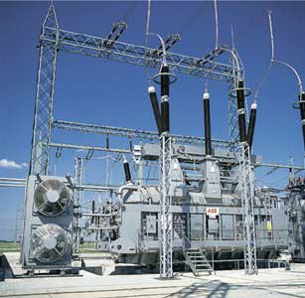
Control of the smart power grid
Suppose that a cloud control system speaks with “two voices”
In physical infrastructure settings, consequences can be very costly
“Canadian 50KV bus going offline”
Bang!
“Switch on the 50KV Canadian bus”

Slide 13
We do need consistency…
But Vsync offers consistency even for g.OrderedSend
For a purpose like this, there is no need for anything fancier.

Slide 14
Consistency model: Virtual synchrony meets Paxos (and they live happily ever after…)
A=3
B=7
B = B-A
A=A+1
Non-replicated reference execution
Synchronous execution
Virtually synchronous execution
Virtual synchrony is a “consistency” model:
Synchronous runs: indistinguishable from non-replicated object that saw the same updates (like Paxos)
Virtually synchronous runs are indistinguishable from synchronous runs

Slide 15
So why does Vsync include Paxos?
Inside Vsync, Paxos is supported by g.SafeSend
A more costly protocol that stores data into disk files
Not intended for tier1 use! This is for Vsync use deeper in the cloud, where a machine that restarts will still remember its files from before the crash
Vsync is trying to be universal: use it anywhere, make smart choices matched to your use case!

Slide 16
SafeSend vs OrderedSend vs Send
SafeSend is durable and totally ordered and never has any form of odd behavior. Logs messages, replays them after a group shuts down and then later restarts. == Paxos.
OrderedSend is much faster but doesn’t log the messages (not durable) and also is “optimistic” in a sense we will discuss. Sometimes must combine with Flush.
Send is FIFO and optimistic, and also may need to be combined with Flush.

Slide 17
One oddity: a weird crash case
There is one thing you need to be aware of with g.OrderedSend.
To understand it, first think about writing data to files using printf in C or cout in C++.
Have you ever noticed that if a program crashes, the tail end of the file might not be written?
This is because data is buffered and written in blocks
With files, you need to call “flush” to be sure the data was output, and “fsync” to be sure it is on disk.

Slide 18
Analgous issue with g.OrderedSend
Virtually synchronous execution “amnesia” example (Send but without calling Flush)

Slide 19
What made it odd?
In this example a network partition occurred and, before anyone noticed, some messages were sent and delivered
“Flush” would have blocked the caller, and SafeSend would not have delivered those messages
Then the failure erases the events in question: no evidence remains at all
So was this bad? OK? A kind of transient internal inconsistency that repaired itself?

Slide 20
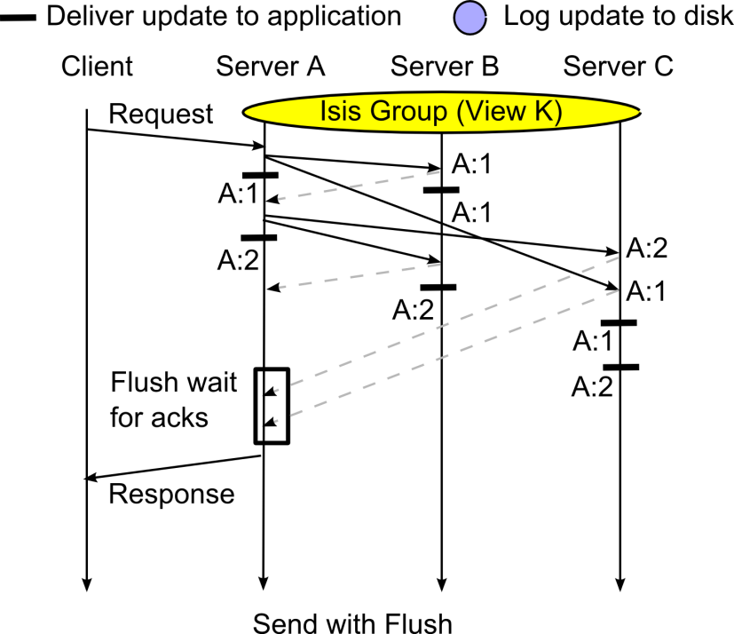
Looking closely at that “oddity”

Slide 21
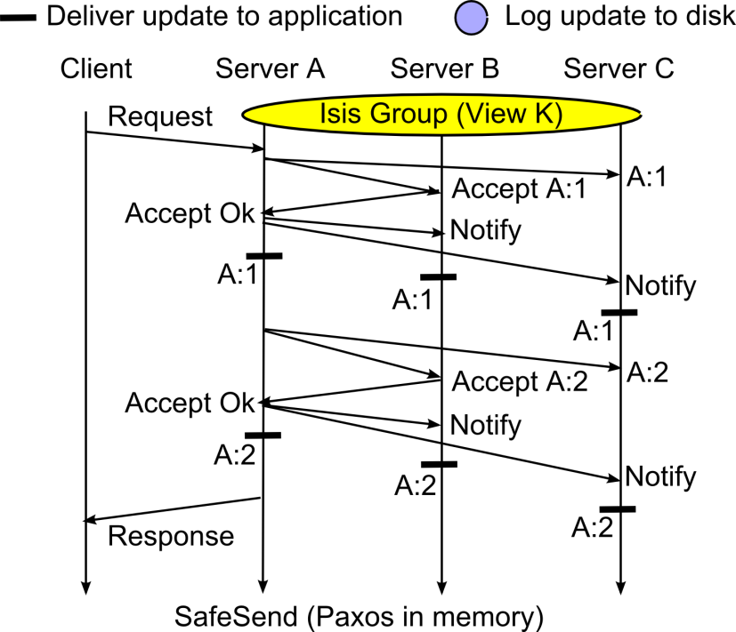
Looking closely at that “oddity”

Slide 22
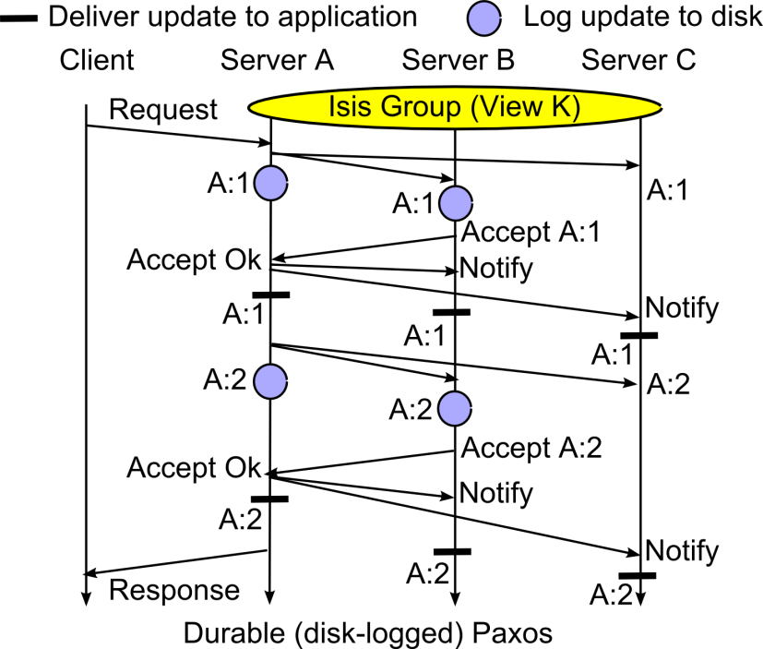
Looking closely at that “oddity”

Slide 23
Paxos avoided the issue… at a price
SafeSend, Paxos and other multi-phase protocols don’t deliver in the first round/phase
This gives them stronger safety on a message by message basis, but also makes them slower and less scalable
Is this a price we should pay for better speed?

Slide 24
Do you recall our medical example?
Doctor updates the medical prescriptions for a patient: this is a kind of persistent database update
So it needs Paxos, implement via g.SafeSend
Technician updates the online monitoring system
Configuration of that system changes all the time
If something crashes, on reboot it starts by asking “what should I be doing right now?”
So g.OrderedSend or g.Send will suffice

Slide 25
Medical monitoring scenario
Update the monitoring and alarms criteria for Mrs. Marsh as follows…
Execution timeline for an individual first-tier replica
A B C D
Soft-state first-tier service
Response delay seen by end-user would also include Internet latencies
Send
Send
Local response delay
Send
Confirmed
flush
An online monitoring system might focus on real-time response and be less concerned with data durability

Slide 26
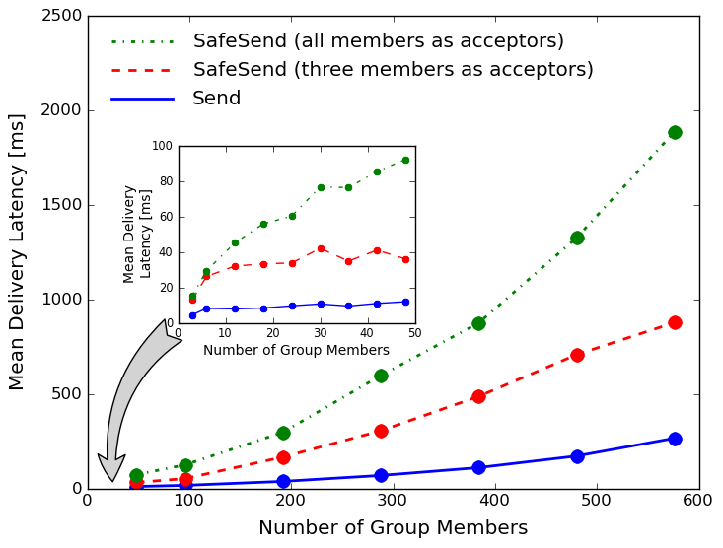
Vsync: Send v.s. in-memory SafeSend
Send scales best, but SafeSend with in-memory (rather than disk) logging and small numbers of acceptors isn’t terrible.

Slide 27
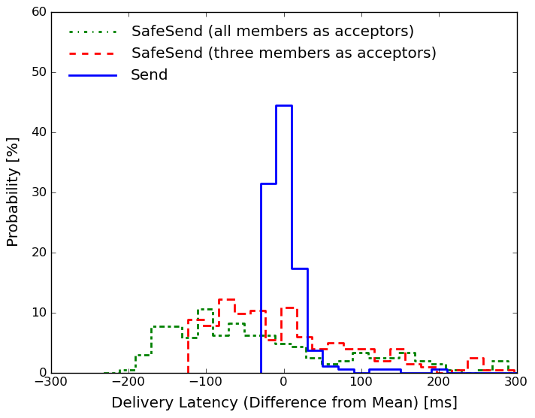
Jitter: how “steady” are latencies?
The “spread” of latencies is much better (tighter) with Send: the 2-phase SafeSend protocol is sensitive to scheduling delays

Slide 28
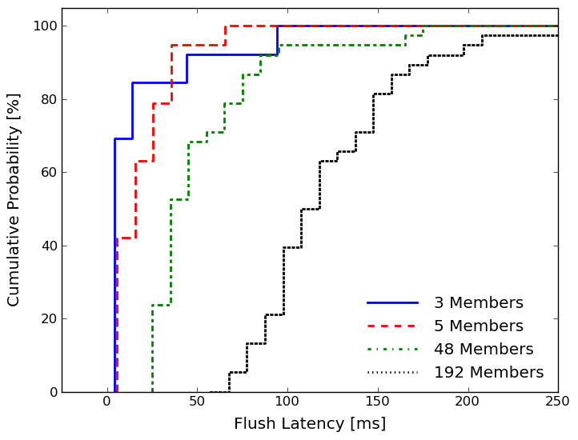
Flush delay as function of shard size
Flush is fairly fast if we only wait for acks from 3-5 members, but is slow if we wait for acks from all members. After we saw this graph, we changed Vsync to let users set the threshold.

Slide 29
Advantage: [Ordered]Send+Flush?
It seems that way, but there is a counter-argument
The problem centers on the Flush delay
We pay it both on writes and on some reads
If a replica has been updated by an unstable multicast, it can’t safely be read until a Flush occurs
Thus need to call Flush prior to replying to client even in a read-only procedure
Delay will occur only if there are pending unstable multicasts

Slide 30
Only real option is to experiment
In the cloud we often see questions that arise at
Large scale,
High event rates,
… and where millisecond timings matter
Best to use tools to help visualize performance
Let’s see how one was used in developing Vsync

Slide 31
Something was… strangely slow
We weren’t sure why or where
Only saw it at high data rates in big shards
So we ended up creating a visualization tool just to see how long the system needed from when a message was sent until it was delivered
Here’s what we saw

Slide 32
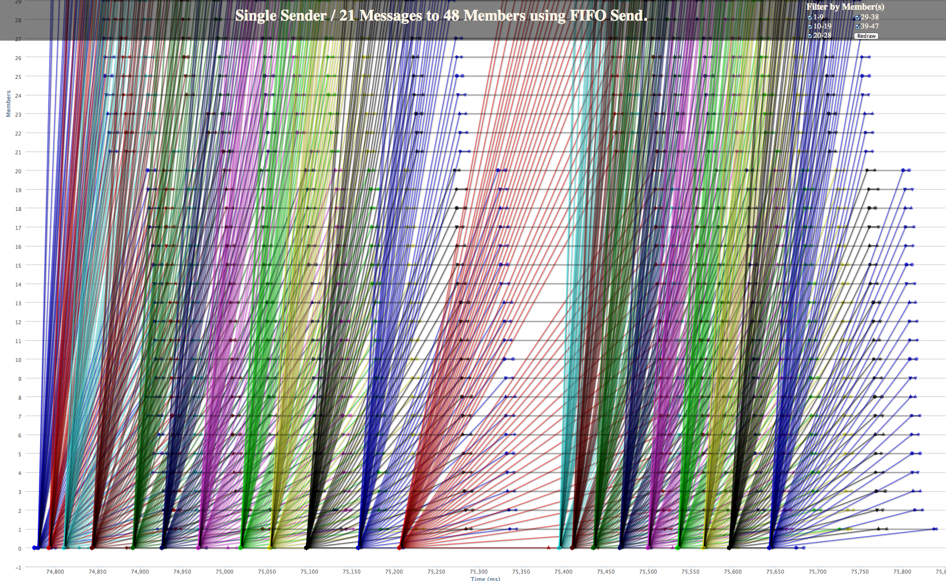
Debugging: Stabilization bug
At first Vsync is running very fast (as we later learned, too fast to sustain)
Eventually it pauses. The delay is similar to a Flush delay. A backlog was forming

Slide 33
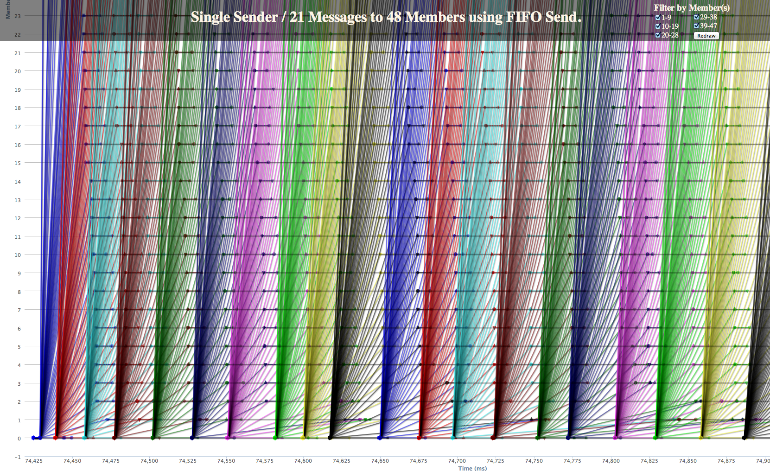
Debugging : Stabilization bug fixed
The revised protocol is actually a tiny bit slower, but now we can sustain the rate

Slide 34
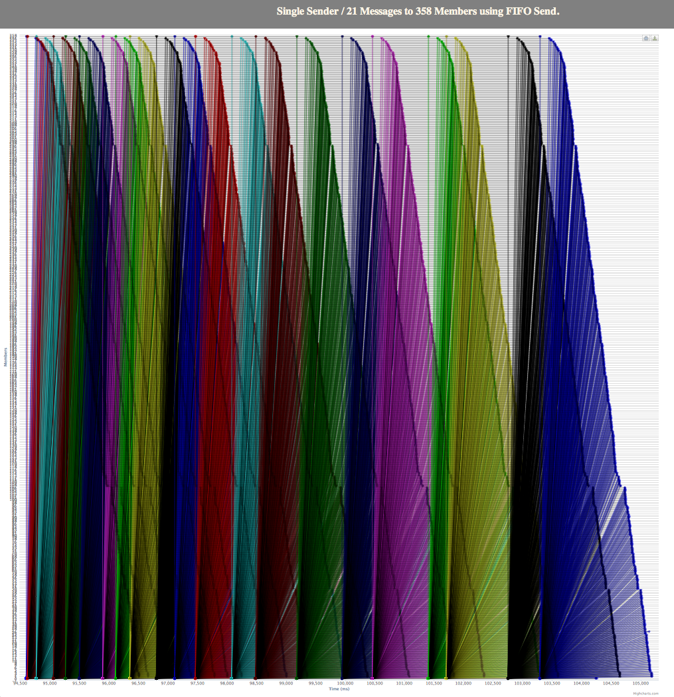
Debugging : 358-node run slowdown
Original problem but at an even larger scale

Slide 35
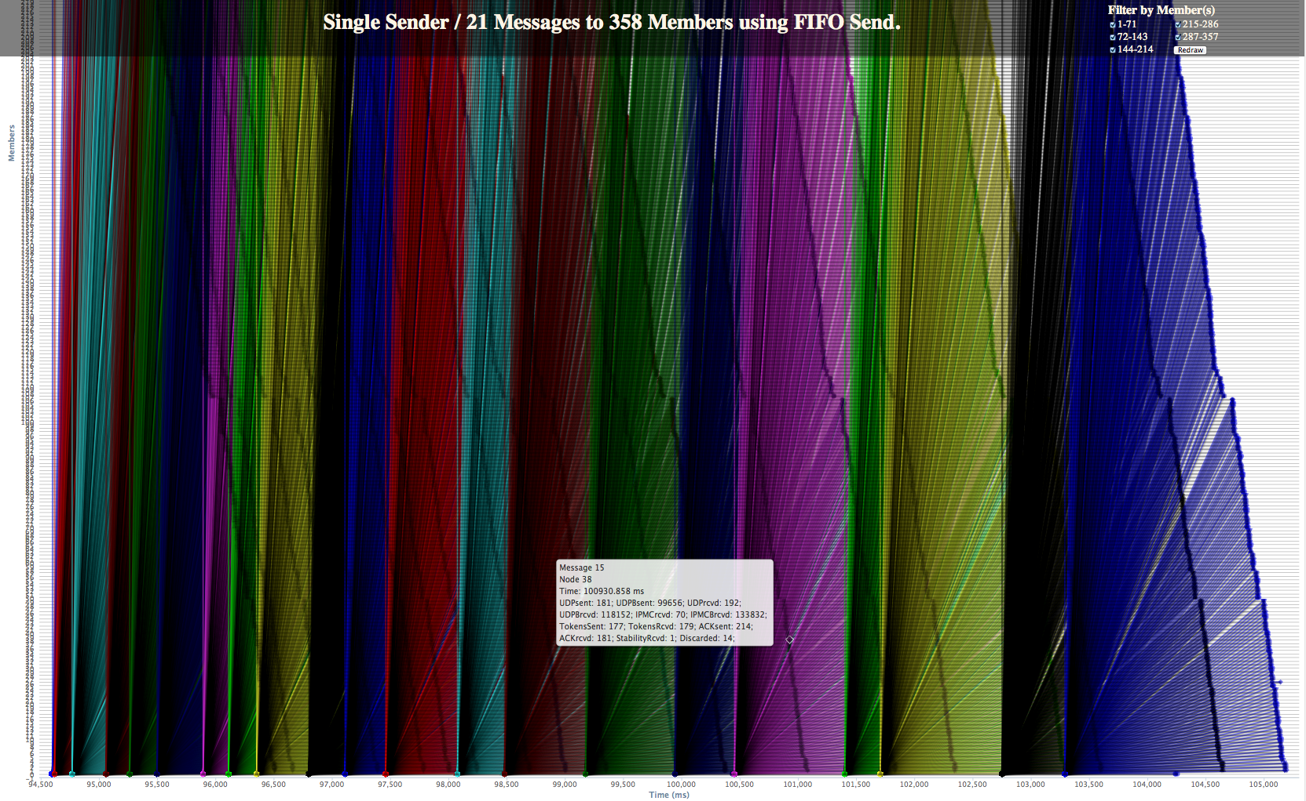
358-node run slowdown: Zoom in
Hard to make sense of the situation: Too much data!

Slide 36
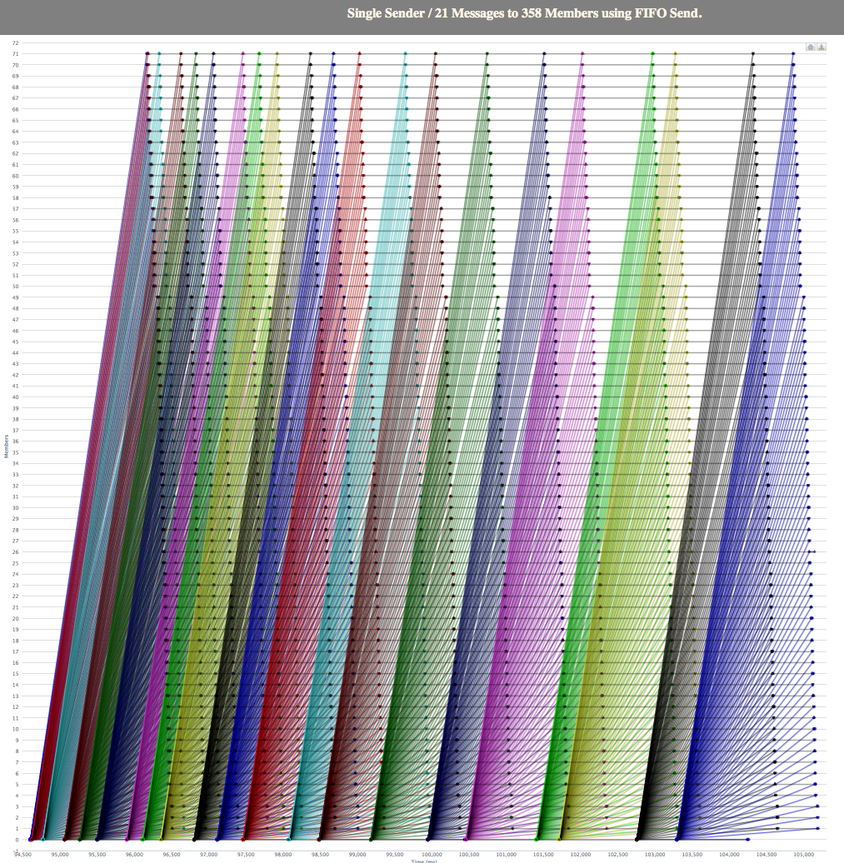
358-node run slowdown: Filter
Filtering is a necessary part of this kind of experimental performance debugging!

Slide 37

What did we just see?
Flow control is pretty important!
With a good multicast flow control algorithm, we can garbage collect spare copies of our Send or OrderedSend messages before they pile up and stay in a kind of balance
Why did we need spares? … To resend if the sender fails.
When can they be garbage collected? … When they become stable
How can the sender tell? … Because it gets acknowledgements from recipients

Slide 38
Interesting insight…
In fact, most versions of Paxos will tend to be bursty too. . .
The fastest Q_{W} group members respond to a request before the slowest N-Q_{W}, allowing them to advance while the laggards develop a backlog
This lets Paxos surge ahead, but suppose that conditions change (remember, the cloud is a world of strange scheduling delays and load shifts). One of those laggards will be needed to reestablish a quorum of size Q_{W}
… but it may take a while for them to deal with the backlog and join the group!
Hence Paxos (as normally implemented) will exhibit long delays, triggered when cloud-computing conditions change

Slide 39
Conclusions?
A question like “how much durability do I need in the first tier of the cloud” is easy to ask… harder to answer!
Study of the choices reveals two basic options
OrderedSend + Flush, or Send + Flush
In theory, OrderedSend will automatically notice that Send will suffice
But if you know for sure and want to be sure it will be used, just say so
SafeSend: Paxos, but this is overkill
Steadiness of the underlying flow of messages favors optimistic early delivery protocols such as Send and OrderedSend. Classical versions of Paxos may be very bursty

