Slide 1
CS5412: TIER 2 OVERLAYS
Lecture VI
Ken Birman

Slide 2
Recap
A week ago we discussed RON and Chord: typical examples of P2P network tools popular in the cloud
They were invented purely as content indexing systems, but then we shifted attention and peeked into the data center itself. It has tiers (tier 1, 2, backend) and a wide range of technologies
Many datacenter technologies turn out to use a DHT “concept” and would be build on a DHT
But one important point arises: inside a data center the DHT can be optimized to take advantage of “known membership”

Slide 3
CS5412 DHT “Road map”
Lecture and Topic |  | Lecture and Topic
First the big picture (Tuesday 2/9: RON and Chord) |  | A DHT can support many things! (Thursday 2/11: BigTable, …)
Can a WAN DHT be equally flexible? (Thursday 2/17: Beehive, Pastry) |  | Another kind of overlay: BitTorrent (Tuesday 2/22)
Some key takeaways to deeply understand, likely to show up on tests.
The DHT get/put abstraction is simple, scalable, extremely powerful.
DHTs are very useful for finding content (“indexing”) and for caching data
A DHT can also mimic other functionality but in such cases, keep in mind that DHT guarantees are weak: a DHT is not an SQL database.
DHTs work best inside the datacenter, because accurate membership information is available. This allows us to completely avoid “indirect routing” and just talk directly to the DHT member(s) we need to.
In a WAN we can approximate this kind of membership tracking, but less accurately. This limits WAN DHTs. Thus we can’t use WAN DHTs with the same degree of confidence as we do inside a datacenter.

Slide 4
DHT in a WAN setting
Some cloud companies are focused on Internet of Things scenarios that need DHTs in a WAN.
Content hosting companies like Akamai often have a decentralized pull infrastructure and use a WAN overlay to find content (to avoid asking for the same thing again and again from the origin servers)
Puzzle: Nobody can tolerate log(N) delays

Slide 5
Native Chord wouldn’t be fast enough
Internal to a cloud data center a DHT can be pretty reliable and blindingly fast
Nodes don’t crash often, and RPC is quite fast
Get/Put operation runs in 1RPC directly to the node(s) where the data is being held. Typical cost? 100us or less.
But to get this speed every application needs access to a copy of the table of DHT member nodes
In a WAN deployment of Chord with 1000 participants, we lack that table of members. With “Chord style routing”, the get/put costs soar to perhaps 9 routing hops: maybe 1.5-2s. This overhead is unacceptable

Slide 6

Why was 1-hop 100us but 9 1.5s?
Seems like 9 hops should be 900us?
Actually not: not all hops are the same!
Inside a data center, a hop really is directly over the network and only involves optical links and optical routers. So these are fast local hops.
In a WAN setting, each hop is over the Internet and for Chord, to a global destination! So each node- to-node hop could easily take 75- 150ms. 9 such hops add up.

Slide 7
Churn
We use this term when a WAN system has many nodes that come and go dynamically
Common with mobile clients who try to have a WAN system right on their handheld devices, but move in and out of 3G network coverage areas
Their nodes leave and join frequently, so Chord ends up with very inaccurate pointer tables

Slide 8

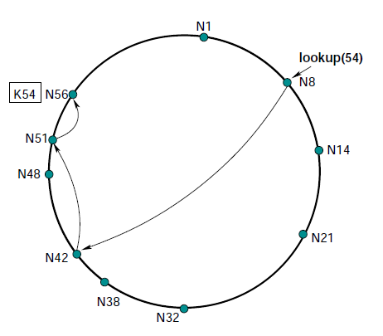

Hot spots
In heavily used systems
Some items may become far more popular than others and be referenced often; others rarely: hot/cold spots
Members may join that are close to the place a finger pointer should point... but not exactly at the right spot
Churn could cause many of the pointers to point to nodes that are no longer in the network, or behind firewalls where they can’t be reached
This has stimulated work on “adaptive” overlays

Slide 9
Today look at three examples
Beehive: A way of extending Chord so that average delay for finding an item drops to a constant: O(1)
Pastry: A different way of designing the overlay so that nodes have a choice of where a finger pointer should point, enabling big speedups
Kelips: A simple way of creating an O(1) overlay that trades extra memory for faster performance

Slide 10
WAN structures on overlays
We won’t have time to discuss how better overlays are used in the WAN, but CDN search in a system with a large number of servers is a common case.
In settings where privacy matters, a DHT can support privacy-preserving applications that just keep all data on the owner’s device. With a standard cloud we would have to trust the cloud operator/provider.

Slide 11
Goals
So… we want to support a DHT (get, put)
Want it to have fast lookups, like inside a data center, but in a situation where we can’t just have a membership managing service
Need it to be tolerant of churn, hence “adaptive”

Slide 12
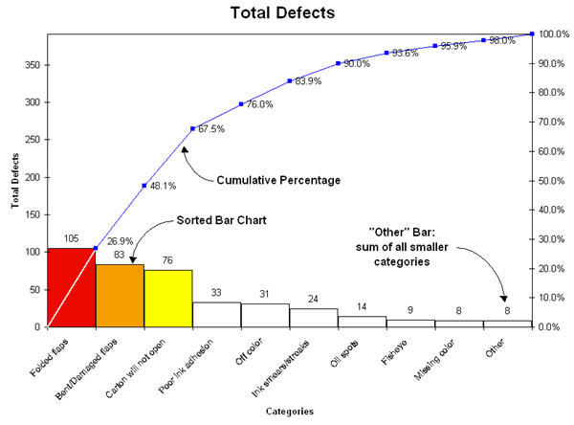
Insight into adaptation
Many “things” in computer networks exhbit Pareto popularity distributions
This one graphs frequency by category for problems with cardboard shipping cartons
Notice that a small subset of issues account for most problems

Slide 13
Beehive insight
Small subset of keys will get the majority of Put and Get operations
Intuition is simply that everything is Pareto!
By replicating data, we can make the search path shorter for a Chord operation
... so by replicating in a way proportional to the popularity of an item, we can speed access to popular items!

Slide 14
Beehive: Item replicated on N/2 nodes
If an item isn’t on “my side” of the Chord ring it must be on the “other side”
In this example, by replicating a (key,value) tuple over half the ring, Beehive is able to guarantee that it will always be found in at most 1 hop. The system generalizes this idea, matching the level of replication to the popularity of the item.

Slide 15
Beehive strategy
Replicate an item on N nodes to ensure O(0) lookup
Replicate on N/2 nodes to ensure O(1) lookup
. . .
Replicate on just a single node (the “home” node) and worst case lookup will be the original O(log n)
So use popularity of the item to select replication level

Slide 16
Tracking popularity
Each key has a home node (the one Chord would pick)
Put (key,value) to the home node
Get by finding any copy. Increment access counter
Periodically, aggregate the counters for a key at the home node, thus learning the access rate over time
A leader aggregates all access counters over all keys, then broadcasts the total access rate
... enabling Beehive home nodes to learn relative rankings of items they host
... and to compute the optimal replication factor for any target O(c) cost!

Slide 17
Notice interplay of ideas here
Beehive wouldn’t work if every item was equally popular: we would need to replicate everything very aggressively. Pareto assumption addresses this
Tradeoffs between parallel aspects (counting, creating replicas) and leader-driven aspects (aggregating counts, computing replication factors)
We’ll see ideas like these in many systems throughout CS5412

Slide 18
Pastry
A DHT much like Chord or Beehive
But the goal here is to have more flexibility in picking finger links
In Chord, the node with hashed key H must look for the nodes with keys H/2, H/4, etc....
In Pastry, there are a set of possible target nodes and this allows Pastry flexibility to pick one with good network connectivity, RTT (latency), load, etc

Slide 19
Pastry also uses a circular number space
d471f1
d467c4
Difference is in how the “fingers” are created
Pastry uses prefix match rather than binary splitting
More flexibility in neighbor selection
d462ba
d46a1c
d4213f
Route(d46a1c)
d13da3
65a1fc

Slide 20
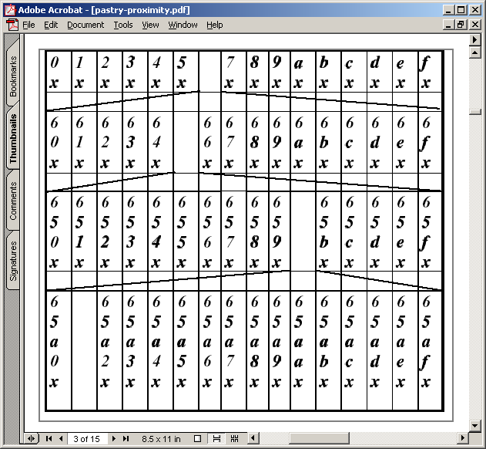
Pastry routing table (for node 65a1fc)
Pastry nodes also have a “leaf set” of immediate neighbors up and down the ring
Similar to Chord’s list of successors

Slide 21
Pastry join
X = new node, A = bootstrap, Z = nearest node
A finds Z for X
In process, A, Z, and all nodes in path send state tables to X
X settles on own table
Possibly after contacting other nodes
X tells everyone who needs to know about itself
Pastry paper doesn’t give enough information to understand how concurrent joins work
18th IFIP/ACM, Nov 2001

Slide 22
Pastry leave
Noticed by leaf set neighbors when leaving node doesn’t respond
Neighbors ask highest and lowest nodes in leaf set for new leaf set
Noticed by routing neighbors when message forward fails
Immediately can route to another neighbor
Fix entry by asking another neighbor in the same “row” for its neighbor
If this fails, ask somebody a level up

Slide 23
For instance, this neighbor fails

Slide 24
Ask other neighbors
Try asking some neighbor in the same row for its 655x entry
If it doesn’t have one, try asking some neighbor in the row below, etc.

Slide 25
CAN, Chord, Pastry differences
CAN, Chord, and Pastry have deep similarities
Some (important???) differences exist
CAN nodes tend to know of multiple nodes that allow equal progress
Can therefore use additional criteria (RTT) to pick next hop
Pastry allows greater choice of neighbor
Can thus use additional criteria (RTT) to pick neighbor
In contrast, Chord has more determinism
How might an attacker try to manipulate system?

Slide 26
Security issues
In many P2P systems, members may be malicious
If peers untrusted, all content must be signed to detect forged content
Requires certificate authority
Like we discussed in secure web services talk
This is not hard, so can assume at least this level of security

Slide 27
Security issues: Sybil attack
Attacker pretends to be multiple system
If surrounds a node on the circle, can potentially arrange to capture all traffic
Or if not this, at least cause a lot of trouble by being many nodes
Chord requires node ID to be an SHA-1 hash of its IP address
But to deal with load balance issues, Chord variant allows nodes to replicate themselves
A central authority must hand out node IDs and certificates to go with them
Not P2P in the Gnutella sense

Slide 28
General security rules
Check things that can be checked
Invariants, such as successor list in Chord
Minimize invariants, maximize randomness
Hard for an attacker to exploit randomness
Avoid any single dependencies
Allow multiple paths through the network
Allow content to be placed at multiple nodes
But all this is expensive…

Slide 29
Load balancing
Query hotspots: given object is popular
Cache at neighbors of hotspot, neighbors of neighbors, etc.
Classic caching issues
Routing hotspot: node is on many paths
Of the three, Pastry seems most likely to have this problem, because neighbor selection more flexible (and based on proximity)
This doesn’t seem adequately studied

Slide 30
Load balancing
Heterogeneity (variance in bandwidth or node capacity
Poor distribution in entries due to hash function inaccuracies
One class of solution is to allow each node to be multiple virtual nodes
Higher capacity nodes virtualize more often
But security makes this harder to do

Slide 31
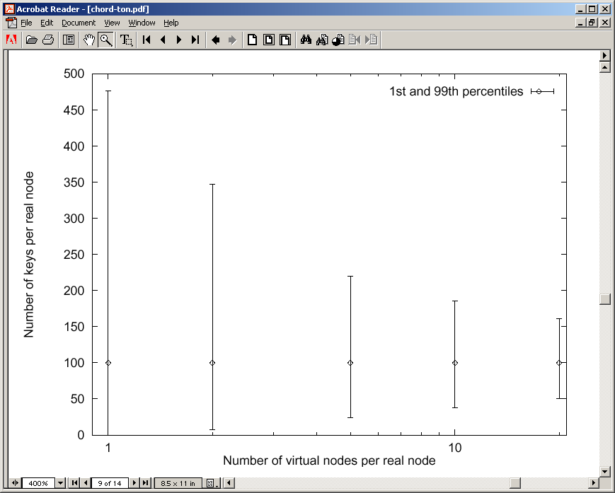
Chord node virtualization
10K nodes, 1M objects
20 virtual nodes per node has much better load balance, but each node requires ~400 neighbors!

Slide 32
Fireflies
Van Renesse uses this same trick (virtual nodes)
In his version a form of attack-tolerant agreement is used so that the virtual nodes can repell many kinds of disruptive attacks
We won’t have time to look at the details today

Slide 33
Another major concern: churn
Churn: nodes joining and leaving frequently
Join or leave requires a change in some number of links
Those changes depend on correct routing tables in other nodes
Cost of a change is higher if routing tables not correct
In chord, ~6% of lookups fail if three failures per stabilization
But as more changes occur, probability of incorrect routing tables increases

Slide 34
Control traffic load generated by churn
Chord and Pastry appear to deal with churn differently
Chord join involves some immediate work, but repair is done periodically
Extra load only due to join messages
Pastry join and leave involves immediate repair of all effected nodes’ tables
Routing tables repaired more quickly, but cost of each join/leave goes up with frequency of joins/leaves
Scales quadratically with number of changes???
Can result in network meltdown???

Slide 35
Kelips takes a different approach
Network partitioned into √N “affinity groups”
Hash of node ID determines which affinity group a node is in
Each node knows:
One or more nodes in each group
All objects and nodes in own group
But this knowledge is soft-state, spread through peer-to-peer “gossip” (epidemic multicast)!

Slide 36
Rationale?
Kelips has a completely predictable behavior under worst-case conditions
It may do “better” but won’t do “worse”
Bounded message sizes and rates that never exceed what the administrator picks no matter how much churn occurs
Main impact of disruption: Kelips may need longer before Get is guaranteed to return value from prior Put with the same key

Slide 37
Kelips
110 knows about other members – 230, 30…
Affinity Groups:
peer membership thru consistent hash
Affinity group view
id | hbeat | rtt
30 | 234 | 90ms
230 | 322 | 30ms
0
1
2
N
−
1
110
230
202
N
members per affinity group
30
Affinity group pointers

Slide 38
Kelips
202 is a “contact” for 110 in group 2
Affinity Groups:
peer membership thru consistent hash
Affinity group view
id | hbeat | rtt
30 | 234 | 90ms
230 | 322 | 30ms
0
1
2
N
−
1
110
Contacts
N
230
202
members per affinity group
group | contactNode
… | …
2 | 202
30
Contact pointers

Slide 39
Kelips
“cnn.com” maps to group 2. So 110 tells group 2 to “route” inquiries about cnn.com to it.
Affinity Groups:
peer membership thru consistent hash
Affinity group view
id | hbeat | rtt
30 | 234 | 90ms
230 | 322 | 30ms
0
1
2
N
−
1
110
Contacts
N
230
202
members per affinity group
group | contactNode
… | …
2 | 202
30
Resource Tuples
Gossip protocol replicates data cheaply
resource | info
… | …
cnn.com | 110

Slide 40
How it works
Kelips is entirely gossip based!
Gossip about membership
Gossip to replicate and repair data
Gossip about “last heard from” time used to discard failed nodes
Gossip “channel” uses fixed bandwidth
… fixed rate, packets of limited size

Slide 41
Gossip 101
Suppose that I know something
I’m sitting next to Fred, and I tell him
Now 2 of us “know”
Later, he tells Mimi and I tell Anne
Now 4
This is an example of a push epidemic
Push-pull occurs if we exchange data

Slide 42
Gossip scales very nicely
Participants’ loads independent of size
Network load linear in system size
Information spreads in log(system size) time
1.0
% infected
0.0
Time →

Slide 43
Gossip in distributed systems
We can gossip about membership
Need a bootstrap mechanism, but then discuss failures, new members
Gossip to repair faults in replicated data
“I have 6 updates from Charlie”
If we aren’t in a hurry, gossip to replicate data too

Slide 44
Gossip about membership
Start with a bootstrap protocol
For example, processes go to some web site and it lists a dozen nodes where the system has been stable for a long time
Pick one at random
Then track “processes I’ve heard from recently” and “processes other people have heard from recently”
Use push gossip to spread the word

Slide 45
Gossip about membership
Until messages get full, everyone will known when everyone else last sent a message
With delay of log(N) gossip rounds…
But messages will have bounded size
Perhaps 8K bytes
Then use some form of “prioritization” to decide what to omit – but never send more, or larger messages
Thus: load has a fixed, constant upper bound except on the network itself, which usually has infinite capacity

Slide 46
Back to Kelips: Quick reminder
Affinity Groups:
peer membership thru consistent hash
Affinity group view
id | hbeat | rtt
30 | 234 | 90ms
230 | 322 | 30ms
0
1
2
N
−
1
110
Contacts
N
230
202
members per affinity group
group | contactNode
… | …
2 | 202
30
Contact pointers

Slide 47
How Kelips works
Node 175 is a contact for Node 102 in some affinity group
175
Hmm…Node 19 looks like a much better contact in affinity group 2
RTT: 235ms
Node 102
19
RTT: 6 ms
Gossip data stream
Gossip about everything
Heuristic to pick contacts: periodically ping contacts to check liveness, RTT… swap so-so ones for better ones.

Slide 48
Replication makes it robust
Kelips should work even during disruptive episodes
After all, tuples are replicated to √N nodes
Query k nodes concurrently to overcome isolated crashes, also reduces risk that very recent data could be missed
… we often overlook importance of showing that systems work while recovering from a disruption

Slide 49
Control traffic load generated by churn
O(Changes x Nodes)?
None
O(changes)
Kelips
Chord
Pastry

Slide 50
Summary
Adaptive behaviors can improve overlays
Reduce costs for inserting or looking up information
Improve robustness to churn or serious disruption
As we move from CAN to Chord to Beehive or Pastry one could argue that complexity increases
Kelips gets to a similar place and yet is very simple, but pays a higher storage cost than Chord/Pastry

