Slide 1
CS5412: Spring 2016
Cloud Computing
Lecture 1
Ken Birman

Slide 2

Welcome to CS 5412...
A course dedicated to the technology behind cloud computing!
In my country of Khazackstan, many excellent hacker. We hack cloud, steal private stuff of whole world!

Slide 3
Cloud Computing: The Next New Thing
A general term for the style of computing that supports web services, search, social networking
Increasingly powerful and universal
Enables a new kind of massively scaled, elastic app
Our goal: understand the technology of the cloud, its limitations, and how to push beyond them
Invent “highly assured cloud computing” options

Slide 4









Today’s Cloud: Surprisingly limited
Big data, updates by “owner”
Dominated by reads
Index... search... share
Monetized by advertising, sales

Slide 5










Tomorrow’s cloud?
Big data, updates by “owner”
Dominated by reads
Index... search... share
Monetized by advertising, sales
eHealth
High assurance
Real-time control
Runs “everything”
Monitized by “roles”
eChauffer
CloudBank
GridCloud

Slide 6
Clouds are hosted by data centers
Huge data centers, far larger than past systems
Very automated: far from where developers work. Often close to where power is generated
(ship bits... not watts)
Packed for high efficiency. Each machine hosts many applications (usually in lightweight virtual machines to provide isolation)
Scheduled to keep everything busy (but overloads hurt performance so we avoid them)

Slide 7


Clouds are cheaper… and winning…
Range in size from “edge” facilities to megascale.
Incredible economies of scale
  Approximate costs for a small size center (1K servers) and a larger, 50K server center.
Technology | Cost in small-sized Data Center | Cost in Large Data Center | Cloud Advantage
Network | $95 per Mbps/ month | $13 per Mbps/ month | 7.1
Storage | $2.20 per GB/ month | $0.40 per GB/ month | 5.7
Administration | ~140 servers/ Administrator | >1000 Servers/ Administrator | 7.1
Each data center is
11.5 times
the size of a football field
Slide provided by Roger Barga, Head of Cloud Computing, Microsoft

Slide 8
Key benefits?
Machines busier, earn more $’s for each $ investment
  Hardware handled a whole truckload at a time
Applications far more standardized
  Automated management: few “sys admins” needed
  Power consumed near generator: less wastage
  Data center runs hot, wasting less on cooling
  Can “rent” resources rather than owning them
Supports new, extremely large-scale services
  Elasticity to accomodate surging demands
  Can accumulate and access massive amounts of data
    But must read or process it in a massively parallel way
  Enables overnight emergence of major companies, but scalability model does require new programming styles, and imposes new limits

Slide 9
Assurance properties
Unfortunately, today’s cloud
  Has a limited security model focused on credit card transactions
  Weakens consistency to achieve faster response times: the cloud is “inconsistent by design”
  Pushes many aspects of failure handling to clients
Model supported by the “CAP” and “FLP” theorems, which are cited by many application designers
Instead, cloud favors “BASE”

Slide 10
Acronyms
CAP: A theorem that says one can have just two from {Consistency, Availability, Partition Tolerance}
FLP: A theorem that says it is impossible to guarantee “live” fault-tolerance in asynchronous systems (here, “live” ≡ certain to make progress)
BASE: A cloud computing methodology that seeks “Basically available soft-state services with eventual consistency” and is popular in the outer layers (first tier) of the cloud. The opposite of ACID
ACID: A database methodology: offers guaranted {Atomicity, Consistency, Isolation and Durability}.

Slide 11
CS5412: How to do better!
Future cloud will need stronger guarantees than we see with today’s cloud
  How can we achieve those?
  Are strong guarantees “scalable”?
Betting that the cloud will win
  Cheaper than other options...
  ... and the cheaper option usually wins!
  But technology also advances over time, which helps!

Slide 12
Making the cloud highly assured
Find ways to overcome limitations like FLP and CAP
Define new assurance goals that might still be forms of security and consistency but are easier to achieve
Only consider things that are real enough to be implemented and demonstrated to scale well and perform in a way that would compete with today’s cloud platforms. A practical mindset.
But use theoretical tools when theory helps with goals.

Slide 13
… And making it fast
The cloud makes it easy to create “mashups”
  Applications send data to each other, one system might “call upon” 10 or 100 others for help
  Very powerful but also very inefficient in some ways
    Example: Networks that become overloaded because of the same image or video being sent again and again!
Getting the cloud to “scale” and perform well comes down to enabling productivity while also finding tricks to ensure super good performance
    Example”: store the image, ship a URL…

Slide 14



CS5412: Topics Covered
We’ll treat the cloud as having three main parts
  The client side: Everything on your device
  The Internet, as used by the cloud
  Data centers, which themselves have a “tiered” structure
    Like a dedicated and
    personal computer
    Yet massively scaled
    with many moving parts
Special theme:
high assurance

Slide 15
The Old World and the New
Old world: we replicated servers for speed and availability, but maintained consistency
New world: scalability matters most of all
  Focus is on extremely rapid response times
  Amazon estimates that each millisecond of delay has a measurable impact on sales!
But our premise is that we can have scalability and also have other guarantees that today’s cloud lacks

Slide 16
High Assurance: Many (conflicting) goals
Security: Only correctly authorized users (who are properly authenticated) can perform actions
Scalability: Can support lots of simultaneous users
Privacy: Data doesn’t leak to intruders
Rapid response despite failures or disruption
Consistency and coordinated behavior
Ability to overcome attacks or mishaps
Guarantee that center operates at a high level of efficiency and in a highly automated manner
Archival protection of important data

Slide 17
Must ask many questions
If we were to run high assurance solutions on today’s cloud, what parts of the standards would limit or harm our assurance properties?
Goal is to leverage the cloud or even run on standard clouds, yet to improve on normal options
This forces us to look hard at how things work

Slide 18
Today’s cloud focuses on easy stories
Which is better:
  Multithreaded servers?

Slide 19
Today’s cloud focuses on easy stories
Which is better:
  Multithreaded servers?
  Or multiple single-threaded servers?

Slide 20
Which scales best?
Build it the easy way!
  One VM or “container” per server
  Server handles one user
  Make the server single threaded if possible
Why?
  Better fit to the hardware (no lock/memory contention)
  Quicker way to build it, reuses existing stuff

Slide 21
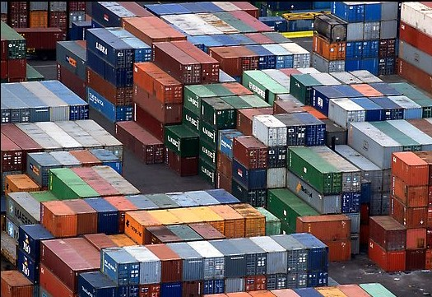
VMs versus Containers
A container is a normal Linux process with a library that mimics a full VM.
  The system looks “private” but actually is shared
  Benefit is that full virtualization has 10% or so performance overheads and containers avoid these
  Also, containers launch and shut down much faster than a full VM, because we don’t need to load the whole OS
  Degree of isolation isn’t quite as strong
In CS5412 we treat both options as forms of virtualization.

Slide 22
Some of today’s rules of thumb
Built from things that already exist and already work, as much as possible
Expect that each 10x scaleup will still break things and that much of your work will be on fixing them
When feasible, go for “no brainer” scalability
  Armies of cheap machines and cheap storage
  A form of “brute force” solution
Success stories of today’s cloud often are applications that naturally fit this approach

Slide 23
Acronyms! (How to be a party bore)
One issue with the cloud is that it has a million acronyms: IaaS, SaaS, PaaS, SOAP, AWS, EC2, S3...
  These make for a very confusing landscape!
  But a business perspective on the cloud only needs to focus on a few of them, as a starting point
What does the “aaS” mean?
  Cloud vendors sell “services”
  “aaS” == “as a Service”

Slide 24
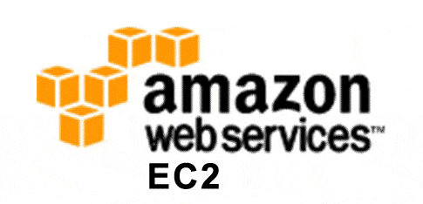
The Important *aaS options
Infrastructure. (IaaS: Infrastructure as a Service)
  Cloud vendor rents you some hardware
    A network, perhaps a wide-area network
    A machine, always “virtual” but perhaps just for you
    A file server, again virtual, but you can save files in it
  They operate this for you, and you pay for what you think you need (or sometimes, for what you use)
  And they sell backup services too
For example, you could rent a private Internet from AT&T, or 500 computers from Amazon EC2
  AWS is elastic: you rent and pay by the hour
  AWS can accommodate huge swings in your needs

Slide 25
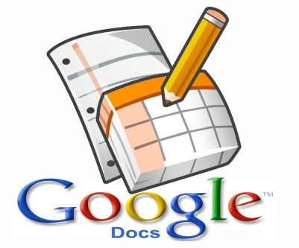
The Important *aaS options
Software. (SaaS: Software as a Service)
  Cloud vendor runs some software that you use remotely
  Classic example: SalesForce.com has a sophisticated infrastructure that manages your sales contact data
In effect you “outsource” your sales support system and SalesForce.com runs it for you
  Other SaaS options: accounting, billing, email, document handling, shared files…
  They also apply patches, fix bugs…

Slide 26

The Important *aaS options
Platform. (PaaS: Platform as a Service)
  Cloud vendor creates a sophisticated platform (typically a software environment for some style of computing, or for database applications)
  Your folks use it to create a custom solution
  Cloud vendor runs your solution in an elastic way
They promise that if you use their PaaS solution, you’ll benefit from better scalability, performance, ease of development or other advantages

Slide 27
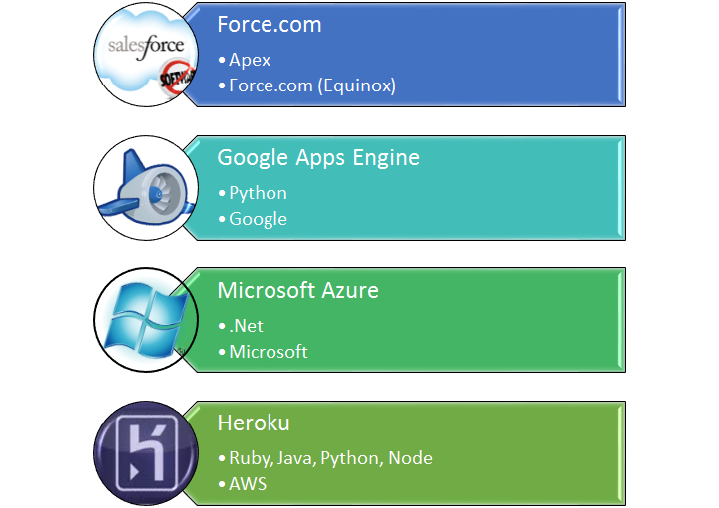
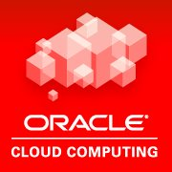
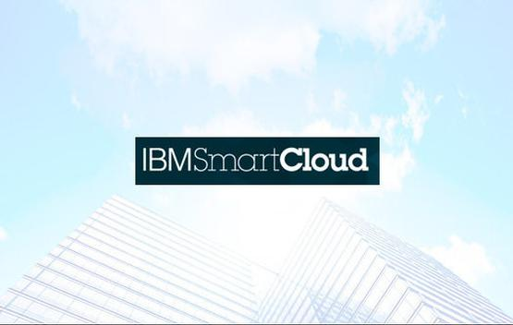
The Important *aaS options
Platform. (PaaS: Platform as a Service)

Slide 28
… these aren’t the whole cloud
The cloud mixes many models
  Some integrate humans into the loop, such as outsourced audio-to-text, or Amazon’s Mechanical Turk
  There are companies with specialized roles
    Akamai: The most famous data hosting company, especially successful for storing videos and images that are used in your web pages. They specialize in rapid data delivery
    DoubleClick: You leave a frame on your web page, they put the perfect advertisement for this particular user in it
  There are even cloud “HPC systems”! (Rent on demand)

Slide 29

Open source
The cloud has hugely benefitted from
  open source (basically, source for programs is made available to customers),
  free open source (same, but no fee for use), and
  open development (many developers at many companies contribute).
In fact nothing about the cloud demands “open.”
But these are certainly powerful factors that help explain the vibrant cloud ecosystem.

Slide 30
So… what’s cloud computing?
In some sense, the term means nothing!
  If you make “full use” of modern off-the-shelf computing products and systems, you are a cloud computing user
  You can’t really buy “non-cloud” systems anymore
The Internet and cloud standards are built into everything
You can block some features, but it is surprisingly hard to create a cloud-free computing system (one of many reasons it is so easy to break into many systems)

Slide 31

Which matters more: consistency or fast response?
Air Traffic Controllers depend on consistent data
With a single server this isn’t hard to guarantee
ATC DB
Safe for US Air 221 to land?

Slide 32
Which matters more: consistency or fast response?
But suppose we replicate the server?
Designate one as “primary”
ATC DB
Backup
Safe for US Air 221 to land?

Slide 33
Which matters more: consistency or fast response?
Failure detection will be key to consistency
Otherwise could end up with two primaries!
ATC DB
ATC DB’
Safe for Air France 31 to take off?
Safe for US Air 221 to land?

Slide 34
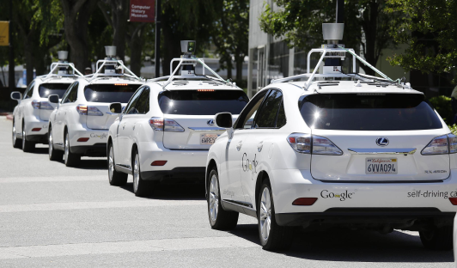
But who uses clouds for ATC?
Nobody, that would be unsafe.
But we do plan to use clouds for smart highways that control smart cars
  The vehicles will have an important part of the control software, but the cloud infrastructure will hold the rest
  A lot like controlling an airplane!
In fact the future will depend on the cloud!

Slide 35
High assurance in the cloud
Today’s cloud is built with simple components and yet even so, exhibits problems like split brain behavior, thrashing, rolling failures, other issues
  Companies spending a fortune to eliminate such issues
  They can limit scalability
Tomorrow’s cloud thus poses a deep question
  Will it be limited to simple applications?
  Or can we migrate application like health care, transportation control, banking, etc to the cloud?

Slide 36
Background assumed?
Solid understanding of computer architectures, operating systems, good programming skills including “threads” in Java, C++ or C#
Some basic appreciation of how networks work, how operating systems work, virtualization
Prior exposure to “distributed computing” not required or expected

Slide 37
Logistics
This ends our introduction lecture
But now a few words about how the class will run
  Lectures (advice: attend them!)
  Exams (prelim, final)
  Projects

