Slide 1
CS5412: The CLoud VALUE PROPOSITION
Lecture XXII
Ken Birman

Slide 2
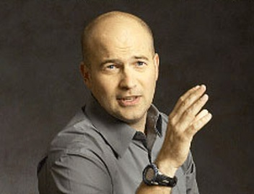
Cloud Hype
The cloud is cheaper!
The cloud business model is growing at an unparalleled pace without any limit in sight
In the future everything will be on the cloud
... can we find evidence to support, or refute, such claims?

Slide 3
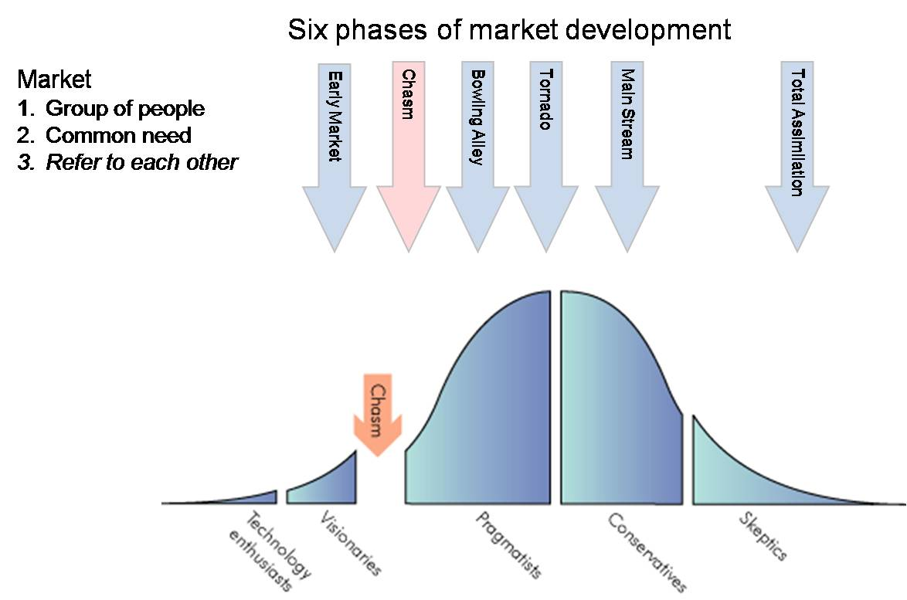
Crossing the Chasm
Insight from Geoff Moore

Slide 4
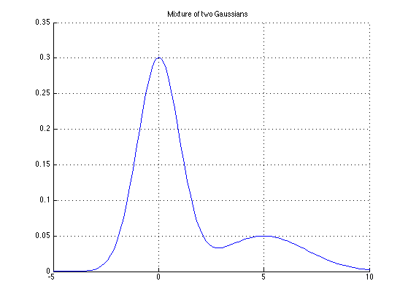
How does the revenue picture look?
One-time purchases

Slide 5
How does the revenue picture look?
“Recurring” revenue: vendor keeps getting paid

Slide 6
Why are these relevant?
Moore was talking about “old tech”.
Do cloud solutions need to cross the same chasm?
Are there ways in which the cloud chasm is different?
Centers on whether cloud revenue/expenses are similar
Do cloud solutions have revenue cycles?
Cloud solutions often use existing components. Does this change anything compared to the past?

Slide 7
But many cloud solutions are free!
Who pays for a “free” app?
Some games have advertising but many apps don’t
So what’s the interest in having the app?
Even more extreme: Who pays for LinkedIn?
Huge number of users so it must cost a lot to run
Yet no advertising and the site is free
They charge companies for “head hunting” but this can’t be a huge revenue stream: how often do people change jobs?

Slide 8
.... and the answer is?
LinkedIn exists to either be acquired, or to eventually change its revenue model using ads
In the “eventually profitable” case, the company would be sustained by venture capital in the interim period
Then an IPO lets the company cash in on its “value”
But what does “value” ultimately mean if the company sells a product that doesn’t really create revenue at all?

Slide 9
Factors to consider
Who pays…
To develop the system?
To use the system?
Why will it be in their interest to pay?
How expensive is a cloud system to build and operate? Is the answer very different compared with old-school approaches

Slide 10
… things we pay for
People to write the code
Do we need more or fewer in the cloud? (Fewer: they ideally work by integrating powerful existing stuff)
Places to run the code on
Cloud: Rent what you need, when you need it
People to operate the hardware
Cloud: Amortized over many customers, hence cheaper

Slide 11
Coping with Demand Bursts
IT Demand
Ouch! How do we deal with this?
Ticket sales open
Ticket sales open
Time
Concert ticket web site

Slide 12
Managing Demand
IT Capacity
Forecast demand
Potential business loss
Compute capacity
Over capacity
Under capacity
Entry barrier
Wasted capacity
Time

Slide 13
IT Agility
How quickly can you
Scale up the infrastructure and applications?
Upgrade to the latest OS?
Respond to a company merger with new requirements for business process and IT capacity?
Respond to a divestiture

Slide 14
Cloud Computing and IT Agility
Shared, multi-tenant environment: costs shared!
Pools of resources: enables dynamic applications
Resources can be requested as required
Pay as you go
Available via the Internet
Works anywhere with a connection (but only with connections that are fast enough and stable)
Private clouds can be available via private WAN or by using encryption for tunnels on the public WAN

Slide 15
Pulling these threads together
We can see that yes, the cloud does change the landscape in ways that matter
It enables new kinds of businesses (like Facebook)
But it also enables small startups that could never have been successful, at all, in the past!
The reuse of technology is central to this change, but in addition there are exciting aspects tied to new capabilities. So the picture is a little confusing: the game isn’t the same, but on aspects that are the same, the cloud also changes the costs

Slide 16
Technologies and monetization
Fundamentally, a technology must be profitable to survive.
Better technologies often fail
The technology everyone buys wins. Then eventually it might acquire features from the losing solutions
Moreover, the income story needs to “scale”

Slide 17
Two more examples. Who wins?
Company A has an amazing technology but you need to be an expert to use it.
So they hire and train experts of their own
When you buy their package they do the work for you
Company B has a less amazing technology but it just installs itself and works
No need to hire experts
Just buy as many user accounts as you need

Slide 18
Theil (Stanford)
Better doesn’t always win!
In addition to incorrectly assuming that better technology wins over inferior technology, people often confuse competition with competitive success
In effect: the best position to be in is to create your own niche and operate it as a mini-monopoly!
Hence first to dominate the niche wins!

Slide 19
Theil (Stanford)
… And winners get better over time!
Aggressive competition often drives pricing down
Much better to be the owner of a unique niche: sole provider of such-and-such a must-have application
You can charge higher prices (although not too high or competitors move in aggressively). So profit margins will be sharply higher
You become a must-be-there platform for advertising aimed at your class of clients, bringing you revenue

Slide 20
Key insight
Company A will eventually be limited by the number of experts it can actually hire & train
So after a period of growth it will stall
The revenue stream peaks and this chokes investment in the evolution of the product
Ultimately, company A will either fail or at least reach some sort of saturation point
Company B sees no end in sight and the money pours in
This allows B to invest to improve its technology
Eventually it will catch up with A on features

Slide 21
Applied to cloud computing?
We need to ask which stage of the cloud we’ve reached!
But one complication: it isn’t just “one” cloud
The cloud is a “sum” of multiple business stories/models
Early business of the cloud was the initial Internet boom (it gave us pets.com and similar web sites)
Only a few survived, like Amazon.com, Expedia
Winning wasn’t easy for them or much fun!

Slide 22
Waves of the cloud revolution
Early web browser stage
Search and advertising (Google)
Social Networking (Facebook, Twitter)
Cloud as your “home”: AOL, Yahoo!, MSN, Google
Emergence of true web services model
Infrastructure as a service (“rent a VM”) Apps (Apple)
Frames, full cross-site federation
Full-featured scripting languages (Javascript, Caja, Silverlight, Adobe Flash...)
What next?

Slide 23
Each has its own revenue model!
For each style of web solution need to ask what monetizes that model!
Google and Facebook make their money on advertising
Microsoft combines technology license revenue with advertising, but earns much more on technology
Apple earns money on every App
Amazon sells stuff but also runs massive data centers really well, and rents space on those
Infosys does rote tasks incredibly well and incredibly cheaply (because most of their employees earn $6,500/yr)
Following the money is the key to understanding what directions each will follow

Slide 24
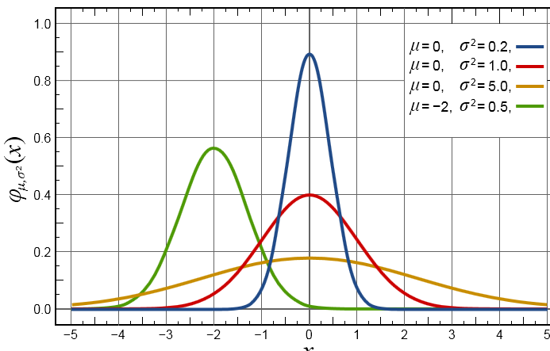
So the cloud is a sum of stories
Many of these revenue stories “superimposed”

Slide 25
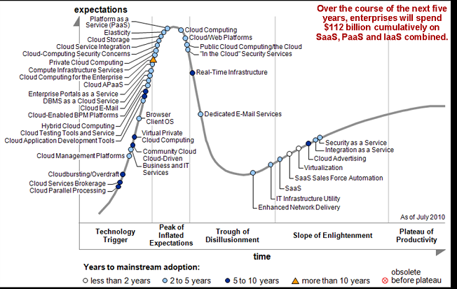

Slide 26
Inescapable Conclusion?
While the cloud enables new models and new kinds of computing stories, it doesn’t really eliminate the need to create value.
Some of today’s cloud computing stories will probably fail as business models
Wallstreet may not realize this, yet!

Slide 27
The terms have too many meanings!
Everyone talks about cloud computing but there is very little consensus on what cloud computing means
We’ve studied it all semester now
But the cloud brings together a lot of technologies that each do very different things
Best definition so far is basically:
A style of computing that makes extensive use of network access to remote data and remote data centers, presented through web standards.
But this is so general it says almost nothing!
Can we be more concrete and tie this back to the business models that matter?

Slide 28
What is a Cloud Platform? Some defining characteristics
It lets developers create and run apps, store data, and more
It provides self-service access to a pool of computing resources
It allows granular, elastic allocation of resources
It allows charging only for the resources an application uses

Slide 29
Public Clouds and Private Clouds Typical definitions
Public cloud: A cloud platform run by a service provider made available to many end-user organizations
Private cloud: A cloud platform run solely for a single end-user organization, such as a bank or retailer
The technology can be much like public clouds, but the economics are different
Most organizations will probably use some hybrid of both

Slide 30
Cloud Platform Technologies
The most important today:
Computing
Infrastructure as a Service (IaaS)
Platform as a Service (PaaS)
Storage
Relational storage
Scale-out storage
Blobs
There are many more
Messaging, identity, caching, …

Slide 31
Computing Infrastructure as a Service (IaaS)
Developers create virtual machines (VMs) on demand
They have full access to these VMs
Strengths:
Can control and configure environment
Familiar technologies
Limited code lock-in
Weaknesses:
Must control and configure environment
Requires administrative skills to use

Slide 32
Computing Platform as a Service (PaaS)
Developers provide an application, which the platform runs
They don’t work directly with VMs
Strengths:
Provides higher-level services than IaaS
Requires essentially no administrative skills
Weaknesses:
Allows less control of the environment
Can be harder to move existing software

Slide 33
Computing What’s the most popular approach?
IaaS is more widely used today than PaaS
Gartner estimates that public IaaS revenues are significantly greater than public PaaS revenues today
Perspective:
IaaS is easier to adopt than PaaS
IaaS emulates your existing world in the cloud
Over time, PaaS is likely to dominate
PaaS should have an overall lower cost than IaaS
It’s typically a better choice for new applications

Slide 34
Storage Relational
Traditional relational storage in the cloud
With support for SQL
Strengths:
Familiar technologies
Many available tools, e.g., for reporting
Limited data lock-in
Can be cheaper than on-premises relational storage
Weaknesses:
Scaling to handle very large data is challenging

Slide 35
Storage Scale-out
Massively scalable storage in the cloud
No support for SQL
Strengths:
Scaling to handle very large data is straightforward
Can be cheaper than relational storage
Weaknesses:
Unfamiliar technologies
Few available tools
Significant data lock-in

Slide 36
Storage Blobs
Storage for Binary Large OBjects in the cloud
Such as video, back-ups, etc.
Strengths:
Globally accessible way to store and access large data
Can be cheaper than on-premises storage
Weaknesses:
Provides only simple unstructured storage

Slide 37
Back to business models
Consider business A that uses cloud as an IaaS but also hosts lots of storage on the cloud
Business B is working in a PaaS model
Suppose they both offer medical records as their goal. Is one fundamentally better than the other?

Slide 38
Time to market
Because business A uses IaaS, they need to develop much more of their own infrastructure
The developers rent virtual machines from Amazon or some other vendor, but the whole technical structure is their private solution
This lets them innovate more and perhaps to offer better privacy assurances or better guarantees
But business A is facing a harder development cycle that will take longer and be more challenging

Slide 39
Time to market
Business B is in the PaaS model, maybe using Amazon’s Elastic Beanstalk or Oracle’s Cloud solution over Oracle DB, or Microsoft’s MySQL Cloud
Easier and faster to create and launch the product
It will also scale “automatically” and because it has the familiar look and feel of such solutions, people will not be surprised by the API
But the weaker guarantees may be an issue (medical privacy laws: HiPPA). And much easier for other companies to compete with identical API and features

Slide 40
So…
Business B probably makes it to the market sooner and cheaper, and can scale easily, but has more competition and hence can’t charge very much (0?)
Business A can offer stronger “proprietary” story, but is harder to build, might not scale as well.
But can perhaps make guarantees that business A can’t afford to offer because A can’t control the properties of the underlying PaaS technologies
A’s use of cloud storage might worry us too: will this be a weak point for A’s goal of satisfying HiPPA?

Slide 41
Crossing the cloudy chasm
As these companies scale they will face different challenges
Company A needs to find ways to build a bigger and bigger solution without performance problems or inconsistency or other major issues.
Hopefully they took Cornell’s CS5412
Company B may see more and more consistency issues as they scale because PaaS solutions embrace CAP
And it can be harder to come up with novel pricing strategies in PaaS settings: “one size fits all”

Slide 42
Is either better?
They represent different basic choices
Ken’s guess: ultimately because PaaS makes dubious decisions on important things, IaaS is “better” if the required properties can be provided
Then could branch out: why not offer a PaaS solution based on company A’s amazing “hardened” cloud infrastructure for medical records?

Slide 43
Need for standards
Fear of vendor lock-in and hidden but critical dependencies today limits the cloud
A huge market yet probably just in its infancy if these issues can be solved
Standards can really help: like SuperCloud but now industry wide.

Slide 44
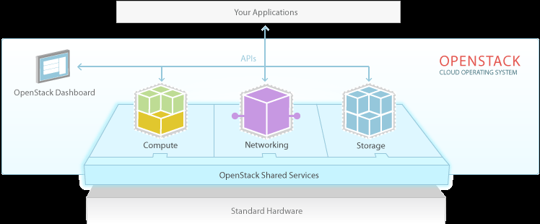
OpenStack.org
A standards organization for cloud technology
Key insight: if everything is standard, we can trust the cloud more easily because risks are reduced

Slide 45
The last word
Joni Mitchell summed it up best:
The cloud is a very complex marketplace and evolving rapidly.
Economics are the key
But nobody really understands cloud economics
There are many barriers to entry
I've looked at clouds from both sides now From up and down, and still somehow It's cloud illusions I recall... I really don't know clouds at all

