Slide 1

Supercloud: Going beyond Federated Clouds
Hakim Weatherspoon
Robbert
van Renesse

Slide 2
Controlling High Assurance Cloud Computation
Should we migrate critical data to computation
. . . or vice versa?
E.g. app needs to import or export data
App
Notes:
Imagine an application running on a tank, may need to export data to a larger cloud for processing
But limited bandwidth

Slide 3
ControlLING High Assurance Cloud Computation
Should we migrate critical data to computation
. . . or vice versa?
E.g. app needs to import or export data
Challenges
Limited bandwidth tactical networks
Interoperability
Secure sharing
App
App
How can we securely and efficiently
migration computation across the cloud?
Notes:
Imagine an application running on a tank, may need to export data to a larger cloud for processing
But limited bandwidth

Slide 4
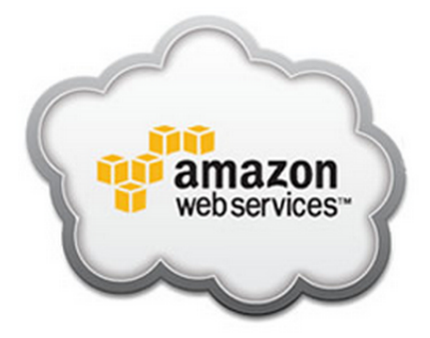
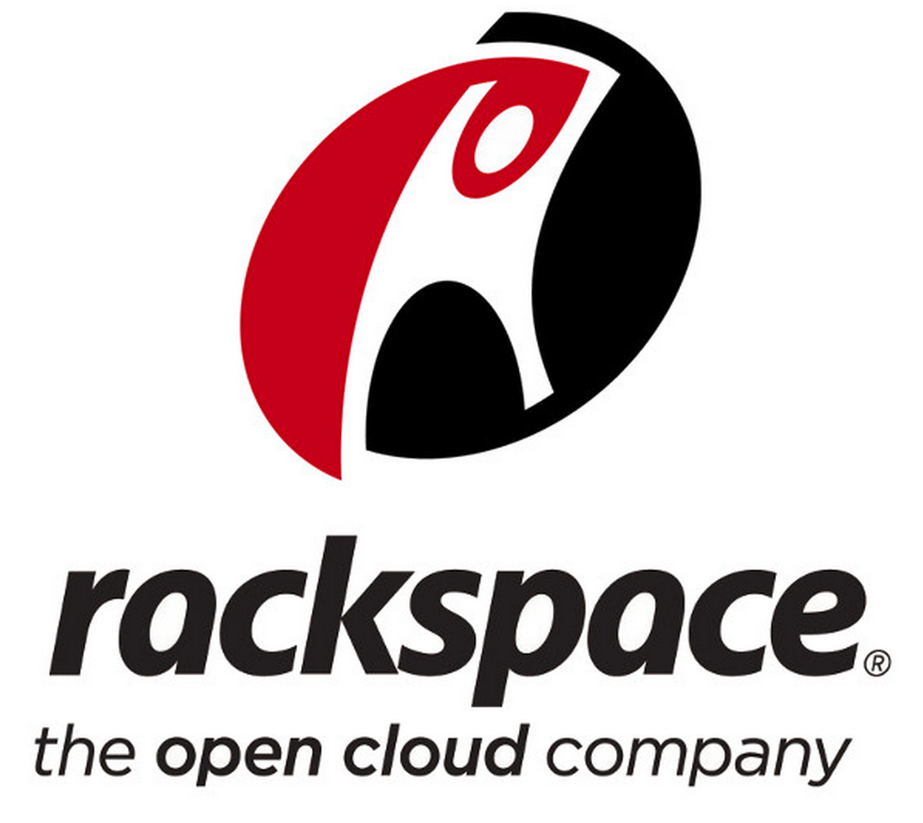
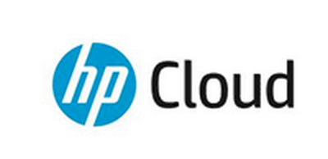
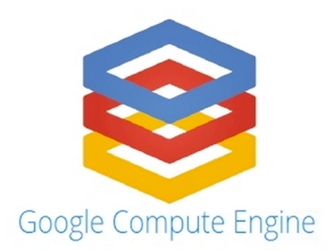
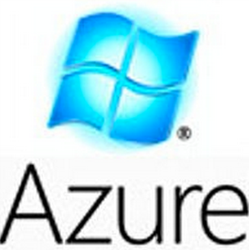
Infrastructure as a Service
Offer on-demand virtual machines
Charge according to used hours
Multiple data center locations
……
Notes:
Nowadays, there are a lot of cloud providers such as amazon EC2, rackspace, hp cloud, Google Compute Engine and Windows Azure. Users reserve for virtual machines and pays for the hours they rent. In order to improve the availability, the cloud providers usually have different locations globally.
----- Meeting Notes (10/21/14 10:33) -----
Add another sentense to go to the other slide by saying "this is good..., but there are problem"
Point of the slides, writes know

Slide 5

Problem – Single Cloud
Vendor lock-in
Latency limitation
No control of price
Availability limitation
Which one?
Price?
Migration?
Availability?
……
Notes:
However, users need to choose one before starting their service. The users need to consider which clouds satisfies their requirements – and if they have multiple sites in the world, there might no clouds optimizes all sites. The user has no control of the price after the choice and they suffer from vendor lock-in problem Because it is not possible to live migrate VMs from one cloud to another. In addition, some clouds becomes temporarily unavailable sometimes, but the users can’t do anything about it.
----- Meeting Notes (10/20/14 17:30) -----
Google -> Rackspace, HP Cloud
Delete the azure and google
Just report them into
Introduce importance of the clouds their promise. State-of-the-art, however there are some problem.
Vendor lock-in:
-
-
-
Point for each slide, practice,
----- Meeting Notes (10/21/14 10:33) -----
We can resolve all this if we can run on multiple clouds.

Slide 6
Benefits of Multiple Clouds
Provide power, control and flexibility to user
Lower latency
Reduce Cost
Higher availability
Burst Relief
Security Improvement
Multi-cloud
Notes:
What if we can take advantage of the multiple clouds? That means we will have a lower latency because we can choose the closest data center. Cost can be reduced because it is possible to choose any clouds with no vendor lockin. Multi-cloud also result in a higher availability because the service can span on independent data centers from different clouds and migrate between them. It is also useful when there is a burst in the private cloud and migrate VMs to public clouds to relief the burst.
----- Meeting Notes (10/20/14 17:30) -----
- aggrage the cloud
- Security Improvement
study in the future / availability

Slide 7
Supercloud
The Supercloud goes beyond a Federated Cloud in that it
supports user-level migration between autonomous clouds;
Permits environment to include “stubs” for resources that actually are tied to specific places, making them seem to be available from anywhere;
supports a variety of underlying virtual machine monitors;
supports a shared but decentralized storage system and a novel virtualized network that can migrate with the app;
supports system-wide pub/sub for event notification.

Slide 8
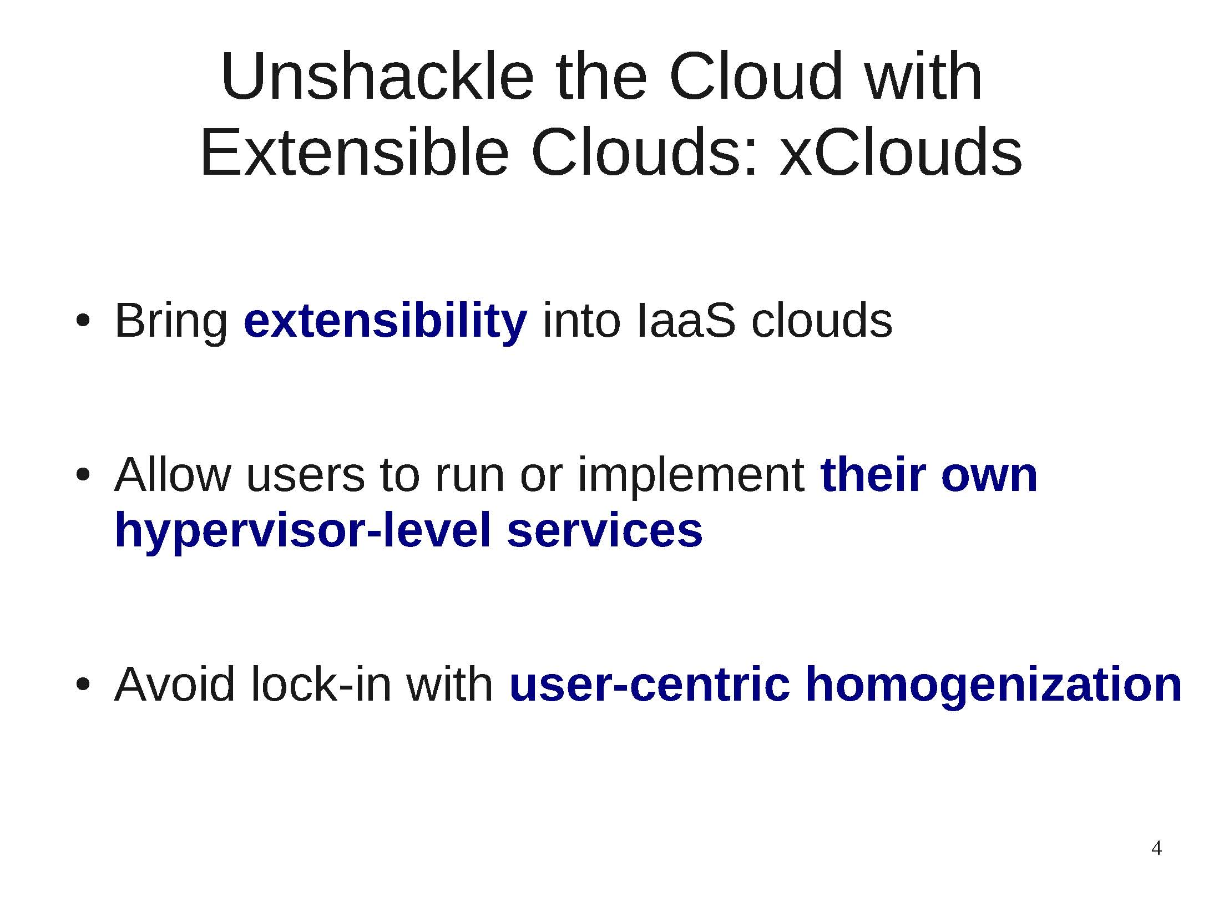

Unshackle the Cloud: xClouds
Old slides from Hakim…

Slide 9
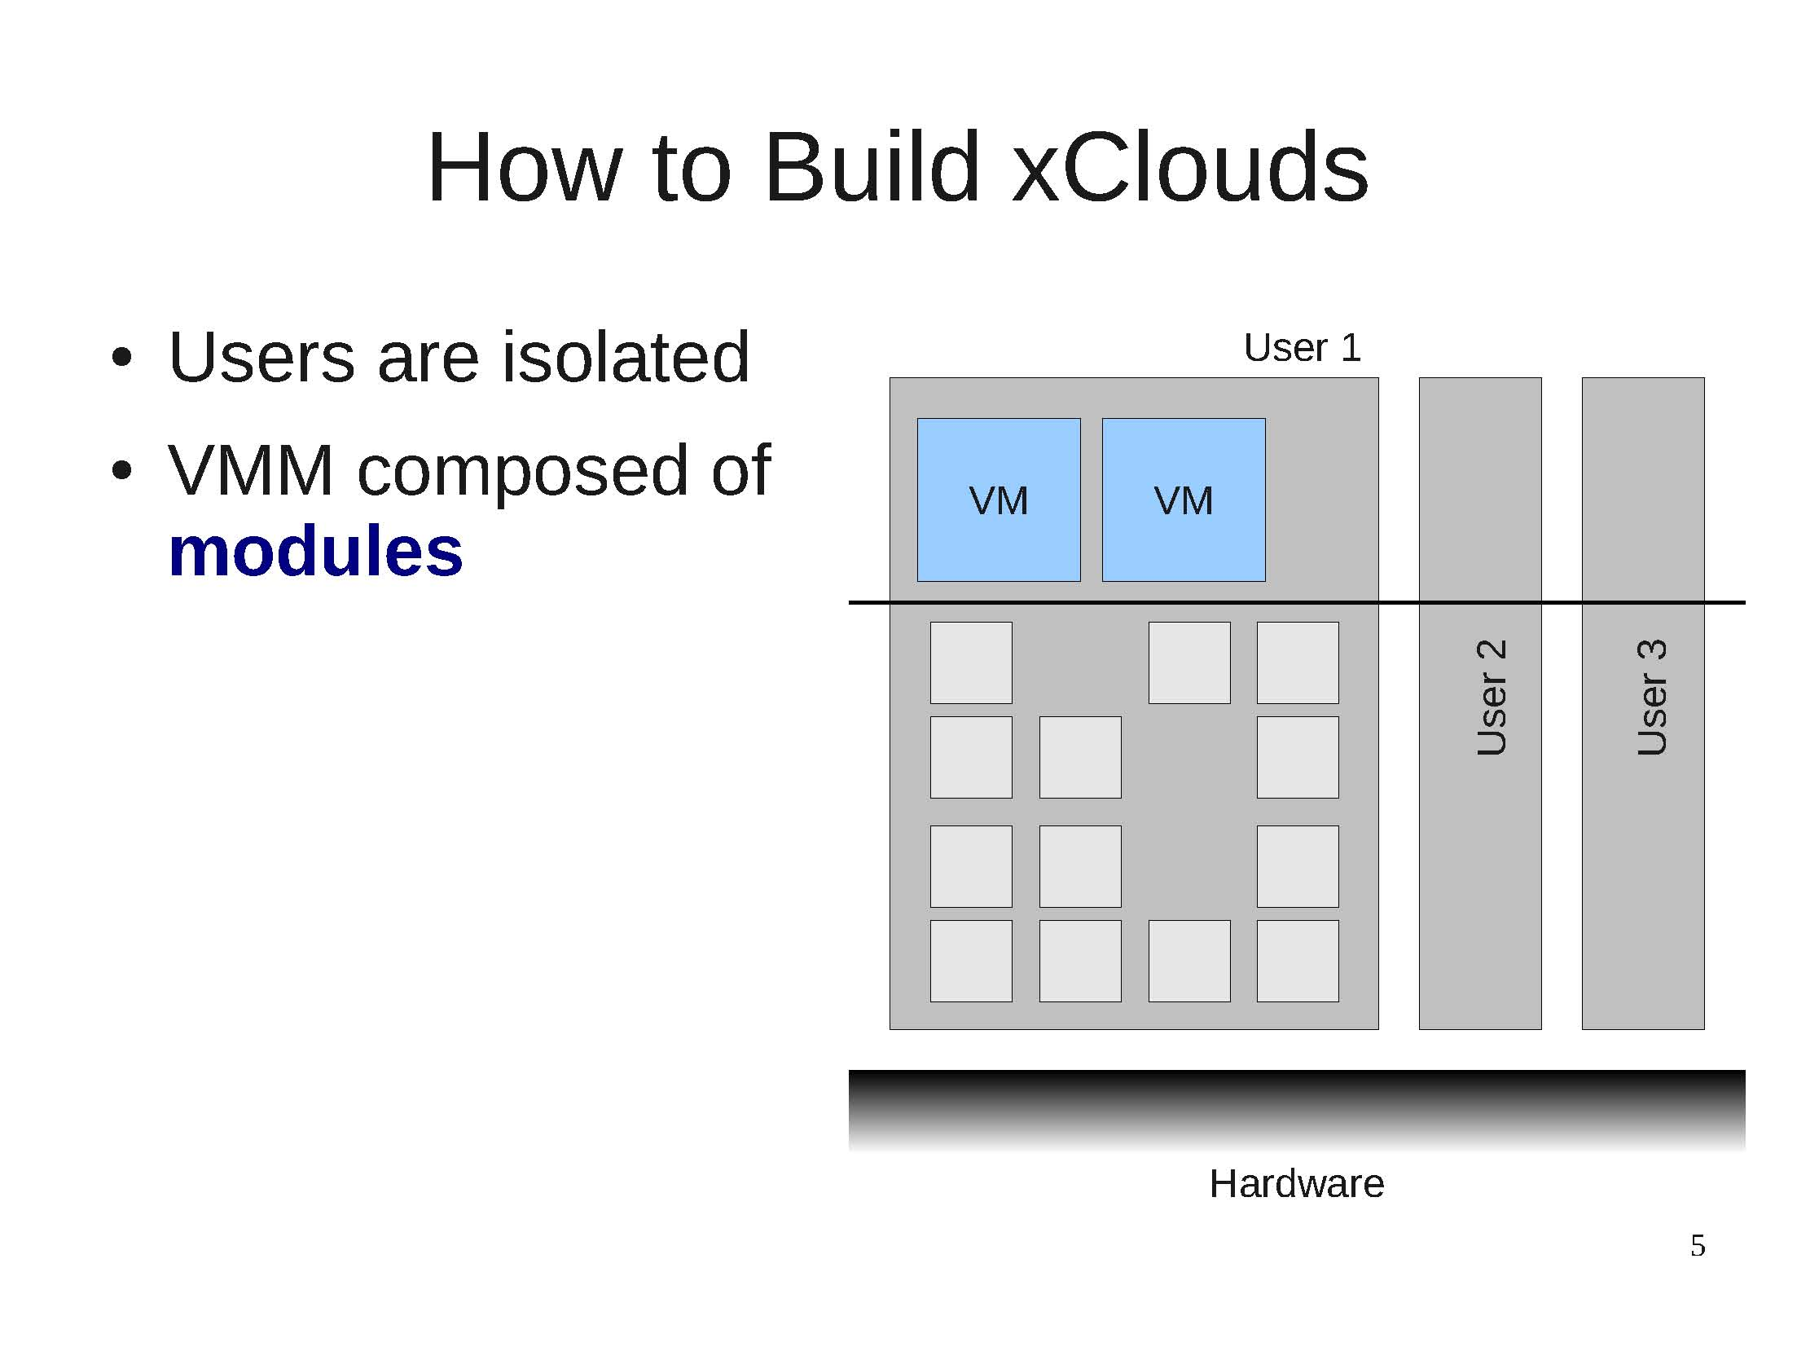
How to Build xClouds

Slide 10
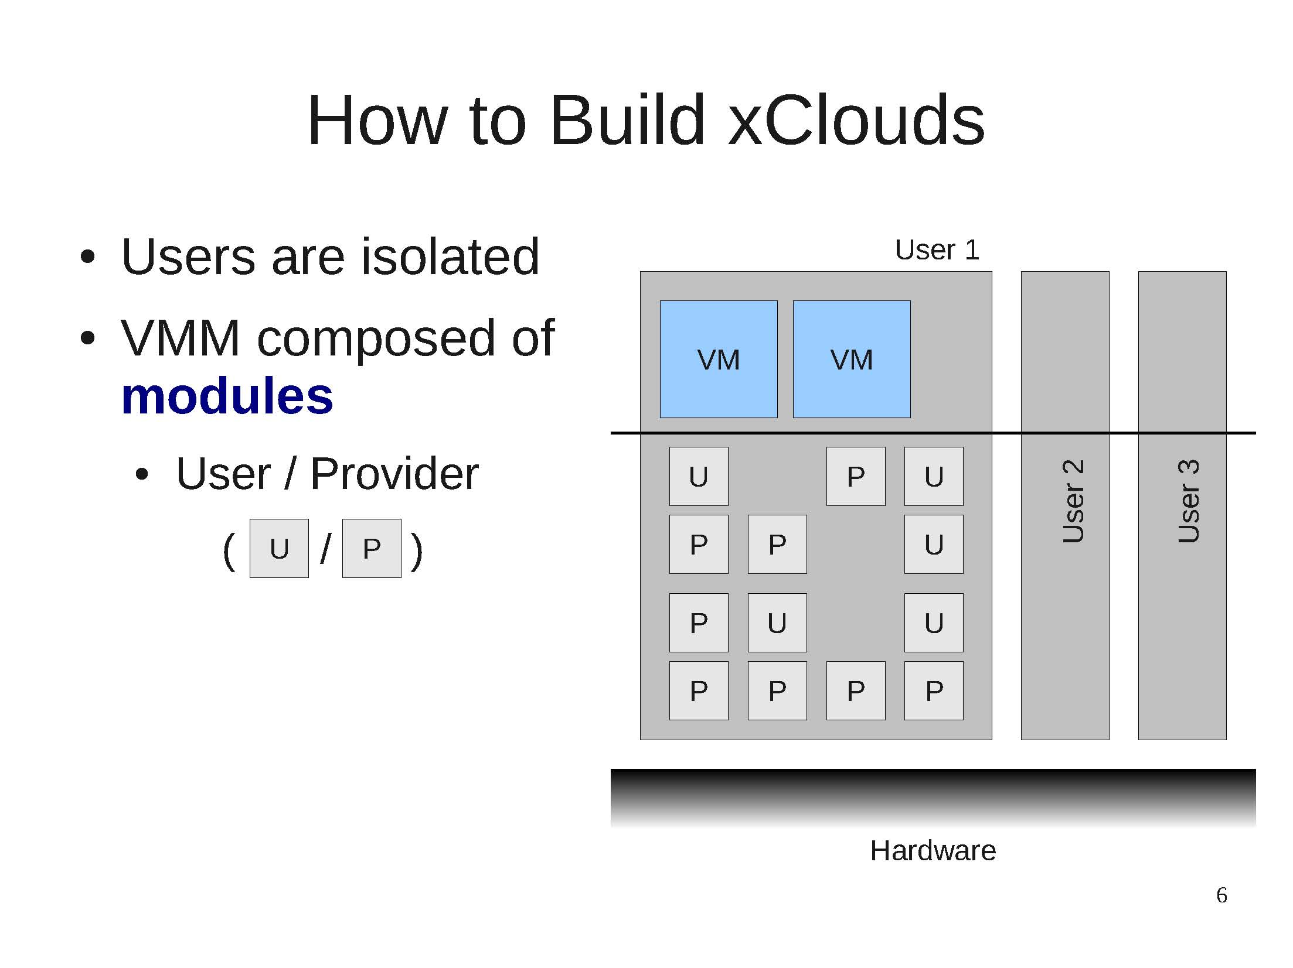
How to Build xClouds

Slide 11
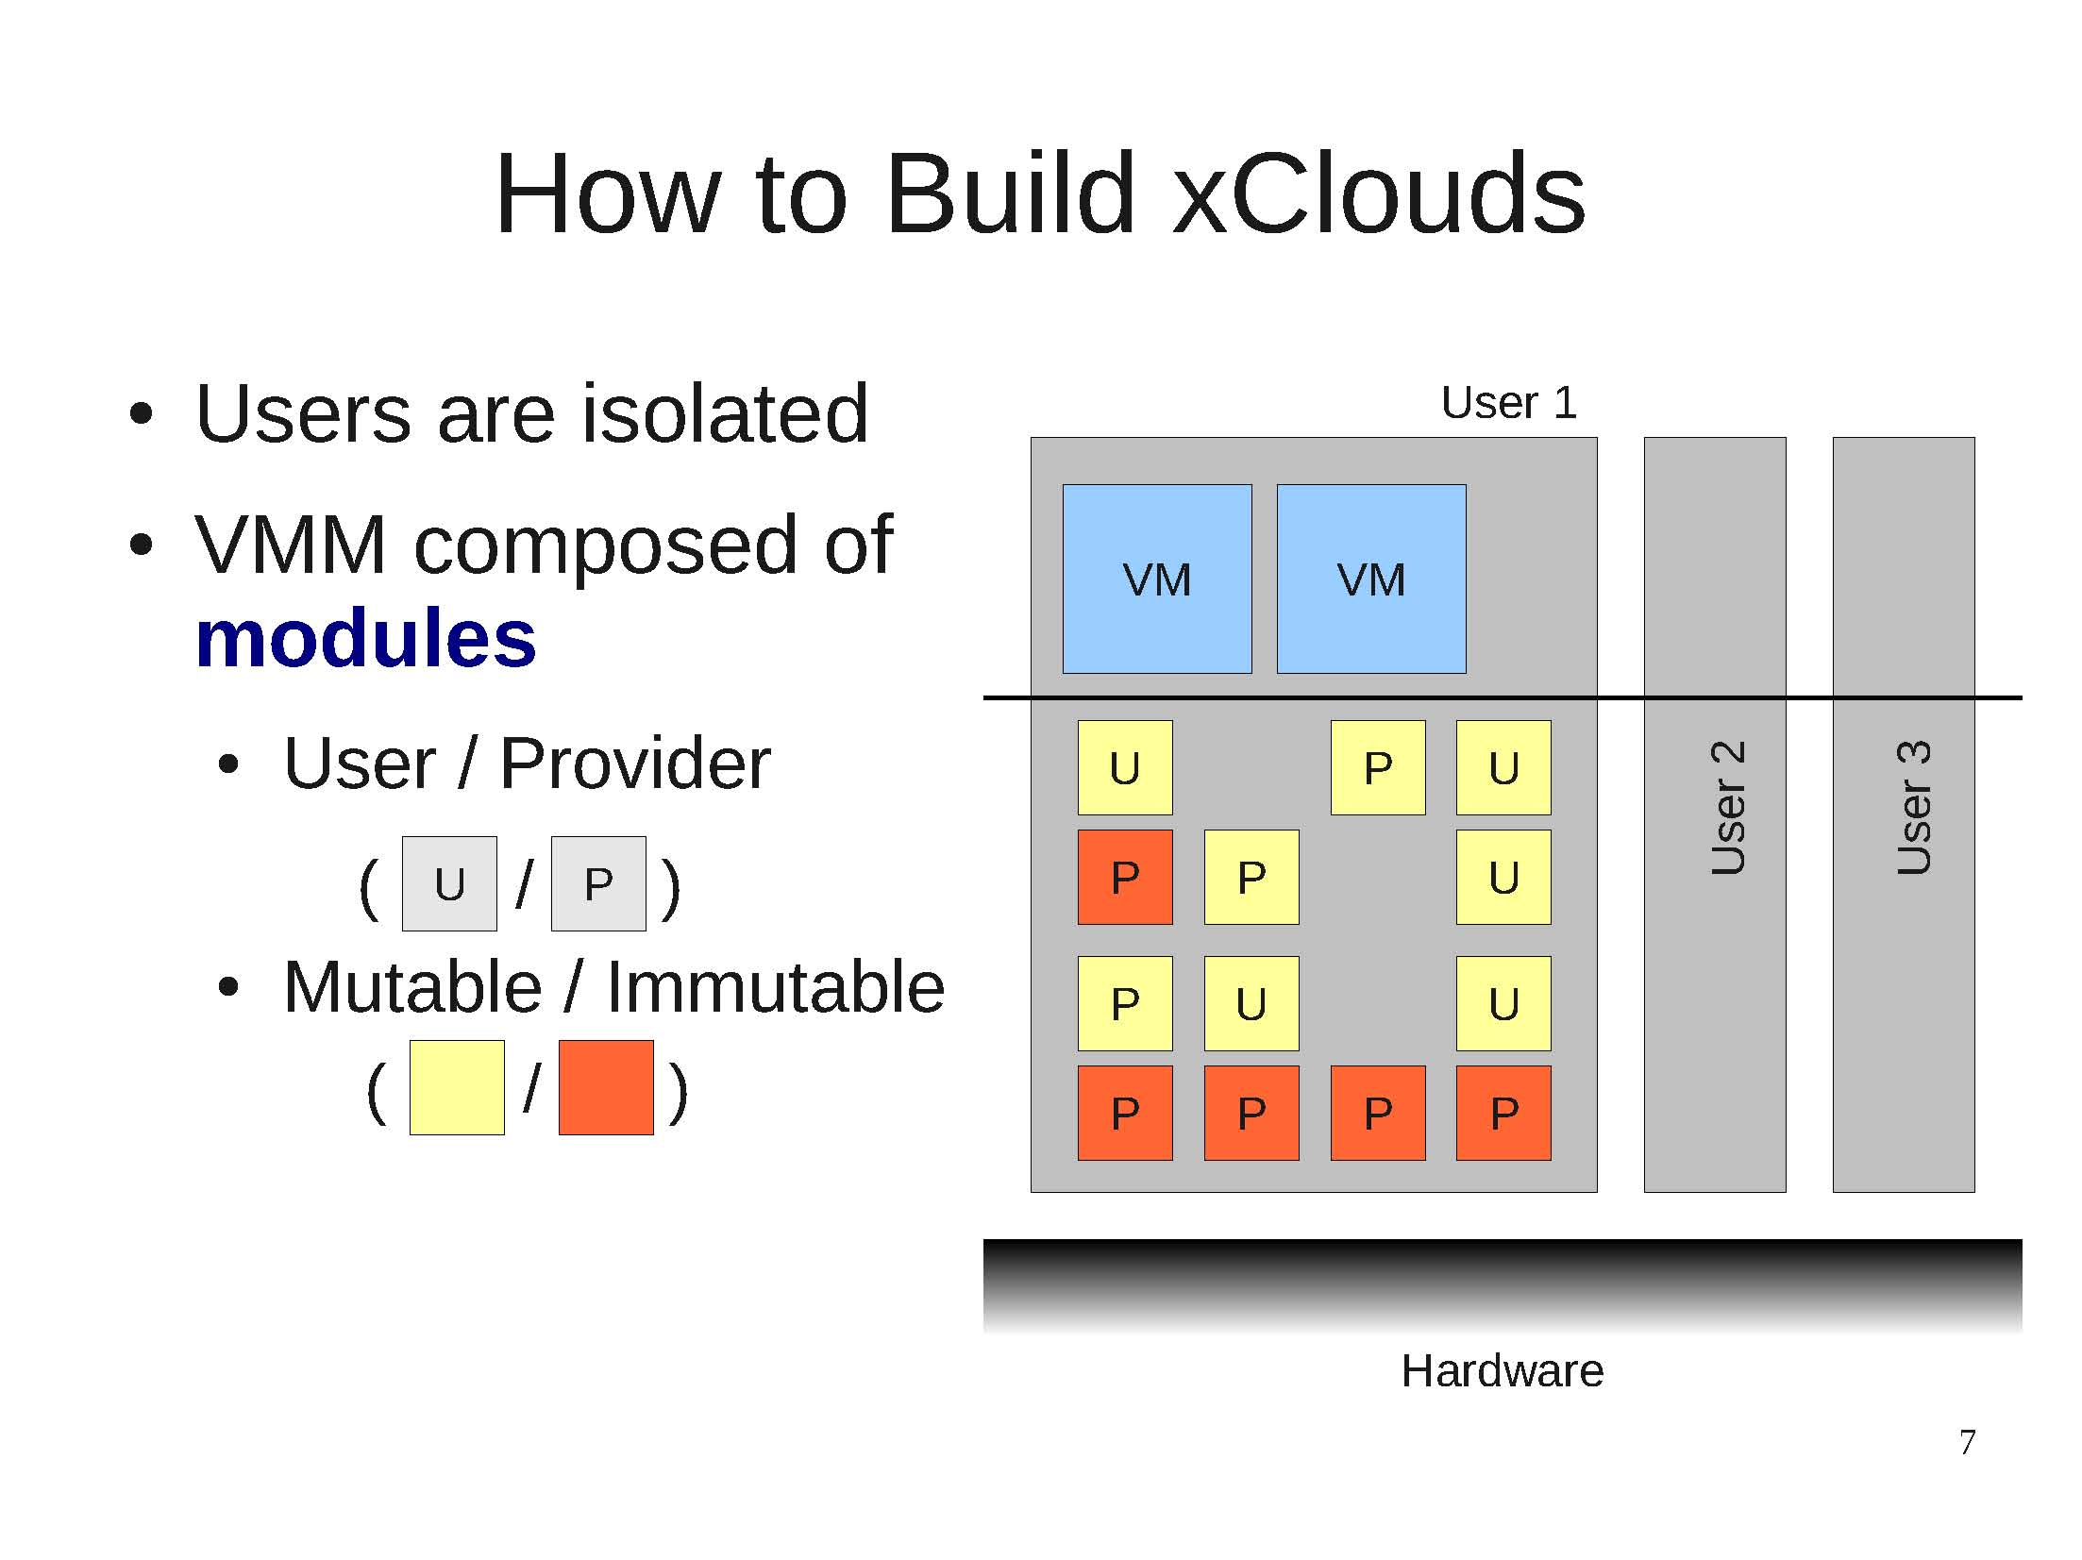
How to Build xClouds

Slide 12
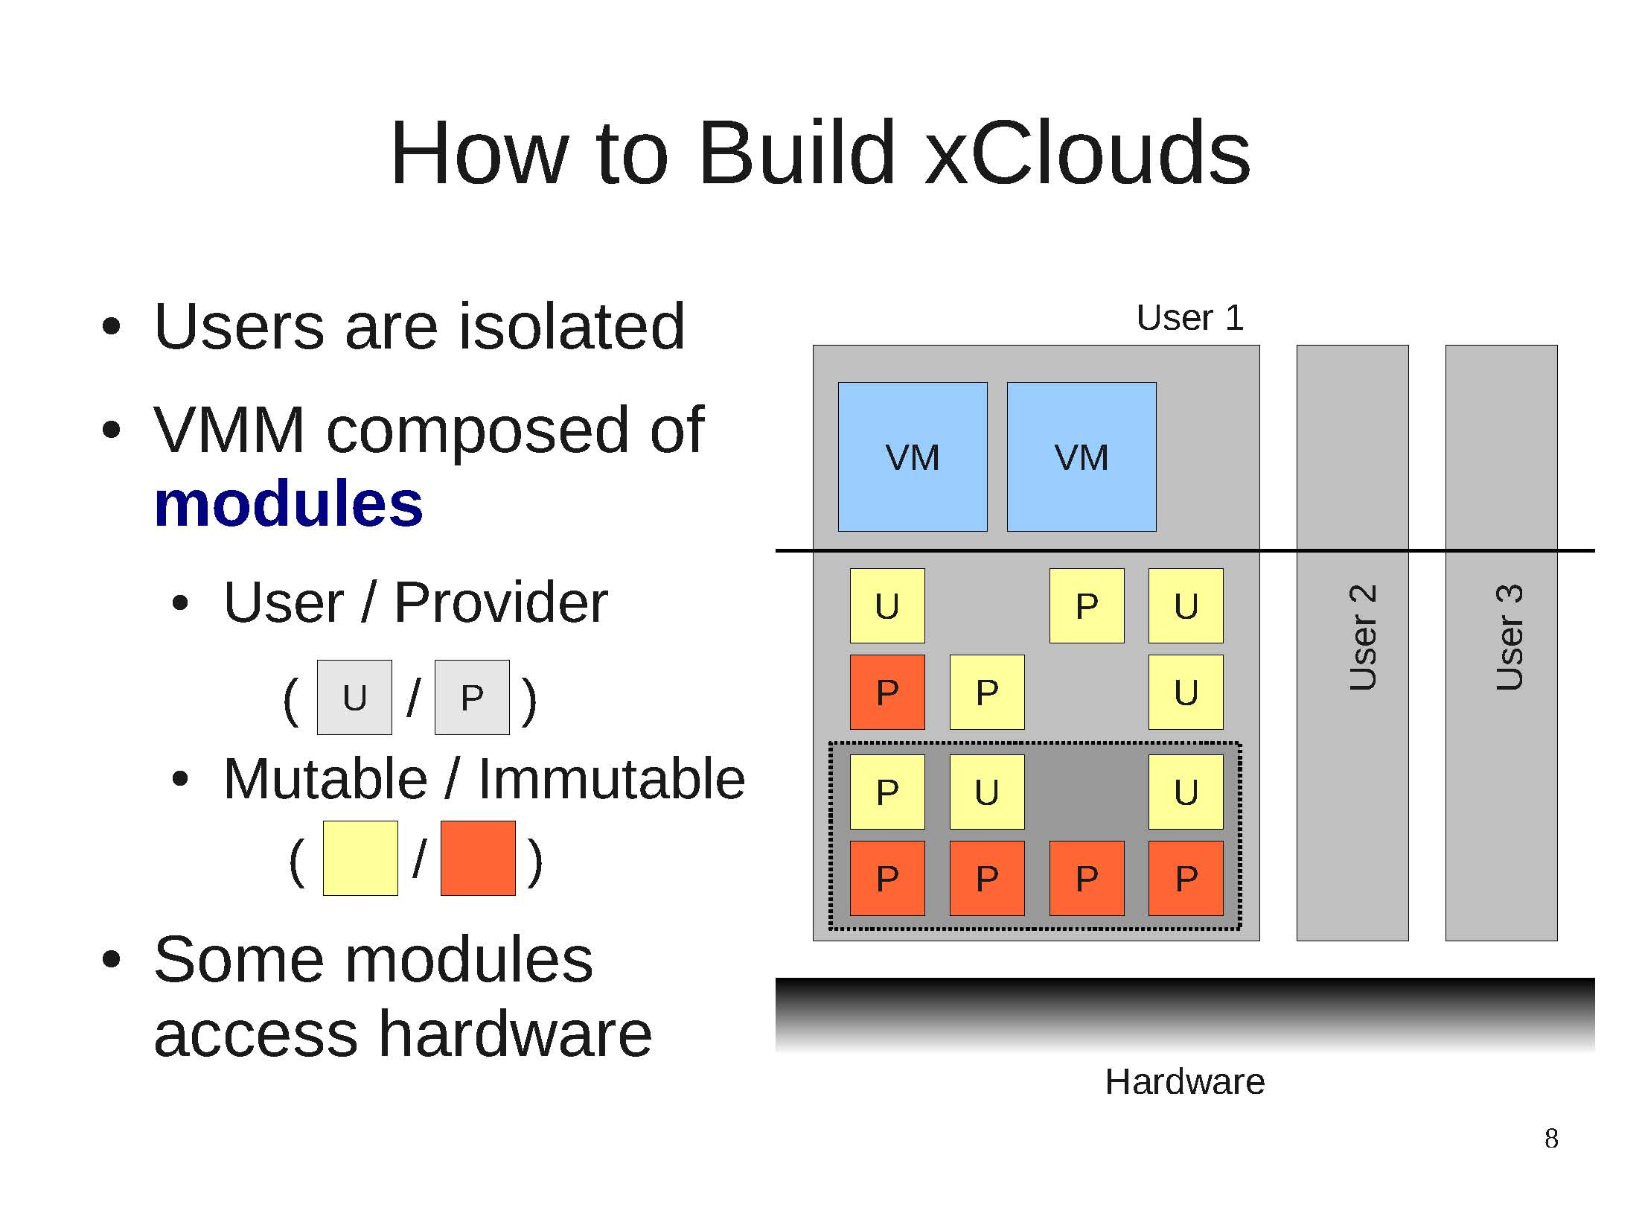
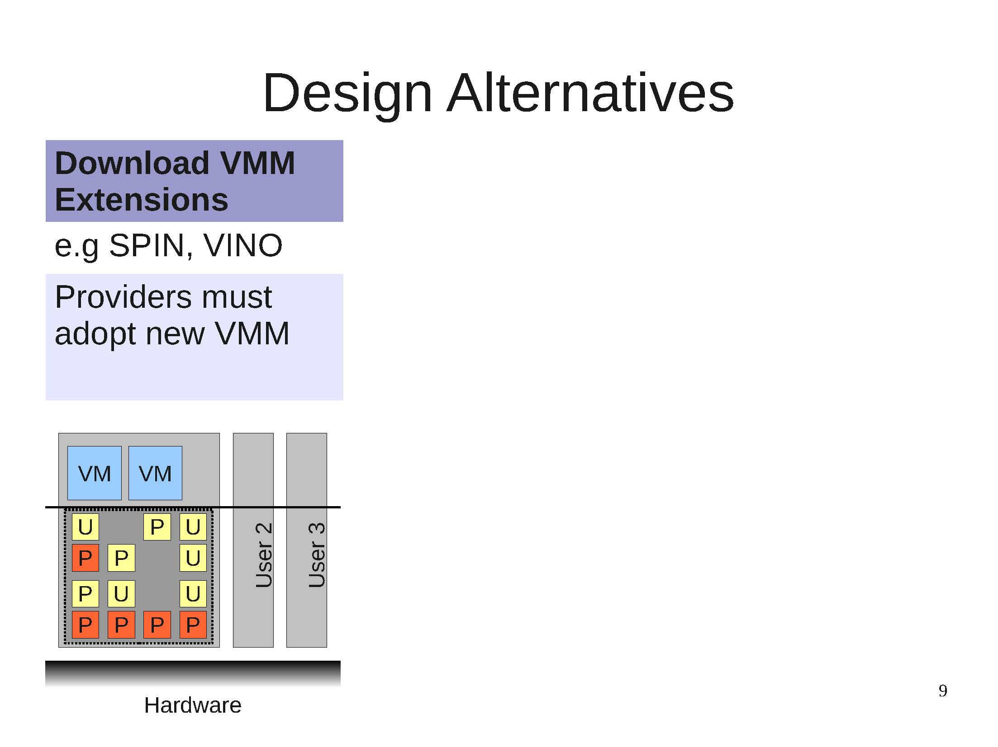
How to Build xClouds: Alternatives

Slide 13
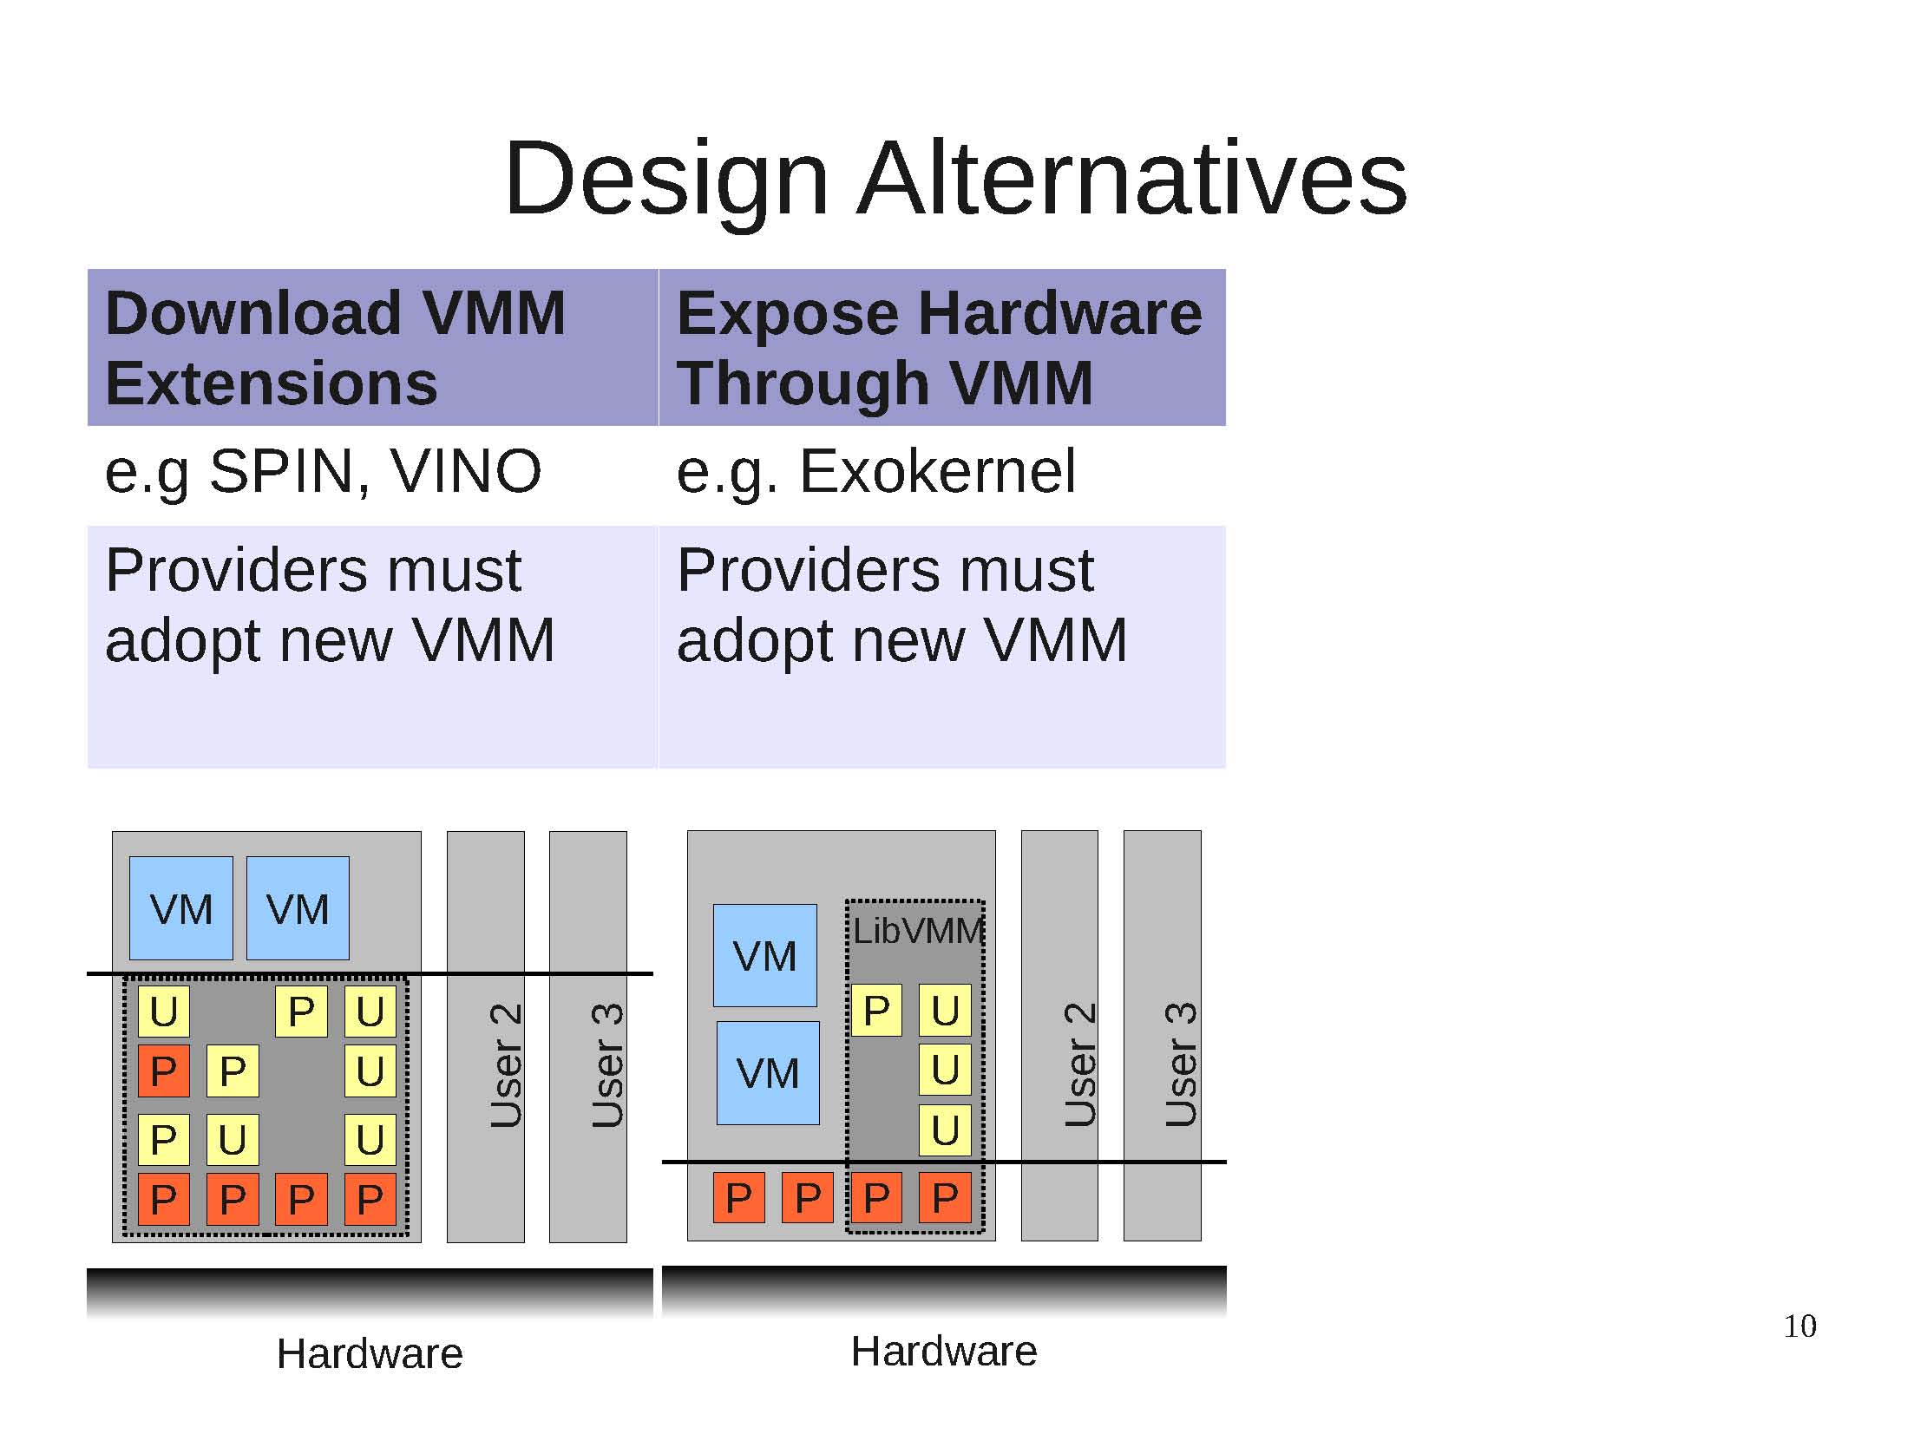
How to Build xClouds: Alternatives

Slide 14
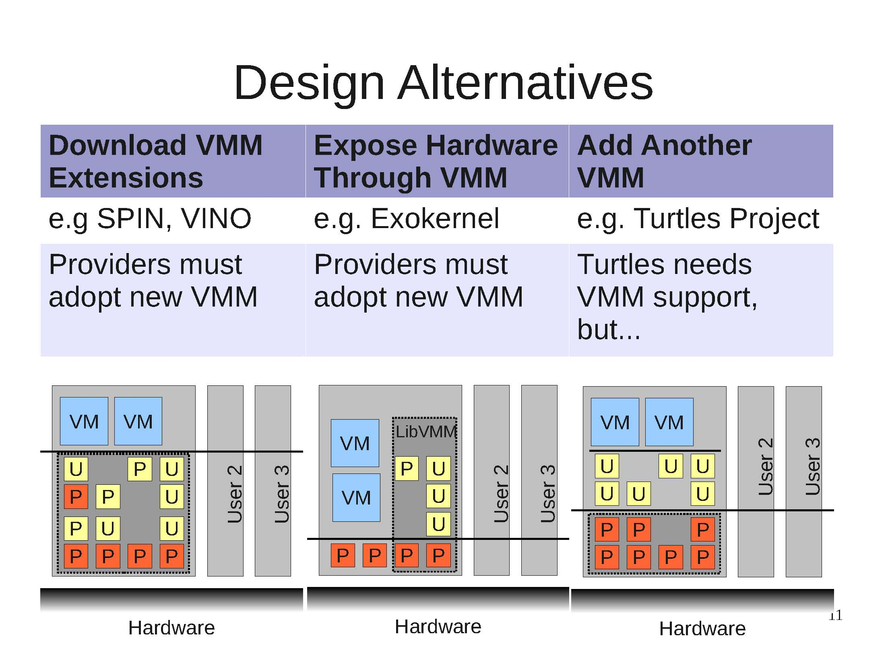
How to Build xClouds: Alternatives

Slide 15
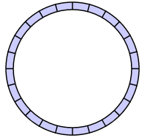
How to Build xClouds: Another Layer
Linux Dom0
Linux DomU: VM
Shared Memory Device: Ring
Backend
Frontend
PCI-Driver
Xen
Baremetal

Slide 16
How to Build xClouds: Another Layer
Linux Dom0
Dom0 for
Xenblanket
PV-
DomU
PV-
DomU
Backend
Frontend
Frontend
Frontend
Backend
Xen - 4.1.1 Blanket
PCI-Driver
1st-Layer Xen
Hypercalls
Baremetal
Device
Notes:
The Dom0 lacks the driver for shared memory devices
nested Xen: helps nested Dom0 to access shared memory devices
nested Dom0: drives and multiplexes shared memory devices
nested DomU: modified Linux3.x, transparent to User Apps

Slide 17
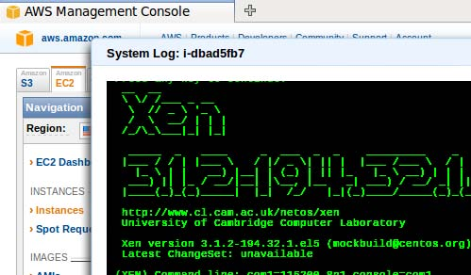
xClouds works Today!
Nested paravirtual device drivers
Xen on EC2

Slide 18





xClouds works Today!
Nested paravirtual device drivers
Xen on EC2
Can create your own
Cloud-within-a-Cloud
App
33KB
Guest OS
VMM
VMM
App
Object
100 KB
Guest OS
33KB
App
VMM
Guest OS
VMM
VMM
33KB
VMM
VMM
VMM
33KB
VMM
VMM

Slide 19
How to Build xClouds: Another Layer
Event-Channel Drivers for virtual interrupts
One for Receive Event from 1st-Layer Xen: virtual interrupts
One for multiplexing to nested DomU
Grant Page Table Drivers for shared memory
One for Shared Ring buffer with 1st-Layer Dom0
One for sharing memory with/or between nested DomUs
Two Xenbus drivers
One for connect to 1st-Layer shared memory devices
One for nested DomUs to connect to nested shared memory devices
Block and Net Frontend Drivers
- For virtual disk and network devices of nested Dom0

Slide 20
Hypercall Passthrough
Need Hypercall Passthrough
Nested Dom0 must be able to get information about shared memory devices from 1st Layer-Xen
Nested Dom0 can only issue hypercall to Nested Xen
So, nested Xen should help passthrough related hypercalls

Slide 21
Killer Apps for the Supercloud
Sensitive Resource
Follow the sun
Geographic proximity
Spot Instances
Dynamic Resource Scaling
Bursting

Slide 22
Killer Apps for the Supercloud
Sensitive resource
Some provider has a special device, or special data
Supercloud allows you to add a “stub” for it to your environment. Looks like a normal local device or local data file / database
If you access the resource, SuperCloud migrates your VM to where it resides
Moving computation to data on demand avoids locking app to the place where that resource resides

Slide 23
Supercloud Challenges
Uniform VM image?
- using nested virtualization
Cross-cloud migration?
- developed a new image storage facility
Transparent networking?
- based on SDN: Open vSwitch and VXLAN
Notes:
There are a lot of challenges to take advantage of multiple clouds because of the heterogeneity. For example, amazon, google compute engine and windows azure are build on different hypervisors – Xen, KVM and hyper-V respectively. So there is no uniform VM images. Cross-cloud migration and scaling across clouds are not possible. We propose the supercloud to solve the problem. Current we can only support Xen and KVM based clouds. Supporting Hyper-V is the ongoing work.
----- Meeting Notes (10/17/14 13:45) -----
one slide for the problem before this
explain the problem, Challenges ahead of the time
Diversity
Outline
----- Meeting Notes (10/20/14 17:30) -----
Google -> HP
Azure -> gray
Currently Hyper-V is
Multi-cloud Challenges
Remove that

Slide 24
SuperCloud Architecture
Amazon
HP Cloud
XenServer
XenServer
Open
Stack
User VMs
Dom0
Open
Stack
User VMs
Dom0
Xen-Blanket
Xen-Blanket
SDN
KVM/virtio
Xen/PV-on-HVM
XenServer
Dom0
Open
Stack
User VMs
Rackspace
Xen-Blanket
Xen/PV-on-HVM
Notes:
The supercloud can built on top xen hypervisor taking advantage of PV-on-HVM drivers. We implemented a nested virtualization called xen-blanket which can run on different hypervisors. It uses xen-blanket which is a second layer xen hypervisor and provide a serious of drivers for performance optimization. On top of that we start xenserver and openstack which forms a second layer of cloud. Then users can start second layer VMs via openstack APIs. On other clouds on KVM and Hyper-V we do the same thing because xen-blanket can work with different hypervisors and device drivers. The second layer clouds can be connected by virtual networks.
----- Meeting Notes (10/17/14 13:45) -----
VPN->Virtual Networks
----- Meeting Notes (10/20/14 17:30) -----
Amazon, HP and Rackpace
title: SuperCloud
----- Meeting Notes (10/21/14 10:33) -----
OpenStack in different color. We can't control the orange but we can ( different cloud stack entirely. ) ingrate the
Openstack competely seperate stack

Slide 25

Benefits of Multiple Clouds
Provide power, control and flexibility to user
Lower latency
Reduce Cost
Higher availability
Burst Relief
Security Improvement
Multi-cloud
Notes:
Let’s revisit the benefits of multiple clouds and see if supercloud provide the power, control and flexibility to users. The first example is that supercloud can achieve lower latency than any single cloud.
----- Meeting Notes (10/17/14 13:45) -----
- Power Control and Flexibility
Reduce Cost
limit coverage
More Flexiblity -> User Control (More Choices) more power for the user to control
Outline

Slide 26
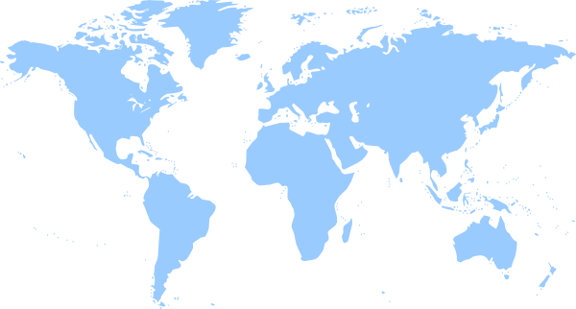




Content Delivery Network
Which data center is closer?
Notes:
The different cloud providers have different datacenters all over the world. The map shows the regions of the Windows Azure, amazon EC2, rackspace and HP clouds. The clients for a content delivery network would be all over the world. For example, a user here at London need to find a closest server. If it only uses hp cloud, it can only connect the east coast regions. For Amazon, it can connect to the amazon Ireland cite to achieve a lower latency. The closest should be the rackspace London cite. However, it There is not a provider can optimize all sites and provide as high availability as supercloud because it is a best-of-breed cloud.
----- Meeting Notes (10/20/14 17:30) -----
Delete the Azure here.
Locate user in London (Zoom in London)

Slide 27
Content Delivery Network
Notes:
We test the minimum latency of supercloud on top of Rackspace, Amazon EC2 and HP cloud. The clients are planet lab nodes from all over the world. We test the lowest latency from Rackspace, Amazon EC2, HP cloud and supercloud to the clients.
----- Meeting Notes (10/17/14 13:45) -----
Outline: benefit of the supercloud
add a world map before this
----- Meeting Notes (10/20/14 17:30) -----
One company at a time.
Overhead

Slide 28
Content Delivery Network

Slide 29
Content Delivery Network

Slide 30
Content Delivery Network
Supercloud and Rackspakce has the lowest Latency
Supercloud and Amazon has the lowest Latency
SuperCloud is closer to the clients
Notes:
For example, unc.us is from university of north Carolina, Amazon achieve the lowest latency. Supercloud has the comparable low latency. As another example, bupt locates in Beijing China, and the closest datacenter is from rackspace. Supercloud also achieves the lowest latency. So we claime that supercloud is closer to the clients.

Slide 31
Benefits of Multiple Clouds
Provide power, control and flexibility to user
Lower latency
Reduce Cost
Higher availability
Burst Relief
Security Improvement
Multi-cloud
Notes:
As we said before, supercloud can also reduce the cost for the users.
----- Meeting Notes (10/17/14 13:45) -----
- Power Control and Flexibility
Reduce Cost
limit coverage
More Flexiblity -> User Control (More Choices) more power for the user to control
Outline
----- Meeting Notes (10/21/14 10:33) -----
check mark here

Slide 32
Spot Instance
Amazon Spot Instance
Dramatic Price Change
Usually Cheap
Charges hourly
Ready to be terminated
Can’t save money when prices goes high
Only stateless jobs!
Notes:
Amazon provide spot instances for the cloud users. The spot instance has very dramatic price changes. But they are usually very cheap. It is charged at the beginning of each billing hour although price may change every five minutes. The user set up a max bid for the instance, and amazon will terminate the instance when the price goes above it. So it should be ready to be terminated. There are two drawbacks of the spot instance – it can’t save money when the price goes high. And we can only run stateless jobs because it is unpredictable when it will be terminated.
----- Meeting Notes (10/21/14 10:33) -----
amazon will notify the user (grace period)

Slide 33
Smart Spot Instance
SuperCloud on Spot Instances
Migrate out to other places when instances being terminated
Migrate to the cheapest place when starting new billing hours
Benefits
No termination
Lower budget
Notes:
Most cloud providers don’t offer migration, so when you chose one availability zone and want to move to another, you need to stop the instance and start it again. Supercloud can migrate out to other places when the instances is being terminated, so the service will not be stopped. It can also migrate to the cheapest place when a new billing cycle starts. This could lower the budget.

Slide 34
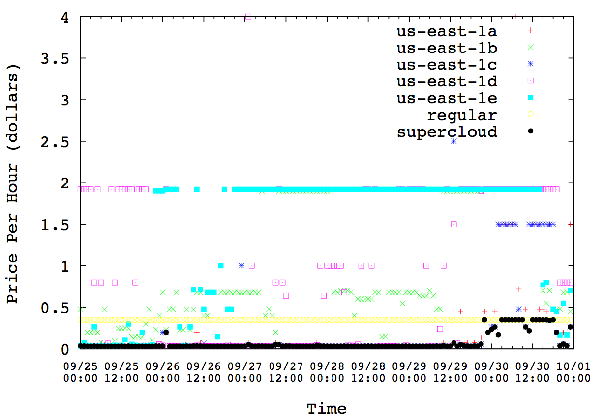
Spot Instance Price History
Spot price goes very high sometimes
Regular instances have stable price
Migrate supercloud to regular instances
Supercloud is migrated to the cheapest place every hour
Spot price is usually low
Notes:
This figure shows the price history of spot instances from all five availability zones in us east, regular instance and supercloud instance from september 25 to Oct 1. As shown in the figure, the price for the regular instance remains unchanged. Most of the time, the price of the spot instances remains very low. But sometimes, the price goes very high, much higher than the regular price. As for the supercloud, it is migrated to the cheapest place every hour so its cost is always low. When the spot instances in all availability zones becomes high, it is possible to migrate supercloud to the regular instances. In addition to that, we can also migrate to other clouds, if their price is cheaper although it is not shown in the figure.
----- Meeting Notes (10/21/14 10:33) -----
m1.xlarge
game

Slide 35
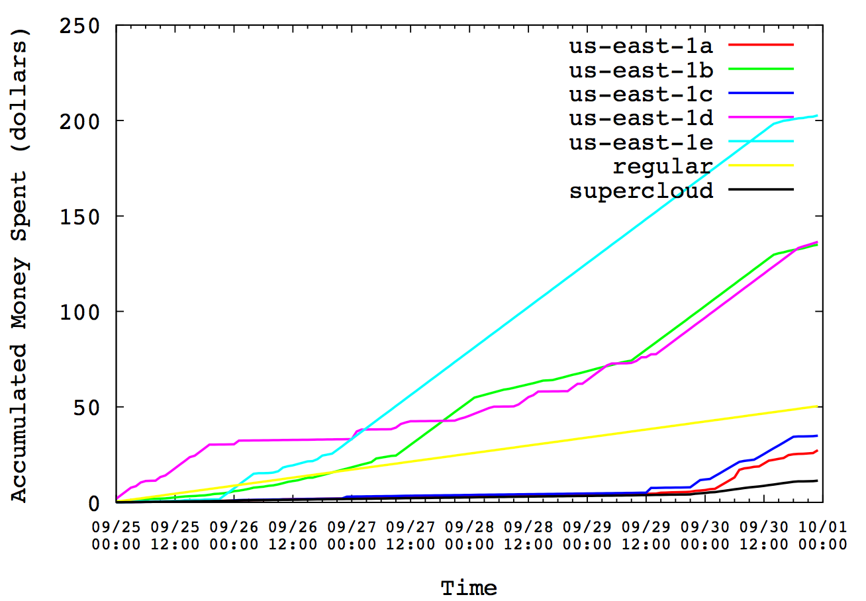
Accumulated Price
Smart spot instances save money!
Notes:
This figure shows the accumulated price for running spot instances for the period. Supercloud costs much less than any other availability zones and regular instances.
----- Meeting Notes (10/20/14 17:30) -----
Mention we can also migrate to other places.
Mention migration is not support the migration

Slide 36
Summary
SuperCloud uses Xen on Xen virtualization
Has some extra overheads, obviously
But enables migration of the entire VM and its runtime environment
SuperCloud is able to…
Moves computation to data if data is big, sensitive, special device on a special host, etc
Can also migrate to chase lowest-priced resources
Transparent to the application: standard OS APIs

