Slide 1
CS5412: Where Did My Performance Go?
Lecture XVIII
Ken Birman

Slide 2
Suppose you follow the rules…
You set out to build a fairly complex large-scale system for some kind of important task
Maybe not as mission-critical as a power grid or an air traffic control system…
… but on the other hand, smart cars are a hot topic, and robots, and many of these play safety critical roles
You use clean-room techniques, object oriented programming, cutting edge quality-assurance

Slide 3
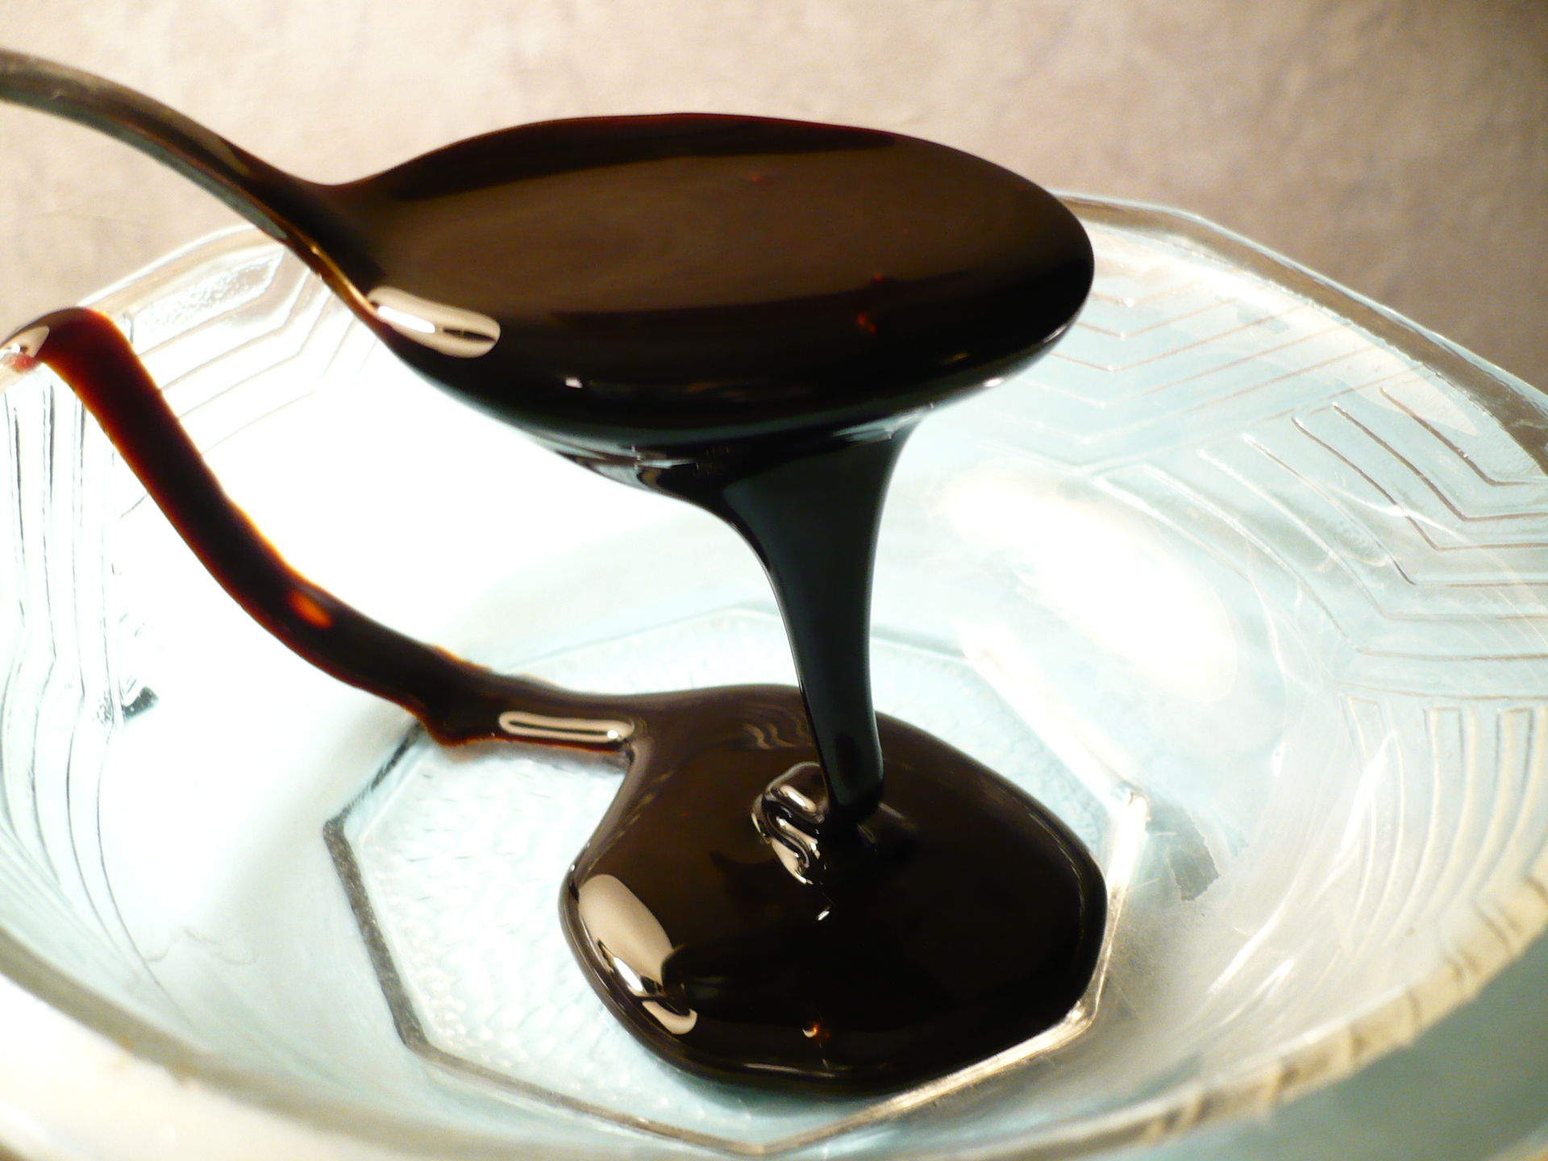
… and when you are done, the system is slow as molasses!
What makes complex systems so slow?
How can we run complex solutions in cloud settings without paying a huge performance cost?

Slide 4

Example: A smart car platform
1
Gateway (backup)
log
3
2
log
Gateway (primary)
3
Multicast Notifications
4
6
Message Bus
Computational Services
Computational Services
Computational Services
5
5
5
(1) Automobile notifies system of a new event
(2, 3) System gateway accepts event, logs it locally and to a backup node
(4) Message bus (DDS) used to notify computational services
(5) Services compute routes, recommendations, etc.
(6) Multicast used to update knowledge database in the vehicle and also in other vehicles impacted by the event

Slide 5
Componentized design
There is a dominant trend towards building complex systems from “components”, which can be entire programs and might be coded in different languages. Each element in this design is probably created from multiple components
For example you could have a C# library used from C++/CLI and talking to other helper components written in C, standard C++ and Java, all on one platform
This implies frequent “domain crossing” events, which also require serialization and deserialization

Slide 6
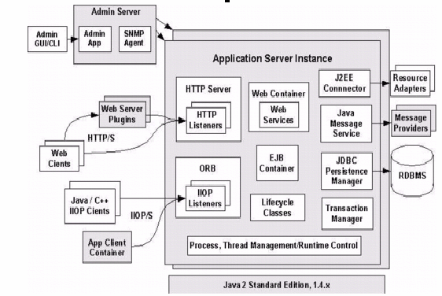
Componentized design
This example comes from the ORACLE Java.com site
Notice that in addition to your code there are many other helper components
Every modern system looks like this!

Slide 7
Where would costs arise?
Some events involve capturing images, video, lidar, etc. and might have large associated binary objects
To send messages in an object oriented setting
Need to “serialize” data into out-form, often costly and the out-form can be much larger than the in-form
Send it on the wire or log it to disk
Later on reception (or reading it) must de-serialize
Question: how many times might this occur in this kind of architecture?

Slide 8
Complex objects
A first thing to realize is that most objects are fairly complex
A lidar image captured by a smart car would have the radar data but might also include GPS coordinates, vehicle orientation and speed, altitude, angle of the sun, any filters being applied…
So these have many fields that must be serialized

Slide 9
High costs of serialization
We use the term serialization when a computing system converts data from its internal form to some kind of external form that can go on disk, on a network, or be passed to a component in a different language
The external representation needs to be self-explanatory so that the receiving component can use it to build an object that matches what was sent
A common style of representation is to use text and format it using XML, like a web page

Slide 10

SOAP: Simple Object Access Protocol
SOAP is a widely supported standard for using this kind of “web page” as the basis for one component accessing another component
SOAP assumes an object to object style of interaction, but in practice a component could have many objects and can expose any of their static interfaces if the arguments are all by value.

Slide 11
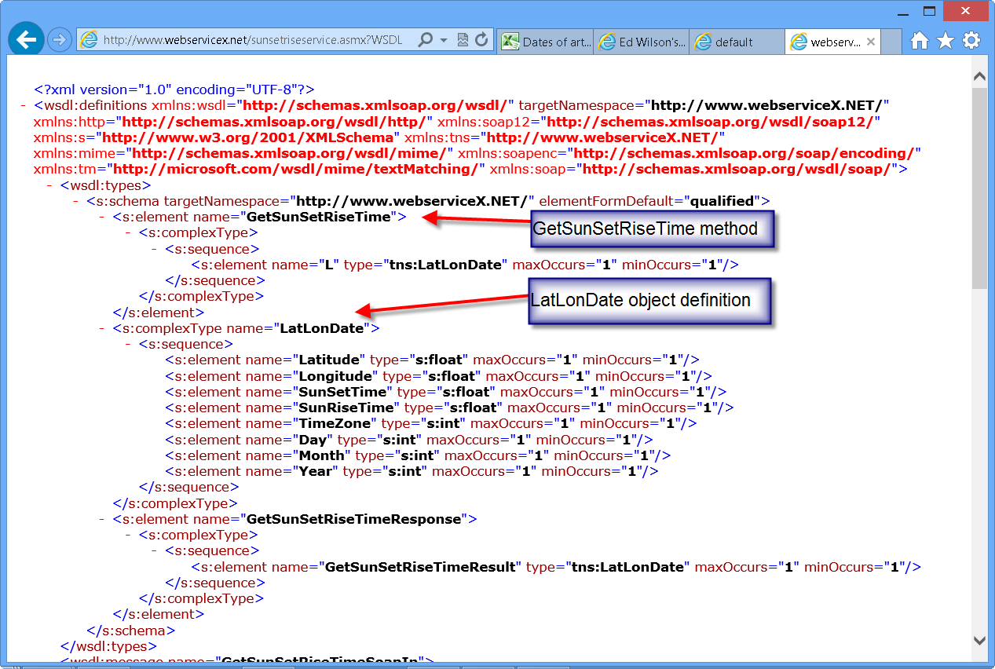
SOAP: Simple Object Access Protocol
SOAP is a widely supported standard for using this kind of “web page” as the basis for one component accessing another component
SOAP assumes an object to object style of interaction, but in practice a component could have many objects and can expose any of their static interfaces if the arguments are all by value.

Slide 12
SOAP representation
The SOAP request format includes things like the service being accessed, the version number of the API that the caller was compiled against, the request being issued, and the arguments that were supplied to the request.
Each argument could be a complex object, and it can include references to other objects as long as all of them are fully contained in a single “tree”
XML nesting is used to represent inner objects

Slide 13
SOAP representation
Later when the request finishes, the component can send back a reply
This is done in a similar manner, using a SOAP response object, again with a header and so forth
SOAP type checks at every stage
If a type exception arises, SOAP always throws it on the caller side, not on the service side
This way if a server is upgraded, old clients that are launched accidentally won’t crash it

Slide 14
What makes serialization costly?
Generating the SOAP message can be surprisingly computationally expensive
Recursively we need to visit each element
For each one, make sure to output a “type description” and then emit the corresponding object
Any value types will need to be converted accurately into a text form. For example, we can’t lose floating point precision in a SOAP request/response, unlike when you print a floating point number on the console
All of this makes messages big and slow to create

Slide 15
Why not use binary format?
Older systems often used binary representations and in fact there are many popular request/reply formats and representations
The super efficient ones assume same data representations on source and destination: same programming language, version (patches included), hardware architecture and operating system
But we can’t always be so lucky. SOAP is universal.

Slide 16
Costs of serialization, deserialization
CPU overheads to serialize (left) and deserialize (right), 10,000 times
Estimating the Cost of XML Serialization of Java Objects. Imre, G. ; Charaf, H. ; Lengyel, L. IEEE Engineering of Computer Based Systems (ECBS-EERC), 2013.

Slide 17
Example: A beverage distribution center
Suppose that we are just looking at a very simple case, like records sent from the cash-register at the Ithaca Imported Beverages company to the database it uses for inventory
They specialize in imported beers, so consider costs of serialization of a “beer record”
Example from M@X on DEV (www.maxondev.com)

Slide 18
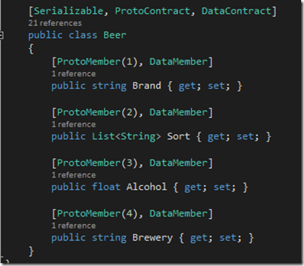
Size overheads: A “beer” object
C# example of a class that might describe a Belgian beer
It has a brand, a level of alcohol, a brewery, etc.
Notice that only some of these are fields with associated data and the data is very simple in this example!

Slide 19
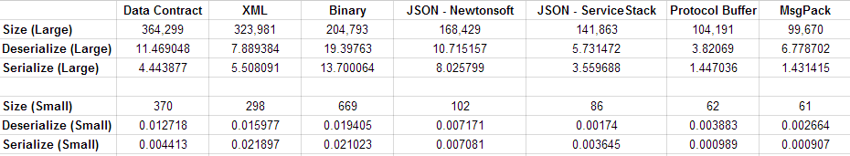
Tabular summary of costs
Space costs in bytes, time costs in ms

Slide 20
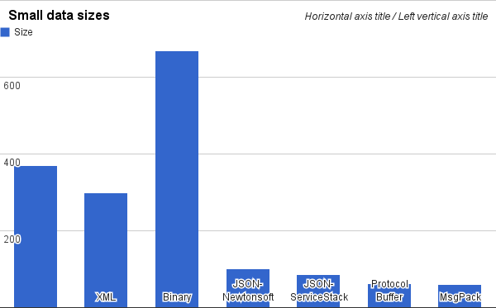
Time cost: Serialize a “beer” object

Slide 21
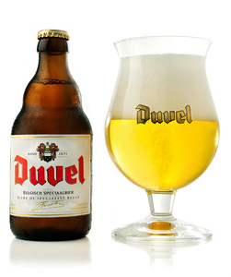
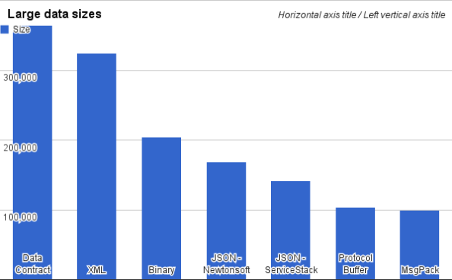
Time cost: List of all 1610 Belgian beers
http://en.wikipedia.org/wiki/List_of_Belgian_beer

Slide 22
How many such operations occur?
1
Gateway (backup)
log
3
2
log
Gateway (primary)
3
ulticast Notifications
4
6
Message Bus
Computational Services
Computational Services
Computational Services
5
5
5
We identified 6 steps, each requiring serialization/deserialization, but if elements are componentized, the total could be 5x or 10x more!

Slide 23
What can we do?
Even binary serialization wasn’t really so cheap
The only thing that turns out to be cheap is to send very simple messages with very simple content, like “one string”
So… can we magically transform our code into very simple code? Introducing… logging!

Slide 24
Key ideas: Very simple
Write the large complex objects into a reliable log service, just once.
Logging means “append only, durable, file”
You write it once, can read it later
Now we substitute a URL for the large object.
We could modify the application itself
Or we could create a “wrapper” for the object itself or for the libraries used in the application

Slide 25
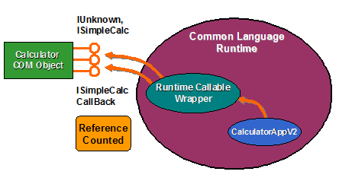
Concept: A “wrapper”
Start with a complex application… you really don’t want to modify it
Identify some big objects it sends, and modify the setter/getter methods to first “memory-fy” it
If we have the URL but not the object, fetch the object
Then perform action as usual
A lazy fetch! Question: why will this help?

Slide 26
Concept: A “wrapper”
On receipt, object has just the URL
But if the application accesses data we load the real content first
“URL”
Application
Logic
Wrapper
Log
Object
Application
Logic
Wrapper

Slide 27
Can it be totally transparent?
In many cases, a wrapper can completely hide the log from the real application
But if the object is modified, then transmitted, we need to create a new logged version, and use a new URL for it.
The log service won’t allow you to modify a logged object, only to create “new” logged objects

Slide 28
Data center logging services
This area was very ad-hoc for a while
Then the Berkeley “log structured file system” was proposed. LFS was really popular.
More recently, Corfu and Tango were introduced by Microsoft. These are logging services for situations where reliability and speed are paramount
The slides that follow are from Mahesh Balakrishnan, one of the team leaders for this project at MSR

Slide 29

The shared log abstraction
. . .
clients
shared log API:
O = append(V)
V = read(O)
trim(O) //GC
O = check() //tail
remote shared log
read from anywhere
append to tail
clients can concurrently append to the log,
read from anywhere in its body, check the current tail, and trim entries that are no longer needed.

Slide 30
Outline
a shared log is a powerful and versatile abstraction. Tango (SOSP 2013) provides transactional in-memory data structures backed by a shared log.
the shared log abstraction can be implemented efficiently. CORFU (NSDI 2012) is a scalable, distributed shared log that supports millions of appends/sec.
a fast, scalable shared log enables fast, scalable distributed services. Tango+CORFU supports millions of transactions/sec.

Slide 31
The shared log approach
application
application
a Tango object
=
view
in-memory data structure
+
history
updates in shared log
Tango objects are easy to use
Tango objects are easy to build
Tango runtime
Tango runtime
the shared log is the source of
persistence
consistency
elasticity
atomicity and isolation
… across multiple objects
shared log
uncommitted data
commit record
no messages… only appends/reads on the shared log!
Notes:
(3.5 min) Tango provides applications with the abstraction of an in-memory data structure backed by a shared log. A Tango object consists of two parts: a view that resides on the client and is an in-memory data structure, and a history, which is a sequence of updates to the data structure and resides on the shared log. When an application modifies a Tango object, the Tango runtime first appends an update to the shared log, and then modifies the local view. For now, assume that this shared log is highly available, persistent, and scalable; later, I’ll describe exactly how we implement it, and what its properties are.
The central thesis of this talk is that this simple design provides a host of useful properties for applications that are usually difficult to achieve. <click> To start with, this design obviously gives you persistence. If the client crashes and comes back up, it can reconstruct the in-memory view of the object simply by playing the history in the shared log.
<click> Second, this design gives you availability. Multiple clients can host views for the same object. When a client accesses the object, the Tango runtime first synchronizes the local view with the history by playing the shared log forward. Effectively, we are implementing state machine replication over the shared log.
<click> Third, we can also get elasticity with this design. When new instances of the service are created on new machines, they can reconstruct the state of the service by playing the shared log.
<click> Finally, this design gives you atomicity and isolation for transactions. Atomicity is achieved simply by storing two types of updates in the shared log: speculative updates, and commit records that make the updates visible. This is a well-known technique for implementing atomicity via a log. We can also provide isolation using these commit records, which I’ll describe in a couple of slides. Also, we can enable transactions across different data structures simply by storing all of them on the same shared log.
An important point to note is that Tango achieves all these properties using simple append and read operations on the shared log. Clients do not exchange messages with each other. Of course, the shared log itself can be implemented using message-passing, but Tango does not send any messages on its own.
In the remainder of this talk, I’ll focus on three points. First, Tango objects are very easy to use. Next, defining a new Tango data structure is easy. Finally, I’ll show you how we achieve high performance despite funneling all activity through the a single shared log.

Slide 32
Tango objects are easy to use
implement standard interfaces (Java/C# Collections)
linearizability for single operations
under the hood:
example:
curowner = ownermap.get(“ledger”);
if(curowner.equals(myname))
ledger.add(item);
Notes:
To the application developer, a Tango object is like any other Java or C# object; we provide applications with Tango versions of the data structures in Java and C# collections, and these are indistinguishable from the originals. In this example code, the application is doing a get on a TangoMap and then an add on a TangoList. For singleton operations, we provide linearizability. Under the hood, the way this works is that the local views of the data structures are synchronized up to some position in the log. When the application accesses the Tango object, the Tango runtime first plays the log forward until its tail to apply any new updates to the view. When we do a mutator operation like the list add in the example, the Tango runtime appends an entry to the shared log. This simple protocol gives us linearizability for single operations.

Slide 33
Tango objects are easy to use
implement standard interfaces (Java/C# Collections)
linearizability for single operations
serializable transactions
under the hood:
TX commits if read-set (ownermap) has not changed in conflict window
example:
TR.BeginTX();
curowner = ownermap.get(“ledger”);
if(curowner.equals(myname))
ledger.add(item);
status = TR.EndTX();
TX commit record:
read-set: (ownermap, ver:2)
write-set: (ledger, ver:6)
speculative commit records: each client decides if the TX commits or aborts independently but deterministically
[similar to Hyder (Bernstein et al., CIDR 2011)]
Notes:
Tango also provides read/write transactions. This means that a code fragment like the one in the previous slide can be encapsulated within a transaction. When code executes within a transactional context, the Tango runtime treats it differently. Under the hood, the begintx call creates an in-memory commit record, but does not yet append it to the log. When the application accesses an object within a transaction, the operation is satisfied with the local, potentially stale view of the object. There can be concurrent activity by other clients in the shared log (the orange updates), but these are not reflected by the read. Meanwhile, the commit record is updated with the version of the object that was read. Here we use the shared log as a source of versioning; the version of an object is simply the position of the last update in the log that affected it. So in a sense, reads are done speculatively. Writes are also done speculatively, in that they result in speculative updates being appended to the log; these updates are not immediately made visible by other clients. Finally, when the application calls EndTX, its time to validate this transaction. The way we do this is by appending the commit record to the log, and then playing the log forward until the commit record. If any data read by the transaction has changed by the time the commit record is encountered, the transaction is aborted, else it commits. Note that the commit/abort decision is purely a function of the contents of the shared log; as a result, every client can make the commit/abort decision independently but deterministically.

Slide 34
Tango objects are easy to build
15 LOC == persistent, highly available, transactional register
class TangoRegister {
int oid;
TangoRuntime ∗T;
int state;
void apply(void ∗X) {
state = ∗(int ∗)X;
}
void writeRegister (int newstate) {
T−>update_helper(&newstate , sizeof (int) , oid);
}
int readRegister () {
T−>query_helper(oid);
return state;
}
}
object-specific state
invoked by Tango runtime on EndTX to change state
mutator: updates TX write-set, appends to shared log
accessor: updates TX read-set, returns local state
Other examples:
Java ConcurrentMap: 350 LOC
Apache ZooKeeper: 1000 LOC
Apache BookKeeper: 300 LOC
simple API exposed by runtime to object: 1 upcall + two helper methods
arbitrary API exposed by object to application: mutators and accessors
15 LOC == persistent, available, elastic, transactional register
2 clients: 10K/sec writes, 30K/sec reads
18 clients: 10K/sec writes, 150K/sec reads
Other examples:
Java ConcurrentMap: 350 LOC
Apache ZooKeeper: 1000 LOC
Apache BookKeeper: 300 LOC
Notes:
We provide a number of data structures to the application (a subset of the data structures in Java and C# collections). However, we also want developers to be able to easily roll out their own custom data structures. You don’t have to read all this code, I’ll walk you through it in a moment; the high level point is that with 15 lines of code we can implement a full-fledged Tango object, in this case a Register. Zooming in on this code, it really has four parts. First, there is the internal state of the object; in the case of a register, this is a simple integer, but this varies depending on the data structure. The second part is an upcall that the Tango runtime invokes to apply new updates from the shared log to the object. This is exactly equivalent to a state machine upcall. Third, the object has a set of publicly facing mutator interfaces (in this case, a writeRegister operation; in the case of a TangoMap, this would be a put function). Inside the mutator, the object serializes the update and provides it to the Tango runtime. Finally, the object has publicly facing accessor methods; inside these, the object notifies the runtime of the access, so the runtime can record the version being read, and then satisfies the access using local state.
There are three important points here. The first is that the interface between a Tango object and the Tango runtime is very simple: 1 upcall and 2 helper methods. Second, the public API exposed by the object can be arbitrary; the Tango runtime is completely oblivious to this. Third, this is a toy example, but we can build fairly sophisticated data structures in a few hundred lines of code. In fact, we can emulate a system like ZooKeeper with a thousand lines of code, in contrast to original ZooKeeper which uses more than 13K lines of code; plus, we get new functionality such as transactions in the process.

Slide 35
Outline
a shared log is a powerful and versatile abstraction. Tango (SOSP 2013) provides transactional in-memory data structures backed by a shared log.
the shared log abstraction can be implemented efficiently. CORFU (NSDI 2012) is a scalable, distributed shared log that supports millions of appends/sec.
a fast, scalable shared log enables fast, scalable distributed services. Tango+CORFU supports millions of transactions/sec.

Slide 36

The CORFU design
application
CORFU API:
O = append(V)
V = read(O)
trim(O) //GC
O = check() //tail
smart client library
Tango runtime
passive flash units:
write-once, sparse address spaces
CORFU
read from anywhere
append to tail
4KB
each entry maps to a replica set

Slide 37
The CORFU protocol: reads
client
page 0
page 1
…
D1/D2
L₀
L₄
...
D3/D4
L₁
L₅
...
D5/D6
L₂
L₆
...
D7/D8
L₃
L₇
...
Tango
read(pos)
D1 D3 D5 D7
CORFU library
Projection:
D1 D2
D3 D4
D5 D6
D7 D8
read(D1/D2, page#)
D2 D4 D6 D8
CORFU cluster
L₀
L₁
L₂
L₃
L₄
L₅
L₆
L₇
.
.

Slide 38
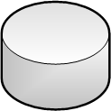
The CORFU protocol: appends
client
other clients can fill holes in the log caused by a crashed client
CORFU append throughput: # of 64-bit tokens issued per second
sequencer is only an optimization! clients can probe for tail or reconstruct it from flash units
reserve next position in log (e.g., 8)
sequencer (T0)
Tango
read(pos)
append(val)
D1 D3 D5 D7
CORFU library
Projection:
D1 D2
D3 D4
D5 D6
D7 D8
write(D1/D2, val)
D2 D4 D6 D8
fast reconfiguration protocol: 10 ms for 32-drive cluster
CORFU cluster
L₀
L₁
L₂
L₃
L₄
L₅
L₆
L₇
.
.

Slide 39
Chain replication in CORFU
client C1
2
1
client C2
client C3
safety under contention:
if multiple clients try to write to same log position concurrently, only one wins
writes to already written pages => error
durability:
data is only visible to reads if entire chain has seen it
reads on unwritten pages => error
requires write-once semantics from flash unit

Slide 40
Outline
a shared log is a powerful and versatile abstraction. Tango (SOSP 2013) provides transactional in-memory data structures backed by a shared log.
the shared log abstraction can be implemented efficiently. CORFU (NSDI 2012) is a scalable, distributed shared log that supports millions of appends/sec.
a fast, scalable shared log enables fast, scalable distributed services. Tango+CORFU supports millions of transactions/sec.

Slide 41
a fast shared log isn’t enough…
node 1
node 2
B
B
B
B
B
B
allocation ← table
aggregation tree →
A
A
A
A
A
A
the playback bottleneck:
clients must read all entries →
inbound NIC is a bottleneck
free list →
C
C
C
C
C
C
10 Gbps
10 Gbps
solution: stream abstraction
readnext(streamid)
append(value, streamid1, … )
A
B
C
B
A
C
A
C
…
…
B
C
A
B
B
B
each client only plays entries of interest to it
C
C
C
A
A
A
A

Slide 42
txes over streams
node 1
node 2
B
B
B
B
B
B
allocation ← table
aggregation tree →
A
A
A
A
A
A
beginTX
read A
write C
endTX
decision record with commit/abort bit
free list →
C
C
C
C
C
C
A
skip
C
skip
A
C
A
C
skip
A
skip
C
skip
A
C
A
C
0
skip
skip
B
C
B
skip
C
skip
C
B
skip
B
C
B
skip
C
skip
C
0
B
commit/abort?
has A changed?
yes, abort
commit/abort?
has A changed?
don’t know!
node 1 helps node 2

Slide 43
What about transactions?
Recent work (Tango, aka “Corfu-DB”) looked at this
They focused on back-end applications, but in fact there is some talk of experimenting with this idea in the first tier as well because it really is very fast
Basically, modified transactional implementation uses Corfu for the “state of the transactional DB”

Slide 44
distributed txes over streams
node 1
node 2
B
B
B
B
B
B
allocation ← table
aggregation tree →
A
A
A
A
A
A
beginTX
read A, B
write C
endTX
free list →
C
C
C
C
C
C
A
skip
C
skip
A
C
A
C
skip
A
skip
C
skip
A
C
A
C
O
1
skip
skip
B
C
B
skip
C
skip
C
B
skip
B
C
B
skip
C
skip
C
0
1
B
commit/abort?
has B changed?
don’t know!
commit/abort?
has A changed?
don’t know!
node 1 and node 2 help each other!
distributed transactions without a distributed (commit) protocol!

Slide 45
Research insights
A durable, iterable total order (i.e., a shared log) is a unifying abstraction for distributed systems, subsuming the roles of many distributed protocols
It is possible to impose a total order at speeds exceeding the I/O capacity of any single machine
A total order is useful even when individual nodes consume a subsequence of it

Slide 46
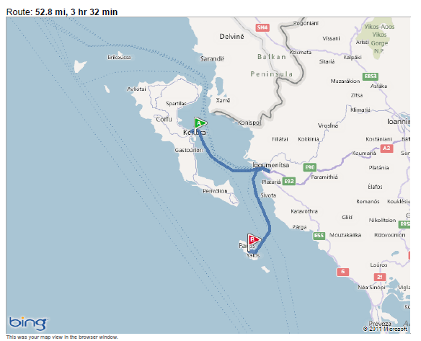
how far is CORFU from Paxos?

Slide 47
how far is CORFU from Paxos?
CORFU scales the Paxos acceptor role:
each consensus decision is made by a different set of acceptors
learners
L₀
L₁
L₂
L₃
L₄
L₅
L₆
L₇
.
.
L₀
L₁
L₂
L₃
L₄
L₅
L₆
L₇
.
.
streaming CORFU scales the Paxos learner role:
each learner plays a subsequence of commands
D1 D3 D5 D7
acceptors
acceptors
D2 D4 D6 D8
CORFU cluster

Slide 48
Conclusions
Wrap objects and use a logging service for higher performance in cloud settings
Tango objects: data structures backed by a shared log
key idea: the shared log does all the heavy lifting
(durability, consistency, atomicity, isolation, elasticity…)
Tango objects are easy to use, easy to build, and fast…
… thanks to CORFU, a shared log without an I/O bottleneck

