Slide 1
CS5412: The CLoud VALUE PROPOSITION
Lecture XXII
Ken Birman

Slide 2
Cloud Hype
The cloud is cheaper
The cloud business model is growing at an unparalleled pace without any limit in sight
In the future everything will be on the cloud
... can we find evidence to support, or refute, such claims?

Slide 3
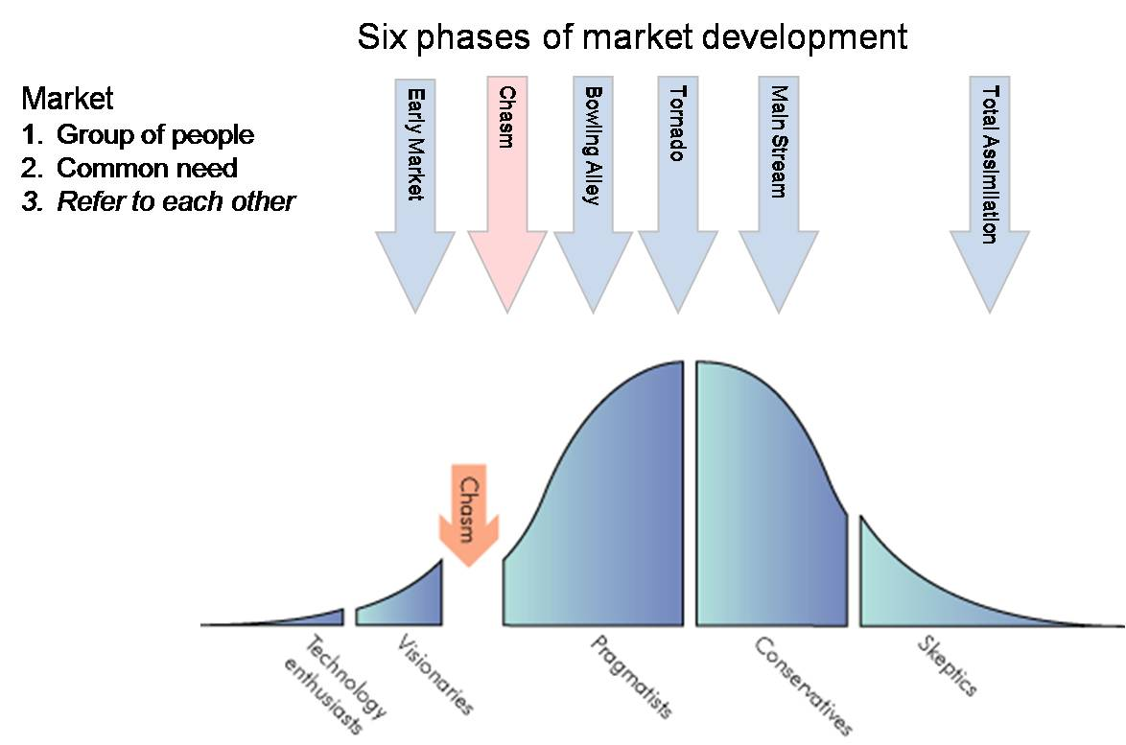
Crossing the Chasm
Insight from Geoff Moore

Slide 4
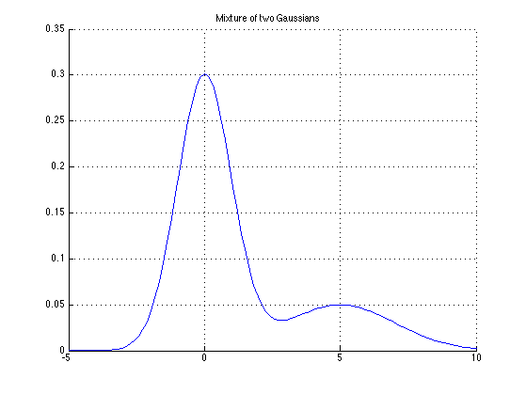
How does the revenue picture look?
One-time purchases

Slide 5
How does the revenue picture look?
“Recurring” revenue

Slide 6
A thought question
Who pays for a “free” app?
Some games have advertising but many apps don’t
So what’s the interest in having the app?
Even more extreme: Who pays for LinkedIn?
Huge number of users so it must cost a lot to run
Yet no advertising and the site is free

Slide 7
.... and the answer is?
LinkedIn exists to either be acquired, or to eventually change its revenue model using ads
In the eventual profit case, the company would be sustained by venture capital in the interim period
Then an IPO lets the company cash in on its “value”
But what does “value” ultimately mean if the company sells a product that doesn’t really create revenue at all?

Slide 8
These aren’t the only models
What about a revenue-generating application
Why might it ever live on the cloud?
Imagine that doctors pay “MedRecords4Us” a subscription fee
Would it make sense for the company to migrate their application to a cloud?

Slide 9
Managing Demand
IT Capacity
Forecast demand
Potential business loss
Compute capacity
Over capacity
Under capacity
Entry barrier
Wasted capacity
Time

Slide 10
Coping with Demand Bursts
IT Demand
Ouch! How do we deal with this?
Ticket sales open
Ticket sales open
Time
Concert ticket web site

Slide 11
IT Agility
How quickly can you
Scale up the infrastructure and applications?
Upgrade to the latest OS?
Respond to a company merger with new requirements for business process and IT capacity?
Respond to a divestiture

Slide 12
Cloud Computing
Shared, multi-tenant environment
Pools of computing resources
Resources can be requested as required
Available via the Internet
Private clouds can be available via private WAN
Pay as you go

Slide 13
Technologies and monetization
Fundamentally, a technology must be profitable to survive.
Better technologies often fail
The technology everyone buys wins. Then eventually it might acquire features from the losing solutions
Moreover, the income story needs to “scale”

Slide 14
Two more examples. Who wins?
Company A has an amazing technology but you need to be an expert to use it.
So they hire and train experts of their own
When you buy their package they do the work for you
Company B has a less amazing technology but it just installs itself and works
No need to hire experts
Just buy as many user accounts as you need

Slide 15
Theil (Stanford)
In addition to incorrectly assuming that better technology wins over inferior technology, people often confuse competition with competitive success
Aggressive competition often drives pricing down
Much better to be the owner of a unique niche: sole provider of such-and-such a must-have application
You can charge higher prices (although not too high or competitors move in aggressively). So profit margins will be sharply higher
You become a must-be-there platform for advertising aimed at your class of clients, bringing you revenue
In effect: the best position to be in is to create your own niche and operate it as a mini-monopoly!

Slide 16
Key insight
Company A will eventually be limited by the number of experts it can actually hire & train
So after a period of growth it will stall
The revenue stream peaks and this chokes investment in the evolution of the product
Ultimately, company A will either fail or at least reach some sort of saturation point
Company B sees no end in sight and the money pours in
This allows B to invest to improve its technology
Eventually it will catch up with A on features

Slide 17
Applied to cloud computing?
We need to ask which stage of the cloud we’ve reached!
But one complication: it isn’t just “one” cloud
The cloud is a “sum” of multiple business stories/models
Early business of the cloud was the initial Internet boom (it gave us pets.com and similar web sites)
Only a few survived, like Amazon.com, Expedia
Winning wasn’t easy for them or much fun!

Slide 18
Waves of the cloud revolution
Early web browser stage
Search and advertising (Google)
Social Networking (Facebook, Twitter)
Cloud as your “home”: AOL, Yahoo!, MSN, Google
Emergence of true web services model
Infrastructure as a service (“rent a VM”) Apps (Apple)
Frames, full cross-site federation
Full-featured scripting languages (Javascript, Caja, Silverlight, Adobe Flash...)
What next?

Slide 19
Each has its own revenue model!
For each style of web solution need to ask what monetizes that model!
Google and Facebook make their money on advertising
Microsoft combines technology license revenue with advertising, but earns much more on technology
Apple earns money on every App
Amazon sells stuff but also runs massive data centers really well, and rents space on those
Infosys does rote tasks incredibly well and incredibly cheaply (because most of their employees earn $6,500/yr)
Following the money is the key to understanding what directions each will follow

Slide 20
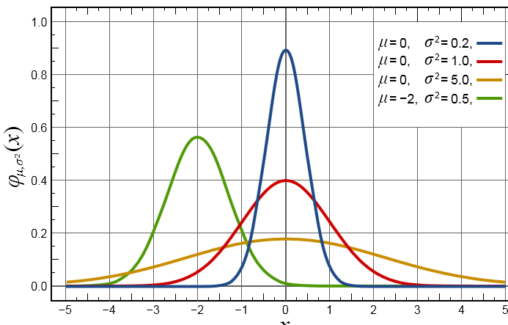
So the cloud is a sum of stories
Many of these revenue stories “superimposed”

Slide 21
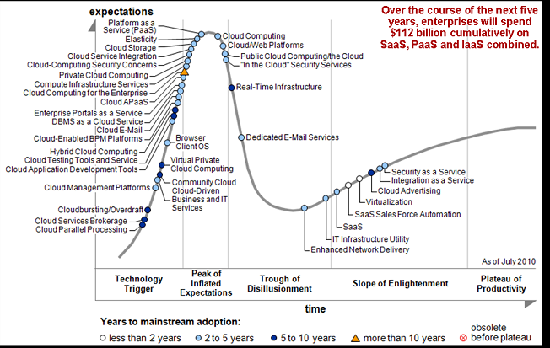

Slide 22
Inescapable Conclusion?
Some of today’s cloud computing stories will probably fail as business models
Wallstreet may not realize this, yet!

Slide 23
The terms have many meanings!
Everyone talks about cloud computing but there is very little consensus on what cloud computing means
We’ve studied it all semester now
But the cloud brings together a lot of technologies that each do very different things
Best definition so far is basically:
A style of computing that makes extensive use of network access to remote data and remote data centers, presented through web standards.
But this is so general it says almost nothing!

Slide 24
What is a Cloud Platform? Some defining characteristics
It lets developers create and run apps, store data, and more
It provides self-service access to a pool of computing resources
It allows granular, elastic allocation of resources
It allows charging only for the resources an application uses

Slide 25
Public Clouds and Private Clouds Typical definitions
Public cloud: A cloud platform run by a service provider made available to many end-user organizations
Private cloud: A cloud platform run solely for a single end-user organization, such as a bank or retailer
The technology can be much like public clouds, but the economics are different
Most organizations will probably use some hybrid of both

Slide 26
Cloud Platform Technologies
The most important today:
Computing
Infrastructure as a Service (IaaS)
Platform as a Service (PaaS)
Storage
Relational storage
Scale-out storage
Blobs
There are many more
Messaging, identity, caching, …

Slide 27
Computing Infrastructure as a Service (IaaS)
Developers create virtual machines (VMs) on demand
They have full access to these VMs
Strengths:
Can control and configure environment
Familiar technologies
Limited code lock-in
Weaknesses:
Must control and configure environment
Requires administrative skills to use

Slide 28
Computing Platform as a Service (PaaS)
Developers provide an application, which the platform runs
They don’t work directly with VMs
Strengths:
Provides higher-level services than IaaS
Requires essentially no administrative skills
Weaknesses:
Allows less control of the environment
Can be harder to move existing software

Slide 29
Computing What’s the most popular approach?
IaaS is more widely used today than PaaS
Gartner estimates that public IaaS revenues are significantly greater than public PaaS revenues today
Perspective:
IaaS is easier to adopt than PaaS
IaaS emulates your existing world in the cloud
Over time, PaaS is likely to dominate
PaaS should have an overall lower cost than IaaS
It’s typically a better choice for new applications

Slide 30
Storage Relational
Traditional relational storage in the cloud
With support for SQL
Strengths:
Familiar technologies
Many available tools, e.g., for reporting
Limited data lock-in
Can be cheaper than on-premises relational storage
Weaknesses:
Scaling to handle very large data is challenging

Slide 31
Storage Scale-out
Massively scalable storage in the cloud
No support for SQL
Strengths:
Scaling to handle very large data is straightforward
Can be cheaper than relational storage
Weaknesses:
Unfamiliar technologies
Few available tools
Significant data lock-in

Slide 32
Storage Blobs
Storage for Binary Large OBjects in the cloud
Such as video, back-ups, etc.
Strengths:
Globally accessible way to store and access large data
Can be cheaper than on-premises storage
Weaknesses:
Provides only simple unstructured storage

Slide 33
Cloud Platforms: Building a Framework

Slide 34
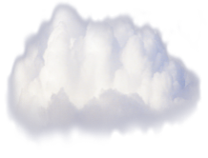
Cloud Platforms Representative technologies and vendors
Private
Public
Computing
Storage
IaaS
IaaS
PaaS
Relational
Scale-Out
Blobs
Microsoft
VMware
Amazon
Google
Key
Cloud Platform Service
Salesforce
Cloud Platform Software

Slide 35
Cloud Service or Cloud Software? Understanding the alternatives
Cloud platform service
A hardware/software combination
Typically provided by organizations that run Internet-scale services, e.g., Microsoft, Amazon, and Google
They write their own software
Cloud platform software
Provided by software vendors and open source projects
Hosters can use this software to offer a public cloud service
The same software can also be used in private clouds

Slide 36
Applying Public Cloud Platforms (1) Some characteristics of typical applications
Apps that need high reliability
Example: A SaaS application
Apps that need massive scale
Example: A Web 2.0 application
Apps with variable load
Example: An on-line ticketing application
Apps that do parallel processing
Example: A financial modeling application

Slide 37
Applying Public Cloud Platforms (2) Some characteristics of typical applications
Apps with a short or unpredictable lifetime
Example: An app created for a marketing campaign
Apps that must fail fast or scale fast
Example: Start-ups
Apps that don’t fit well in an organization’s data center
Example: A business unit that wishes to avoid its IT department
Apps that can benefit from external storage
Example: An application that archives data

Slide 38
Cloud Platforms: Applying the Framework

Slide 39
From Server Virtualization to Private Clouds
IaaS allows allocating, managing, and charging for VMs in a more effective way
This idea first appeared in a public cloud platform
If it makes sense there, why not use it in your own data center?
Private clouds provide IaaS in your data center
Although they can also offer more application-oriented services

Slide 40
Microsoft Private and public cloud platform software
Private
Public
Computing
Storage
IaaS
IaaS
PaaS
Relational
Scale-Out
Blobs
Hyper-V
Cloud
For Hosters: Hyper-V Cloud
Microsoft
VMware
Amazon
Google
Key
Cloud Platform Service
Salesforce
Cloud Platform Software

Slide 41
VMware Private and public cloud platform software
Private
Public
Computing
Storage
IaaS
IaaS
PaaS
Relational
Scale-Out
Blobs
Hyper-V
Cloud
For Hosters: Hyper-V Cloud
Microsoft
VMware
vCloud
For Hosters:
vCloud
Amazon
Google
Key
Cloud Platform Service
Salesforce
Cloud Platform Software

Slide 42
Windows Azure Platform Public cloud platform
Private
Public
Computing
Storage
IaaS
IaaS
PaaS
Relational
Scale-Out
Blobs
Hyper-V
Cloud
For Hosters: Hyper-V Cloud
Windows Azure
SQL
Azure
Windows Azure Tables
Windows Azure Blobs
Microsoft
VMware
vCloud
For Hosters:
vCloud
Amazon
Google
Key
Cloud Platform Service
Salesforce
Cloud Platform Software

Slide 43
Windows Azure Platform Pricing examples (in US dollars)
Compute: $0.05/hour to $0.96/hour for each instance (depending on instance size)
Storage:
Blobs and tables:
Data: $0.15/GB per month
Access: $0.01/10,000 operations
Relational:
$9.99/GB per month
Bandwidth:
Inbound: Free
Outbound: $0.15/GB

Slide 44
VMware Cloud Foundry Public cloud platform software
Private
Public
Computing
Storage
IaaS
IaaS
PaaS
Relational
Scale-Out
Blobs
Hyper-V
Cloud
For Hosters: Hyper-V Cloud
Windows Azure
SQL
Azure
Windows Azure Tables
Windows Azure Blobs
Microsoft
VMware
For Hosters:
vCloud
Cloud Foundry Frameworks
Cloud Foundry Storage
vCloud
Amazon
Google
Key
Cloud Platform Service
Salesforce
Cloud Platform Software

Slide 45
VMware Cloud Foundry Essentials
Cloud Foundry is an open source PaaS platform
Led by VMware
Designed to support diverse technologies:
Frameworks: Spring, Rails, etc.
Storage: MySQL, MongoDB, etc.
Not yet available as a service
VMware provides a public dev/test service
Partners will provide commercial public platforms

Slide 46
Amazon Web Services Public cloud platform
Private
Public
Computing
Storage
IaaS
IaaS
PaaS
Relational
Scale-Out
Blobs
Hyper-V
Cloud
For Hosters: Hyper-V Cloud
Windows Azure
SQL
Azure
Windows Azure Tables
Windows Azure Blobs
Microsoft
VMware
For Hosters:
vCloud
Cloud Foundry Frameworks
Cloud Foundry Storage
vCloud
Elastic Compute Cloud (EC2)
Elastic
Beanstalk
Relational Database Service (RDS)
Simple Storage Service (S3)
Amazon
SimpleDB
Google
Key
Cloud Platform Service
Salesforce
Cloud Platform Software

Slide 47
A Broader View of IaaS/Paas An aside
More than cloud compute can be viewed through the IaaS/PaaS lens
Example: Cloud options for relational storage
Run a database server in an AWS EC2 VM
An IaaS storage service
Use a managed database server with AWS RDS
Use a managed database service with SQL Azure
A PaaS storage service

Slide 48
Amazon Web Services Pricing examples
Compute: $0.02/hour to $3.68/hour for each VM (depending on size and OS)
Storage (blobs):
Data: $0.14/GB per month to $0.037/GB per month (depending on data size and redundancy)
Access: $0.01/1,000 PUT, COPY, POST, LIST operations, $0.01/10,000 GET operations
Bandwidth: Free inbound, $0.12/GB to $0.05/GB out (depending on volume)

Slide 49
Eucalyptus Private cloud software
Private
Public
Computing
Storage
IaaS
IaaS
PaaS
Relational
Scale-Out
Blobs
Hyper-V
Cloud
For Hosters: Hyper-V Cloud
Windows Azure
SQL
Azure
Windows Azure Tables
Windows Azure Blobs
Microsoft
VMware
For Hosters:
vCloud
Cloud Foundry Frameworks
Cloud Foundry Storage
vCloud
Elastic Compute Cloud (EC2)
Elastic
Beanstalk
Relational Database Service (RDS)
Simple Storage Service (S3)
Amazon
Eucalyptus
SimpleDB
Google
Key
Cloud Platform Service
Salesforce
Cloud Platform Software

Slide 50
The Commoditization of IaaS An aside
Public IaaS compute service is widely available today
Providers include:
GoGrid Cloud Hosting
Terremark vCloud Express
IBM SmartCloud Enterprise
Rackspace Cloud Servers
A leader in creating OpenStack, open source IaaS private/public cloud platform software

Slide 51
Google App Engine Public cloud platform
Private
Public
Computing
Storage
IaaS
IaaS
PaaS
Relational
Scale-Out
Blobs
Hyper-V
Cloud
For Hosters: Hyper-V Cloud
Windows Azure
SQL
Azure
Windows Azure Tables
Windows Azure Blobs
Microsoft
VMware
For Hosters:
vCloud
Cloud Foundry Frameworks
Cloud Foundry Storage
vCloud
Elastic Compute Cloud (EC2)
Elastic
Beanstalk
Relational Database Service (RDS)
Simple Storage Service (S3)
Amazon
Eucalyptus
SimpleDB
Google
App
Engine
Datastore
Blobstore
Key
Cloud Platform Service
Salesforce
Cloud Platform Software

Slide 52
Google App Engine Pricing examples (today)
Compute: $0.10/CPU hour
Storage:
Datastore: $0.15/GB per month
Blobstore: $0.15/GB per month
Bandwidth: $0.10/GB in, $0.12/GB out
App Engine also allows some free usage every day
Other platforms have a free tier as well

Slide 53
Salesforce.com Force.com Public cloud platform
Private
Public
Computing
Storage
IaaS
IaaS
PaaS
Relational
Scale-Out
Blobs
Hyper-V
Cloud
For Hosters: Hyper-V Cloud
Windows Azure
SQL
Azure
Windows Azure Tables
Windows Azure Blobs
Microsoft
VMware
For Hosters:
vCloud
Cloud Foundry Frameworks
Cloud Foundry Storage
vCloud
Elastic Compute Cloud (EC2)
Elastic
Beanstalk
Relational Database Service (RDS)
Simple Storage Service (S3)
Amazon
Eucalyptus
SimpleDB
Google
App
Engine
Datastore
Blobstore
Key
Cloud Platform Service
Salesforce
AppForce
Database
.com
Cloud Platform Software
VMForce

Slide 54
Salesforce.com Force.com Pricing examples
One (small) application is free
Enterprise Edition: $50/user per month
Compute: up to 10 applications
Storage: up to 200 database objects
Bandwidth: No extra charge
Unlimited Edition: $75/user per month
Compute: unlimited applications
Storage: up to 2,000 database objects
Bandwidth: No extra charge

Slide 55
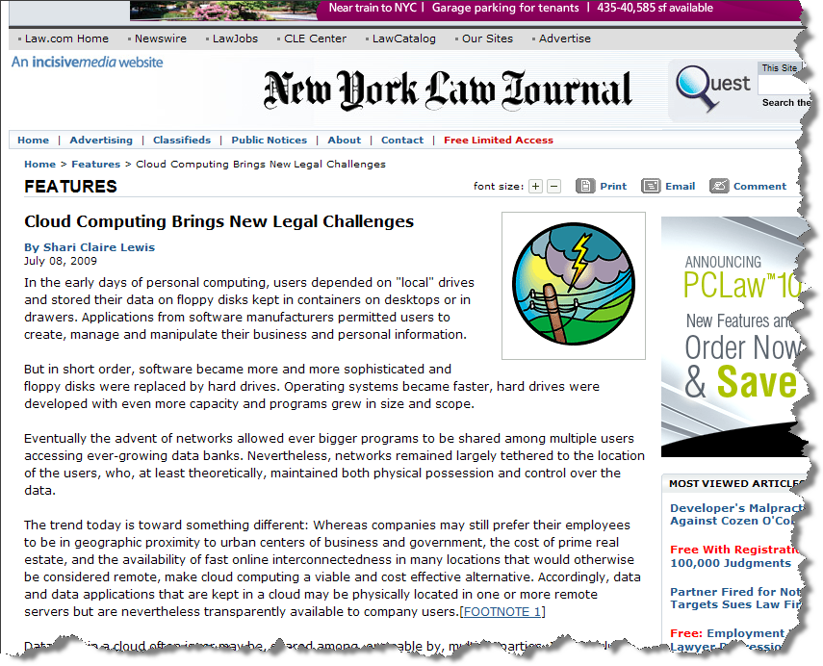
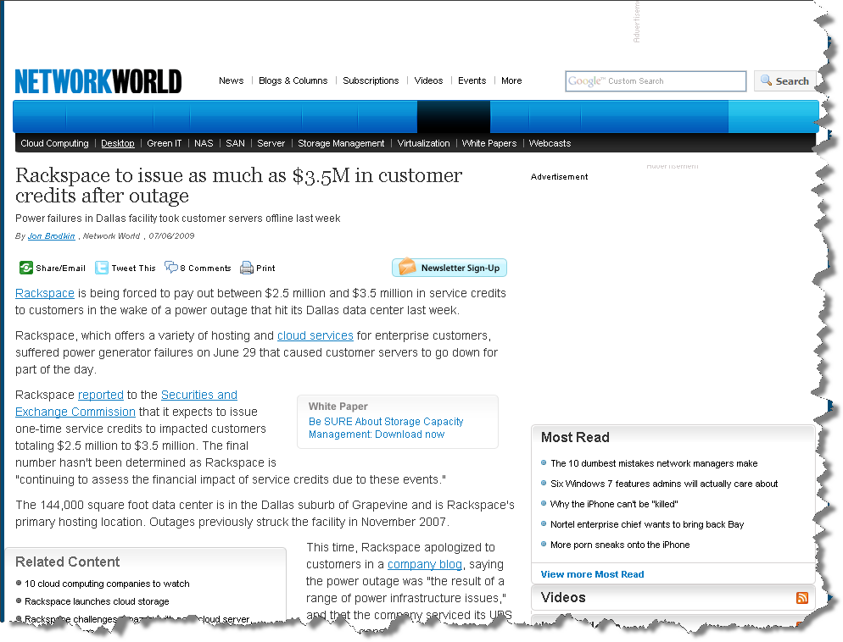
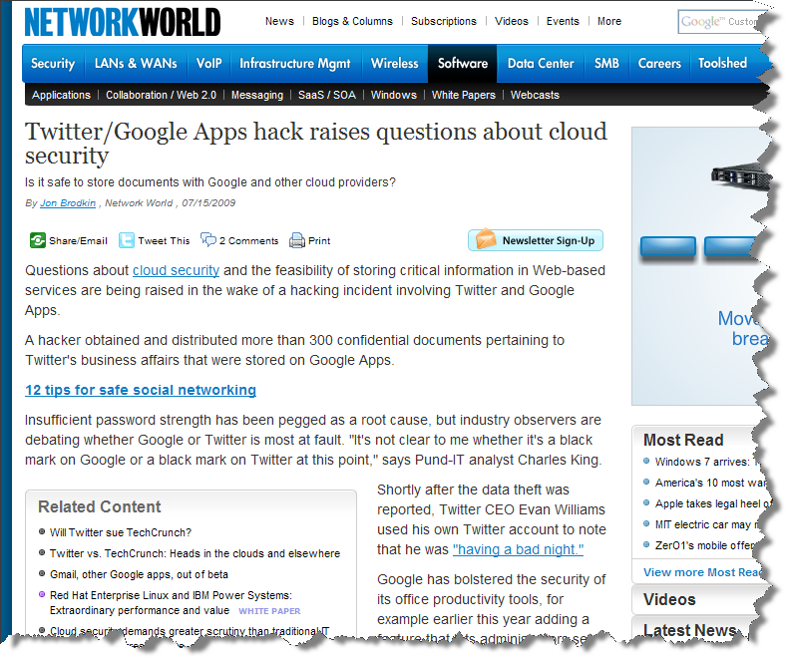
Challenges to Adoption

Slide 56
Challenges to Adoption (continued)
 |  |  |  | Ownership Dimension
Area |  |  | Specific Challenge | Private Cloud | Public Cloud
Understanding of the Paradigm |  |  | Agreement on Definition | Low | Medium
 |  |  | Confusion on What Provided | High | High
 |  |  | Multi-Tenancy Concerns | Low to NA | Medium
 |  |  | Unrealistic Vendor Claims | Medium | High
 |  |  | CIO Role Changes | Low | Low
 |  |  | Cloud Lock-In | Low to NA | High
Implementation/Operations |  |  | Architecture Immaturity | High | High
 |  |  | Manageability | High | High
 |  |  | VM Memory Limits | Low | Low
 |  |  | WAN Performance | Low | Medium
 |  |  | Potential Loss of Control | Low | Medium
 |  |  | Provisioning | Medium | Medium
 |  |  | Licensing Models | Medium | Medium
 |  |  | Governance | High | High
 |  |  | Confidence | Low | Medium
 |  |  | Service Provider Motivation | Low | High
 |  |  | Provider SLAs | Low | High
Security/Compliance |  |  | Adequate Threat Models | Medium | High
 |  |  | Workable Cross-Domain Security | Low | Medium
 |  |  | Data-at-Rest Security | Low | High
 |  |  | Auditability | Medium | High
 |  |  | Accepted Accreditation Processes | Medium | High
 |  |  | Accepted Compliance Processes | Medium | High
 |  |  | Physical Location | Low to NA | Medium

Slide 57
Challenges to Adoption (continued)
 |  |  |  | Ownership Dimension
Area |  |  | Specific Challenge | Private Cloud | Public Cloud
Understanding of the Paradigm |  |  | Agreement on Definition | Low | Medium
 |  |  | Confusion on What Provided | High | High
 |  |  | Multi-Tenancy Concerns | Low to NA | Medium
 |  |  | Unrealistic Vendor Claims | Medium | High
 |  |  | CIO Role Changes | Low | Low
 |  |  | Cloud Lock-In | Low to NA | High
Implementation/Operations |  |  | Architecture Immaturity | High | High
 |  |  | Manageability | High | High
 |  |  | VM Memory Limits | Low | Low
 |  |  | WAN Performance | Low | Medium
 |  |  | Potential Loss of Control | Low | Medium
 |  |  | Provisioning | Medium | Medium
 |  |  | Licensing Models | Medium | Medium
 |  |  | Governance | High | High
 |  |  | Confidence | Low | Medium
 |  |  | Service Provider Motivation | Low | High
 |  |  | Provider SLAs | Low | High
Security/Compliance |  |  | Adequate Threat Models | Medium | High
 |  |  | Workable Cross-Domain Security | Low | Medium
 |  |  | Data-at-Rest Security | Low | High
 |  |  | Auditability | Medium | High
 |  |  | Accepted Accreditation Processes | Medium | High
 |  |  | Accepted Compliance Processes | Medium | High
 |  |  | Physical Location | Low to NA | Medium
Understanding of the Paradigm
Definition: Lack of agreement over what exactly constitutes “cloud computing”
Confusion: Over what benefits cloud computing will provide, and the trade-offs
Multi-Tenancy:
How comfortable is an enterprise in storing its data in an environment shared with other customers?
What is the risk and the mitigation for data leakage?
How does this differ from what we did in the mainframe era?
Outrageous Vendor Claims and Obfuscation of Challenges:
Hinder understanding of cloud computing
What exactly are we buying?
To what is the vendor committing (especially true for a hosting vendor)?

Slide 58
Challenges to Adoption (continued)
Understanding of the Paradigm (continued)
Role changes: The CIO (or equivalent) may need to evolve to a general contractor in many areas.
Lock-In:
How difficult would it be to move large volumes of data to a different cloud (cloud provider)?
This is both a procedural and a technical issue (format, bandwidth)

Slide 59
Challenges to Adoption (continued)
 |  |  |  | Ownership Dimension
Area |  |  | Specific Challenge | Private Cloud | Public Cloud
Understanding of the Paradigm |  |  | Agreement on Definition | Low | Medium
 |  |  | Confusion on What Provided | High | High
 |  |  | Multi-Tenancy Concerns | Low to NA | Medium
 |  |  | Unrealistic Vendor Claims | Medium | High
 |  |  | CIO Role Changes | Low | Low
 |  |  | Cloud Lock-In | Low to NA | High
Implementation/Operations |  |  | Architecture Immaturity | High | High
 |  |  | Manageability | High | High
 |  |  | VM Memory Limits | Low | Low
 |  |  | WAN Performance | Low | Medium
 |  |  | Potential Loss of Control | Low | Medium
 |  |  | Provisioning | Medium | Medium
 |  |  | Licensing Models | Medium | Medium
 |  |  | Governance | High | High
 |  |  | Confidence | Low | Medium
 |  |  | Service Provider Motivation | Low | High
 |  |  | Provider SLAs | Low | High
Security/Compliance |  |  | Adequate Threat Models | Medium | High
 |  |  | Workable Cross-Domain Security | Low | Medium
 |  |  | Data-at-Rest Security | Low | High
 |  |  | Auditability | Medium | High
 |  |  | Accepted Accreditation Processes | Medium | High
 |  |  | Accepted Compliance Processes | Medium | High
 |  |  | Physical Location | Low to NA | Medium
Implementation and Operations
Architecture:
There is much disagreement over the necessary elements for a cloud technical architecture, and the elements are not mature.
In addition, SOA is the best approach for interface to clouds, yet culture for SOA success is immature and poorly understood.
There is much discussion over common cloud APIs, but none exist
Manageability: from the user perspective:
Existing management tools do not seem to be able to track metrics for applications that may reside on a varying number of different systems (not a problem where solution is a single VM)
How does asset management change in the cloud?
Distributed Management Task Force (DMTF) has initiated a working group to address (http://www.dmtf.org/about/cloud-incubator)
Memory limits within VM technology: VMs, which are approaching being a requisite design element, can address less memory than the physical OS. The latest product releases largely obviate this limitation.
WAN performance: Many geographies still are limited in their backbone capacity.

Slide 60
Challenges to Adoption (continued)
Implementation and Operations (continued)
Loss of control: Will business elements of the enterprise bypass the enterprise’s IT organization?
Governance:
In which deployment models and use-cases does this play?
Is governance antithetical to the concept of cloud?
Will lack of governance aggravate problems already associated with lack of SOA governance?
Provisioning: For SaaS, how will applications and application components be provisioned?
Licensing: Vendors have been slow to develop appropriate models.
Confidence: As to reliability, scalability, and security in public clouds (economics will also drive cloud vendors to minimize costs)

Slide 61
Challenges to Adoption (continued)
Implementation and Operations (continued)
Motivation for the Provider:
Ideally, providers keep just ahead of demand
May provide motivation for providers to federate and sell capacity to each other as do utility companies. Are there lessons from the power utility companies?
Aggravates manageability problem
Is the capacity really there for surge levels? Will another tenant’s surge impede your ability to do the same?
Service-Level Agreements: There have been effectively no substantive guarantees from public cloud providers.

Slide 62
Challenges to Adoption (continued)
 |  |  |  | Ownership Dimension
Area |  |  | Specific Challenge | Private Cloud | Public Cloud
Understanding of the Paradigm |  |  | Agreement on Definition | Low | Medium
 |  |  | Confusion on What Provided | High | High
 |  |  | Multi-Tenancy Concerns | Low to NA | Medium
 |  |  | Unrealistic Vendor Claims | Medium | High
 |  |  | CIO Role Changes | Low | Low
 |  |  | Cloud Lock-In | Low to NA | High
Implementation/Operations |  |  | Architecture Immaturity | High | High
 |  |  | Manageability | High | High
 |  |  | VM Memory Limits | Low | Low
 |  |  | WAN Performance | Low | Medium
 |  |  | Potential Loss of Control | Low | Medium
 |  |  | Provisioning | Medium | Medium
 |  |  | Licensing Models | Medium | Medium
 |  |  | Governance | High | High
 |  |  | Confidence | Low | Medium
 |  |  | Service Provider Motivation | Low | High
 |  |  | Provider SLAs | Low | High
Security/Compliance |  |  | Adequate Threat Models | Medium | High
 |  |  | Workable Cross-Domain Security | Low | Medium
 |  |  | Data-at-Rest Security | Low | High
 |  |  | Auditability | Medium | High
 |  |  | Accepted Accreditation Processes | Medium | High
 |  |  | Accepted Compliance Processes | Medium | High
 |  |  | Physical Location | Low to NA | Medium
Security and Compliance
Threat Models: What new models arise in the cloud? Have we further aggravated issues already present within SOA and with standard computing vulnerabilities?
Examples:
Dynamic virtual machines – How much control to the user?
Resource isolation (appropriate isolation measures are needed):
VM-to-VM attacks
Data leakage
Weakened perimeter – Firewall ports enabling user access are a vulnerability
Patch and security control management – Becomes the user’s responsibility; aggravated by VM dynamism
Hybrid usage – Consistency of control; ensuring the user understands where their data resides
Administrative access across networks – A vulnerability also inconsistent with some security policies

Slide 63
Challenges to Adoption (continued)
Security and Compliance (continued)
Cross-Domain Security: How does an organization extend or federate its authentication and authorization mechanisms into the cloud?
Data-at-Rest Security: What encryption and segregation mechanisms are provided?
Auditability: Can access to the data be audited?
Are data storage formats even amenable to auditing (more of an issue for chunking types of storage that lose the concept of a file)?
Forensics, as applications are not linked to physical infrastructure and the number of physical assets in play may vary
Accreditation in the Cloud:
How can you tell a cloud is “secure”?
Is there governing policy and procedures to accredit a cloud?
What processes and controls must be in place? (Pre-accredited clouds may actually simplify this process)

Slide 64
Challenges to Adoption (continued)
Security and Compliance (continued)
Compliance: May preclude cloud paradigm in some cases due to:
Physical chain of custody requirements
Regulatory requirements
Physical Location:
Do you know what country your cloud resides in?
Would you know if it changed?
What compliance requirements change?
Is there governing law that recognizes the paradigm?
Conclusions:
There are many challenges to adoption of the cloud paradigm
Public clouds and private clouds have different sets of challenges, with some overlap

Slide 65

The last word
Joni Mitchell summed it up best:
The cloud is a very complex marketplace and evolving rapidly.
Economics are the key
But nobody really understands cloud economics
There are many barriers to entry
I've looked at clouds from both sides now From up and down, and still somehow It's cloud illusions I recall... I really don't know clouds at all

